Slide 1
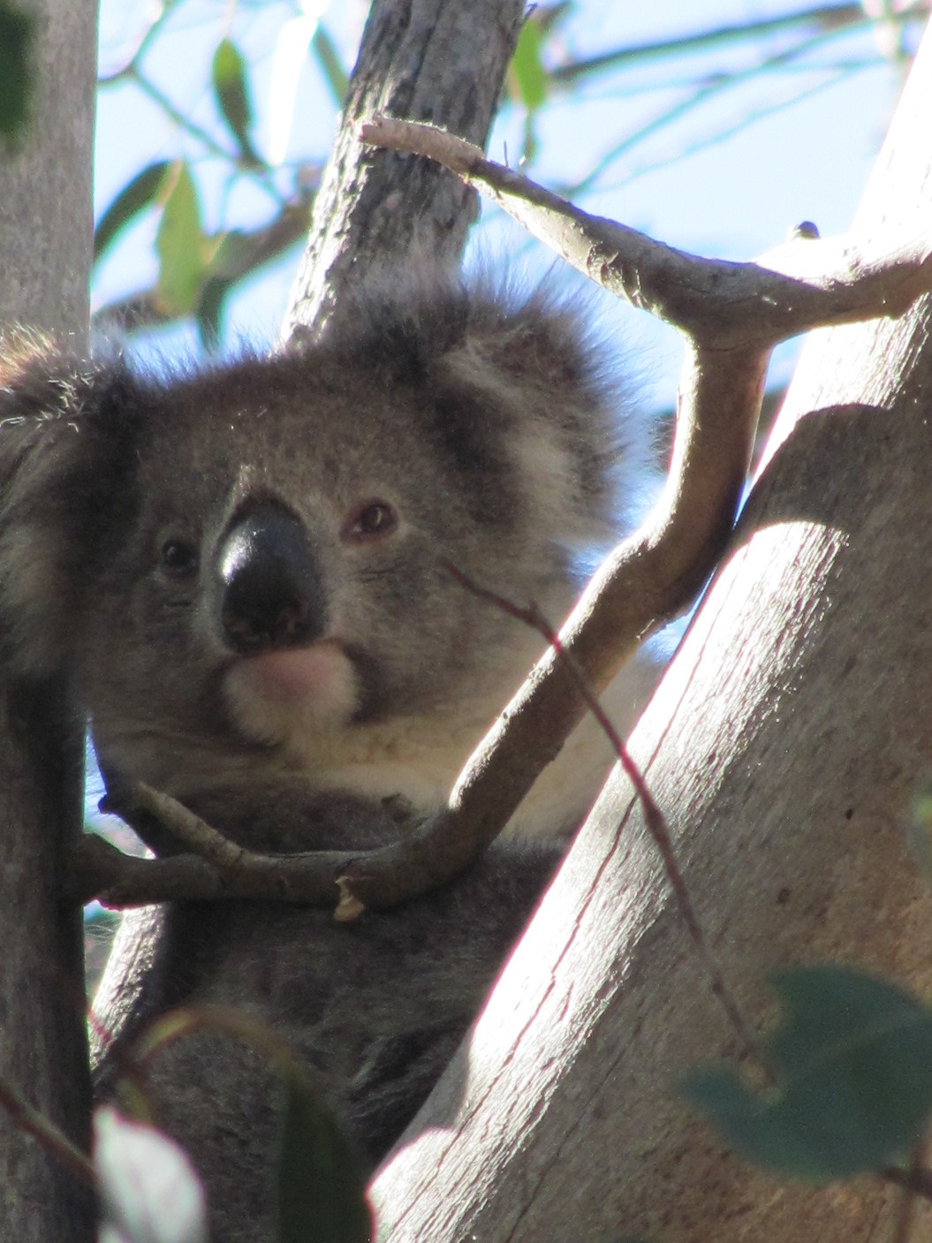
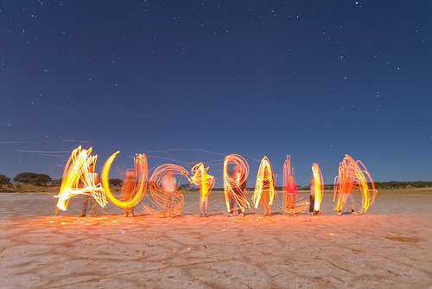
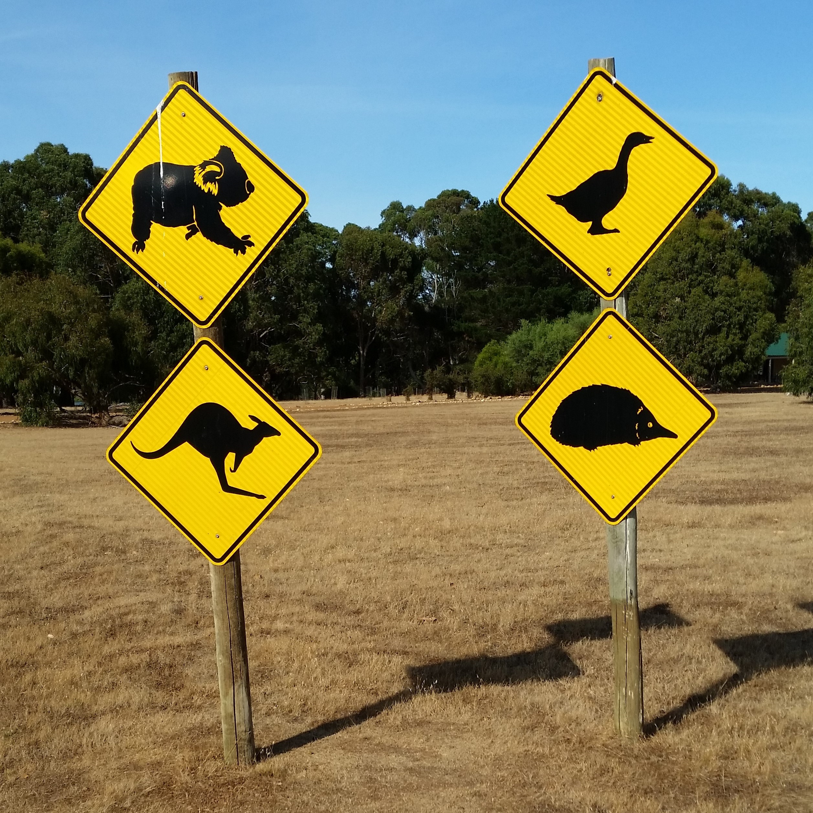
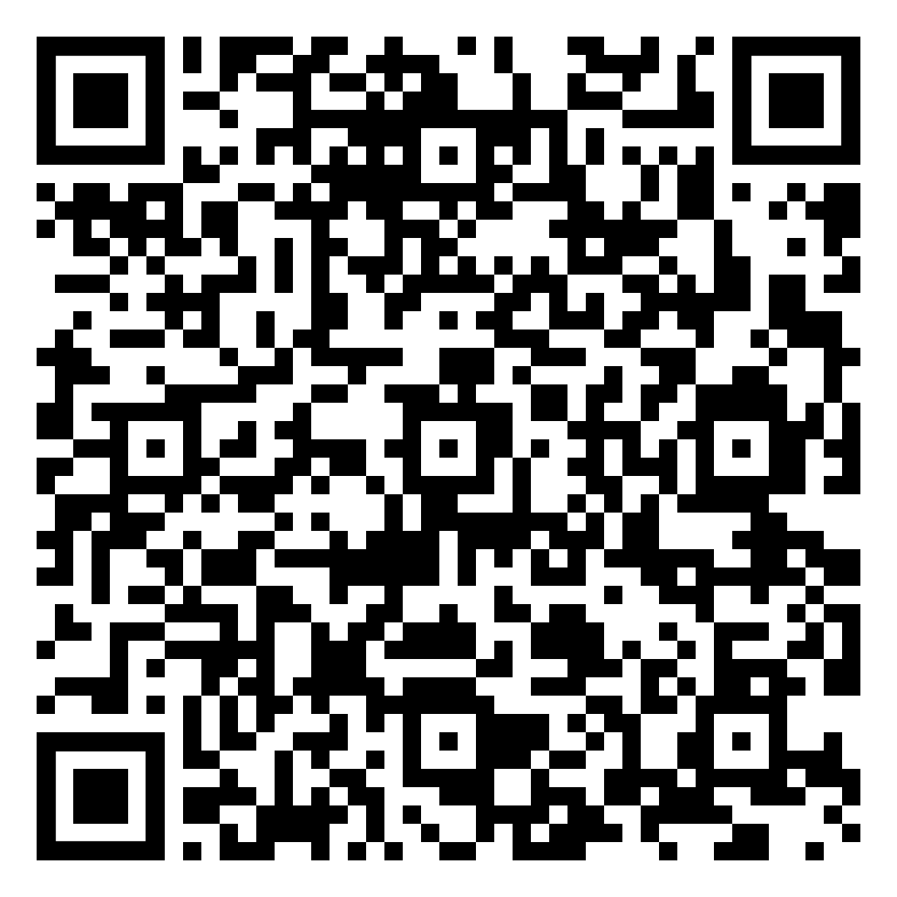
Study Abroad Melbourne, Australia May 31 - June 23, 2024
Applications are now being accepted.
Email Dr. Z at jz15@txstate.edu
Get pre-approved to enroll by following the QR code

