Slide 1
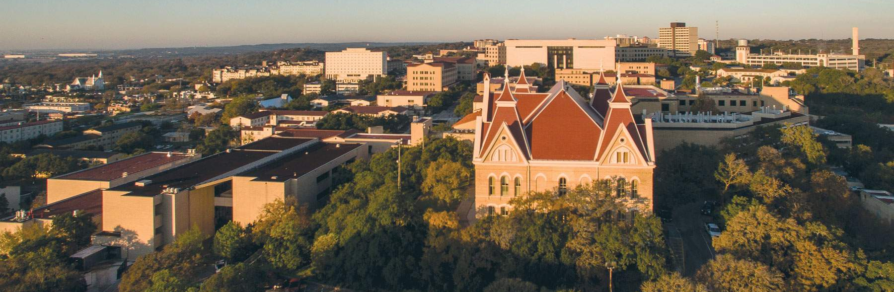
Facilities Construction Update
June 2, 2023

Slide 2
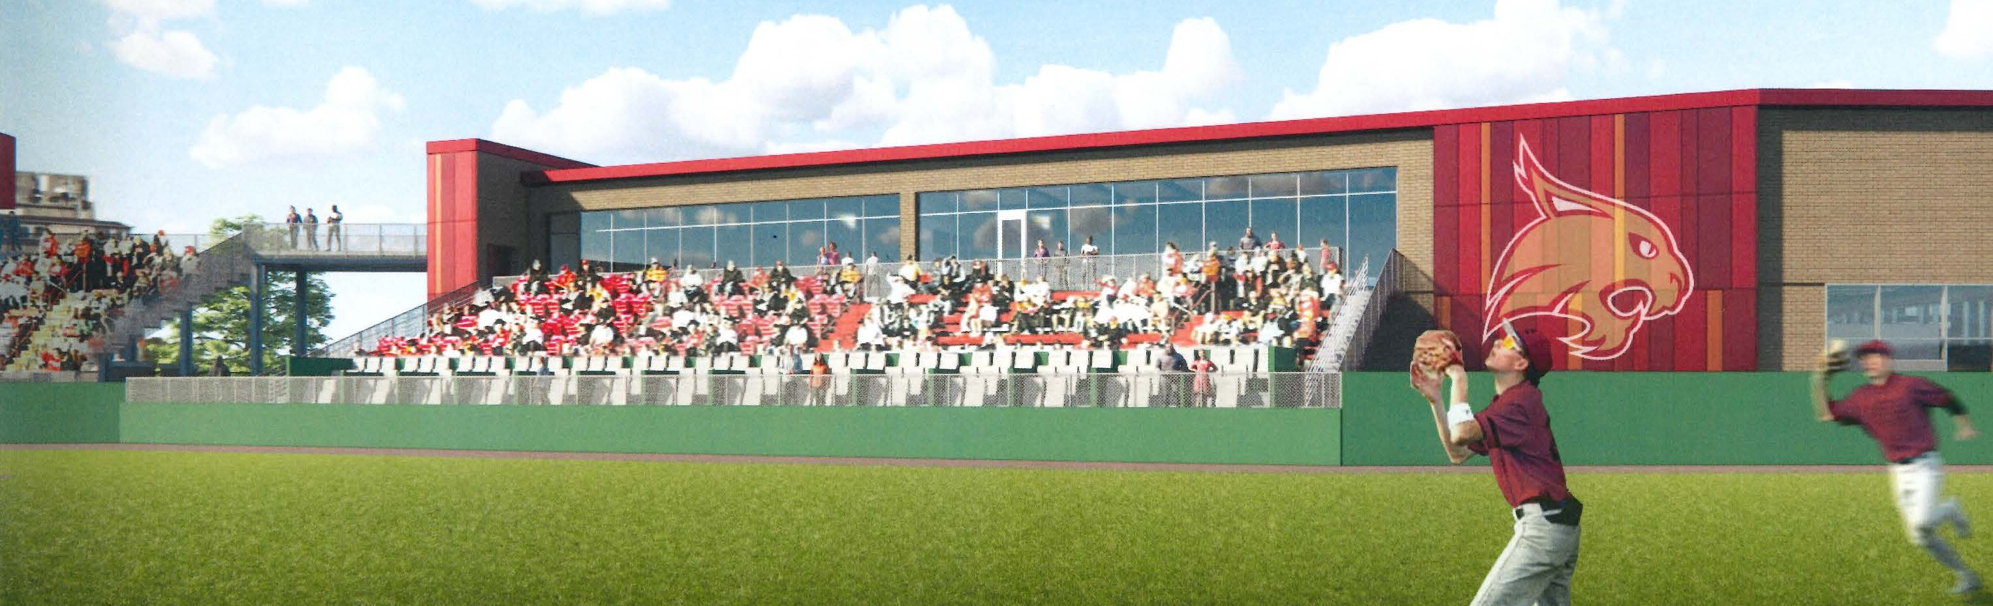
Ballpark Clubhouse
Budget: $9.9M
Status: Notice given to proceed with Phase I of project which includes Pitching Lab and Batting Cage relocation.
Est. Construction Start: TBD
Est. Construction Completion: January 2025
Scope: Project includes hospitality suite,
new box seating, players lounge, batting
cages, pitching lab and new softball players
lounge.

Slide 3
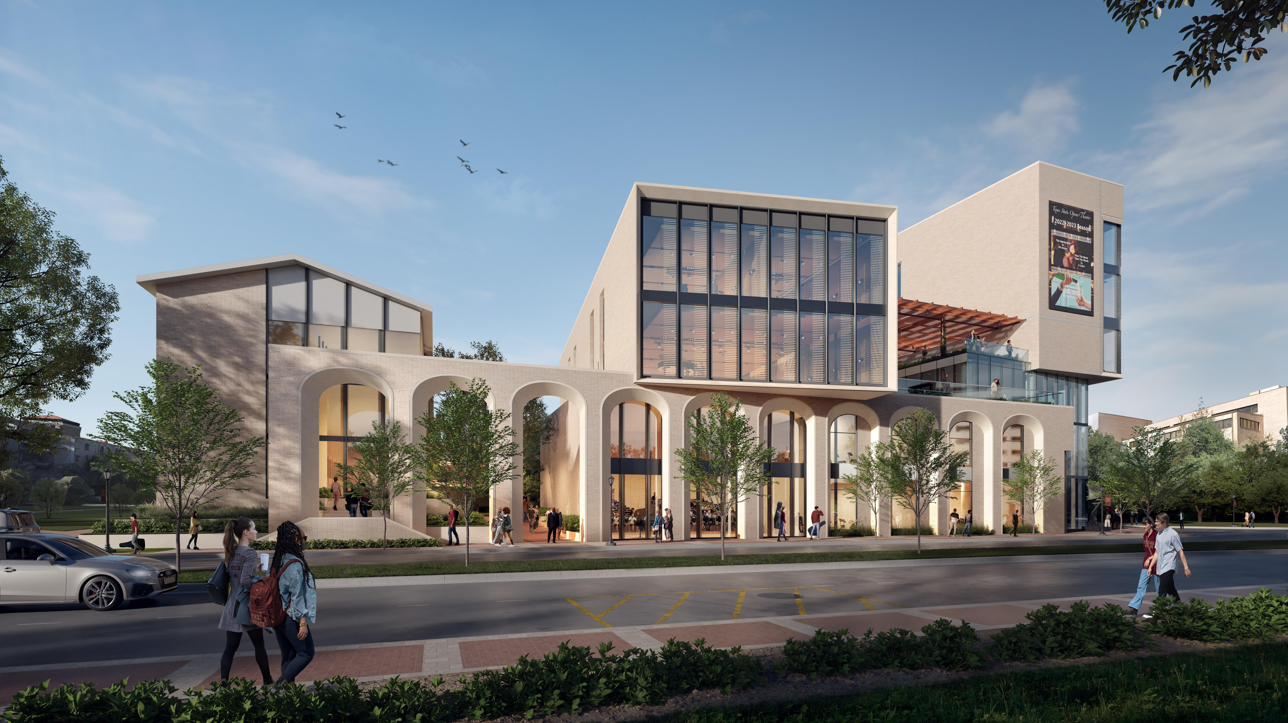
Music Building
Budget: $90.0M (CIP)
Status: Pre-planning/Fundraising
Estimated Construction Start: TBD
Estimated Construction Completion: TBD
Scope: New 85,000 GSF music center will include classroom and rehearsal space, located next to the Performing Arts Center.

Slide 4
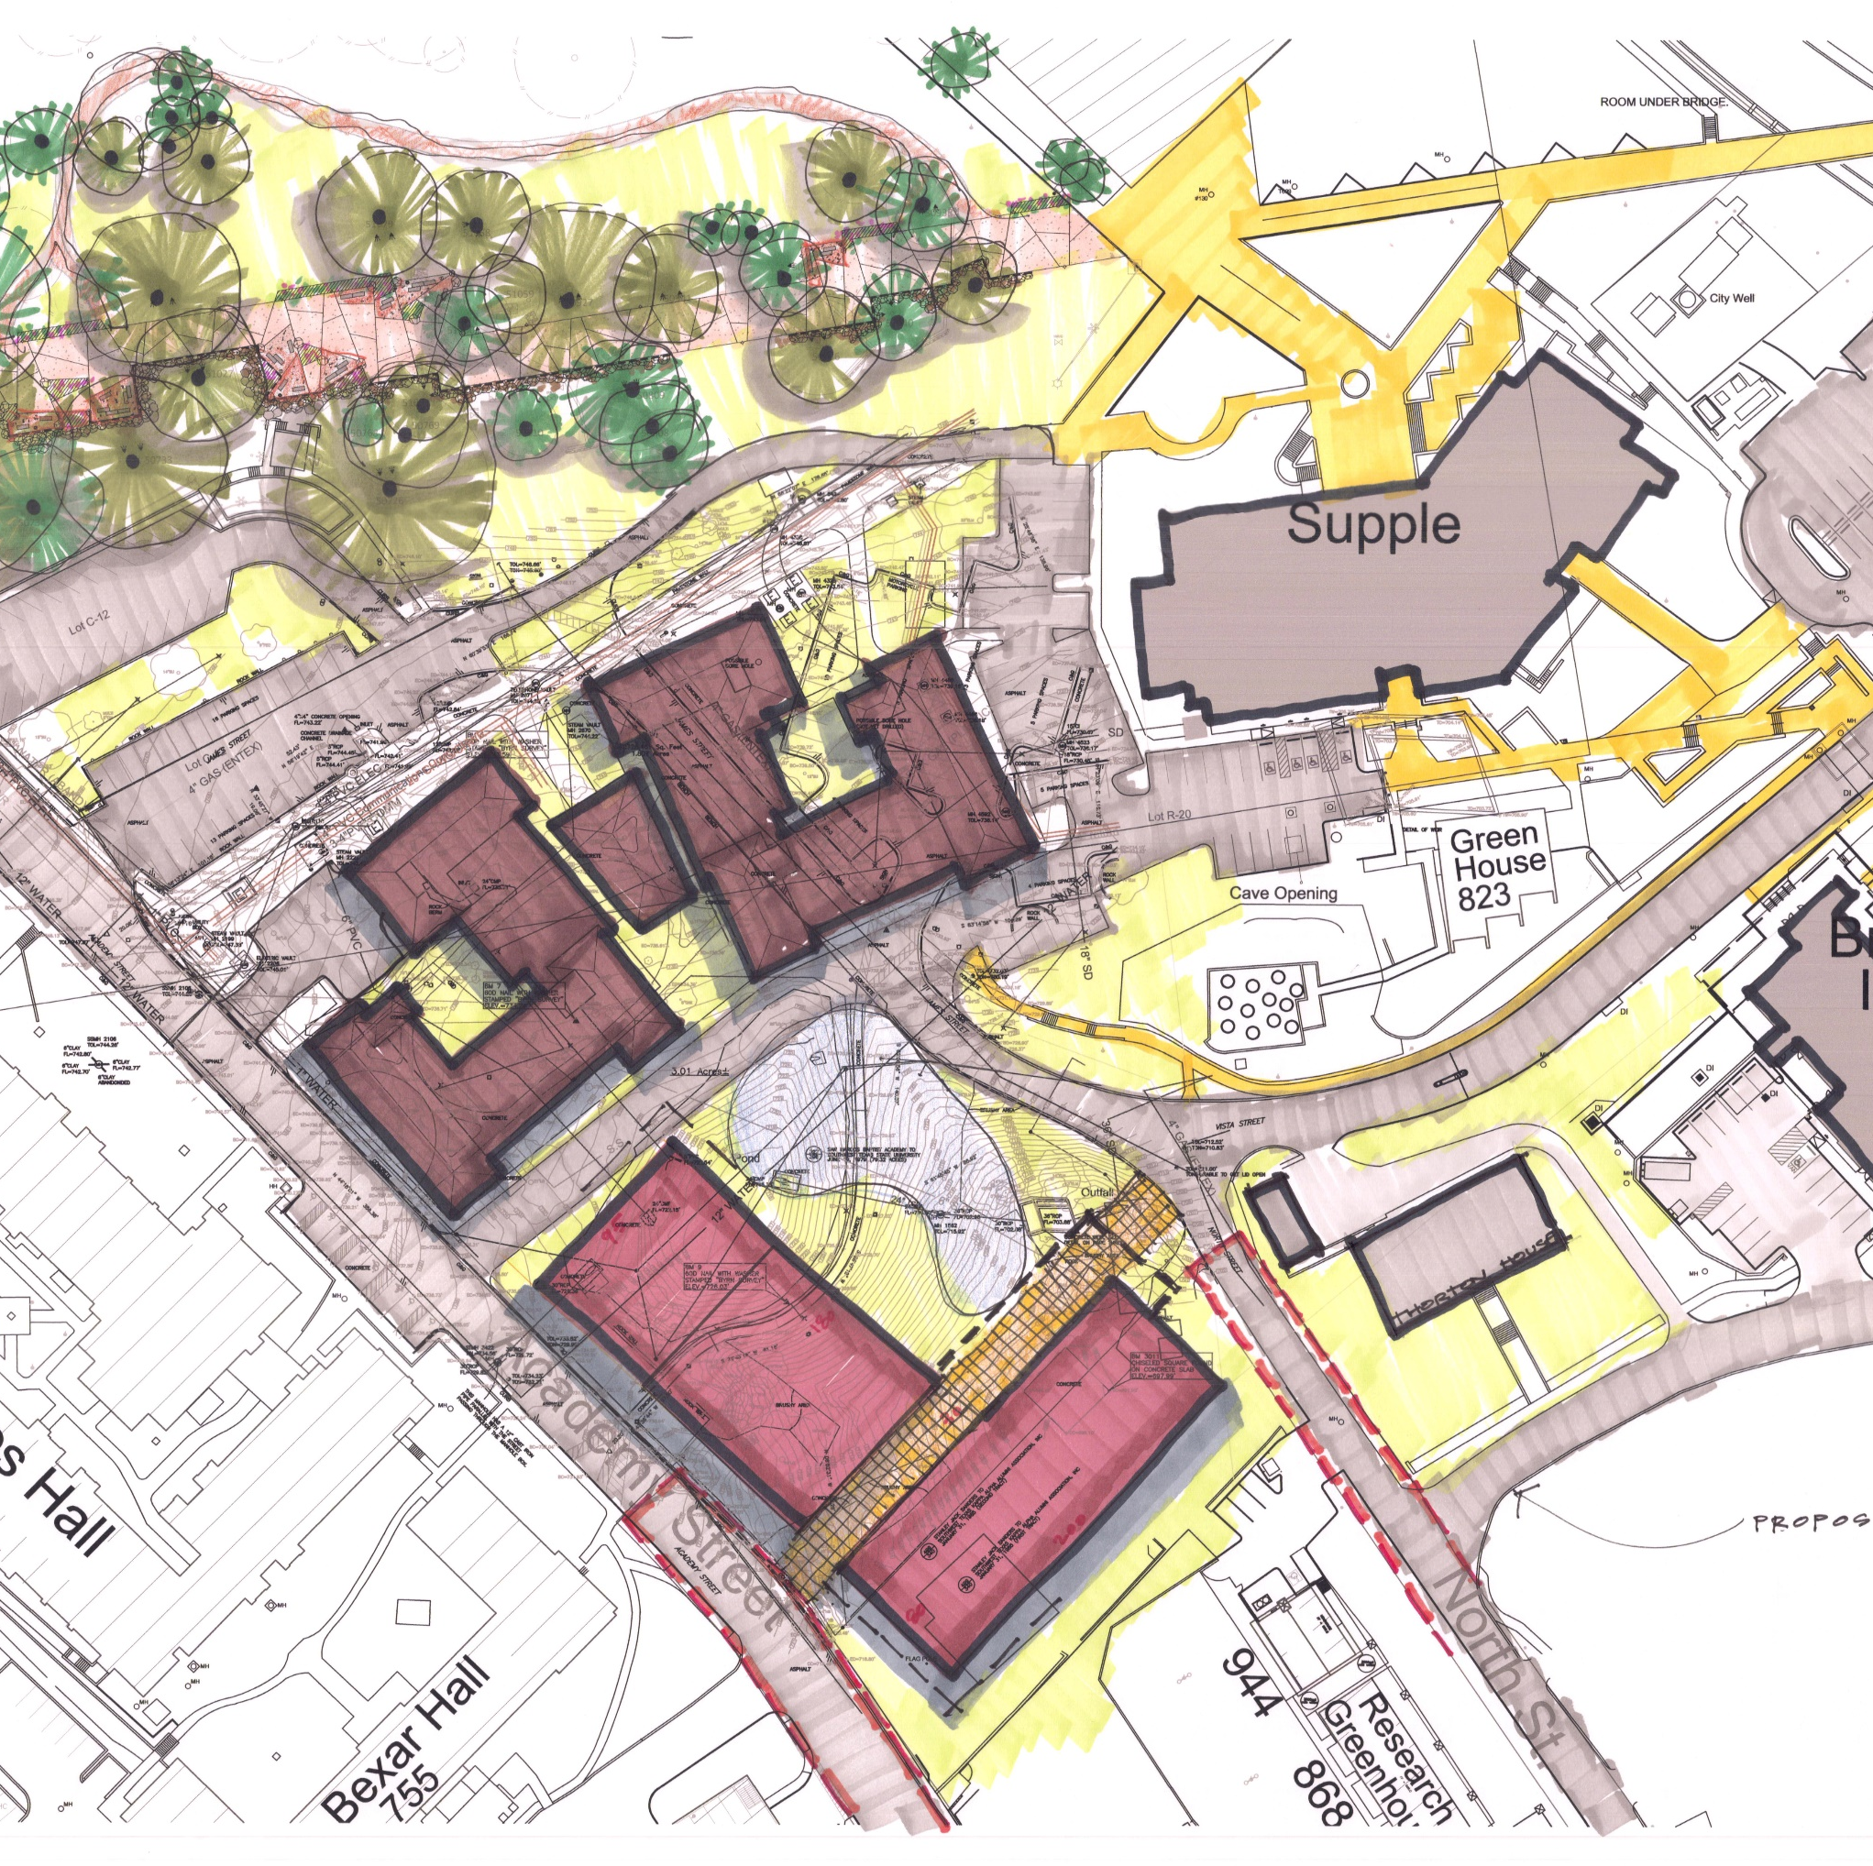
STEM Classroom Building
Budget: $137.4M
Status: Architect negotiations underway / CM@R selection pending
Est. Construction Start: June 2024
Est. Construction Completion: July 2026
Scope: New 154,000 academic/lab building will house the Departments of Mathematics and Computer Science on the San Marcos Campus.
STEM

Slide 5
Esperanza Hall
Budget: $52.4M
Status: A/E Negotiations Pending / CM@R Solicitation Cancelled. Space Utilization Survey of RR Campus is underway to help determine the best use of the future Esperanza Hall.
Estimated Construction Start: TBD
Estimated Construction Completion: TBD
Scope: New 81,651 sf academic building to house classrooms,
labs, and offices to support the College of Health Professions,
on the Round Rock Campus.

Slide 6
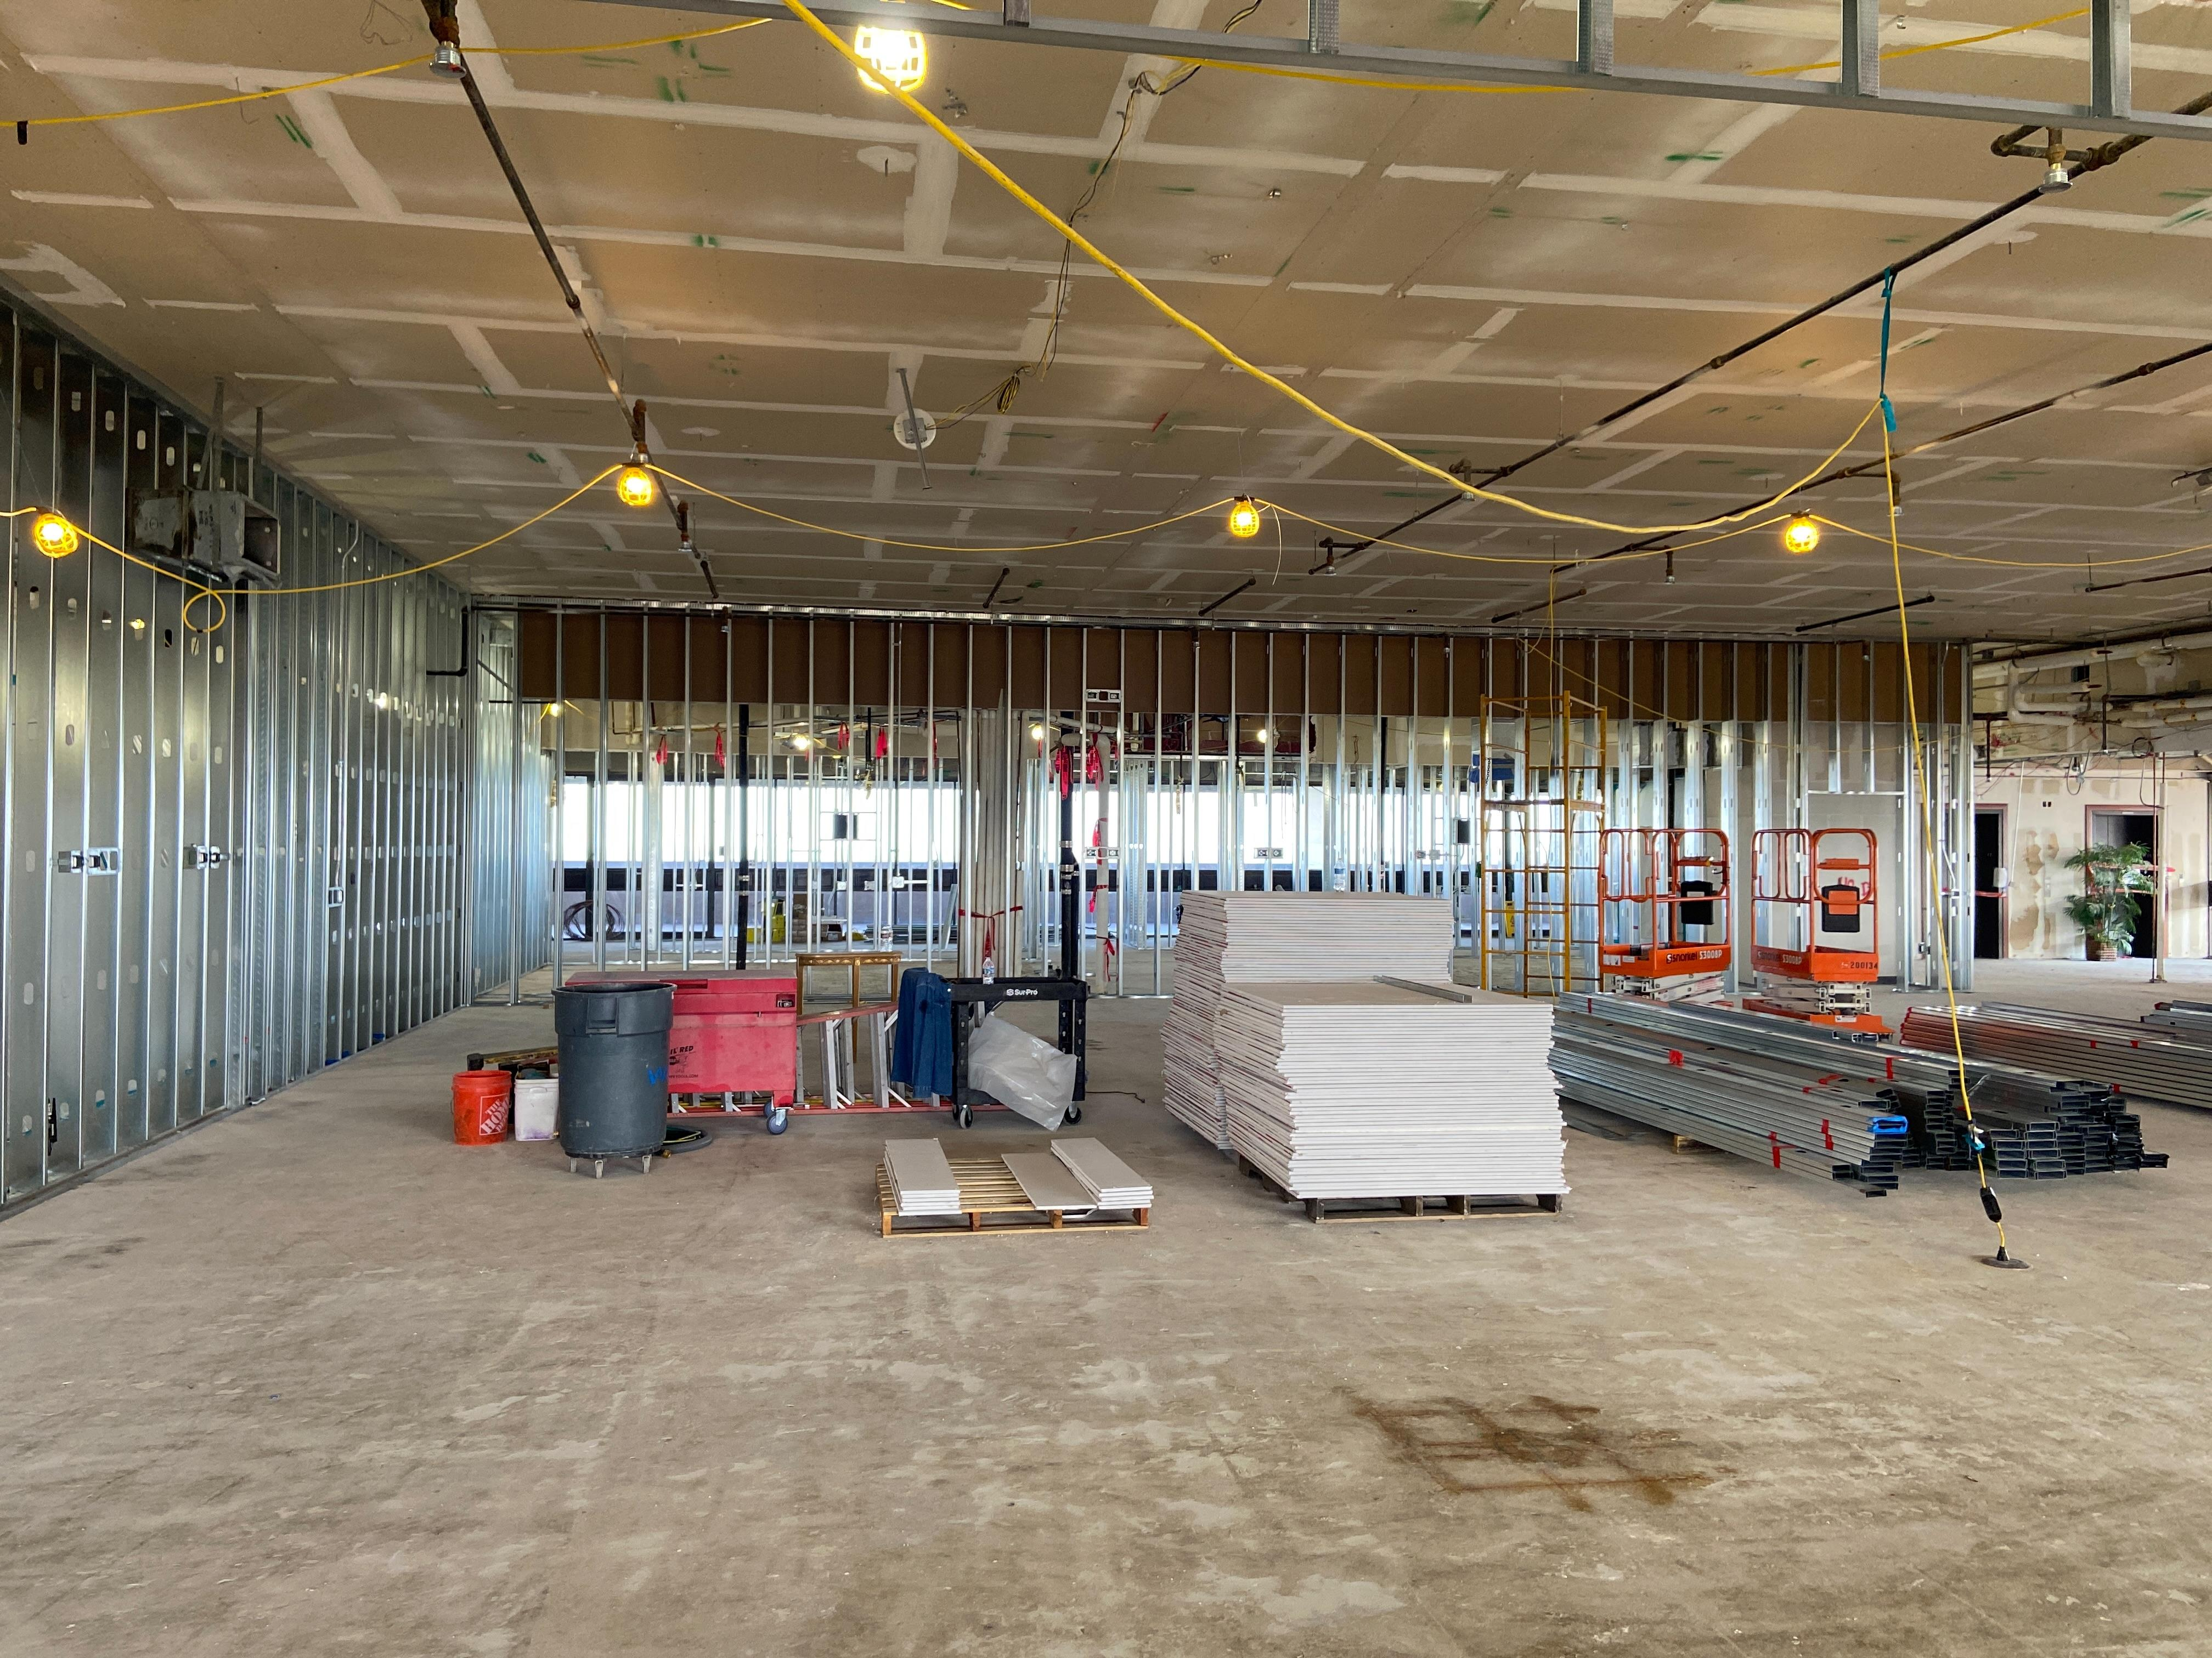
JC Kellam (JCK) Administration Building Reconfiguration
Budget: $7.9M
Status: 16% Complete. Demolition of interior is complete. Installation of metal framing, MEP rough-in on-going
Construction Start: March 2023
Estimated Construction Completion: September 2023
Scope: This project will convert the eleventh-floor into event, hospitality and meeting space for various functions, and replace existing roof.

Slide 7
JC Kellam- 11th Floor Reconfiguration

Slide 8
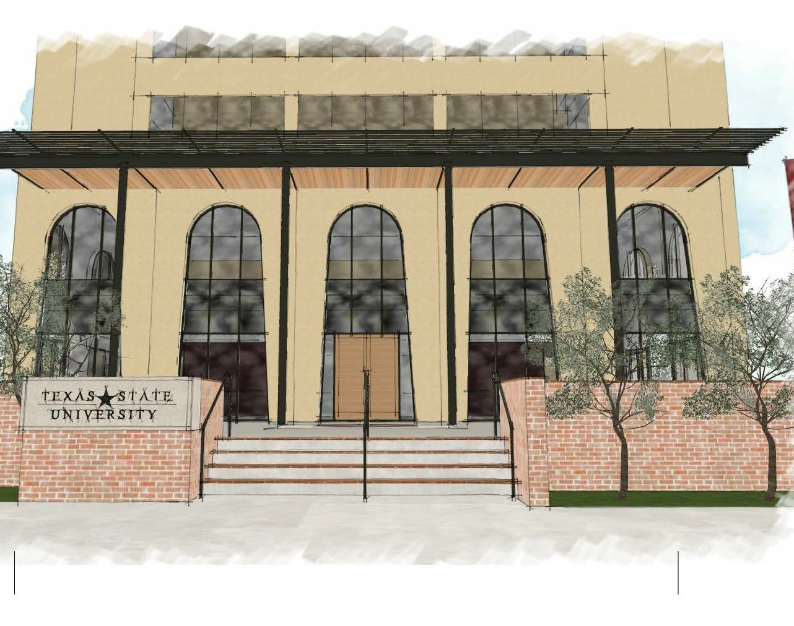
JC Kellam (JCK) Lobby/Parking Modifications
Budget: $4.0M
Status: Design Development
Construction Start: August 2023
Estimated Construction Completion: December 2023
Scope: This project will construct a new covered entry Lobby and reconfigure the parking to allow pick-up / drop-off in front of the building.

Slide 9
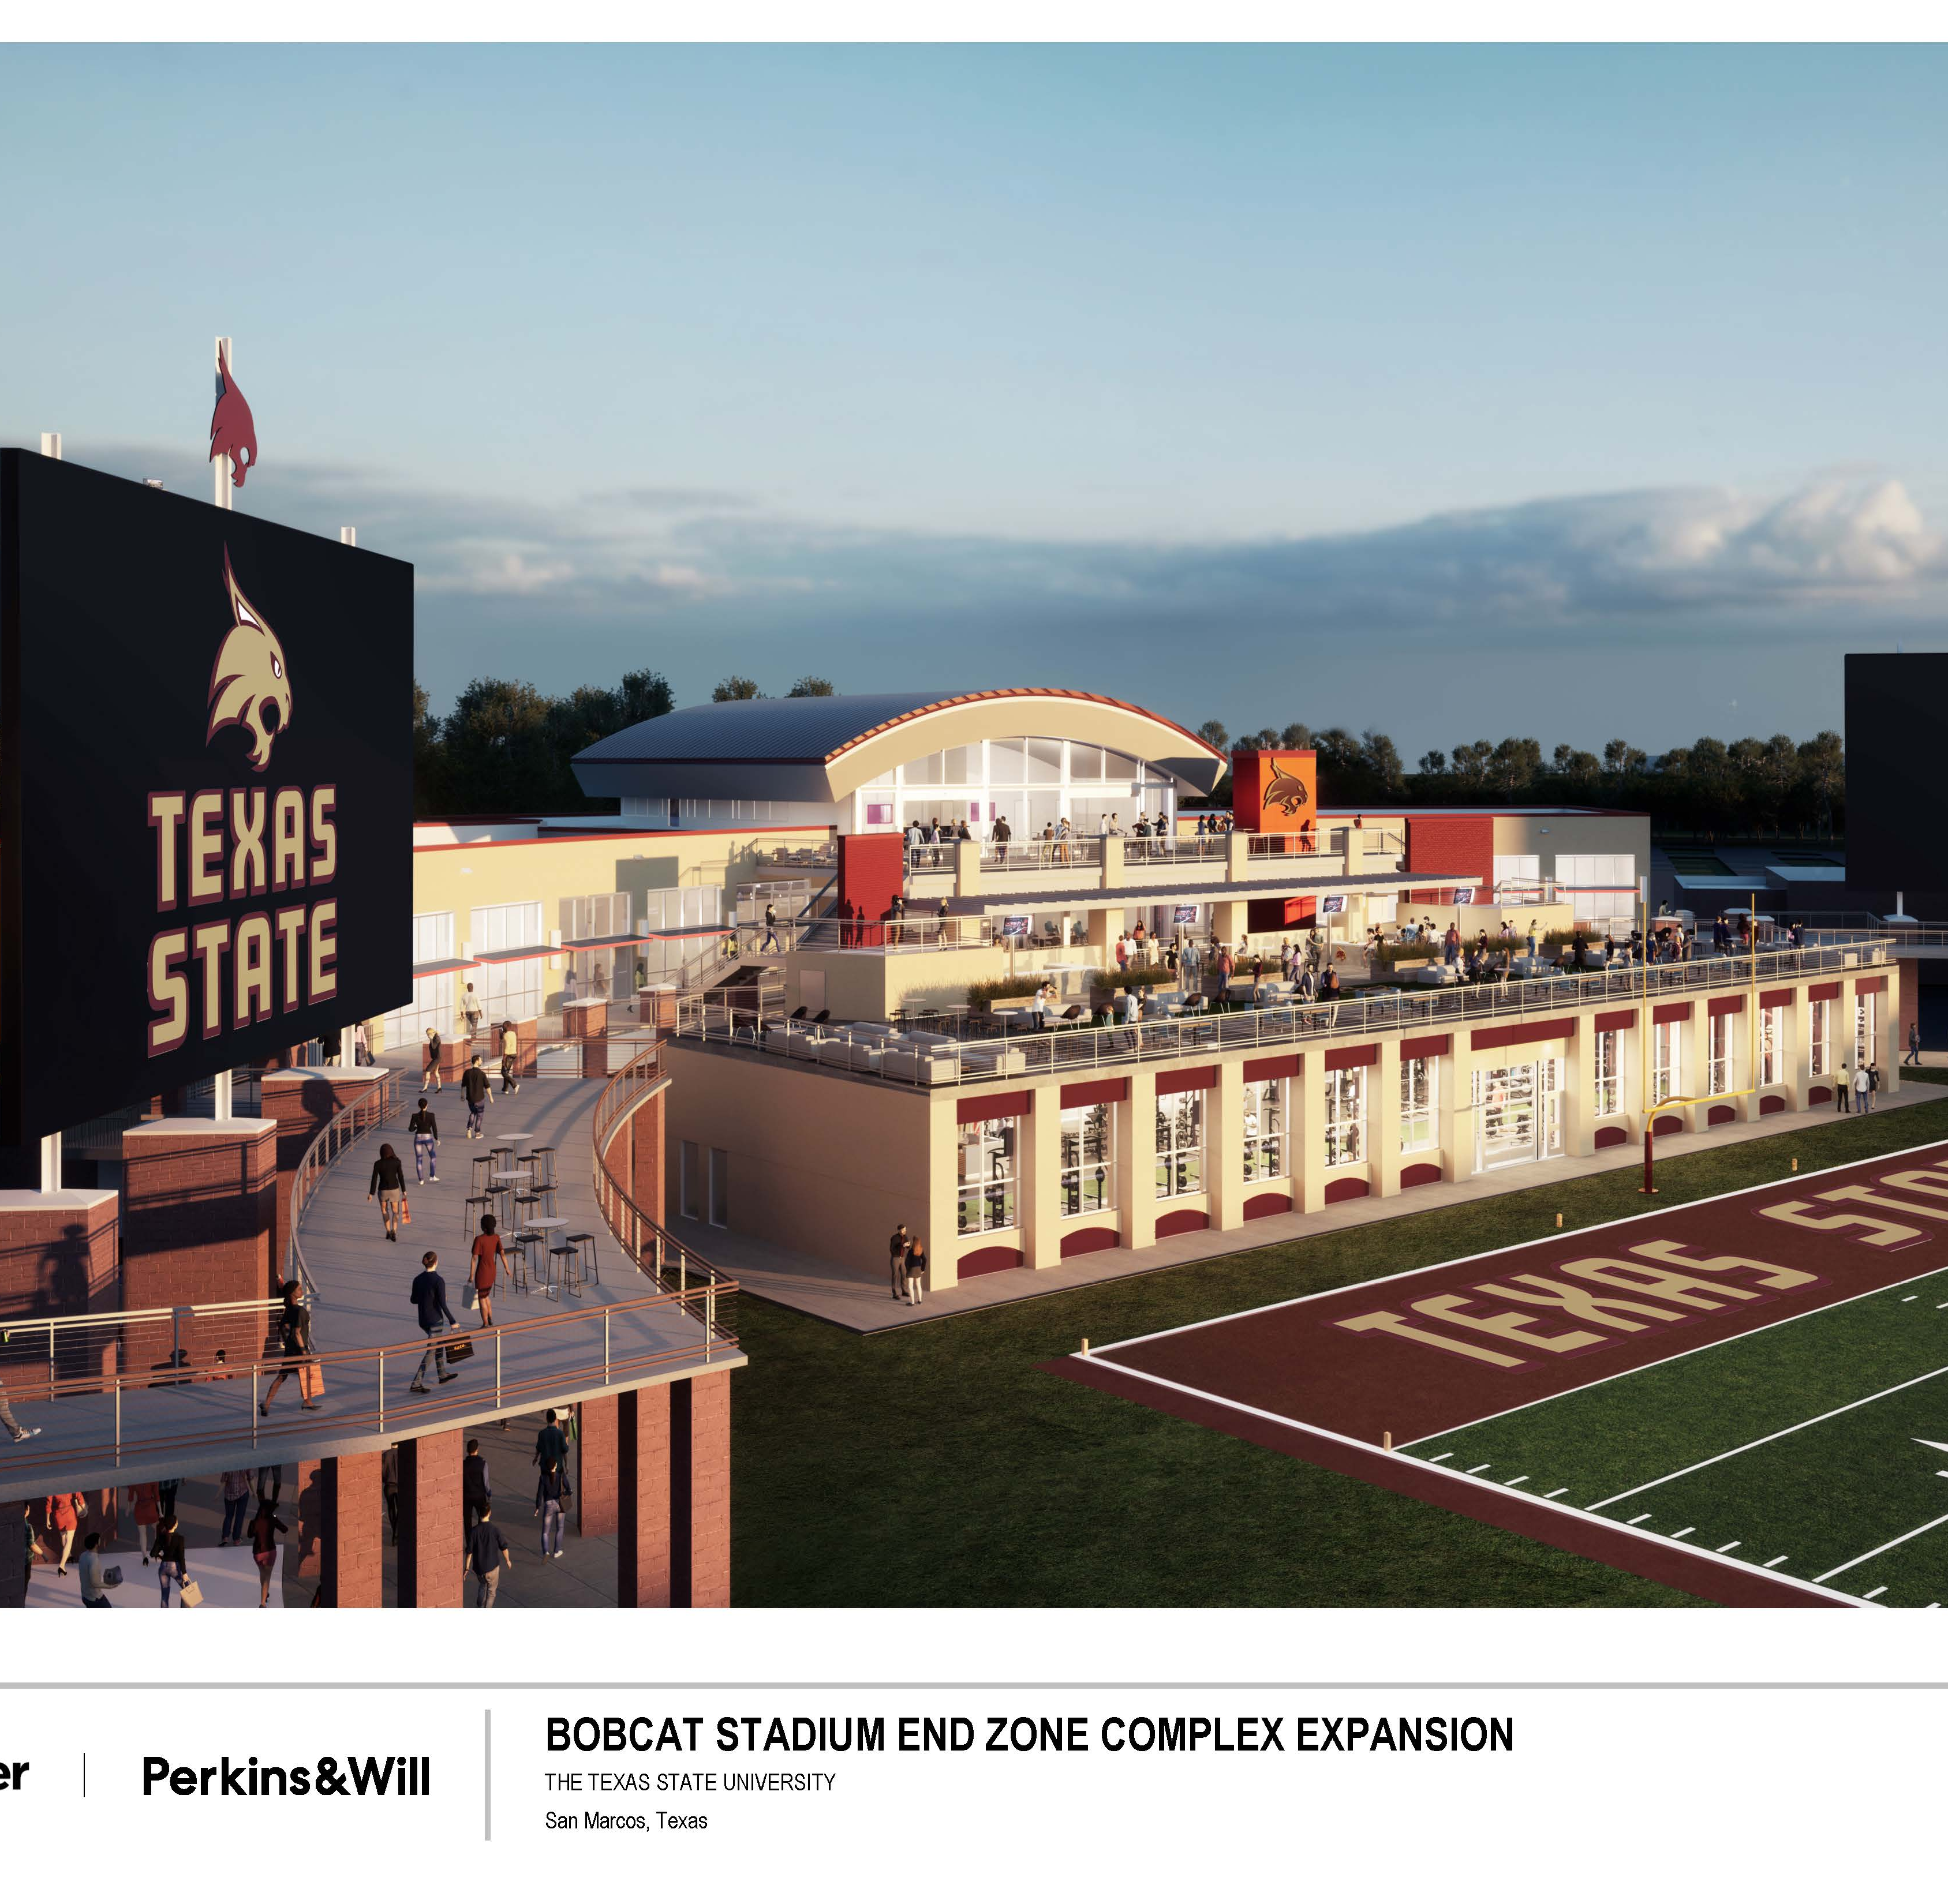
Bobcat Stadium End Zone Complex Expansion
Budget: $37.0M (CIP)
Status: 40% Construction Documents – CMR developing GMP for project.
Estimated Construction Start: June 2023
Estimated Construction Completion: October 2024
Scope: New weight and athletic training room, expand the current locker rooms, repurpose the existing weight room space for position meeting rooms, and create additional hospitality spaces.

Slide 10
Rooftop Terrace

Slide 11
Hilltop Housing Complex
Budget: $125.1M
Status: Construction – 30%
Construction Start: May 2022
Estimated Construction Completion: June 2024
Scope: Construction of two, seven-story structures comprised of 241,000 sf, and accommodating 1006 beds.
North Tower – Alamito Hall
South Tower – Cibolo Hall

Slide 12
Hilltop Housing Complex

Slide 13
Hilltop Housing Complex

Slide 14
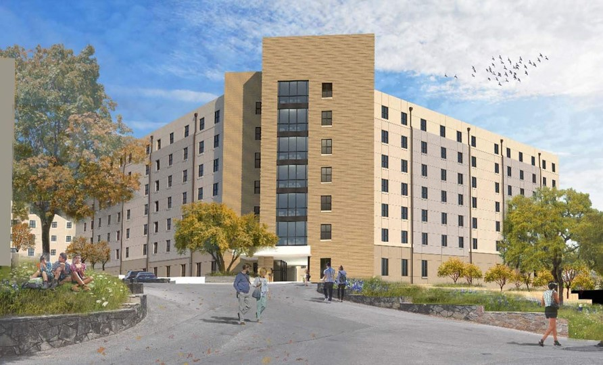

Slide 15
James Street Housing
James Street Housing
Budget: $124M
Status: Design-Builder selection underway
Est. Construction Start: November 2023
Est. Construction Completion: July 2025
Scope: Construction of two, seven-story structures, with connecting community building, comprised of 221,240sf, and accommodating 888 beds.

Slide 16
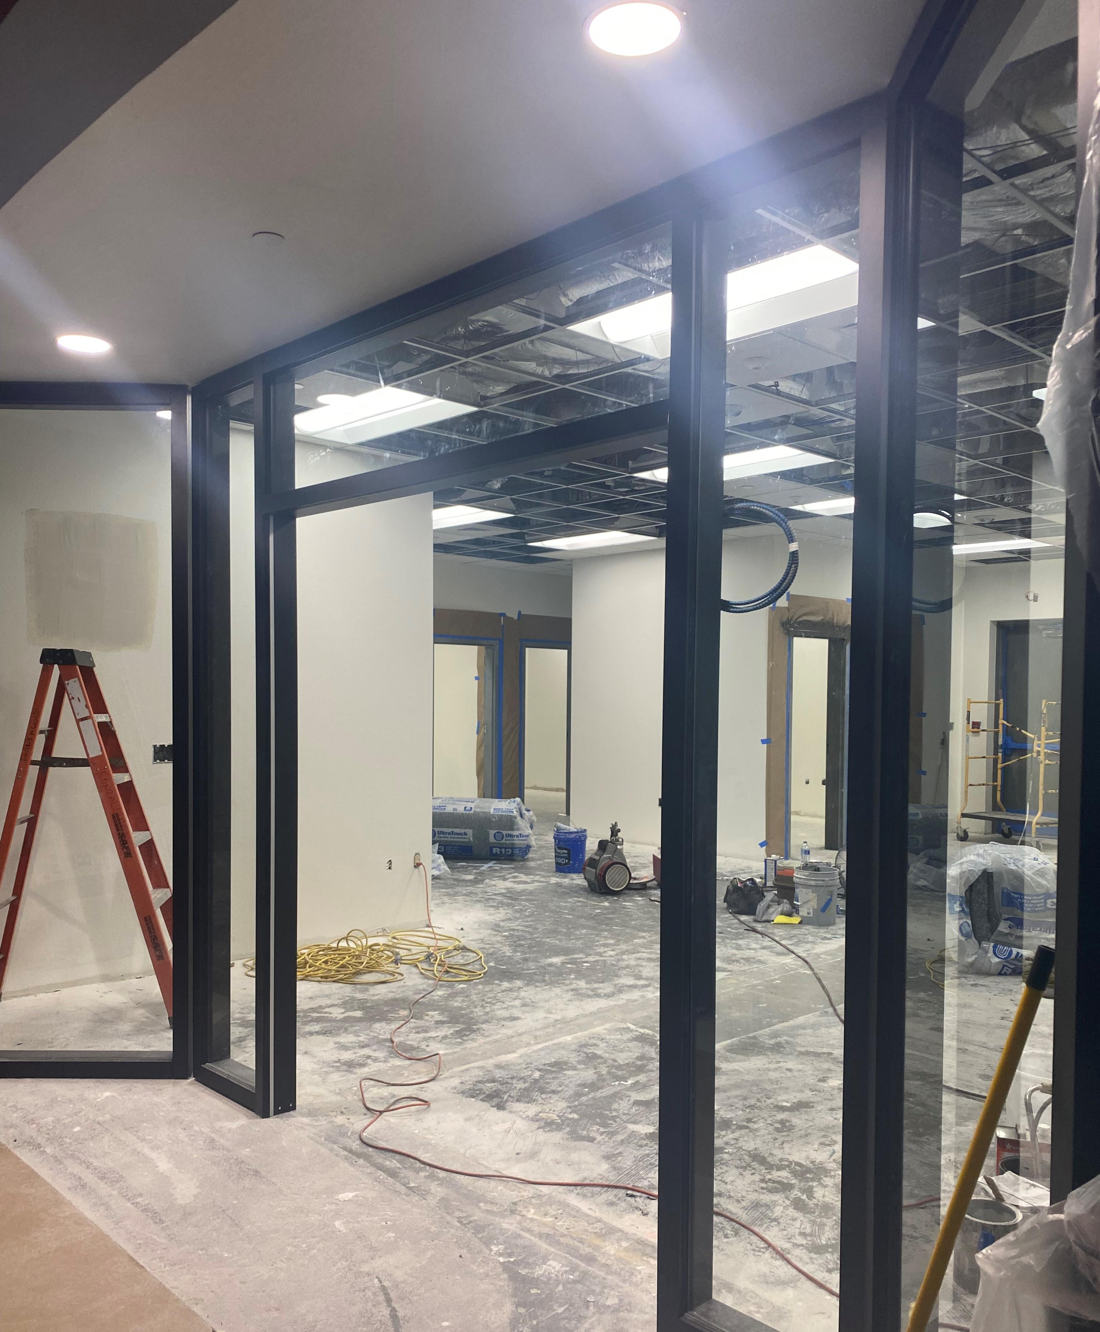
McCoy Student Success Center
Budget: $1.0M (CIP)
Status: Construction – 90%
Construction Start: March 2023
Estimated Construction Completion: June 2023
Scope: This project renovates Classroom 111 and Student Organization Room 110 into the new Student Success Center. Center will house offices, conference room, interview room and lobby.
Drywall installation is underway.

Slide 17
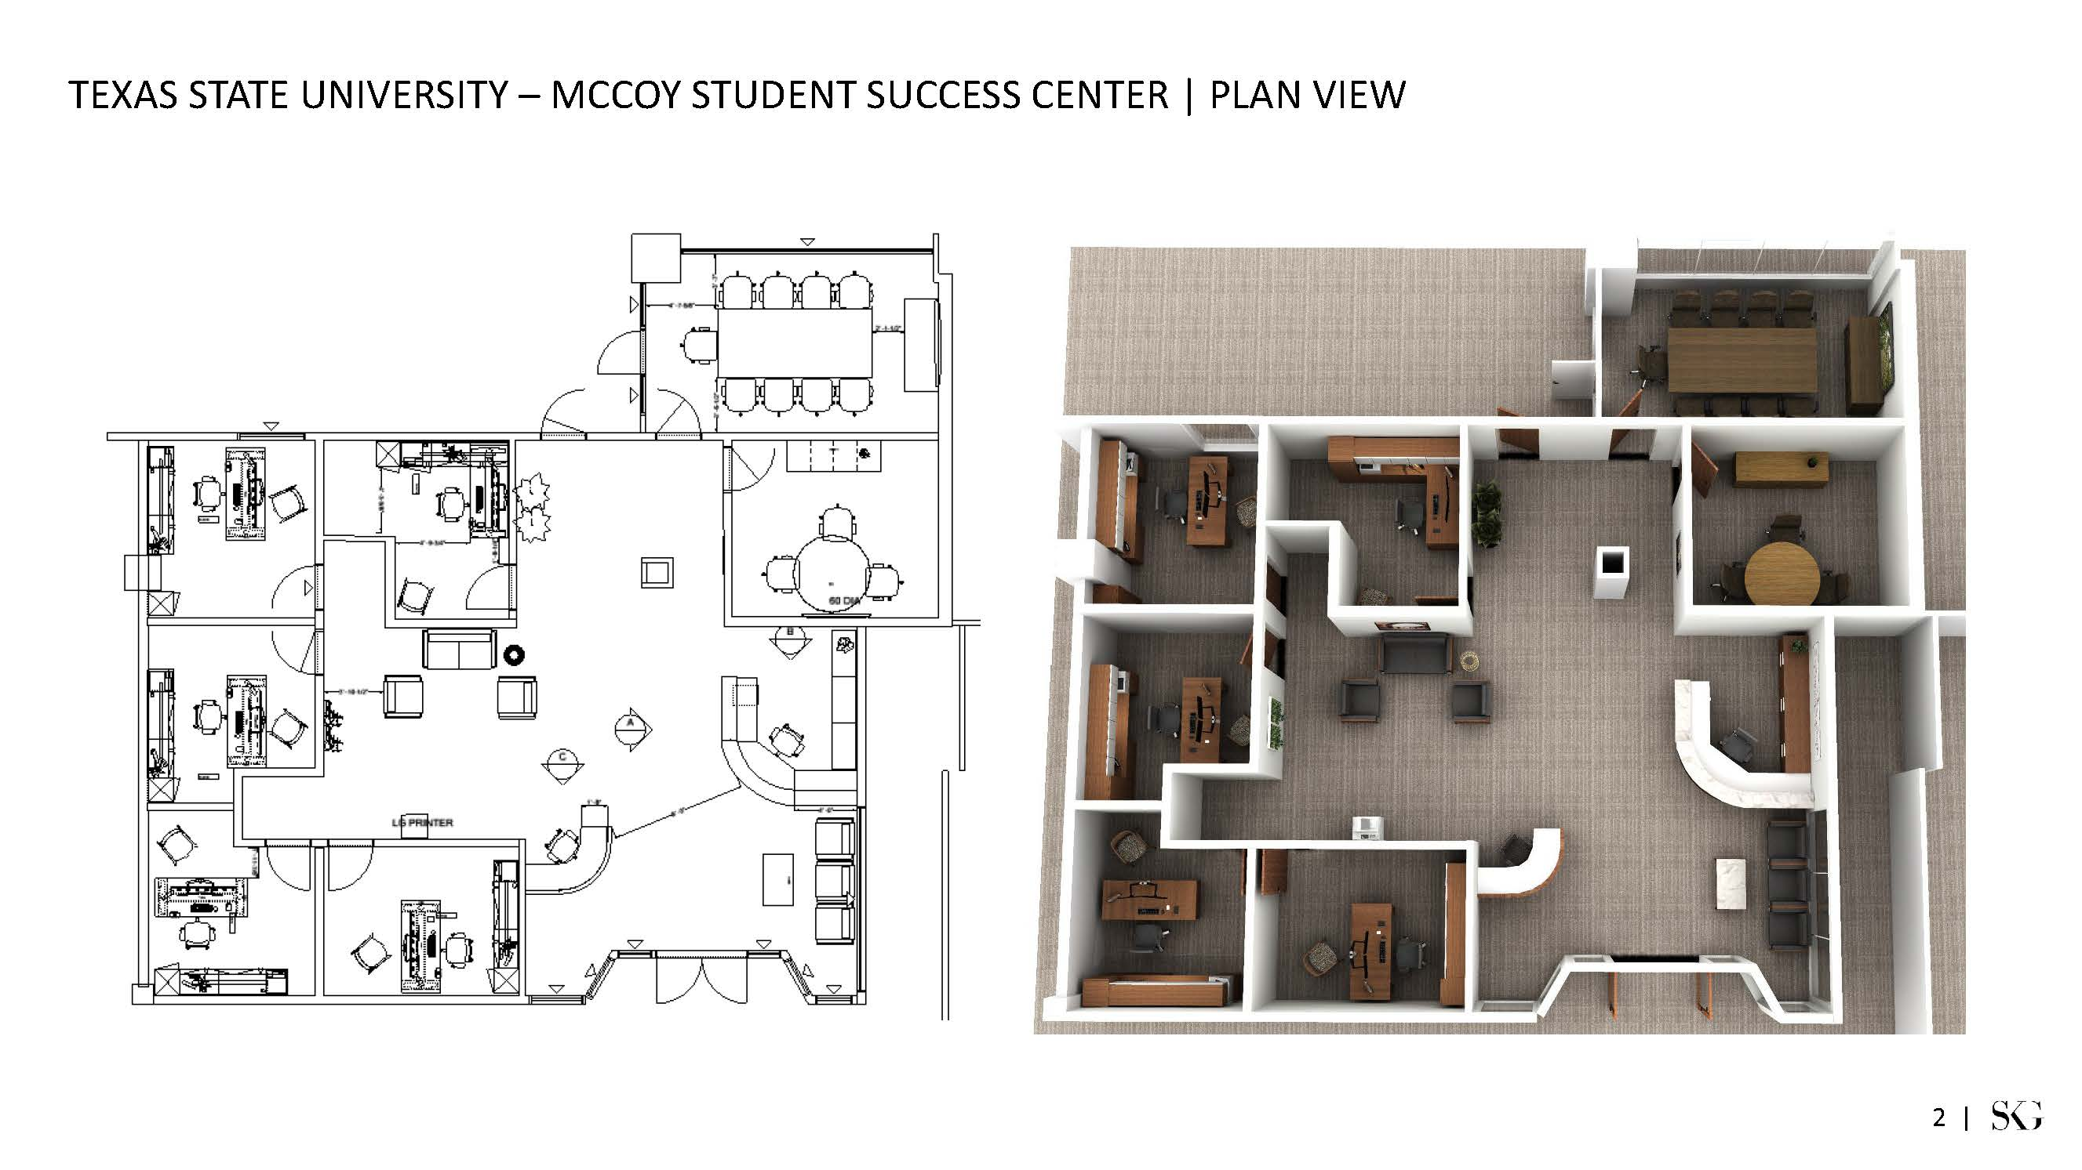
McCoy Student Success Center

Slide 18
East-West Mall Connection
Budget: $1.6M
Status: Site mobilization & lay-out
Construction Start: May 2023
Estimated Construction Completion: December 2023
Scope: Construct new paved pedestrian mall from RF Mitte to Academy Street. New pedestrian mall to include landscaping, seating, power pedestals and lighting.

Slide 19
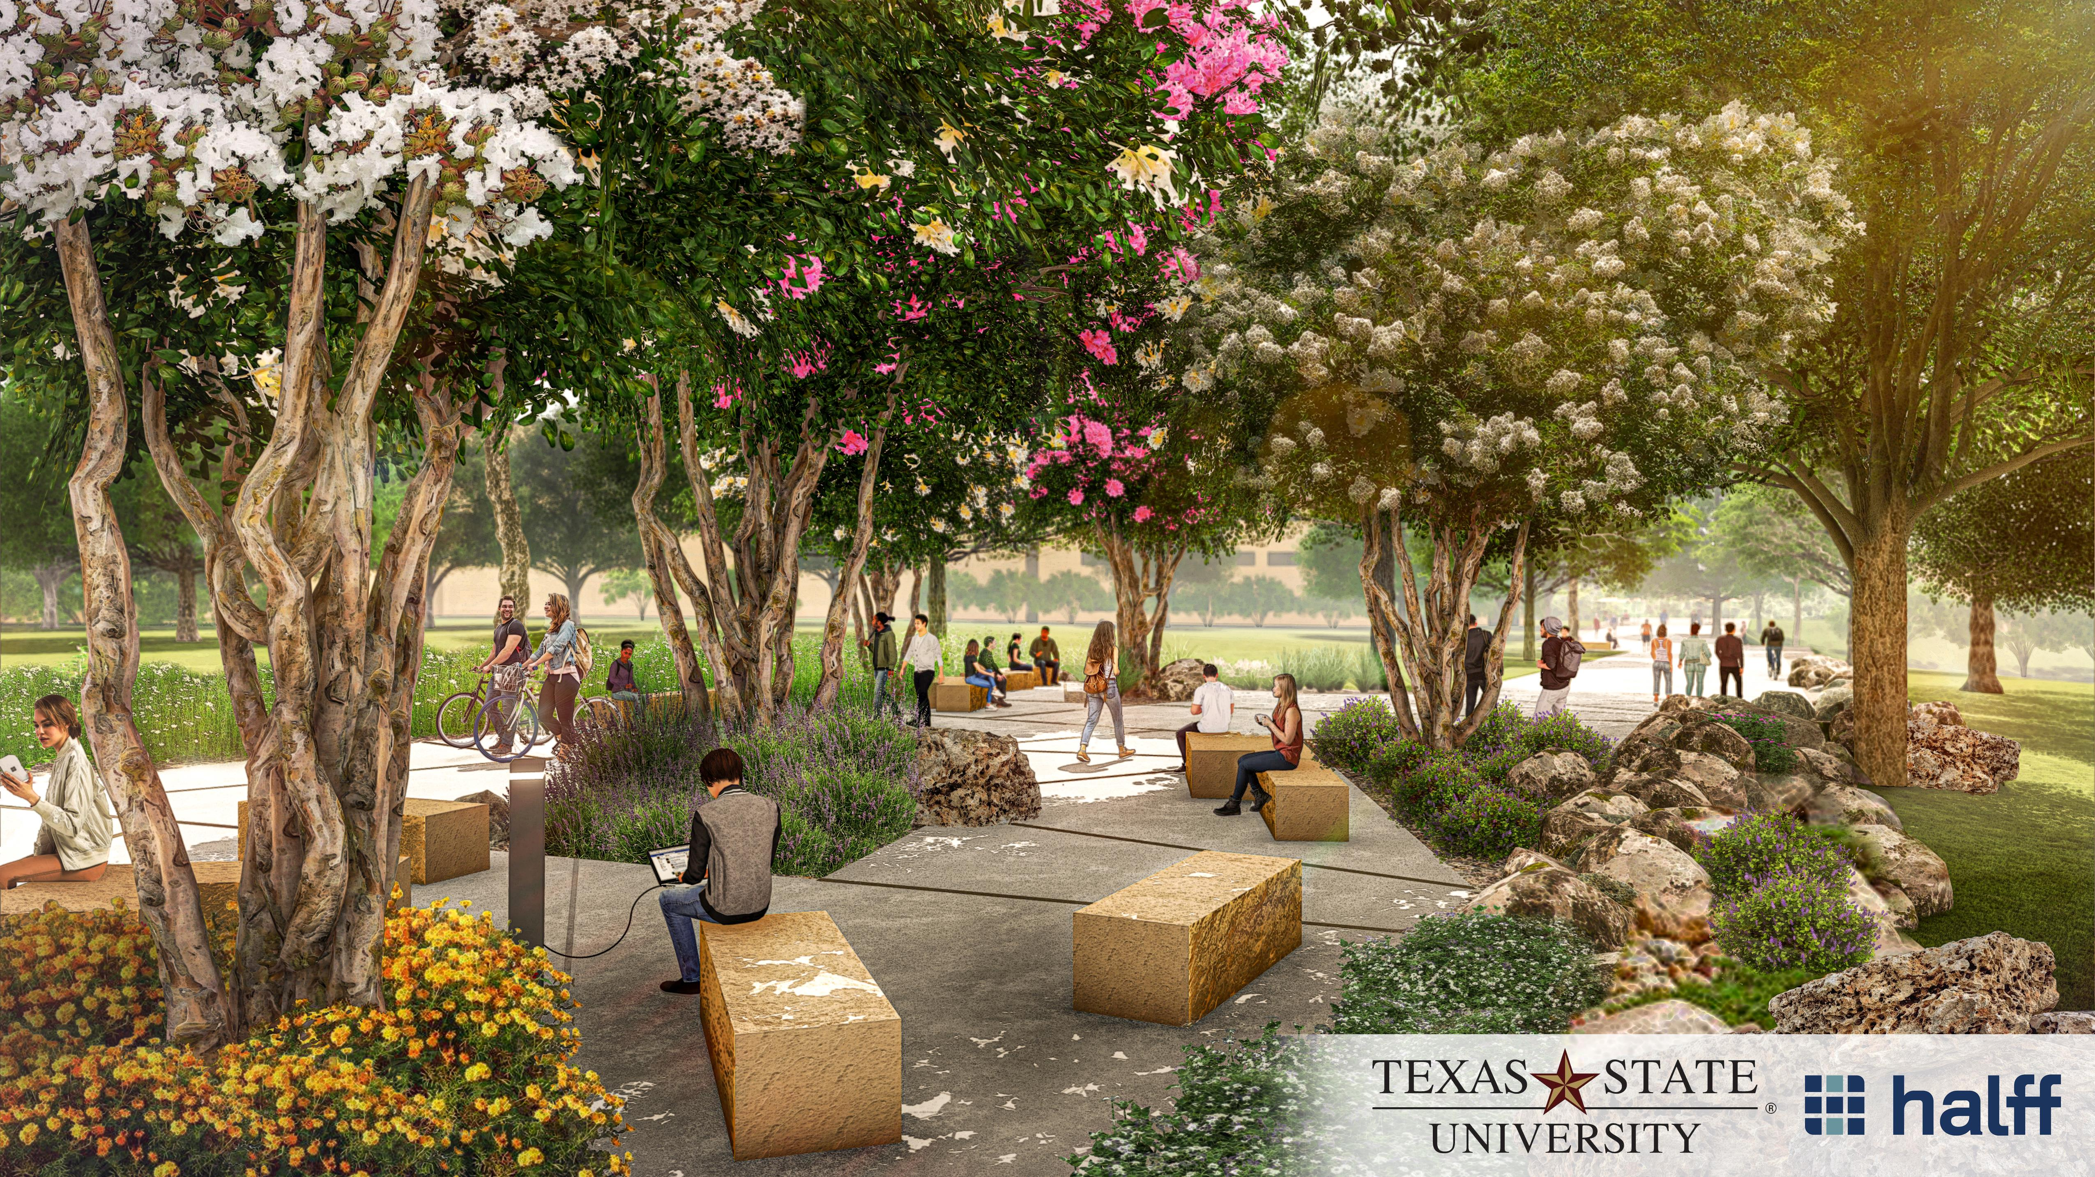
East – West Mall Connection

Slide 20
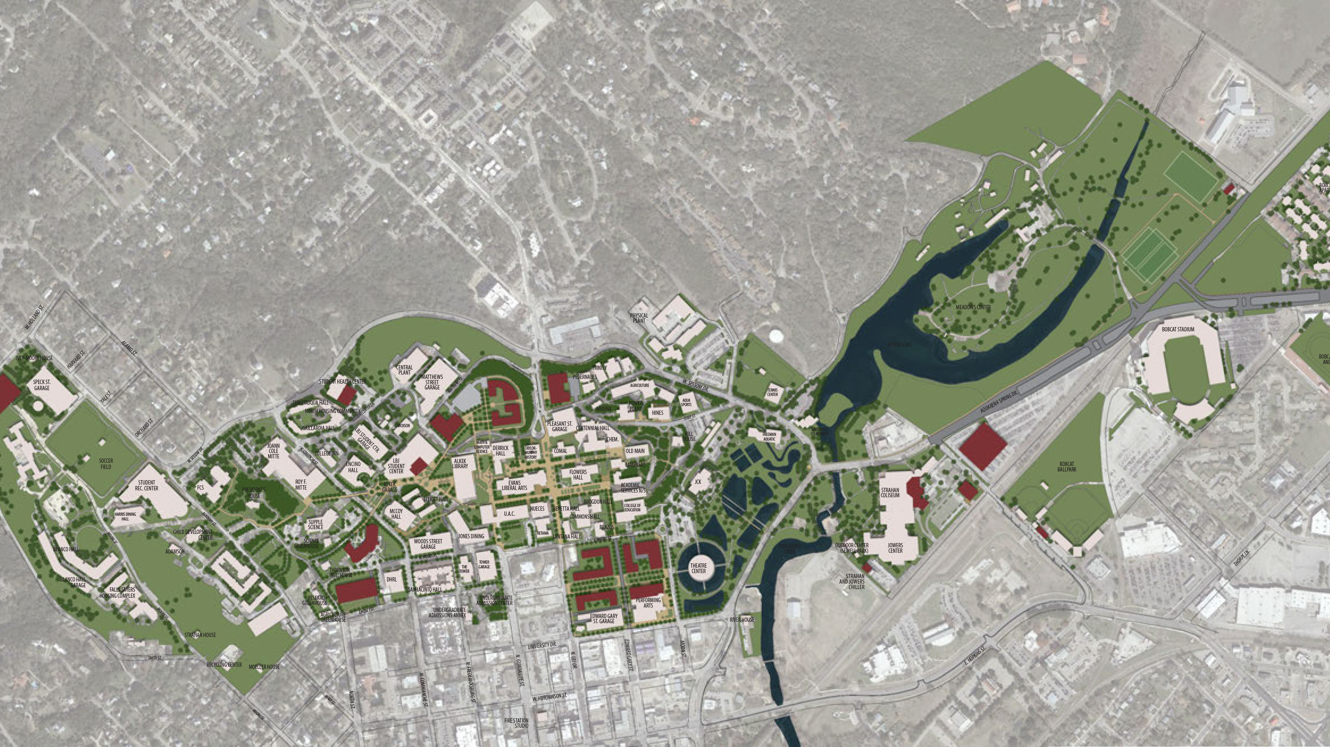
Campus Master Plan
Status: Contract negotiations underway with selected consultant.
Schedule:
Begin Master Plan Process – 06/2023
Final Draft (Review) – 09/2024
TSUS Planning & Construction Comm –10/2024
Approval by BOR – 11/21/2024

Slide 21
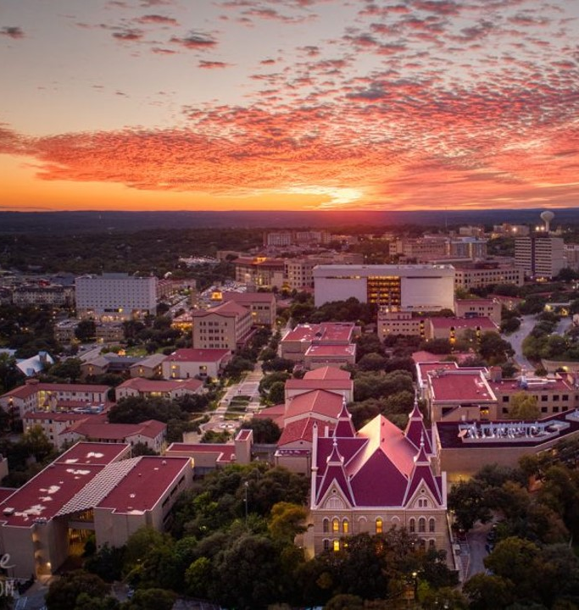
Facilities Construction Update

