Slide 1

Texas State University
1
Fall 2021 Campus Safety and Emergency Management Update
November 2021

Slide 2
Campus Safety
Texas State University ‘s campuses are safe by most objective measurements. For example, we have lower crime rates than nearly any city in Texas, including San Marcos and Round Rock. However, safety is something that can always be improved, and this is certainly a case were the perception of the thing really is akin to reality. We want members of our community to feel safe. In light of the many possible concerns regarding safety, this presentation provides an update on recent and ongoing safety initiatives.
Facilities
Technology & Services
Communications
Emergency Management
Police
Student Behavior Assessment
Communications

Slide 3
Facilities
  Lighting
    The Campus Lighting Committee Safety Walk continues each semester.
    A San Marcos campus lighting study was completed in 2019 and approximately $2.2 million involving over 200 new lights have been installed.
  Safety Phones and Cameras
    Complete audit of Blue Light devices has been performed to ensure all are in good operating order.
    An expert-led comprehensive review of the 900+ cameras on the San Marcos campus is currently underway and the entire system will be improved over the next 2 years.
  Building Access
    The replacement of first-call classroom door locks has been completed. This project amounted to an investment of over $800,000.
    Swipe card access is now a requirement for the primary exterior doors of all major buildings on campus, and all major academic buildings now have swipe-card access.

Slide 4
Emergency Planning and Management
  Our storm-hardened Emergency Operations Center will open in January 2022
  Conducted three emergency management exercises in the past year (Protest, Biosafety incident, Chemical Spill)
  Published our first 110-page comprehensive Multi-Hazard Emergency Operations Plan in 2021
  Currently revising COOP planning and Building Safety Coordinator Programs

Slide 5
Police
  Chief of Police finalists both have an unprecedented amount of experience in campus policing at major R1 institutions.
  Cadet training reimbursement program with diversity focus initiated in 2021
  Increased walking, ATV and bike patrols
  Enhanced Training Offerings
  Joined Hays County Emergency Communications Center

Slide 6
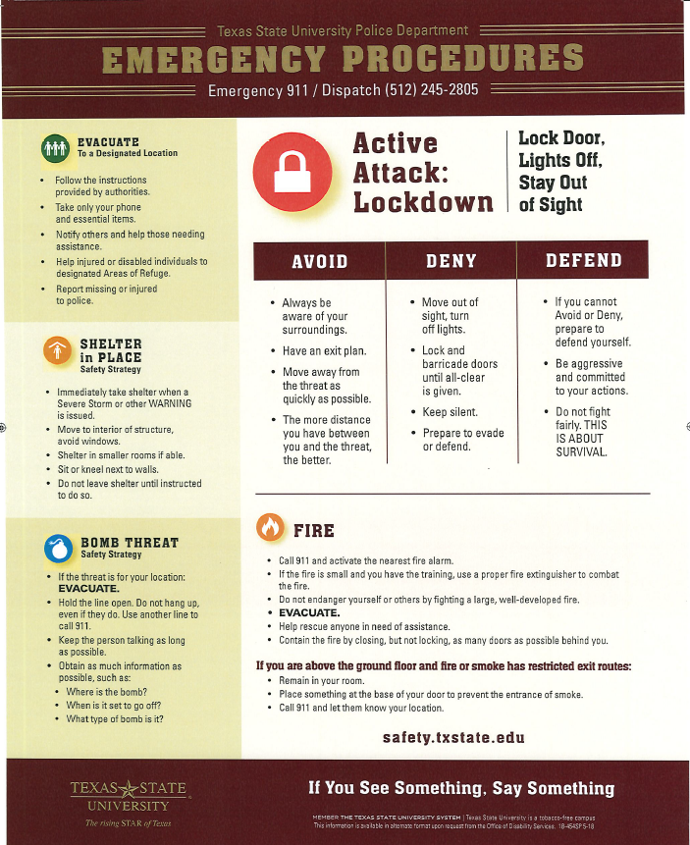
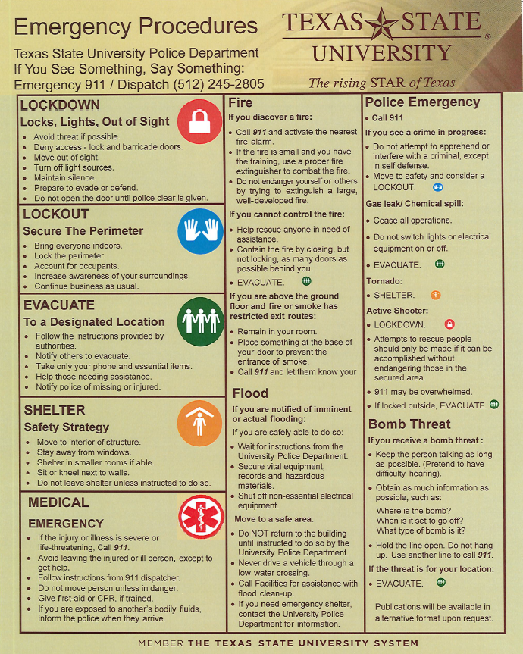
Run, Hide, Fight
Avoid, Deny, Defend
Lockdown, Lockout, Evacuate

Slide 7
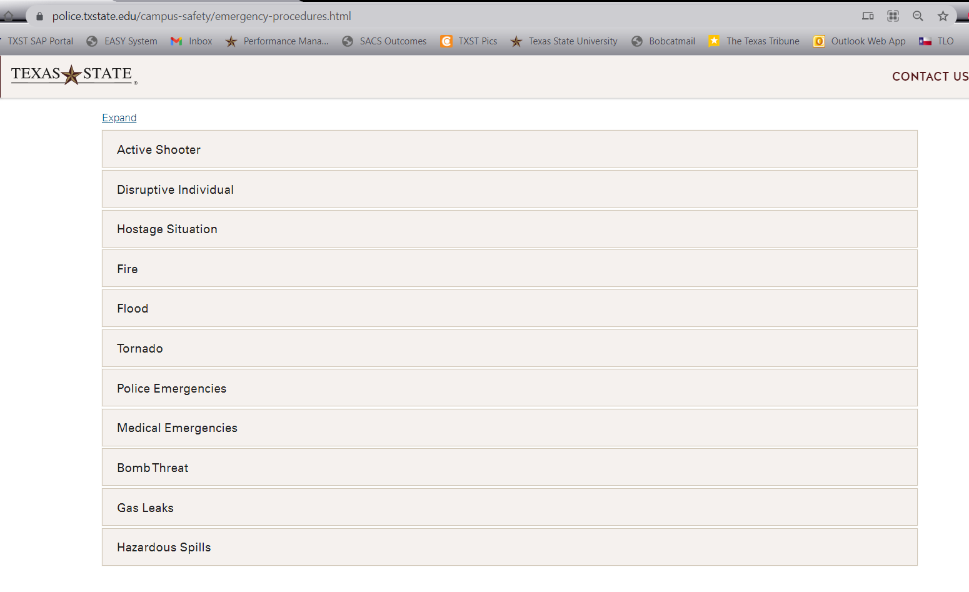
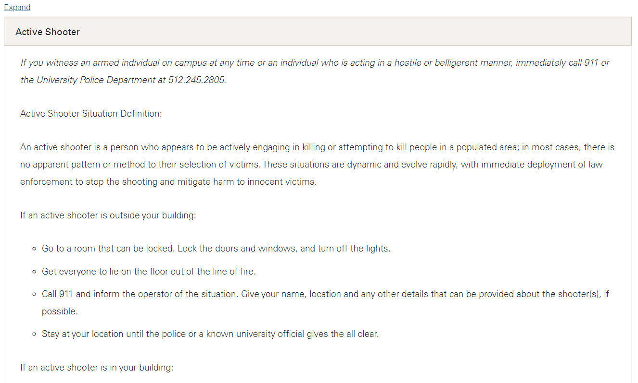
Emergency Procedures
https://www.police.txstate.edu/campus-safety/emergency-procedures.html

Slide 8
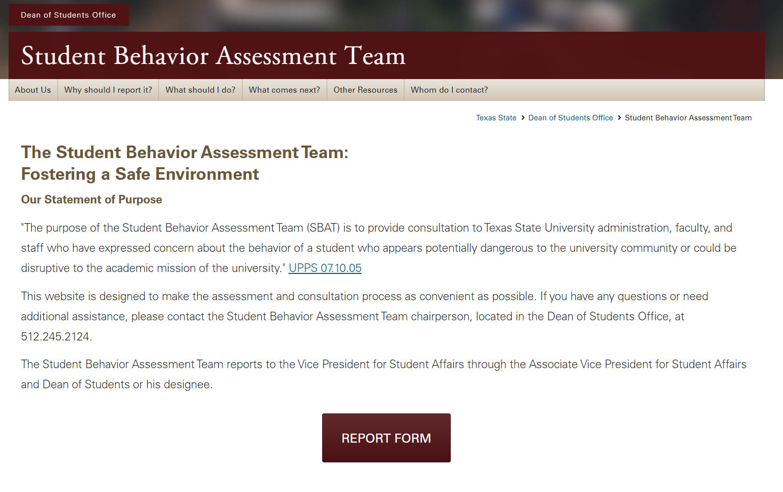
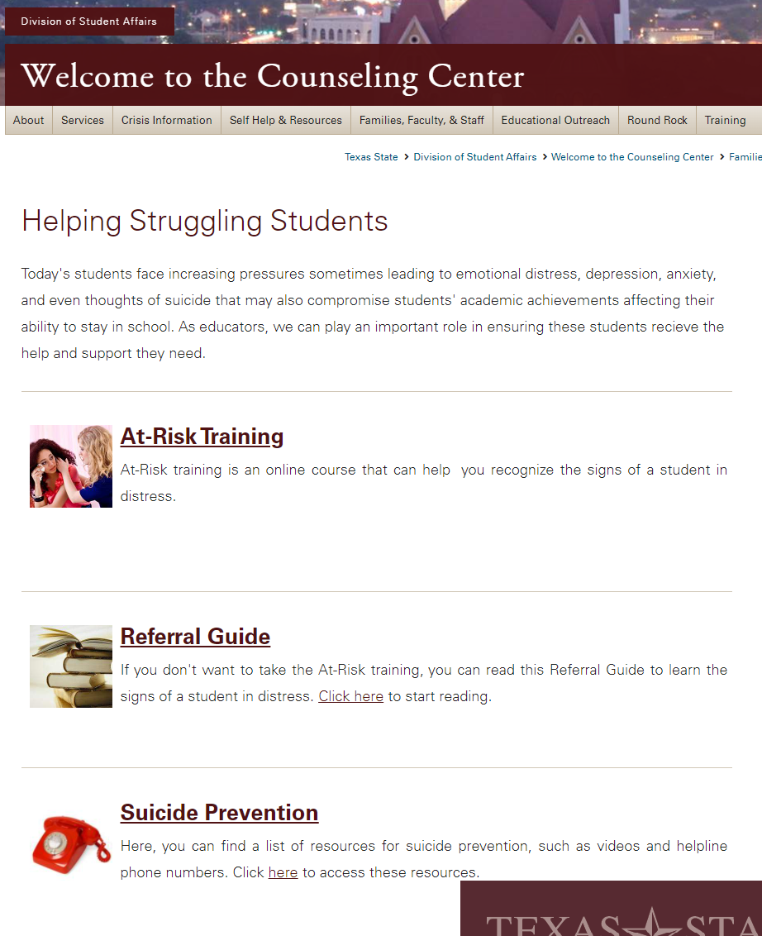
Student Behavior Assessment Team

Slide 9
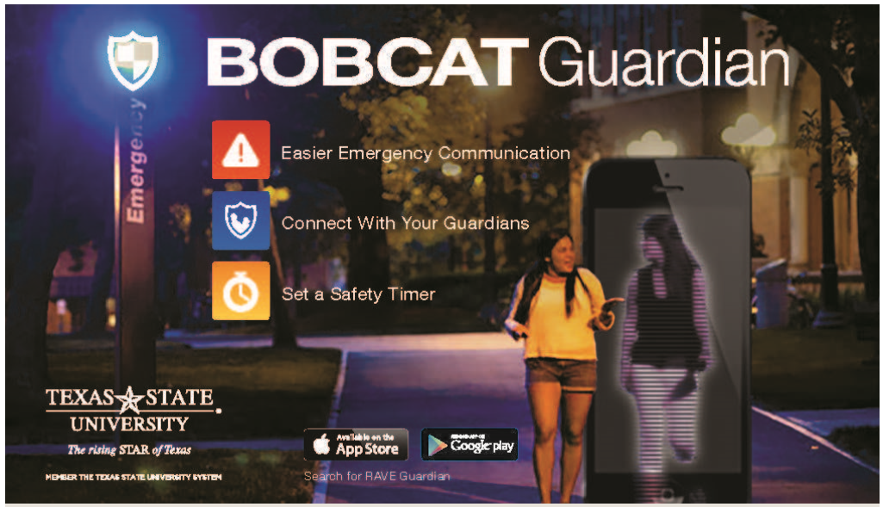
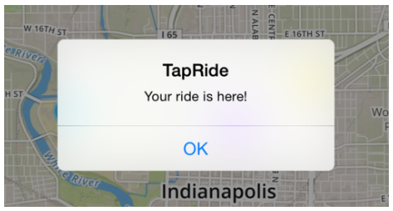
Technology & Services
  Emergency Notification Opt-Out
  Technology and Mobile Applications
    The Bobcat Guardian Mobile App
    Transportation Services provides real-time bus tracking.
    TapRide App is available for the Night Cat and Safe Ride services
    Implemented New World Computer Aided Dispatch

Slide 10
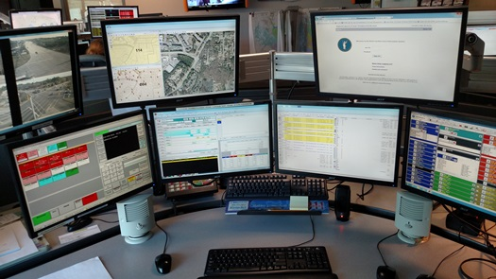
Emergency Communications
  Life-Safety Messages are sent by University Police without review or delay.
  Less-then-life-threatening emergencies come from University Communications with a goal of having messages approved in under 20 minutes.
  Cabinet and University Communications conduct training and tabletop drills on this process.

