Slide 1

DEVELOPING SURVEYS
MEGAN KROU, PhD
OFFICE OF INSTITUTIONAL RESEARCH
This Photo by Unknown Author is licensed under CC BY-NC-ND

Slide 2
DEVELOPING SURVEYS
Why do a survey
How to survey
What to ask
Who to survey
Resources
How to encourage responses

Slide 3
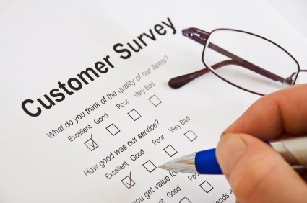
Why: Reasons to Survey
Identify need for new/changed programs or services
Determine customer satisfaction with current programs/services
  Identify areas where improvement can be made
Evaluate impact of changes made to programs/services
  Obtain benchmark first, then re-survey after change
This Photo by Unknown Author is licensed under CC BY-SA-NC

Slide 4

How: Types of Surveys
Questionnaires
Online
  Emailed, posted link, kiosk, QR code
Paper/pencil
  Mailed, group administration, point of service
Interviews
Telephone, in-person, virtual
This Photo by Unknown Author is licensed under CC BY-SA-NC

Slide 5
Choosing a Survey Method
What
What is the purpose?
What are you trying to find out?
Who
Who has the answers to your questions?
How
How can you best reach the target group?

Slide 6
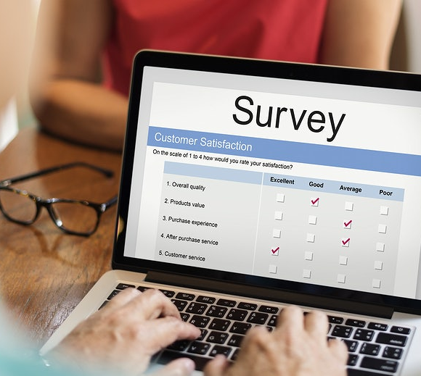
Online Questionnaires
Good for larger groups
Lower cost (sometimes)
Can customize survey and questions
  Branching or routing
No data entry required
Quicker reporting of results (sometimes)
Often yield lower response rates

Slide 7
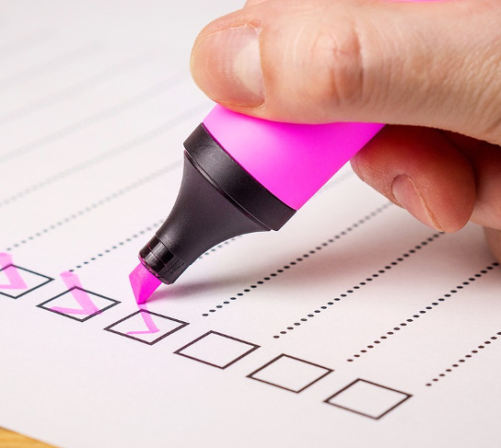
Paper and Pencil Surveys
Better for smaller groups
May be expensive
  Printing and/or postage costs
Variety of distribution methods can be used
  Mail
  Group setting
  Point of service
Better response rate than online (in most cases)
This Photo by Unknown Author is licensed under CC BY-SA

Slide 8

Interviews
Best for small groups
More personal; harder to ignore or deny request
Time/personnel intensive
Require training for interviewer
Can ask for clarification of responses
This Photo by Unknown Author is licensed under CC BY-SA

Slide 9
Choose a Survey Method for this Research Question:
Are students who use services provided by our office satisfied?
Do faculty and staff know about the services provided by my office?
Why don’t students use our services?
We are considering adding a new service. Would students use it?
Do customers who call our office experience the same level of service as those who walk-in?

Slide 10
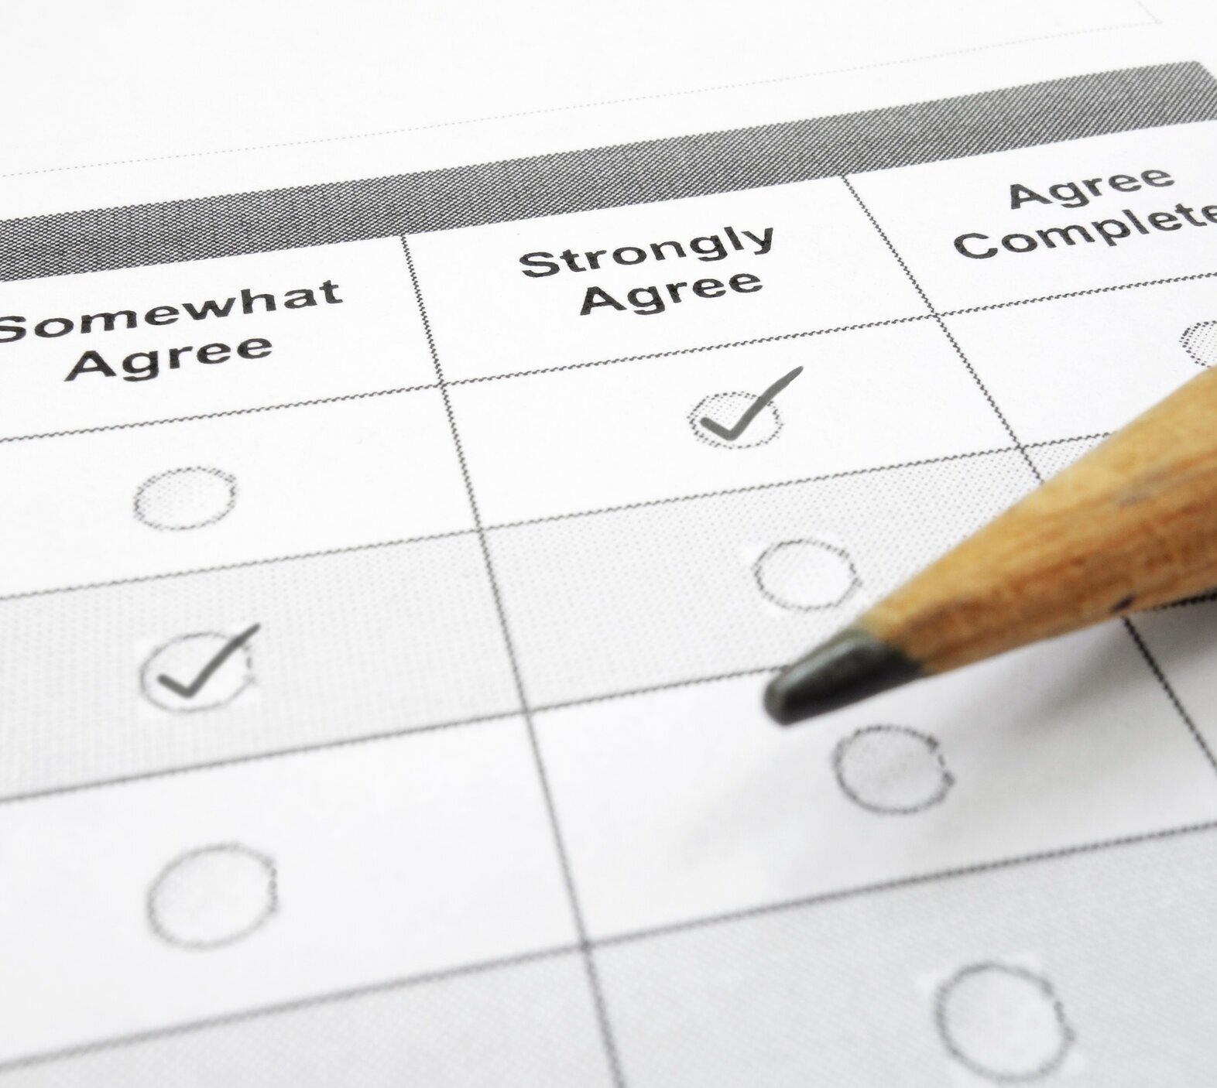
When to Survey
One time
Recurring
  Annual
  Each semester
  1 week after service
  At time of service
As a baseline or after improvements have been implemented
This Photo by Unknown Author is licensed under CC BY-SA

Slide 11
Types of Data Collected on Surveys:
Demographic
Descriptive information about respondent
Gender, age, GPA, home location
Behavioral
How does respondent behave?
Use/non-use, frequency, actions
Attitudinal
Respondent’s opinions/attitudes
Satisfaction, agreement, preference

Slide 12

Demographic Questions
Use to determine how closely your respondents represent the target group
Use to compare responses among groups of people with similar characteristics
  Gender identity; traditional/non-traditional student; new staff/long-time staff, etc.
Use sparingly
  Can seem intrusive and discourage response
  Do not require response
This Photo by Unknown Author is licensed under CC BY-SA-NC

Slide 13

Behavioral Questions
Use to compare responses among groups of people who behave in a similar way
  Users/non-users; first-time/long-time customer
Ask about specific time frame to ensure respondents have the same understanding of the question
  More recent is better; memory introduces error
Ask about respondent’s behavior only
This Photo by Unknown Author is licensed under CC BY

Slide 14
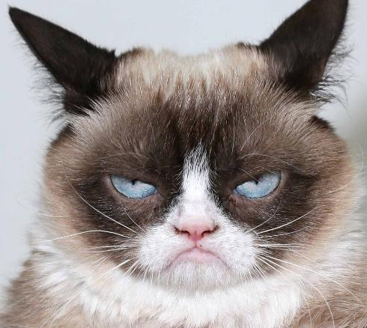
Attitudinal Questions
Use to collect opinions and attitudes
  Evaluation of a program or service
  Demonstrate need
Often responses are presented on a scale
  Agree-Disagree; Satisfied-Dissatisfied; Excellent-Poor, etc.
Attitudes predict behavior
This Photo by Unknown Author is licensed under CC BY-SA

Slide 15
Why Sample?
Reduce survey fatigue by limiting number of surveys received
  UPPS 01.03.05 Administrative Survey Policy discourages surveying all students or large proportion
Target smaller number of individuals, so resources can be used effectively to encourage responses
  Save money and time
  Smaller sample with higher response rate is more desirable than a larger sample with lower response rate
Can make data entry/reporting/analysis easier

Slide 16
How Many to Sample
Examples:
Sample Size Calculator:
http://www.raosoft.com/samplesize.html
 | Sample Size Needed for a…
Population Size | +/- 5% level of precision | +/- 3% level of precision
200 | 132 | 169
1,000 | 278 | 517
10,000 | 370 | 965
37,000 | 381 | 1,038
1,000,000 | 384 | 1,066

Slide 17

Software Options for Online Surveys
Qualtrics
Free to faculty, staff, and students
https://doit.txstate.edu/services/qualtrics.html
Gato Forms
https://gato.its.txstate.edu/user-guides/tutorials/forms.html

Slide 18
Sources for Distribution Lists
Email List Management - https://doit.txstate.edu/services/email-lists.html
Email distribution list for students based on general criteria (e.g., major, classification, residence hall, hours completed)
Email distribution list for faculty and/or staff based on general criteria (e.g., division, department, employment status, EEO Category, etc.)
Email can be sent from within the application or downloaded for use in mail merge
Report Net Portal - https://tim.txstate.edu/reportnetportal/Home.aspx
Allows more detailed selection of students including classification, GPA, major, gender, race/ethnicity, and several other fields

Slide 19
Select a Random Sample Using Excel
After downloading a list…
Make note of how many people are in the file.
Create a new column. Use the “random between” function to create a random number for each person listed in the file. The formula is “=RANDBETWEEN(1,x)” where x=the number of people in the list.
Copy the entire column of random numbers, then paste them back into the same column using the “Paste Special – paste values” option, so that the column now contains the actual values instead of the formula.
Sort the file on the random number column.
Select the number of people you need for your sample, starting with row number 1 and counting down until you reach the target number. You can copy them out and save into a different file, or you can delete the extra people from the bottom of the list.

Slide 20
Survey Design
Use a simple design
Start with easy or interesting questions
Logically order questions and responses
The shorter, the better
  Include a progress indicator
Ask relevant questions
For online surveys, consider respondents may use a mobile device
Collect demographic information at end
This Photo by Unknown Author is licensed under CC BY-SA-NC

Slide 21

Survey Invitation Message
Message must be salient
  Clearly affiliate with institution/office/program
  Explain why respondent was selected
  Explain purpose of survey
Personalize!
Provide honest estimate of time to complete survey
For online surveys:
  Explain how data will be kept secure
  Provide a technical contact for help with problems
  Send messages at appropriate times
  Send no more than 3 messages (first invite + 2 reminders)

Slide 22
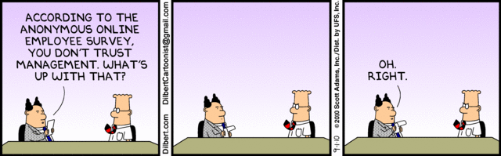
Anonymity vs. Confidentiality

Slide 23
Is my survey Anonymous or Confidential?
Anonymous Surveys:
When you cannot identify an individual’s responses
Can give a sense of security to respondents, and thereby increase response rate
If reminders are sent, can use “If you have already responded, thank you…if not, please response…” in message
Confidential Surveys:
When you can identify an individual’s responses, but will not release their individual data
Allows for matching responses with other data
Allows for tracking responses; can target reminder messages to non-respondents

Slide 24

Pilot Test your Survey
Before starting a survey, always test to find out:
Are the instructions clear?
Are the questions interpreted the same way by all respondents?
Can every question be answered?
Did you include all the possible answer categories?
How long does the survey take to complete?

Slide 25
Strategies to Increase Responses
Choose best survey method – way to reach target group
  Use personal contact whenever possible
Use a well-designed questionnaire
Communicate clearly in recruitment messages
Use a respected sponsor
Make the return easy and free
Use incentives such as thank you gifts or raffle drawings
Follow up with sample
  Use reminder messages, phone calls
Send pre-notification that people have been selected to participate
  They will expect and view it as a legitimate invitation

Slide 26
Administrative Survey Approval
UPPS 01.03.05 Administrative Surveys
Administrative Survey:
  Collects information directly from individuals who comprise a significant proportion of the university community
  For quality improvement purposes, not academic research
University Survey Committee reviews, approves, and maintains calendar to schedule survey
  Priority deadlines: February 1, July 1, and October 1
Process and forms posted on Institutional Research website
  https://www.ir.txstate.edu/surveys/conducting_surveys/administrative_surveys.html

Slide 27
References
Publications:
Dillman, D. A. (2000). Mail and Internet Surveys: The tailored design method, second edition. New York: John Wiley.
Dillman, D.A. (2002). Navigating the rapids of change: Some observations on survey methodology in the early twenty-first century. Public Opinion Quarterly 66, 473-494.
Dillman, D. A. and Bowker, D. K. (2001). The web questionnaire challenge to survey methodologists. Retrieved January 17, 2017 from http://www.sesrc.wsu.edu/dillman/papers/2001/thewebquestionnairechallenge.pdf.
Malaney, G. D. (2002). You still need high response rates with web-based surveys. Retrieved January 17, 2017 from StudentAffairs.com e-journal web site: http://studentaffairs.com/ejournal/Winter_2002/rates.htm.
Molasso, W. R. (2005). Ten tangible and practical tips to improve student participation in web surveys. Retrieved January 17, 2017 from StudentAffairs.com e-journal web site: http://studentaffairs.com/ejournal/Fall_2005/StudentParticipationinWebSurveys.htm.
Schuh, J. H. (2009). Assessment methods for student affairs. San Francisco: Jossey-Bass.
Website:
Institutional Research’s Survey Design Resources: http://www.ir.txstate.edu/survey-services/survey-resources.html

Slide 28
CONTACT US

512.245.2386

IR@txstate.edu
Office of Institutional Research
JCK 883
601 University Drive
San Marcos, Texas 78666


