Slide 1
Delve into the Data: Institutional Data at Texas State
G. Marc Turner
Office of Institutional Research
Texas State University

Slide 2
Today’s Agenda
About the Office of Institutional Research
Terminology
Types of Data You Might Need
Comparison Data
Texas State Data

Slide 3
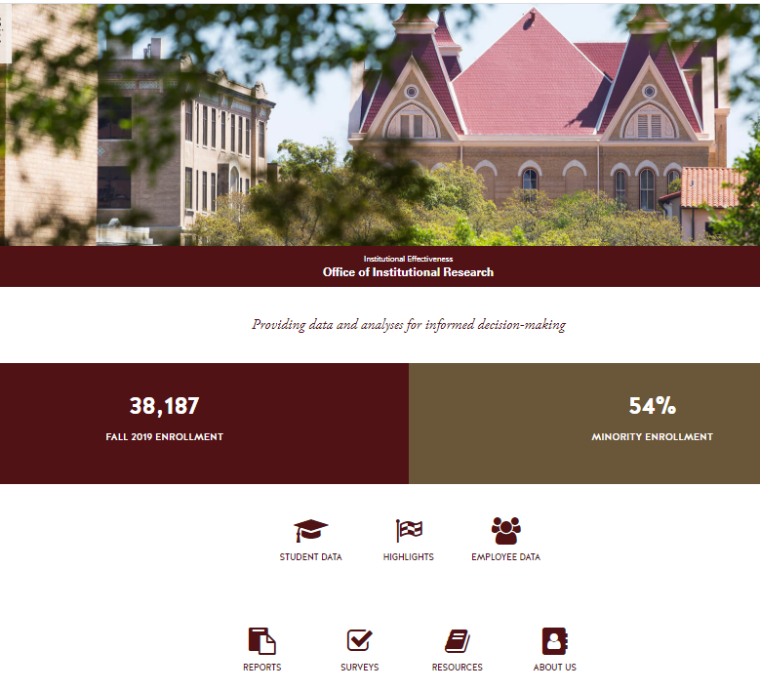
About Us: The Office of Institutional Research
http://www.ir.txstate.edu/
Our Mission
Our Staff
What we do
Notes:
Our mission: The Office of Institutional Research serves Texas State University and The Texas State University System by providing the information and analyses needed to make informed, data-driven decisions. Our office supports data governance at Texas State University, promoting the integrity of university data and reports. We work to advance the university mission by collecting, analyzing, and disseminating information through ad hoc and standard reports, conducting original research, supporting survey management policies and processes, and providing data for administrative assessment and planning.

Slide 4
Texas State Data
Stored in multiple databases and “silos”
Limited access to the data directly
Different versions of the data:
Definitions used (terminology)
When data is reported (timing)
Notes:
Texas State does not have a data warehouse meaning data exists in different forms across multiple systems without a single “source” for answering questions. Access to data requires SQL programming, knowledge of how the data is structured in each of the various systems, and understanding of the terminology being used.

Slide 5
Terminology Issues
First-generation student
Faculty vs Instructor of Record
Student to faculty ratio
Retention vs Persistence
Graduation Rates vs Ratios vs Percentages
Notes:
Example Student-to-faculty ratio for a department. Which students are included (Majors? Minors? Enrolled students? Full-time or part-time?) Which faculty are included (full-time and/or part-time)? Often use full-time equivalents based on student SCH and Faculty FTE, but different surveys/reports might request actual headcounts of Majors to Full-Time Faculty (or maybe just tenure/tenure-track faculty).

Slide 6
Terminology Issues: Definitions
Texas Higher Education Coordinating Board (THECB) Glossary
Website: http://www.thecb.state.tx.us/reports/PDF/1316.PDF
Integrated Postsecondary Education Data System (IPEDS) Glossary
Website: http://nces.ed.gov/ipeds/glossary/
The IR Office Glossary (a work in progress)
Website: https://www.ir.txstate.edu/resources/data-literacy.html
Notes:
When responding to a survey or report, be sure to see what definition(s) they are using and how that definition relates to the numbers we provide in our reports.

Slide 7
Types of Data You Might Need
Comparison Information
Texas State versus other Texas Universities
Texas State versus other Peer Institutions
Texas State Data
University Enrollment Figures
Degrees Awarded
Retention and Graduation Rates
Faculty and Staff Related Data
Administrative Survey Results

Slide 8
Comparison Data
Texas Higher Education Coordinating Board (THECB)
Website: http://www.txhighereddata.org/
Integrated Postsecondary Education Data System (IPEDS)
Website: http://nces.ed.gov/ipeds/datacenter/
Texas State IR Reports
Website: https://www.ir.txstate.edu/reports.html

Slide 9
Texas State Data from IR
IR Website
Survey Results
Facts and Highlights
Reports
Student Data
Employee Data
CatStats
Additional Resources
Notes:
Data from various sources around campus collected and organized by our office and made available to you in a more “user-friendly” form. Most reporting is done based on either Fall data (e.g. enrollment & retention) or annual data available in the Fall (e.g. degrees awarded during prior academic year and graduation rates).

Slide 10
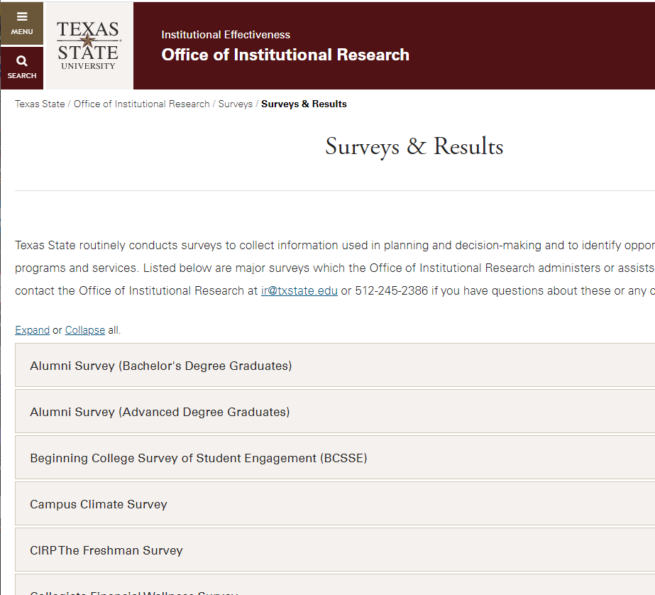
Texas State: Admin. Survey Results
Currently summary results
Working to improve and provide additional analysis.
Notes:
Example: NSSE Data

Slide 11
Texas State: Reports
Common Data Set
General information, admissions data, degrees offered, student life, expenses, financial aid, etc.
Board of Regents Fact Sheet
General overview of student population, faculty and staff, finances, and facilities; includes some peer comparisons

Slide 12
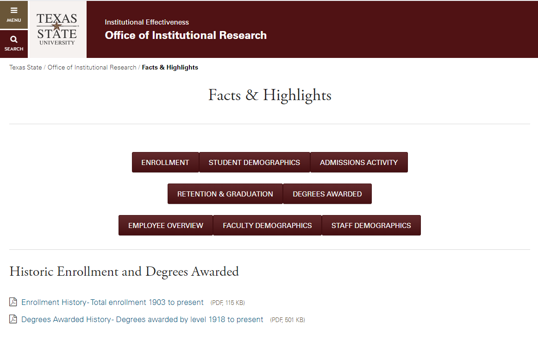
Texas State: Highlights

Slide 13
Texas State Student Data
General Enrollment
Applications and Admissions
Retention, Persistence, and Graduation
Committee and Special Reports

Slide 14
Texas State Employee Data
General Employee Data
Employee Hiring and Retention
Specialized and Committee Reports

Slide 15
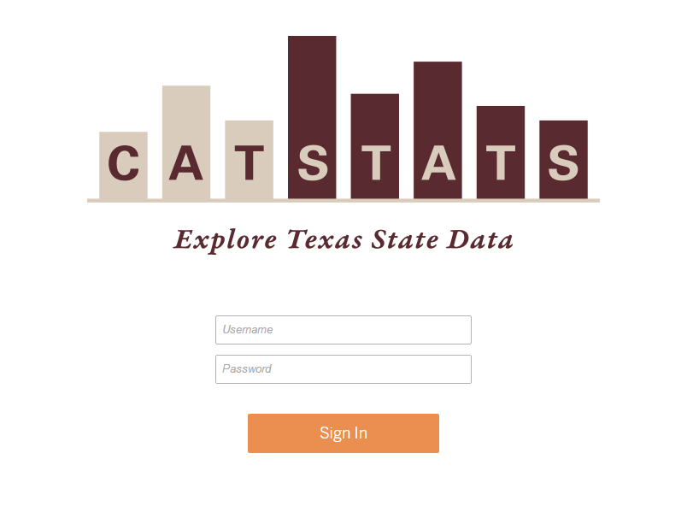
About CatStats
Internal Use Only
https://catstats.txstate.edu
Requires connection to Texas State Network (on-campus or via VPN)
Different people have access to different reports within the system
Students by special request only

Slide 16
Additional Resources
Data Literacy and Training
Peer Institutions
Survey Design Resources

Slide 17
Example Scenarios
Growth in the number of majors in Psychology over the past 10 years
Number of faculty in the College of Education
Retention rate for Hispanic students over the past 5 years

Slide 18
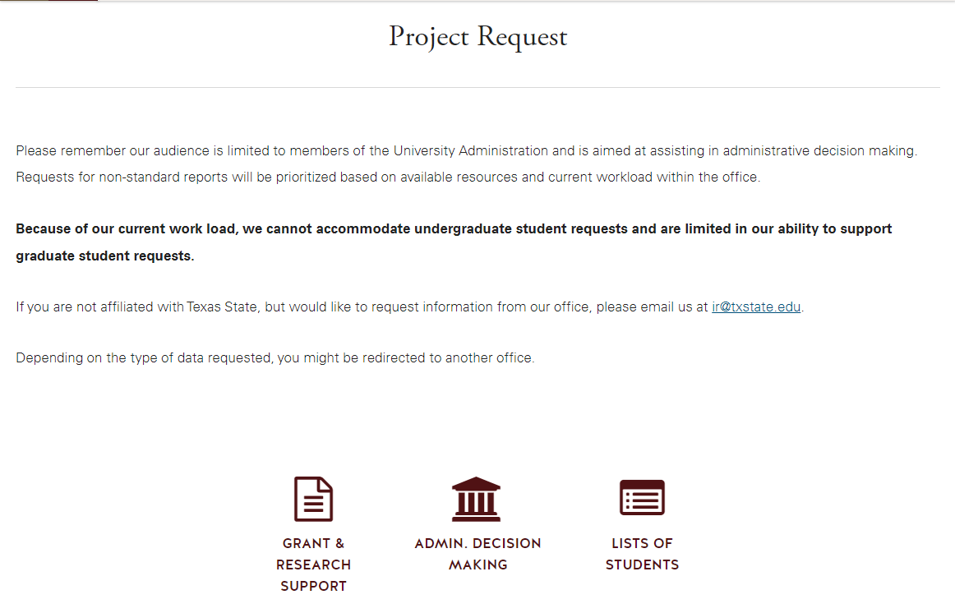
Texas State Data: Project Requests
Not all data is readily available
Some questions are more detailed
We are here to help!

Slide 19
Help Us to Help You
What information do you need?
What reports would you find most helpful?
What reports do you find confusing?
How often do you need data updated?
What data do you have that we could use?

