Slide 1
Understanding Data Used For Academic Program Review
Part 2 – Using the APR Tables
Office of Institutional Research
Texas State University
Notes:
Hello and welcome to part 2 of the Understanding data for Academic Program Review series from the Office of Institutional Research at Texas State University. I’m Marc Turner, the Assistant Vice President for Institution Research and in this video I will walk you through the use of the Academic Program Review tables available to members of the campus community.

Slide 2
Academic Program Review (APR)
Required by the Texas Higher Education Coordinating Board (THECB)
AA/PPS 02.01.50
https://policies.txstate.edu/division-policies/academic-affairs/02-01-50.html
Based on the 4-digit CIP code of an academic program
Notes:
As we begin, I want to take a couple of minutes to remind you of why we have Academic Program Review and why these tables exist.
Academic Program Review, or APR for short, is a requirement of the Texas Higher Education Coordinating Board and Academic Affairs PPS 02.01.50. The APR is conducted based on the 4 digit CIP code for each academic program.

Slide 3
Purpose
Recognize strengths and achievements
Identifying areas in need of attention
Promoting goal setting and planning
Notes:
The primary purpose of the APR is to recognize the strengths and accomplishments of each academic program. As part of this process it is also a chance to identify areas within a program that might need more attention. Through the process of conducting a review of the program it is also possible to set goals and plan for the future of the program. Many programs have also adopted measures found in the APR as part of their administrative outcomes for SACSCOC review.

Slide 4
Sources of Data
APR
THECB
Banner
IR
Notes:
The data used for the APR tables comes from official data submitted to THECB by the department of institutional research as well as additional information from Banner and our office. As a result, the tables make use of multiple data sources that could be hard to interpret individually.

Slide 5
APR Tables at Texas State
a single source for APR data
match data provided to THECB
Organized Around APR report Structure
Available through the IR website
Notes:
The APR tables at Texas state were created many years ago to provide programs with a single source for the data used as part of the review process. This helps to ensure the data provided matches the official data on record with the THECB. The APR tables are organized around the structure of the APR and available to all faculty and staff through the IR website.

Slide 6
Using the APR Tables Accessing the Tables

Slide 7
Accessing the APR Tables
Available to all Texas State Faculty and Staff
Start at the IR Website!
https://www.ir.txstate.edu
Student Data
Committee and Special Reports
- Academic Program Review Tables
Hosted through CatStats
Available on-campus or via the Texas State VPN
Notes:
Although there are multiple ways to get to the APR tables, we recommend that you start with the IR website. The APR Tables are available under the Committee and Special Reports section in the Student Data area of our website. Since the reports are hosted via CatStats you must be connected to the university network either from a computer on campus or by using the Texas State VPN for remote access.

Slide 8
Using the APR Tables Navigating the Tables

Slide 9
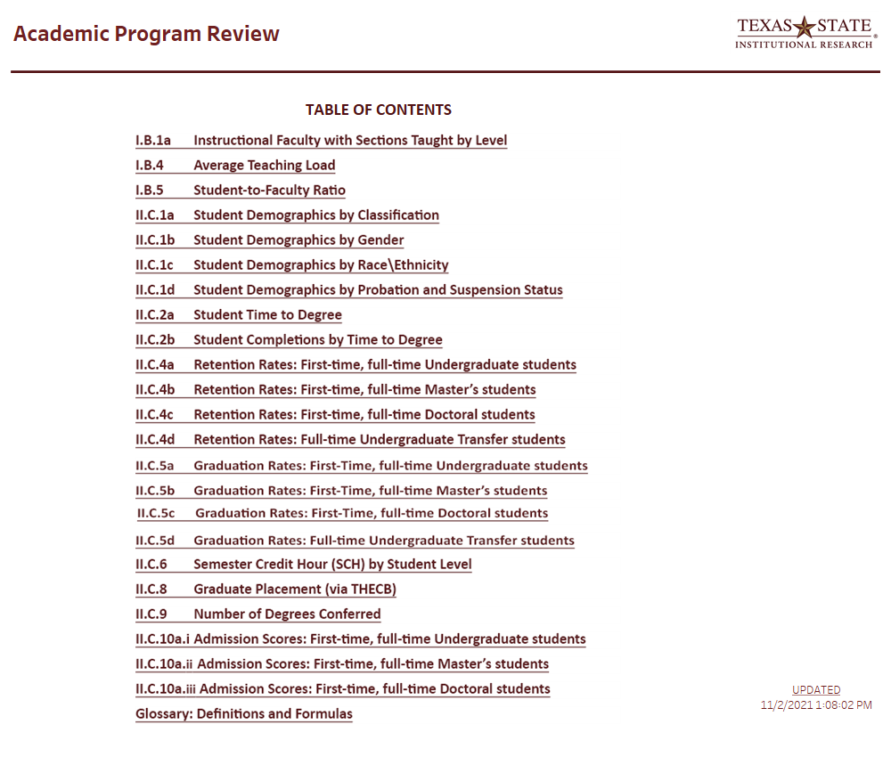
Using the APR Tables
Notes:
When you first access the APR tables you will see the Table of Contents which lists each of the tables available to you. The tables include information about instructional faculty; teaching load; student demographics; time to degree; retention, persistence/graduation rates; semester credit hour production; degrees conferred; and admission scores.

Slide 10
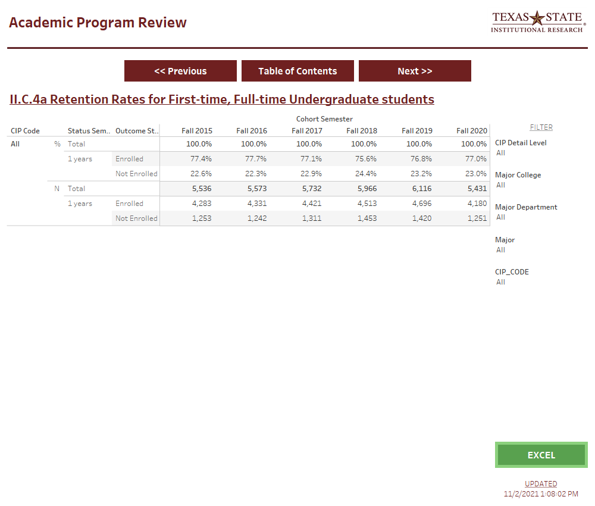
Using the APR Tables
Navigation Buttons
Filters
Table Organization
Date Last Updated
Export
Button
Table
Title
Notes:
There are six main areas displayed on the screen for each table.

Slide 11
Using the APR Tables
Navigation Buttons
Filters
Table Organization
Date Last Updated
Export
Button
Table
Title
Notes:
At the top you will see navigation buttons which allow you to move between the various tables or return to the table of contents.

Slide 12
Using the APR Tables
Navigation Buttons
Filters
Table Organization
Date Last Updated
Export
Button
Table
Title
Notes:
Below that is the title of the table you are viewing.

Slide 13
Using the APR Tables
Navigation Buttons
Filters
Table Organization
Date Last Updated
Export
Button
Table
Title
Notes:
Below the title in the middle of the page is the table which displays the data for the table.

Slide 14
Using the APR Tables
Navigation Buttons
Filters
Table Organization
Date Last Updated
Export
Button
Table
Title
Notes:
On the right-hand side is a list of filters that allow you change the level of information being displayed, for example by narrowing it to a specific program by using the 4-digit CIP code. Since the APR tables are built using multiple data sources the filters currently only apply to the table you are viewing. This means you will need to set the filters for each page. We are working on a solution to this problem and will update the tables when it is available.

Slide 15
Using the APR Tables
Navigation Buttons
Filters
Table Organization
Date Last Updated
Export
Button
Table
Title
Notes:
Towards the bottom right is a green “Excel” button which will allow you to export the table to Excel. More information on using this button is provided towards the end of this video.

Slide 16
Using the APR Tables
Navigation Buttons
Filters
Table Organization
Date Last Updated
Export
Button
Table
Title
Notes:
And finally, in the bottom right corner is information on when the data was last updated. In most cases we update the data in early November to include all information from the previous academic year which ended in August.

Slide 17
Using the APR Tables Examining the Tables
Notes:
Now, let’s take a closer look at each of the tables available.

Slide 18
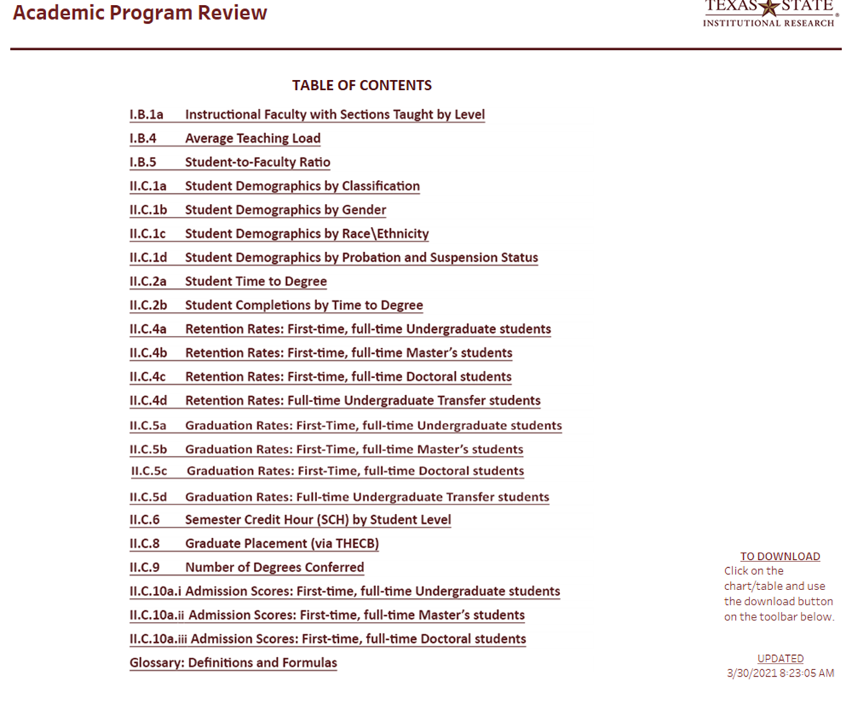
Table of Contents
Notes:
As I just mentioned the first page of the APR tables is the table of contents.

Slide 19
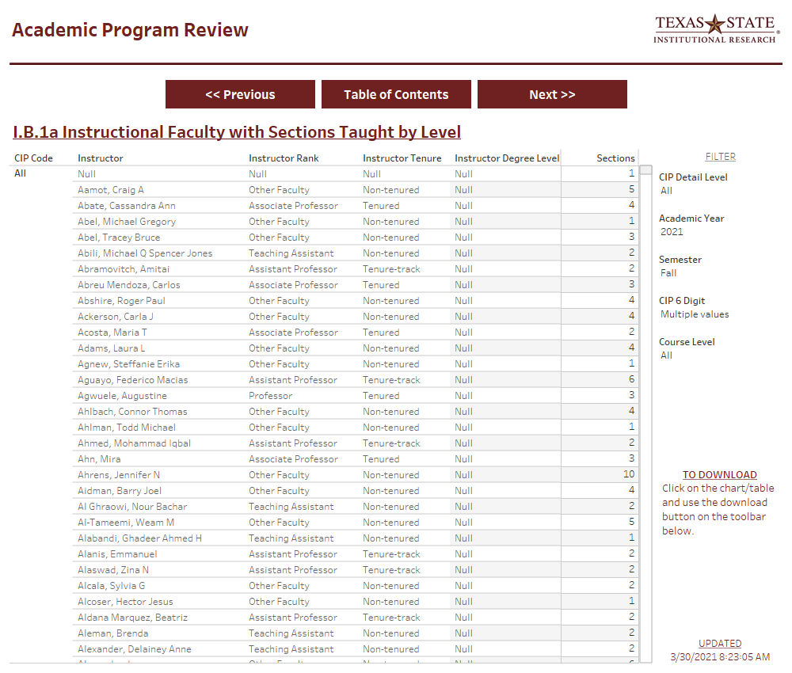
Table I.B.1a Instructional Faculty with Sections Taught by Level
Primary Source: THECB-CBM004
Notes:
The first table, I B 1a lists instructional faculty and the number of sections taught by course level. This information is from the THECB CBM004 report. This data is provided on a per semester basis within the academic year. It is important to remember that the Academic Year runs from September to August, so Fall of academic year 2021 represents the Fall 2020 semester.

Slide 20
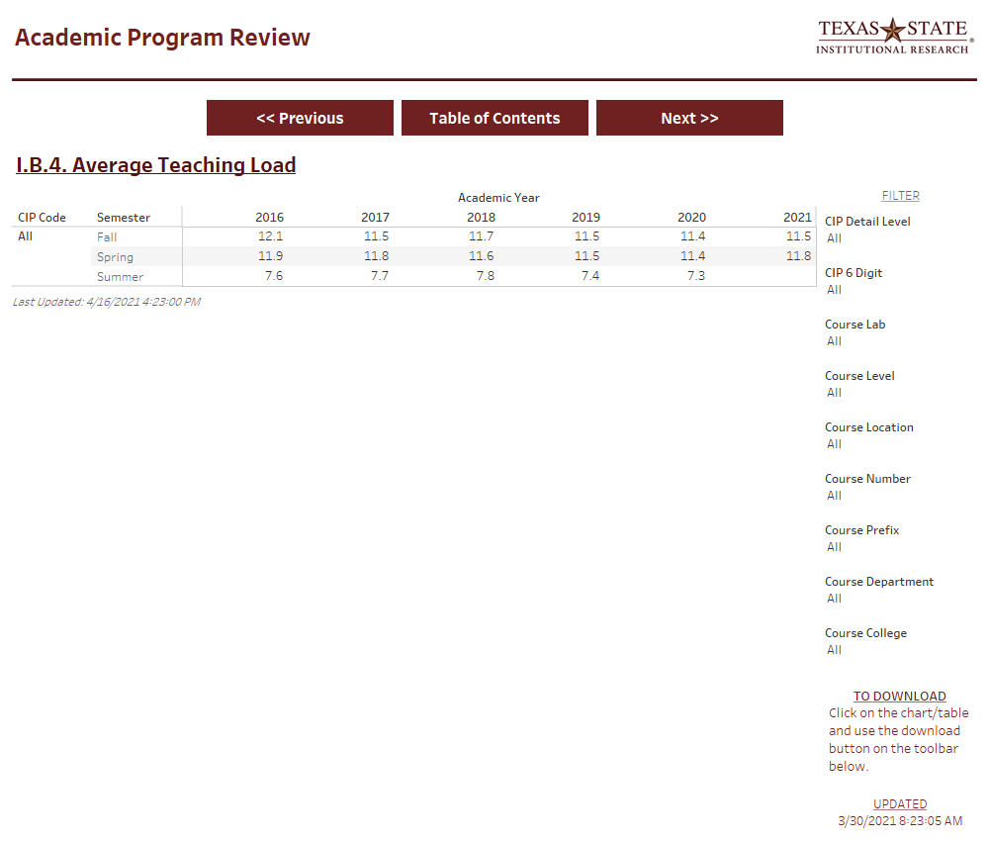
Table I.B.4 Average Teaching Load
Primary Source: THECB-CBM004
Notes:
The second table, I B 4 shows the average teaching load across all faculty within the department, which is also derived from data found in the CBM004 report.

Slide 21
Table I.B.5 Student-to-Faculty Ratio
Primary Source: THECB-CBM004
Notes:
Next we have table I B 5 which shows the student-to-faculty ratio based on student FTE and instructor FTE. Additional information about this calculation can be found in the glossary and in Part 1 of this series.

Slide 22
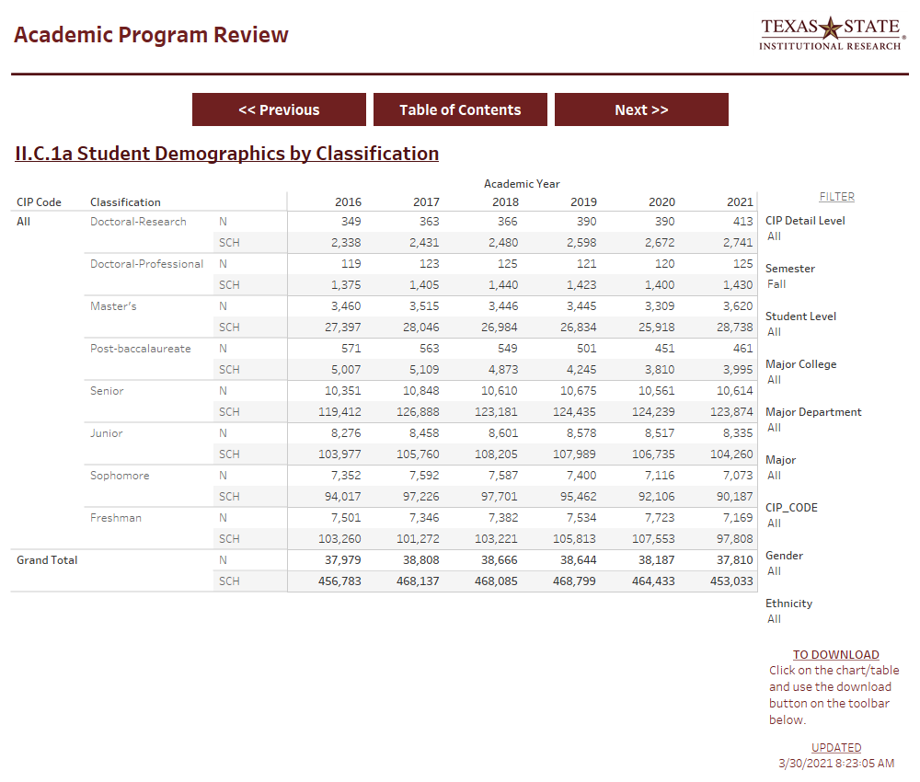
Table II.C.1a Student Demographics by Classification
Primary Source: THECB-CBM001
Notes:
Following the tables related to faculty, we get into data about the students starting with Table II C 1a, student demographics by classification. This table provides both the student headcount and the SCH produced by students within a specific program. This is different than the SCH produced by a department since courses within a department could be taken by students in various majors. This data is pulled from the CBM001 report to the THECB.

Slide 23
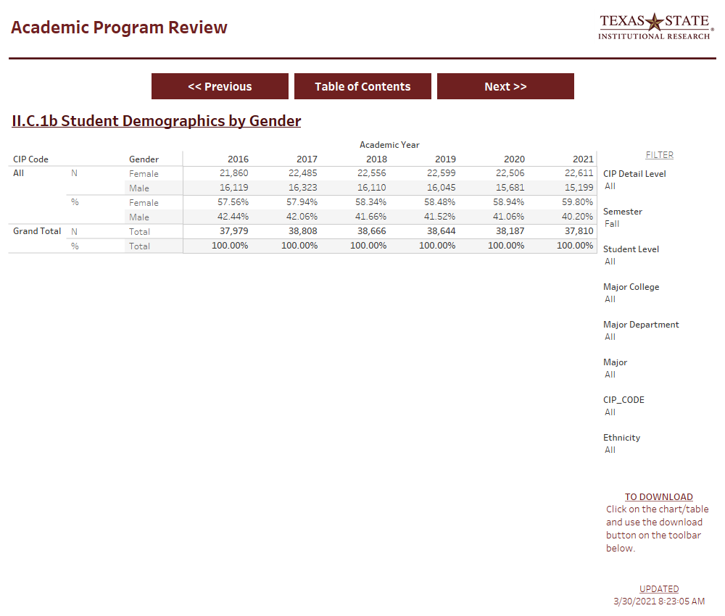
Table II.C.1b Student Demographics by Gender
Primary Source: THECB-CBM001
Notes:
Next, table II C 1b provides the breakdown of students by gender.

Slide 24
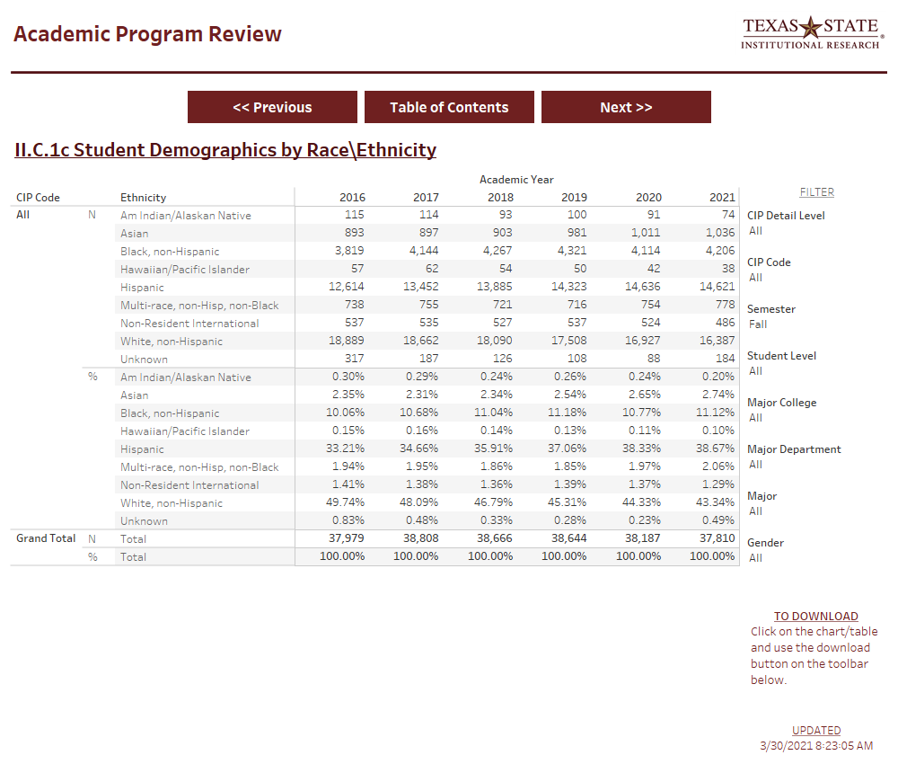
Table II.C.1c Student Demographics by Race\Ethnicity
Primary Source: THECB-CBM001
Notes:
Table II C 1c breaks the students down by race and ethnicity using the methodology of the THECB.

Slide 25
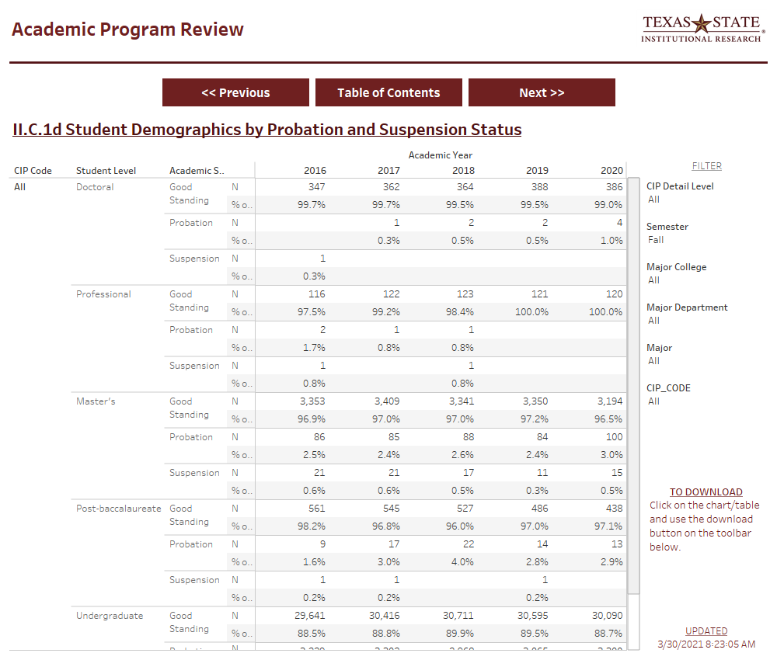
Table II.C.1d Student Demographics by Probation and Suspension Status
Primary Source: THECB-CBM001
Notes:
Finally, table II C 1d is the last of the student demographic tables and combines information from the CBM001 with data about academic standing at the end of each semester of the academic year.

Slide 26
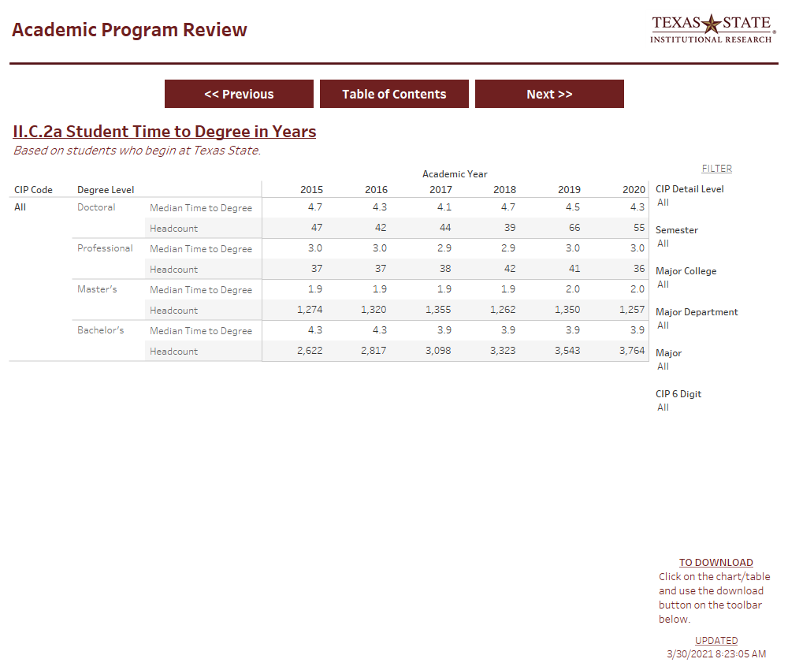
Table II.C.2a Student Time to Degree
Primary Source: THECB-CBM009
Notes:
Table II C 2a provides the median time to degree for students by level who graduated within an academic year. Because of the semester system, each semester is approximately one third of a year. Because of summer terms, eight long semesters actually works out to be slightly less than four full years. Data on graduations and degrees awarded comes from the CBM009 report to THECB.

Slide 27
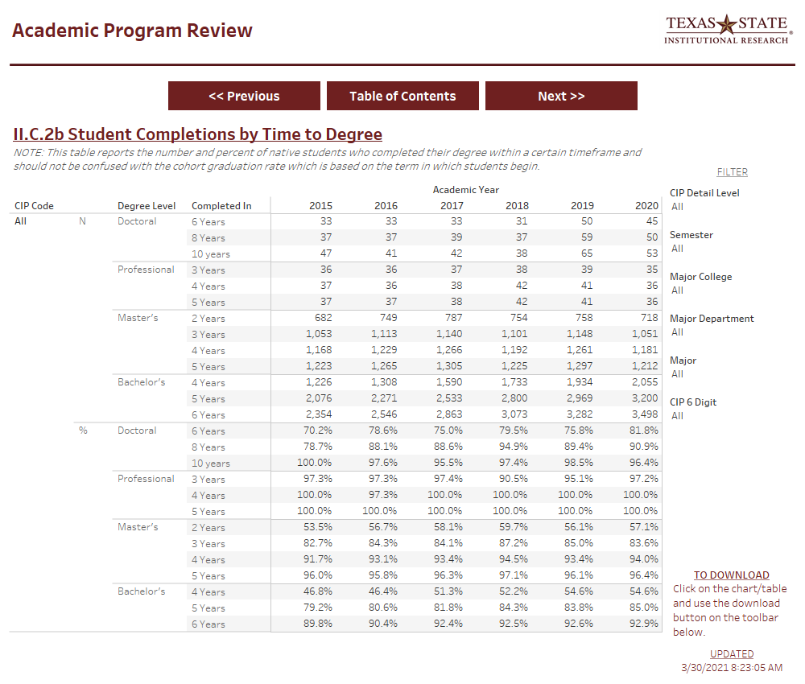
Table II.C.2b Student Completions by Time to Degree
Primary Source: THECB-CBM009
Notes:
Table II C 2b takes a slightly different look at time to degree and shows the percent of students who graduated in an academic year broken out by how long it took them.

Slide 28
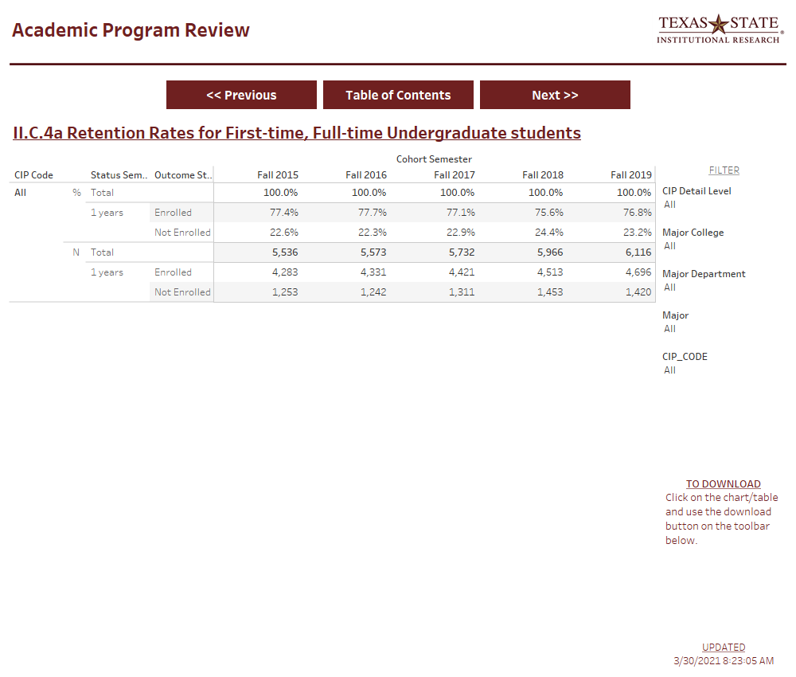
Table II.C.4a Retention Rates: First-time, full-time Undergraduate Students
Primary Source: THECB-CBM001
Notes:
Following the time to degree, we have information about retention provided in Table II C 4a for the first-time, full-time undergraduate cohorts. Remember that these cohorts are based on students who are first-time in college in the summer or fall semester and enrolled full-time in their first fall semester at Texas State. Retention is the percent of those students who were enrolled again after one year, in their second fall semester.

Slide 29
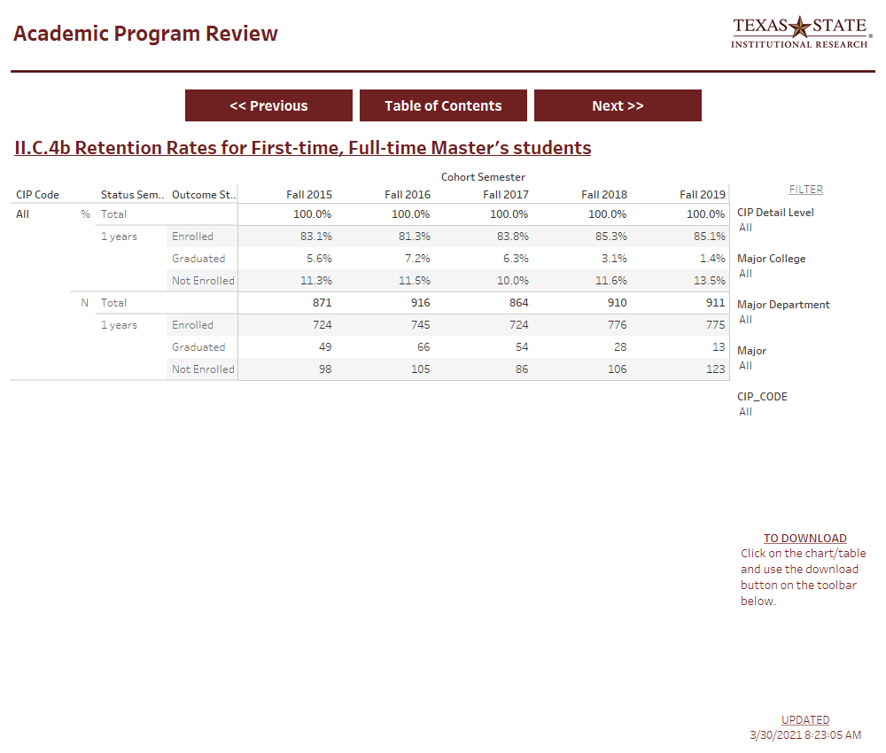
Table II.C.4b Retention Rates: First-time, full-time Master’s students
Primary Source: THECB-CBM001
Notes:
The same approach to cohorts is used for looking at the retention rate of Master’s students in table II C 4b.

Slide 30
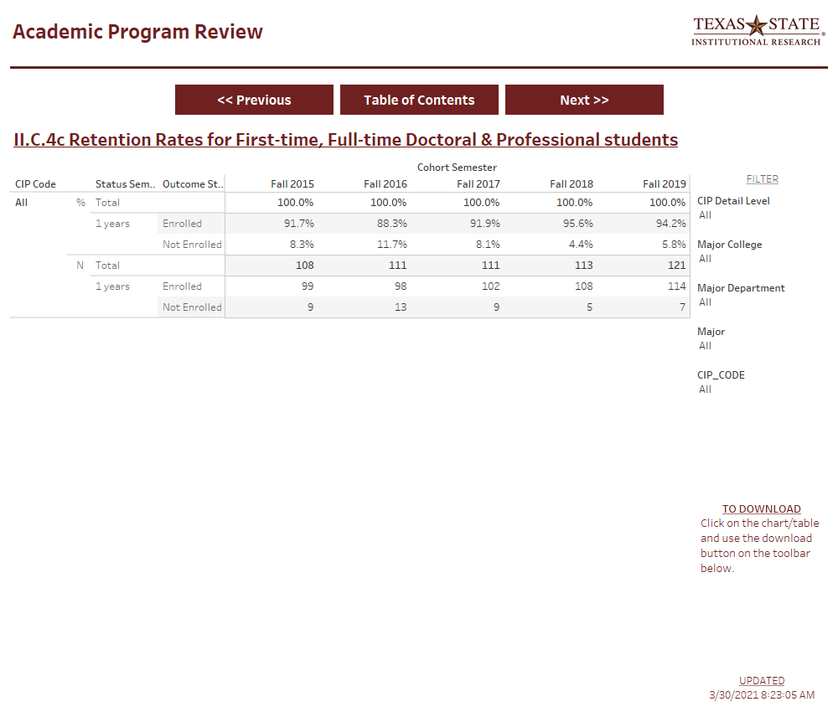
Table II.C.4c Retention Rates: First-time, Full-time Doctoral Students
Primary Source: THECB-CBM001
Notes:
And for doctoral students in Table II C 4c. Again, these rates are based on first-time, full-time students in the Fall semester, so students who begin in the Spring are not included. The table for doctoral students also includes retention information for students who are in a special professional degree.

Slide 31
Table II.C.4d Retention Rates: Full-time Undergraduate Transfer Students
Primary Source: THECB-CBM001
Notes:
Table II C 4d is the last of the retention rate tables and looks at the one year persistence of incoming transfer students from the summer or fall who are enrolled in the Fall semester.

Slide 32
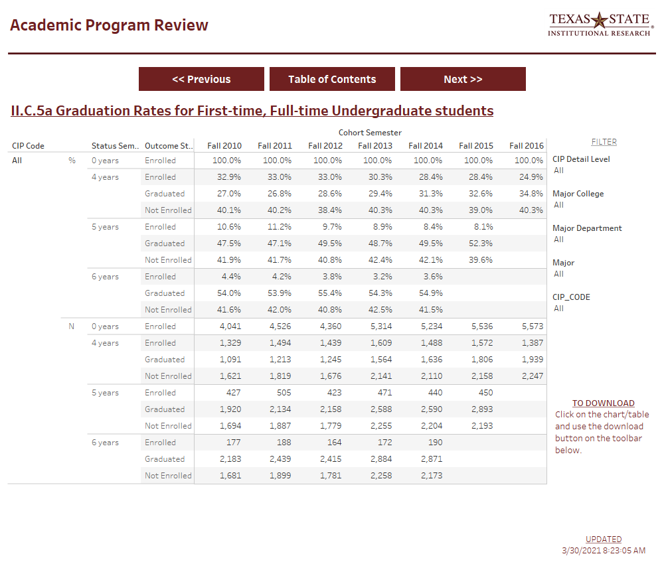
Table II.C.5a Graduation Rates: First-time, full-time Undergraduate Students
Primary Source: THECB-CBM009
Notes:
Table II C 5a starts our look at graduation rates. The graduation rates are based on the same cohorts of incoming full-time students used for tracking retention rates. For undergraduate students, the graduation rates at 4, 5, and 6 years are provided.

Slide 33
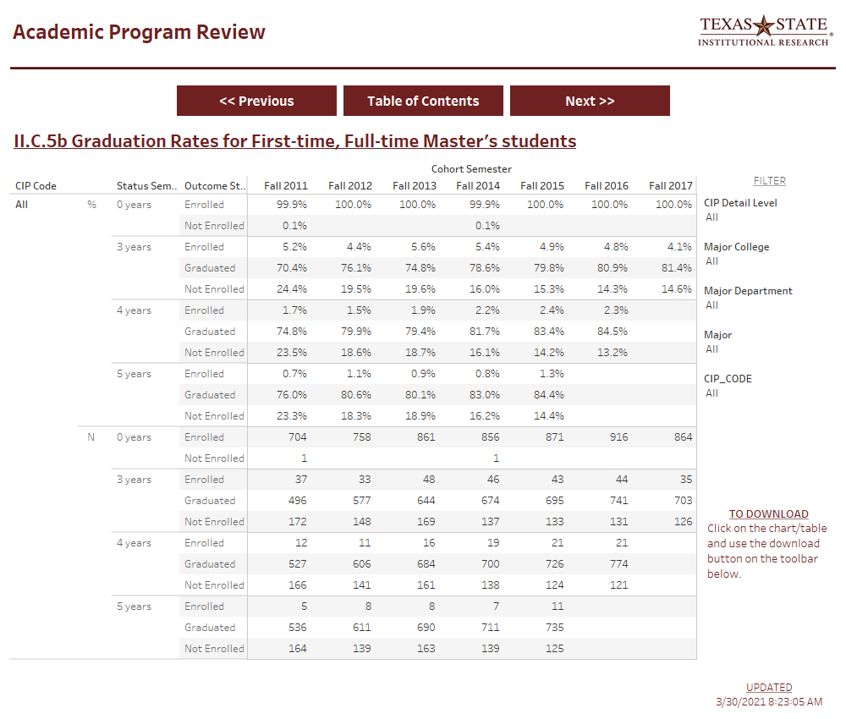
Table II.C.5b Graduation Rates: First-time, full-time Master’s Students
Primary Source: THECB-CBM009
Notes:
Table II C 5b provides the graduation rates for Master’s students. Given the length of most Master’s programs, the graduation rates at 3, 4, and 5 years are provided.

Slide 34
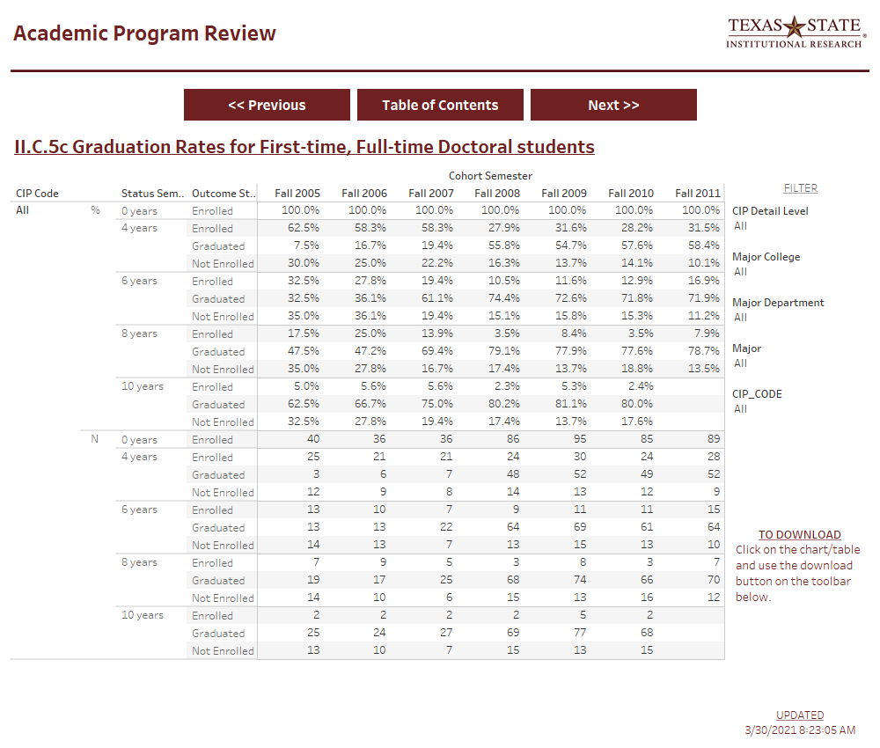
Table II.C.5c Graduation Rates: First-time, Full-time Doctoral Students
Primary Source: THECB-CBM009
Notes:
And Table II C 5c provides the graduation rates for doctoral and professional students, again using the cohorts of first-time, full-time students from the Fall semester. Here the 6, 8, and 10 year graduation rates are provided.

Slide 35
Table II.C.5d Graduation Rates: Full-time Undergraduate Transfer students
Primary Source: THECB-CBM009
Notes:
Table II C 5d shows the graduation rates of our full-time transfer students at 4, 5, and 6 years following their arrival at Texas State. We do not calculate the total time to degree for transfer students as part of the APR tables.

Slide 36
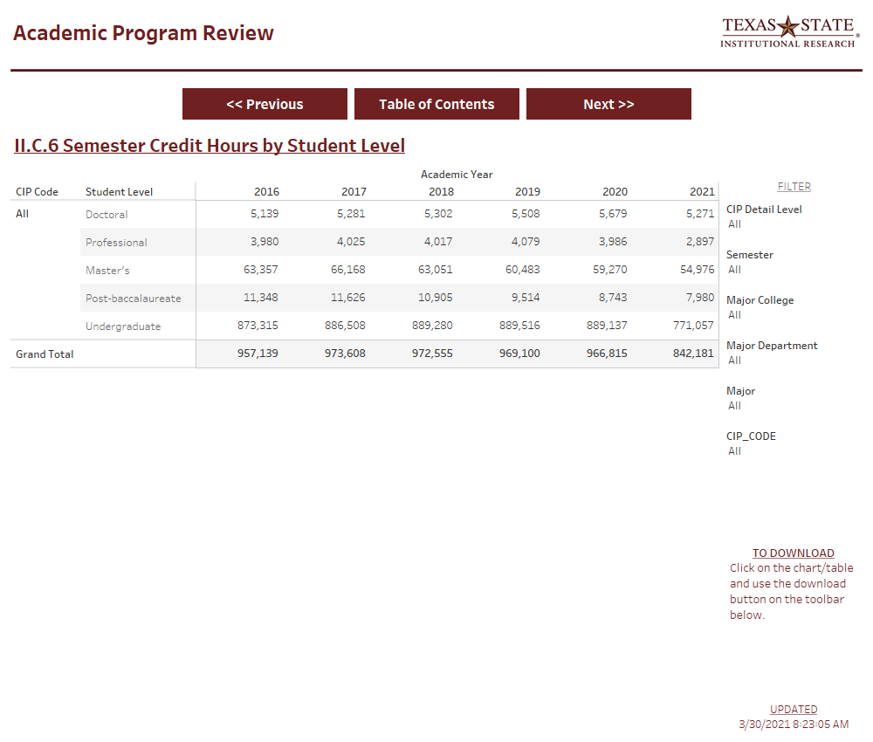
Table II.C.6 Semester Credit Hour(SCH) by Student Level
Primary Source: THECB-CBM001
Notes:
Table II C 6 shows the Semester Credit Hours produced by students from a given program broken out by level. This SCH is for all courses taken by the students and not just the SCH generated by those students within a program.

Slide 37
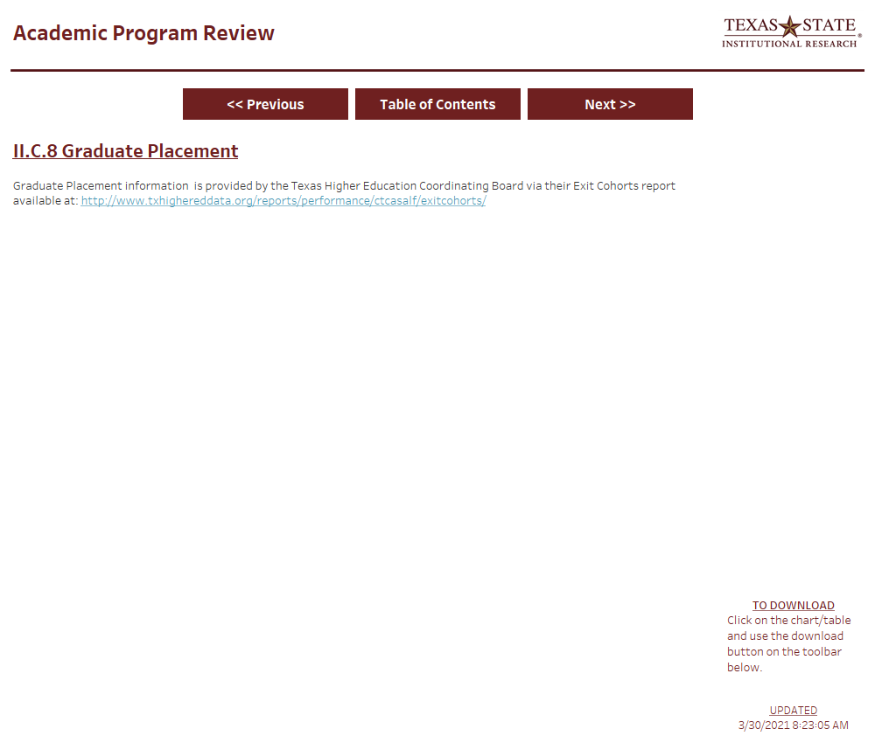
Table II.C.8 Graduate Placement (via THECB)
Primary Source: THECB-Website
Notes:
Table II C 8 is actually a link to information provided by THECB about graduate placement of student through their Exit Cohort report.

Slide 38
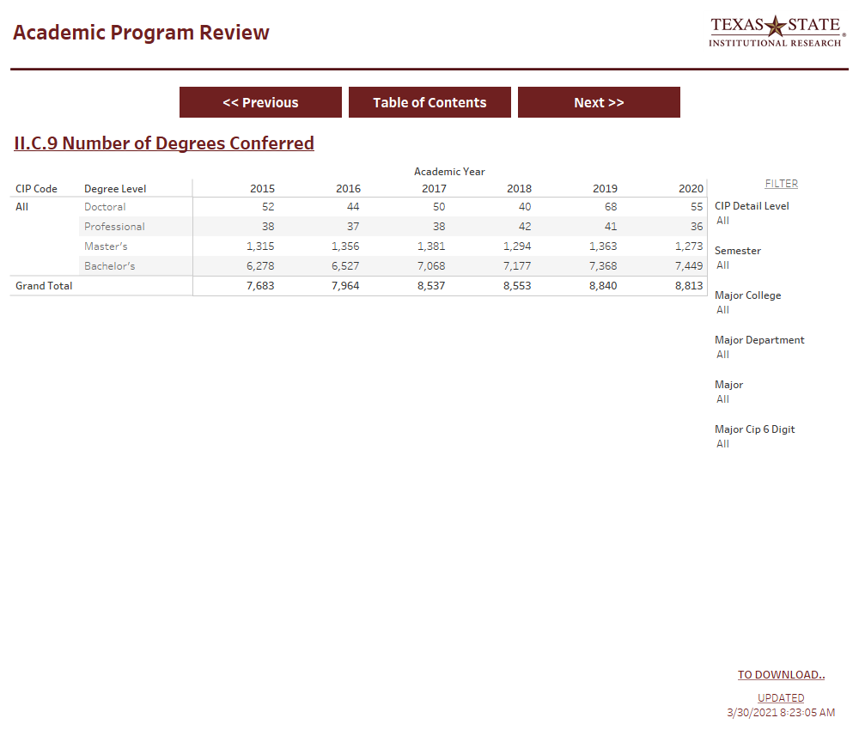
Table II.C.9 Number of Degrees Conferred
Primary Source: THECB-CBM009
Notes:
The total number of degrees awarded for the academic year is provided in Table II C 9.

Slide 39
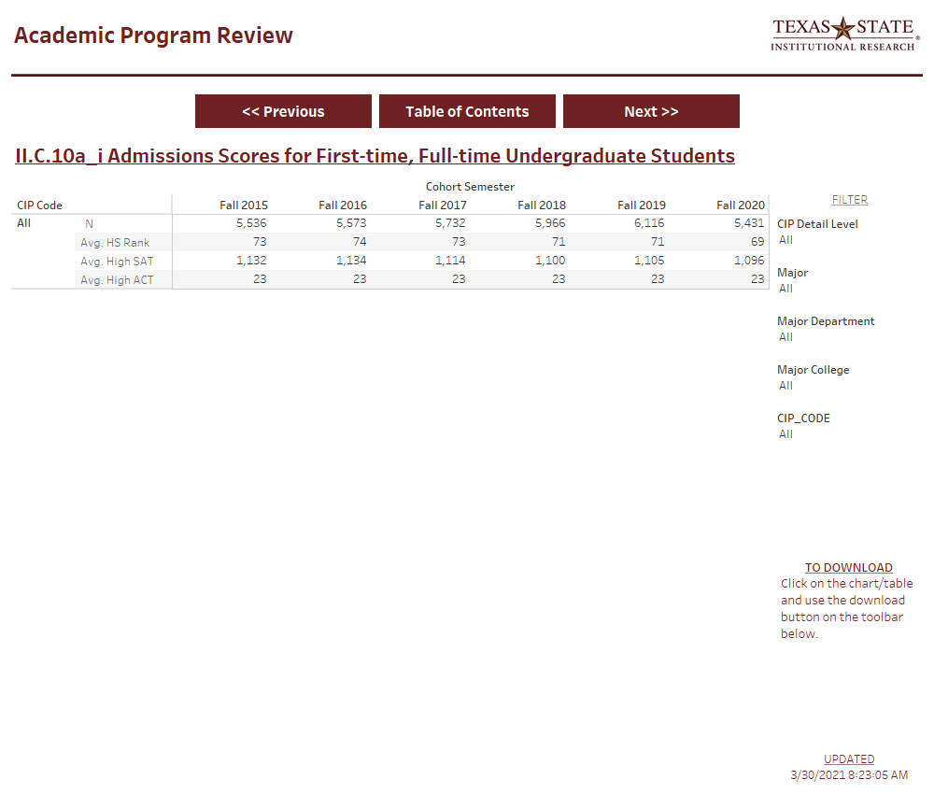
Table II.C.10a.i Admission Scores: First-time, full-time Undergraduate Students
Primary Source: Banner
Notes:
Information on admission scores and criteria is provided starting with table II C 10a.i with the average HS Rank, Avg SAT, and Avg ACT score. This information is based on the first-time, full-time cohorts used in other parts of the APR tables.

Slide 40
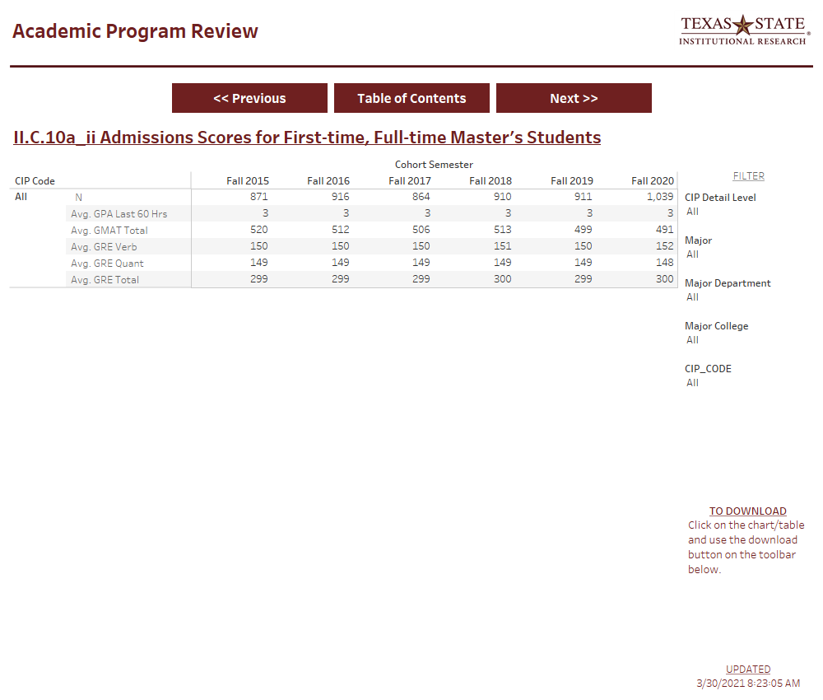
Table II.C.10a.ii Admission Scores: First-time, full-time Master’s Students
Primary Source: Banner
Notes:
Table II C 10a.ii provides the average admission scores for first-time, full-time master’s students.

Slide 41
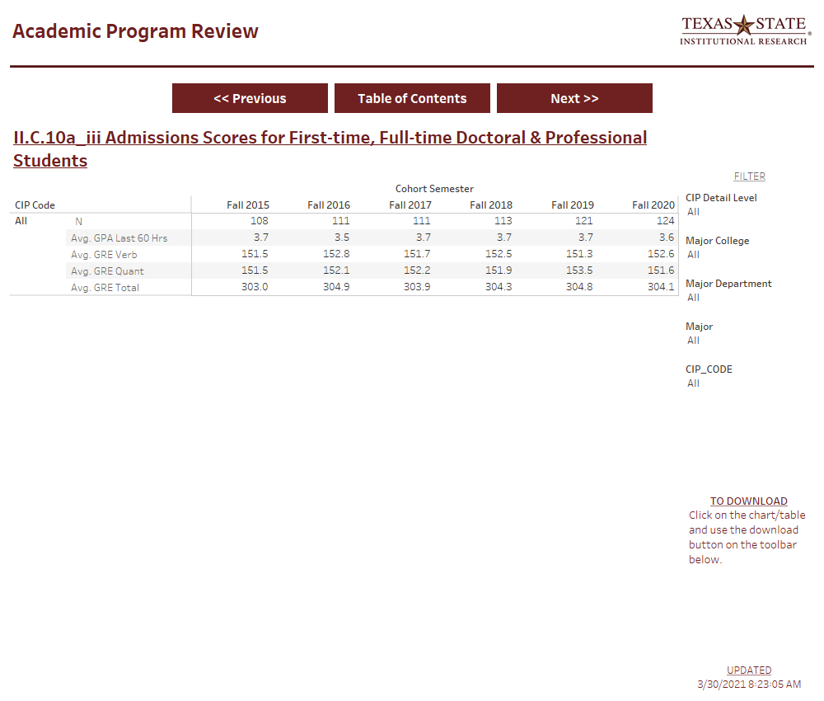
Table II.C.10a.iii Admission Scores: First-time, full-time Doctoral Students
Primary Source: Banner
Notes:
And table II C 10a.iii gives the average admission scores for first-time, full-time doctoral students.

Slide 42
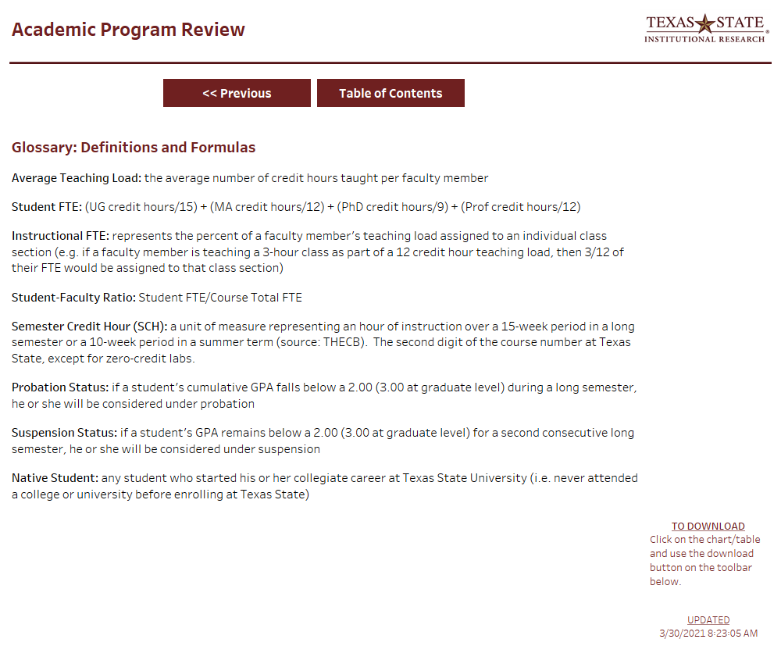
Glossary
Notes:
The last page of the APR table is a glossary that describes and defines many of the terms used in the report. I encourage you to watch Part 1 of this video series on terminology to learn more about the terms and definitions used.

Slide 43
Using the APR Tables Exporting to Excel
Notes:
As mentioned previously, there is now a green “Excel” button at the bottom right of each table which you can use to export tables to excel.

Slide 44
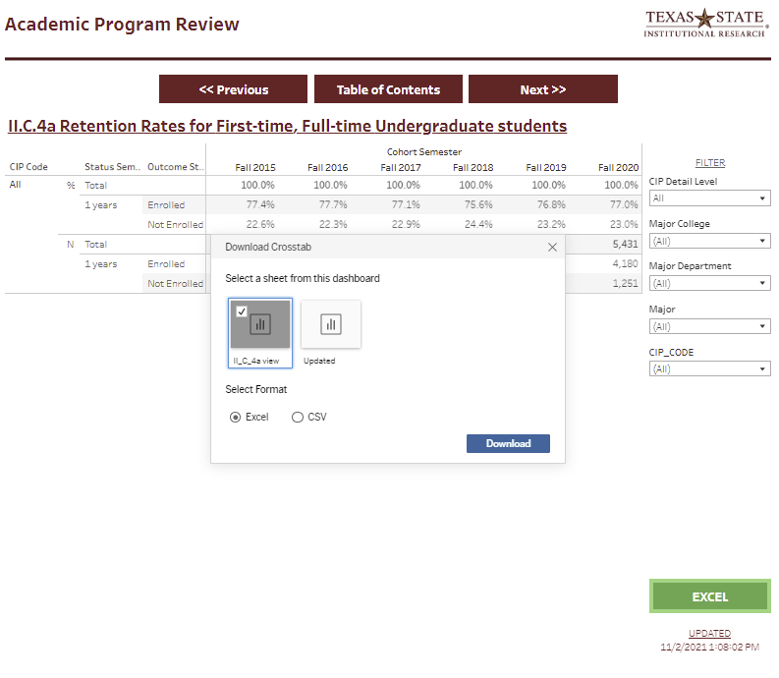
Exporting to Excel
Notes:
When you click on this button you will be provided with a dialog box prompting you to make a selection to download a crosstab of the data. If it is not already selected, click on the icon with the name of the table you are viewing, choose excel as the format, and then click download.

Slide 45
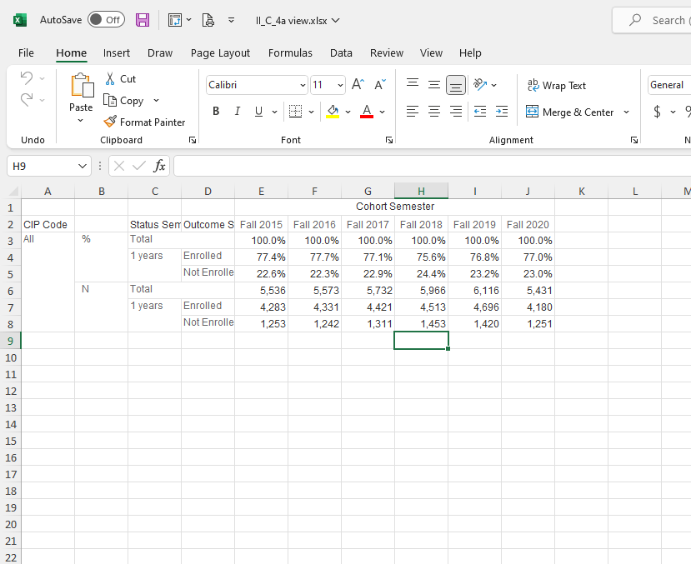
Exporting to Excel
Notes:
After you click download, an excel file will be downloaded to your computer which you can open and use to copy-and-paste the information into other documents.

Slide 46
Thank You
Please contact us if you have any questions.
Web: www.ir.txstate.edu
Email: ir@txstate.edu
Phone: (512)245-2386
Notes:
Thank you for watching this video. If you have any questions about the APR tables or other data provided by the office of institutional research, please reach out to us. You can find us on the web at www.ir.txstate.edu, email us at ir@txstate.edu, or give us a call at 512-245-2386.

