Slide 1
Maintaining your F-1 Visa Status
Texas State University
International Student and Scholar Services (ISSS)

Slide 2
You Are Welcome Here

Slide 3
Immigration Terms
(P)DSO – (Principal) Designated School Official
DOS – Department of State
DHS – Department of Homeland Security
ICE – Immigration and Customs Enforcement
SEVP – Student and Exchange Visitor Program
SEVIS – Student and Exchange Visitor Information System
CBP – U.S. Customs and Border Protection
POE – Port of Entry
D/S – Duration of Stay
COA – Class of Admission
USCIS – U.S. Citizenship and Immigration Services
COS – Change of Status
AOS – Adjustment of Status
Study in the States – information hub for international students

Slide 4
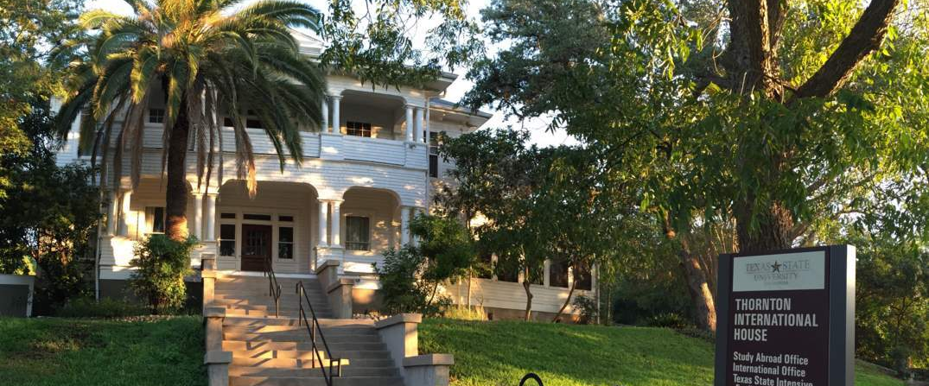
DSO Designated School Official
Responsible for creating the Form I-20
Maintain F-1 student records in SEVIS
Advise F-1 students on academic, personal, immigration-related issues.

Slide 5
Being an F-1 Student in the U.S.
F-1 students MUST follow specific regulations.
F-1 student status is classified as a non-immigrant status, which means you do not have intent to immigrate into the U.S.
Your F-1 student status is for studying in the U.S. but does have certain privileges such as work authorization.
You are required to submit the following documents to ISSS:
Signed I-20
Passport
Visa
I-94 (https://i94.cbp.dhs.gov/I94/#/recent-search)
I-901
Emergency Contact and Address Form
Important F-1 Status Requirements Form

Slide 6
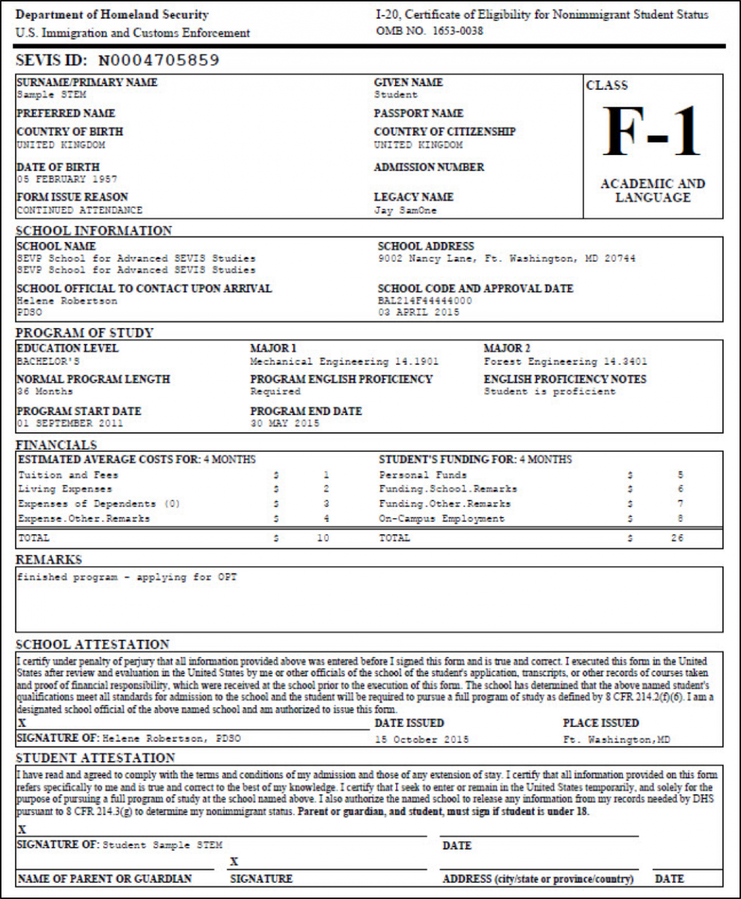
Form I-20: Certificate of Eligibility for Nonimmigrant Student Status The I-20 must always reflect accurate personal and academic information.
Start Date – First day of class
May enter the US 30 days prior to the start date.
End Date – Expected date program completion
An I-20 Program Extension must be requested before the end date.
Change of Major – Receive a new I-20 when changing major.
Change of Degree Level – Receive a new I-20 before new program start date or international travel.
Travel Signature – a DSO’s endorsement certifying reentry eligibility is required prior to international travel.
Should be requested every semester traveling abroad.
Treat your I-20 like a passport, do not damage or lose, and keep all copies of I-20s.

Slide 7
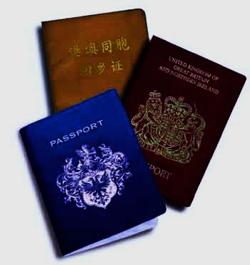
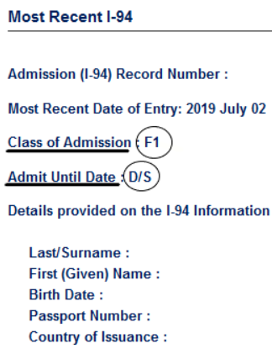
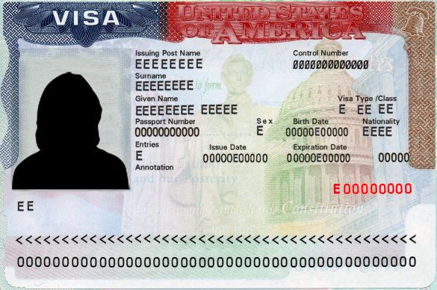
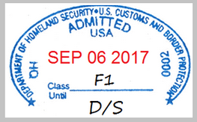
Additional Immigration Documents
Passport
(identity)
I-94
(Admission & Departure Record)
VISA
(entry permit)
Six-Month Rule – F-1 students are required to be in possession of passports that are valid for 6 months beyond their intended stay.
Renewal – Contact local embassy or regional consulate for instructions.
Electronic I-94 - Access from the CBP website https://i94.cbp.dhs.gov/I94.
Duration of Status (D/S) – F-1 students may remain in the US as long as the I-20 is valid. If your I-94 has an error, contact ISSS.
Class of Admission = F1
If not F1, contact ISSS.
A visa grants an F-1 student eligibility to apply for entry into the US at a POE.
F-1 students are permitted to remain in the US with an expired visa.
Students are encouraged to maintain a valid visa in case of emergency international travel.

Slide 8
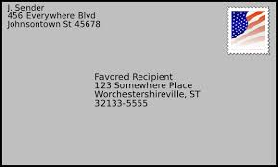
Update Address
IMPORTANT!
F-1 students are required to report any change of contact information and address to ISSS within 10 days of the change.
The local address and phone number are reported to SEVIS to activate an F-1’s record.
DHS at all times wants to know how and where to contact F-1 students.
Update address using the ISSS Online Address Portal.

Slide 9
Full-Time Enrollment Requirement
Full-time required every Fall and Spring semester.
12 hours for Undergraduate
9 hours for Graduate/Doctoral
ISSS registers enrollment to ICE through SEVIS.
Failure to enroll full-time at any time in the semester results in a SEVIS termination.
Only students who begin in summer are required to enroll full-time in summer.

Slide 10
Reduced Course Load (RCL)
Exception to the full-time enrollment requirement with authorized RCL
Academic Difficulties
Medical Conditions
Completion of Course of Study
Students must apply for an RCL before enrollment less than full-time or dropping a course that results in less than full-time.
RCLs are processed in SEVIS by the DSO.
http://www.international.txstate.edu/current/regulations.html

Slide 11
Academic RCL
Enrollment: 6 hour minimum
Condition: 1 semester per degree level
Requires evidence of the following:
difficulty with the English language or reading requirements
unfamiliarity with U.S. teaching methods
improper course level placement

Slide 12
Medical RCL
Enrollment: No minimum credit hour limit
Condition: Maximum of 12 months
Requires supporting medical documentation
Note: documentation of a medical condition is required from a licensed medical doctor, doctor of osteopathy, or licensed clinical psychologist.

Slide 13
Final Semester RCL (Completion of Course of Study)
Enrollment: 1 credit hour
Condition: Final semester only
Students who do not graduate may be eligible for a subsequent final semester RCL.
Graduate students holding an assistantship should consult with the Graduate College when enrolling less than full-time.

Slide 14
Financial Difficulty
All F-1 students are required to enroll full-time unless authorized by RCL to be less than full-time.
F-1 students must show sufficient financial resources to cover the cost of attendance when applying for the Form I-20 and F-1 visa.
F-1 students who cannot pay tuition bills will be advised to apply for economic hardship or return home. Failure to enroll is a SEVIS termination action.
NOTE: The F-1 regulations do not allow financial difficulty as an acceptable reason to enroll less than full-time.

Slide 15
Concurrent Enrollment
F-1 students may be enrolled in two SEVIS approved institutions.
Combined enrollment must equal full-time.
Apply for Concurrent Enrollment approval with ISSS:
An academic advisor completes the Concurrent Enrollment Form
A concurrent transcript must be submitted at the end of the semester
NOTE: Dropping a Texas State or concurrent course that results in less than full-time enrollment is a SEVIS termination action.
 | Texas State University | Austin Community College
Grad | 6 hours | 3 hours
Undergrad | 6 hours | 6 hours

Slide 16
Distance Learning Courses
Only one distance learning course
per semester may count towards
the full-time requirement.
Courses conducted 100% online or through Correspondence.
Does not require physical attendance for classes, examination, or other purposes integral to completion of the class.
Students unsure if a course is distance learning should check the syllabus, ask an academic advisor or professor.
 | Online | Face-to-Face
Grad | 3 hours | 6 hours
Undergrad | 3 hours | 9 hours

Slide 17
Employment
On-campus Employment
Pre-authorized by DHS
No additional authorization from ISSS
May work on campus only
Only 20 hours a week while school is in session
May work full-time during annual school breaks
Off-campus Employment
Required authorization from ISSS or DHS
Enroll one full academic year before eligible
Exception: If the degree requires immediate off-campus work.
Work must be related to major
May be authorized to work full-time or part-time
Apply each semester (CPT) or after graduation (OPT)
https://www.international.txstate.edu/Work-Authorization.html

Slide 18
Curricular Practical Training (CPT)
What is CPT? Training that is an integral part of an established curriculum and directly related to the student's major area of study.
When to apply: before the start of the semester and before working
How to apply: Submit online request to ISSS for a DSO’s CPT authorization in SEVIS
Duration: 1 semester (must reapply each semester)
Condition: Employment must be directly related to your major
Must be enrolled in a course that requires off-campus work (i.e. internship, practicum, directed project, student teaching)
Hours: Part time (less than 20 hours) or full-time (20 or more hours) per week
Processing time: ISSS may take up to 5-10 business days
https://www.international.txstate.edu/Work-Authorization/cpt.html

Slide 19
Optional Practical Training (OPT)
What is OPT? 12-months of temporary work authorization granted by DHS.
When to apply: 90 days before graduation
How to apply:
1) Submit request to ISSS for a DSO’s OPT recommendation in SEVIS
2) Submit required documents and fees to USCIS
Duration: 12 months
Can be extended for an additional 24-months if STEM-degree eligible.
Condition: Employment must be directly related to your major
Hours: 20 or more hours per week
Processing time: USCIS may take up to 5 months or more
ISSS hosts OPT workshops each semester.
https://www.international.txstate.edu/Work-Authorization/opt.html

Slide 20
SEVIS Transfer
ISSS will transfer your SEVIS record to the new institution.
You must obtain a new I-20 from the new institution.
Transferring keeps the SEVIS record active and avoids the need to pay the I-901 SEVIS fee again.
Upon graduation, the SEVIS record must be transferred within 60 days otherwise the record will auto-complete.
Must begin classes at the new institution within 5 months or the next available term which ever is earlier.
http://www.international.txstate.edu/current/TransferOut.html

Slide 21
Scams and Frauds ~BE VIGILANT~
The U.S. government and law enforcement agencies will never:
Call, email, text, or use social media to demand immediate payment for fees, debts, or taxes.
Though intimidating, remember that these callers are trying to scam you and they are not real threats!
Demand payment without an appeal or evidence of money owed.
Require you to use a specific payment method.
Example prepaid debit card or gift cards: iTunes Gift Card Scam.
Ask for confidential, personal, or banking information over the phone.
Threaten to arrest, detain, or deport you over the phone.
Review the ISSS Scams and Fraud site for more examples.
http://www.international.txstate.edu/help/scamsandfraud.html

Slide 22
Completion of Course of Study
8 CFR 214.2(f)(6)(iii)(C) Completion of course of study.
The DSO may authorize a reduced course load in the student's final term, semester, or session if fewer courses are needed to complete the course of study.
If the student is not required to take any additional courses to satisfy the requirements for completion, but continues to be enrolled for administrative purposes, the student is considered to have completed the course of study and must take action to maintain status. Such action may include application for change of status or departure from the U.S.

Slide 23
After Graduation
Students have a 60-day Grace Period to do one of the following:
Apply for Optional Practical Training (OPT).
Depart the US, send departure itinerary to international@txstate.edu
Apply for a change or adjustment of status.
Request a SEVIS Transfer to begin a new degree at a different institution.
Request a Change of Level I-20 to begin a new degree at Texas State.

Slide 24
Summary
*Do not work off campus without authorization
Work on campus no more than 20 hours per week
Request a travel signature for all international travel
Enroll full-time every Fall and Spring
Review ISSS for all immigration updates: http://www.international.txstate.edu/
Schedule an appointment with a DSO by calling 512-245-7966

Slide 25
Thank you and welcome!

