Slide 1
Welcome International Students!

Slide 2
International Student and Scholar Services (ISSS) Staff
Associate Director, PDSO | Coordinator, DSO International Student Advisor
Engagement Specialist, DSO, International Student Advisor | Administrative Assistant II, DSO
Graduate Assistant | Student Worker
Student Worker | Student Worker
Student Worker | Student Worker

Slide 3
ISSS Services
Front Desk Staffs
Provide general information on immigration rules and procedures
Assist students to navigate campus and community resources
Answer general questions via in person, phone calls and emails
Process requests of letters for Social Security Number (SSN) and Proof of Enrollment
Coordinate requests for DSO
DSOs
Maintain international student records in SEVIS.
Advise immigration issues concerning F-1 and J-1 visa status
Process I-20s, RCL, Travel Signatures, CPT and OPT
Conduct workshops for new international student check-in and OPT
Assist the university to maintain compliance with federal regulations

Slide 4
ISSS Contact Information
ISSS: 512-245-7966 (save to your phone) this will help you to recognize when we are trying to reach you
General inquiries and holiday mailbox: international@txstate.edu
Health insurance questions: intlhealth@txstate.edu
Events and programs: intlevents@txstate.edu
Request a new I-20: i20request@txstate.edu

Slide 5
Helpful Information for Your SUCCESS!

Slide 6
Culture Shock!
Honeymoon/ Euphoria
Culture Shock
Graduate Adjustment
Feeling at Home
Pre-arrival Anxiety

Slide 7
Strategies to Cope with Culture Shock!
Learn as much about your new surroundings as possible
Be patient, be open-minded, and be curious
Ask questions and do not assume
Allow yourself to make mistakes and learn
Take care of your physical and mental health
Get involved with the campus and surrounding community
Make friends and allies that can support your growth
Be honest and talk to other faculty, staff, and students about how you feel
Keep in contact with family and friends back home
Identify resources and needs for any accompanying dependents

Slide 8
READ YOUR EMAILS

Slide 9
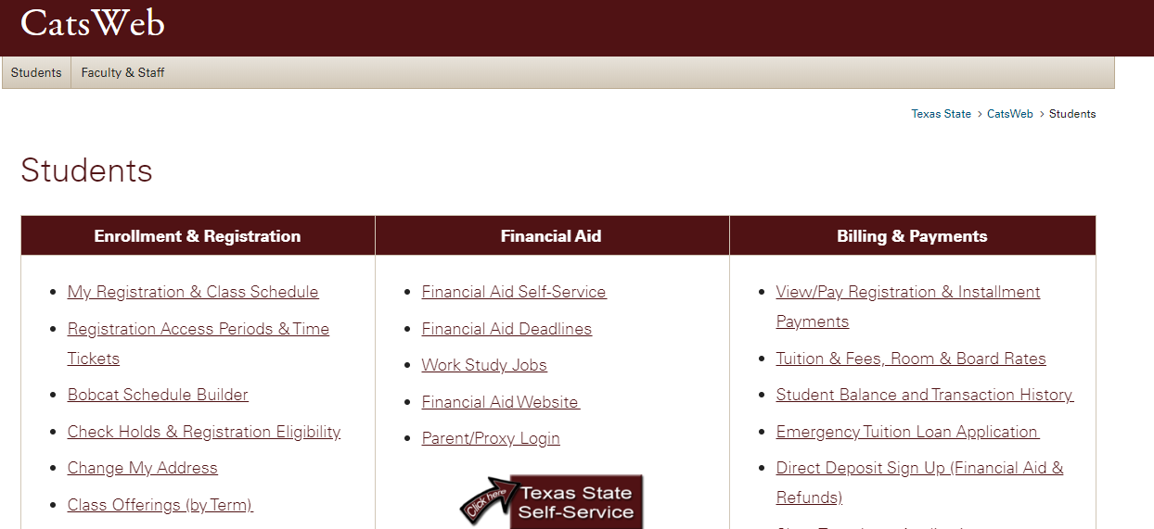
IMPORTANT – Update Your Address
ISSS Website
CatsWeb

Slide 10
Pay Your Tuition Bill
You can only pay your tuition bill after you have registered for courses at Texas State (after meeting with an Academic Advisor or Faculty Advisor).
Login to the Student Business Services website (SBS) or visit the SBS office in J.C. Kellam Building (JCK).
Student Business Services website: http://www.sbs.txstate.edu/
Tuition payment due, Thursday, January 16th by 5 PM
Note: ISSS cannot assist with paying tuition or viewing your bill.

Slide 11
Scholarships at Texas State
Texas State has many competitive scholarships, refer to your Department or College for major specific scholarships.
Find more information regarding scholarships on ISSS website: http://www.international.txstate.edu/Financial.html
Check the Financial Aid and Scholarships website: http://www.finaid.txstate.edu/scholarships.html
Tuition Assistance for Mexican Students (TAMS)
The Good Neighbor Scholarship is available to students from the following countries:

Slide 12
On-Campus Employment
The first step in finding an on-campus job is to create an account on Jobs4Cats (Handshake), which lists all available jobs on campus.
Register on Jobs4Cats (Handshake) by visiting: http://www.careerservices.txstate.edu/students.html
Most job openings require you to submit your application, resume and class schedule.
Apply for regular wage-jobs not work-study jobs.
IMPORTANT: Once you have been offered a job, apply for a Social Security Number, and make sure you visit the Payroll and Tax Compliance Office to complete your W-4 to get on the university payroll. (JCK 582, payroll@txstate.edu)
Note: Graduate students are not eligible to apply for Graduate Assistantships unless they are “full” or “regular” admits.

Slide 13
University Terms You Should Know
NetID: (abc123) – Activate NetID: https://tim.txstate.edu/onlinetoolkit/Login?ProceedIdVet=True
Login to BobcatMail, on-campus computers/printing, access Texas State service websites.
TEXAS STATE ID: (A0…)
Sign up for an event, sending an email to your professor etc.
CATSWEB - https://www.catsweb.txstate.edu/
Register for class, degree audit, view/pay tuition bill, financial aid, update address, check holds, and view transcript.
BOBCAT MAIL - https://portal.office.com/
Texas State University email service.
TRACS/CANVAS
https://tracs.txstate.edu/ (soon to be deactivated)
https://canvas.txstate.edu/ (replaces TRACS)
Post syllabus, make announcements, submit final grades, certify class rosters, administer assignments and tests.

Slide 14
University Terms You Should Know
Texas State Honor Code
Conscientious, Respectful, and Honest (Plagiarism)
Academic Probation
Texas State GPA below 3.0 for Grads, 2.0 for Undergrads
Academic Suspension
Texas State GPA below 3.0 for Grads, 2.0 for Undergrads
Review the Texas State Catalog for more academic policies.
Review the Texas State University Policy and Procedure Statements (UPPS) for more university policies.

Slide 15
Academic Expectations
The course syllabus is a contract between the student and the instructor. Students are expected to be familiar with the syllabus.
Instructors hold office hours each week and students are encouraged to take advantage and visit with instructors during this time to ask questions or receive clarification on the course.
Students are encouraged to engage in meaningful and critical dialogs with professors and classmates.
Academic dishonesty such as plagiarism and cheating will be penalized.
To learn more about academic integrity, please click the link below: https://www.international.txstate.edu/help/Academic-Integrity.html

Slide 16
Communication Tips for Interacting with Domestic Faculty, Staff, and Students
In the United States, both respect and personal opinions are highly valued.
Do not be hesitant to voice your opinion or share your perspective.
Ask a lot of questions. You are here to learn.
Be honest and respectful to fellow members of the Texas State community.
Professional courtesy response time – Allow at least 2 business days before following up with someone via email. Sending a follow up email can be viewed as rude.

Slide 17
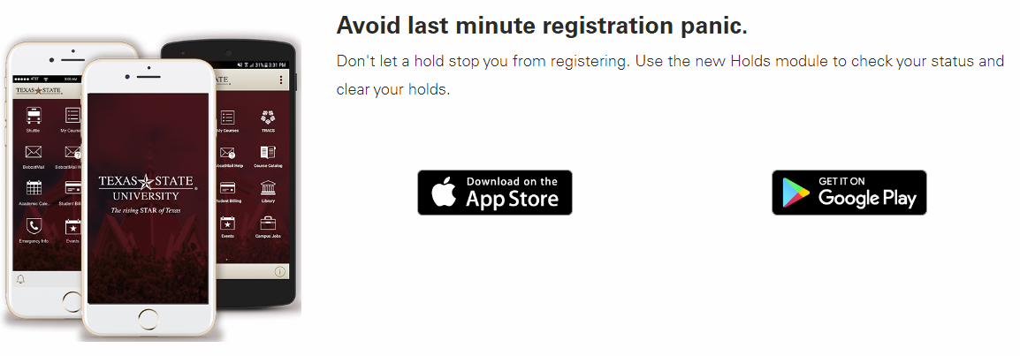
Download the TXST Mobile http://www.mobile.txstate.edu/
Access to university news, updates, Shuttle Bus schedules, academic calendar, campus map, and more!

Slide 18
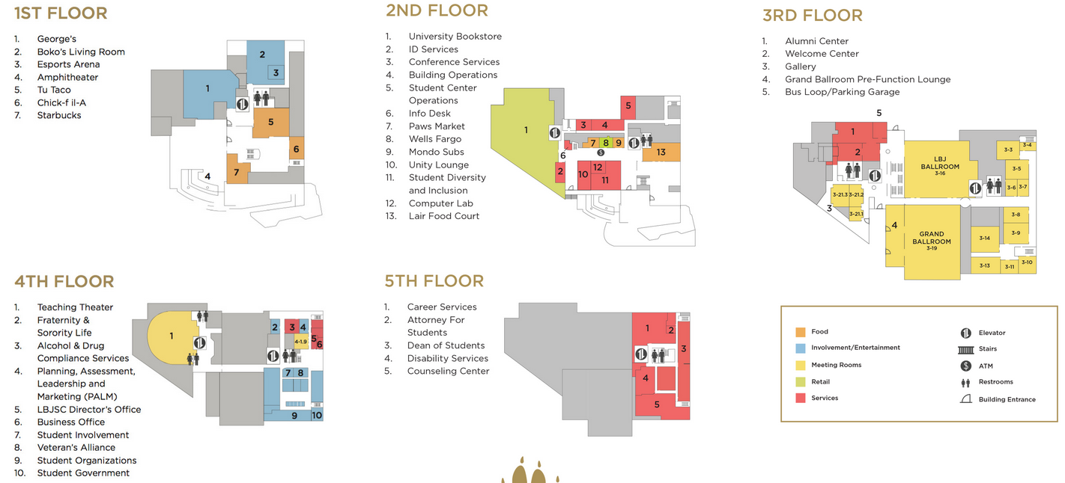
LBJ Student Center Resources https://www.lbjsc.txstate.edu/About/Brochure.html

Slide 19
Campus Events and Student Involvement
Join an Internationally Minded Student Organization
View hundreds of other student organization: https://www.lbjsc.txstate.edu/soc/join/search-orgs.html
Join free on-campus events sponsored by the Student Association for Campus Activities (SACA): http://www.lbjsc.txstate.edu/involvement/saca.html
View the Texas State University Calendar: https://events.txstate.edu/
View the Texas State Diversity Calendar: https://events.txstate.edu/equity-and-inclusion
Visit the Wittliff Collections at the Texas State Alkek Library: https://www.thewittliffcollections.txstate.edu/
Watch a Theater, dance, or musical performance by Texas State Students and Staff: https://txstatepresents.universitytickets.com/

Slide 20
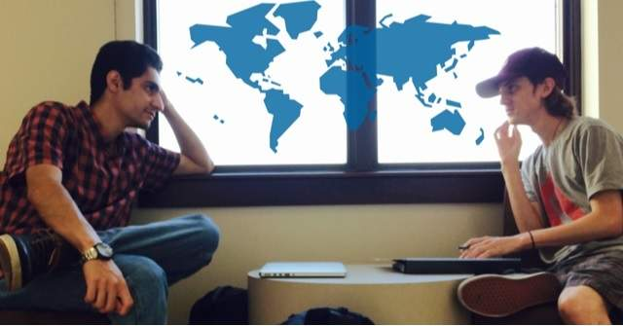
Mentoring and Conversation Programs
Request a Mentor in the Bobcat Bond Mentoring Program:
https://www.studentsuccess.txstate.edu/programs/bobcatbond.html
Participate in the Global Bobcats Conversation Partner Program: https://www.txstate.edu/internationalminds/internationalengagement/Global-Bobcats.html

Slide 21
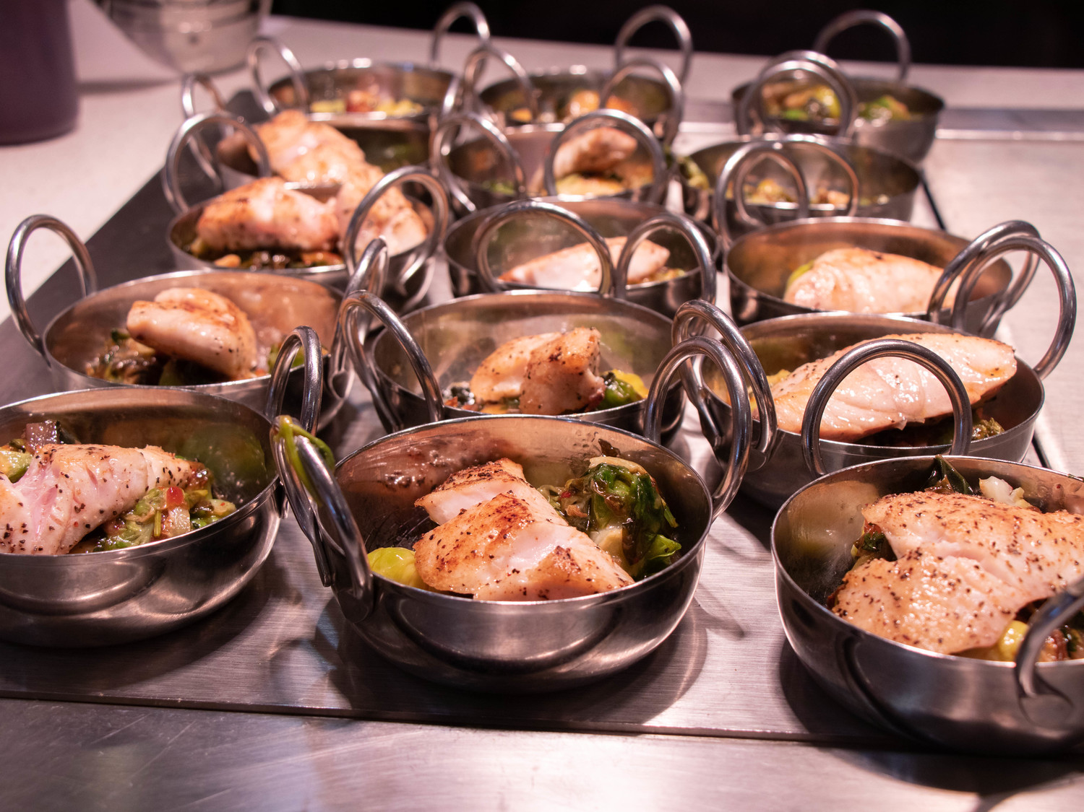
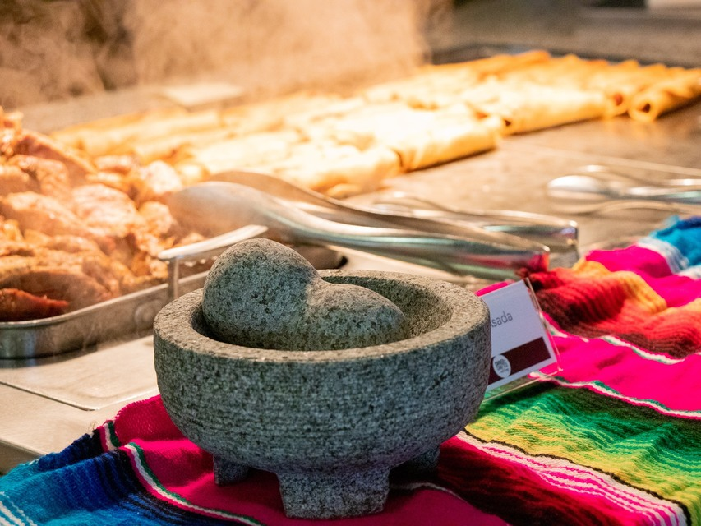
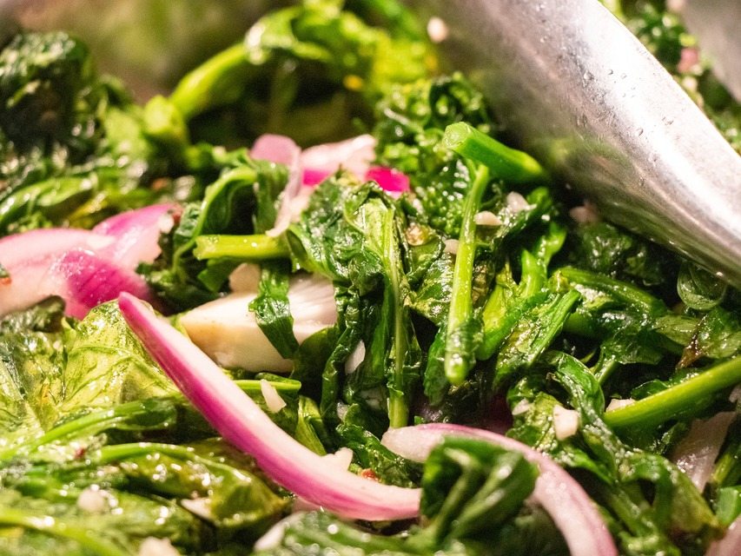
Dining On Campus https://dineoncampus.com/txstate
Several on-campus food court, buffet dining, café, and food market options
Purchase on-campus meal plans
View different campus dining location menus

Slide 22
Safety in the United States
911 is for emergencies only.
Save local police contacts for non-emergency situations:
University Police: 512-245-8336
Non-emergency TXST UPD: 512-245-2805
Safety Escort: 512-245-SAFE (512-245-7233)
Sign up for TXST Alerts: https://www.police.txstate.edu/campus-safety/sign-up-for-txstate-alerts.html
Bobcat Guardian App: http://www.police.txstate.edu/campus-safety/bobcat-guardian.html (App will appear as Rave Guardian until you register)
Title IX – “protects all Texas State students, faculty, staff, and visitors from discrimination on the basis of gender, sex, gender identity or expression, and sexual orientation.”
Report all violations of Title IX to the Office of Equity and Inclusion: https://www.txstate.edu/oei/title-IX.html.
Personal Space – No one has the right to touch or grab you.
Notes:
(Student’s story in apartment parking lot)

Slide 23
Alcohol
Legal drinking age in the United States is 21 years old
Being a part of underage drinking is a crime
Driving with an opened bottle of alcohol is illegal
Do not leave your drink unattended
Do not drink something you did not see being made
Drink responsibly

Slide 24
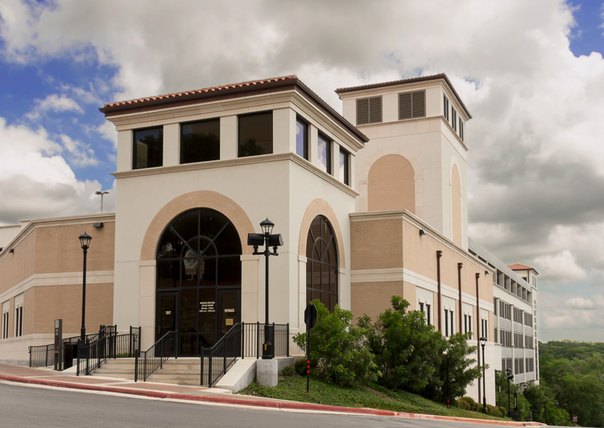
Parking Services
Purchase a parking permit or pay a parking ticket
Website: http://www.parking.txstate.edu/

Slide 25
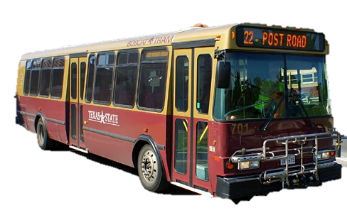
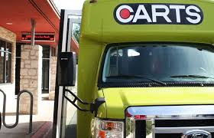
Bus Systems
Bobcat Shuttle
Commute within campus and to nearby off-campus apartments
Maps are located throughout campus at major bus hubs. You can also check online at http://www.shuttle.txstate.edu.
Closed when school is not in session
CARTS/CAT City Bus
Free for TXST Students (must show Student ID) in San Marcos
Available Route to Social Security Number (SSN) Office
Austin Route (Interurban Coach)
Website: http://www.ridecarts.com/

Slide 26
Alternative Transportation
Amtrak Trains – travels daily between Chicago and San Antonio traveling through major cities like Austin and Dallas
Greyhound Bus – travel service to cities around the country
Kerrville Bus Company – weekend and holiday transportation from San Marcos to Waco, Dallas, and Houston.
Megabus – travel service to cities around the country
Taxi and Rideshare – Uber or Lyft
Cars
Zip Cars – (https://www.zipcar.com/universities/texas-state-university-san-marcos)
Buying a car – Driver’s license, car insurance, parking permit to park on-campus (http://www.international.txstate.edu/prospective/afterapplying/transportation.html)
For more information on alternative transportation: https://www.transportation.txstate.edu/alternative.html

Slide 27
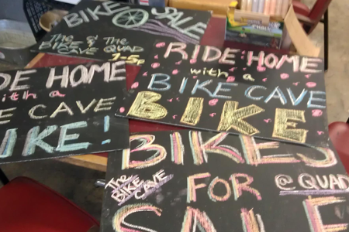
Bicycles and the Texas State Bike Cave
Tips: Buy a helmet, a bike lock, and front and rear lights.
Bicycle Laws: Bicycles are subject to the same laws as cars. Bicycle riders must obey street signs and maintain safe riding practices. In downtown San Marcos, bicycles must have front and rear lights to operate after dark.
Website: http://bikecave.transportation.txstate.edu/

Slide 28
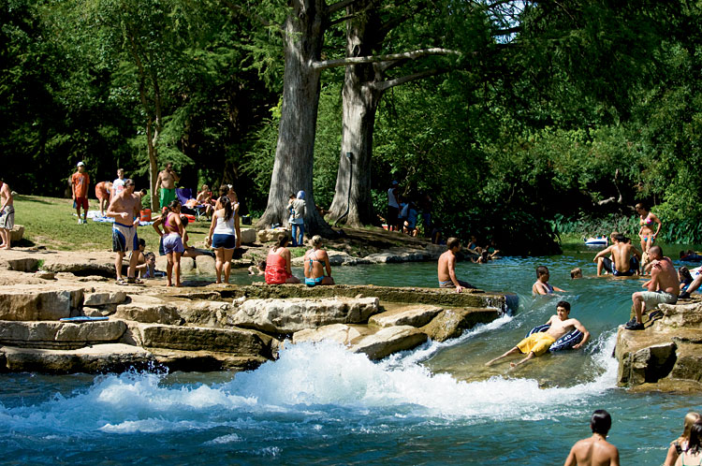
The Great Outdoors of San Marcos
The San Marcos River
Year-round temperature: 72F (22C)
Popular recreational area, and is frequented for tubing, canoeing, swimming etc.
Rents Kayak, Canoe, Tubes
Home for endangered species
Glass Bottom Boat Tours
Sewell Park
https://www.campusrecreation.txstate.edu/outdoor/sewell-park.html
Adventure Trip Program
https://www.campusrecreation.txstate.edu/outdoor/atp.html
Greenspaces
Natural Areas for Walking/Hiking/ Biking (http://www.smgreenbelt.org)
City Activities
(http://www.ci.san-marcos.tx.us)

Slide 29
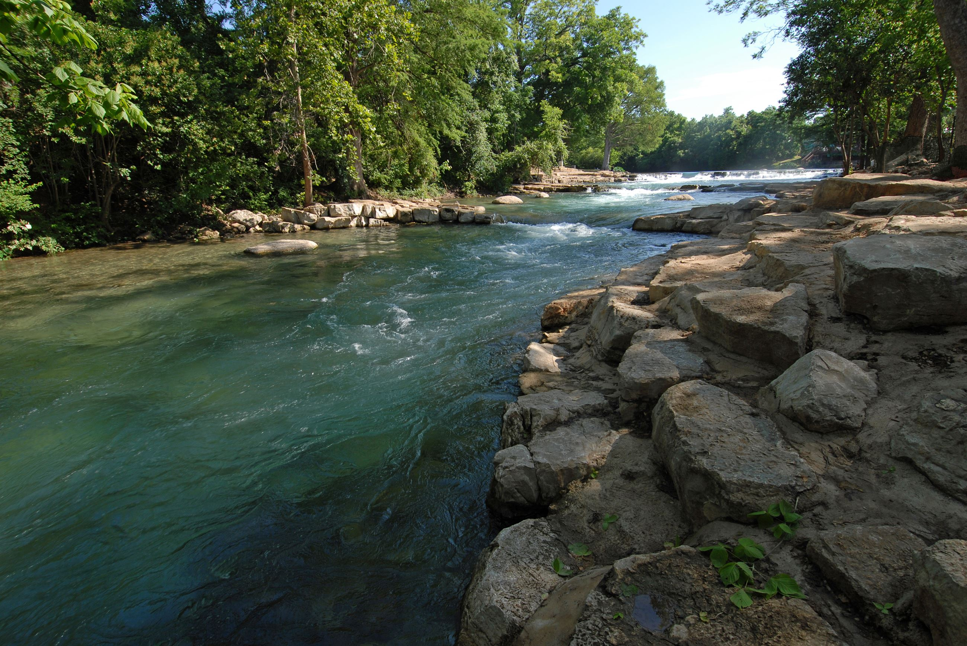
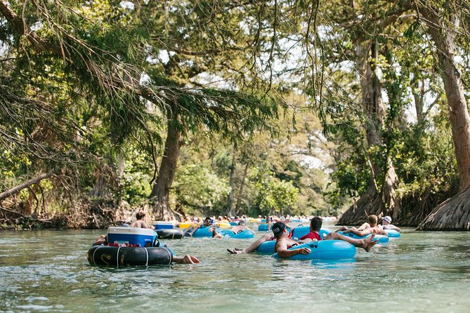
Water Safety
Kayaking, tubing, and swimming at the San Marcos river are common activities in San Marcos. However, a day at the river or the pool can become dangerous without proper water safety precautions in place.
* Warning *
If you do not know how to swim, please consider taking swimming classes before entering the river or the pool.
The Department of Campus Recreation provides a variety of swim lessons for children and adults. Review: https://www.campusrecreation.txstate.edu/Aquatics-and-Safety/Swim-Lessons.html

Slide 30
Follow ISSS on social media!
Twitter: @txst_isss
Facebook: /txstISSS
Instagram: @txst_isss

Slide 31
Welcome to Texas State University

