Slide 1
Welcome New International Bobcats!!!

Slide 2
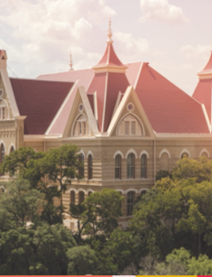
International Students Pre-Arrival Session
Dr. Laura Rodriguez Amaya
Associate Director, ISSS
Aragelia Salazar
Coordinator, ISSS

Slide 3
AGENDA
Registration
Housing
Transportation
Paying for Your Tuition
Health Insurance
Port-of-Entry
F-1 Check-In
You MUST activate your NetID before accessing most of this information.

Slide 4
REGISTRATION
Freshman: Mandatory New Student Orientation (NSO)
Exchange: Follow EA instructions
Graduate: Must meet with their Graduate Advisor

Slide 5
On-Campus Housing
Off-Campus Housing
The Off-Campus Housing Market can help you find the right apartment for you!
Texas State University has a housing policy that requires new first year students under the age of 20 with fewer than 30 credit hours to live in on-campus university housing.
Problems with your lease? Contact the Attorney for Students Office

Slide 6
Transportation
Texas State University does not provide transportation from the airport. We recommend arriving at the Austin or San Antonio airport and taking ground transportation such as a taxi or Super Shuttle from the airport to your residence.
If you arrive at the airport after 5:00 PM, most housing offices (on and off campus) will be CLOSED.
Notes:
Texas State University has a housing policy that requires new first year students under the age of 20 (by September 1 for fall admission or January 1 for spring admission) with fewer than 30 credit hours to live in on-campus university housing.

Slide 7
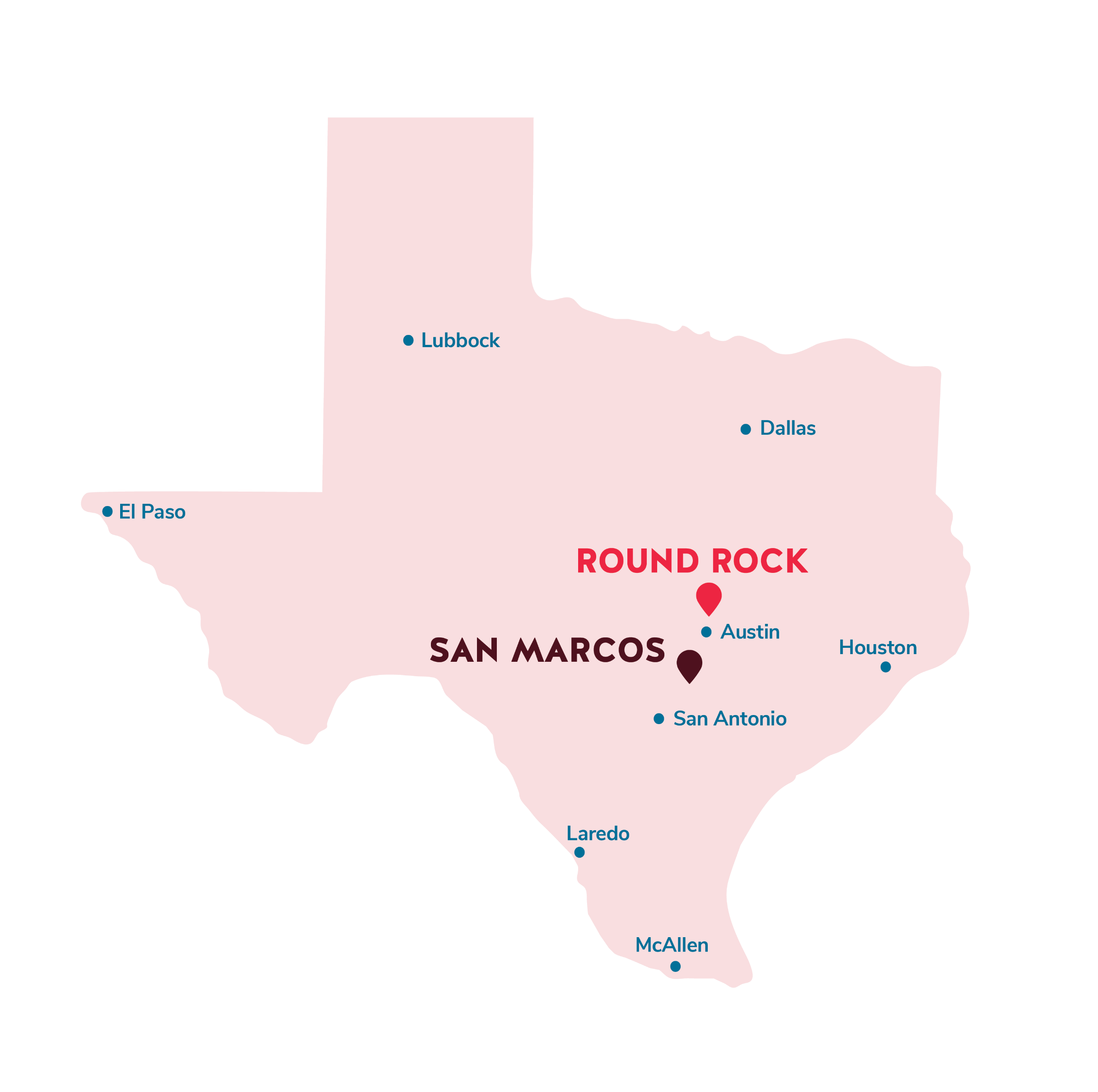
CAMPUS
We have two vibrant campuses — one in San Marcos, one in Round Rock — and a variety of ways for you to discover each through in-person or digital experiences. Both our campuses are filled with opportunities to engage in life-changing learning, creative energy and community spirit.
San Marcos Campus
601 University Drive
San Marcos, Texas 78666
Round Rock Campus
1555 University Blvd.
Round Rock, Texas 78665

Slide 8
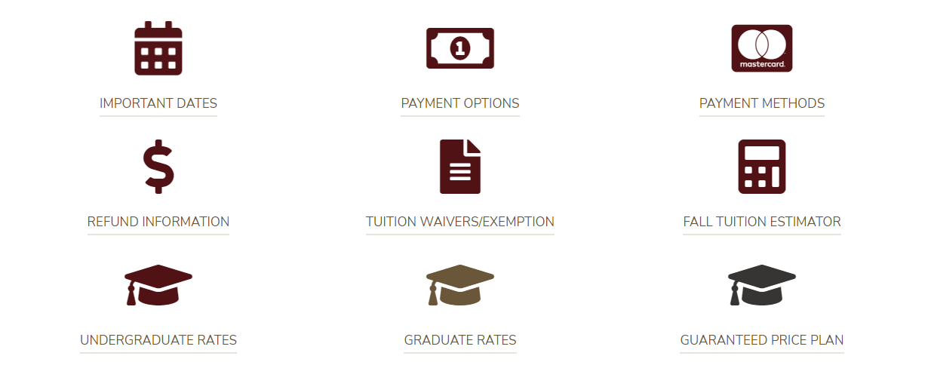
Paying Your Tuition
Notes:
Go to new student orientation link

Slide 9
Health Insurance
All International students on non-immigrant F and J visas are required by university policy to have health insurance coverage while enrolled in classes at Texas State University.
The health insurance cost will be added automatically to your student bill.
For more information: F-1 and J-1 International Student Health Insurance : International Student and Scholar Services (ISSS) : Texas State University (txst.edu)
Notes:
Texas State University has a housing policy that requires new first year students under the age of 20 (by September 1 for fall admission or January 1 for spring admission) with fewer than 30 credit hours to live in on-campus university housing.

Slide 10
F1 Visa Student Document Checklist at US Port of Entry
Valid Passport with expiration date long enough for your studies in the US
I-20 Signed by DSO
Admission/Acceptance letters from school
I-901 SEVIS fee payment receipt
Document proof for your financial support to cover your education
Original documents of your undergrad and other education certificates
Copy of your past transcripts that were sent to school
Name and contact info of DSO at your school
Address of where you will stay in the US
Contact info of seniors or anyone whom you interacted with (optional, but recommended)
Any other documents like GRE, TOEFL score reports (optional, but recommended)
For more information go to : Traveling to the US

Slide 11
CONTACT US

512-245-7966

international@txstate.edu
Thornton House
2nd Floor


