Slide 1
Are multiplication and division the same operation?

Slide 2
A window into mathematics education research
PLAY ALONG:
Open the participants list.
I’ve learned about subgroups.
Kate Melhuish
Texas State University
Mathworks Colloquium
July 17

Slide 3
Mathematics Education Research Talks tend to be deep dives into one research question and study.

Slide 4
Mathematics Education Research Talks tend to be deep dives into one research question and study.
This talk is not that.

Slide 5
My Journey to Mathematics Education
Philosophy!
Math Teacher!
Undergraduate
Engineering!
English Education!
Math!
Why don’t all my students love math?
What are those weird things they are doing? Why?
We can derive computational shortcuts to find Galois Groups of polynomials with special features.
Master’s
What are those cool things they are doing? Why?
Ph.D.
MATH!
MATH ED!

Slide 6
So what is mathematics education research?
PLAY ALONG:
Take a minute and just think about your image of mathematics education research. Put some of those in the chat.

Slide 7
So what is mathematics education research?
Applying a treatment instruction to one group of students and a control to another. Compare.
Writing textbooks.
Trying a cool thing when you teach and seeing how it works.
Learning to teach better.

Slide 8
So what is mathematics education research?
The study of the teaching and learning of mathematics.
Applying a treatment instruction to one group of students and a control to another. Compare.
Writing textbooks.
Trying a cool thing when you teach and seeing how it works.
Learning to teach better.

Slide 9
Mathematics Education Research
Math
People
Logical
Clean
Messy
Philosophy Analytic Writing Mathematics Psychology Anthropology Statistics Linguistics Data Science Cognitive Science Sociology

Slide 10
Instructional Design Study
State of the Field Study
Comparison Study
Group Theory Concept Assessment
Modelling Classrooms
Small-Scale Studies
Philosophy Analytic Writing Mathematics Psychology Anthropology Statistics Linguistics Data Science Cognitive Science Sociology
Some of my research projects

Slide 11
Collaborative: Teaching Inquiry-oriented Mathematics: Establishing Supports , $1,196,203 Estrella Johnson, Principal Investigator. Karen Keene, Principal Investigator. Christine Andrews-Larson, Principal Investigator. Improving Undergraduate STEM Education (IUSE), National Science Foundation, DRL- 1431595; 1431641, 07/31/2014-07/31/2016.
Instructional Design Study
State of the Field Study
Comparison Study
THANKS!!
Orchestrating Discussions Around Proof, $299,574. Kathleen Melhuish, Principal Investigator; Kristen Lew, Paul Dawkins, Co-Principal Investigators. Improving Undergraduate STEM Education (IUSE), National Science Foundation, DRL-1836559, 11/2018 - current.
Group Theory Concept Assessment
Modelling Classrooms
Small-Scale Studies
Using Technology to Capture Classroom Interactions: The Design, Validation, and Dissemination of a Formative Assessment of Instruction Tool for Diverse K-8 Mathematics Classrooms $1,984,657. Kathleen Melhuish, Principal Investigator; Ruth Heaton, Eva Thanheiser, Co-Principal Investigators. Discovery Research K-12, National Science Foundation, DRL-1814114, 09/2018 - current.
Philosophy Analytic Writing Mathematics Psychology Anthropology Statistics Linguistics Data Science Cognitive Science Sociology
Some of my research projects

Slide 12
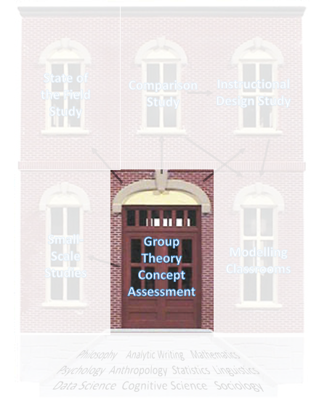

Slide 13
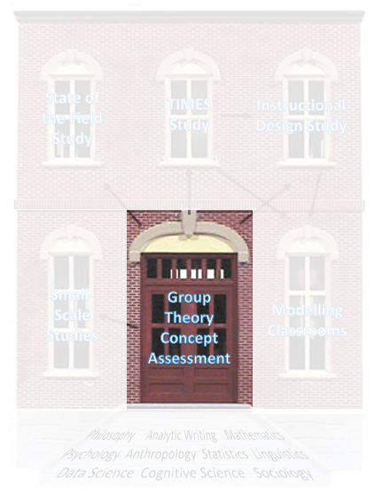
Need: A way to measure, at scale, students’ conceptual understanding of group theory topics
Problem: What does it mean to have conceptual understanding of topics at this level of mathematics?
Problem: What topics are important at this level of mathematics?
Problem: How do we design an assessment that captures student thinking about these topics AND can be administered at scale?
Instrument Study

Slide 14
Need: A way to measure, at scale, students’ conceptual understanding of group theory topics
Problem: What does it mean to have conceptual understanding of topics at this level of mathematics?
Problem: What topics are important at this level of mathematics?
Problem: How do we design an assessment that captures student thinking about these topics AND can be administered at scale?
Instrument Study
(rich) Understanding that is internally coherent and rich in relationships (e.g. Hiebert and Lefevre 1986)
(conceptual) Understanding that is connected directly to (or logically necessitated by) the definition (or meaning) of a concept or mathematical statement (c.f. Wladis et al. 2018)
capture conceptual understanding independent of ability to produce formal proofs

Slide 15
What topics do instructors, textbook authors, algebraists, and abstract algebra math ed researchers deem as important in an introduction to group theory?
Instrument Study
Methods: Delphi Study (a iterative survey process for coming to consensus)

Slide 16
How are essential group theory topics described formally and informally across textbooks? What representations and examples are used and for what purposes?
Instrument Study
Methods: Textbook Analysis

Slide 17
What do we know about student thinking related to essential topics from prior studies? What tasks can unearth student conceptual understanding?
Instrument Study
Methods: Literature Analysis

Slide 18
Essential Topic: Binary Operation
A binary operation on a set G is a function G×G→G that assigns to each pair (a,b)∈G×G a unique element a∘b in G. (Judson,2020).
Need a set.
And a rule for combining two elements where the result is still in the set.
Instrument Study
PLAY ALONG:
Put some binary operations (include the set) in chat
∘(a,b)= a+b mod 6
a +₆ b
Representations
Examples

Slide 19
Are tasks targeting the intended topic? Can they be answered by appealing to conceptual understanding? Can they be answered without appealing to conceptual understanding? Are they at the appropriate difficulty level ?
Instrument Study
Methods: Expert Evaluation

Slide 20
PLAY ALONG:

Slide 21
Are tasks targeting the intended topic? Can they be answered by appealing to conceptual understanding? Can they be answered without appealing to conceptual understanding?
Instrument Study
Methods: Open-ended surveys, qualitative analysis of response
Methods: Cognitive Interviews where students explain how they arrived at their responses.

Slide 22
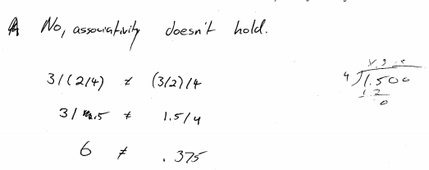

Slide 27
Instrument Study

Slide 28
Is the multiple-choice assessment operating as intended?
Are students picking responses for the anticipated reasons?
Are all options viable? (being selected by sufficient number of students?)
Are any prevalent ways of thinking about the item not represented?
Does the assessment have a valid underlying structure?
Are the questions of reasonable difficulty and discrimination?
Instrument Study
Methods: Field study
Methods: Cognitive Interviews
Methods: Item Response Theory, Correlating grades with GTCA, Factor Analysis

Slide 29
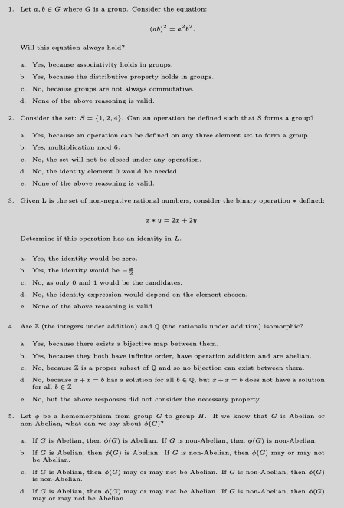
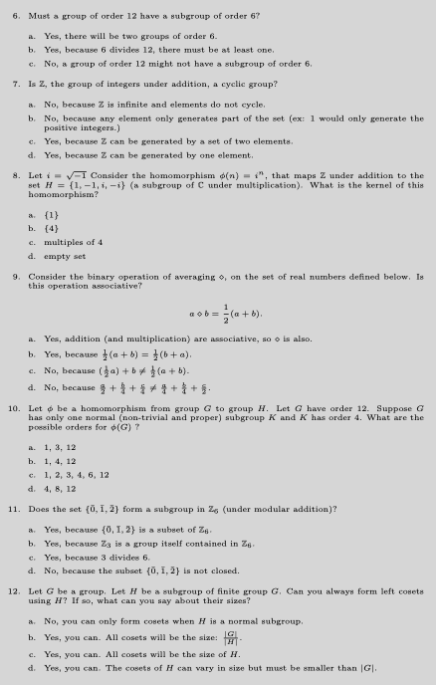
The GTCA

Slide 30
Instructional Design Study
State of the Field Study
TIMES Study
Group Theory Concept Assessment
Modelling Classrooms
Small-Scale Studies
Philosophy Analytic Writing Mathematics Psychology Anthropology Statistics Linguistics Data Science Cognitive Science Sociology

Slide 31
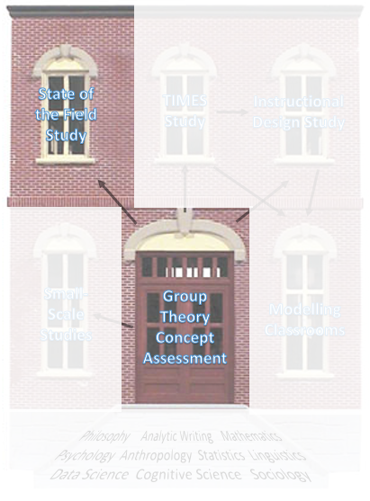
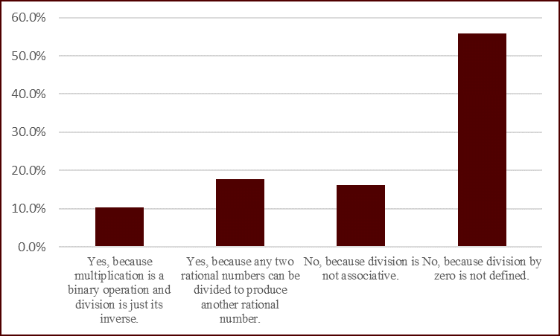
How common are the various ways of approaching these prompts?
Are the ways students are answering consistent with prior research?
State of the Field Study

Slide 32
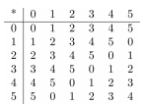
Because many items were modified from small-scale studies, this also
was a chance to replicate and challenge prior findings using a more representative sample.
Example:
A group is a set with a binary operation that has the following properties:
An identity element
All elements have inverses
The associative property holds
A subgroup is a subset of a group that is a group itself under the same binary operation.
State of the Field Study
addition mod 6

Slide 33
Because many items were modified from small-scale studies, this also
was a chance to replicate and challenge prior findings using a more representative sample.
Example:
A group is a set with a binary operation that has the following properties:
An identity element
All elements have inverses
The associative property holds
A subgroup is a subset of a group that is a group itself under the same binary operation.
State of the Field Study
addition mod 6
PLAY ALONG:
Is this a subgroup of Z₆?

Slide 34
Because many items were modified from small-scale studies, this also
was a chance to replicate and challenge prior findings using a more representative sample.
Example:
A group is a set with a binary operation that has the following properties:
An identity element
All elements have inverses
The associative property holds
A subgroup is a subset of a group that is a group itself under the same binary operation.
State of the Field Study
addition mod 6
PLAY ALONG:
Is this a subgroup of Z₆?

Slide 35
Because many items were modified from small-scale studies, this also
was a chance to replicate and challenge prior findings using a more representative sample.
Example:
A group is a set with a binary operation that has the following properties:
An identity element
All elements have inverses
The associative property holds
A subgroup is a subset of a group that is a group itself under the same binary operation.
State of the Field Study
addition mod 6
“Yes, it’s a subgroup. It’s a group. Then Z mod 3, if we assume is under modular addition still, it’s the same operation as our group, Z mod 6.”
addition mod 3

Slide 36
A subgroup is a subset of a group that is a group itself under the same binary operation.
What are students not getting?
Prior research:
Students are not coordinating the idea that a subgroup and parent group need to have the same operation.
My counter narrative:
Students may using a different notion of “same” operation in this context.
State of the Field Study
addition mod 6
What reasonable way of thinking would account for this response
“Yes, it’s a subgroup. It’s a group. Then Z mod 3, if we assume is under modular addition still, it’s the same operation as our group, Z mod 6.”
addition mod 3

Slide 37
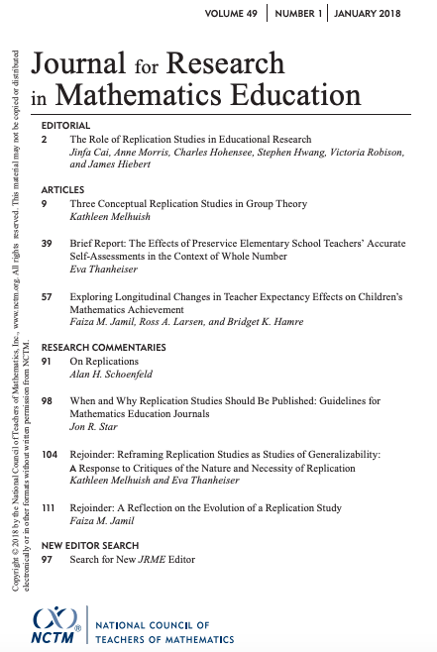
Because many items were modified from small-scale studies, this also
was a chance to replicate and challenge prior findings using a more representative sample.
Scientific Method:
Researchers propose a result and theoretical explanation
Researchers repeat (or scale-up / out) a study. Counter results, propose new theory.
…
State of the Field Study

Slide 38
Instructional Design Study
State of the Field Study
Comparison Study
Group Theory Concept Assessment
Modelling Classrooms
Small-Scale Studies
Philosophy Analytic Writing Mathematics Psychology Anthropology Statistics Linguistics Data Science Cognitive Science Sociology

Slide 39
Binary Operation Focused

Slide 40
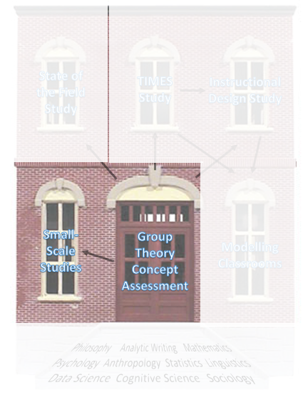
How are students thinking about binary operations?
What attributes do students treat as critical when engaging with binary operation tasks?
What metaphors do students leverage when communicating about operations and their attributes?
Small Scale Follow-up Studies

Slide 41
Exercises
Which of the following are binary operations:
a+b, integers
a-b, positive integers
a+₆b, {0,1,2,3,4,5}
1/2(ab), real numbers
Assumptions:
Understanding a concept involves attending to which properties are critical and which are permissible variations.
Often critical properties are backgrounded or permissible variations are overgeneralized as critical based on experience with examples of a concept.
Metaphors provides a means to structure and communicate these properties.
Small Scale Follow-up Studies
A binary operation on a set G is a function G×G→G that assigns to each pair (a,b)∈G×G a unique element a∘b in G. (Judson,2020).

Slide 42
Small Scale Follow-up Studies
24 students finishing AA at two institutions
6 follow-up interviews

Slide 43
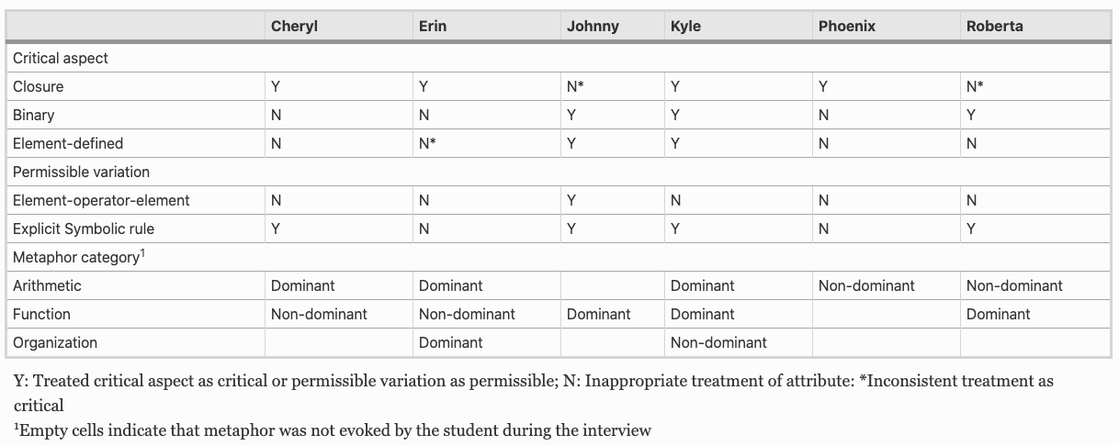
Small Scale Follow-up Studies

Slide 44
Small Scale Follow-up Studies

Slide 45
Small Scale Follow-up Studies

Slide 46
Metaphors
Metaphor Type 1: Function-based
“This stood out immediately, as not binary operation, because root a has nothing to do with b and so even though it's taking two numbers in the input, the output doesn't depend on b”
Metaphor Type 2: Arithmetic-based
“If you could combine other numbers and still get the same answer, then it wouldn't give you something unique.”
Metaphor Type 3: Structure-based
‘Well, wait a minute, what pattern do we have going on there?’
Small Scale Follow-up Studies

Slide 47
Metaphors
Metaphor Type 1: Function-based
“This stood out immediately, as not binary operation, because root a has nothing to do with b and so even though it's taking two numbers in the input, the output doesn't depend on b”
Metaphor Type 2: Arithmetic-based
“If you could combine other numbers and still get the same answer, then it wouldn't give you something unique.”
Metaphor Type 3: Structure-based
‘Well, wait a minute, what pattern do we have going on there?’
Small Scale Follow-up Studies

Slide 48
Metaphors
Metaphor Type 1: Function-based
“This stood out immediately, as not binary operation, because root a has nothing to do with b and so even though it's taking two numbers in the input, the output doesn't depend on b”
Metaphor Type 2: Arithmetic-based
“If you could combine other numbers and still get the same answer, then it wouldn't give you something unique.”
Metaphor Type 3: Structure-based
‘Well, wait a minute, what pattern do we have going on there?’
Small Scale Follow-up Studies

Slide 49
Metaphors
Metaphor Type 1: Function-based
“This stood out immediately, as not binary operation, because root a has nothing to do with b and so even though it's taking two numbers in the input, the output doesn't depend on b”
Metaphor Type 2: Arithmetic-based
“If you could combine other numbers and still get the same answer, then it wouldn't give you something unique.”
Metaphor Type 3: Structure-based
‘Well, wait a minute, what pattern do we have going on there?’
Small Scale Follow-up Studies

Slide 50
Sameness Focused
Small Scale Follow-up Studies

Slide 51
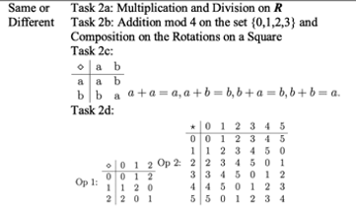
Small Scale Follow-up Studies

Slide 52
Are multiplication and division the same operation?
PLAY ALONG:
Small Scale Follow-up Studies
Is this a trick question?
No
Yes?
No?
Not a well-defined question!

Slide 53
Are multiplication and division the same operation?
What does it mean for two objects to be mathematically the same (or not)?
How can we operationalize sameness in order to account for unexpected student response?
Small Scale Follow-up Studies
Is this a trick question?

Slide 54
Philosophical Roots
If x and y are the same, then x and y possess all of the same properties.
Are these two triangles the same?
Small Scale Follow-up Studies
PLAY ALONG:
Same angles
Same orientation
Same color
Same side-lengths
Different locations
☹

Slide 55
Philosophical Roots
If x and y are the same, then x and y possess all of the same properties.
Are these two triangles the same?
Small Scale Follow-up Studies
Same angles
Same orientation
Same color
Same side-lengths
These triangles are the same in terms of congruence, but not location.
Different locations
☹

Slide 56
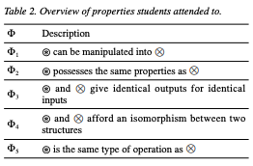
Sameness operationalization:
“Division is pretty much just multiplication.”
“Then Z mod 3, if we assume is under modular addition still, it’s the same operation as our group, Z mod 6.”

Slide 57
Instructional Design Study
State of the Field Study
Comparison Study
Group Theory Concept Assessment
Modelling Classrooms
Small-Scale Studies
Philosophy Analytic Writing Mathematics Psychology Anthropology Statistics Linguistics Data Science Cognitive Science Sociology

Slide 58
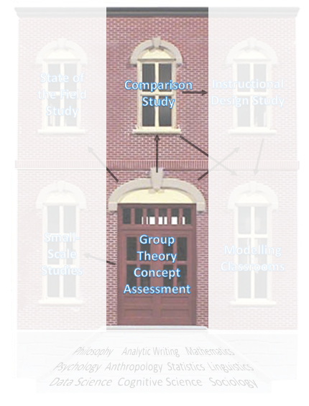
TIMES project:
Professional development for instructors implementing an inquiry-oriented curriculum: students actively reinvent important group theory concepts
TIMES Sample:
n=147 students
National Sample:
n=375 students
Comparison Study
What is the relationship between inquiry-oriented instruction, as manifested by the TIMES program, and student performance on a content
assessment?
Is this relationship consistent across genders?

Slide 59
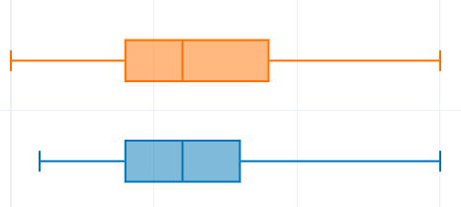
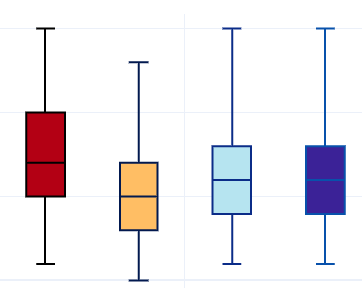
By Gender? WOAH.
What happened?
Comparison Study
TIMES
National Sample
Students from TIMES (not lecture classes) are doing just as well! (about .5 items better, but this is not significant)
TIMES Men
TIMES Women
National Sample Men
National Sample Women

Slide 60
HLM model nesting students in classrooms… adding variables like the university’s Carnegie Classification, Average SAT scores… but the finding is robust:
No difference in performance by gender in national sample.
Men outperform women in TIMES Sample
Comparison Study
TIMES
National Sample
TIMES Men
TIMES Women
National Sample Men
National Sample Women

Slide 61
Why?
Conjectures:
Perceived status in group work setting
Certain student voices and ideas may dominate
Instructor implicit bias
….
We need to know more about what is going on inside of classrooms.
We need to design more than just high quality tasks, but also attend to how students and instructors engage with each other’s ideas.

Slide 62
Instructional Design Study
State of the Field Study
Comparison Study
Group Theory Concept Assessment
Modelling Classrooms
Small-Scale Studies
Philosophy Analytic Writing Mathematics Psychology Anthropology Statistics Linguistics Data Science Cognitive Science Sociology

Slide 63
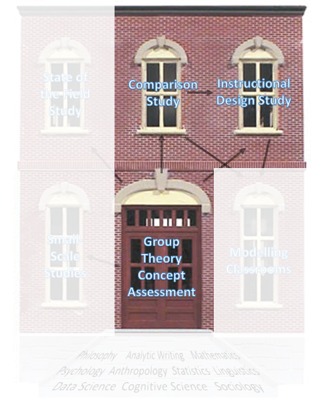
How can we design instructional tasks that support students in engaging meaningfully in important group theory topics and integrate best practices for student–centered instruction
Series of task-based interviews with three students
Series of task-based interviews with four students
Year 1
Instructional Design Study
Series of task-based interviews with four students
Tested in classroom
Year 2

Slide 64
Design-based research:
Design Heuristics + A Theory about How Students Will Engage in a Task
Test out. Refine Theory and Tasks. Iteratively.
Informed by GTCA study results about student understanding of topics
Orchestrating Discussions Around Proof (ODAP)
PROJECT
Three tasks
Learning Goal: engender students in authentic mathematical activity around validating, constructing, and comprehending proof in introductory group theory
Participation Goal: all students engage meaningfully with mathematics and each other’s ideas
Informed by: Best practices for teaching K-12
Instructional Design Study
Meeting need from TIMES study to more carefully lay out how we work with student ideas

Slide 65
Design-based research:
Design Heuristics + A Theory about How Students Will Engage in a Task
Test out. Refine Theory and Tasks. Iteratively.
Series of task-based interviews with three students
Series of task-based interviews with four students
Year 1
Instructional Design Study
Tested in classroom
Series of task-based interviews with four students
Year 2
Tested in classroom
Year 3

Slide 66
Instructional Design Study
State of the Field Study
Comparison Study
Group Theory Concept Assessment
Modelling Classrooms
Small-Scale Studies
Philosophy Analytic Writing Mathematics Psychology Anthropology Statistics Linguistics Data Science Cognitive Science Sociology

Slide 67
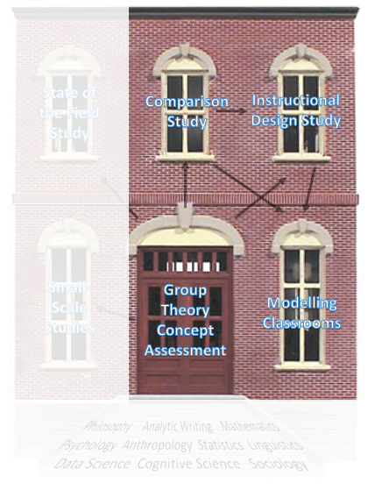
What is going on in classrooms in terms of teacher and student activity??
How can we model teacher and student actions that we value in the classroom?
How do the rates of teachers actions impact the rates of studrnt actions?
Modelling Classrooms Study

Slide 68
We need a tool.
Here’s the tool my project team has been working on:
Student Activity
Modelling Classrooms Study
Teacher Activity
iPad Application

Slide 69
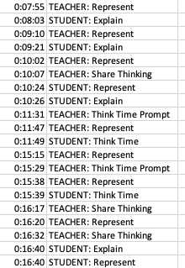
Two “coders” watch a video recorded lesson and identify the various student and teacher actions
Meet to come to agreement on finalized interpretation
Modelling Classrooms Study

Slide 70
Convert these logs into meaningful things:
Explore causality Shout out to ALEX WHITE and his team
Model the process (using data/process mining techniques)
Alex Models

Slide 71
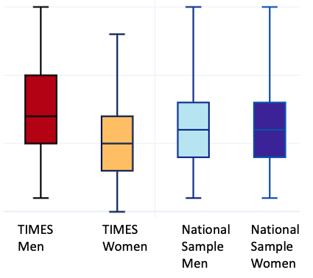
Need: Convert K-12 instrument to undergraduate level to better understand teacher and student activity in those classrooms. Requires: Instrumentation study. Don’t worry I won’t bore you through one of those again.
Modelling Classrooms Study

Slide 72
What student activities are valued in a proof-based classroom?
How can we describe these activities meaningfully?
Modelling Classrooms Study

Slide 73
Assumption: We want mathematics undergraduates to engage in activity reflective of the mathematician community.
Leverage the managerial literature on professional practice + literature on mathematician activity
objects that are transformed through mathematical practice (statements, concepts, and proof)
the why for these transformations (telos)
the corresponding how (actions).
Build from the literature then test with data from different projects:
Modelling Classrooms Study
Reasoning with Examples and Diagrams to Test and Construct Definitions
Data from K. Vroom and S. Larsen’s Inquiry-Oriented Analysis Tasks

Slide 74
Assumption: We want mathematics undergraduates to engage in activity reflective of the mathematician community.
Leverage the managerial literature on professional practice + literature on mathematician activity
objects that are transformed through mathematical practice (statements, concepts, and proof)
the why for these transformations (telos)
the corresponding how (actions).
Build from the literature then test with data from different projects:
Modelling Classrooms Study
Reasoning with Examples and Diagrams to Test and Construct Definitions
Data from K. Vroom and S. Larsen’s Inquiry-Oriented Analysis Tasks

Slide 75
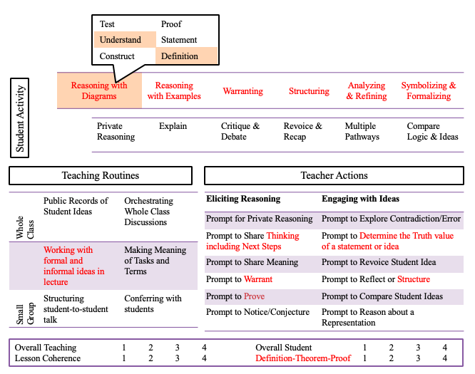
Converting to proof-based classrooms in order to study a large-scale data set about what is going on
Purpose
Object
How
Modelling Classrooms Study

Slide 76
TEACHER: COMPARE
STUDENT: Analyze to Understand Proof
TEACHER REVOICE
Modelling Classrooms Study
TEACHER: Analyze Strategy
STUDENT: Reason w Example to TEST PROOF
STUDENT: Reason w Diagram to TEST PROOF
Methods:
Process-Mining techniques to find the most common paths
AL Models to establish causality
STUDENT: Analyze to TEST PROOF

Slide 77
Instructional Design Study
State of the Field Study
Comparison Study
Group Theory Concept Assessment
Modelling Classrooms
Small-Scale Studies
Philosophy Analytic Writing Mathematics Psychology Anthropology Statistics Linguistics Data Science Cognitive Science Sociology
Some of my research projects

Slide 78
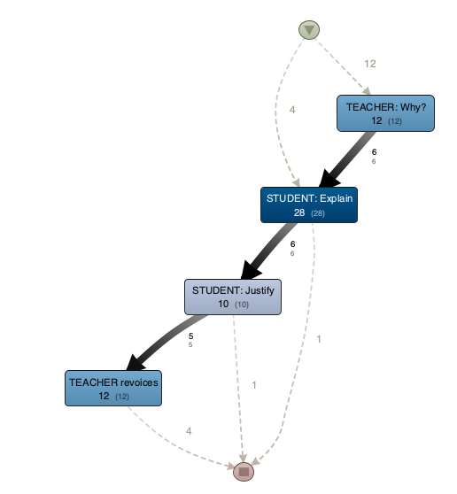
So what is mathematics education research?
The study of the teaching and learning of mathematics.
Task Design
Instrument Design
Making sense of student/mathematician activity
Comparisons
Modelling Data
Making sense of student thinking
Theory Development

Slide 79
Thank you!
For more info on these projects:
http://melhuish.wp.txstate.edu/

