Slide 1
Math “Magic” tricks using topology!!!
Notes:
Presented on June 14th for 3rd and 4th graders
Students will need: several sheets of paper, scissors, pencil/pen/marker, a piece of string/yarn (at least 12 inches long), clear tape.

Slide 2
Magic Rope and Pencil Trick By: Dr. Chase
Can you make a string magically unwrap itself?
How about after it's been twisted tightly around a pencil and strip of paper?
Can you break the strip of paper without breaking the pencil?
Notes:
Ask the kids to think about these questions and have Dr. Chase do the trick before going to the next slide.

Slide 3
How did he do it???
In this trick, Dr. Chase wrapped a string around a pencil and a strip of paper. The string seems to pass straight through both, tearing the cardboard, but leaving the pencil untouched!
Can anyone figure out how Dr. Chase was able to do this?

Slide 4
How is this applied in the real world?
Biology:
DNA Strand
Understanding knots helps us learn more about DNA strands because of their knotted-shape.
Mathematics:
Algebra!!!
The seemingly “magic” tricks behind knots can
be explained through basic algebra.
Example:
3x – 1 = 8
+ 1 + 1
3x = 9
*Divide both sides by 3*
x = 3

Slide 5
A “Magical” Knot Trick!!!
Can you tie a knot in the center of a string without letting go of either end?
Go ahead, give it a try!

Slide 6
But Noe how is this related to math?!

Slide 7
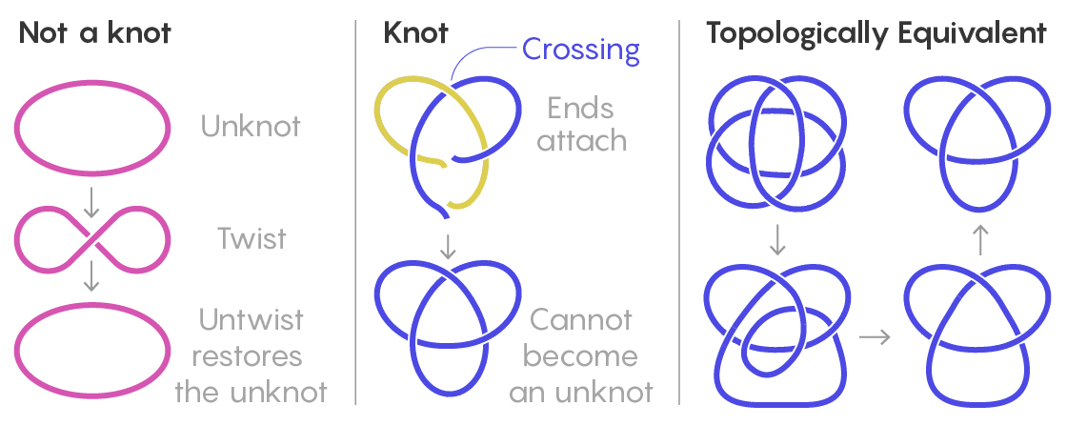
Knot Theory
Study of Mathematical Knots that are inspired by common knot we already see in our day-to-day life.
You can’t transform one to another without breaking the circle.
How the knot trick is done:
Basically, what we do before it happens is we manipulate the circle before we grab each end of the string by crossing our arms first.
Notes:
You can’t create something out of nowhere.
For our trick I didn’t create a knot out of thin air. I manipulated or shaped the environment it was in .

Slide 8
The Paper Portal
What is the biggest circle you can make with one piece of paper?
Cut the biggest hole you can in a piece of paper.
Can you cut a hole big enough to fit through?
Notes:
*** don’t break the rule of what a hole is though
Why does this work?

Slide 9
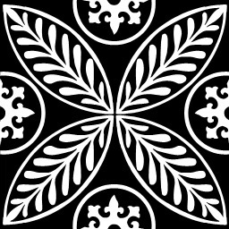
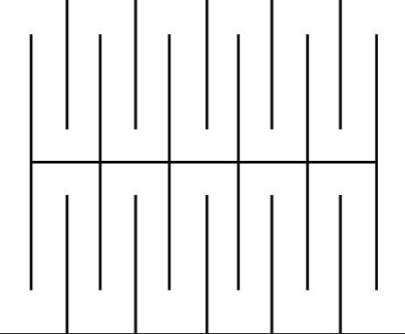
My Turn
What you will need is a piece of paper, scissors, pen or pencil

Slide 10
How is this possible?
The big question for this trick is
What is a hole?
For most people, a hole is just an empty space.
BUT for mathematician, the holes are defined more by the boundary or the edge of the hole than the empty space.
What this means is if you make thinner cuts the bigger you can make the hole.

Slide 11
Bonus Trick: Switching Sides
Grab your piece of paper and cut where the black lines are located.
You will now have a flap. Grab a friend or someone to hold the flap and you will roll the hanging piece and flip it upside down.
YouTube link for a visual how to:
https://www.youtube.com/watch?v=CN8hK3YFqhM

Slide 12
Extra Links to Learn More
Cool Number Tricks
https://sciencenotes.org/cool-math-tricks-amaze-friends/
Cool Paper Trick
https://allfortheboys.com/easy-paper-illusion/

