Slide 1
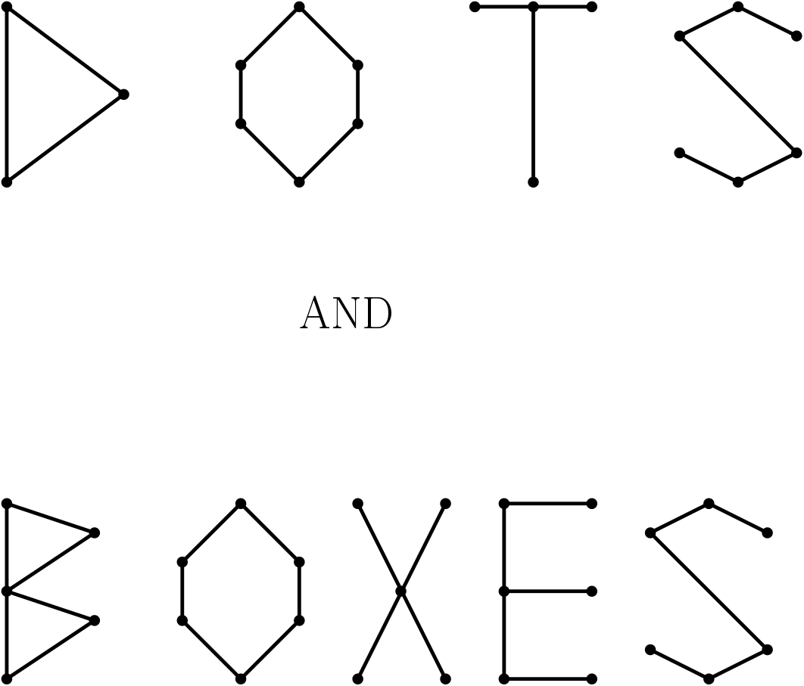

Slide 2
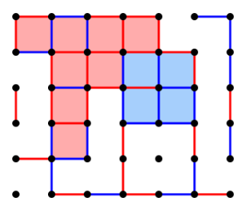
The Game:
Simple game for two players
Players take turns connecting adjacent dots with horizontal or vertical lines
Drawing the fourth side of a box wins a point, and player must take another turn
Lines are drawn until all squares are claimed
Whoever has most points at the end wins.

Slide 3
Let’s Play!
http://dotsandboxes.org/
https://www.math.ucla.edu/~tom/Games/dots&boxes.html
https://www.mathplayground.com/logic_dots_and_boxes.html

Slide 4
The Math:
Combinatorial game theory – studies games in which the difficulty of finding an optimal strategy stems from the number of possible moves
Types / Ways to classify games
Cooperative
Non-cooperative
Symmetric
Asymmetric
Zero Sum
Non-zero Sum
Simultaneous
Sequential
Perfect Information
Imperfect Information
Many, many more…
Partial
Impartial

Slide 5
Goals of Combinatorial Game Theory:
Strategy - is any of the options which a player can choose in a setting where the outcome depends not only on their own actions but on the actions of others
A player's strategy will determine the action which the player will take at any stage of the game.
A game is solved if the outcome (win, lose, or tie) can be predicted from any position, assuming both players always make the best play possible
While some variations of Dots and Boxes have been solved, this simple game still has quite a lot of complexity that keeps it from being completely solved.

Slide 6
Math of Dots and Boxes:
Only one center box

Slide 7
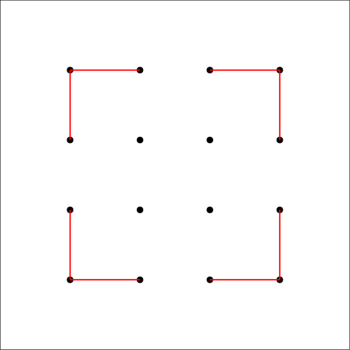
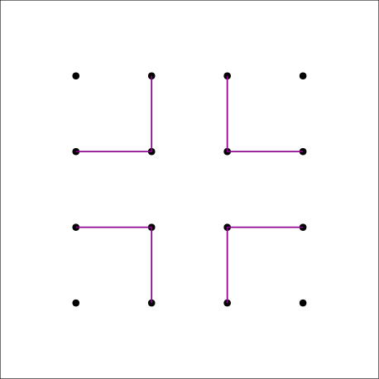
Math of Dots and Boxes: Moves
Corner Moves
Center Moves
Edge Moves
Spokes

Slide 8
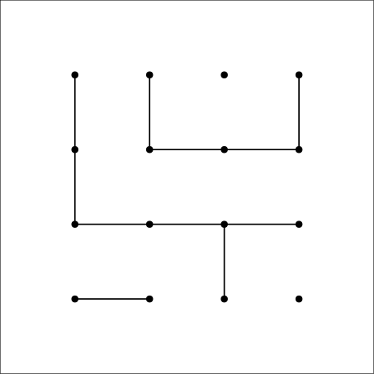
Math of Dots and Boxes: Strategy
Terminal Position – any new line will force creation of completed boxes (for opponent)
Chains are the most important strategy for scoring boxes:
Long chains = 3 or more boxes
Short chains = 1 or 2 boxes
Long Chains = most important
Short Chains = don’t really affect outcome

Slide 9
Math of Dots and Boxes: Long Chains
Long chains score significant numbers of points
Long chains allow the player making them to “turn around” play
Player 1 wants even number of long chains
Player 2 wants an odd number of long chains

Slide 10
Math of Dots and Boxes: Player 2’s Strategy
Spoke moves can cut long chains, or make sure they don’t get made
Player 2 therefore can control the creation of
long chains by using spoke moves
Player 2 should always win!

Slide 11
Let’s Play!
http://dotsandboxes.org/
https://www.math.ucla.edu/~tom/Games/dots&boxes.html
https://www.mathplayground.com/logic_dots_and_boxes.html

Slide 12
More Resources…
Numberphile Youtube channel:
a great video that shows quite clearly how the strategy portrayed in this presentation works
Some Strategy For Dots and Boxes:
a site that talks about the basic ideas in a more mathematical way. Kind of “deep” but interesting
The Strategy of Dots and Boxes
This site goes into great depth on the strategy for each player in Dots and Boxes. LOTS of stuff here.

