Slide 1
Terrific Tangrams

Slide 2
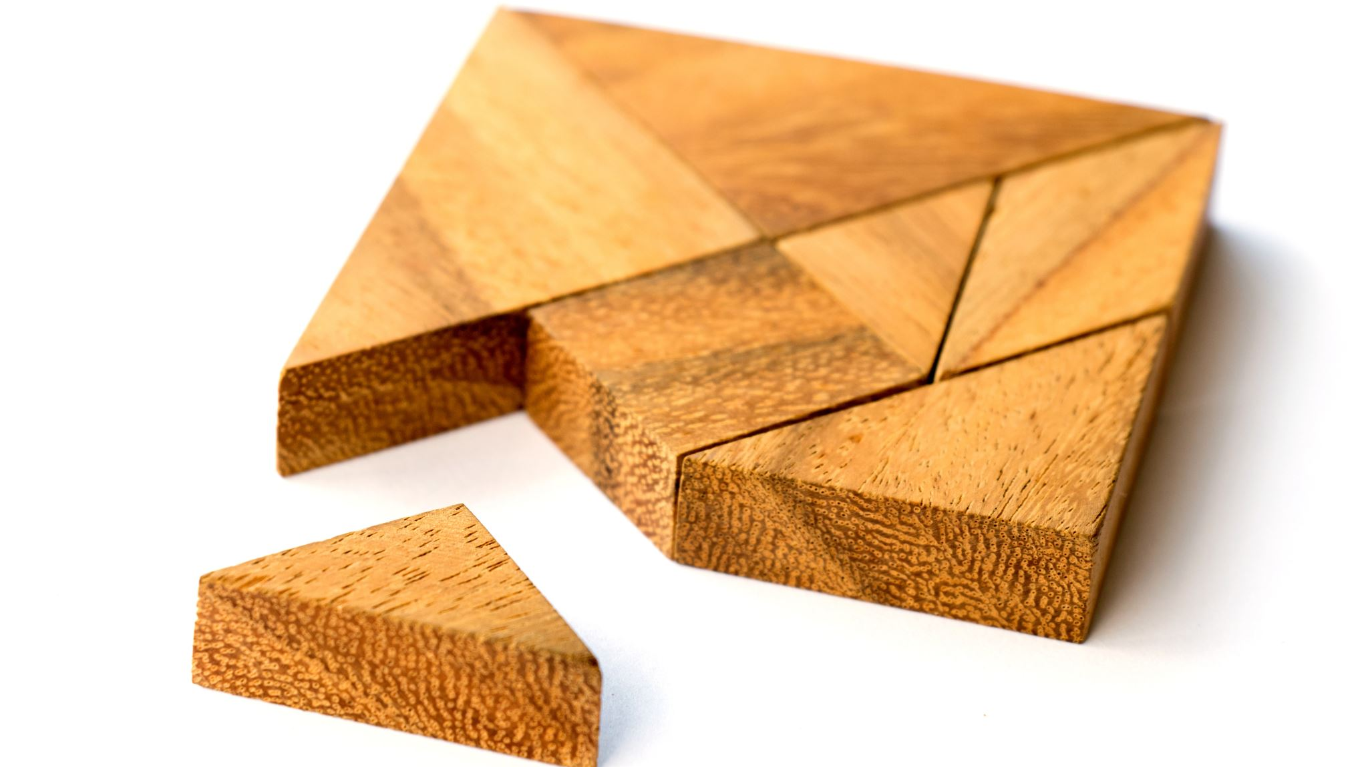
Dissection puzzle or Transformation puzzle
Puzzle that uses tiles and the set of pieces can be assembled in different ways to produce two or more distinct geometric shapes
What is a Tangram?
The objective of the puzzle is to make a copy of a given a pattern – usually only shown in outline – using all pieces without overlap.
Over 6500 different tangram problems have been created from 19th century texts alone, and the current number is ever-growing.
It was proved in 1942 that there are only thirteen convex tangram configurations

Slide 3
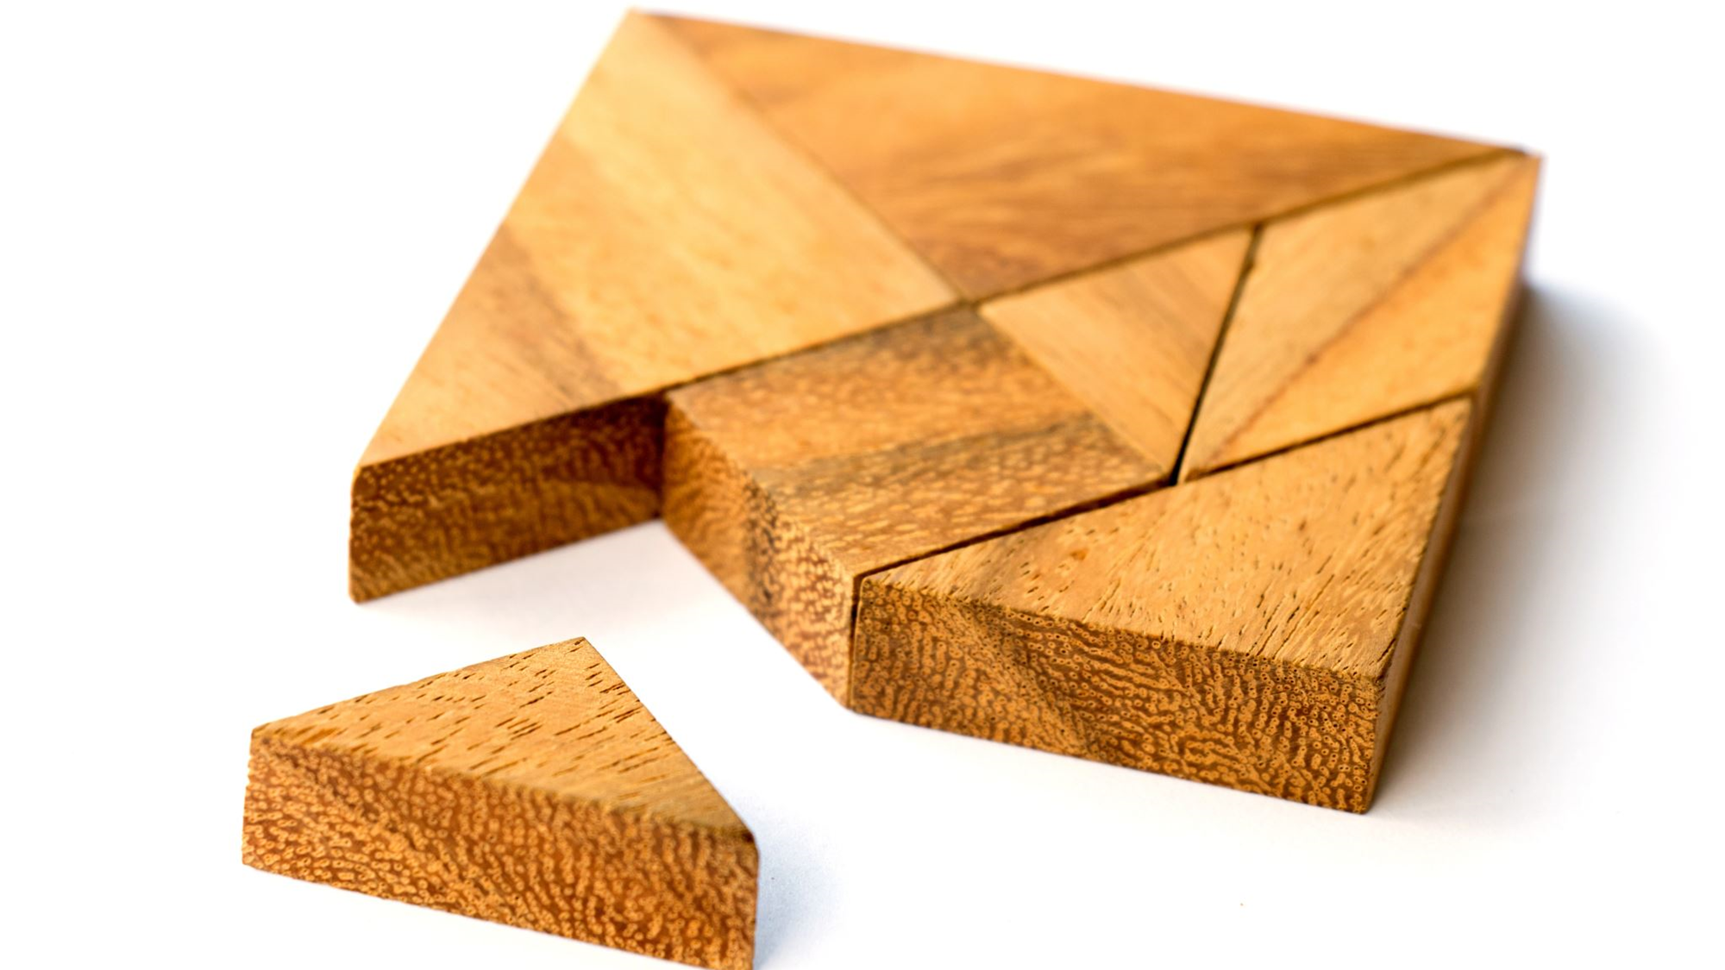
A Bit of History…
Origin of name “tangram” is not known
Attributed as an “ancient Chinese puzzle”
Earliest written sources are from 1815, it is believed to have been “created” around that time
May have evolved from older dissection amusements from China, specifically modular banquet tables from the Song Dynasty
A prominent third-century mathematician Liu Hui made use of construction proofs in his works that resemble the tangram

Slide 4
The pieces…
2 large right triangles
1 medium right triangle
2 small right triangles
1 square
1 parallelogram

Slide 5
Goal:
Given the silhouette of a shape, use all seven tiles or tans, to make that shape, without overlap.

Slide 6
Let’s Play!
https://mathigon.org/tangram
https://www.abcya.com/games/tangrams

Slide 7
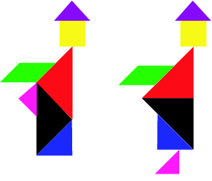
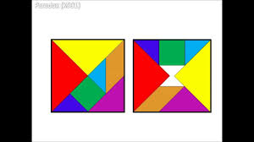
The Tangram “Paradoxes”

Slide 8
More Tangram Fun!!!
https://www.tangram-channel.com/
https://www.education.com/slideshow/tangrams/
https://www.fun-stuff-to-do.com/tangrams.html

