Slide 1
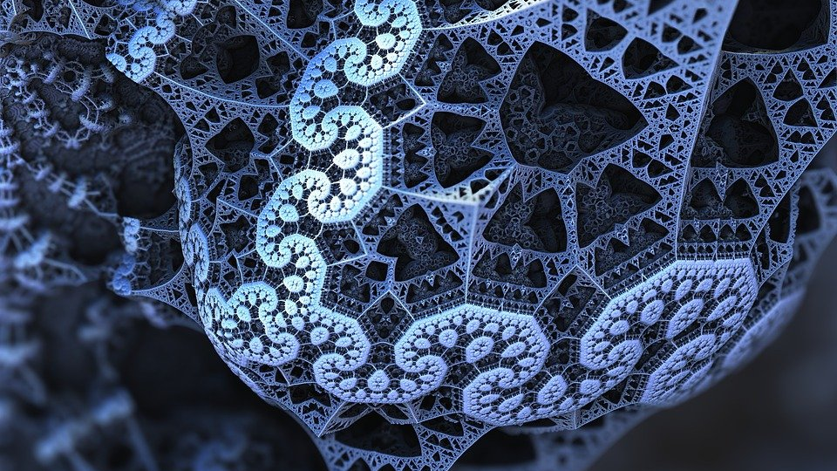
Fractals
Learn how to create amazing complex designs with simple mathematics

Slide 2
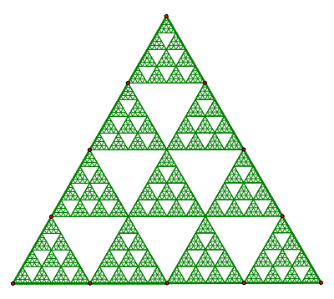
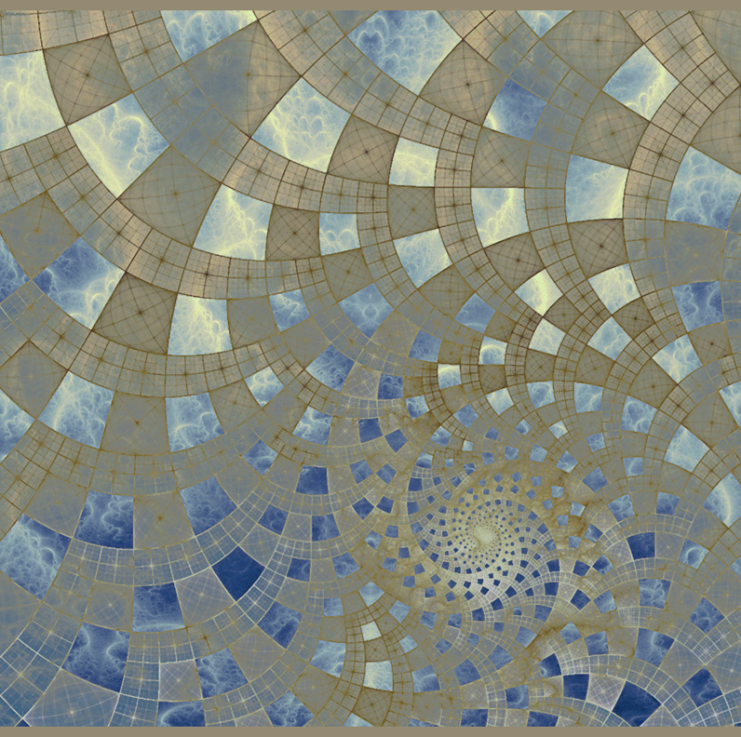
FRACTALS ARE EVERYWHERE!!
Nature
Mathematics
Art
Notes:
Fractals are our familiar dimensions. We see them around us everyday.
Visual learner? Fractals can be a great way to introduce yourself to high level mathematics before you even know how to do it. Understanding the visual aspects of mathematics makes the numerical part easier to understand. You can be creating graduate level mathematical representations and not even know it!
The great value of fractals for education is that they make abstract math visual. When people see the intricate and beautiful patterns produced by equations, they lose their fear and instead become curious.

Slide 3
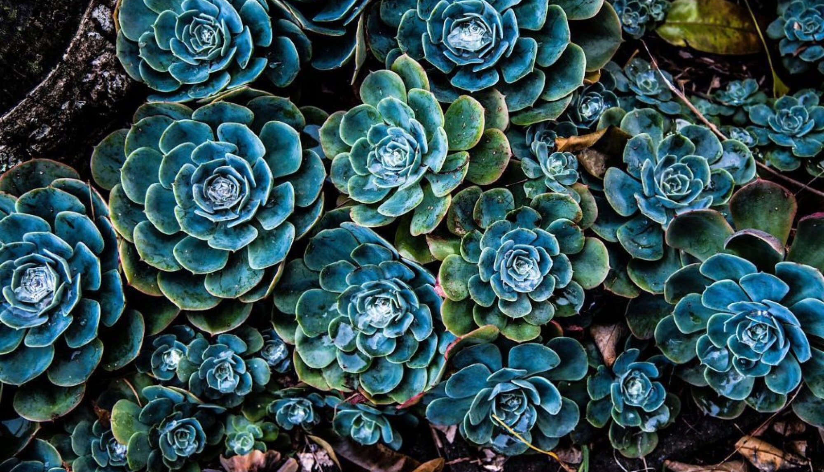
Fractals in Nature: our familiar dimensions
The image above shows a type of fractal occurring naturally in world.
Do you notice any reoccurring patterns?
Can you think of any other examples of fractals in nature?
Notes:
Who knows what self similarity means?
Self similarity: is the property of an object which looks the same whatever the scale.

Slide 4
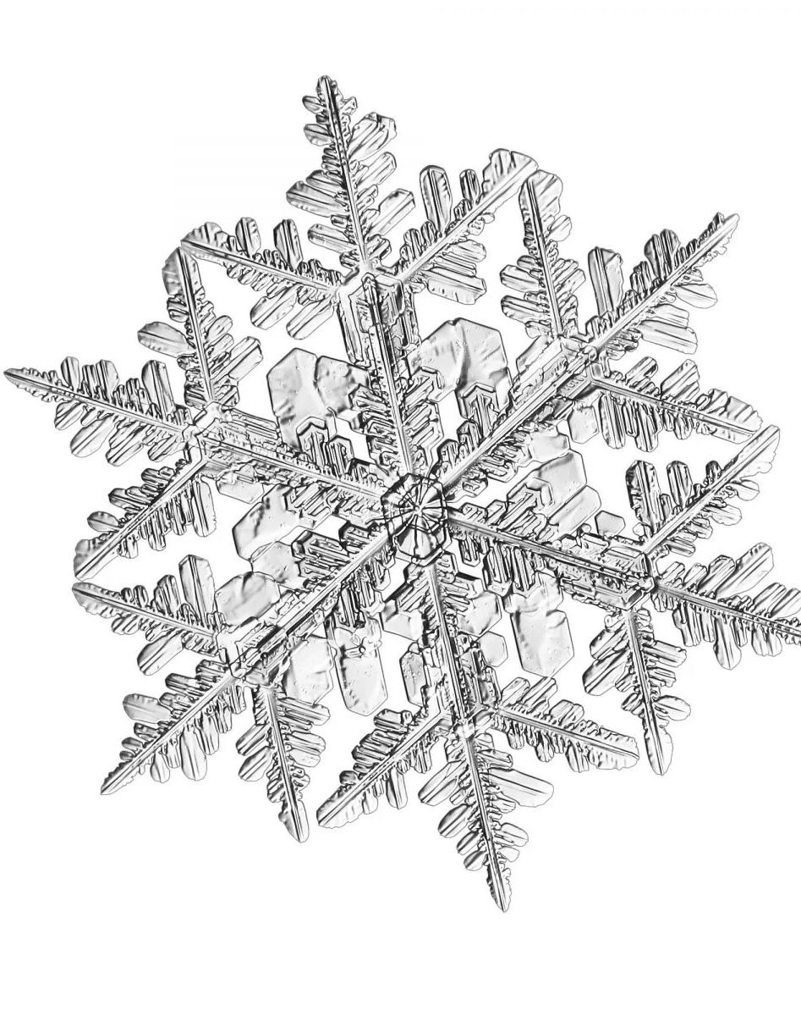
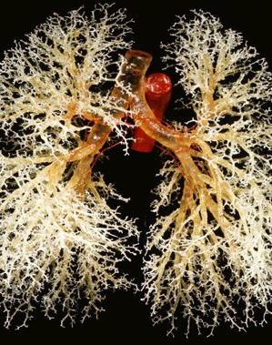
Fractals in nature Examples
How fractals can help us understand the universe
Video link
Notes:
More examples: seashells, galaxy and star formation, water droplets, leaves, rivers, electricity, crystal formation, and more.
After understanding the beauty of fractals you will always try to find fractal structures in your environment. And you will find them. Fractals are more than just a mathematical theory to describe certain things. Fractals are the answer to so many different questions.

Slide 5
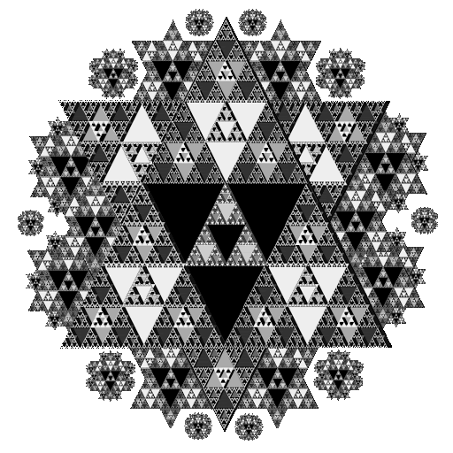
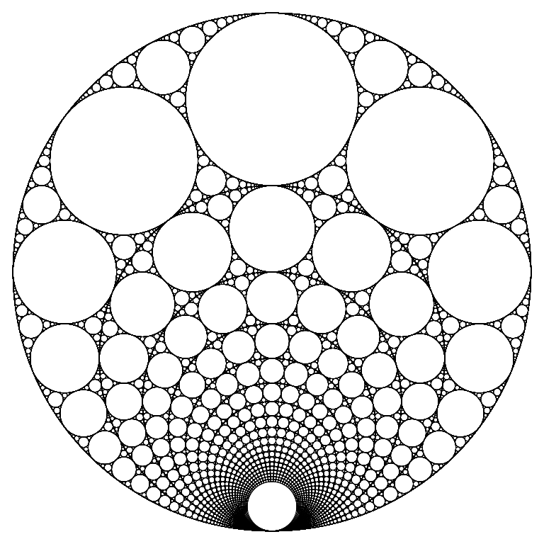
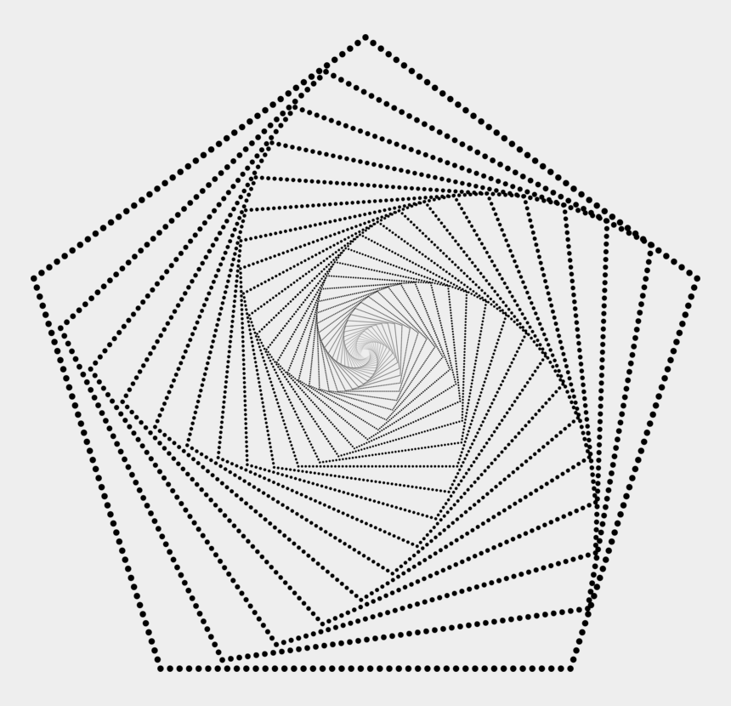
Geometric Fractals
Notes:
Fractals in nature can be geometric is their structure as well. However, now we are going to focus on fractals designed by people using geometry.
Today we are going to be creating our own artwork using geometry and the concepts we learn about fractals.

Slide 6
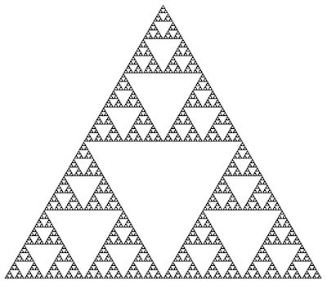
A famous Geometric Fractal: Sierpinski’s Triangle
A great example of a geometric fractal is the famous Sierpinski’s triangle.
Why do you think this became one of the most famous fractal designs?
In terms of mathematics, can you explain the pattern Sierpinski used?
Notes:
First introduced by Waclaw Sierpinski in 1915, this beautifully complex shape can be formed by simple repetition.
If there is time, ask:
Fractals are infinite, can anyone explain what I mean by this?
Discuss the number of triangles present in each iteration see if any of your students can recognize the pattern.
Have the students discuss what they believe will happen to the area of Sierpinki's Triangle as the number of iterations go beyond the computers computational capability. Will the area of the triangle ever reach zero?

Slide 7
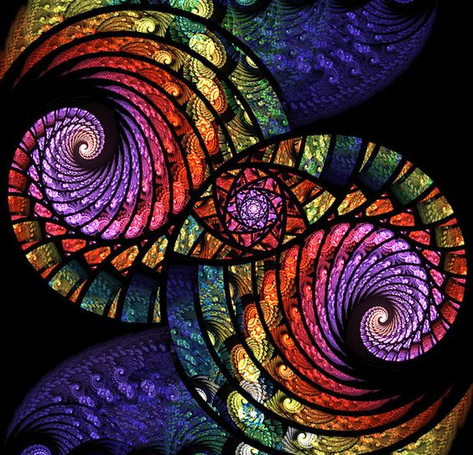
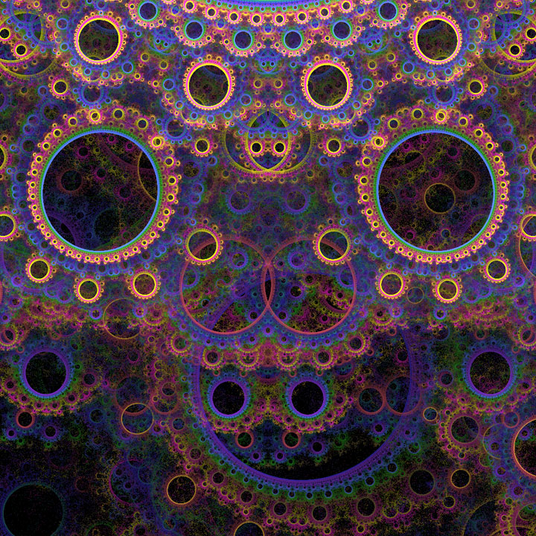
Computer-generated fractal art
Notes:
A type of algorithmic or computer-generated art, fractal art was developed in the 1980s. This art form is based on the calculations of fractal objects that are represented as images. fractal art is created with the use of computer software; it is not art that is rendered by hand.
Computer-generated fractals can make elaborate 3-dimensional fractals and beautiful digital artworks using the process of recursion.
Fractals are graphical representations of equations and, like numbers themselves, the possibilities for unique fractal images are infinite.
By modifying their formulae, artists can create unique art.
The most famous work of fractal art is typically regarded as the Mandelbrot Set Fractal, which took nine hours to execute.

Slide 8
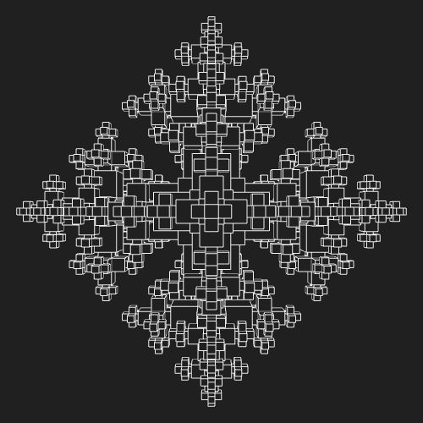
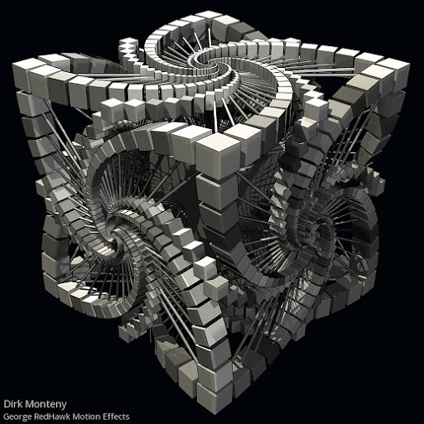
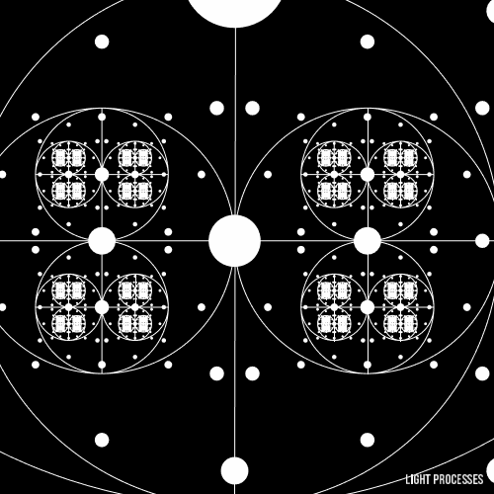
Animated Geometric Fractals!
Notes:
Looks crazy right? Believe it or not these gifs were created using a simple algorithm or computer program. If you know computer science, you may even have a basic idea of how to do this!

Slide 9
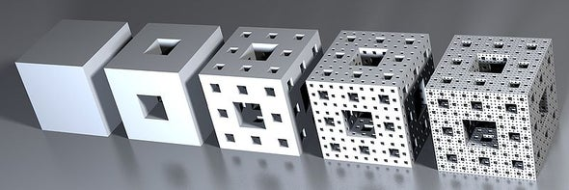
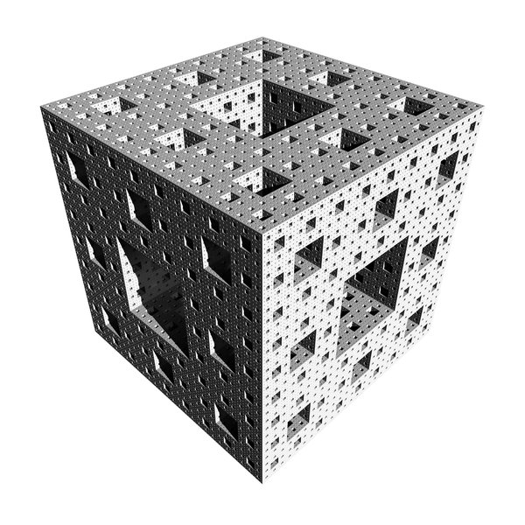
So basically…
A fractal is a drawing or shape made by a simple pattern that is repeated forever at different scales.
Geometrical fractals are formed by calculating a simple equation thousands of times and are infinitely complex, meaning we can zoom in forever.
The image to the left is known as the Menger Sponge and you can create it yourself in Minecraft!!!
Notes:
Textbook Definition of Fractals:
A curve or geometric figure, with each part having the same statistical character as the whole. Fractals have self-similarity or symmetry with respect to scale, meaning they stay symmetrical, but their size can change.
Recursion definition: defining a problem in terms of a simpler version of itself. It is a powerful tool in writing algorithms and comes straight from mathematics (writing expressions in terms of themselves).
Fractals are a good tool in mathematics because they make the behavior of an equation visible. This will make them seem less intimidating and instead becomes intriguing.

Slide 10
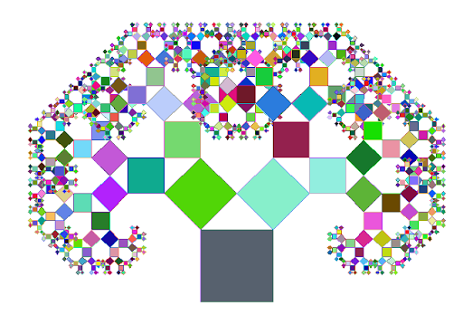
Ready to make your own fractal design?
Today you will be using the following website to create your very own fractal designs: https://www.visnos.com/demos/fractal

Slide 11
How to draw the Sierpinski triangle:
Start by drawing one big equilateral triangle.
Remove an upside-down triangle from the middle by finding the midpoint of each side (put a small dot to mark it) and connecting the dots.
You should now have three triangles in the corners and one “removed” from the middle.
For each of the three corner triangles, repeat step two in each corner.
Continue this infinite process and you will have made your own Sierpinski’s triangle!
Step 1
Step 2
Step 3
Notes:
If you were to have used a piece of paper in the shape of a triangle and cut along the midpoint, creating a triangular hole in the middle. Hypothetically, or if you just have a lot of time on your hands, you could continue to cut away triangles and eventually will run out of paper. This means the area of your original triangle is now zero. In calculus, we would say that the area of the triangle approaches zero as the number of triangles you cut out gets infinitely bigger.
*** notice how the number of colored triangles increases by a factor of three each time***

Slide 12
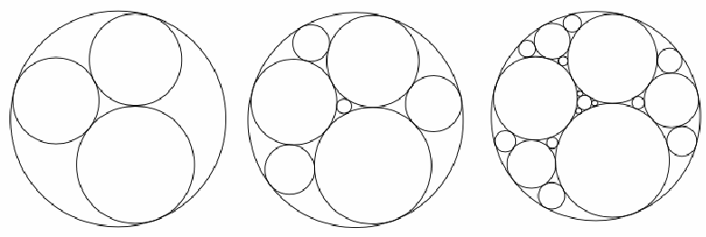
The Apollonian Gasket
Step 1: Start by drawing a circle.
Step 2: Inside your circle, draw 2 or 3 inner circles of any size.
***The edges of your inner circles must be touching each other and the outer circle with no overlap***
Step 3: Continue to draw circles that fit snugly into the space between those you have already drawn.
Step 4: Keep drawing smaller circles in the empty spaces forever, or at least until they become too small to see.
Notes:
Also known as the Apollonian Gasket, this geometric fractal allows any mathematician to become an artist. If you can draw a circle, then you can easily make an Apollonian Gasket!
It’s named after Apollonius of Perga, an ancient Greek geometer who lived during the 3rd century BC and wrote some of the first known books to systematically study ellipses, hyperbolas and parabolas (all of which are curves that we have used in mathematics ever since).
European scholars of the Renaissance later studied the work of Apollonius and his predecessors (since much of Apollonius’ books were lost). Rene Descartes (The same man who the Cartesian (x-y) plane is named after) correctly stated a formula to solve some of the unanswered questions of Apollonius’ gasket. The formula is usually simplified by writing it in terms of the curvatures or the bends of the circles. Descartes’s formula greatly simplifies the task of finding the size of the fourth circle, assuming the sizes of the first three are known.

Slide 13
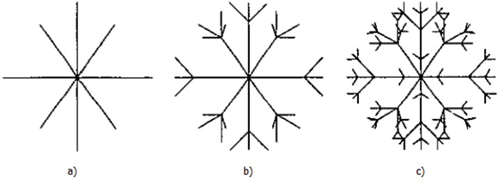
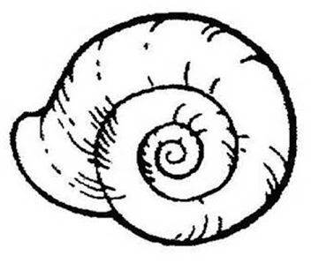
Simple examples of drawing fractals in nature
Notes:
May get rid of this slide

Slide 14
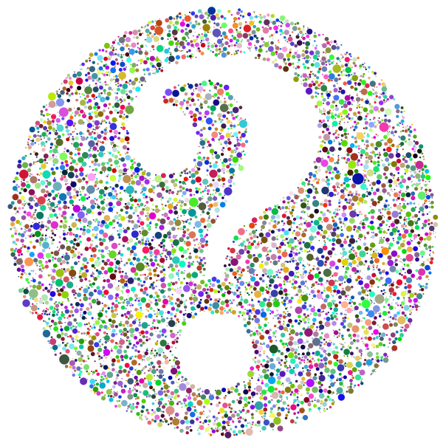
Thinking and contemplating
Is it possible for a 2D shape to have an infinite perimeter and a finite area? Why or why not?
Can you think of a shape that justifies your answer? *Hint: check out the BBC video link and Coastline Paradox Video on last slide.
Notes:
Yes! The perimeter can be infinite with fractals – their perimeter is always increasing as you go through the infinite number of stages constructing the figure. A good example of this in the real world is finding the perimeter of a country’s coastline. You can zoom in on a coastline until you get to the atomic level or infinitely. However, the country will always have a finite area which can be found using a formula (geometric series).

Slide 15
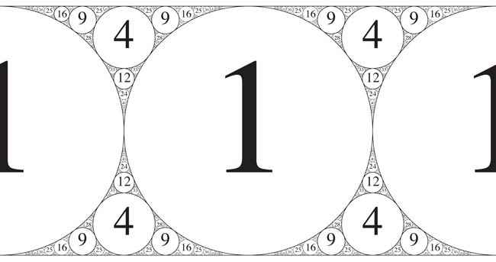
Do you see any patterns in these numbers?
Notes:
The answer is that all the numbers 1, 4, 9, 16, and 25 are perfect squares. This gives a visual to the idea that these are not just random circles and there is actually a mathematical equation behind the apollonian gasket. As you may notice, the pattern is not the same in every direction (the 12 seems out of place) but there is still a relationship between these numbers.

Slide 16
Want to learn more about fractals?
BBC Ideas Video: How fractals can help you understand the universe link
Tour of the Menger Sponge in Minecraft link
Step to make your own Menger Sponge in Minecraft link
The Mandelbrot Set & Fractal Explorer link
List of “Fractivities” by the Fractal Foundation link
Fractivities are hands-on projects that teach fractal concepts in a fun, artistic way.

