Slide 1
Hydrogen Fuel Cell Vehicle
Undergraduate Research Project

Slide 2
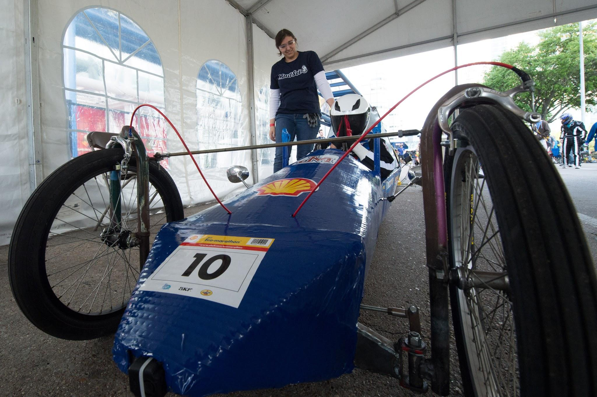
Purpose
Design and build a Hydrogen Fuel Cell car for the Shell Eco Marathon
Promote STEM to our students on campus
Promote renewable energy in a fun & unique way

Slide 3
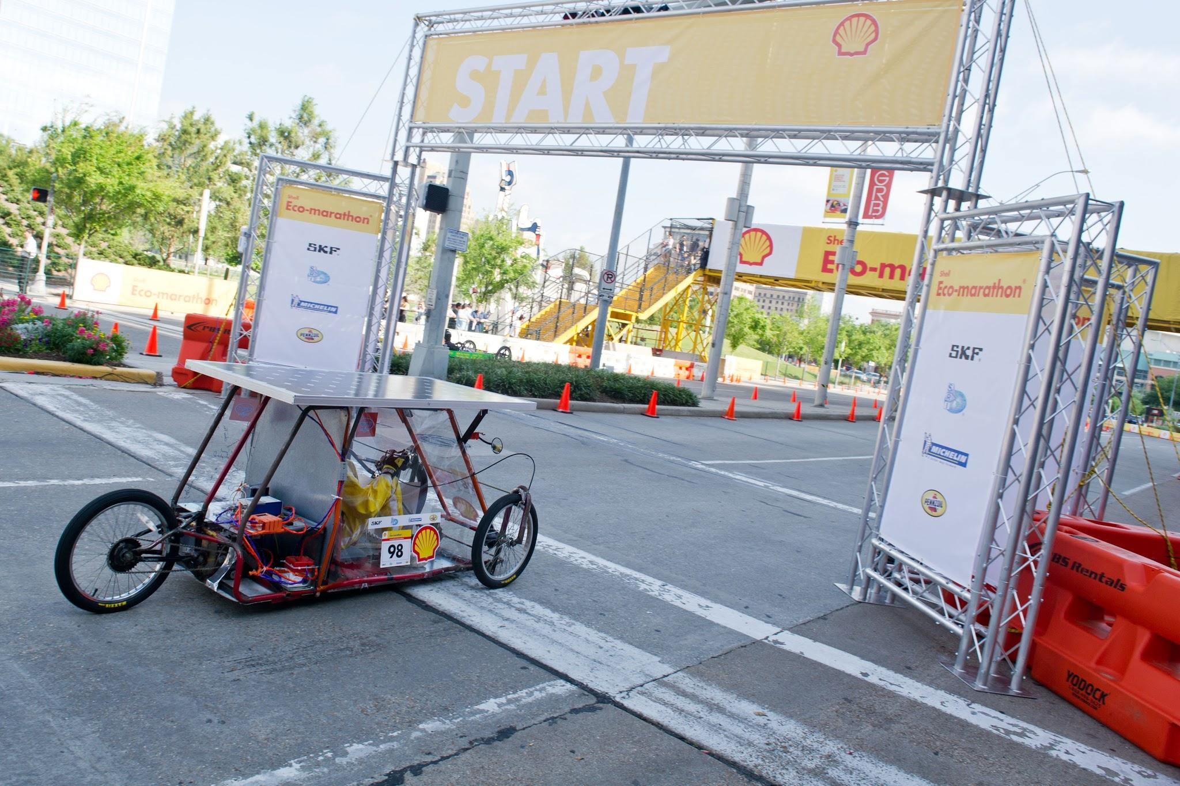
What is the Shell Eco Marathon?
A global event in Asia, Europe, Africa, and the Americas
Design and build highly fuel efficient vehicles
Fosters innovation and encourages conservation for greater energy efficiency

Slide 4
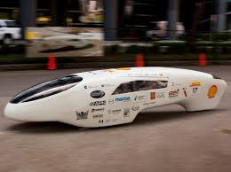
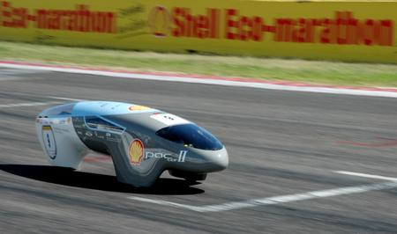
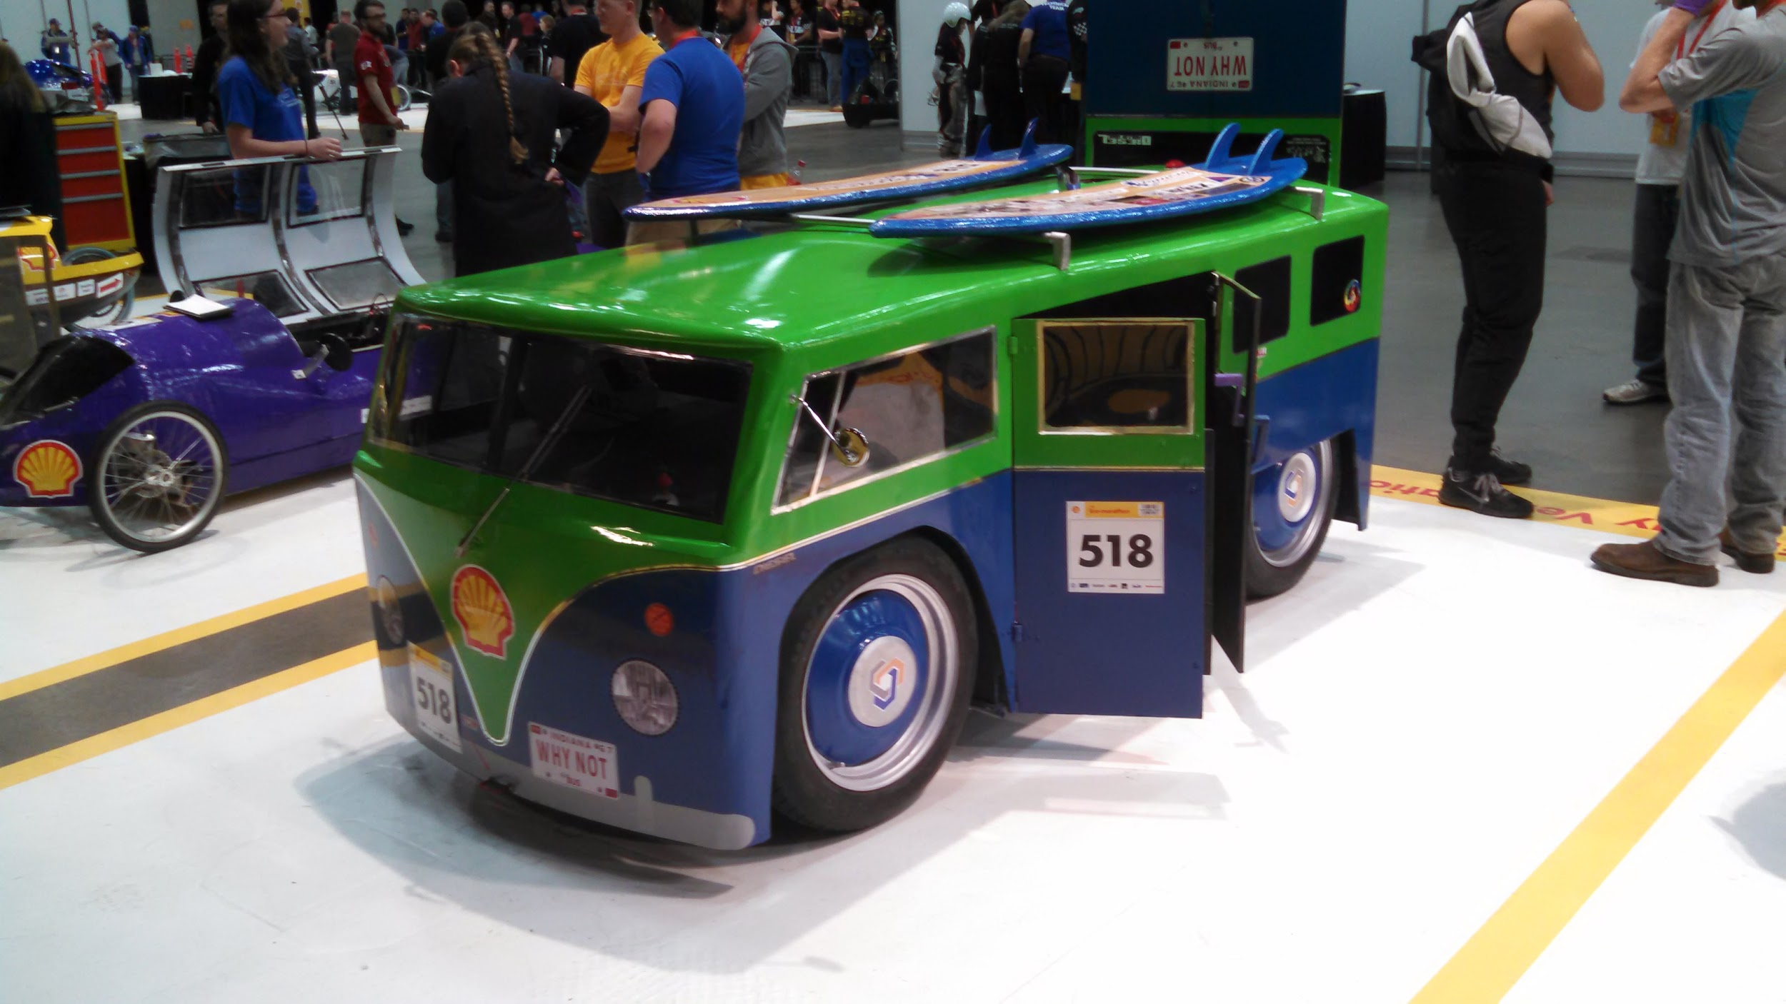
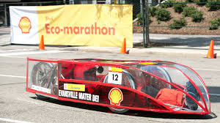
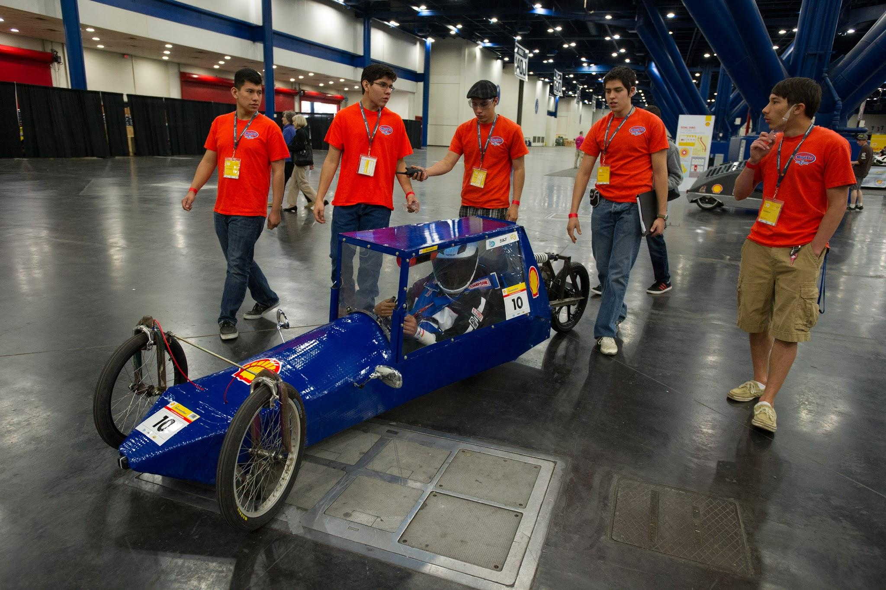
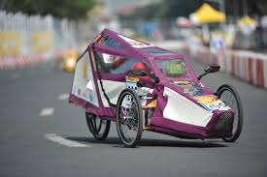
Competition Details
Gasoline
Hydrogen Fuel Cell
Natural Gas
Diesel
Battery Electric
Ethanol

Slide 5
Sponsors

Slide 6
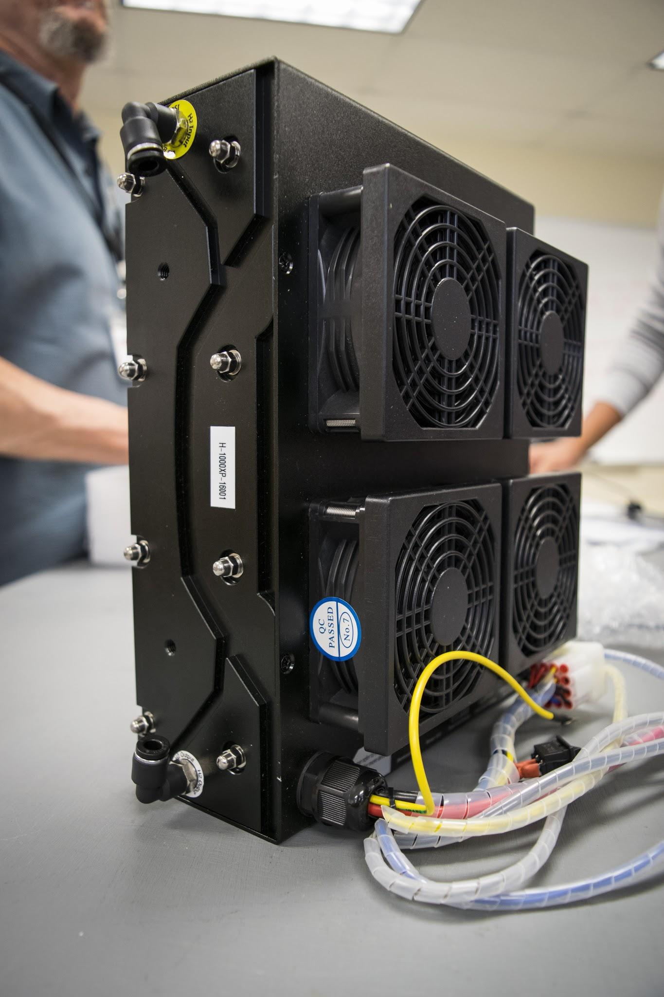
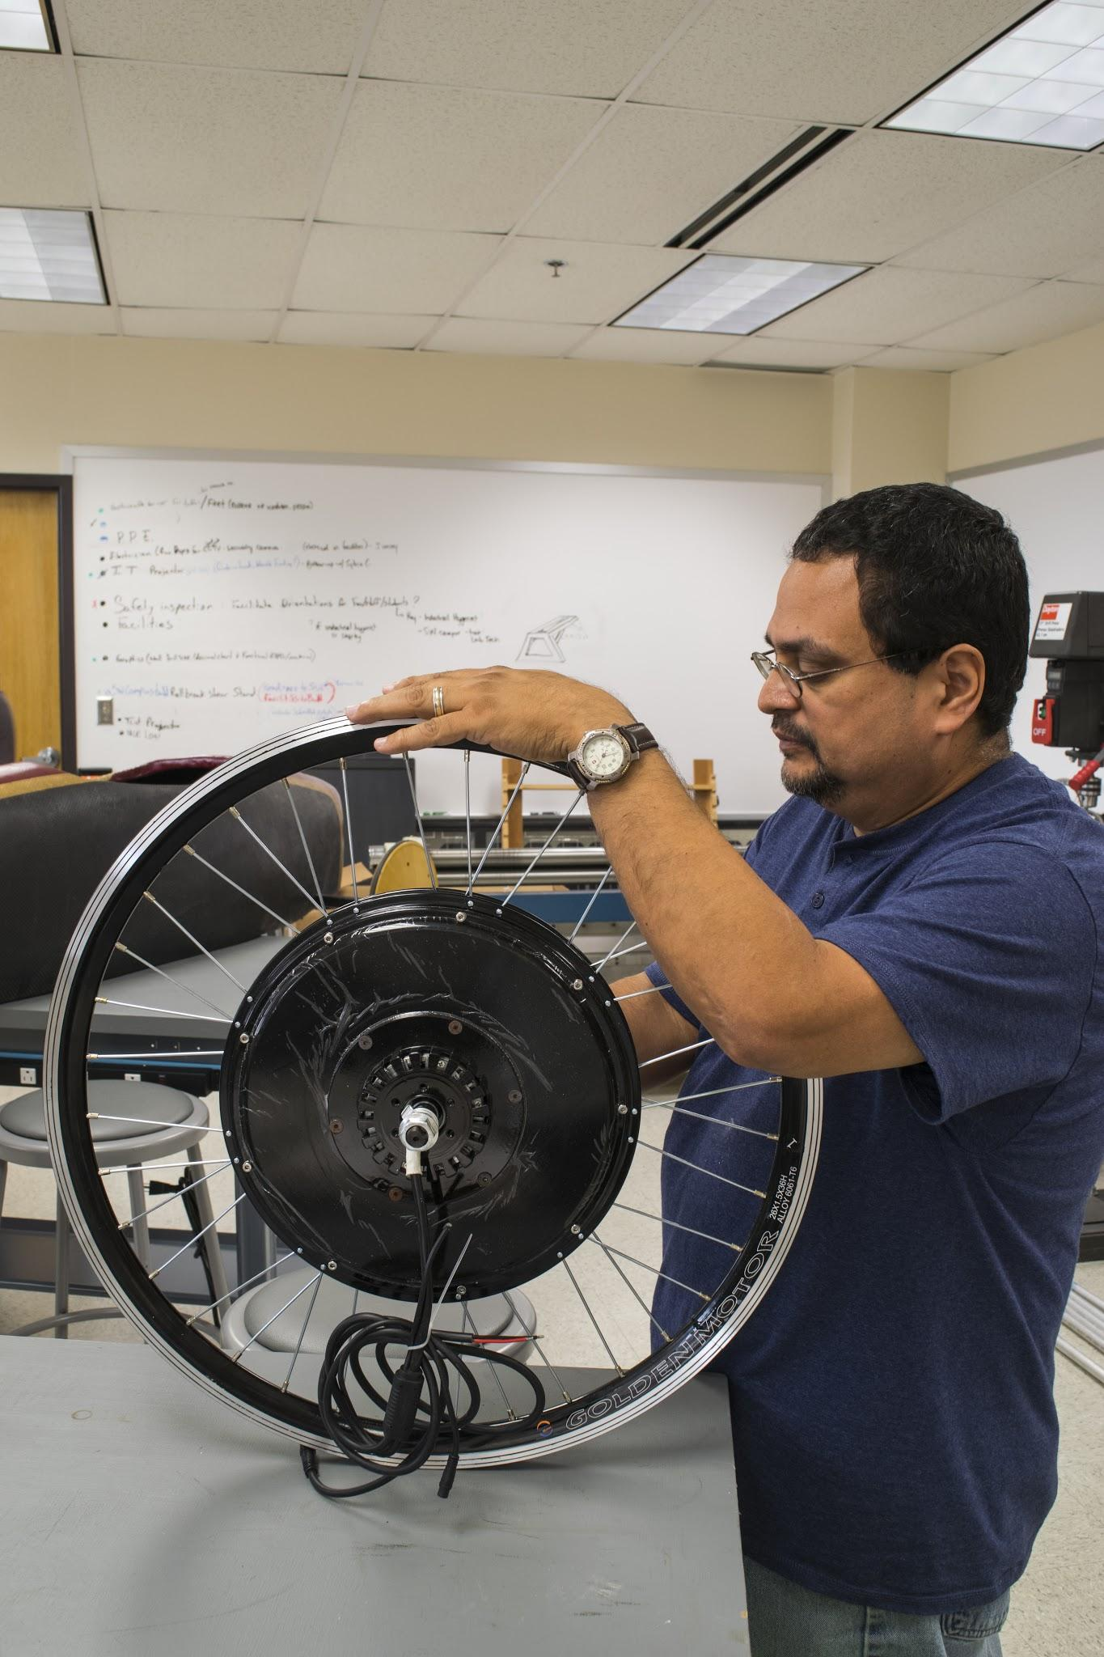
Electrical
Emergency Shut-off Valve
Flow Meter
Fuel Cell (1000W)
30V @ 33.5A
Solenoid Valve
Pressure Regulator
Motor
Fuel Cell Controller
Motor Controller
Hydrogen Cylinder
Vehicle Cutoff Mechanism

Slide 7
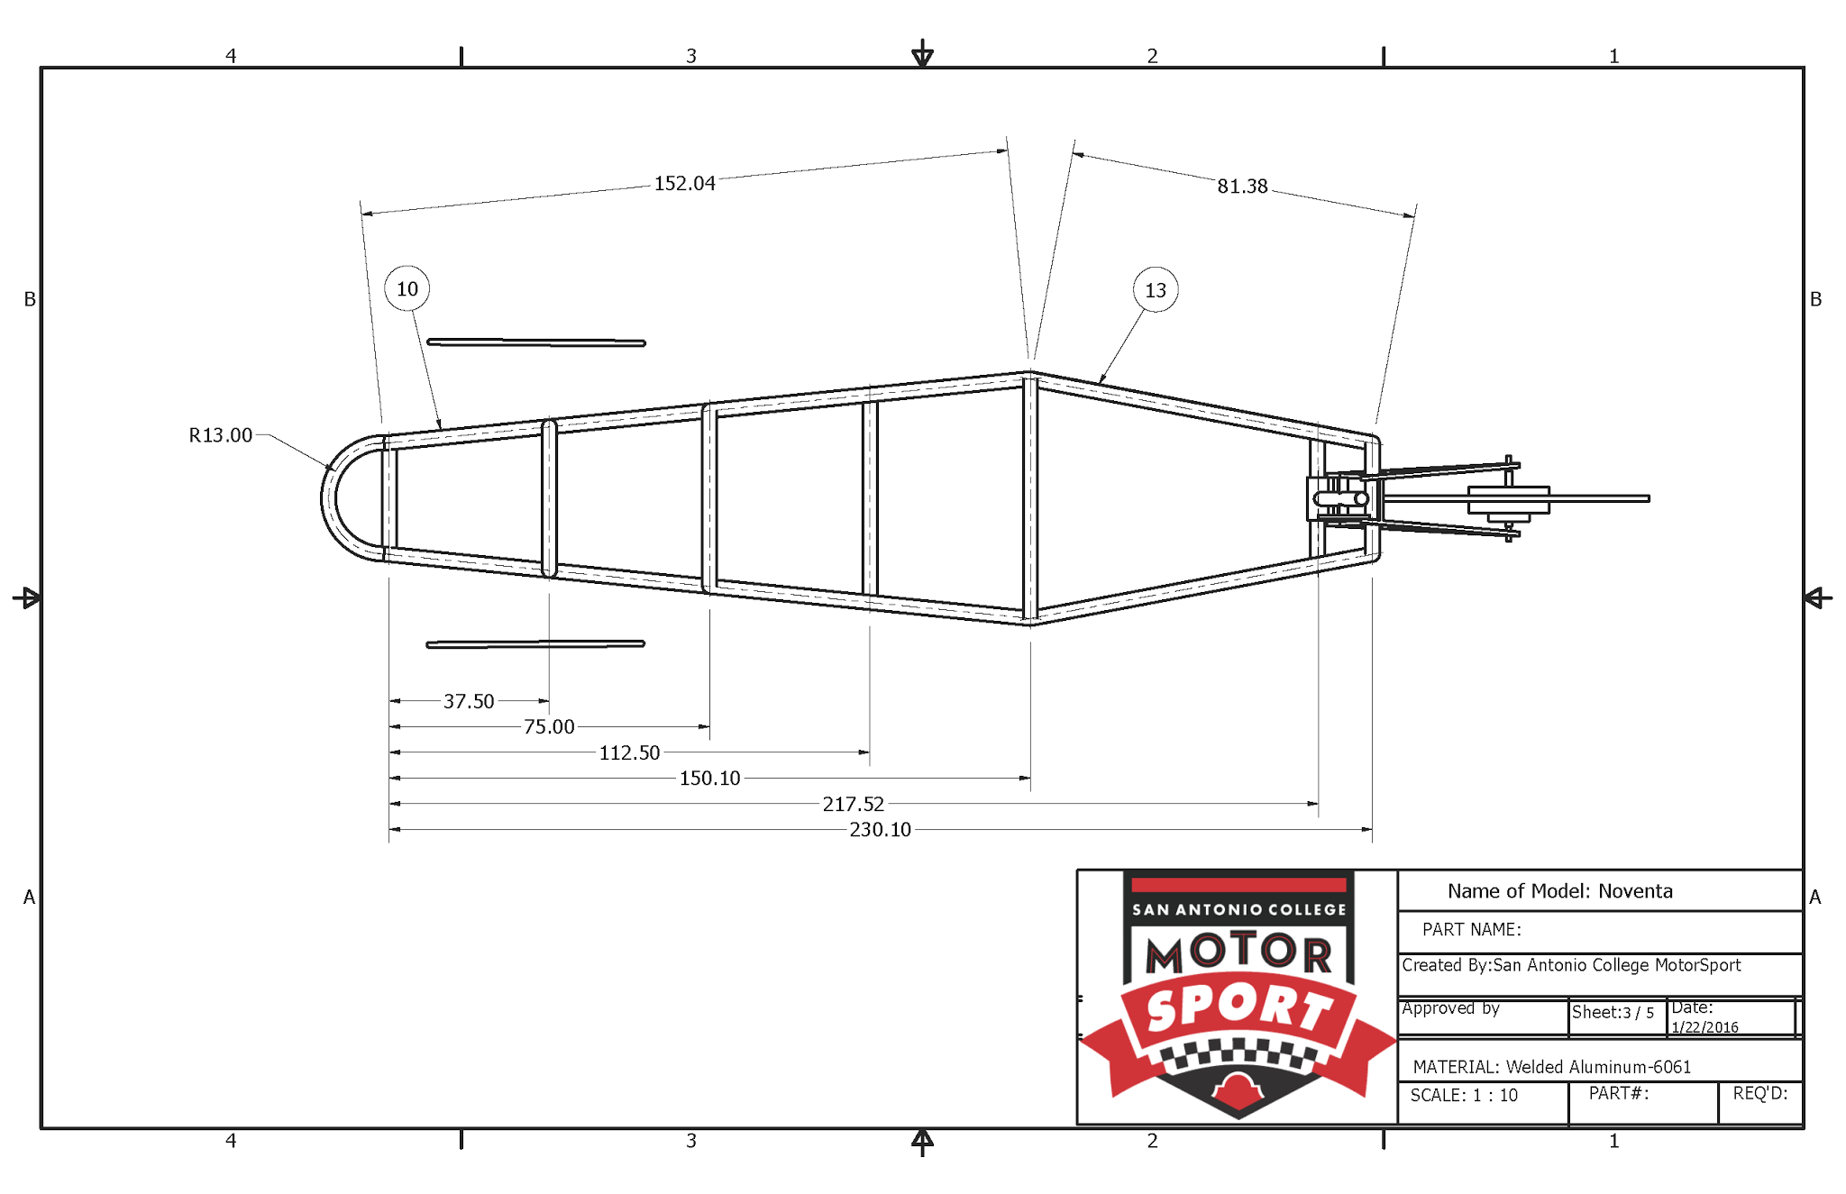
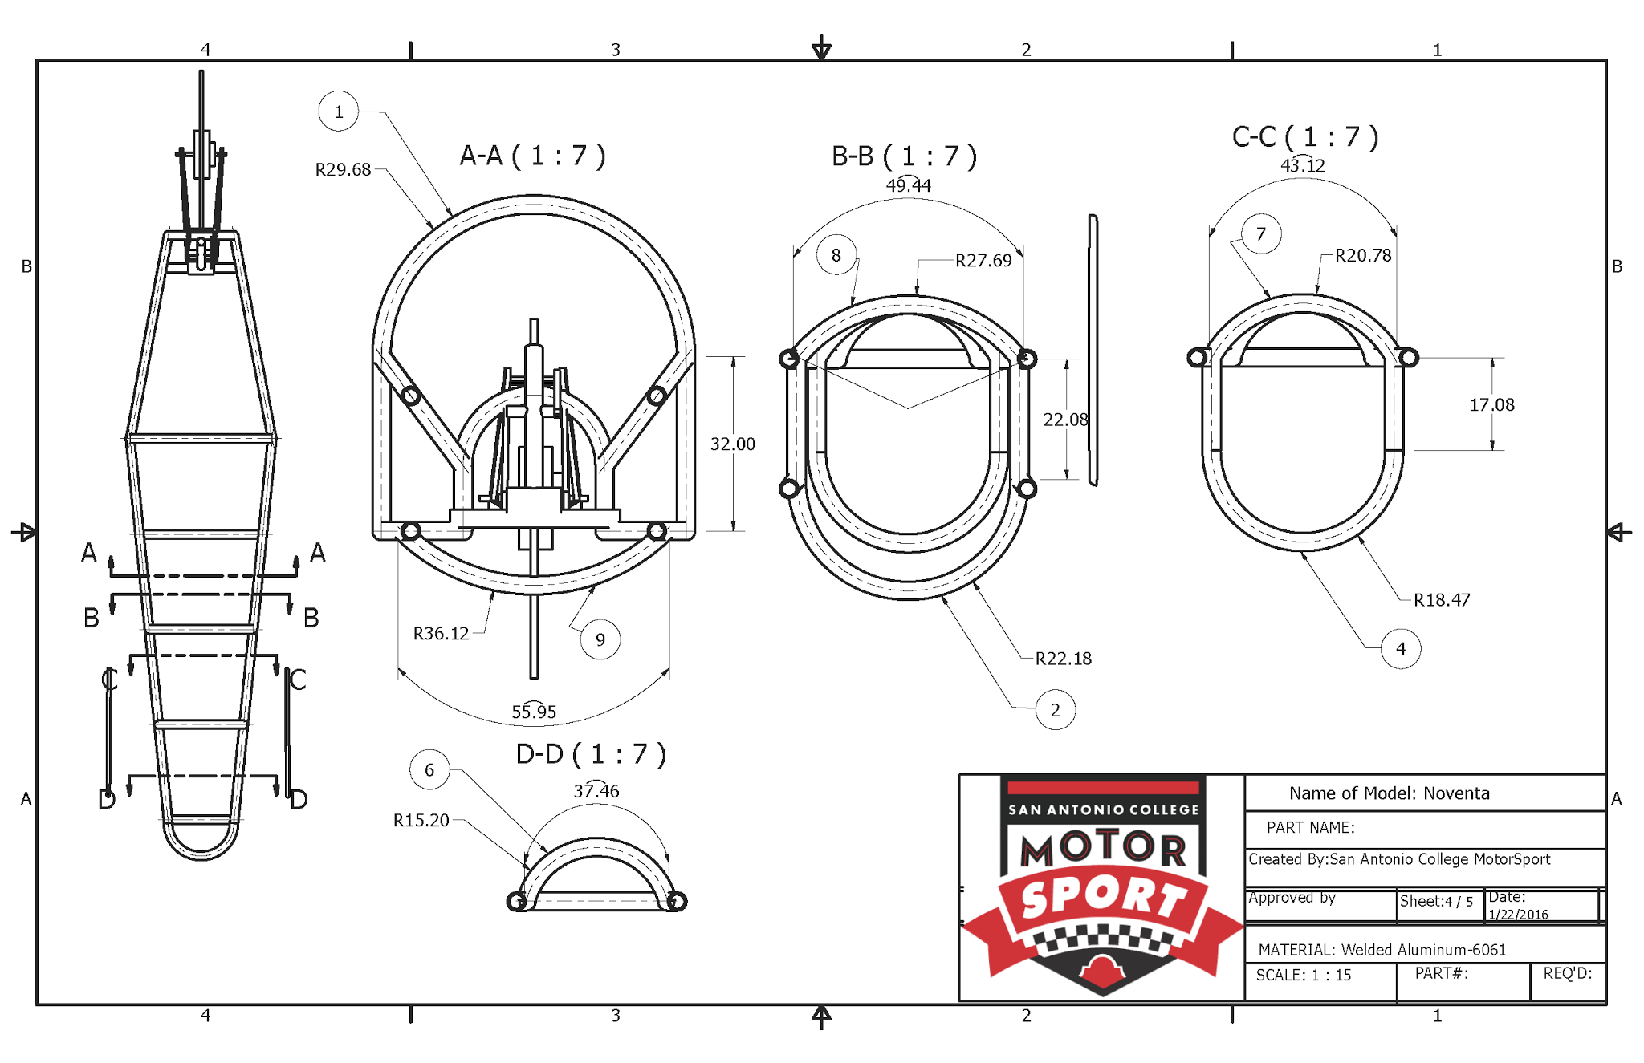
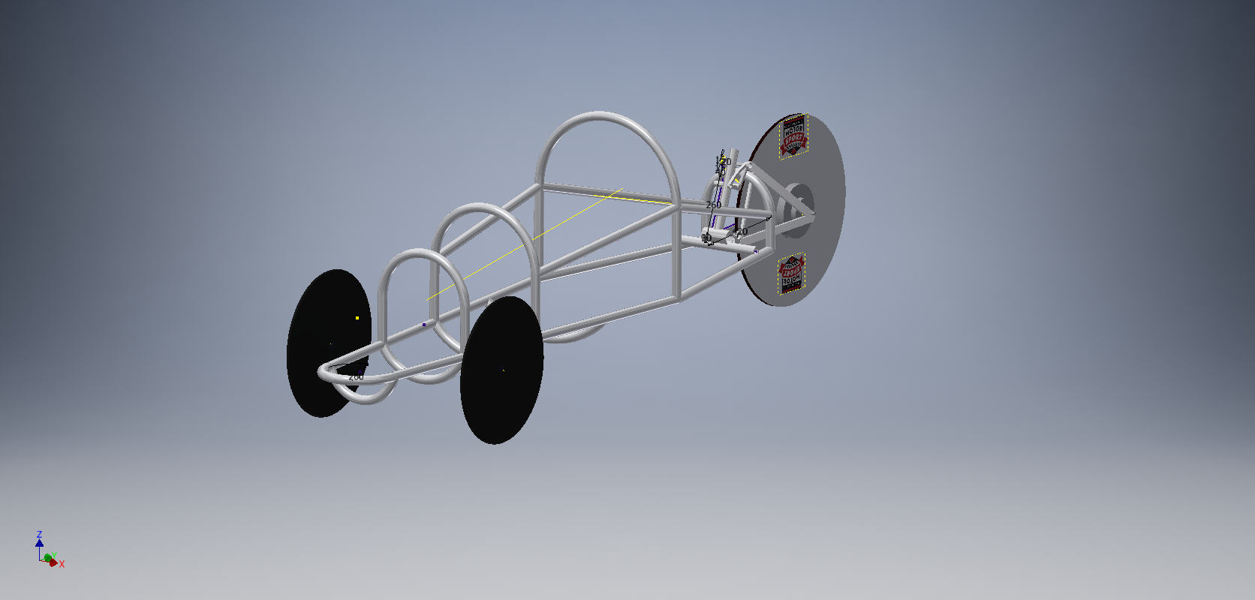
Mechanical

Slide 8
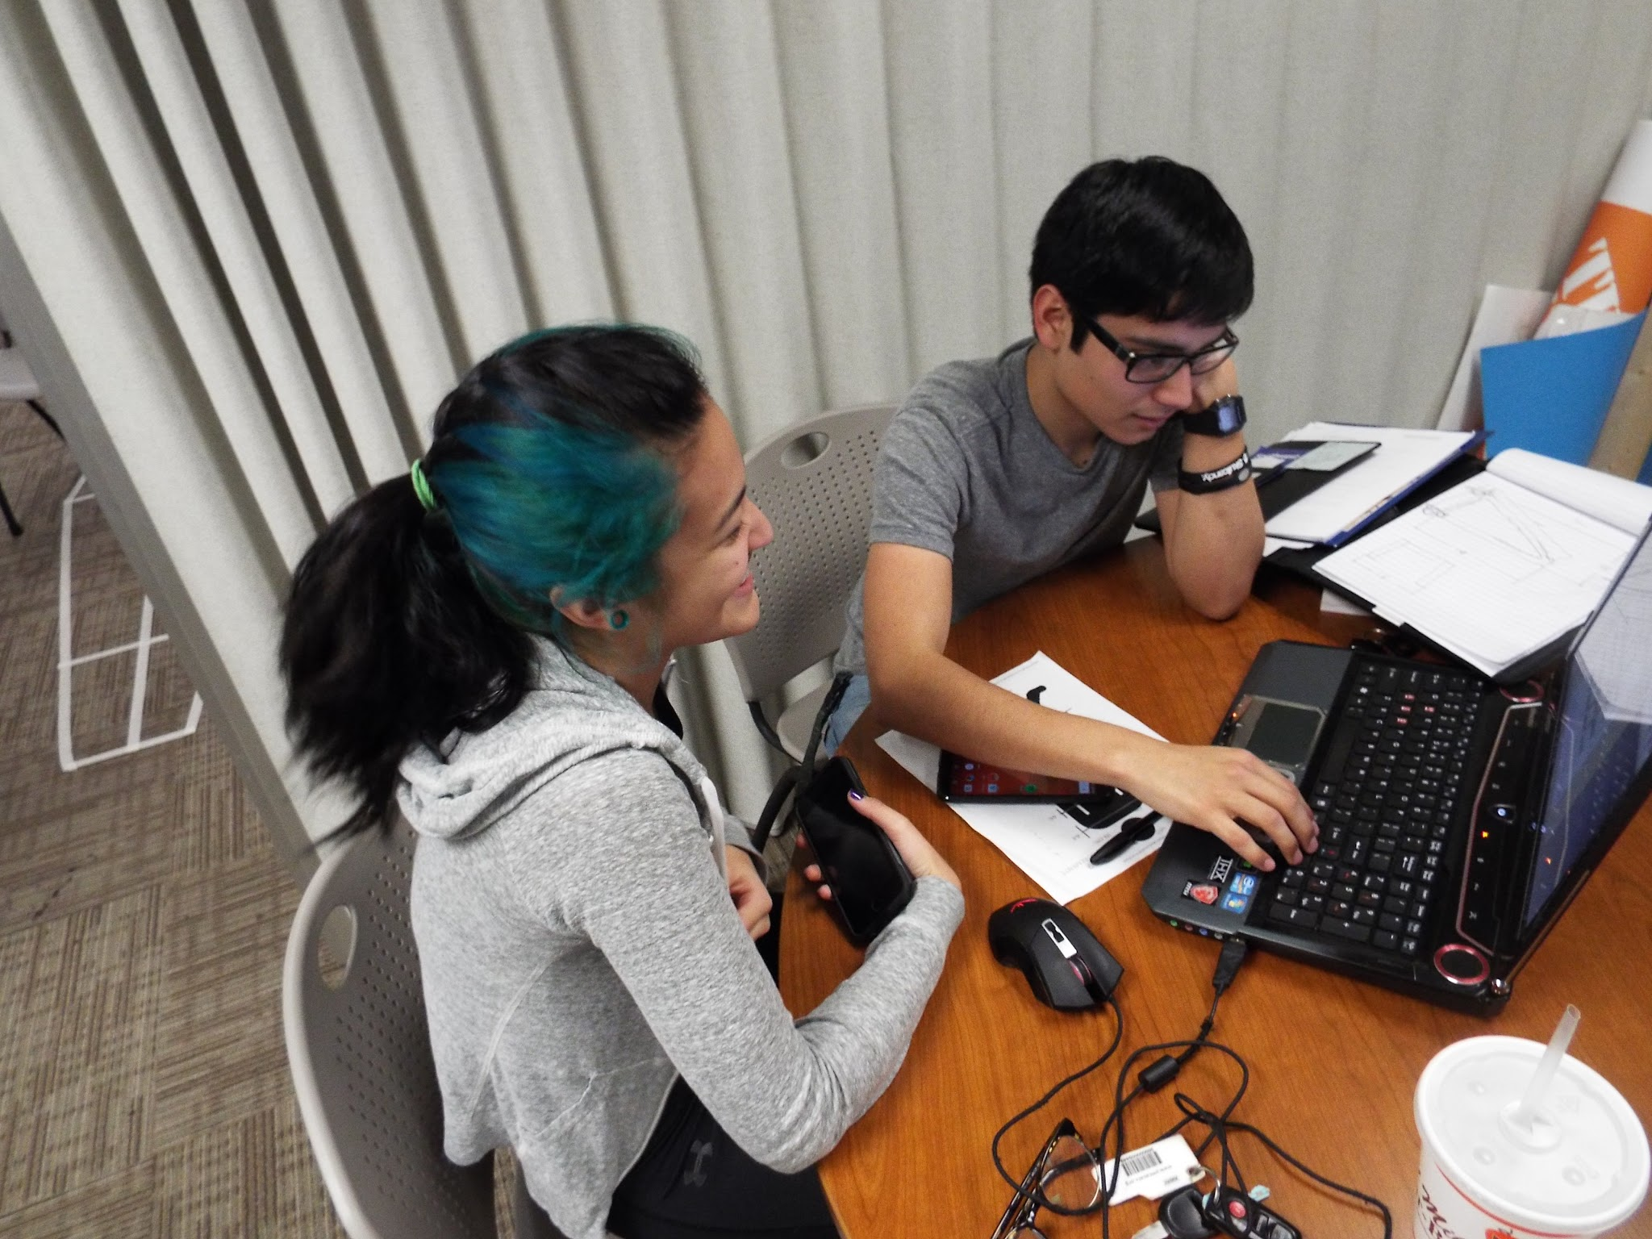
Accomplishments so far
Completely Designed tubular frame and purchased needed metal
Purchased 1000W Fuel Cell
Purchased 1000W Hub Motor and motor controller

Slide 9
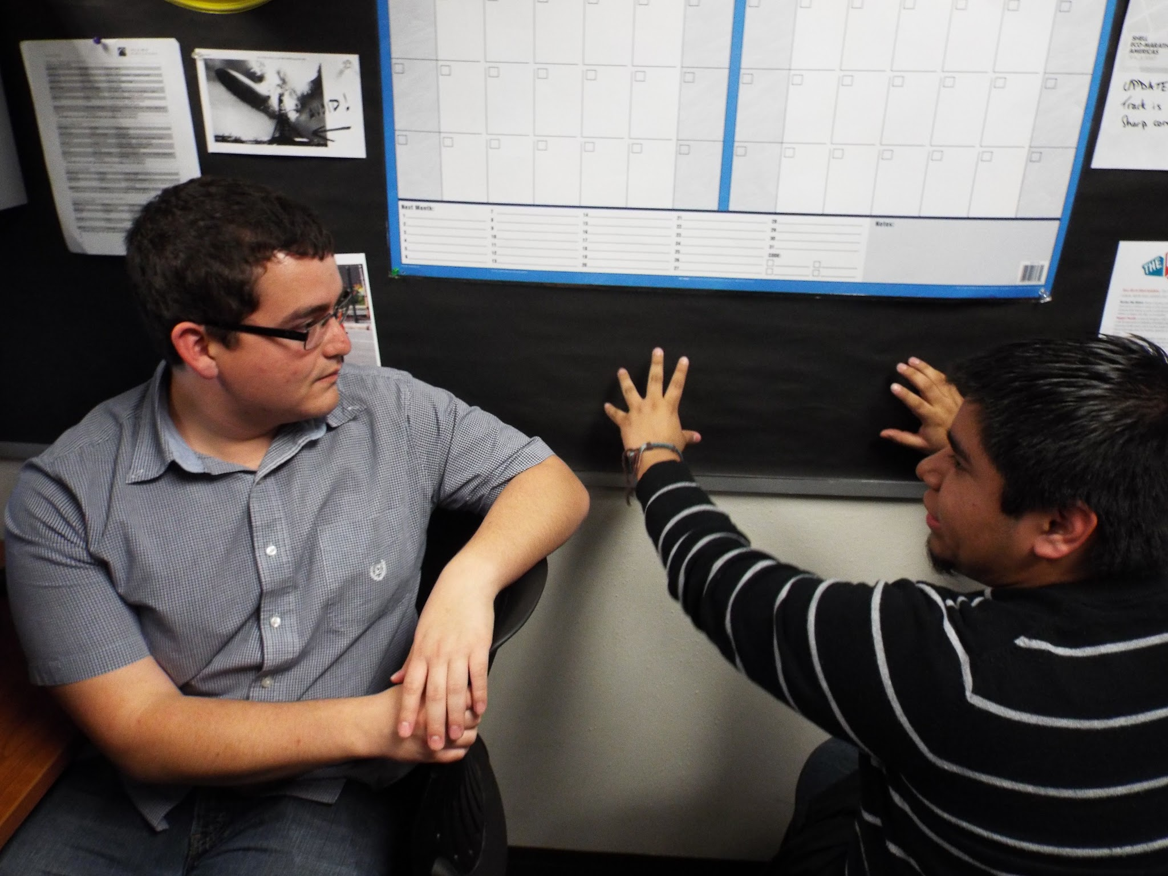
Going Forward
Build frame & body
Incorporate fuel cell and motor system into the car
Fundraise an additional $5,000
Compete in the Shell Eco Marathon 2017
WIN!

Slide 10
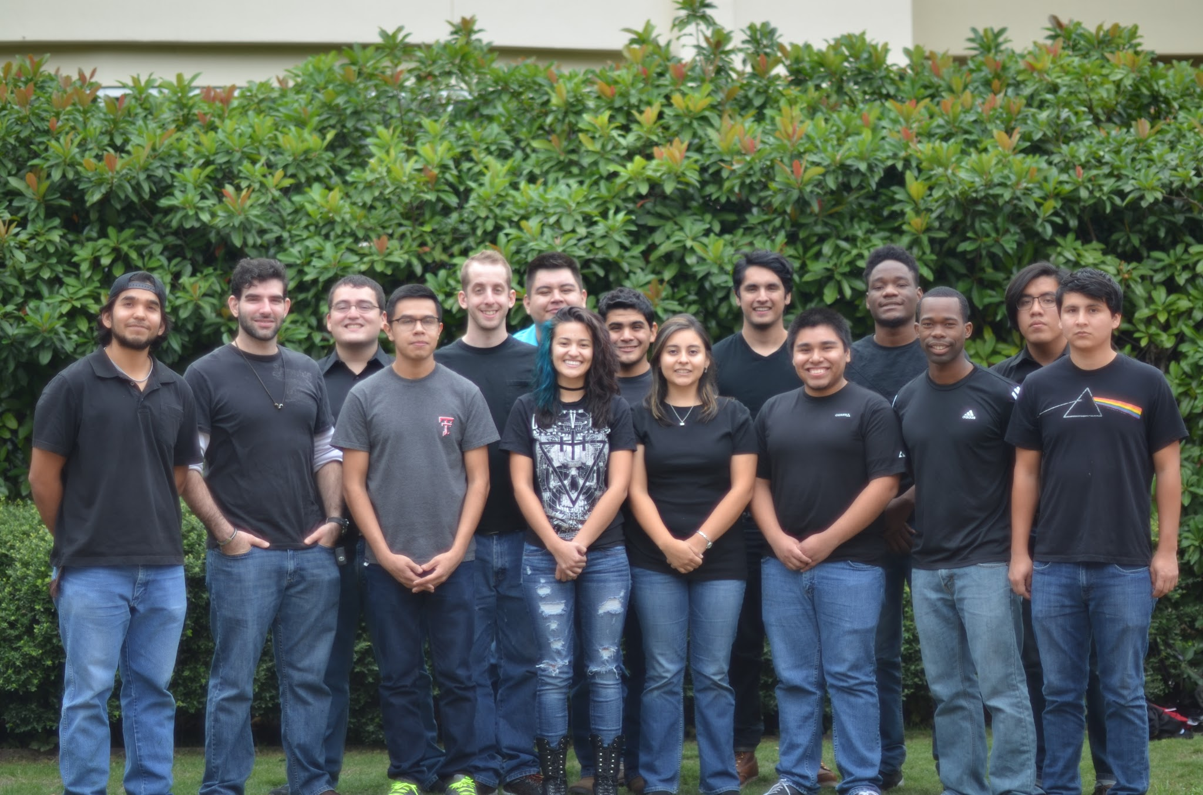
Steering
Roberto Orrostieta
Daniel Martinez
Faculty & Staff
Prof. Alfred Alaniz, Prof. Klaus Bartels, Dr. Dan Dimitriu, Ms. Deborah Martin, Mr. Ben Uresti, Ms. Analisa Sengele
Leads
Dominic Ochoa - Manager
Daniel Benavides - Co-Manager
Wheels & Tires
Amisadai Trinidad
Fuel Cell
Julio Banda
Linda Hogner
Frame & Body
Eben Pfeil
Saul Ceniceros
Jose Carreon
Pablo Guajardo
Motor & Motor Controller
Irene Salazar
Broderick Camel
Guillermo Garcia
Cesar Ventura
Aldair Mendes

