Slide 1
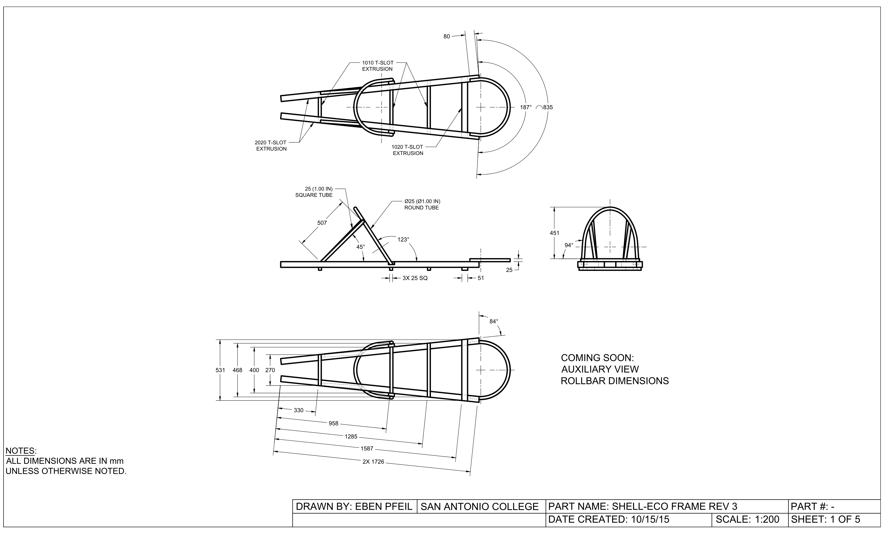
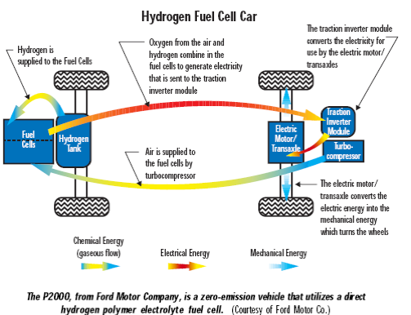
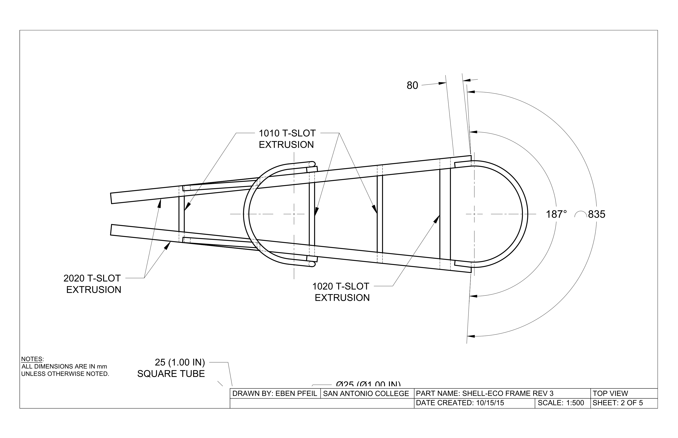
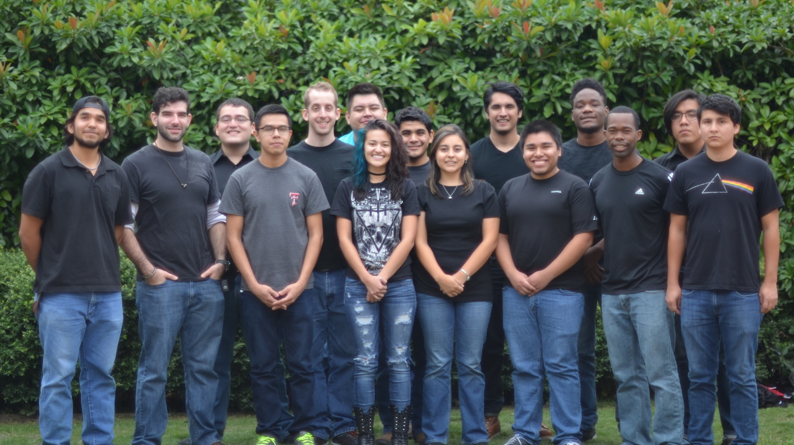
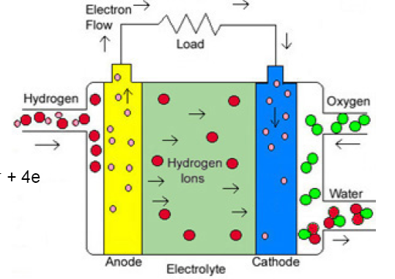
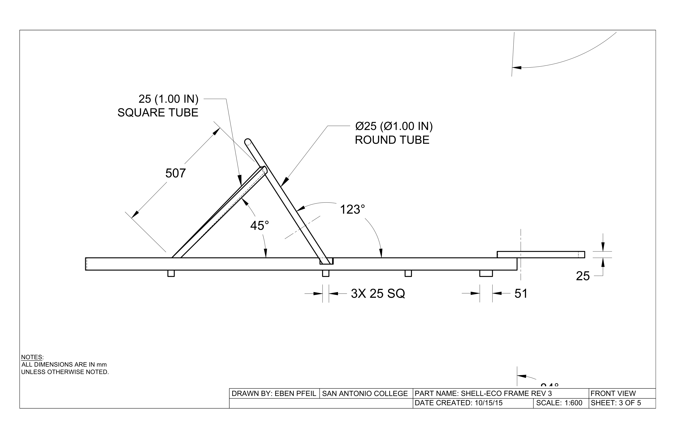
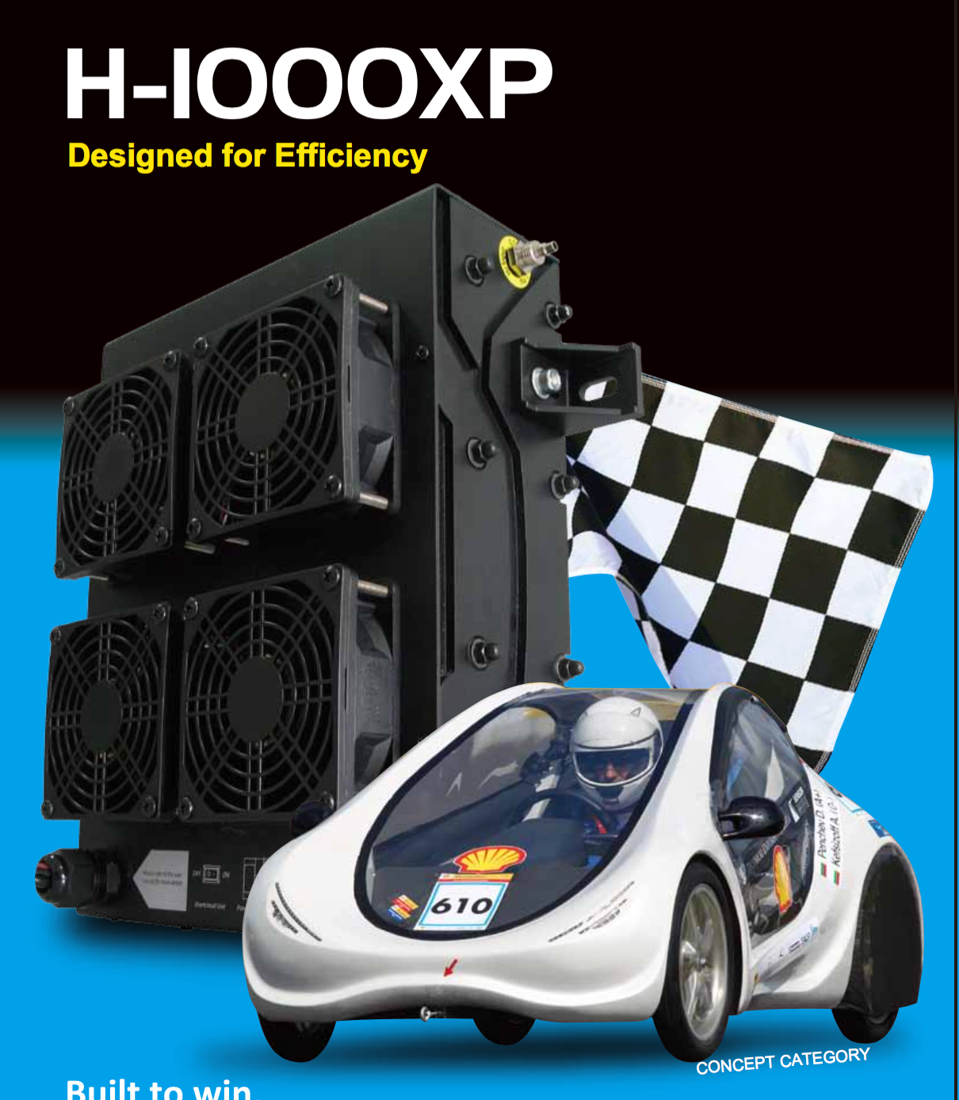
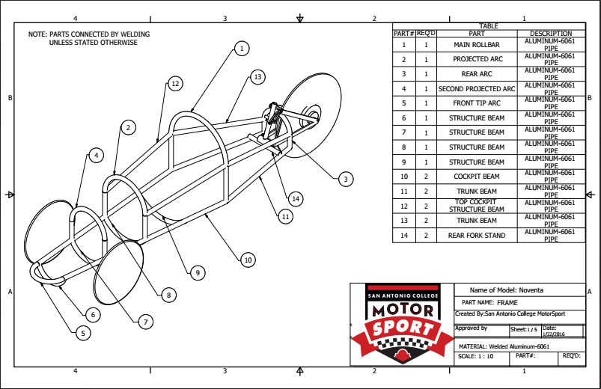
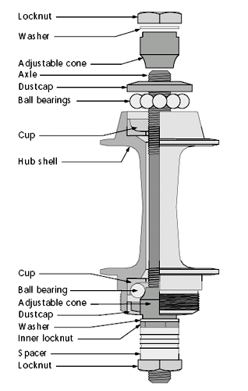
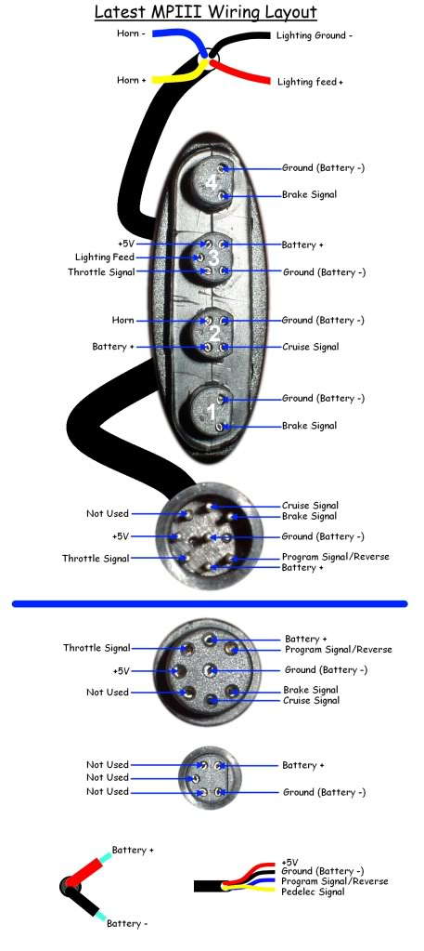
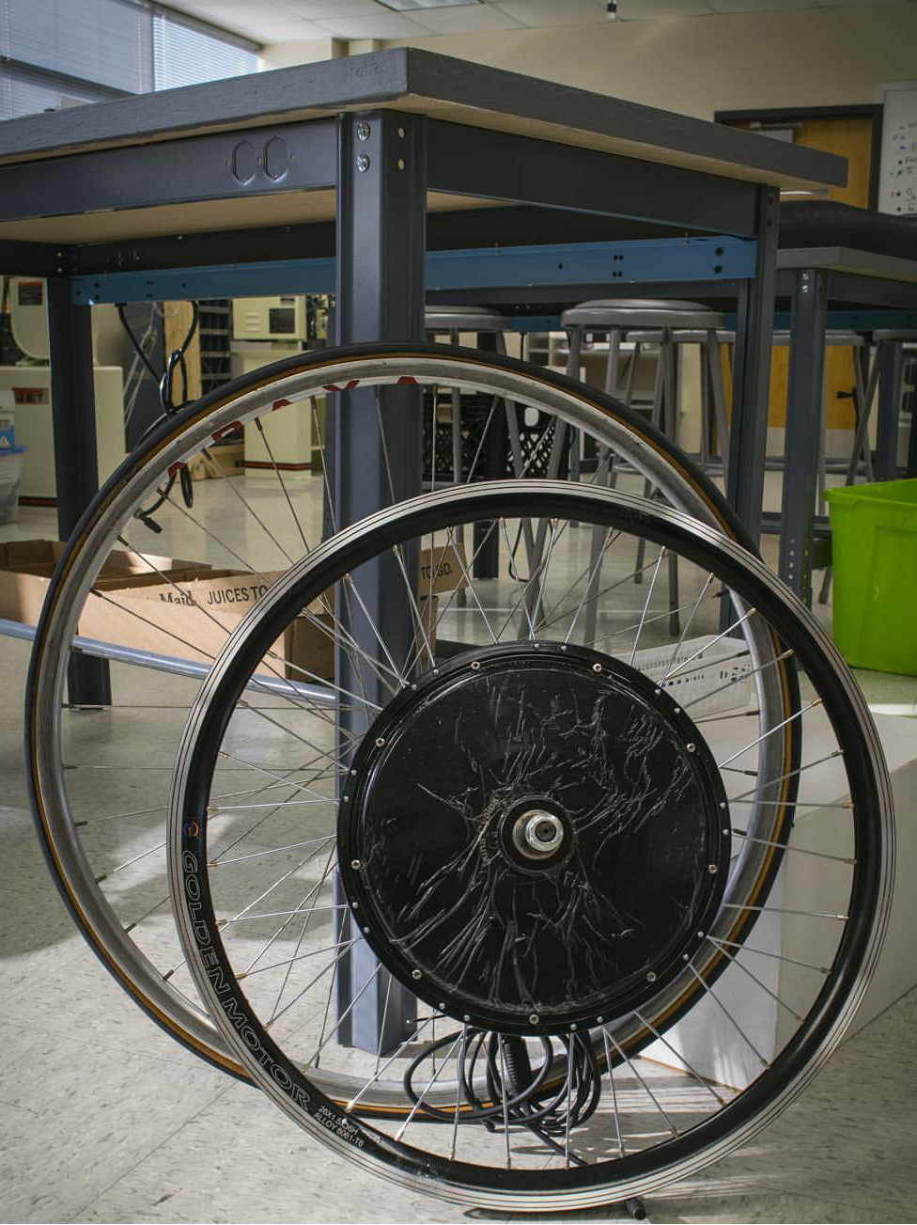
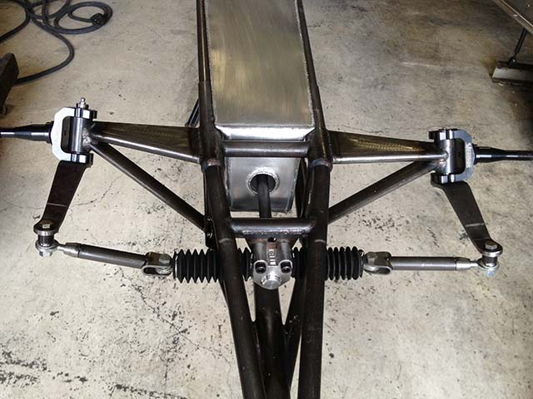
Hydrogen Fuel Cell Car
Professor Alaniz, Dominic Ochoa, Julio B, Daniel B, Roberto O, Amisadai T, Daniel M, Cesar V, Broderick C, Irene S, Saul S, Geraldo S, Jose C San Antonio College 1819 N. Main Ave San Antonio, TX 78212
Frame and Body
Fuel Cell
In a national radio address on February 23, 1934, Huey Long unveiled his “Share Our Wealth” plan, a program designed to provide a decent standard of living to all Americans by spreading the nation’s wealth among the people.
Long proposed capping personal fortunes at $50 million each (roughly $600 million in today's dollars) through a restructured, progressive federal tax code and sharing the resulting revenue with the public through government benefits and public works. In subsequent speeches and writings, he revised his graduated tax levy on wealth over $1 million to cap fortunes at $5 - $8 million (or $60 - $96 million today). dollars) through a restructured, progressive federa his graduated tax levy on wealth over $1 million to cap fortunes at $5 -
A Hydrogen Fuel Cell Stack (HFCS) is a device that produces electricity through the use of a chemical reaction between hydrogen and oxygen. After researching various HFCS we came to a consensus that the H-1000XP fuel cell stack was the most promising as our source of electricity to power vital components. We determined the H-1000XP fuel cell was the best choice for our use because it would supply enough electricity to the motor enabling to properly function, purposely built for the Shell Eco Marathon competition (meets their rules and policies), its straightforward assembly of the electrical components (saved time would be directed to other important issues), and how efficient the fuel cell is compared to other fuel cells.
Introduction
Students from San Antonio College (SAC) along with the help of SAC faculty, industry partners, and Texas State University researched into building and designing a vehicle for the Shell Eco Marathon competition. A competition held by Shell, the oil company, challenging groups of students (High School and University) to research and develop their own vehicle, in addition to attempting to reach the highest possible fuel efficiency. We decided to enter the Hydrogen gas category for the competition and researched accordingly as to what was necessary to make it as fuel efficient as possible.
Steering and Suspension
2D Model
Motor and Motor Controller
The steering system will have three major components. Steering wheel. Rack and pinion, and spindles. These are the most relevant parts because they a design based on the frame measurements. The spindles will be custom made because there are not spindles that adjust our geometry or are design to fit regular bicycle wheels. So, we decided to make our own for those reasons. The steering will be also custom made because of the lack of space for the driver and also because we need to adjust the handle such that the throttle fits in it. We already have one; we just need to machine a second one. Originally, we planed to used the rack and pinion that we got from the donated car. Then I realize that it was welded so instead were going to get a new one. Since we are going to get a new one we have more possibilities to adjust the steering wheel ratio so that the driver does not have to turn the steering wheel so much in order to get the wheel to turn 30°. That is the part that I'm working on right now.
a national radio address on February 23, 1934, Huey Long unveiled his “Share Our Wealth” plan, a program designed to provide a decent standard of living to all Americans by spreading the nation’s wealth among the people.
Long proposed capping personal fortunes at $50 million each (roughly $600 million in today's dollars) through a restructured, progressive federal tax code and sharing the resulting revenue with the public through government benefits and public works. In subsequent speeches and writings, he revised his graduated tax levy on wealth over $1 million to cap fortunes at $5 - $8 million (or $60 - $96 million today). dollars) through a restructured,

