Slide 1
Spill Prevention, Control, and Countermeasure (SPCC) Training

Slide 2
SPCC Background Information
What is Spill Prevention, Control, and Countermeasure (SPCC)?
Federal regulation required by EPA to prevent oil pollution in waters of the United States
Oil Pollution Prevention Regulations
40 CFR 112
Originally published in 1973
Why is Texas State required to comply?
We store more than 1,320 gallons of fuel or oil on campus in aboveground tanks
Approximately 54,500 gallons onsite

Slide 3
SPCC Background Information
What types of oils are covered in the SPCC Plan?
Petroleum-based oils
Crude oil, fuel, mineral oils, etc.
New and used oils
Animal-based oils
Fats, oils, and greases from mammals or fish
Vegetable oils
Oils from seeds, nuts, fruits or kernels
SPCC regulation requires Texas State to:
Prepare an SPCC Plan
Annual employee training requirement
Routinely inspect units and prevent discharge of oil storing units

Slide 4
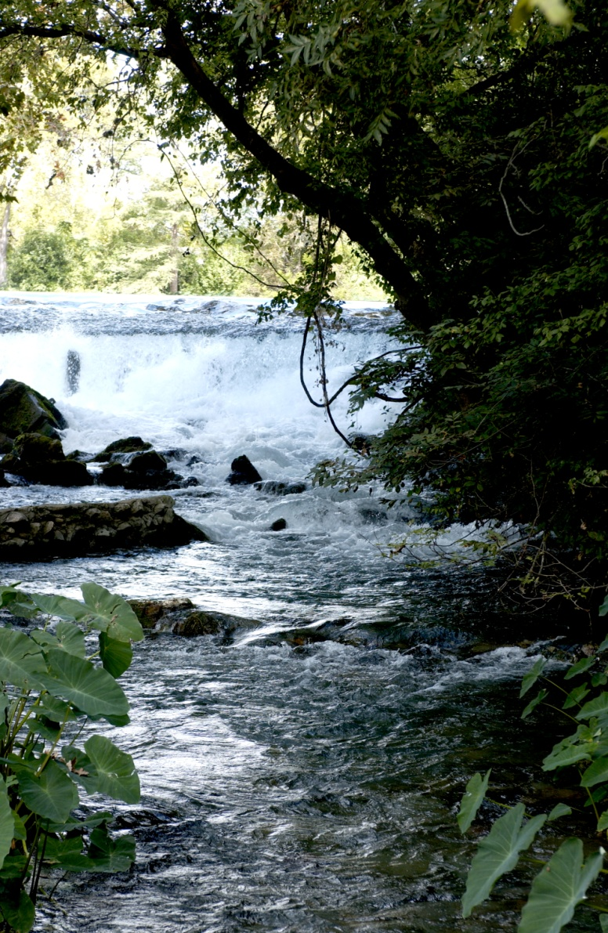
SPCC Background Information
Main Takeaway Points:
Why does Texas State need an SPCC Plan?
To prevent accidental discharge of oil into navigable waters of the United States
Illicit discharge of oil into San Marcos River or Sessom Creek can cause harm to wildlife, swimmers, and the ecosystem
Texas State can be subject to fines and violations if oil is discharged to local waterbodies

Slide 5
Training Requirements
Applicable to all oil-handling employees of the University
Training is administered:
Initially upon hire via SAP – online training database
Annually thereafter
SPCC Training will cover:
SPCC Plan background and program goals
Potential spill pathways
Prevention measures
Response procedures

Slide 6
Goals of SPCC Program
Spill Prevention
Practices or procedures implemented to prevent oil discharges to the ground or navigable waters of the United States
Spill Control
Control measures in place to prevent and/or contain incidental discharges of oil
Spill Countermeasures
Procedures for responding to, cleaning up, and disposing of discharged oil
Documentation and reporting

Slide 7
Goals of SPCC Program
Spill Prevention Examples
Maintain updated inventory of oil storage areas
Maintain updated SPCC Plan
Proper selection and installation of equipment
Preventative maintenance
Regular inspections of units
Timely repair of malfunctioning systems
Good oil-handling/fueling practices
Employee training

Slide 8
Goals of SPCC Program
Spill Control Examples
Monitoring of leak detection systems
Proper and timely reporting
Utilizing secondary containment units
Inspections of containment systems for functionality
Spill kit utilization
Spill Countermeasure Examples
Timely reporting to campus emergency response team (EHSRM)
Swift response to spills
Proper cleanup and disposal
Documentation and reporting to the regulatory agency (if necessary)

Slide 9
Spill Prevention

Slide 10
Spill Prevention: Oil Storage
Where is oil stored on campus?
Numerous elevator hydraulic systems
Aboveground storage tanks – 6
Oil-filled electrical step-down transformers – 86
Electrical selector switch – 1
Waste cooking oil tanks – 18
Drum storage areas (used and new oil) – 9
Diesel fueled generators – 24
Hydraulic trash compactors – 9

Slide 11
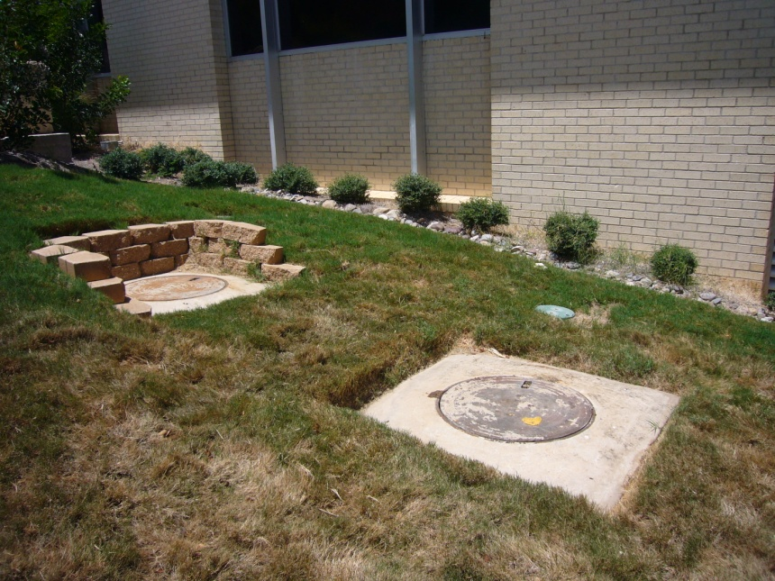
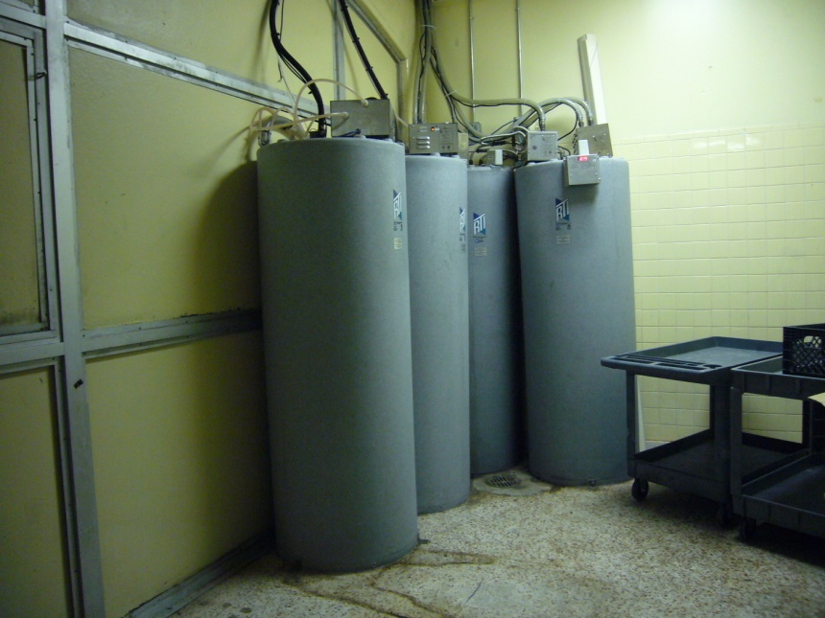
Oil Storage Locations
Food Service Areas
Dining Halls (Jones, Commons, The Den, The Lair, Harris)
Grease Traps
Cooking Oil

Slide 12
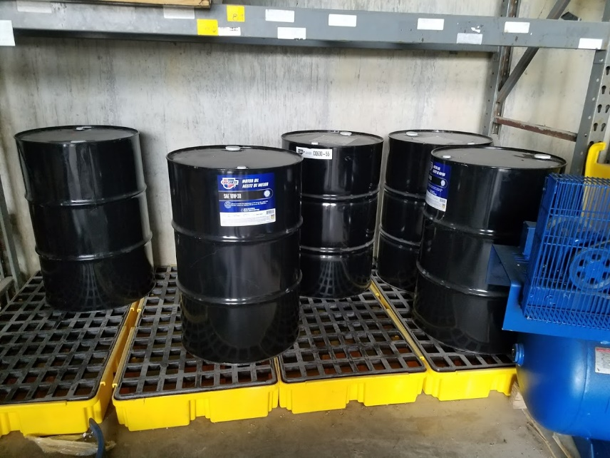
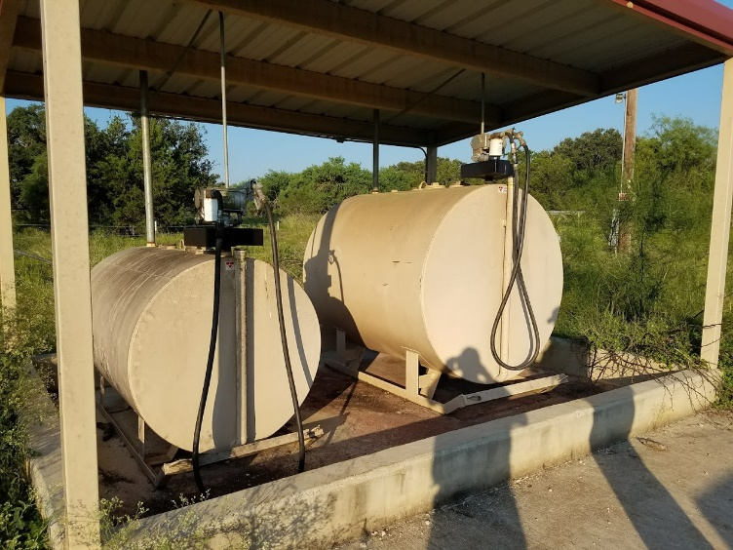
Oil Storage Locations
Vehicle Servicing Areas
Maintenance Garages (Facilities, Parking Services)
Fueling (Freeman Ranch)
Fuel Oil Storage
Lubricant Storage

Slide 13
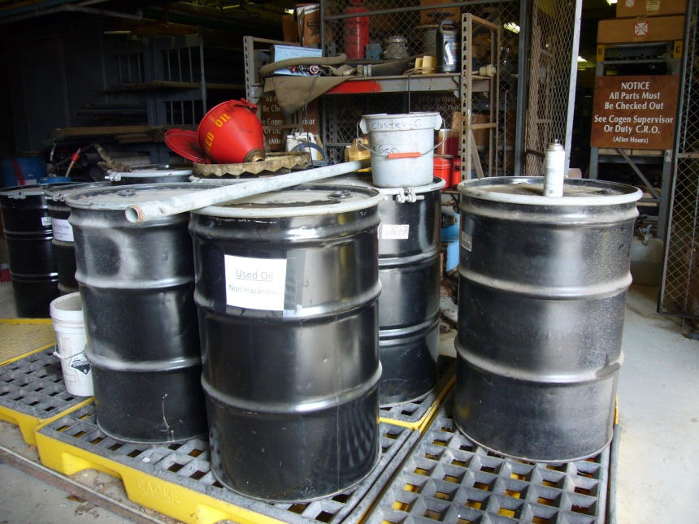
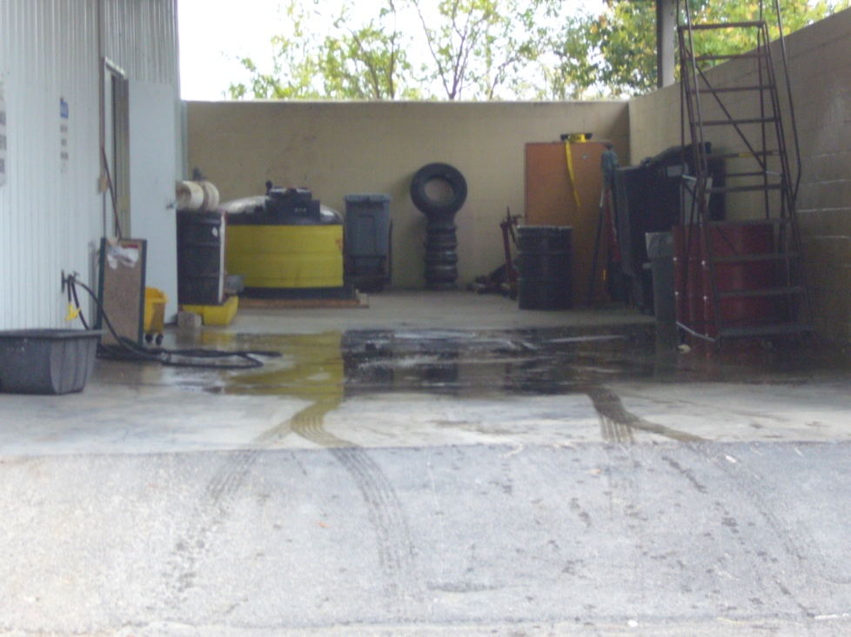
Oil Storage Locations
Vehicle Servicing Areas
Maintenance Garages (Facilities, Parking Services)
Waste Oil
Used Oil, Oil Filters, and Antifreeze

Slide 14
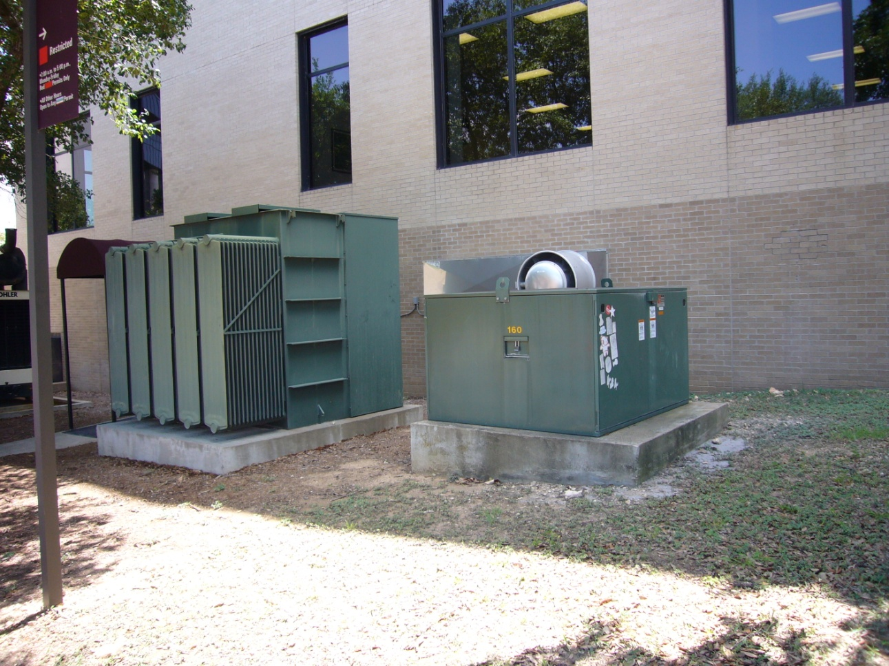
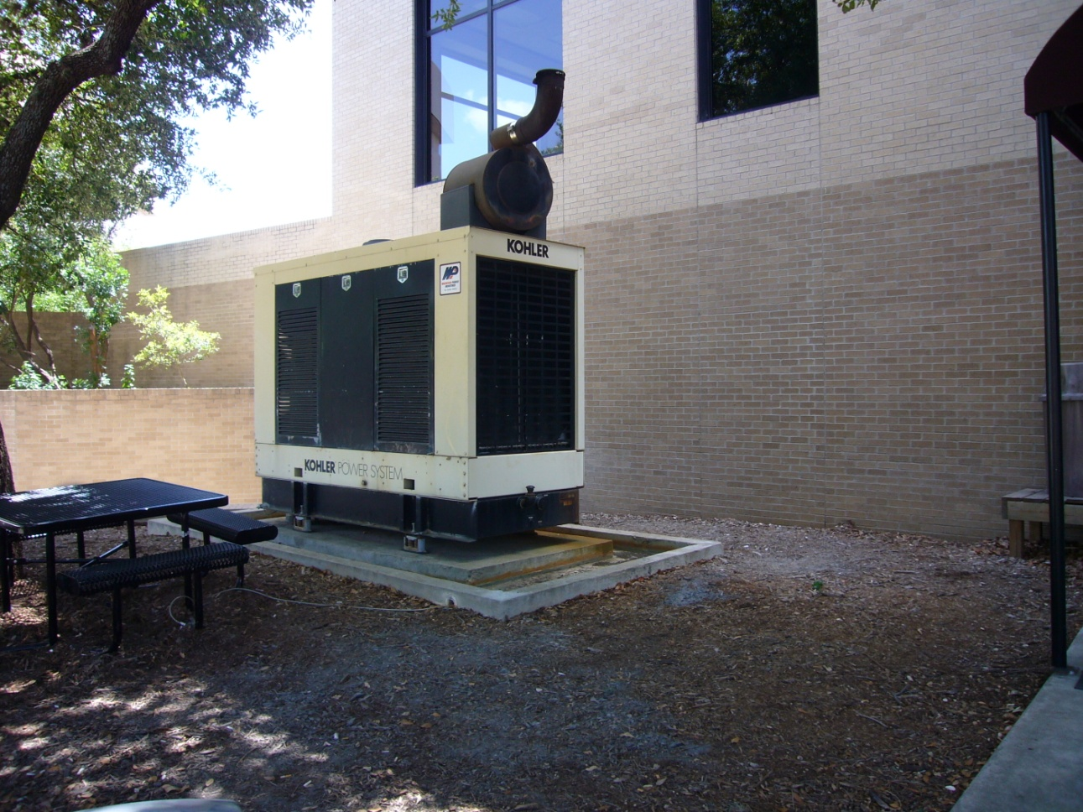
Oil Storage Locations
Various areas throughout campus with emergency power units or operational equipment
Transformers & Switches
Diesel Generators

Slide 15
Inspection and Maintenance of Units
EHSRM Responsibilities:
Conduct monthly inspections of all oil storage units
Document findings and send reports to responsible departments
Responsible Department Duties:
Complete preventative maintenance on units
Respond to EHSRM reports and make necessary repairs
All Departments and Employees:
Report unusual observations, leaks, or issues to supervisor
You are the eyes and ears of Texas State – We rely on you to report these issues so they can be fixed!

Slide 16
Best Practices for Oil Handling
Oil Transfers/Deliveries
Implement responsible transportation procedures to minimize spills/leaks
Always pay close attention to box/transportation instructions (i.e. THIS SIDE UP)
If using contractor, ensure they are experienced in transporting oil products
Vehicle and Equipment Maintenance
Monitor fluid levels for volume decreases
Inspect vehicles after performing maintenance to ensure all lines are disconnected and valves are closed

Slide 17
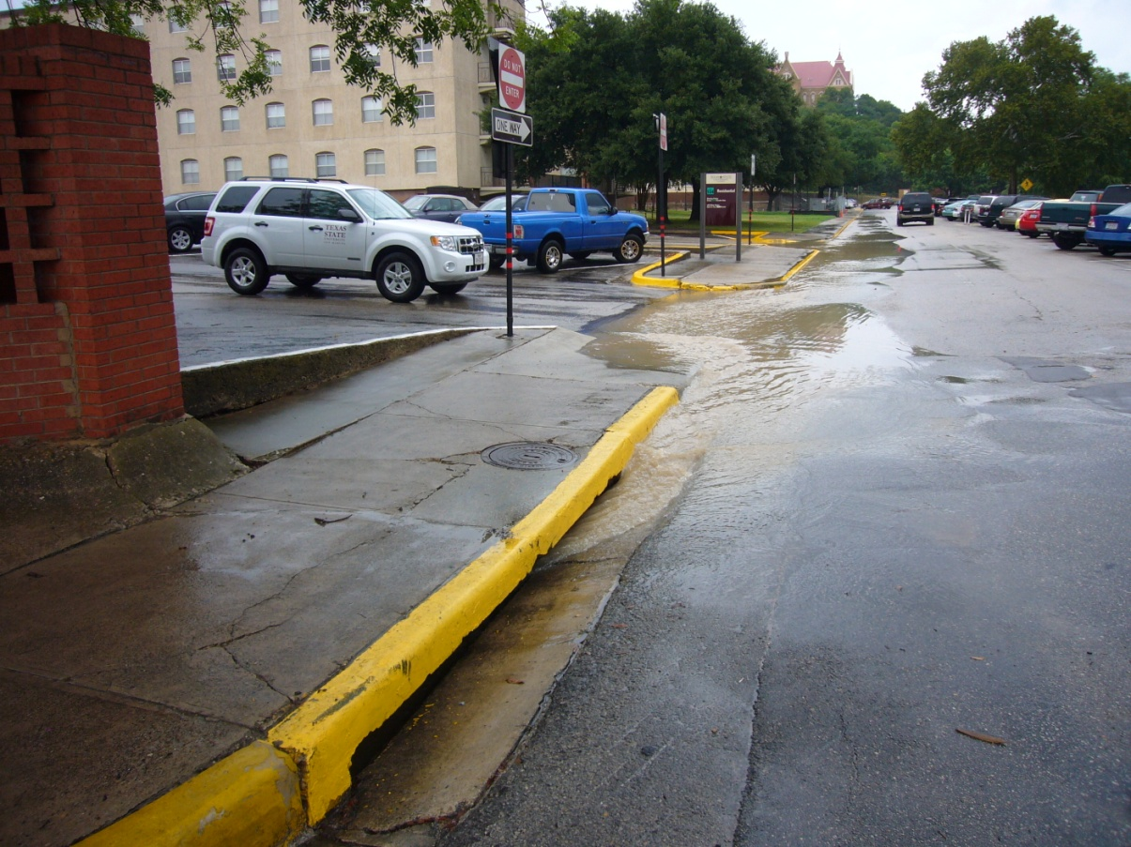
Spill Prevention
What if we don’t implement these prevention procedures?
Failure to prevent oil discharges can result in oil entering “navigable waters of the United States” via:
Spillage on the ground uphill from a storm drain
Intentional dumping of oil directly into a storm drain or waterbody (San Marcos River, Sessom Creek, etc.)
Storm drain inlet receiving rainwater

Slide 18
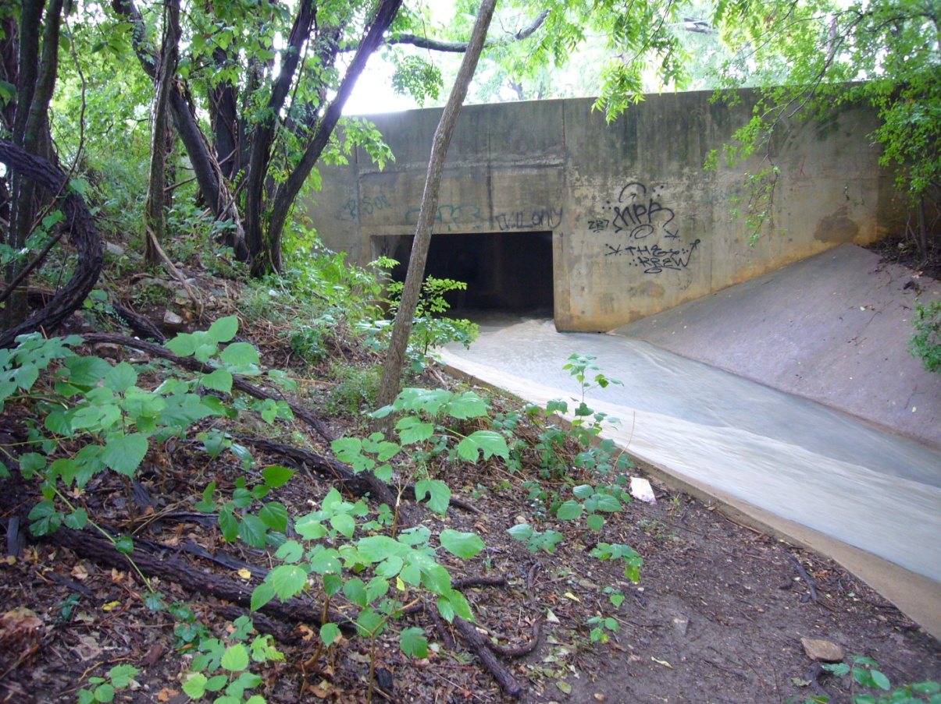
Spill Prevention
What if we don’t implement these prevention procedures?
If oil enters “navigable waters of the United States,” the following can occur:
Detrimental environmental impacts to wildlife, swimmers, and habitat
Texas State may be subject to federal/state violations (and potential fines)
Oil that has entered navigable waters of the U.S. is considered an illicit discharge. Illicit discharges are prohibited by UPPS 04.05.16 and should be reported immediately.

Slide 19
Spill Control

Slide 20
Spill Control
Methods of Spill Control
Utilization of leak detection systems
Secondary containment is used to capture oil that is accidentally discharged from unit
Double Walled Transfer Piping
Preventing leakage and backup to piping with “pipe over pipe” protection
Slug Control Plan
Local Program required document detailing how to prevent spills

Slide 21
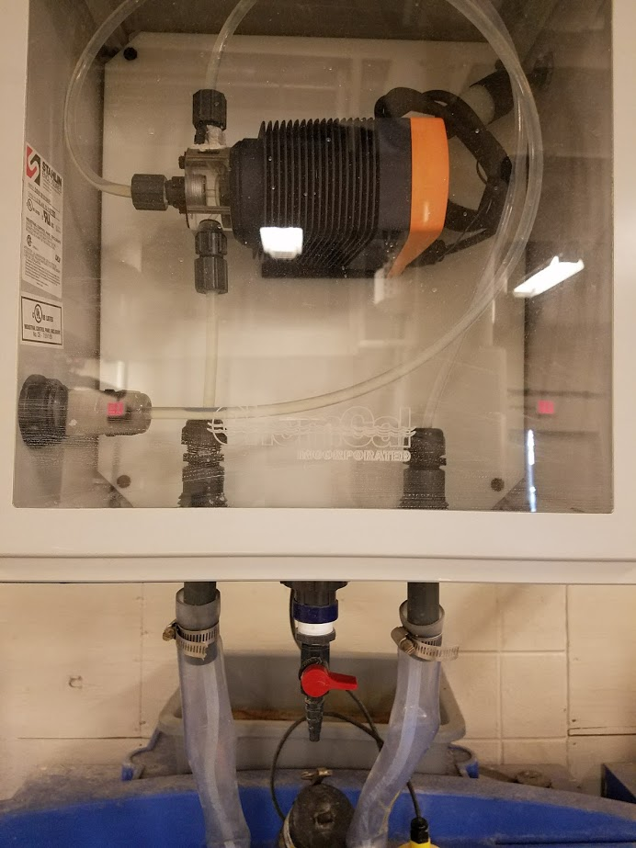
Spill Control
Double Walled Piping

Slide 22
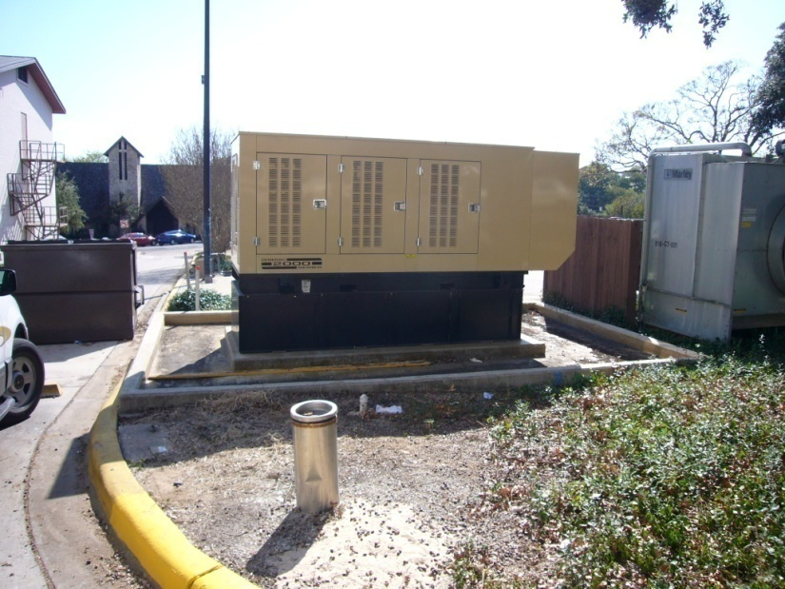
Spill Control
Methods of Spill Control
Utilize secondary containment units (permanent or temporary)
Secondary containment is used to capture oil that is accidentally discharged from unit
Inspect secondary containment for cracks, openings, or weaknesses that could result in a discharge of oil to the ground
Monitor spills in secondary containment, clean as needed

Slide 23
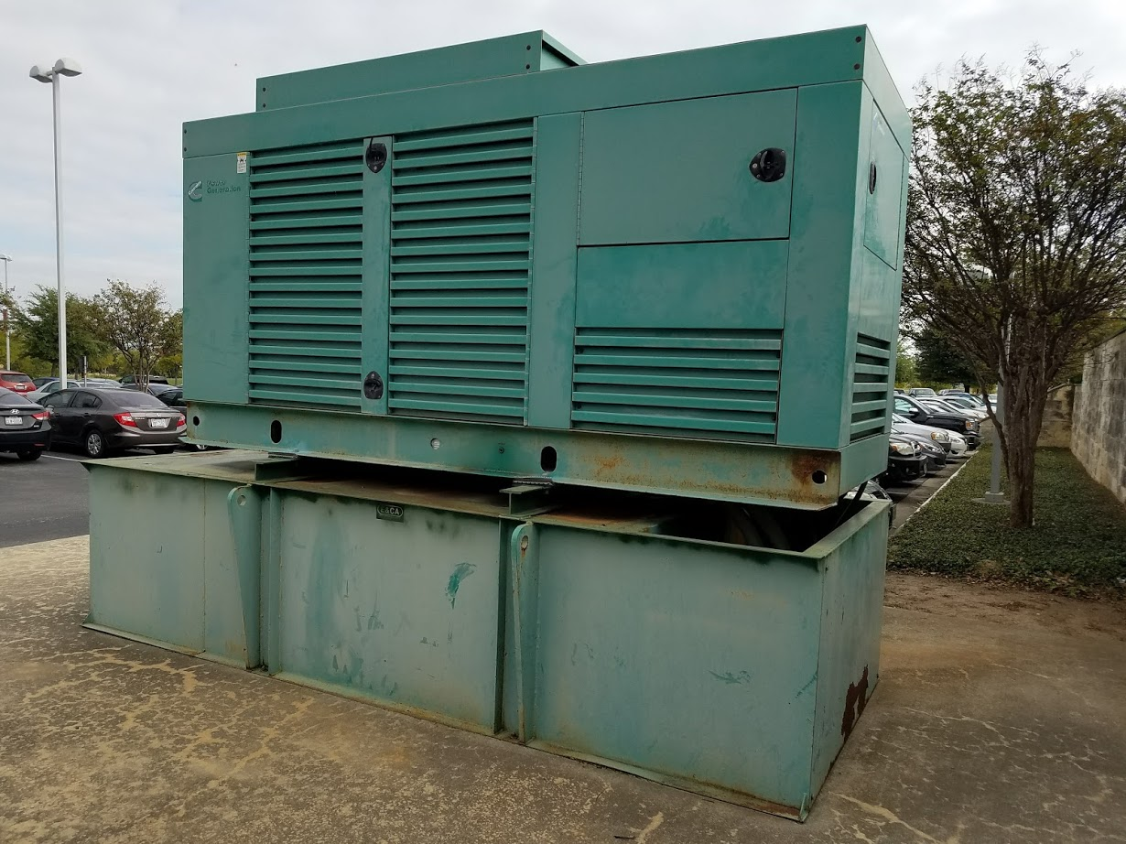
Spill Control
Methods of Spill Control
Double-walled tanks do not require structural secondary containment outside the unit
Secondary wall acts as secondary containment within the unit to capture discharges of oil
Double Walled Tank

Slide 24
Spill Control
Methods of Spill Control
Reporting discharges to EHSRM as soon as possible can help control the impacts of the spill
If discharges are not reported on time…
Texas State could be liable for impacts to the environment
Regulatory reporting will be delayed, resulting in possible violations and fines
Impacts to wildlife could be exacerbated should a response be delayed
EHSRM Phone – Regular Business Hours
512-245-3616
EHSRM Phone – After Hours/On-Call
512-738-6650

Slide 25
Spill Countermeasure

Slide 26
Spill Response
Reporting and Responding to Spills
Safety First
Call 911 immediately if anyone is injured
Extinguish open flames or ignition sources (ex: cigarettes)
Stop the Spill
If possible and safe to do, stop the spill at it’s source
Turn off valves
Make sure containers are upright
Protect floor drains/storm inlets
Notify EHSRM
Regular Business Hours: 512-245-3616
After Hours: 512-738-6650

Slide 27
Spill Response
Incidental or “Small” Spills
Less than or equal to five (5) gallons
Considered “manageable”
Low threat to the environment (i.e. not discharged to sanitary or storm sewer, isolated in nature)
Clean-Up Procedures
Only begin clean-up activities if you have appropriate training, if supplies are readily available, AND only if you feel comfortable cleaning up the spill
Use appropriate PPE and spill response supplies (clean-up supplies will depend on the spill)
Contact EHSRM for disposal of materials
If you do not have spill response supplies, or you do not feel comfortable cleaning up the spill –
Contact EHSRM for assistance

Slide 28
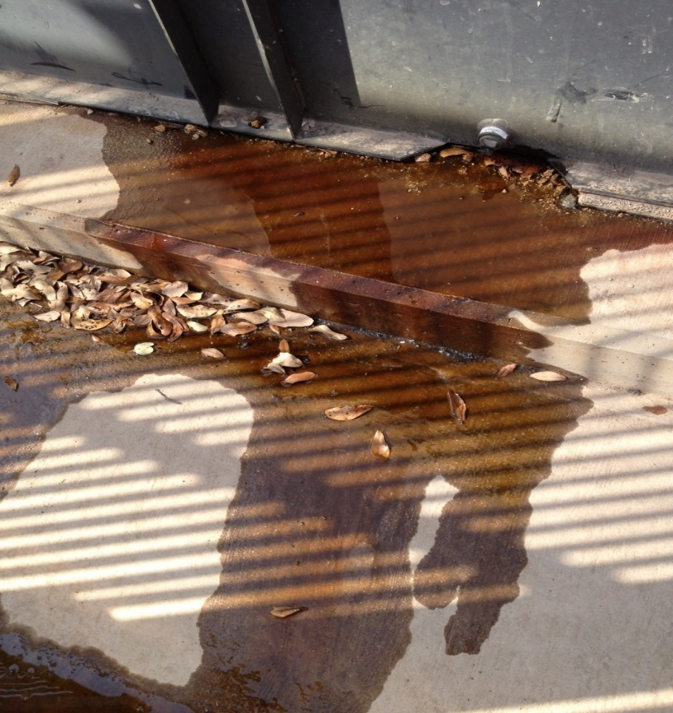
Spill Response
Examples of Incidental Spills

Slide 29
Spill Response
Emergency or “Large” Spills
More than five (5) gallons
Imminent threat to the environment
Considered outside the scope of Texas State Spill Response Team
Notify EHSRM immediately
Clean-Up Procedures
EHSRM will contact 911 or spill response contractor
You may be required to provide additional information for reporting (i.e. who, what, when, where, how)

Slide 30
Spill Response
Contact EHSRM if…
The spill is more than five gallons and/or unmanageable
You need assistance with spill cleanup
You are unsure about proper spill cleanup methods
The spill has discharged to storm or sanitary sewer
When in doubt – Call EHSRM
Regular Business Hours: 512-245-3616
After Hours: 512-738-6650

Slide 31
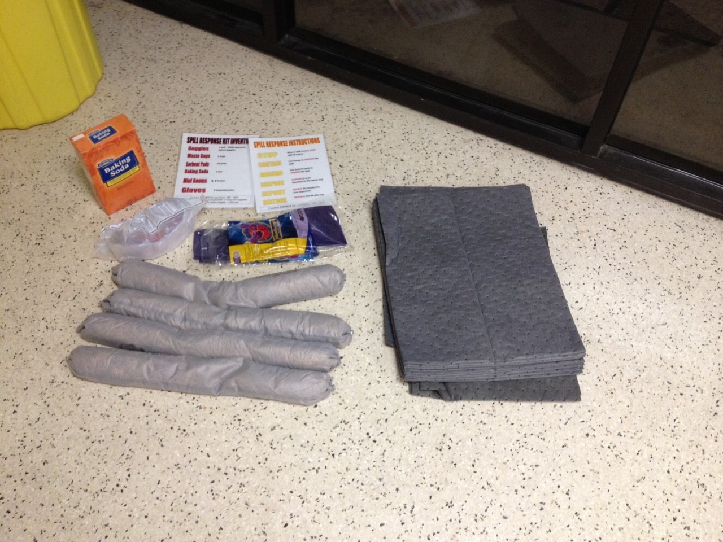
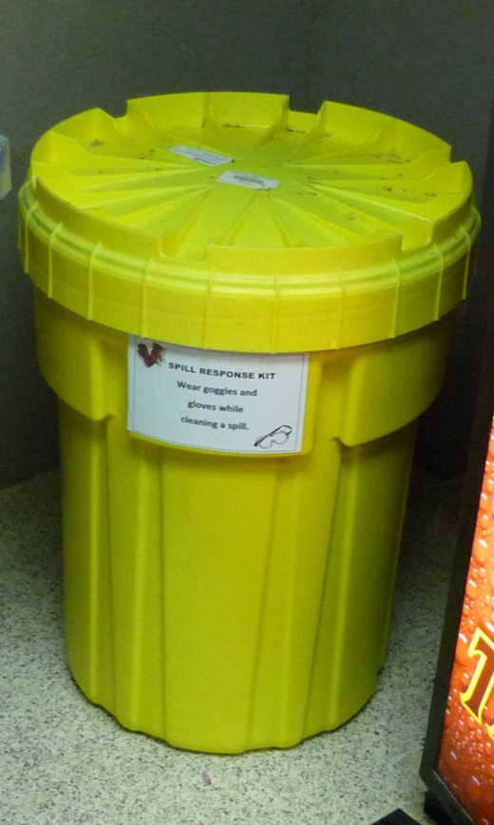
Spill Kits
Where are spill kits located?
Strategically placed throughout campus
What is inside your spill kit?
Baking soda
Absorbent pads
Gloves
Goggles
Booms
Trash Bags
Waste tags
Emergency Numbers
Notify your supervisor if EHSRM needs to restock materials

Slide 32
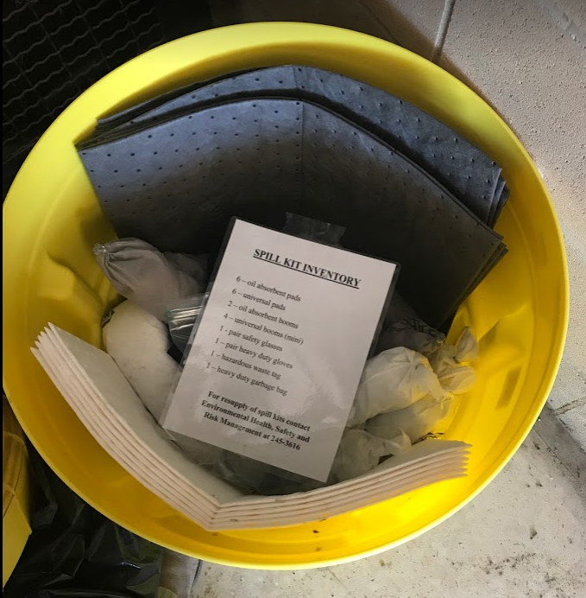
Spill Kits

Slide 33
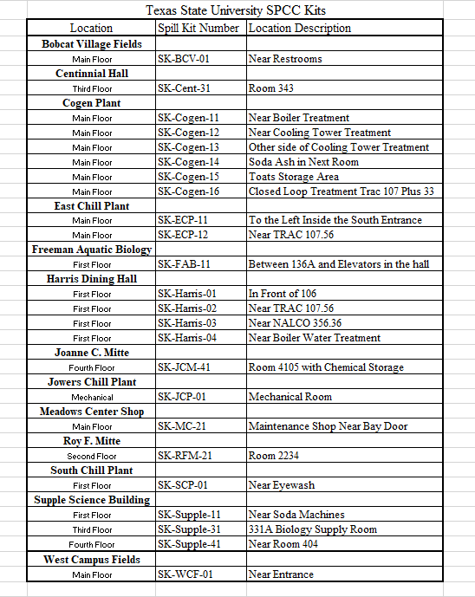
Spill Kit Locations

Slide 34
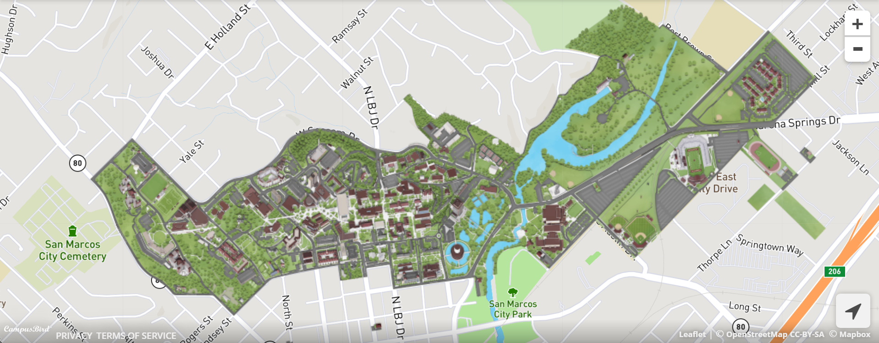
Spill Kits
Spill Kit Location
Spill Kit Location
Spill Kit Location
Spill Kit Location
Spill Kit Location
Spill Kit Location
Spill Kit Location
Spill Kit Location
Spill Kit Location
Spill Kit Location
Spill Kit Location
Spill Kit Location
Spill Kit Location
Spill Kit Location
Strategically Placed

Slide 35
Reporting Spills
Reportable Quantities
What is considered “reportable” to the State of Texas (TCEQ) or EPA?
Any petroleum product (oil, gas, kerosene, diesel, etc.) that makes a sheen on navigable waters (San Marcos River, Sessom Creek)
Chemicals discharged into water or onto land that exceeds the Reportable Quantity limit
EHSRM will contact the appropriate regulatory entity in the event of a discharge to land or navigable waters –
This is only for your information

Slide 36
Main Points
Be aware of where oil and chemicals are stored
Preventing spills is easier and cheaper than cleanup measures
All storm drains lead to the San Marcos River
If you see a spill or leak, report it immediately to your supervisor
Cleanup any spills in your workspace as soon as possible
Contact EHSRM with any questions – We are here to help!

Slide 37
Questions/Comments?
Environmental Health, Safety and Risk Management Department
Smith House
736 Oscar Smith St., San Marcos, TX 78666
http://www.fss.txstate.edu/ehsrm/
EHSRM Contact Info
Regular Business Hours: 512-245-3616
After Hours: 512-738-6650

