Slide 1
Developing Faculty-led
Education Abroad Programs

Slide 2
Academic Affairs
International Affairs
Education Abroad

Slide 3
FACULTY-LED PROGRAMS
Total number of programs: ˜ 50
Total number of faculty members: ˜100

Slide 4
WHO CAN TEACH ABROAD?
Full-time Texas State University faculty members are preferred
Prior education abroad experience is preferred
The ability to speak the language of the host country is desired, but not required
Support/approved by the Department Chair and Dean of College

Slide 5
WHEN CAN I TEACH ABROAD?
FALL SPRING SUMMER (most popular)

Slide 6
WHAT COURSES CAN I TEACH ABROAD?
Any course that is part of the course inventory at Texas State
You may add a pre or post travel academic component
More than 50 % of the content will need to be taught abroad
Same requirements as on campus courses (contact hours, pre-requisites, etc.)
Usually two courses
Length of program varies (average 3-4 weeks abroad)

Slide 7
WHERE CAN I TEACH ABROAD?
Any destination that is classified with a travel advisory level 1 or 2 according to the U.S. Department of State.

Slide 8
WHAT IS THE APPROVAL PROCESS?
Submission of Feasibility Proposal to be reviewed and approved by the Faculty-led Advisory Board.
Program Application approved by Chair, Dean and International Affairs
Approval from International Affairs and the Texas State University System Board of Regents.

Slide 9
BEFORE SUBMITTING THE FEASIBILITY PROPOSAL
Meet with Education Abroad for guidance in developing your program.
Discuss your plans with your Department Chair/School Director.

Slide 10
DEVELOPING YOUR FEASIBILITY PROPOSAL
Academic Component
Ensure your program supports the overall mission of the institution, college, and department
The learning outcomes of this program should be clear
Explain how the proposed courses to be taught abroad are connected to the location
As you plan the cultural experiences in your program, consider opportunities that will enhance global competency

Slide 11
Cost effectiveness:
Consider how the cost of this program compares to the cost of studying on campus
See how the cost of your program compares to the cost of other Texas State faculty-led programs
Keep in mind financial aid requirements; students must maintain full-time status
Keep in mind any services and/or activities that are not essential in your program that might be impacting the cost significantly
Maintain a good balance between the number of faculty and students given the academic and logistical support available
Maintain a good balance between the number of faculty and students given the minimum and maximum number of students expected in your program

Slide 12
Program Marketability:
Consider the minimum number of students required for this program
Align with the Texas State academic calendar and students’ degree plans
Explore with other academic department the possibility to cross-list courses
Aim for your program to fit a needed academic or geographic niche not currently available to Texas State students
Prepare a good continuity plan for your program

Slide 13
Health and Safety:
Be familiar with the area
Identify resources available to participants (i.e. hospitals, clinics, embassy, etc.)
Full-service third party provider who will be available for 24/7 assistance is required
Inquire about full-service third party provider’s emergency response procedures
No locations with high-risk (level 3 or 4) according to the Department of State
Any potentially high-risk activities planned for this program must be essential to the academic objectives of your program

Slide 14
PROGRAM APPLICATION
Once you have received approval from Education Abroad, you may begin working on your program application.

Slide 15
APPROVAL PROCESS
Create program concept
Meet with Education Abroad staff for guidance in developing a program
Meet with your Department Chair/School Director to discuss program idea and seek support
Complete Feasibility Proposal for Faculty-led Programs
Due: March 1
The Advisory Board for Faculty-led Programs will review feasibility proposal and provide feedback
Submit Program Application
Program is submitted for BOR approval
Attend mandatory workshop
Follow up/Provide response to Advisory Board

Slide 16
FACULTY TRAVEL EXPENSES
Faculty travel expenses are covered by the program (airfare, lodging, insurance, meals and incidentals)

Slide 17
PROGRAM PROVIDERS FOR ALL NEW PROGRAMS
Third-party providers develop tailor-made study abroad programs in which Texas State retains the academic control for the program, but the provider makes all of the logistical arrangement, including:
Housing
Meals
Classrooms
Cultural and academic visits
Transportation
Instruction
Etc.

Slide 18
EXAMPLES OF PROGRAM PROVIDERS
Local universities, schools or institutes
Travel agencies
Local experts
Education abroad organizations

Slide 19
EDUCATION ABROAD FACULTY RESPONSIBILITIES
Planning and development
Recruiting
Pre-departure orientations
Course instruction
Student support (24/7)
Grading
Expense receipts

Slide 20
SERVICES PROVIDED by EDUCATION ABROAD
Provide guidance
Assist faculty with completion of forms
Faculty workshops
Advertisement
Enrollment management
Student registration
Review and process contracts
Assist with program-specific requirements
Pay bills
Maintain program budgets
Health and safety support
Assist with expense reconciliations
Program evaluations
Process travel-advance checks/deposits
Etc.

Slide 21
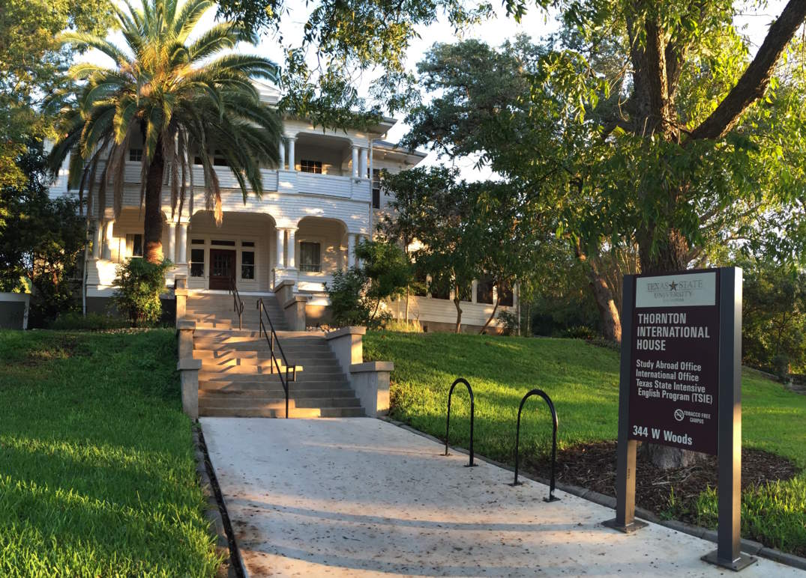
Education Abroad
Thornton International House
344 W. Woods Street
Phone: 512.245.1967
educationabroad@txstate.edu

