Slide 1
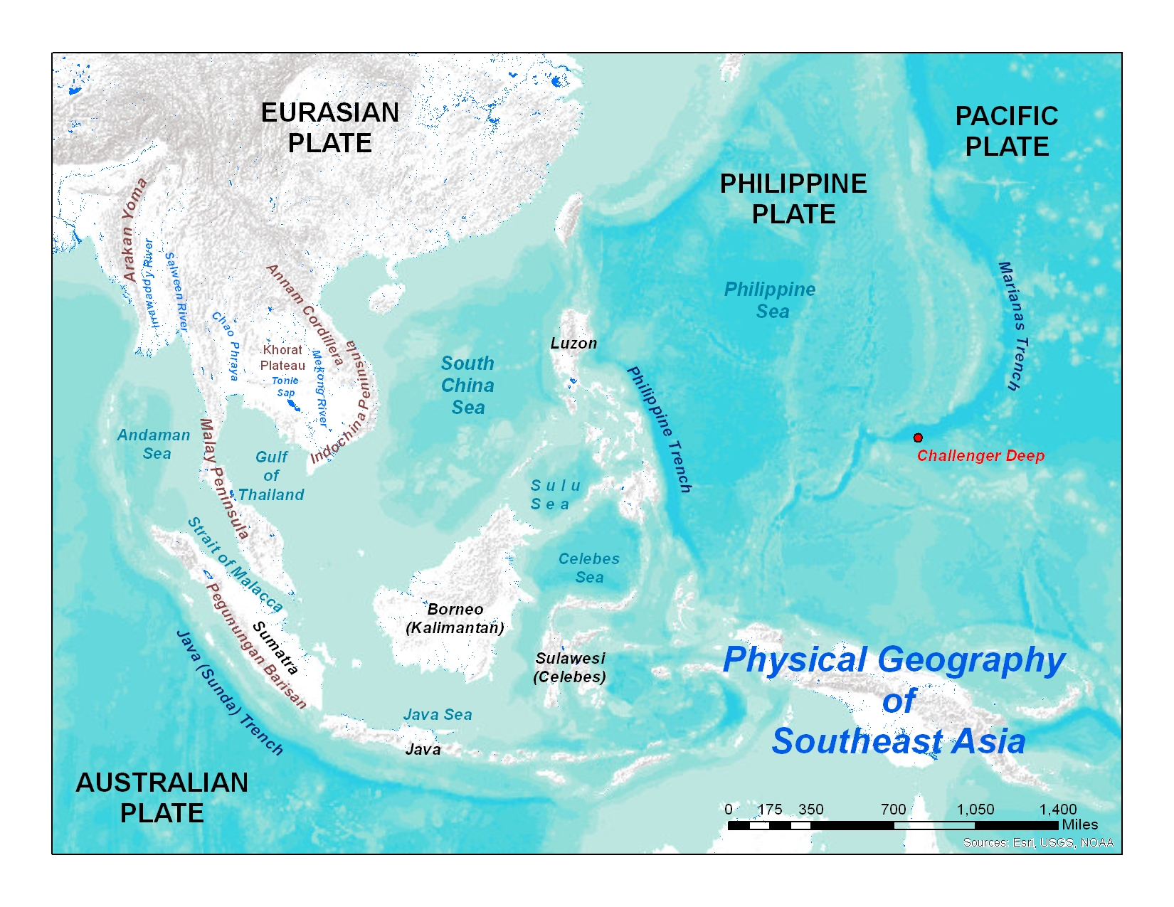
Notes:
Display this map for students to use as a reference while drawing their sketch. Remind them not to add features in at this time.

Slide 2
Looking at your outline map, what two landforms do you see that seem to dominate this region? Predict how these two landforms would affect the people who live in this region?
Notes:
Southeast Asia is a region dominated by peninsulas and islands. These landforms tend to isolate groups of people, creating a wide variety of different culture groups in the region.

Slide 3
Peninsulas & Islands
Mainland SE Asia consists of two large peninsulas
Malay Peninsula
Indochina Peninsula
Label these peninsulas in brown
Insular SE Asia consists of thousands of islands
Label these islands in black:
Sumatra
Java
Sulawesi (Celebes)
Borneo (Kalimantan)
Luzon
Notes:
Indicate to students that red, underlined words are vocabulary words, which should be included in their annotations.

Slide 4
Draw a line on your map to indicate the division between insular and mainland SE Asia.
Notes:
You may inform the students that since Malaysia straddles both the peninsula and islands, it could be considered both, or cut in divided between mainland Southeast Asia and insular Southeast Asia. By convention, it is typically marked as part of insular Southeast Asia.

Slide 5
Explain how the presence of so many mountains in this region might affect the people who live here.
Be sure to include how the volcanic mountains would affect people.
Notes:
Mountains would further isolate culture groups. While they may provide important mineral resources, they are difficult to farm. Volcanic mountains would provide fertile soil for growing food, but volcanic activity would threaten the lives of the people.

Slide 6
Explain your answer.
Looking at your map, predict which waterway you think would be the most valuable to control in order to control shipping in the region.
Notes:
The Strait of Malacca is one of the world’s most important shipping lanes. The strait provides the quickest route between the countries which border the Indian Ocean and those on the Pacific.

Slide 7
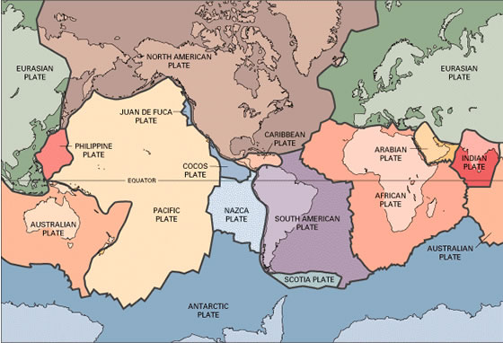
Notes:
Plate Tectonic Map used courtesy of the U.S. Geological Survey You might note to the students that while the region is almost entirely located on the Eurasian plate, the presence of the Australian, the Philippine and the Pacific plates significantly impact the people in Southeast Asia. You might also note that a fifth plate – the North American plate, also borders the Philippine plate.

Slide 8
Based upon what you already know about the geology of Southeast Asia, which type of boundary would you most expect to find here? Explain why.
List the three types of plate boundaries and the features which are found along them.
Notes:
Convergent, Divergent, and Transform. The folded and volcanic mountains are both evidence of convergent boundaries.

Slide 9
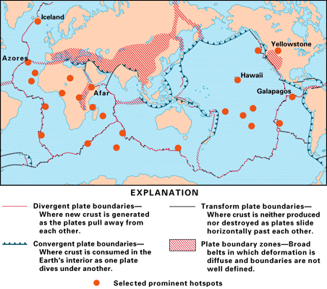
Notes:
Since this is a world map, Southeast Asia might be hard to see. Hold a large sheet of paper or poster board about a foot away from the screen in front of the region. This will cause the region to “pop-out” and can make it easier for students to see. Illustration used courtesy of the U.S. Geological Survey

Slide 10
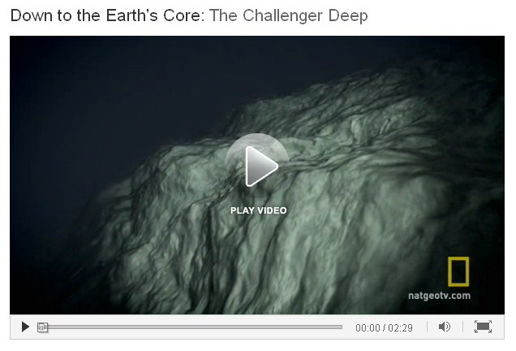
Challenger Deep
Deepest place on earth
It is 35,755 feet below sea level
Label Challenger Deep in red.
http://channel.nationalgeographic.com/videos/the-challenger-deep/
Notes:
Note: The video is NOT imbedded. You will need to be connected to the internet to view the video. Click on the picture to connect to the video. Screenshot taken from http://channel.nationalgeographic.com/videos/the-challenger-deep/

Slide 11
Closing Question
Based upon your map, name the two landform features which dominate Southeast Asia.
This project is funded in part by a grant from the National Geographic Society Education Foundation.
Notes:
From the notes, the students may recall that the answer is peninsulas and islands.

Slide 12
Notes & Credits
Slide 4
Display this map for students to use as a reference while drawing their sketch. Remind them not to add features in at this time.
Slide 5
Southeast Asia is a region dominated by peninsulas and islands. These landforms tend to isolate groups of people, creating a wide variety of different culture groups in the region.
Slide 6
Indicate to students that red, underlined words are vocabulary words, which should be included in their annotations.
Slide 7
You may inform the students that since Malaysia straddles both the peninsula and islands, it could be considered both, or divided in two between mainland Southeast Asia and insular Southeast Asia. By convention, it is typically marked as part of insular Southeast Asia.
Slide 10
Display this map for students to use as a reference while drawing their sketch. Remind them not to add features in at this time.
Slide 11
Mountains would further isolate culture groups. While they may provide important mineral resources, they are difficult to farm. Volcanic mountains would provide fertile soil for growing food, but volcanic activity would threaten the lives of the people.
Slide 14
Display this map for students to use as a reference while drawing their sketch. Remind them not to add features in at this time.

Slide 13
Notes & Credits
Slide 15
The Strait of Malacca is one of the world’s most important shipping lanes. The strait provides the quickest route between the countries which border the Indian Ocean and those on the Pacific.
Slide 18
Plate Tectonic Map used courtesy of the U.S. Geological Survey You might note to the students that while the region is almost entirely located on the Eurasian plate, the presence of the Australian, the Philippine and the Pacific plates significantly impact the people in Southeast Asia. You might also note that a fifth plate – the North American plate, also borders the Philippine plate.
Slide 19
Convergent, Divergent, and Transform. The folded and volcanic mountains are both evidence of convergent boundaries.
Slide 20
Since this is a world map, Southeast Asia might be hard to see. Hold a large sheet of paper or poster board about a foot away from the screen in front of the region. This will cause the region to “pop-out” and can make it easier for students to see. Illustration used courtesy of the U.S. Geological Survey
Slide 23
Note: The video is NOT imbedded. You will need to be connected to the internet to view the video. Click on the picture to connect to the video. Screenshot taken from http://channel.nationalgeographic.com/videos/the-challenger-deep/
Slide 24
Display this map for students to use as a reference while drawing their sketch. Remind them not to add features in at this time.
Slide 25
From the notes, the students may recall that the answer is peninsulas and islands.

