Slide 1
Sedimentation
Lesson 1:
“Dirty” Water

Slide 2
What will we study in this unit?
Dirt (soil) in water
Soil in the water is an important nonpoint source of pollution

Slide 3
It’s time for a demonstration
In front of you, you have two containers
How should you label these containers?

Slide 4
What is sedimentation?
Sediment is the dirt (soil) that goes into water and eventually settles down
Sedimentation is the process of the soil going into the water
Total Suspended Solids is how sediment is measured while suspended in water

Slide 5
What does sediment in water look like?

Slide 6
Water with very little sedimentation

Slide 7
Let’s look back at the water containers:
It is clear which container is “dirty” with soil
Do we know for sure that the clear container has no pollution?

Slide 8
Water Pollution
Pollution is anything in the water that is harmful to life
Water pollution can come from different sources:
Point source
Nonpoint source

Slide 9
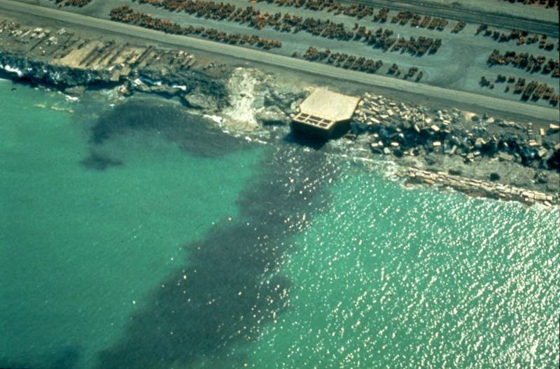
Point Source Pollution

Slide 10
Nonpoint Source Pollution

Slide 11
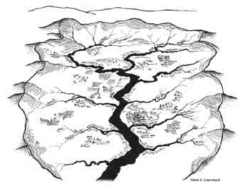
What is the word used to describe the area over which the runoff water from rain flows into a body of water (lake, river, stream)?

Slide 12
Watershed
All land is in a watershed of some body of water (stream, river, lake, ocean)
A watershed is the area of land whose runoff water feeds a specific body of water
Are we in a watershed?

Slide 13
Sedimentation in a watershed
Particulate matter (sediment) gets into the water from soils in the watershed
There are many sources of sediment, and therefore it is a nonpoint source

Slide 14
Important terms:
Sediment
Sedimentation
Pollution
Nonpoint source pollution
Point source pollution
Watershed

