Slide 1
Sedimentation
Lesson two: Soils

Slide 2
Time to observe and learn
You will examine three types of soil:
Clay
Sand
Loam
You will need to read and follow the instructions carefully

Slide 3
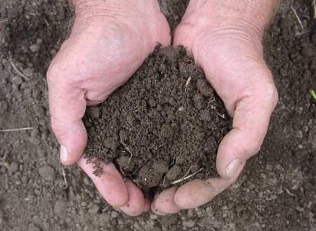
After examining the soil types:
What are some ways we can classify soils?
How can we distinguish one soil type from another?

Slide 4
From your soil investigation
Color/appearance
Smell
The feel of soil between wet fingers
Which pile loses height with water first/ which pile absorbs water best/ which pile breaks down into muddy sediment?
Size of particles and composition

Slide 5
Soils are mainly classified by:
Size of the soil particles
How much organic matter is in the soil
What minerals make up the soil

Slide 6
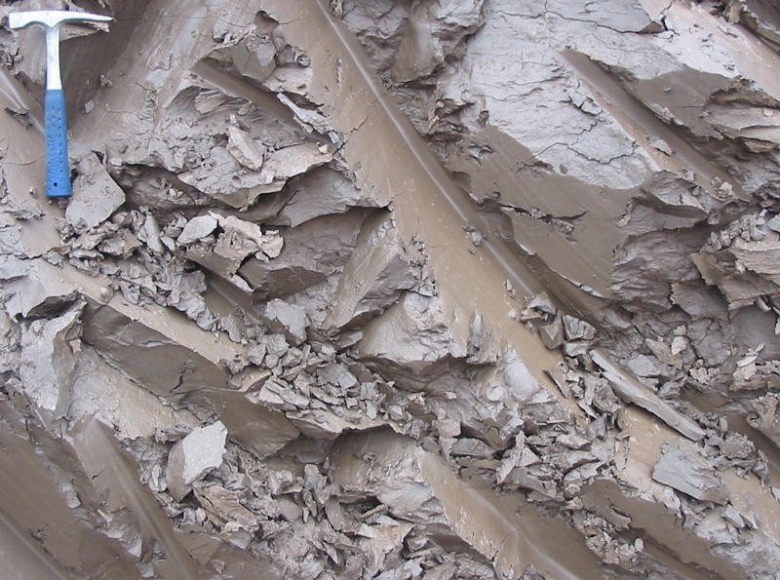
Size of the soil particles
Sand
Clay

Slide 7
This explains why:
The sand particles felt:
The clay particles felt:

Slide 8
Size
The clay particles are very small and relatively flat so they slide over one another easily. This is why it feels slippery to you.
The sand particles are larger and more coarse so they feel grittier.

Slide 9
Classifying soils
Soils are classified by size, but also by:
How much organic matter is in the soil
What minerals make up the soil

Slide 10
What does it mean to be organic?

Slide 11
Organic
The word organic means living, either now or in the past
Because all living things (plants and animals) have carbon in them, we say that organic chemistry is the chemistry of carbon
What organic things might you find in soil?

Slide 12
Organic matter in soils
Twigs
Leaves or parts of leaves
Flower parts
Animal parts (bones, feathers, skin)
Live small animals (worms, insects, etc)
Fungus
Feces

Slide 13
Organic matter in soils:
Organic matter makes the soil darker in color (carbon is black)
It also gives the soil an “earthy” smell
Organic soil is often less dense than water so it floats in water
Which soil that you looked at had the most organic matter? The clay, sand or loam?

Slide 14
Soil
Can anyone tell me
where soil comes from?

Slide 15
Cycles
Just as water has a cycle, SOIL is part of the ROCK CYCLE
All cycles can begin at any point. Let’s begin when rocks are so hot that they melt. Where can liquid rocks be found?

Slide 16
The Rock Cycle

Slide 17
All major rock types that turn into soil will undergo this process:
Weathering
What is weathering?

Slide 18
Agents of weathering
Water
Acidic rain can dissolve some rocks like limestone and marble
Rapid water flow can physically bang up and break rocks
Freezing water can crack rocks
Wind- can be like sandblasting rocks
Plants- roots grow into crevices and can split open rock, breaking it down into soil

Slide 19
We have been looking at cycles
The WATER cycle
The ROCK cycle
Both are continuous processes that use energy to run the cycle
The atoms that make up water and rocks are used over and over- the atoms are billions of years old
The rock cycle takes a MUCH longer time to complete than the water cycle

Slide 20
Matter and Energy Interact
The energy in the rock and water cycle provides the force for the atoms in both cycles to move
Atoms are matter (anything that has mass and occupies space), but energy is NOT matter

Slide 21
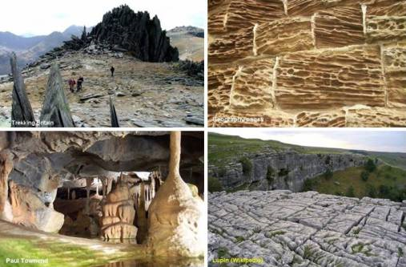
Weathering
Igneous, Metamorphic and Sedimentary rocks all can break down to form soil

Slide 22
Minerals
Remember, soils can be classified by the minerals that make up the soil
Igneous, metamorphic and sedimentary rock are made up of different minerals and when they break down, the soil looks different
Example: Quartz breaks down to make a larger, sand like particle. Feldspar breaks down to make a very small, clay like particle

Slide 23
Important terms and concepts:
Soils are mainly classified by:
Size of the soil particles
How much organic matter is in the soil
The minerals that make up the soil
Rocks in the rock cycle can all break down to make soil through weathering
Organic means anything that is living or has lived

Slide 24
Time to learn and observe
You will examine the interaction of three types of soil with lots of water
You will need to read and follow the instructions carefully

