Slide 1
Sedimentation
Lesson three:
Ecosystems

Slide 2
Let’s look at the jars of “dirty” water again
Do they look the same today as it looked when you left yesterday?

Slide 3
Particle size
Which particles settled out the most rapidly?
The larger particles or the smaller ones?

Slide 4
Why is sedimentation viewed as a nonpoint source of pollution?
Review: What is sedimentation?
What is pollution?

Slide 5
To answer the question of why sedimentation (soil particles going into water and settling down) is a source of nonpoint source pollution (pollution is anything in the water that harms life), we must first review ecosystems.

Slide 6
Ecosystems
An ecosystem is a biological environment consisting of plants and animals living in balance in a specific nonliving (abiotic) environment
What are the factors that make up the nonliving or abiotic part of the environment?

Slide 7
A prairie is an example of an ecosystem
What kinds of plants and animals are in a prairie?
How does the amount of rainfall in a prairie compare to a desert (a different ecosystem)?
How does prairie temperature compare to an arctic tundra?
How does prairie soil compare to an beach?

Slide 8
In a prairie:
What kinds of plants and animals are in a prairie?
How does the amount of rainfall in a prairie compare to a desert (a different ecosystem)?
How does prairie temperature compare to an arctic tundra?
How does prairie soil compare to an beach?
What three abiotic (nonliving) factors are mentioned above?
What are the four ecosystems listed above?

Slide 9
Aquatic Ecosystem
What types of plants and animals would you find in an aquatic ecosystem?
What types of abiotic factors?
Ecosystems are really a web of parts

Slide 10
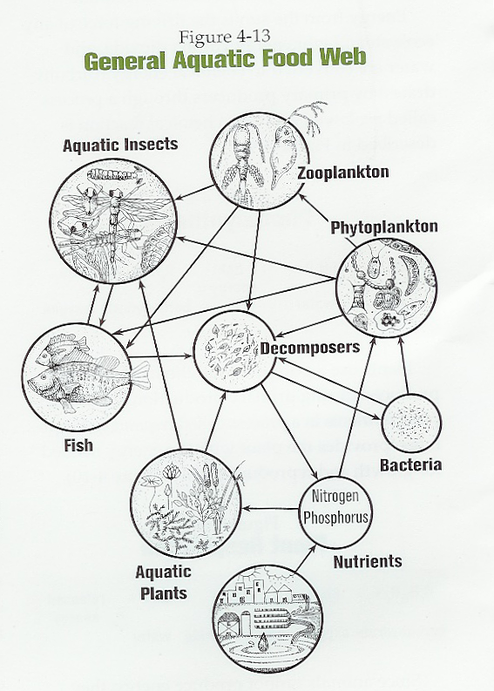
Ecosystem Food Web

Slide 11
Every ecosystem has an energy source.
What is the energy source for ecosystems on earth?

Slide 12
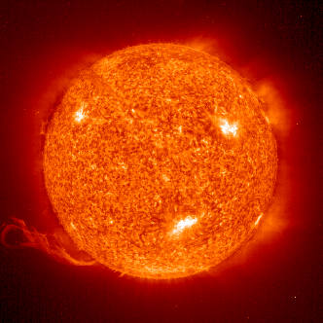
The SUN
The sun is the source of energy for the many different ecosystems of the earth
Does the energy of the sun cycle?

Slide 13
Energy
In the rock and water cycle, energy comes from the sun, but energy does NOT cycle back to the sun
The atoms in rock and water move by the force of energy. There is a big difference between matter and energy.

Slide 14
Energy
Every ecosystem has a source of energy
How is this energy absorbed into the ecosystem?
Hint: this is an essential part of every ecosystem

Slide 15
Plants
Plants absorb the sun’s energy through the process of photosynthesis
Who eats the plants?
Hint: this is another essential part of every ecosystem

Slide 16
Essential parts of every ecosystem:
Source of energy
Plants
Animals
Abiotic (nonliving) factors
Water
Soil
Temperature
Decomposers (to return atoms to system from wastes and death of living things)

Slide 17
What do we mean by essential?
Can an ecosystem survive if we take away:
Plants?
Animals?
Decomposers?
Energy source?
Abiotic factors?

Slide 18
Essential
Plants, animals, source of energy, decomposers and abiotic factors are all necessary for an ecosystem, therefore they are ALL essential!
They live in a balanced web

Slide 19
Back to sedimentation…
Why is sedimentation viewed as a nonpoint source of pollution?
Sedimentation is detrimental to life. How?
Tomorrow we will examine how sediment harms the aquatic ecosystem. Start thinking about this.

Slide 20
Important terms and concepts:
Ecosystem
Essential parts of the ecosystem
Plants
Animals
Decomposers
Source of energy
Abiotic factors

Slide 21
Time to observe and learn
You will be determining how much water can be stored in soil
You will need to read and follow the instructions carefully

