Slide 1
Sedimentation
Lesson Four:
Sedimentation as Nonpoint Source Pollution

Slide 2
Let’s review what we have observed so far
Dirty water and sedimentation
Different types of soil are classified by particle size, amount of organic matter and mineral type
Soils are part of the rock cycle that results from weathering
Smaller particles of soil in water settle out more slowly than larger particles. Some are so small that they remain suspended in water

Slide 3
Sedimentation
Why is sedimentation viewed as a nonpoint source of pollution?
Because sedimentation is detrimental to life.
How?

Slide 4
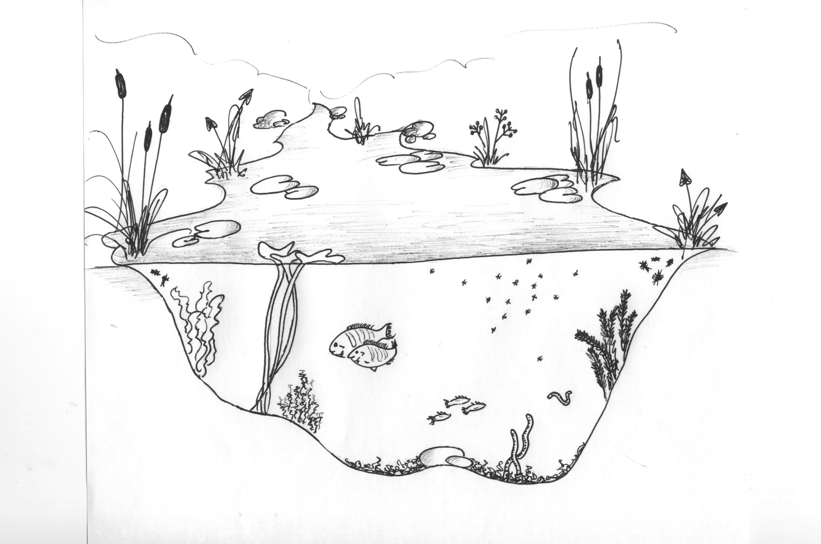
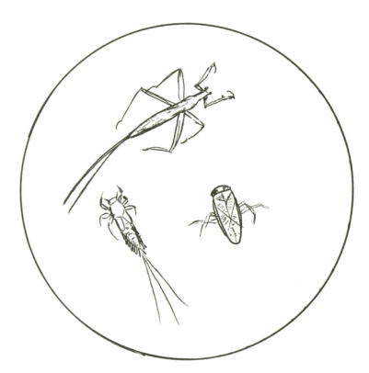
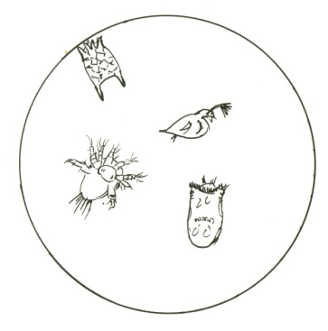
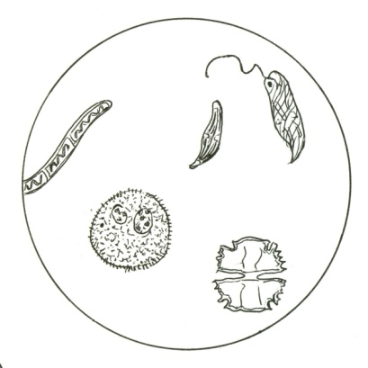
Aquatic Food Web
Oxygen, Carbon Dioxide,
+ Heat and Light Energy
Nutrients from the land
Foraging Fish – Carnivores, Herbivores, and Scavengers
Macroinvertebrates – Herbivores, Carnivores and Omnivores
Zooplankton – Herbivores and Carnivores
Benthos - Mud Dwelling Scavengers and Decomposers
Algae -Producers
Floating and Submerged Vegetation - Producers
Illustrations by

Slide 5
Let’s review:
What essential part of the ecosystem turns the energy from the sun into food for the animals?

Slide 6
Plants
What do plants need to live?

Slide 7
Plants need:
Sunshine to carry out photosynthesis
Water
Soil (nutrients)
Oxygen and carbon dioxide
How does sediment effect these factors in an aquatic ecosystem?

Slide 8
Sediment in water reduces the sunlight that reaches the plants so the plants cannot make as much food for the rest of the ecosystem.

Slide 9
Remember that the organisms in an ecosystem are interdependent

Slide 10
Animals
What do animals need to live?

Slide 11
All animals, including aquatic animals, need:
1. FOOD
We have already seen how sediment reduces food
In addition, animals cannot see their food as well in cloudy water.
2. OXYGEN dissolved in water
Where does the oxygen come from?

Slide 12
Oxygen in water
Oxygen comes from the air
It also comes from plants in the water when they carry out photosynthesis
Since sediment in water reduces photosynthesis, it also reduces the oxygen in the water for the animals

Slide 13
Sediment
Sediment can be in the air and in the water. Sediment in the air is called a dust storm or sandstorm.
If you were in a sandstorm, how would you protect yourself?

Slide 14
Sandstorm
Sandstorm approaching Al Asad, Iraq, just before nightfall on April 27 2005.
This is how sediment coming into the water might look to the fish under water.

Slide 15
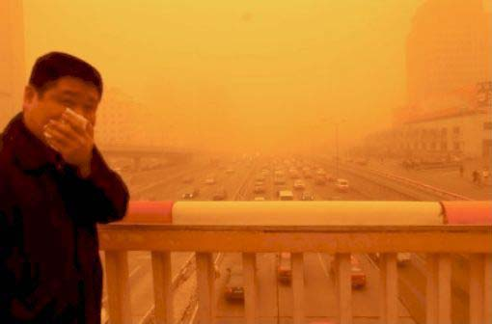
You would protect your lungs (the way you get oxygen) by covering your nose and mouth

Slide 16
Many aquatic animals get their oxygen through their gills

Slide 17
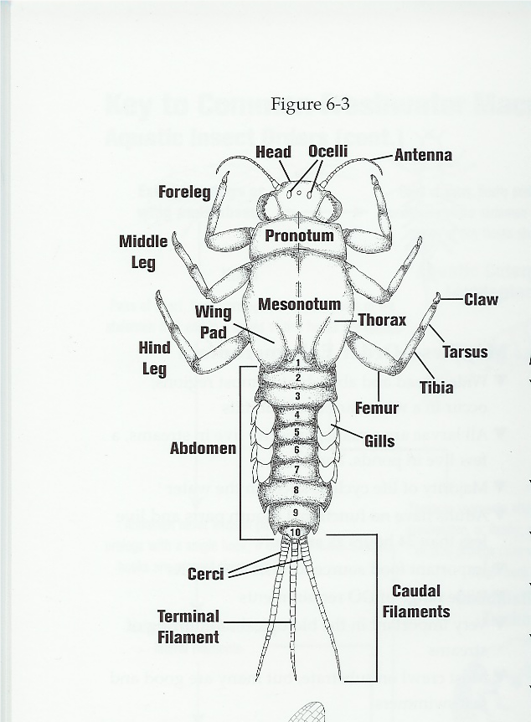
Aquatic animals cannot cover their gills and sediment harms them

Slide 18
Animals have different structures to perform necessary functions
Gills
Lungs
What is the function of gills?
Who has gills?
What is the function of lungs?
Who has lungs?

Slide 19
Sediment
Sediment harms life, so therefore sediment is a pollutant.
Review: Where does sediment come from?

Slide 20
Sediment Review
Sediment comes from bare soil
When wind or water carry soil particles away, we call this erosion
What can we do to reduce erosion?
Reducing erosion reduces sedimentation

Slide 21
In the next lesson, we will examine ways to reduce erosion and prevent sedimentation

Slide 22
Important terms and concepts
Sedimentation is a nonpoint source pollutant
Photosynthesis
Gills are aquatic animal structures with the function of gathering oxygen
Erosion

