Slide 1
Sedimentation
Lesson five:
Reducing Sedimentation

Slide 2
Based on your experiment and the previous lessons, what can you say about soil and water?

Slide 3
Soil and rock can both hold water
Porous rocks, like limestone, can hold large amounts of water
Large underground areas of water-bearing rocks are called aquifers

Slide 4
Aquifers
50% of the water people use in the United States comes from the ground (aquifers).
When you use a well for water, that water comes from an aquifer.

Slide 5
Water types
Water on the surface of the earth is called surface water.
Water under the surface of the earth is called groundwater.
What are some examples of surface water?

Slide 6
Surface water examples
Streams
Ponds
Lakes
Rivers
Wetlands
Oceans
Bays

Slide 8
The Water Cycle

Slide 9
Sediment
Suspended sediment in surface water harms life, so therefore sediment is a pollutant.
Review: Where does sediment come from?

Slide 10
Sediment comes from the soil
When wind or water carry soil particles, we call it erosion.
Soil particles are most easily moved when the soil is BARE, not covered with vegetation.

Slide 11
Bare soil causing erosion

Slide 12
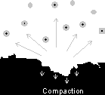
Runoff
Falling raindrop
Where the rain falls faster than the ability of the soil to absorb it, water builds up at the surface and runoff starts. If the land slopes, gravity causes runoff to move rapidly down hill,
which increases its ability to erode and move more soil in the watershed.
Raindrop hitting bare soil
Water transporting soil particles

Slide 13
Actual photograph of a drop of water as it lands

Slide 14
Runoff

Slide 15
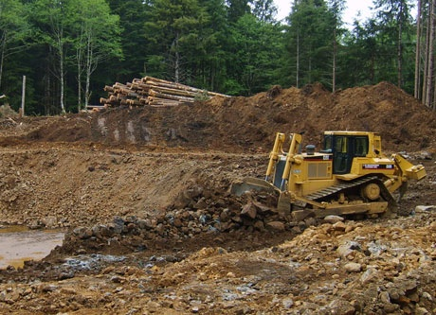
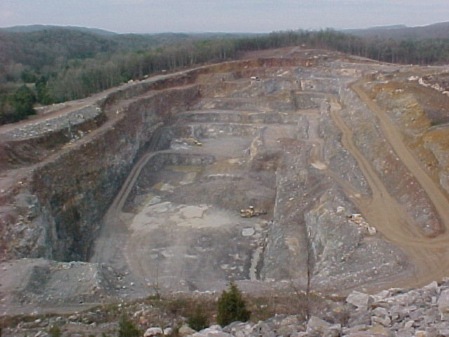
Common sources of suspended solids
Construction activities
Erosion of agricultural lands
Surface mined land (strip mining)

Slide 16
Poor logging practices can also lead to soil erosion and sedimentation
Note the exposed bare soil

Slide 17
Hamilton Pool has silt (sediment) in it because of nearby housing construction. In the fall of 2007, Travis County sued the construction company to make them control the sediment runoff.

Slide 18
In order to reduce erosion, which results in suspended solids in the water, we must first COVER the bare soil!
Can you come up with some ways to cover bare soil?

Slide 19
Ways to cover bare soil
Plants- the very best permanent means of covering bare soil. The roots hold the soil in place, plus roots add to the organic matter in the soil
Mulches- hay, chopped wood, leaves, gravel, tarps help control erosion
Cover crops- alfalfa, clover fields hold the soil in place in the winter and add organic matter and nitrogen to the soil

Slide 20
Notice the plants growing along the banks of the waterway
UT Pan Am "Teaching Environmental Science," Edinburg Main Canal, Edinburg, TX, 7/20/07. Photo by J. Tuason

Slide 21
Roots of plants hold the soil in place and do not allow raindrops to land directly on bare soil.
Note the length of the roots of the plant on the far left-grass/sod. Now note the lengths of the roots of the rest of the plants. The roots of the native plants are much longer the grass/sod are only 2 inches long, the with some extending as long as 15 FEET underground!

Slide 22
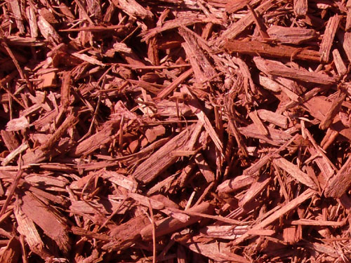
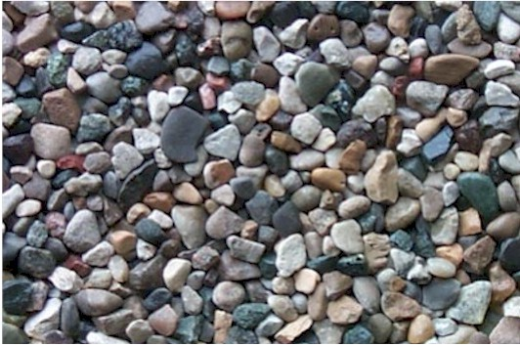
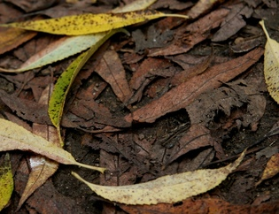
Mulches
There are many different materials
that can be used for mulch

Slide 23
Reclamation of land from surface mining takes a lot of money and effort
Open pit strip mining
Reclaimed land project

Slide 24
Contour farming on a hillside keeps the soil in the ridges
Erosion from farmland
Contour farming

Slide 25
Farmers can also plant cover crops to enrich and hold the soil
Dense cover crop
Cover crops are useful any place where there is bare soil.

Slide 26
Retention ponds
Typically, retention ponds are found in housing and commercial developments. They are dug to slow down the water and allow the sediment to settle out thus preventing the deterioration of "downstream” surface waters such as streams and lakes.

Slide 27
Selective logging reduces soil erosion
Selective logging
Clear cut logging

Slide 28
Silt fences help control sediment runoff during construction

Slide 29
Important terms and concepts
Surface water
Ground water
Erosion
Erosion increases sedimentation
Ways to decrease erosion

