Slide 1
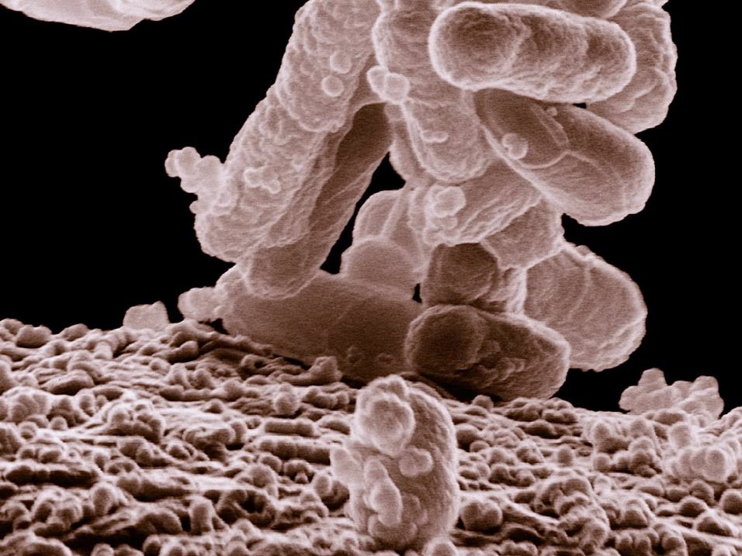
TEXAS STREAM TEAM E. COLI BACTERIA WATER QUALITY COMMUNITY SCIENTIST TRAINING Date - Location
Texas Stream Team is funded in part through a grant from the U.S. Environmental Protection Agency through the Texas Commission on Environmental Quality
Notes:
Use this time to welcome participants to the training!

Slide 2
NAME,
TITLE ORGANIZATION
Notes:
Add some information about yourself/your group here
Your name and title
Your organization and their logo

Slide 3
AGENDA
1
Introduction to Texas Stream Team and E.coli Bacteria
2
Phase I – Recap and continuation
3
Phase II – Conduct protocols with trainer assistance
Phase III – Conduct protocols without trainer assistance
4
5
Wrap Up and Next Steps
Notes:
There are three phases total that must be completed to receive your Texas Stream Team E. coli Bacteria certificate. The virtual module covered a large portion of Phase I. Today, the rest of phase I and the remaining phases will be covered to get everyone certified.
IF PRE-TRAINING MODULE WAS USED: DELETE SLIDES 3-22 AND BEGIN ON SLIDE 23. IF THE MODULE ISN’T USED REMOVE SLIDES 23-25

Slide 4
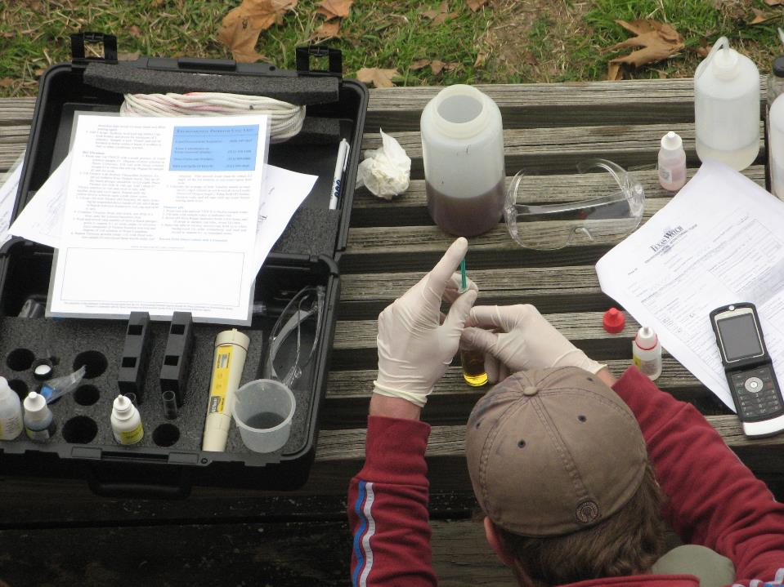
STATEWIDE COMMUNITY SCIENCE WATER QUALITY MONITORING SINCE 1991
A network of trained community scientists and supportive partners administered through a cooperative partnership between:
Notes:
Mention here that Texas Stream Team is a statewide community science water quality monitoring program that has been operating since 1991 and is a network of trained community scientists and supportive partners administered through a cooperative partnership between the United States Environmental Protection Agency, the Texas Commission on Environmental Quality, and the Meadows Center for Water and the Environment.
Mention that the Meadows Center is a research institute affiliated with Texas State University and is home to the Texas Stream Team program which is one of the largest, longest-running statewide water quality community science programs in the country.
Also mention that Texas Stream Team receives partial funding from the EPA, through a clean water act section 319 grant administered by the TCEQ.

Slide 5
MISSION:
To facilitate environmental stewardship by empowering a statewide network of concerned community scientists, partners, and institutions in a collaborative effort to promote a healthy and safe environment through environmental education, data collection, and community action.
11,000+
Community Scientists
400+
Monitoring Sites
100+
Partners
Notes:
Read the mission statement and mention the program metrics to give trainees an understanding of our programs reach.

Slide 6
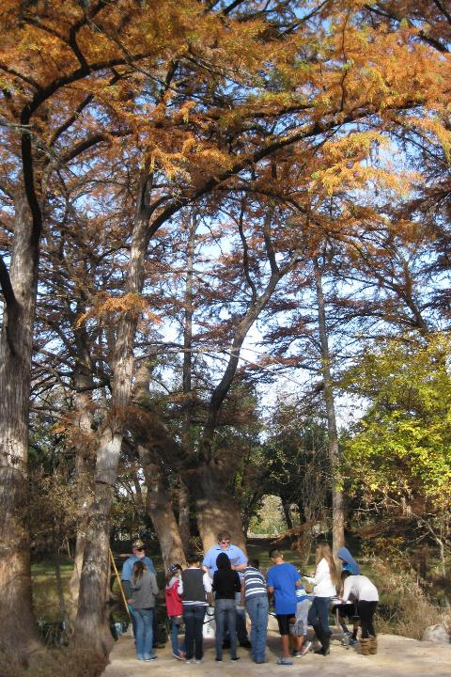
WHAT WE DO
Environmental Education
Data Collection & Analysis
Community Action/Engagement
Watershed Services
6
Notes:
Talk about all the different services that Texas Stream Team offers other than water quality monitoring and data collection. Talking points:
A robust environmental education program
Data collection through our statewide community scientists and they perform different analysis to highlight, review, and showcase data
Community action and engagement by providing educational workshops for schools and youth programs. They also provide community assistance for education and outreach strategies, grants, and loan applications. And they help with informing the public about environmental management decisions.
Watershed services by connecting homeowners to watersheds to promote nonpoint source pollution reduction. They help gather information and grow monitoring efforts to address data gaps. And lastly, we help with local planning, protection, restoration clean-ups, and habitat monitoring.

Slide 7
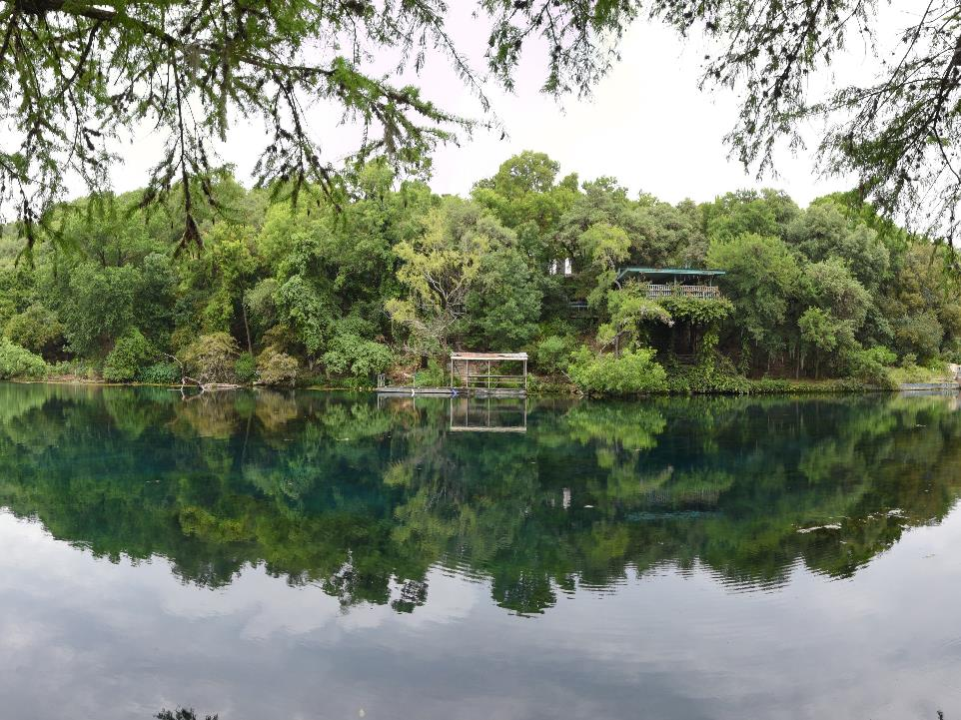
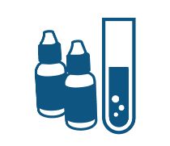
COMMUNITY SCIENTIST TRAININGS
Standard Core
Probe Core
E. coli Bacteria
Advanced
Macroinvertebrate Bioassessment
Riparian Evaluation
Notes:
Briefly review all the trainings Texas Stream Team offers:
Standard Core - involves performing tests for parameters such as conductivity or salinity, dissolved oxygen, pH, temperature and various field observations using a chemical standard core kit.
Probe Core - includes the same parameters as the Standard Core training, however parameters are collected using meters or probes as opposed to the chemical tests.
E. coli Bacteria - involves measuring E. coli bacteria to determine the relative risk of swimming or contact recreation in a water body. E. coli is a bacteria that originates from the waste of warm-blooded animals and the presence of this bacteria indicates that associated pathogens from waste may be reaching a body of water.
Advanced training - performing tests for nitrate-nitrogen, orthophosphate, turbidity, and streamflow using the advanced chemical kit.
Macroinvertebrate bioassessment - uses freshwater macroinvertebrates, fish, and habitat to determine the health of a lake, river, or stream.
Riparian evaluation - used to evaluate the health of a lake, river, stream, or estuary based on the riparian habitat.
It is also worthwhile to mention both the E. coli Bacteria and Advanced Training have prerequisites - must have Core certification plus six months of core monitoring.

Slide 8
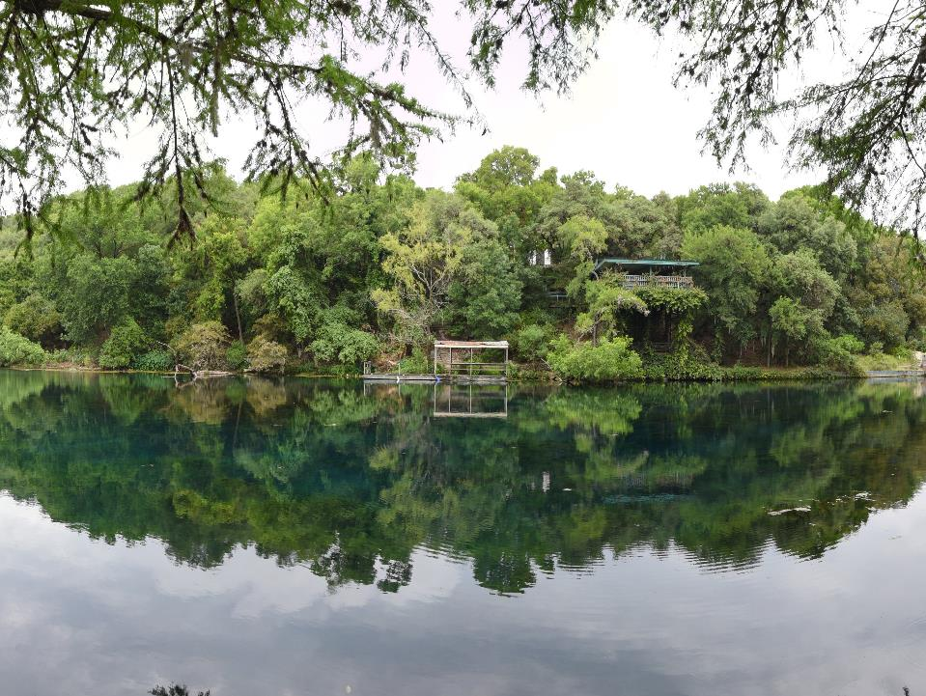
PROGRAMS
Trash Free Texas
Student Organizations
WPP/TMDLs
Notes:
Briefly review the different outreach programs Texas Stream Team also leads:
Trash Free Texas - a statewide program with many partners to help reduce trash pollution from waterways. Texas Stream Team community scientists gather data for the trash free Texas program by collecting trash pollution at their monitoring site and documenting if trash was collected on their environmental monitoring form.
Student organizations - Texas Stream Team offers institutions guidance for creating a Texas Stream Team student chapter.
Watershed Protection Plan and Total Maximum Daily Loads – Texas Stream Team provides assistance on analyzing WQ data, informing SH’s, initiating outreach and more.

Slide 9
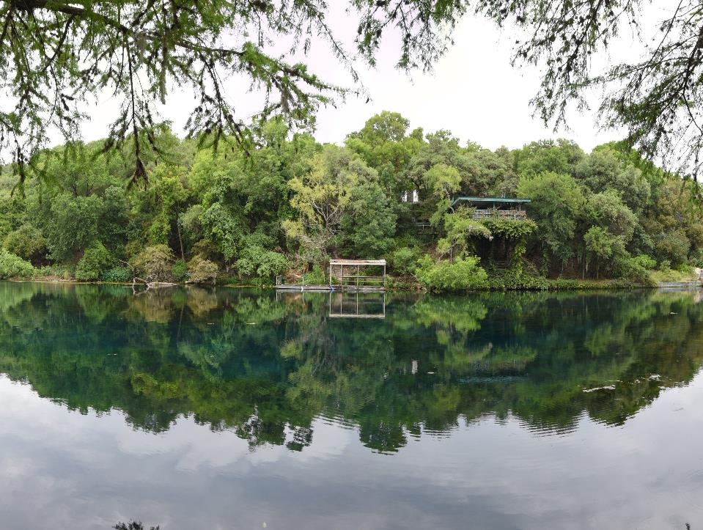
PARTNER PROGRAMS
Nurdle Patrol
Monofilament Finders
Notes:
Briefly review the different partner programs Texas Stream Team works with. Talking points:
Nurdle Patrol - a community science program ran by the Mission-Aransas National Estuarine Research Reserve at the University of Texas Marine Science Institute and focuses on bringing the community together to tackle plastic pollution, specifically focusing around nurdle awareness and removal efforts. A nurdle is a very small pellet of plastic (typically less than 5mm in length) that serves as raw material in plastics manufacturing. The Nurdle Patrol’s aims to gather information about nurdles, locate where they are, and remove them from the environment. Texas Stream Team community scientists help with the nurdle patrol program by documenting on their monitoring form if they conducted a nurdle survey while they were out monitoring. Please note, you must be trained with nurdle patrol to begin surveying for nurdles.
Monofilament finders - an initiative to reduce and recycle monofilament fishing line litter in the environment by setting up monofilament collection stations across the state of Texas. Texas Stream Team community scientists help with the monofilament finders program by documenting on their monitoring form if they found any monofilament line while monitoring at their site.

Slide 10
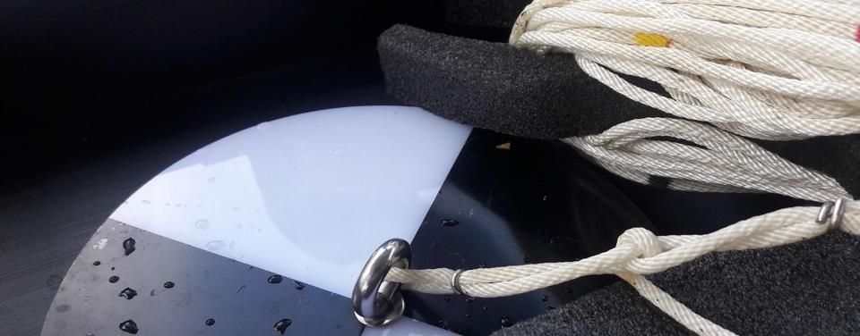
DATA USES
Offers a look at the overall quality of watersheds and local water quality
Assist TCEQ and TPWD in determining causes of NPS pollution
Data trends can have real world effects
Education and outreach
Data Summary Reports
Supports WPP and TMDLs
Research projects
Submitted to EPA’s Water Quality Exchange database
Submitted to the Waterways Dataviewer database
Publicly accessible on our interactive Datamap
Notes:
Talk about the different ways Texas Stream Team data is used.

Slide 11
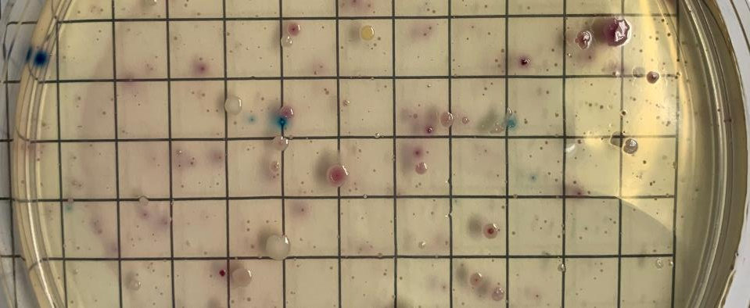
QUALITY ASSURANCE
TCEQ-approved Quality Assurance Project Plan (QAPP)
Monitoring techniques are standardized state-wide to ensure consistent data quality
Data are reviewed to ensure they are representative of the samples analyzed and locations monitored
Notes:
Here, talk about how all monitoring done by Texas Stream Team falls under a Quality Assurance Project Plan (can be pronounced as KWAP or spoken out as Q-A-P-P). Talking points:
Standardizations are included in the QAPP. Given the regulatory implications associated with the use of water quality data, the TCEQ uses scientifically rigorous and consistent water quality sampling methods to help​ ensure valid data outcomes.
Data is reviewed by the group Data Coordinators and our Texas Stream Team staff.

Slide 12
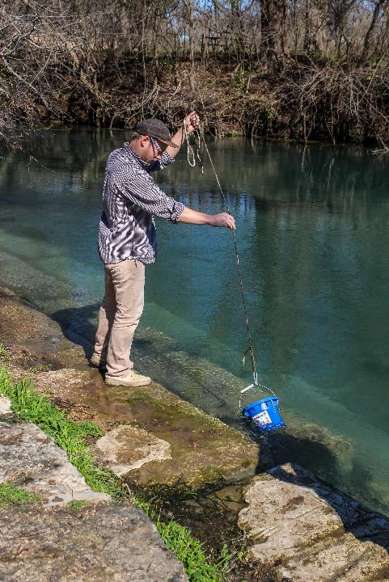
WHY COMMUNITY SCIENCE MONITORING?
More cost effective than professional monitoring
More frequent than professional monitoring
Can trigger alarm bells to alert state officials
Notes:
Explain the importance of community scientist monitoring here. Talking points:
The cost of community science monitoring is very affordable compared to professional monitoring costs. State water quality monitoring equipment can cost well over $10,000. Texas Stream Team offers a way for Texans to get involved using customized kits to collect data, similar to those collected by professionals, at a much lower cost.
Professional monitoring by the state is conducted on a quarterly basis. Whereas Texas Stream Team community scientists are trained to monitor water quality parameters monthly.
Because community scientists monitor more frequently, they might detect measurements that fall outside of the normal range of values before state officials can. Community scientists have alerted state officials of incidents that may have otherwise gone unnoticed, such as fish kills, illegal dumping, and more.

Slide 13
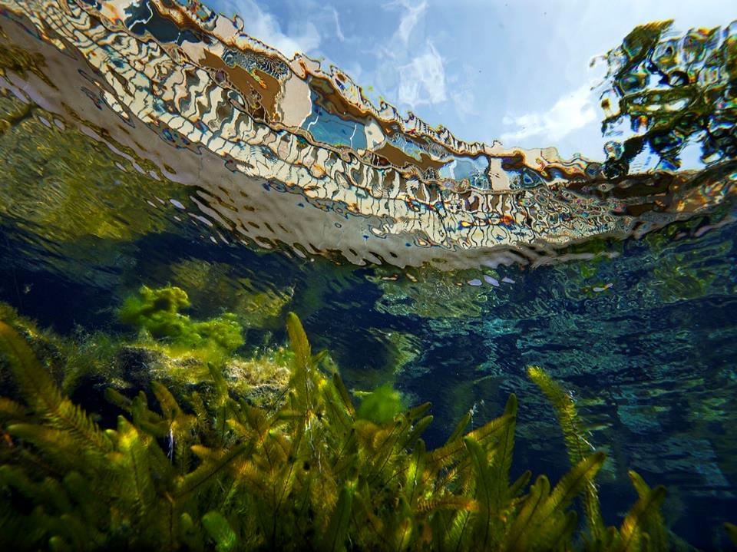
E. COLI BACTERIA INTRODUCTION

Slide 14
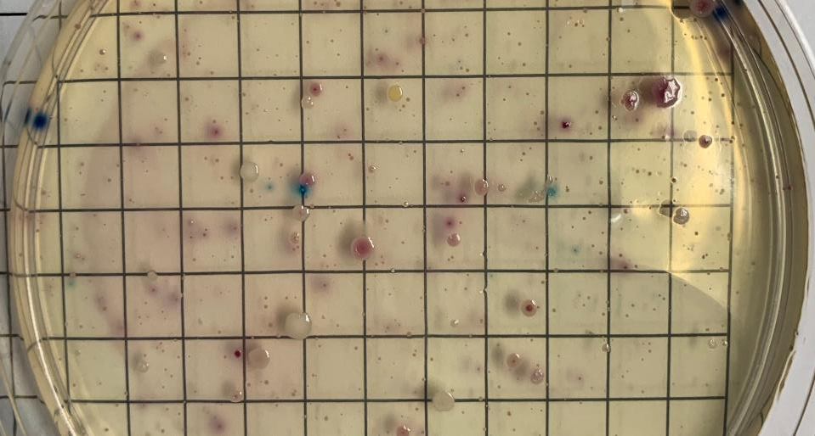
E.COLI BACTERIA TESTING
Texas Commission on Environmental Quality monitors classified water segments around the state.
Segments not meeting the Water Quality Standards are deemed impaired and are placed on the 303(d) list
Notes:
Share the information on the slide.
Water bodies marked as impaired are placed on the 303(d) list of impaired water bodies, along with the type of impairment identified.
Emphasize that it is important to routinely collect E. coli bacteria data because this information helps establish baseline waterbody conditions, as well as identify abnormal environmental events when they occur. Texas Stream Team community science data helps fill in the gaps where the state does not monitor and helps to serve as an early warning system for the state and local governments.

Slide 15
About half of the water bodies in Texas are impaired.
More than half of impairments are because of bacteria.
Notes:
Here you can share that more than half of the 303d listed waters are a result of contact recreation impairments due to high bacteria levels.

Slide 16
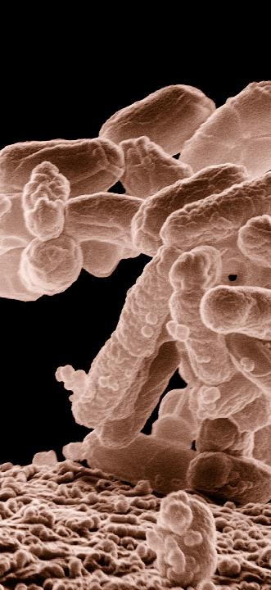
E.COLI BACTERIA
Escherichia coli, is a rod-shaped bacteria found in the intestines and feces of warm-blooded animals
Used as an indicator species
Measured to determine the relative risk of contact recreation in a water body
Indicates the presence of fecal matter in the water
Indicates the possibility of parasites and pathogens in the water
Measured in CFU/100 mL
CFU = Colony Forming Units
Notes:
Read the slide

Slide 17
E.COLI BACTERIA
Water Quality Standard for Primary Contact Recreation in Freshwater Streams:
Geometric mean of 126 CFU/100 mL
Geometric mean (Geomean):
Calculated from between 10 - 20 samples over the 7-year assessment period
Different from the usual arithmetic mean
Arithmetic Mean:
The sum of the samples divided by the total number of samples
Notes:
Read the slide

Slide 18
E.COLI BACTERIA GEOMETRIC MEAN
Geometric Mean: The nth root of the product of the samples where n = the number of samples
A geometric mean is used to summarize bacteria data because those data are so variable. Bacteria can grow at an exponential rate very quickly under the right conditions.
E. coli samples can vary between 1 CFU/100 mL to over 50,000 CFU/100 mL
$$=\sqrt[n]{\left(X_{1}\right)}\left(X_{2}\right)\left(X_{3}\right)…(X_{n})$$
Notes:
Read the slide. Things you can elaborate on:
The geometric mean is calculated by taking the nth root of the product of the samples where n = the number of samples included in the calculation.
The geometric mean will not be overly influenced by large fluctuations in the resulting data.

Slide 19
CALCULATING THE
GEOMETRIC MEAN
Example:
You collected five water grab samples over a one-month time period and tested them for E. coli. The results are as follows:
Sample | E. coli (CFU/100mL)
1 | 10
2 | 100
3 | 300
4 | 15
5 | 4
$$=\sqrt[5]{\left(10\right)}\left(100\right)\left(300\right)(15)(4)$$
= 28.25
Notes:
In this slide we will go over an example of calculating the geometric mean. In this example:
*read slide*
When we plug our sampling event into the geometric mean equation, we get the following equation, where n = 5 since we had 5 total sampling events.
In this example, the resulting geometric mean is 28.25, therefore the water quality standard of 126 CFU per 100 milliliters has been met.

Slide 20
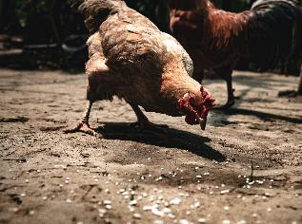
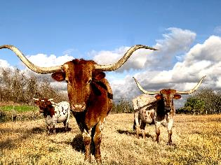
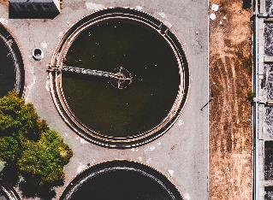
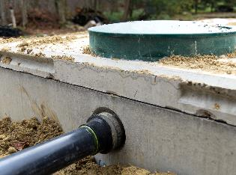
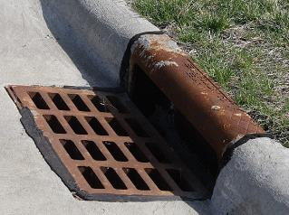
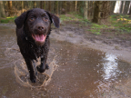
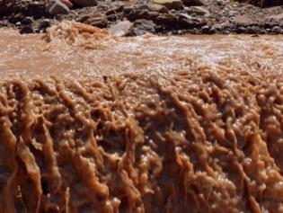
SOURCES OF E. COLI BACTERIA
Notes:
Mention there are many E. coli bacteria sources:
Agriculture or Agricultural Products. Examples include:
Improper distribution of cow manure
Livestock waste is another example of animal waste that poses the same threats as cow manure
Human waste. Examples include:
Inadequately Treated Sewage
Failing Septic Systems (OSSFs)
Illicit Discharge
Urban Runoff

Slide 21
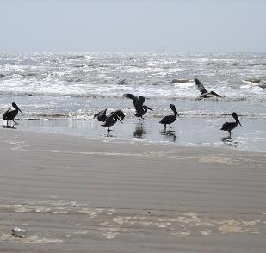
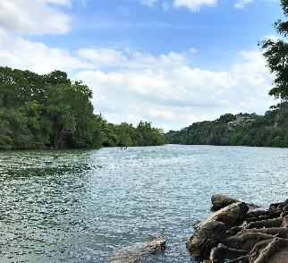
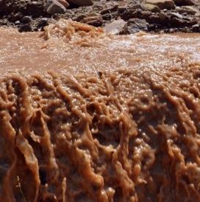
WATER QUALITY PARAMETERS
Field observations
E. coli Bacteria
Notes:
Emphasize that E. coli bacteria monitoring involves performing tests for E. coli bacteria, in addition to recording the same field observations you learned in the Core training.

Slide 22
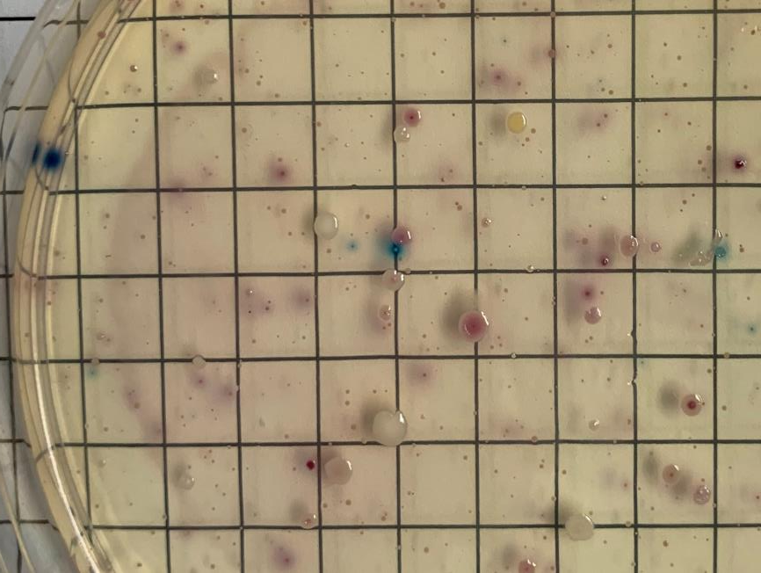
E. COLI BACTERIA MONITORING PREPARATION
Freshwater vs saltwater
Monitoring frequency
Dress for the outdoors
Try to bring a buddy
Always bring:
E. coli Bacteria Environmental Monitoring Form
E. coli Bacteria Field Guide
E. coli bacteria monitoring supplies
Notes:
Go over some steps to prepare for a monitoring event. Talking points:
Emphasize here that that e. coli is the indicator bacteria for freshwater, not saltwater. The monitoring can still take place at saltwater sites, however, the saltwater indicator is enterococcus therefore if anything alarming appears during a monitoring events, further monitoring will need to be conducted through an accredited lab.
We ask community scientist to go out and monitor once a month at the same time each month. Monitoring should take place before 12 or after 4.
Not required, but it is best to suit up in outdoor clothing that is protective of the elements
A buddy is not required, but it is suggested for safety purposes
A monitoring form, field guide and monitoring supplies are always required

Slide 23
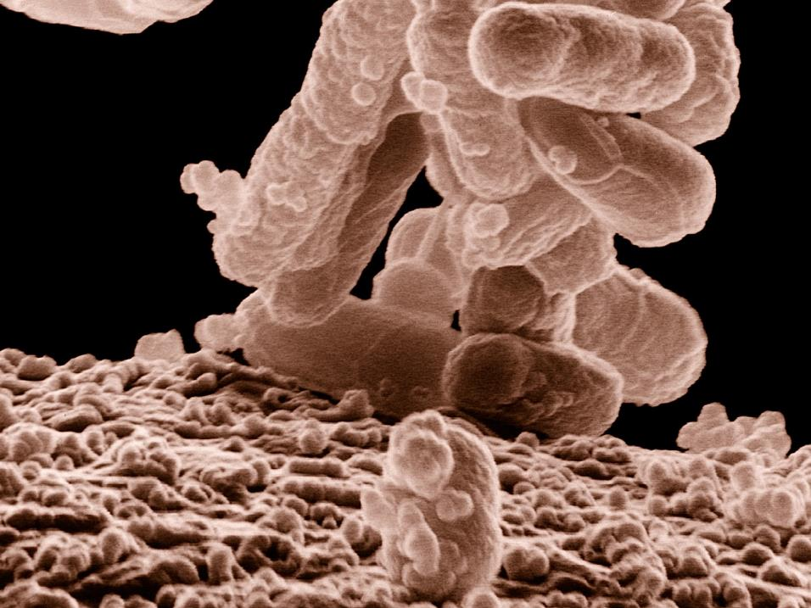
PHASE I

Slide 24
MODULE RECAP
Notes:
IF THE MODULE ISN’T USED REMOVE THIS SLIDE

Slide 25
TESTING YOUR KNOWLEDGE
What units are E. coli bacteria measured in?
CFU/100 L
CU/100 mL
CFU/150 mL
CFU/100 mL
Notes:
IF THE MODULE ISN’T USED REMOVE THIS SLIDE

Slide 26
TESTING YOUR KNOWLEDGE
True or False, more than half of the 303d listed water bodies are listed for non-support of the contact recreation use due to high bacteria levels?
True
False
Notes:
IF THE MODULE ISN’T USED REMOVE THIS SLIDE

Slide 27
IMPORTANT TO NOTE

Slide 28
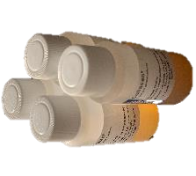
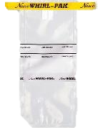
MONITORING SUPPLIES
Whirl-Pak® Bags – make sure seal is not broken
100 mL DI Water
Petri dishes – keep at room temperature, out of direct light, and in a closed bag to prevent drying
Coliscan Easygel – unexpired media should be stored in freezer until ready to use
5 mL graduated sterile pipettes – make sure seal is not broken
Cooler with ice
Incubator
Gloves or hand sanitizer
Permanent Marker
Ziploc Bags, gallon
Vinegar/alcohol
Notes:
Go over each training supply item and important things to note about each. For training purposes item number 6 won’t be used.
A cooler with ice will always be needed since majority will likely always be transporting their samples as the samples have to be taken back to the lab/your home to plate and incubate. The only exception is if you are monitoring on your property (if approved by TST) and you can grab a sample and walk back to your house and plate and incubate.

Slide 29
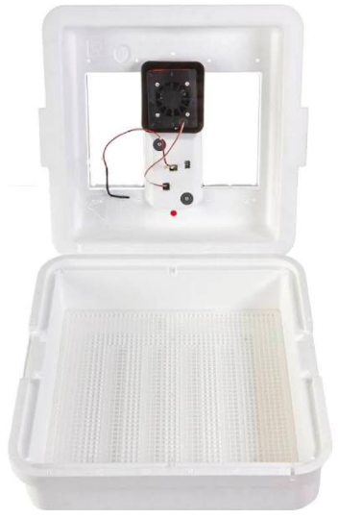
PRE-MONITORING PREPARATION
Take unexpired Coliscan Easygel out of the freezer 2-3 hours before plating the water sample
Can remain thawed up to 2 weeks, but it’s not recommended
Store in refrigerator or at room temperature after thawed (if not using immediately)
Refreezing should be avoided
Turn on incubator before collecting water sample

Slide 30
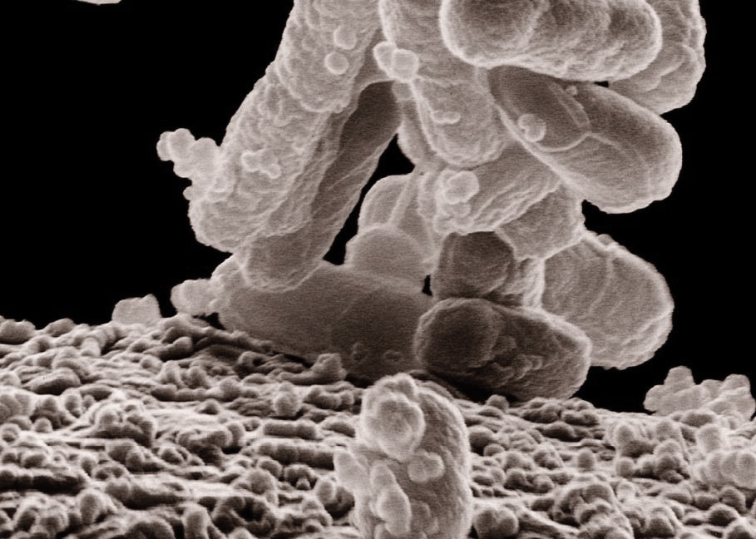
FIELD BLANK
Purpose: To test for potential cross-contamination in your sample. The field blank needs to be treated the same way as the water sample you collected.
The frequency of a bacteria field blank is 1 with every 10 samples
If <10 bacteria samples are collected in a month, include at least 1 field blank per month
QC: There should be no E. coli bacteria colony growth on the field blank samples. If E. coli bacteria growth occurs, discard all E. coli data collected that day. Document the results on the Monitoring Form and consult your trainer.
Notes:
Read the slide to explain the purpose of a field blank

Slide 31
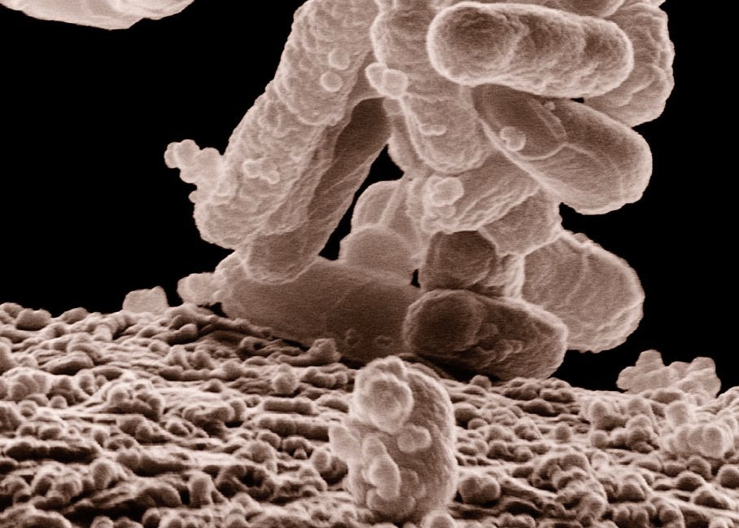
DETERMINING SAMPLE SIZE
Goal: 20-60 colonies but not more than 200
Sample volume: 1 mL, 3 mL, and/or 5 mL
To establish a baseline, collect a 1 mL and a 5 mL sample volume for the first sampling event
If the 1 mL volume results in 0 or only a few colonies, increase sample volume to 3 mL or 5 mL
If the 5 mL sample results in >60 colonies, reduce sample volume to 1 mL or 3 mL
Notes:
Tips to discuss for this site:
If you consistently have high counts, use a 1 mL sample size.
If you consistently have low counts, use a 5 mL sample size.
If it’s somewhere in the middle, use a combination of 1 mL and 3 mL , or 3 mL and 5 mL sample sizes.
NOTE: Environmental and precipitation variables can influence bacteria levels. Waterbodies with low discharge often have more bacteria, and sampling should begin with 1 mL and 3 mL volumes. Pristine waters may require a 5 mL sample to achieve the preferred colony count.

Slide 32
PHASE I SAMPLE
Notes:
Go outside and have folks grab the water sample. Have them conduct each step up until the bacteria count. Make sure to have examples so they can view actual petri dishes for the counting step.

Slide 33
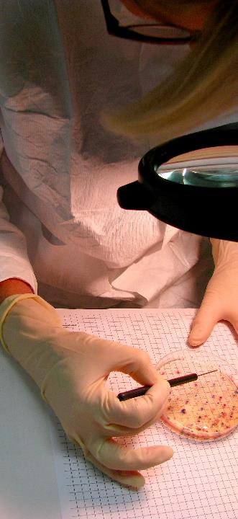
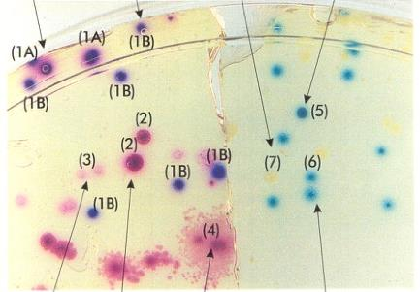
E. COLI BACTERIA FIELD GUIDE -
COUNTING E. COLI BACTERIA COLONIES
Count the number of individual and distinct dark purple and dark blue colonies with and without pink diffused halos. Do not count the pink, white, light blue, or teal/turquoise-colored colonies.
Notes:
Use this slide to discuss how to count the colonies before trainees begin counting.

Slide 34
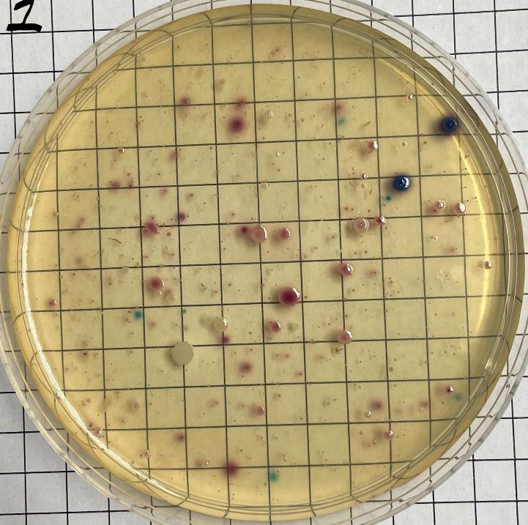
Total Count = 2
1 mL
Notes:
This slide can be used for extra practice

Slide 35
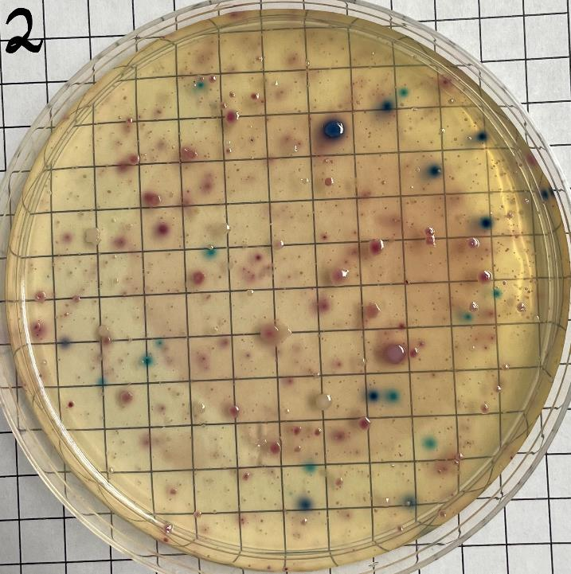
Total Count = 10
5 mL
Notes:
This slide can be used for extra practice

Slide 36
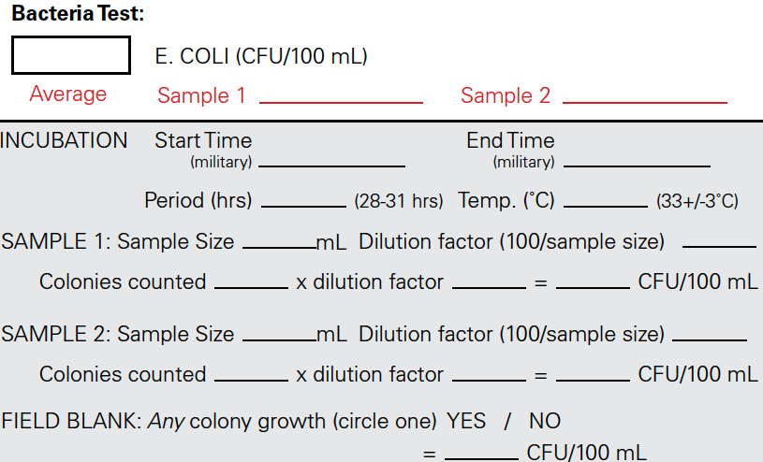
E. COLI BACTERIA FIELD GUIDE -
DATA REPORTING
200
200
200
Enter Time
Enter Time
28
33
1
100
2
100
200
5
20
10
20
200
0
Notes:
This slide can be used for calculation practice. Numbers included are based on the last two slide examples.

Slide 37
PHASE II-III
Notes:
Have trainees conduct phase II-III

Slide 38
WRAP UP & NEXT STEPS

Slide 39
E. COLI BACTERIA –
WASTE DISPOSAL AND CLEAN UP
To dispose of the incubated petri dishes, pour 5 mL (about 1 teaspoon) of vinegar/alcohol into each dish.
Make sure the vinegar/alcohol has covered the entire dish and allow it to sit for a minimum of 15 minutes.
Place the dish in a sealed plastic bag and place in normal household trash.
Clean the inside of the incubator with diluted vinegar/alcohol and allow to air dry before the next use.
Notes:
Review proposer disposal and cleanup with trainees.

Slide 40
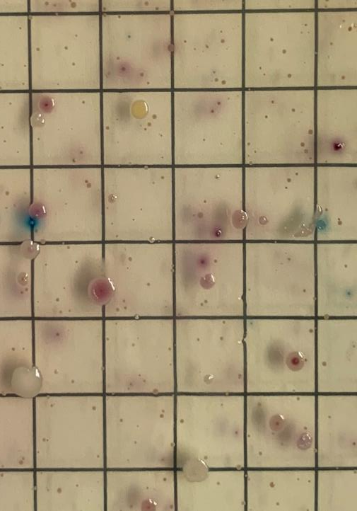
AFTER SAMPLING
Clean and store equipment
Submit monitoring form
Notes:
Discuss what to do after a sampling event by reading the slide. Talking points:
After a monitoring event is complete, properly cleaning and storing of equipment is important. These practices will not only prolong the condition of the equipment, but they will also ensure accurate monitoring results.
Monitoring forms are accessible directly on the Texas Stream Team website (www.TexasStreamTeam.org). After a monitoring event, submit the monitoring form to your Group Data Coordinator, if available. If your group has no Data Coordinator, submit a photo or scanned copy of your monitoring form to Texas Stream Team at TxStreamTeam@txstate.edu and Texas Stream Team will enter your data for you.

Slide 41
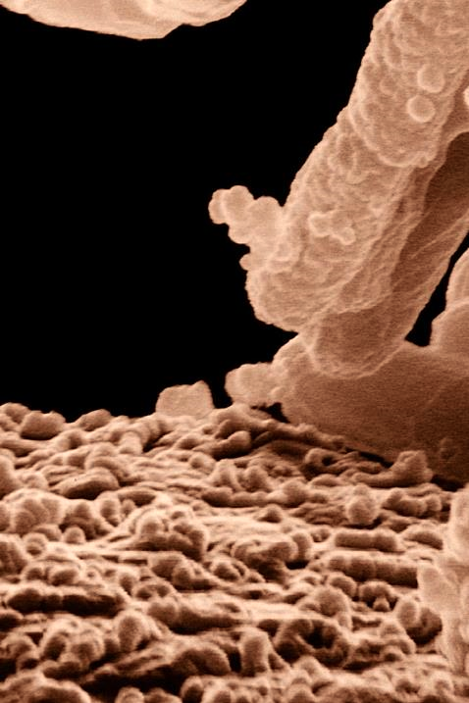
NEXT STEPS
Adopt or create a monitoring site! View the Datamap
Submit data at least once a month to TxStreamTeam@txstate.edu
Visit the Texas Stream Team calendar of events for future trainings.
www.TexasStreamTeam.org | TxStreamTeam@txstate.edu | 512-245-1346
Notes:
Website review: share the monitoring form location, the calendar, trainer page, and equipment form.

Slide 42
PHOTO ARTIST CREDITS
Jennifer Idol
https://www.enasco.com/p/Whirl-Pak%C2%AE-Write-On-Bags---4-oz-%28118-ml%29---Box-of-500---Yellow-Tape%2BB01062

