Slide 1
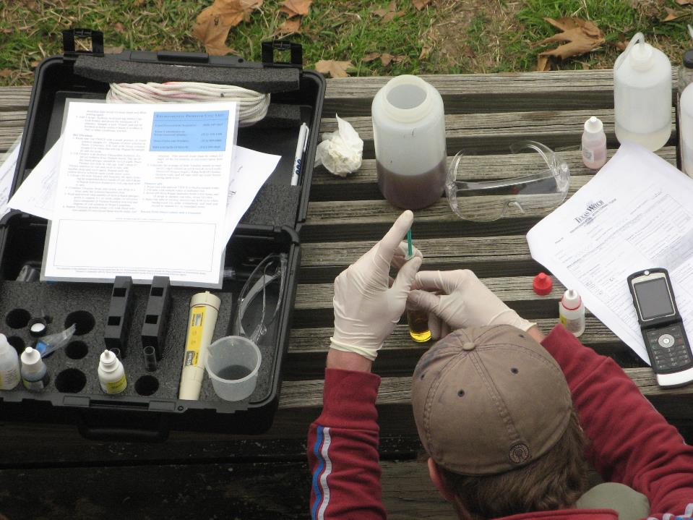
TEXAS STREAM TEAM CORE WATER QUALITY COMMUNITY SCIENTIST TRAINING
Date - Location
Texas Stream Team is funded in part through a grant from the U.S. Environmental Protection Agency through the Texas Commission on Environmental Quality
Notes:
Use this time to welcome participants to the training!

Slide 2
NAME,
TITLE ORGANIZATION
Notes:
Add some information about yourself/your group here
Your name and title
Your organization and their logo

Slide 3
AGENDA
1
Introduction to Texas Stream Team and Core Water Quality Parameters
2
Phase I – Recap and continuation
3
Phase II – Conduct protocols with trainer assistance
Phase III – Conduct protocols without trainer assistance
4
5
Wrap Up and Next Steps
Notes:
There are three phases total that must be completed to receive your Texas Stream Team Core Water Quality certificate. The virtual module covered a large portion of Phase I. Today, the rest of phase I and the remaining phases will be covered to get everyone certified.
IF PRE-TRAINING MODULE WAS USED: DELETE SLIDES 4-16 AND BEGIN ON SLIDE 17

Slide 4
STATEWIDE COMMUNITY SCIENCE WATER QUALITY MONITORING SINCE 1991
A network of trained community scientists and supportive partners administered through a cooperative partnership between:
Notes:
Mention here that Texas Stream Team is a statewide community science water quality monitoring program that has been operating since 1991 and is a network of trained community scientists and supportive partners administered through a cooperative partnership between the United States Environmental Protection Agency, the Texas Commission on Environmental Quality, and the Meadows Center for Water and the Environment.
Mention that the Meadows Center is a research institute affiliated with Texas State University and is home to the Texas Stream Team program which is one of the largest, longest-running statewide water quality community science programs in the country.
Also mention that Texas Stream Team receives partial funding from the EPA, through a clean water act section 319 grant administered by the TCEQ.

Slide 5
MISSION:
To facilitate environmental stewardship by empowering a statewide network of concerned community scientists, partners, and institutions in a collaborative effort to promote a healthy and safe environment through environmental education, data collection, and community action.
11,400+
Community Scientists
400+
Monitoring Sites
100+
Partners
Notes:
Read the mission statement and mention the program metrics to give trainees an understanding of our programs reach.

Slide 6
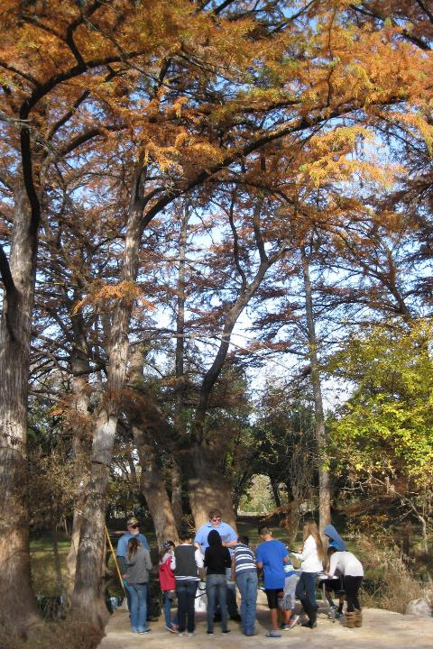
WHAT WE DO
Environmental Education
Data Collection & Analysis
Community Action/Engagement
Watershed Services
6
Notes:
Talk about all the different services that Texas Stream Team offers other than water quality monitoring and data collection. Talking points:
A robust environmental education program
Data collection through our statewide community scientists and they perform different analysis to highlight, review, and showcase data
Community action and engagement by providing educational workshops for schools and youth programs. They also provide community assistance for education and outreach strategies, grants, and loan applications. And they help with informing the public about environmental management decisions.
Watershed services by connecting homeowners to watersheds to promote nonpoint source pollution reduction. They help gather information and grow monitoring efforts to address data gaps. And lastly, we help with local planning, protection, restoration clean-ups, and habitat monitoring.

Slide 7
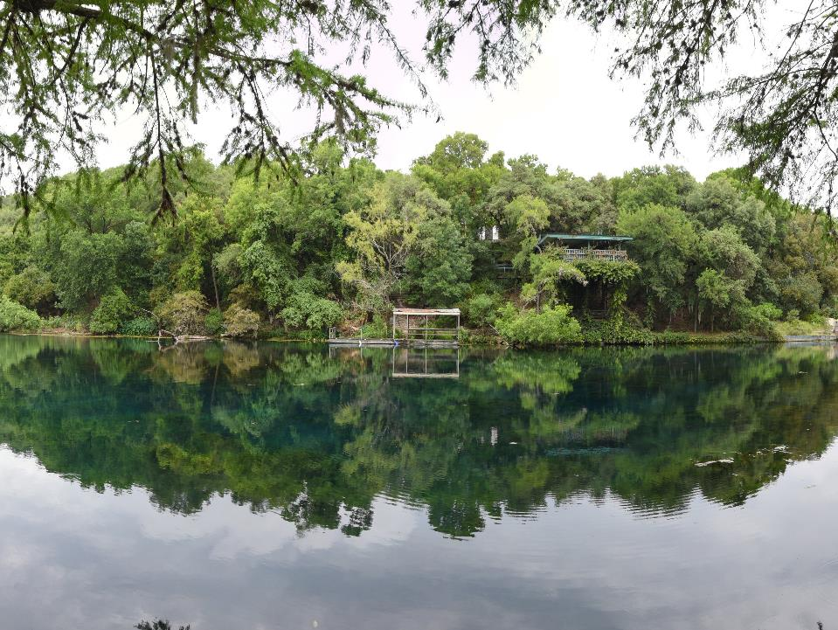
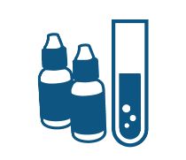
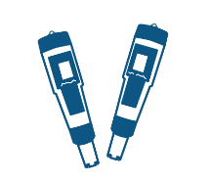
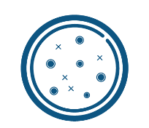
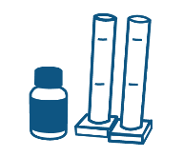
COMMUNITY SCIENTIST TRAININGS
Standard Core
Probe Core
E. coli Bacteria
Advanced
Macroinvertebrate Bioassessment
Riparian Evaluation
Notes:
Briefly review all the trainings Texas Stream Team offers. Talking points:
Be sure to mention which core training is being conducted.
Standard Core – parameters include conductivity or salinity, dissolved oxygen, pH, temperature and various field observations using a chemical standard core kit.
Probe Core - includes the same parameters as the Standard Core training, however parameters are collected using meters or probes as opposed to the chemical tests.
E. coli Bacteria - involves measuring E. coli bacteria to determine the relative risk of swimming or contact recreation in a water body. E. coli is a bacteria that originates from the waste of warm-blooded animals and the presence of this bacteria indicates that associated pathogens from waste may be reaching a body of water.
Advanced training – parameters include nitrate-nitrogen, orthophosphate, turbidity, and streamflow using the advanced chemical kit.
Macroinvertebrate bioassessment - uses freshwater macroinvertebrates, fish, and habitat to determine the health of a lake, river, or stream.
Riparian evaluation - used to evaluate the health of a lake, river, stream, or estuary based on the riparian habitat.
It is also worthwhile to mention both the E. coli Bacteria and Advanced Training have prerequisites - must have Core certification plus six months of core monitoring.

Slide 8
PROGRAMS
Trash Free Texas
Student Organizations
WPP/TMDLs
Notes:
Briefly review the different outreach programs Texas Stream Team also leads. Talking points:
Trash Free Texas - a statewide program with many partners to help reduce trash pollution from waterways. Texas Stream Team community scientists gather data for the trash free Texas program by collecting trash pollution at their monitoring site and documenting if trash was collected on their environmental monitoring form.
Student organizations - Texas Stream Team offers institutions guidance for creating a Texas Stream Team student chapter.
Watershed Protection Plan and Total Maximum Daily Loads – Texas Stream Team provides assistance on analyzing WQ data, informing SH’s, initiating outreach and more.

Slide 9
PARTNER PROGRAMS
Monofilament Finders
Nurdle Patrol
Notes:
Briefly review the different partner programs Texas Stream Team works with. Talking points:
Nurdle Patrol - a community science program ran by the Mission-Aransas National Estuarine Research Reserve at the University of Texas Marine Science Institute and focuses on bringing the community together to tackle plastic pollution, specifically focusing around nurdle awareness and removal efforts. A nurdle is a very small pellet of plastic (typically less than 5mm in length) that serves as raw material in plastics manufacturing. The Nurdle Patrol’s aims to gather information about nurdles, locate where they are, and remove them from the environment. Texas Stream Team community scientists help with the nurdle patrol program by documenting on their monitoring form if they conducted a nurdle survey while they were out monitoring. Please note, you must be trained with nurdle patrol to begin surveying for nurdles.
Monofilament finders - an initiative to reduce and recycle monofilament fishing line litter in the environment by setting up monofilament collection stations across the state of Texas. Texas Stream Team community scientists help with the monofilament finders program by documenting on their monitoring form if they found any monofilament line while monitoring at their site.

Slide 10
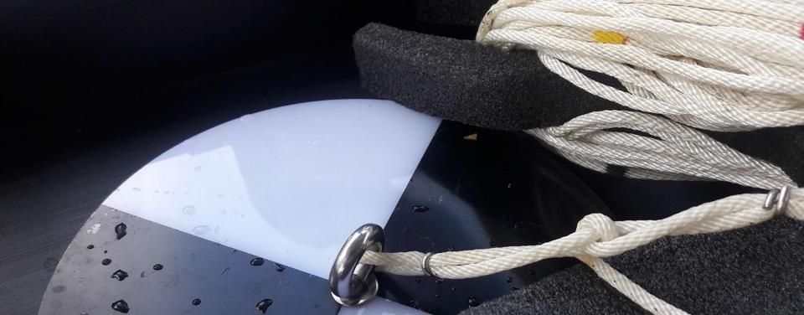
DATA USES
Offers a look at the overall quality of watersheds and local water quality
Assist TCEQ and TPWD in determining causes of NPS pollution
Data trends can have real world effects
Education and outreach
Data Summary Reports
Supports WPP and TMDLs
Research projects
Submitted to EPA’s Water Quality Exchange database
Submitted to the Waterways Dataviewer database
Publicly accessible on our interactive Datamap
Notes:
Talk about the different ways Texas Stream Team data is used.

Slide 11
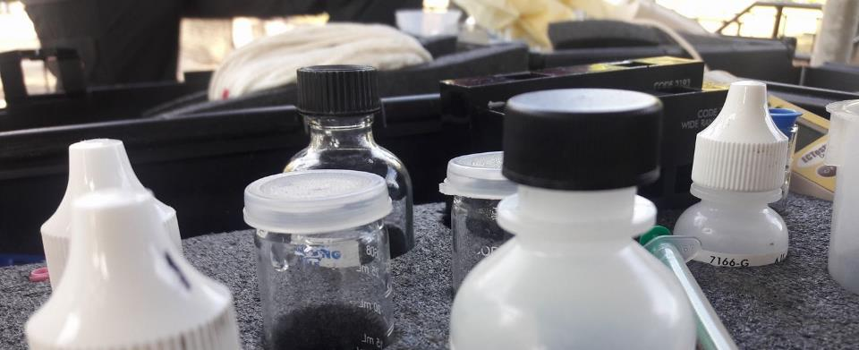
QUALITY ASSURANCE
TCEQ-approved Quality Assurance Project Plan (QAPP)
Monitoring techniques are standardized statewide to ensure consistent data quality
Data are reviewed to ensure they are representative of the samples analyzed and locations monitored
Notes:
Here, talk about how all monitoring done by Texas Stream Team falls under a Quality Assurance Project Plan (can be pronounced as KWAP or spoken out as Q-A-P-P). Talking points:
Standardizations are included in the QAPP. Given the regulatory implications associated with the use of water quality data, the TCEQ uses scientifically rigorous and consistent water quality sampling methods to help​ ensure valid data outcomes.
Data is reviewed by the group Data Coordinators and our Texas Stream Team staff.

Slide 12
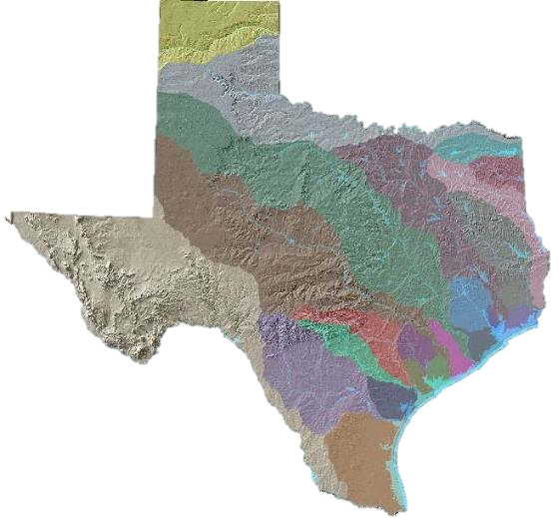
MAJOR SURFACE WATER BASINS OF TEXAS
1. Canadian
2. Red
3. Sulphur
4. Cypress Creek
5. Sabine
6. Neches
7. Neches-Trinity
8. Trinity
9. Trinity-San Jacinto Coastal
10. San Jacinto
11. San Jacinto-Brazos Coastal
12. Brazos
13. Brazos-Colorado Coastal
14. Colorado
15. Colorado-Lavaca Coastal
16. Lavaca
17. Lavaca-Guadalupe Coastal
18. Guadalupe
19. San Antonio
20. San Antonio-Nueces Coastal
21. Nueces
22. Nueces-Rio Grande Coastal
23. Rio Grande
1
2
3
12
8
4
5
14
23
6
10
9
18
7
19
16
11
17
15
13
21
20
22
Notes:
Talk about how there are 23 major river basins within the state of Texas.
Ask your trainees if they can identify which basin they are from or tell them the name of the basin that they are in at that moment.

Slide 13
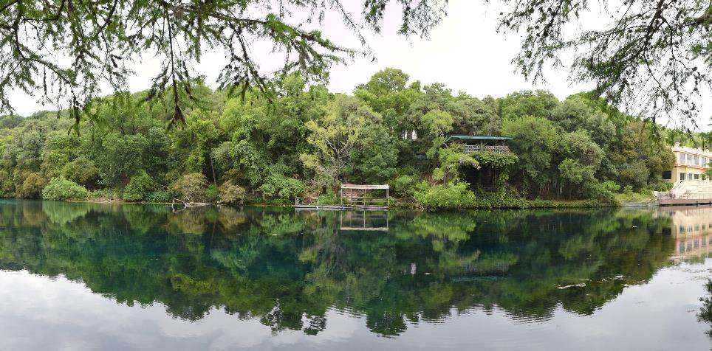
WATERSHED
THE LAND USE WITHIN A WATERSHED DETERMINES THE QUALITY OF THE WATER
Everyone lives in a watershed.
This is the area of land in which water, sediments, and pollutants drain into a common body of water
Notes:
Briefly go over what a watershed is. Talking point:
Watersheds vary in size, they can be small or large, or in between.

Slide 14
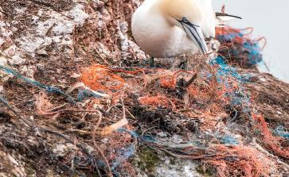
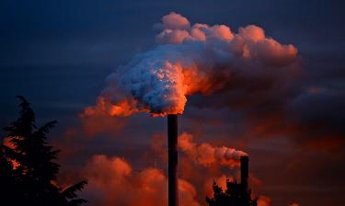
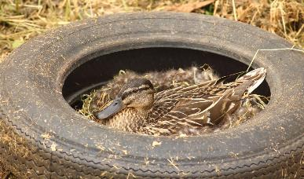
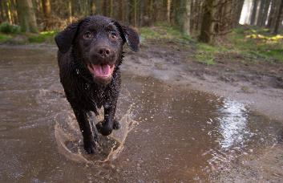
POINT AND NONPOINT SOURCE POLLUTION
Notes:
Go over the two types of pollution that can occur within a watershed that might impact the water quality. Talking points:
1. Point source pollution - identifiable “end of pipe” source of pollution from which pollutants are discharged, such as factory discharges and wastewater effluent; and
2. Nonpoint sources pollution - pollution that can not be traced back to a single source such as: dog or animal waste, a parking lot dotted with oil, fertilizers, etc.

Slide 15
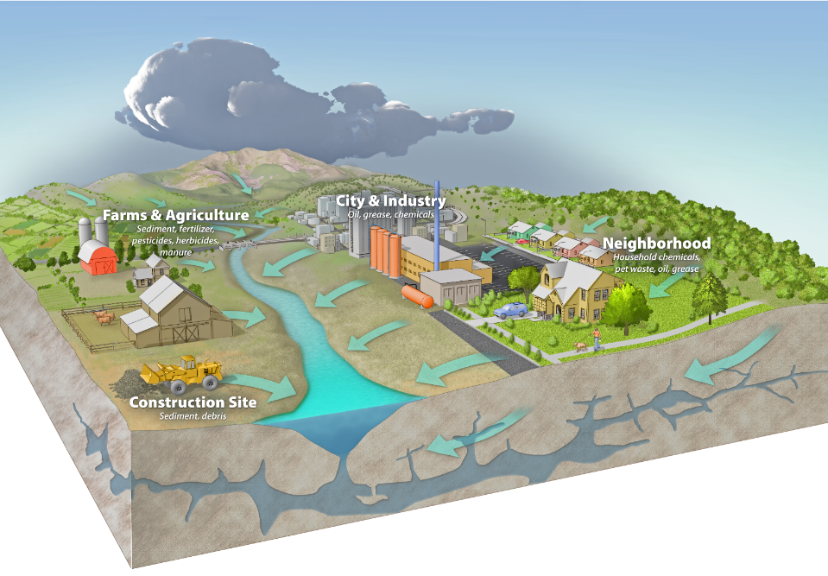
Notes:
This is an example of how different types of pollutants can come from different types of land uses within a watershed. Briefly go over the different examples described within the image. Talking points:
Farms and agriculture - often use fertilizers. Farms often have cows, goats, chickens, etc. which produce waste
Construction sites - can be a source of sediments
Cities and urbanized areas - can be a source of oil from parking lots, trash/litter, and pet waste
Neighborhoods - contribute to pet waste that doesn’t get picked up, as well as household hazardous waste such as grease, oil, paints, and cleaning materials that are tossed into drains or on lawns, instead of being disposed of properly

Slide 16
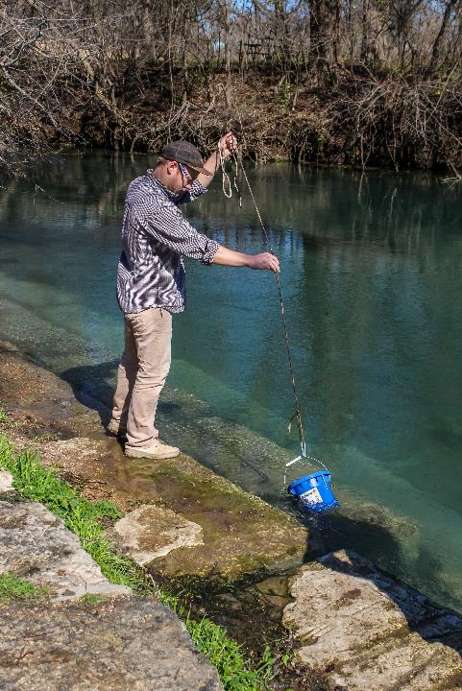
WHY COMMUNITY SCIENCE MONITORING?
More cost effective than professional monitoring
More frequent than professional monitoring
Can trigger alarm bells to alert state officials
Notes:
Explain the importance of community scientist monitoring here. Talking points:
The cost of community science monitoring is very affordable compared to professional monitoring costs. State water quality monitoring equipment can cost well over $10,000. Texas Stream Team offers a way for Texans to get involved using customized kits to collect data, similar to those collected by professionals, at a much lower cost.
Professional monitoring by the state is conducted on a quarterly basis. Whereas Texas Stream Team community scientists are trained to monitor water quality parameters monthly.
Because community scientists monitor more frequently, they might detect measurements that fall outside of the normal range of values before state officials can. Community scientists have alerted state officials of incidents that may have otherwise gone unnoticed, such as fish kills, illegal dumping, and more.

Slide 17
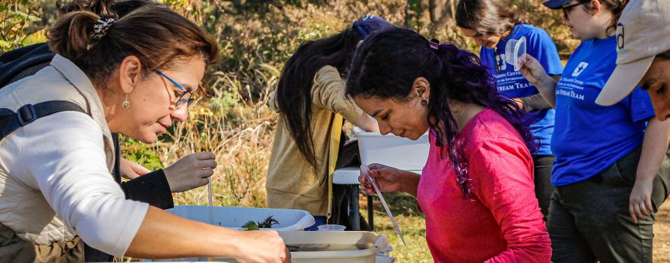
PROGRAM STRUCTURE
TEXAS
STREAM
TEAM
PARTNER ORGANIZATIONS
COMMUNITY
SCIENTIST
Notes:
All partner organizations that lead trainings follow the monitoring methods procedures established by Texas Stream Team. Texas Stream Team is considered the parent organization of all partner monitoring groups, and they are located at The Meadows Center for Water & the Environment, a research institute affiliated with Texas State University in San Marcos, TX.
Texas Stream Team can provide monitoring to partner organizations and their monitoring efforts.

Slide 18
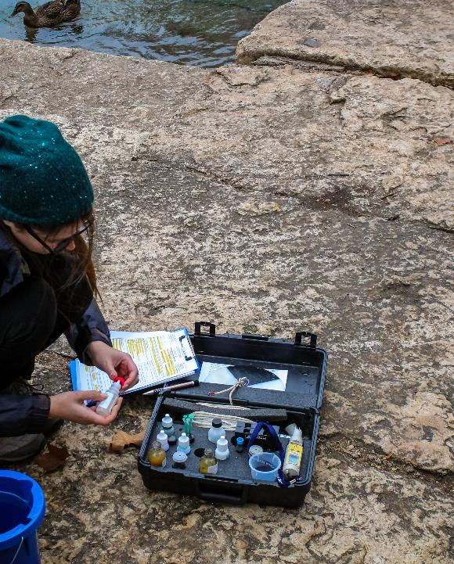
CORE MONITORING PREPARATION
Monitoring frequency
Dress for the outdoors
Try to bring a buddy
Bring the following:
Core Environmental monitoring form
Core Field Guide
Monitoring kit/supplies
Notes:
Go over some steps to prepare for a monitoring event. Talking points:
We ask community scientist to go out and monitor once a month at the same time each month. Monitoring should take place before 12 or after 4.
Not required, but it is best to suit up in outdoor clothing that is protective of the elements
A buddy is not required, but it is suggested for safety purposes
The monitoring form, field guide, and monitoring supplies are always required.

Slide 19
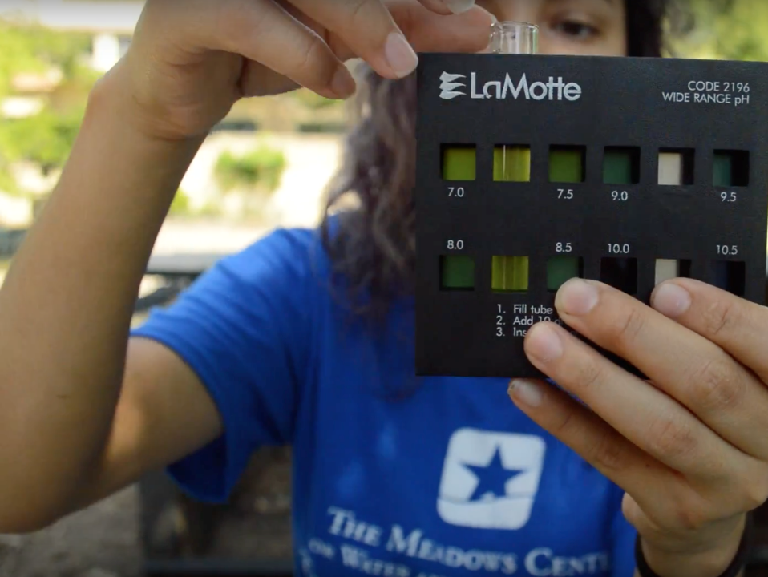
CORE WATER QUALITY AND ENVIRONMENTAL PARAMETERS
Notes:
Give a brief introduction to the next part of the training: going over the parameters that are included in the Texas Stream Team Core water quality community scientist training. The definitions/review can be done as you go through each of the parameter protocols – which we find is more engaging and less information all at once.

Slide 20
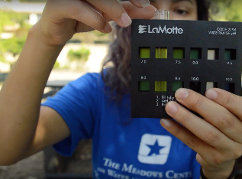
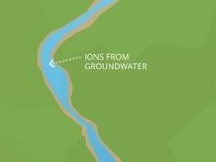
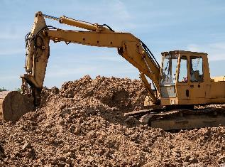
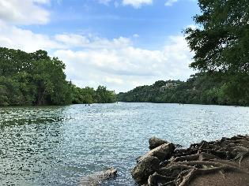
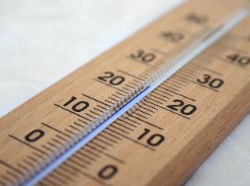
CORE WATER QUALITY PARAMETERS
Field observations
Temperature (Air and Water)
Water Transparency / Water Clarity
Depth
Conductivity
Dissolved oxygen
pH
Notes:
List off the parameters that are measured in Standard Core training, let them know that each of the parameters and the methods will be explained in more detail.

Slide 21
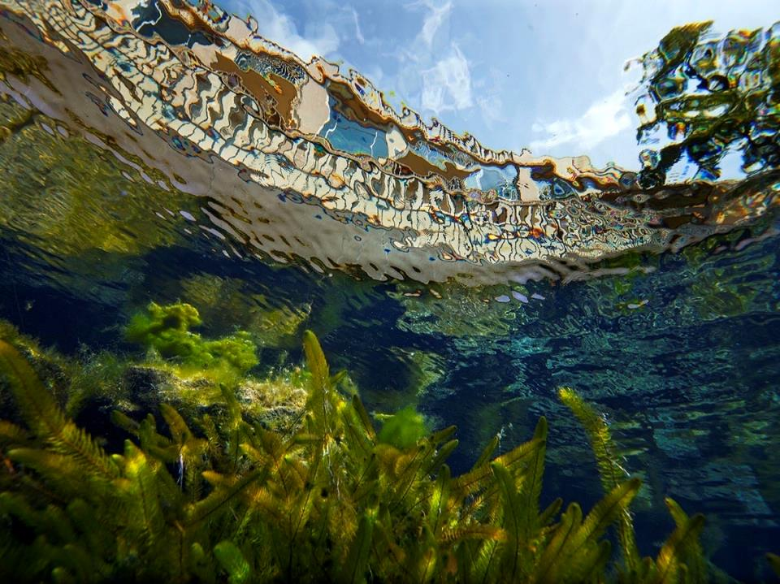
AIR TEMPERATURE

Slide 22
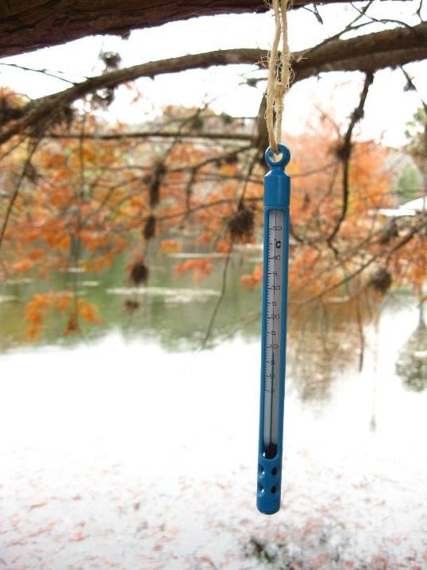
TEMPERATURE
Affects the rates of chemical and biochemical reactions within the water
Measurements above 32ºC (89.6ºF) can be threatening to some aquatic life
Human-caused sources of temperature changes include:
Power plant effluent
Hydroelectric plants
Decreased flows
Notes:
Go over air temperature, reading the information provided on the slide.

Slide 23
TRANSPARENCY:
SECCHI DISK OR TRANSPARENCY TUBE

Slide 24
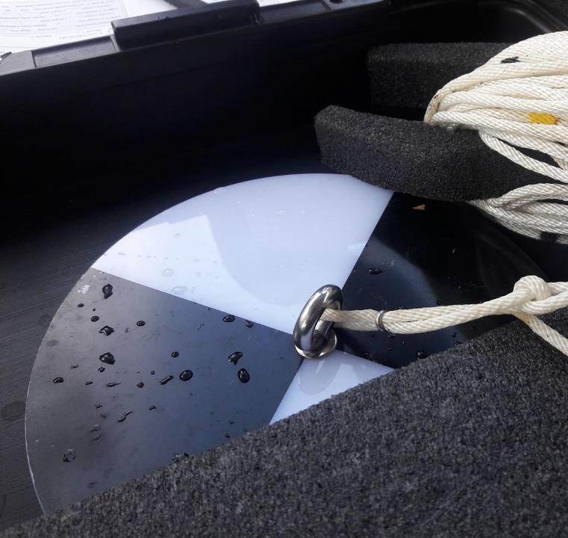
WATER TRANSPARENCY
Materials that become mixed and suspended in water will reduce water clarity and make the water turbid
Many materials contribute to turbidity, which in turn reduces water clarity (transparency)
The effects of turbidity on aquatic life can be significant
Notes:
Go over water transparency, reading the information provided on the slide. Also, be sure to mention that water transparency can be measured using either a Secchi disk or a transparency tube.

Slide 25
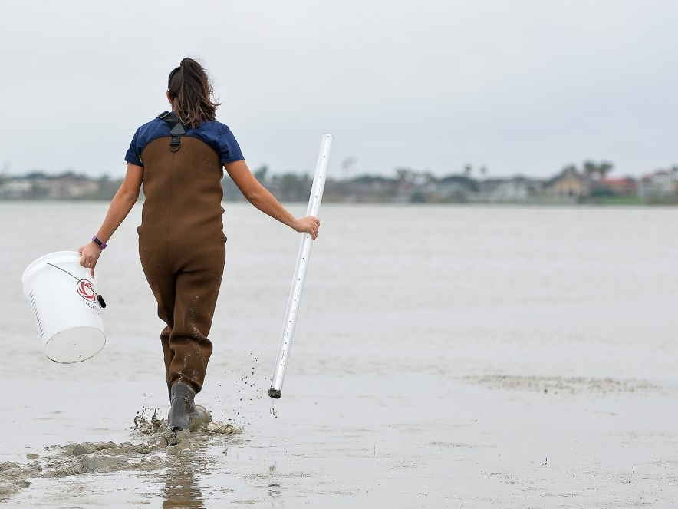
WATER TRANSPARENCY TRANSPARENCY TUBE
A transparency tube is an easy method used to measure water clarity in shallower waters
Transparency can be measured by collecting the sample downstream of the site or by using the bucket grab method
QC CHECK: If using this method, measure after Core parameter sample collection is complete to avoid water disturbance for other tests.
Notes:
Go over what a transparency tube is, reading the information provided on the slide.

Slide 26
CONDUCTIVITY & SALINITY

Slide 27
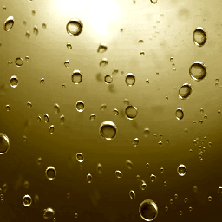
CONDUCTIVITY & SALINITY
Conductivity (µS/cm)
Measured with a conductivity meter
Is a measure of the ability of water to conduct electricity
Indicates the presence of excessive sediment, nutrients, or salt in water
Functions as an indirect measurement of total dissolved solids (TDS)
Salinity (‰)
Is a measure of salt concentration in water
Measured using a refractometer
This Photo by Unknown Author is licensed under CC BY-SA-NC
Notes:
Go over conductivity and salinity, reading the information provided on the slide. Talking points:
µS/cm = microsiemens per centimeter
Salinity is measured in parts per thousand.
Mention if the body of water being monitored is salty, such as a bay or estuary, you will not measure conductivity but measure salinity with a refractometer instead.

Slide 28
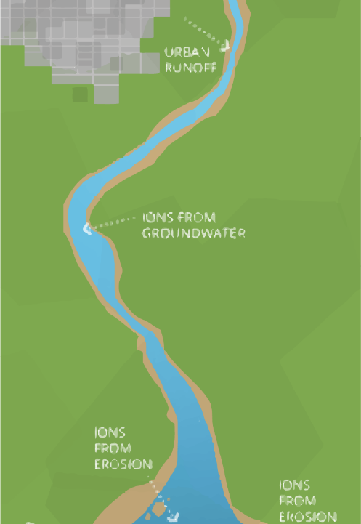
CONDUCTIVITY
0-800 µS/cm
Suitable for drinking, irrigation, and livestock
800-2,500 µS/cm
Suitable for drinking but not preferable
Suitable for irrigation but requires special treatment
Suitable for livestock
2,500-10,000 µS/cm
Not suitable for drinking and irrigation of any crops except those which are salt-tolerant
Suitable for some livestock
Above 10,000 µS/cm
Not suitable for drinking, irrigation, or livestock
Source: Department of Primary Industries, Victoria, Australia, Measuring the Salinity of Water, Available from http://www.dpi.vic.gov.au
Notes:
Go over conductivity readings, reading the information provided on the slide. Talking points:
Conductivity is an important parameter to measure since it can have negative effects on drinking water.
The conductivity standard solution used for calibrating the conductivity meter may vary based on the water body being monitored. Although majority use 1413, there are other conductivity standard solution options.

Slide 29
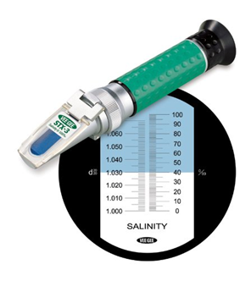
SALINITY
Refractometers operate based on the principle of refraction
Reading ranges 0-100 parts per thousand
Typical salt content of ocean water is 35 ppt
Notes:
Go over salinity readings, reading the information provided on the slide. Talking points:
Refractometers operate based on the principle of refraction. When light rays pass from one medium onto another, the rays are bent towards or away from a line between the two media. Refractometers measure salinity values based on the corresponding angle of refraction. Angle of refraction is converted to percentage salinity which represents the salt concentration.
Remember, if the body of water being monitored is a bay or estuary, salinity will be measure with a refractometer instead of conductivity.

Slide 30
DISSOLVED OXYGEN (DO)

Slide 31
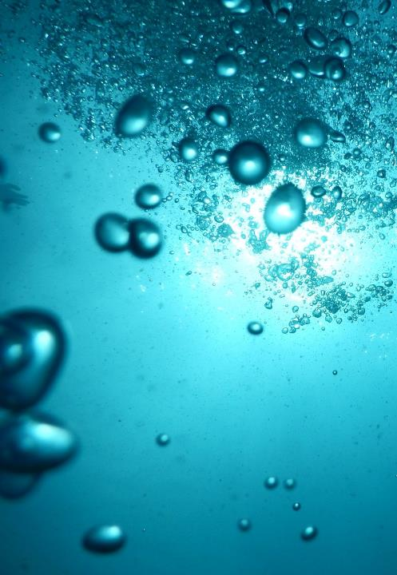
DO
One of the most important indicators of water quality for aquatic life
Measurement of the amount of oxygen freely available in water
Influenced by many factors:
Diffusion from atmosphere
Aeration from waves, waterfalls, riffles
Aquatic plants & organisms
Time of day
Temperature
Notes:
Go over dissolved oxygen, reading the information provided on the slide.

Slide 32
DO
Dissolved oxygen concentrations:
>5 mg/L is sufficient for most species
<3 mg/L is stressful to most species
<2 mg/L is fatal to most species
DO fluctuates during the day with higher concentrations during daylight and lower during nighttime
DO also fluctuates seasonally with lower concentrations during warmer months and higher during cooler months
Notes:
Go over dissolved oxygen readings/ranges by reading the information provided on the slide. Talking points:
DO fluctuates during the day because during daylight plants are capable of photosynthesizing and producing oxygen, a by-product of photosynthesis. During nighttime, oxygen is not being produced and aquatic organisms are consuming the oxygen produced during the day. Therefore, DO is typically lower in the early morning hours before the sun rises and higher during daylight after the sun rises.
DO fluctuates seasonally because warmer water holds less oxygen than colder, denser water.

Slide 33
pH

Slide 34
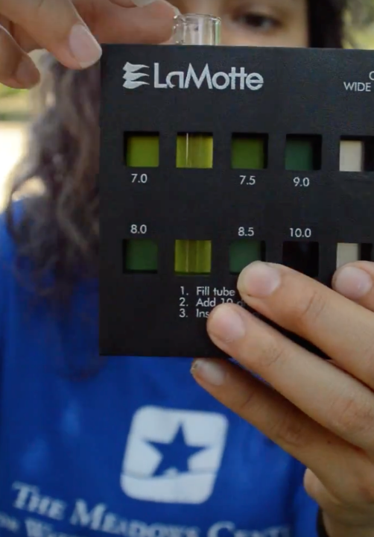
pH
pH is reported in standard units (s.u.)
Sources of acidic pH
Acid rain – caused by coal power plants & volcanoes
Runoff of acidic soils
Sources of alkaline pH
Decomposition of limestone
Runoff of alkali soils
Notes:
Go over pH by reading the information provided on the slide.

Slide 35
pH
Hydrogen ion concentration
Measure of acidity or alkalinity on a scale of 0-14
<7 = acidic
7 = neutral
>7 = alkaline
Most suitable range for aquatic life = 6.5-9
Logarithmic Scale
Ocean Acidification
Increased CO₂ dissolving into ocean creating carbonic acid
Harmful to corals and shell-forming organisms
Notes:
Go over pH readings/ranges by reading the information provided on the slide. Talking points:
Anything greater than 7 is alkaline, which is also known as basic.
pH is measured on a logarithmic scale, therefore a one standard unit change in pH is equivalent to a ten-fold change, either increase or decrease, in the acidity or alkalinity of the water. This means that a pH of 3 is not twice as acidic as a pH of 6, it is 1,000 times as acidic.
Ocean acidification occurs due to changes in pH. An increase in atmospheric carbon dioxide resulting from increased fossil fuel combustion dissolves into the ocean surface water creating carbonic acid. Carbonic acid is harmful to corals and shell-forming organisms that use calcium carbonate to form internal skeletons or external shells.

Slide 36
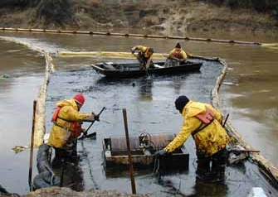
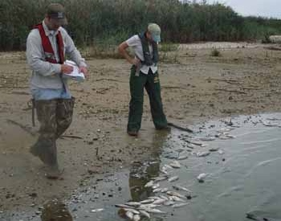
TEXAS PARKS AND WILDLIFE DEPARTMENT KILLS AND SPILLS TEAM (KAST)
Biologists who investigate fish and wildlife kills
If you see a fish or wildlife kill or suspect a pollution event call (512) 389-4848 or contact your regional Kills and Spills Team biologist
Notes:
Tell your trainees about TPWD’s KAST team and how they may help with future monitoring events. Read slide directly. Talking point:
While out monitoring, if you ever come across a fish kill, contact KAST immediately and do not perform your monitoring protocols to ensure your safety. However, do document on a monitoring form the fish kill occurrence and why you were unable to perform your monitoring event.

Slide 37
PHASE I-III
Notes:
From here, you can move on to phase I-III protocols after the introductory information if you chose not to go over the information after you go through the protocols. If you did the later, please be sure to delete this slide.

Slide 38
WRAP UP & NEXT STEPS

Slide 39
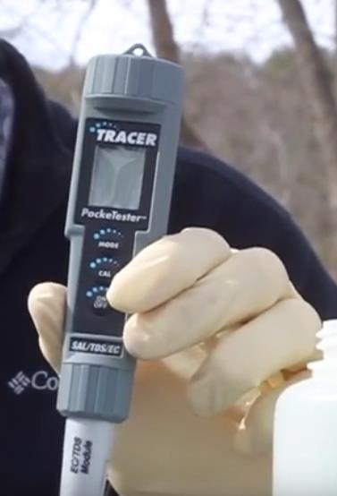
AFTER SAMPLING
Clean and store equipment
Submit electronic monitoring form
Notes:
Discuss what to do after a sampling event by reading the slide. Talking points:
After a monitoring event is complete, properly cleaning and storing of equipment is important. These practices will not only prolong the condition of the equipment, but they will also ensure accurate monitoring results.
A few tips include:
Rinsing all supplies with DI water twice before storing to ensure no residue remains on surface
Store meter without batteries
Store kit and reagents in a temperature-controlled environment
Monitoring forms are accessible directly on the Texas Stream Team website (www.TexasStreamTeam.org). After a monitoring event, submit your electronically (preferred method) or a hard copy can be submitted to your Group Data Coordinator, if available. If your group has no Data Coordinator, submit a photo or scanned copy of your monitoring form to Texas Stream Team at TxStreamTeam@txstate.edu and Texas Stream Team will enter your data for you.

Slide 40
NEXT STEPS
Adopt or create a monitoring site! View the Datamap
Submit data at least once a month to TxStreamTeam@txstate.edu
Visit the Texas Stream Team calendar of events for future trainings.
www.TexasStreamTeam.org | TxStreamTeam@txstate.edu | 512-245-1346
Notes:
Website review: share the electronic monitoring form location, the calendar, trainer page, etc.

Slide 41
PHOTO ARTIST CREDITS
Jason Allen
Anna Huff
Jennifer Idol
Jenya Mendelenko
Sam Massey
Matthew Mohondro
Aspen Navarro
Alexander Neal
Andrew Shirey
Erich Shlegel
Pat Stroka
Valerie Villarreal
Michelle Villarreal Leschper
Islander Stream Team
Notes:
If you use this presentation, please always include this page to give credit to our artists.

Slide 42
https://www.naomifaltin.com/wp-content/uploads/2015/11/sewell.jpeg
https://earthsky.org/upl/2011/07/blanco_river.jpeg
https://i.redd.it/jh3x4lr5dzdz.jpg
https://m.bogalusadailynews.com/wp-content/uploads/sites/39/2017/08/web-Debris-on-river.jpg
https://image.freepik.com/free-photo/blue-sky-with-one-single-white-cloud_105811-181.jpg
https://ak.picdn.net/shutterstock/videos/20812699/thumb/1.jpg
https://upload.wikimedia.org/wikipedia/commons/thumb/b/b4/Falling_tide_%2818890521078%29.jpg/1280px-Falling_tide_%2818890521078%29.jpg
RESOURCES
Notes:
If you use this presentation, please always include this page to give credit to our resources.

