Slide 1
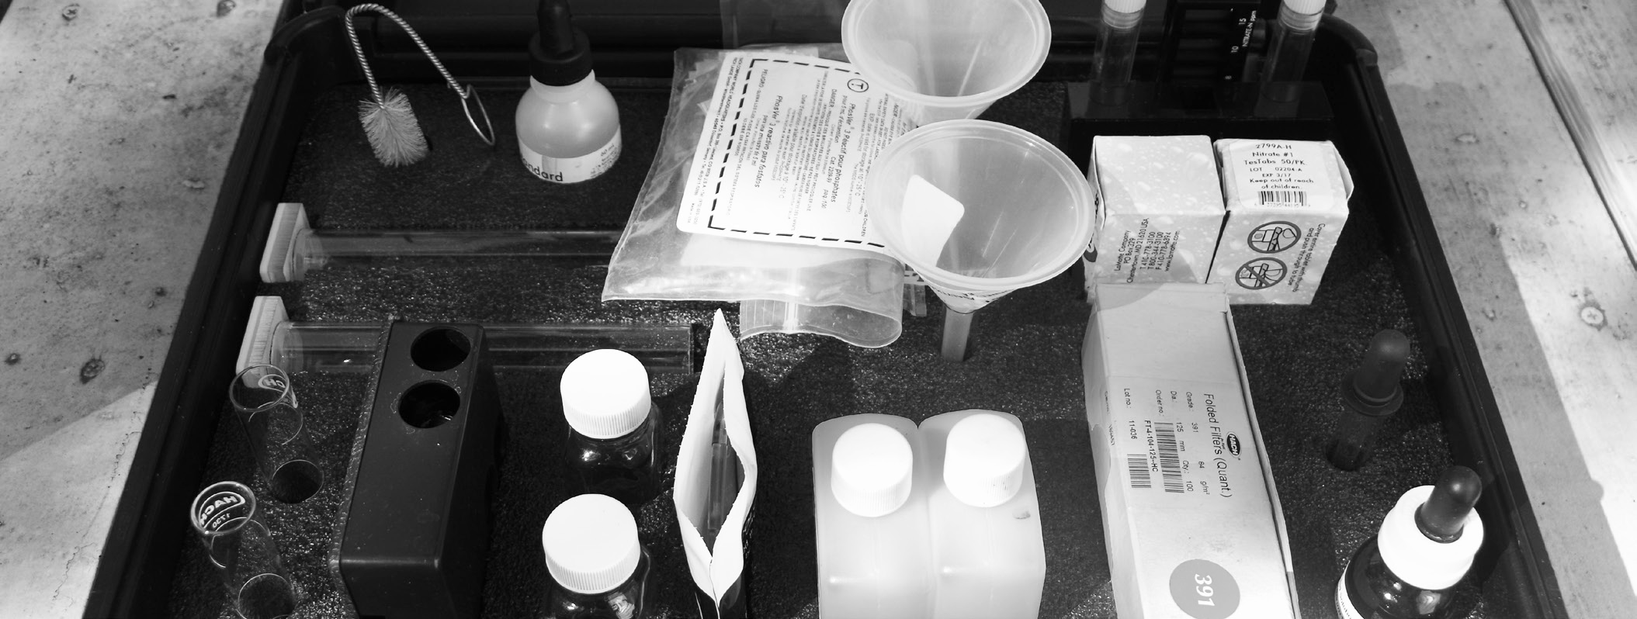
TEXAS STREAM TEAM ADVANCED WATER QUALITY COMMUNITY SCIENTIST TRAINING
Date - Location
Texas Stream Team is funded in part through a grant from the U.S. Environmental Protection Agency through the Texas Commission on Environmental Quality
Notes:
Use this time to welcome participants to the training!

Slide 2
NAME,
TITLE ORGANIZATION
Notes:
Add some information about yourself/your group here
Your name and title
Your organization and their logo

Slide 3
AGENDA
1
Introduction to Texas Stream Team and Advanced Water Quality Parameters
2
Phase I – Recap and continuation
3
Phase II – Conduct protocols with trainer assistance
Phase III – Conduct protocols without trainer assistance
4
5
Wrap Up and Next Steps
Notes:
There are three phases total that must be completed to receive your Texas Stream Team Advanced Water Quality certificate. The virtual module covered a large portion of Phase I. Today, the rest of phase I and the remaining phases will be covered to get everyone certified.
IF PRE-TRAINING MODULE WAS USED: DELETE SLIDES 3-29 AND BEGIN WITH SLIDE 30

Slide 4
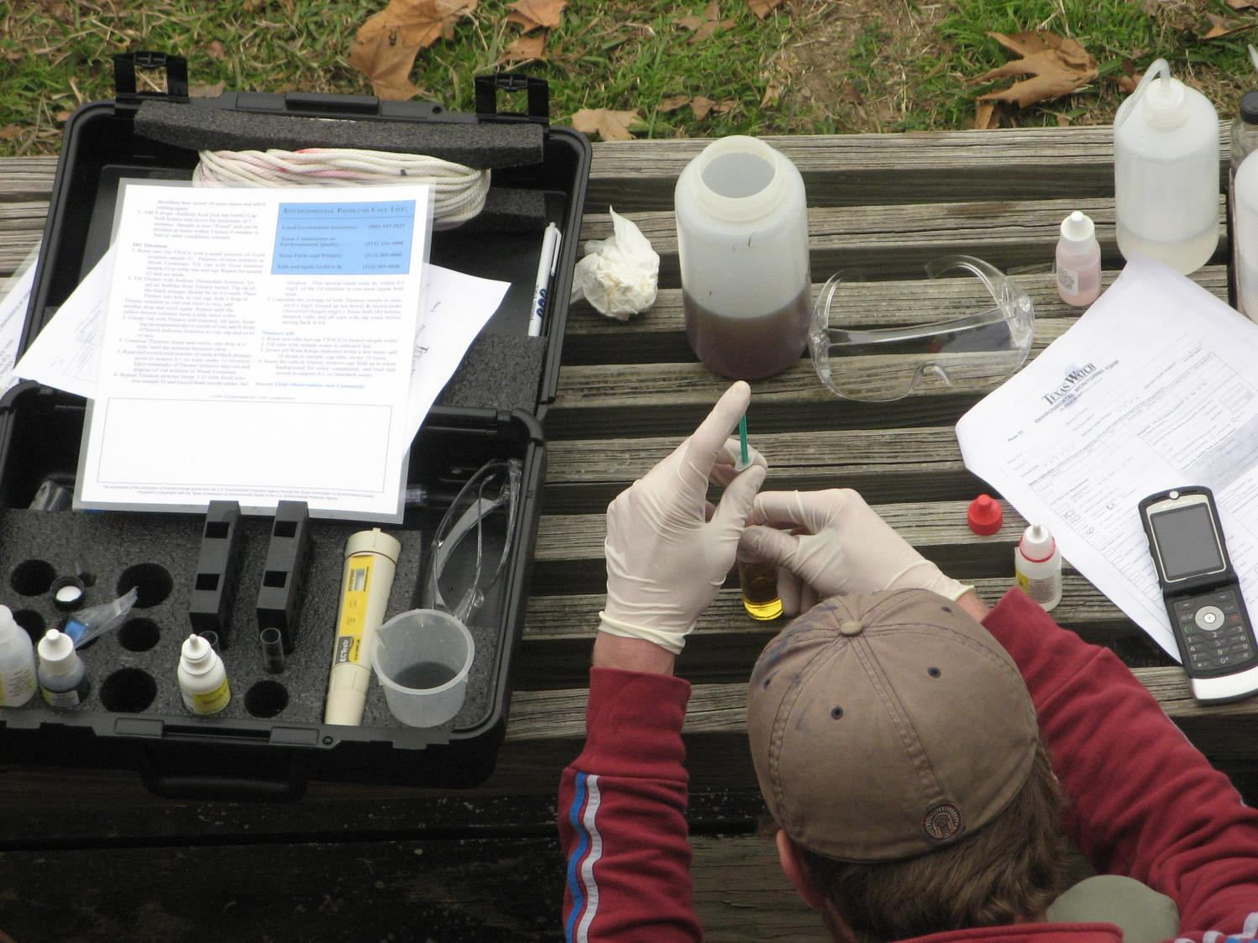
STATEWIDE COMMUNITY SCIENCE WATER QUALITY MONITORING SINCE 1991
A network of trained community scientists and supportive partners administered through a cooperative partnership between:
Notes:
Mention here that Texas Stream Team is a statewide community science water quality monitoring program that has been operating since 1991. We are a network of trained community scientists and supportive partners administered through a cooperative partnership between
the United States Environmental Protection Agency
the Texas Commission on Environmental Quality
and the Meadows Center for Water and the Environment.
Mention that The Meadows Center is a research institute affiliated with Texas State University and is home to the Texas Stream Team, one of the largest, longest-running statewide water quality community science programs in the country.
Also mention that Texas Stream Team receives partial funding from the EPA, through a clean water act section 319 grant administered by the TCEQ.

Slide 5
MISSION:
To facilitate environmental stewardship by empowering a statewide network of concerned community scientists, partners, and institutions in a collaborative effort to promote a healthy and safe environment through environmental education, data collection, and community action.
11,400+
Community Scientists
400+
Monitoring Sites
100+
Partners
Notes:
Read the mission statement and mention the program metrics to give trainees an understanding of our programs reach.

Slide 6
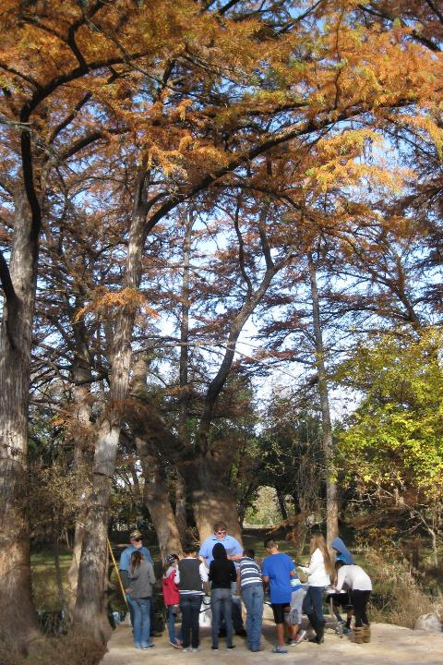
WHAT WE DO
Environmental Education
Data Collection & Analysis
Community Action/Engagement
Watershed Services
6
Notes:
Talk about all the different services that Texas Stream Team offers other than water quality monitoring and data collection. Talking points:
A robust environmental education program
Data collection through our statewide community scientists and they perform different analysis to highlight, review, and showcase data
Community action and engagement by providing educational workshops for schools and youth programs. They also provide community assistance for education and outreach strategies, grants, and loan applications. And they help with informing the public about environmental management decisions.
Watershed services by connecting homeowners to watersheds to promote nonpoint source pollution reduction. They help gather information and grow monitoring efforts to address data gaps. And lastly, we help with local planning, protection, restoration clean-ups, and habitat monitoring.

Slide 7
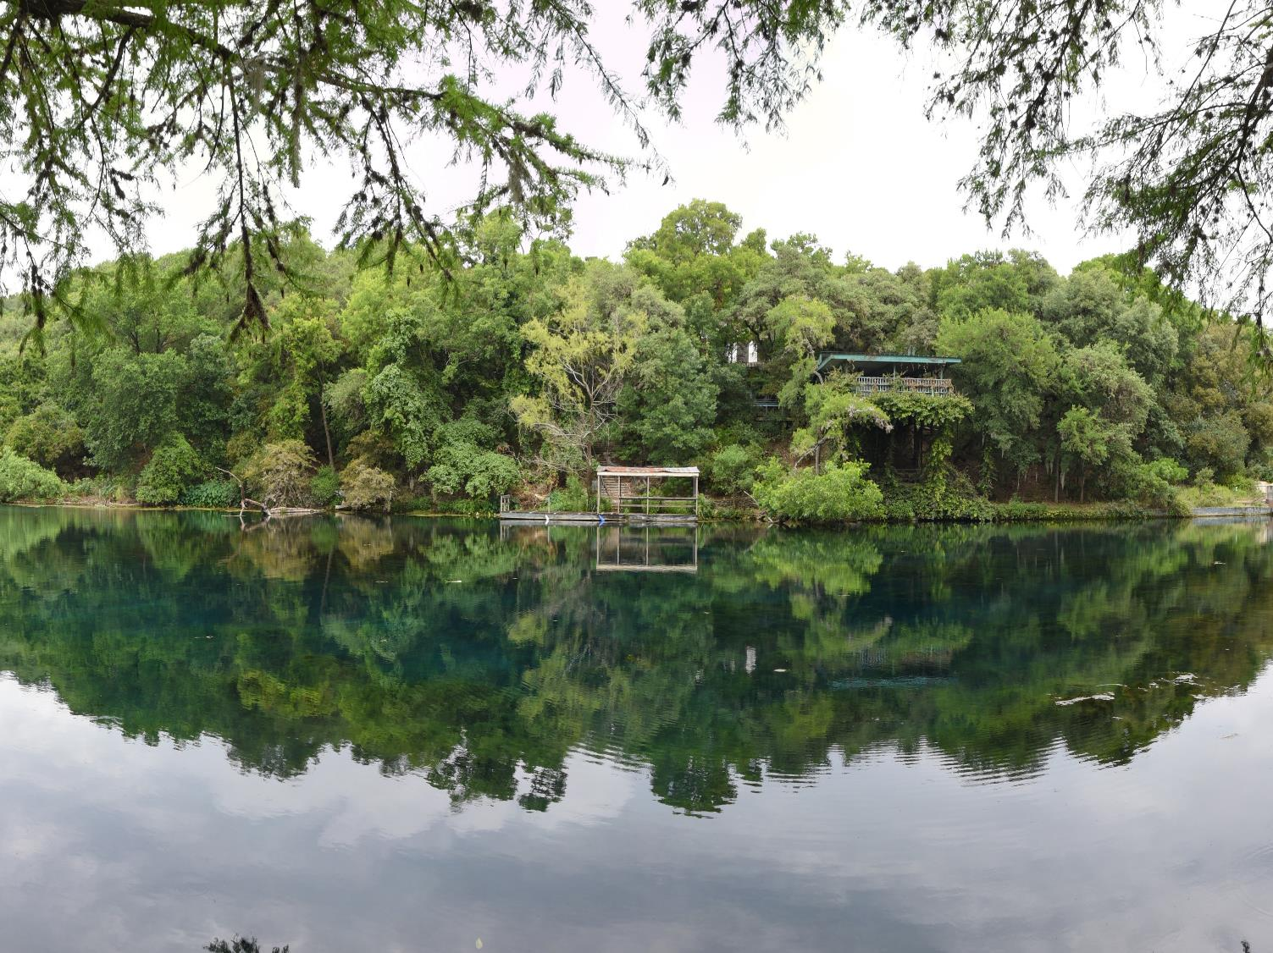
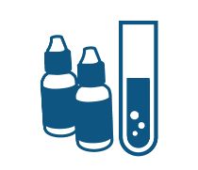
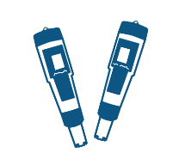
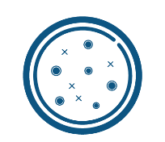
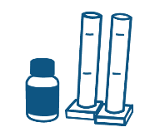
COMMUNITY SCIENTIST TRAININGS
Standard Core
Probe Core
E. coli Bacteria
Advanced
Macroinvertebrate Bioassessment
Riparian Evaluation
Notes:
Briefly review all the trainings Texas Stream Team offers. Talking points:
Be sure to mention which core training is being conducted.
Standard Core – parameters include conductivity or salinity, dissolved oxygen, pH, temperature and various field observations using a chemical standard core kit.
Probe Core - includes the same parameters as the Standard Core training, however parameters are collected using meters or probes as opposed to the chemical tests.
E. coli Bacteria - involves measuring E. coli bacteria to determine the relative risk of swimming or contact recreation in a water body. E. coli is a bacteria that originates from the waste of warm-blooded animals and the presence of this bacteria indicates that associated pathogens from waste may be reaching a body of water.
Advanced training – parameters include nitrate-nitrogen, orthophosphate, turbidity, and streamflow using the advanced chemical kit.
Macroinvertebrate bioassessment - uses freshwater macroinvertebrates, fish, and habitat to determine the health of a lake, river, or stream.
Riparian evaluation - used to evaluate the health of a lake, river, stream, or estuary based on the riparian habitat.
It is also worthwhile to mention both the E. coli Bacteria and Advanced Training have prerequisites - must have Core certification plus six months of core monitoring.

Slide 8
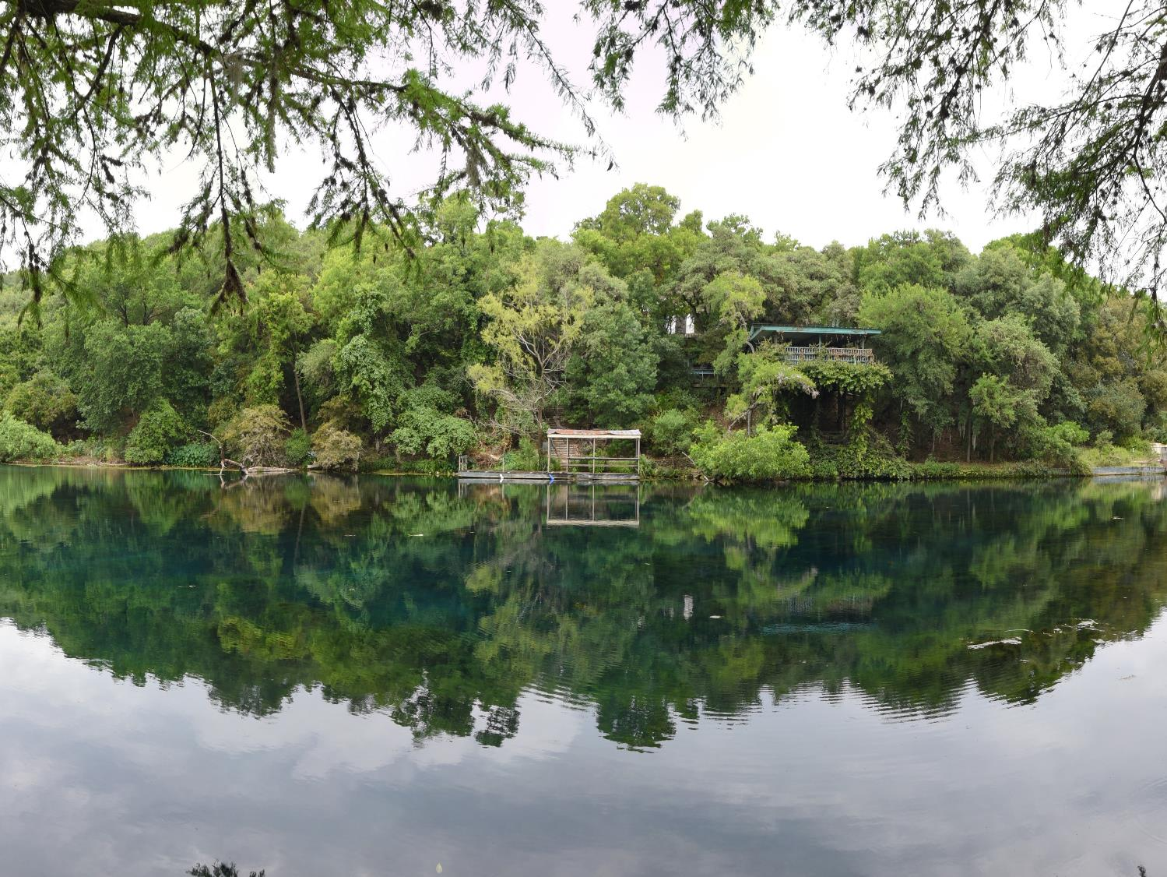
PROGRAMS
Trash Free Texas
Student Organizations
WPP/TMDLs
Notes:
Briefly review the different outreach programs Texas Stream Team also leads:
Trash Free Texas - a statewide program with many partners to help reduce trash pollution from waterways. Texas Stream Team community scientists gather data for the trash free Texas program by collecting trash pollution at their monitoring site and documenting if trash was collected on their environmental monitoring form.
Student organizations - Texas Stream Team offers institutions guidance for creating a Texas Stream Team student chapter.
Watershed Protection Plan and Total Maximum Daily Loads – Texas Stream Team provides assistance on analyzing WQ data, informing SH’s, initiating outreach and more.

Slide 9
PARTNER PROGRAMS
Nurdle Patrol
Monofilament Finders
Notes:
Briefly review the different partner programs Texas Stream Team works with. Talking points:
Nurdle Patrol - a community science program ran by the Mission-Aransas National Estuarine Research Reserve at the University of Texas Marine Science Institute and focuses on bringing the community together to tackle plastic pollution, specifically focusing around nurdle awareness and removal efforts. A nurdle is a very small pellet of plastic (typically less than 5mm in length) that serves as raw material in plastics manufacturing. The Nurdle Patrol’s aims to gather information about nurdles, locate where they are, and remove them from the environment. Texas Stream Team community scientists help with the nurdle patrol program by documenting on their monitoring form if they conducted a nurdle survey while they were out monitoring. Please note, you must be trained with nurdle patrol to begin surveying for nurdles.
Monofilament finders - an initiative to reduce and recycle monofilament fishing line litter in the environment by setting up monofilament collection stations across the state of Texas. Texas Stream Team community scientists help with the monofilament finders program by documenting on their monitoring form if they found any monofilament line while monitoring at their site.

Slide 10
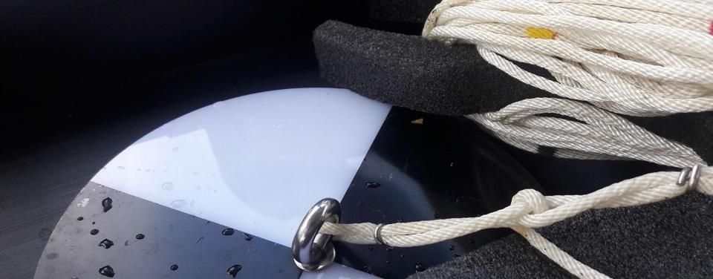
DATA USES
Offers a look at the overall quality of watersheds and local water quality
Assist TCEQ and TPWD in determining causes of NPS pollution
Data trends can have real world effects
Education and outreach
Data Summary Reports
Supports WPP and TMDLs
Research projects
Submitted to EPA’s Water Quality Exchange database
Submitted to the Waterways Dataviewer database
Publicly accessible on our interactive Datamap
Notes:
Talk about the different ways Texas Stream Team data is used.

Slide 11
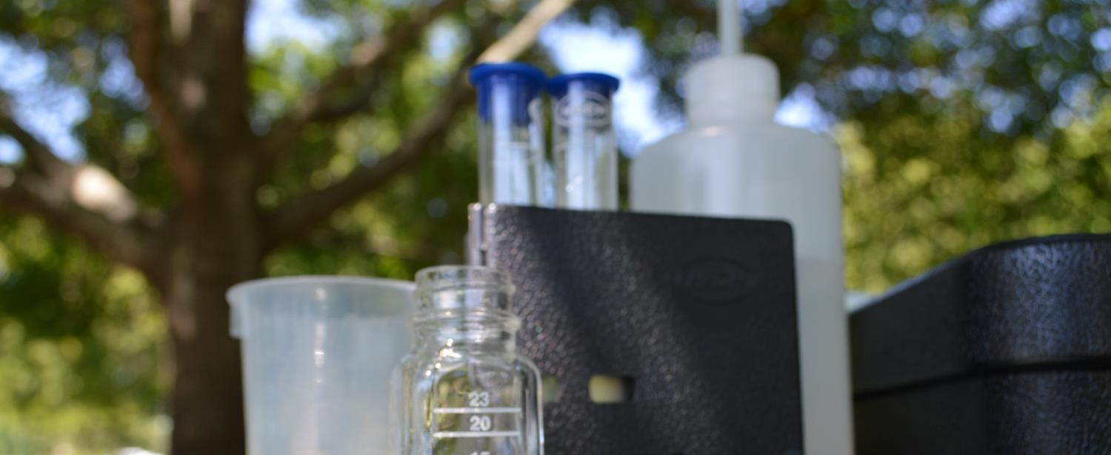
QUALITY ASSURANCE
TCEQ-approved Quality Assurance Project Plan (QAPP)
Monitoring techniques are standardized state-wide to ensure consistent data quality
Data are reviewed to ensure they are representative of the samples analyzed and locations monitored
Notes:
Here, talk about how all monitoring done by Texas Stream Team falls under a Quality Assurance Project Plan (can be pronounced as KWAP or spoken out as Q-A-P-P). Talking points:
Standardizations are included in the QAPP. Given the regulatory implications associated with the use of water quality data, the TCEQ uses scientifically rigorous and consistent water quality sampling methods to help​ ensure valid data outcomes.
Data is reviewed by the group Data Coordinators and our Texas Stream Team staff.

Slide 12
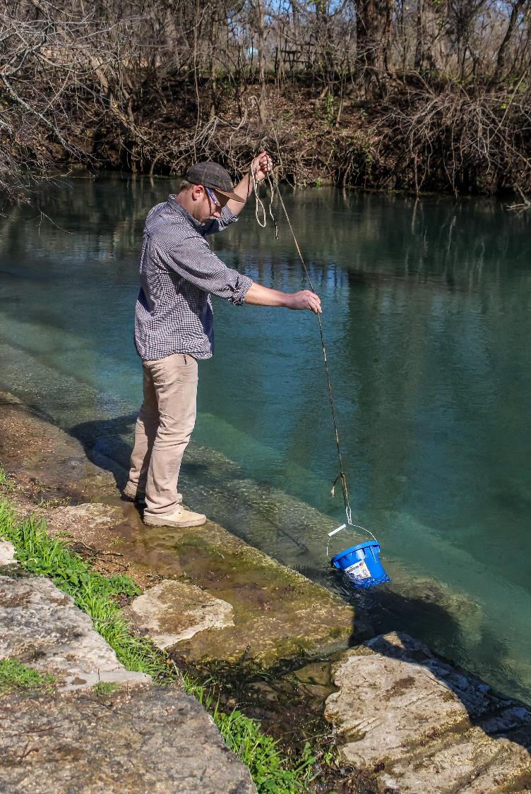
WHY COMMUNITY SCIENCE MONITORING?
More cost effective than professional monitoring
More frequent than professional monitoring
Can trigger alarm bells to alert state officials
Notes:
Explain the importance of community scientist monitoring here. Talking points:
The cost of community science monitoring is very affordable compared to professional monitoring costs. State water quality monitoring equipment can cost well over $10,000. Texas Stream Team offers a way for Texans to get involved using customized kits to collect data, similar to those collected by professionals, at a much lower cost.
Professional monitoring by the state is conducted on a quarterly basis. Whereas Texas Stream Team community scientists are trained to monitor water quality parameters monthly.
Because community scientists monitor more frequently, they might detect measurements that fall outside of the normal range of values before state officials can. Community scientists have alerted state officials of incidents that may have otherwise gone unnoticed, such as fish kills, illegal dumping, and more.

Slide 13
ADVANCED WATER QUALITY MONITORING

Slide 14
STREAMFLOW
TURBIDITY
NITRATE-NITROGEN
ORTHOPHOSPHATE
Notes:
Introduce the parameters that are measured in the Advanced training, and let them know that they will be explained in more detail in subsequent slides.

Slide 15
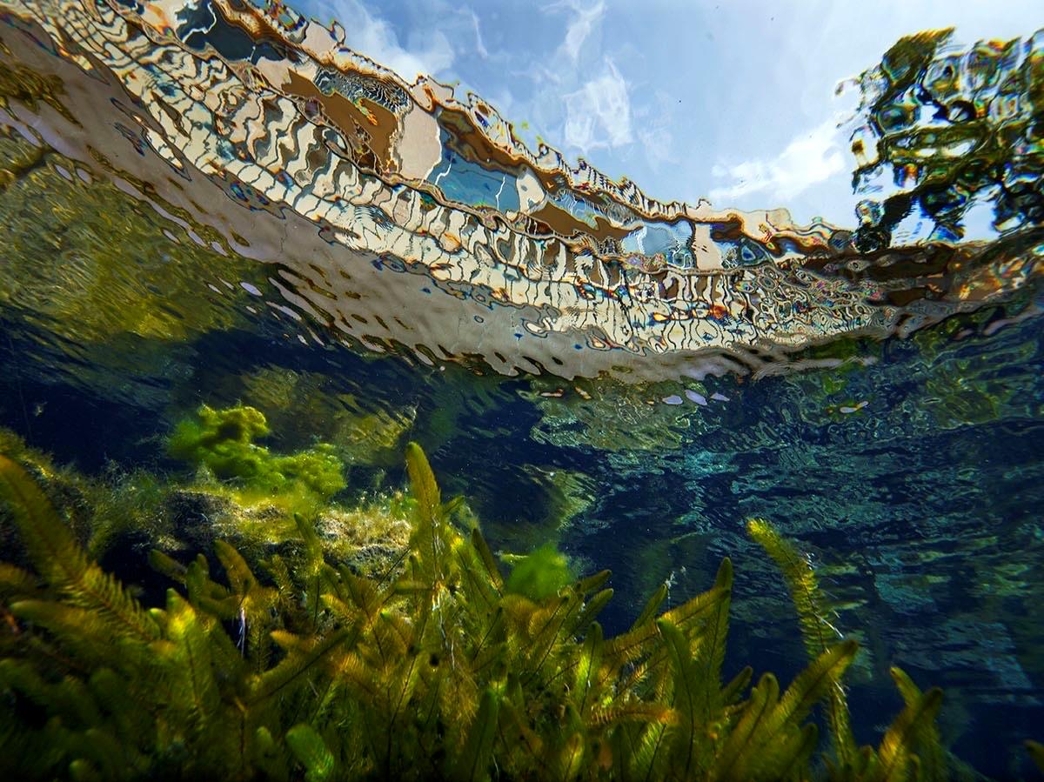
STREAMFLOW

Slide 16
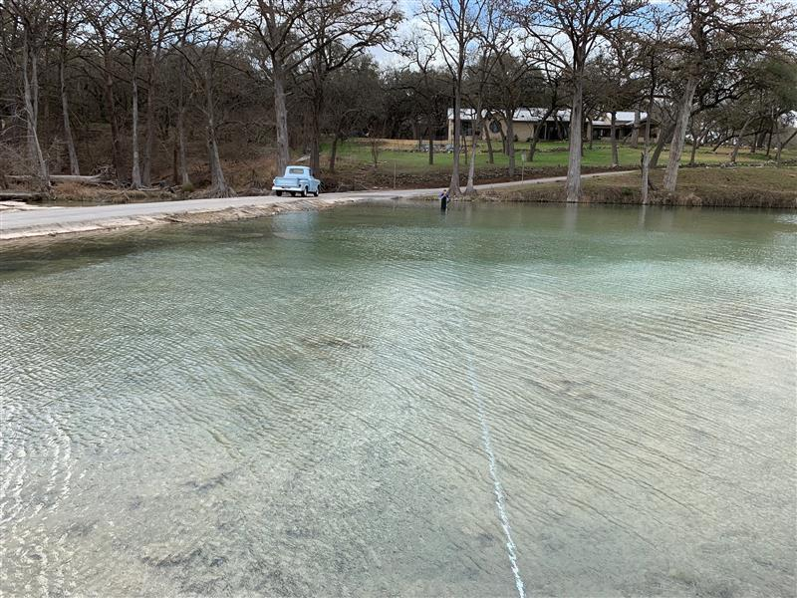
STREAMFLOW
The volume of water that passes through a specific point over a fixed period of time
Measured in cubic feet per second (CFS or ft³/sec)
Notes:
Go over Streamflow, reading the information provided on the slides

Slide 17
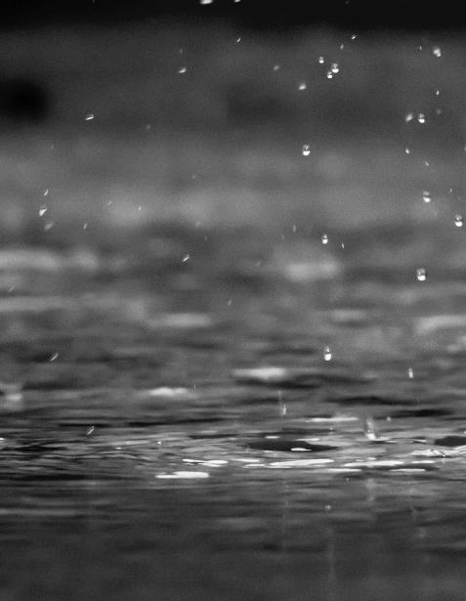
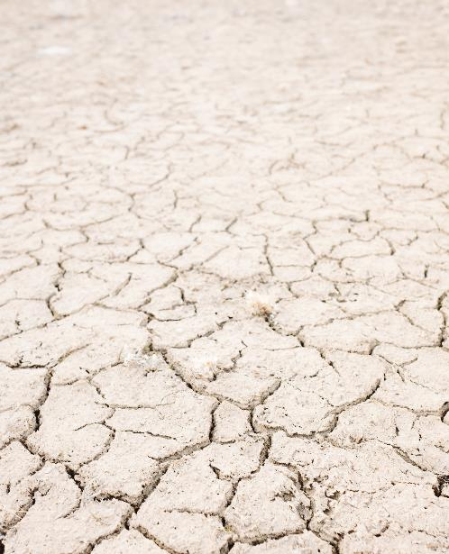
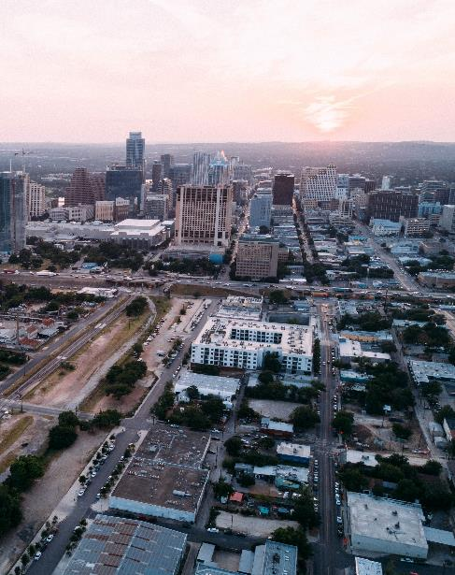
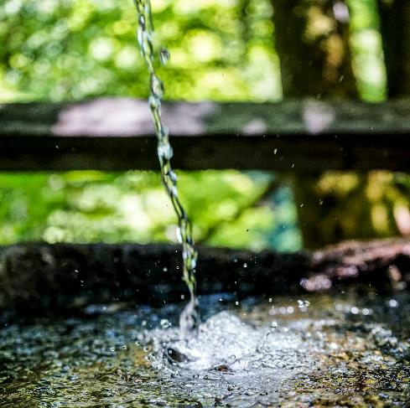
FACTORS THAT AFFECT STREAMFLOW
Rain
Drought
Development
Pumping
Notes:
Explain some scenarios that could impact streamflow:
Rain events can increase flow, increasing the amount of water making its way to a water body
Drought can decrease flow as less water is making its way to a water body
Development can increase flow as development often comes with an increase in impervious surfaces such as roads, sidewalks, parking lots, etc. These surfaces cannot retain rainwater and instead causes rainwater to build up on the earth’s surface, turning into runoff where it moves across the land and ends up in the nearest downstream water body
We rely on surface and groundwater for our water resources. When more water is pumped for use, less ends up in the water body itself, and therefore decreasing streamflow levels

Slide 18
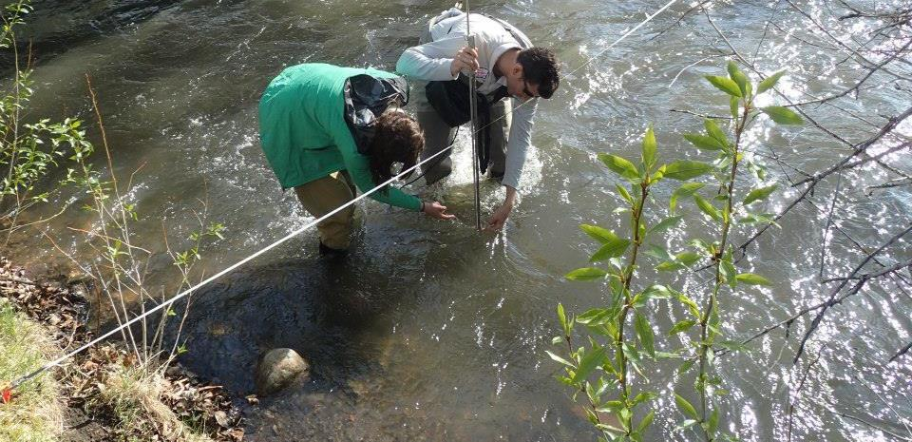
IMPACTS OF STREAMFLOW
Some organisms depend on streamflow
Less flow leads to concentrations of contaminants
More flow increases dissolved oxygen
Streamflow can alter water quality
Notes:
Explain why streamflow is an important parameter to measure, and how it can impact the entire stream ecosystem. Read the information provided on the slides.

Slide 19
TURBIDITY

Slide 20
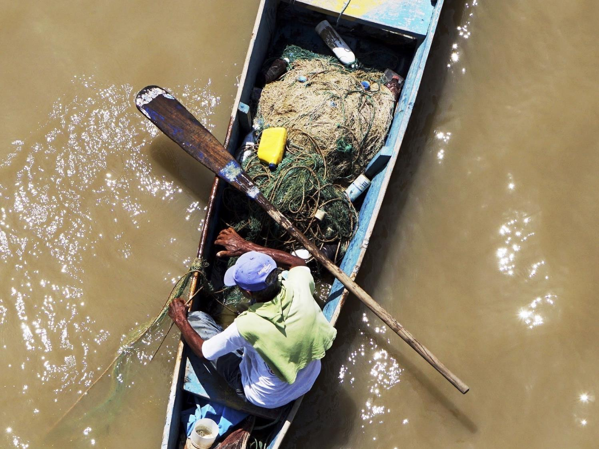
TURBIDITY
The cloudiness or haziness of a fluid caused by suspended solids such as soil, algae, plankton, microbes, and other substance.
Recorded in Nephelometric Turbidity Unit (NTU) or mg/L
Notes:
Go over turbidity, reading the information provided on the slide.
Something to note:
There are various methods to measure turbidity and it can be recorded in Nephelometric Turbidity Units or mg/L based on the method being used.
Be sure to mention that Texas Stream Team uses the Turbidity Tube method to measure turbidity, and results are recorded in NTUs.

Slide 21
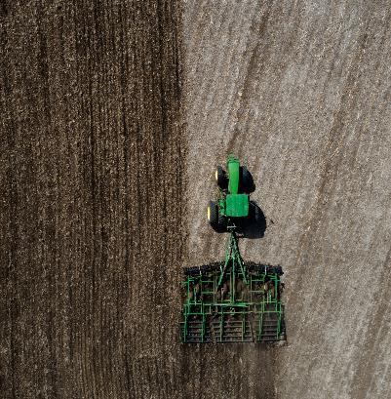
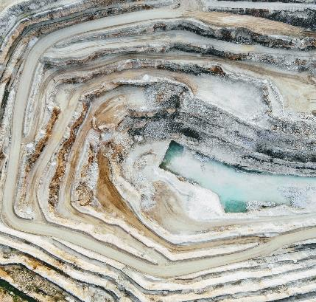
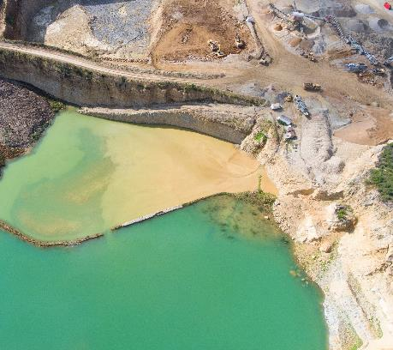
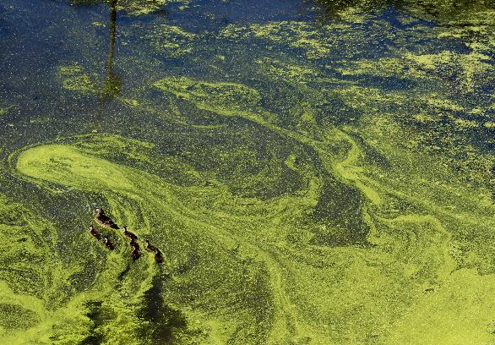
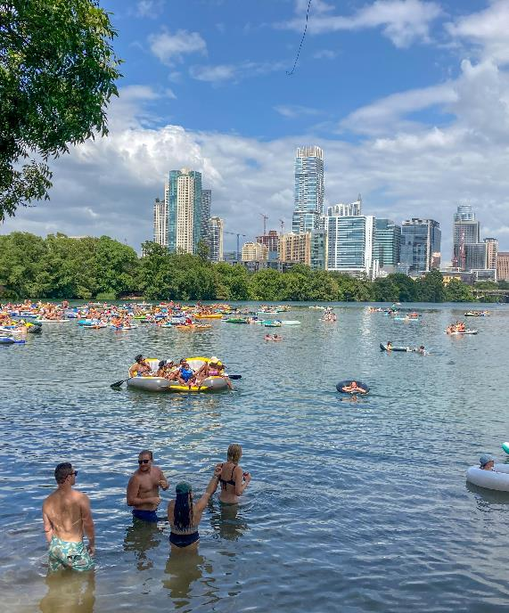
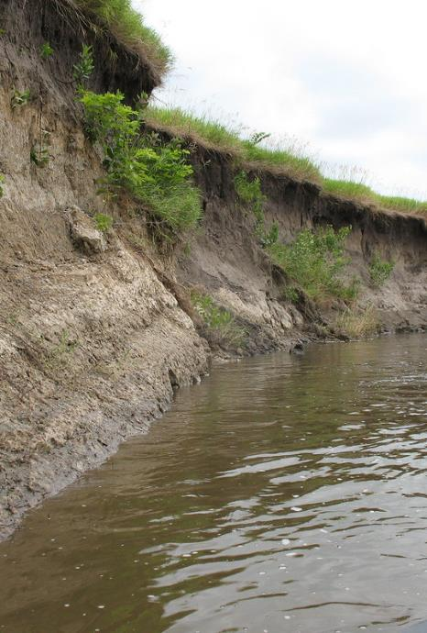
SOURCES OF TURBIDITY
Tilling, mining, construction, drought, etc.
Excessive algae growth
Bottom feeders
Swimmers disturbing sediment
Eroding stream banks
Notes:
Go over sources of turbidity

Slide 22
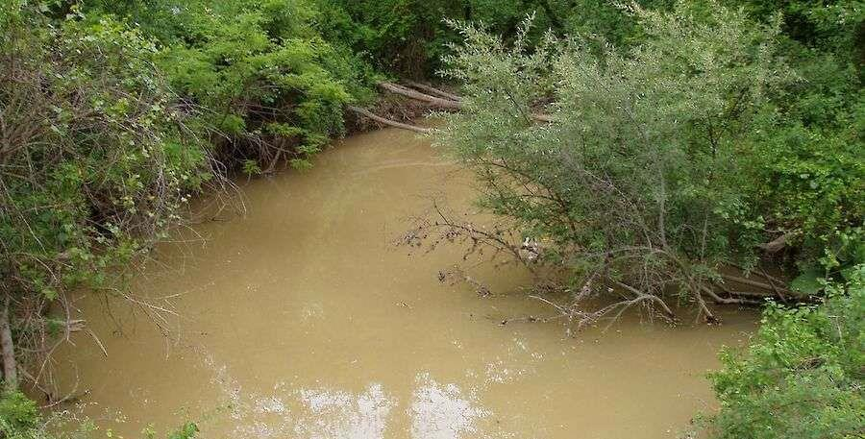
IMPACTS OF SUSPENDED PARTICLES
Absorbs heat
increases water temperature
lowers dissolved oxygen
Reduces sunlight penetration
limits photosynthesis
lowers dissolved oxygen
Increases contamination
Poses a risk to aquatic life
clogs gills
reduces resistance to disease
lowers growth rates
affects egg and larval development
Notes:
Go over the impacts of suspended particles in waterbodies, reading the information provided in the slide

Slide 23
NITRATE-NITROGEN

Slide 24
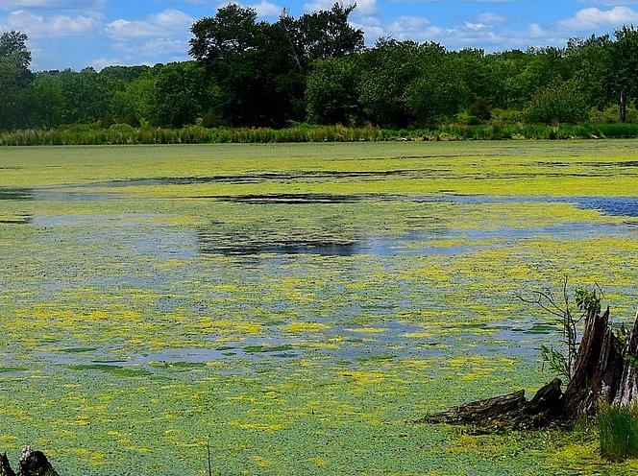
NITRATE-NITROGEN (NO₃-N)
An essential nutrient for plants and animals
Dissolve easier than phosphates
Recorded in mg/L
Freshwater screening level = 1.95 mg/L
Notes:
Introduce Nitrate-Nitrogen, reading the information provided on slides. Helpful things to go over:
Explain what a screening level is
Now would be a good time to ask trainees to name off different sources of nitrate-nitrogen

Slide 25
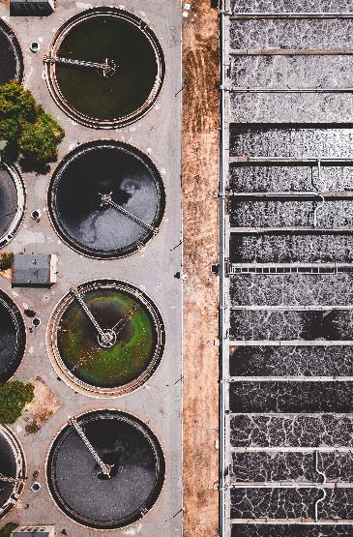
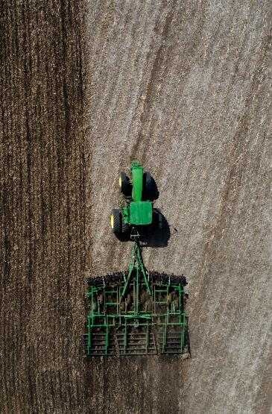
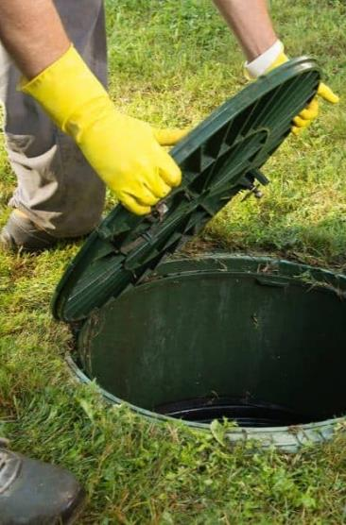
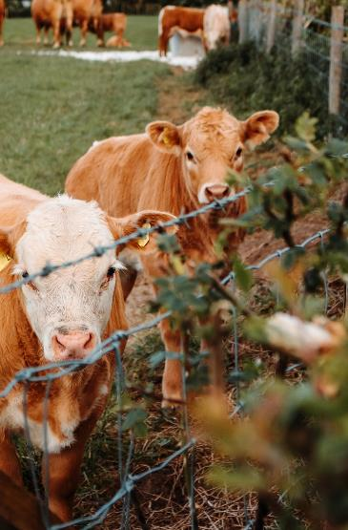
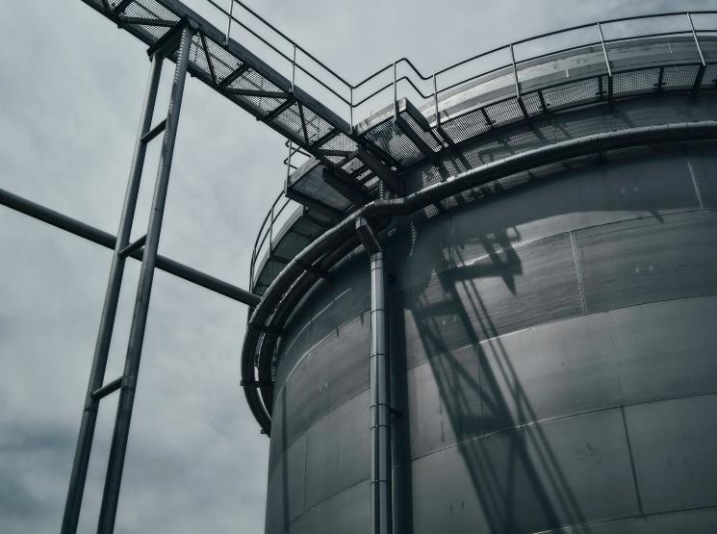
NITRATE-NITROGEN SOURCES
Wastewater treatment plants
Fertilized lawns and cropland
Failing septic systems
Animal waste
Industrial discharges
Notes:
Go over the different sources of nitrate-nitrogen sources, reading the information provided in the slides.

Slide 26
IMPACTS OF EXCESS NITROGEN
Stimulates plants and algae
Lowers dissolved oxygen
Harm fish and aquatic invertebrates
Eutrophication
Notes:
Go over the impacts of excess nitrogen in waterbodies.
Talking points:
Fish kills
Algal blooms

Slide 27
PHOSPHATE

Slide 28
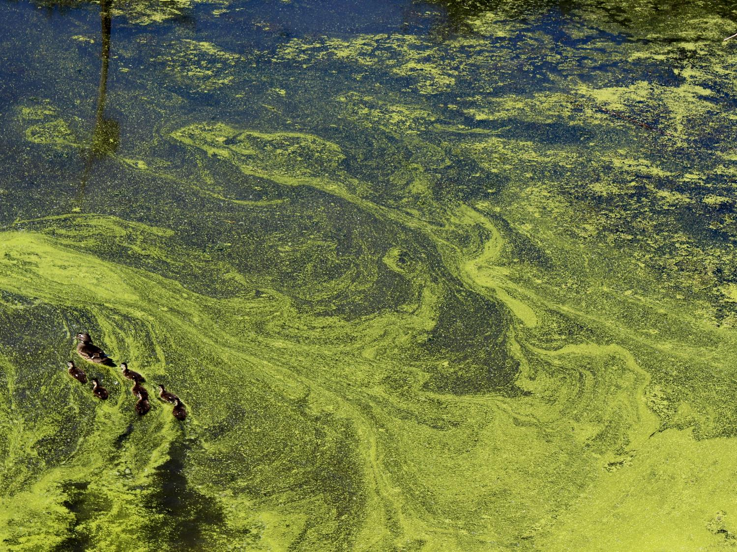
PHOSPHATE
An essential nutrient for plants and animals
Normally in short supply in fresh water
Recorded in mg/L
Total Phosphorus Screening level = 0.69 mg/L
Notes:
Go over phosphate, reading the information provided on the slides.
Talking points:
It is a nutrient necessary for the growth of most organisms.
The states screening level for total phosphorus in freshwater streams is 0.69 mg/L

Slide 29
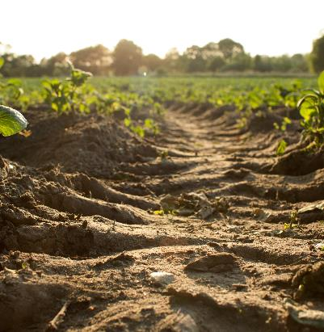
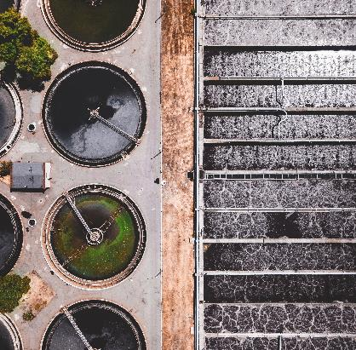
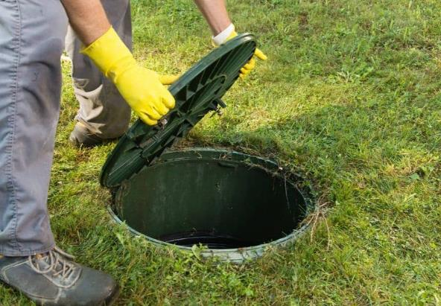
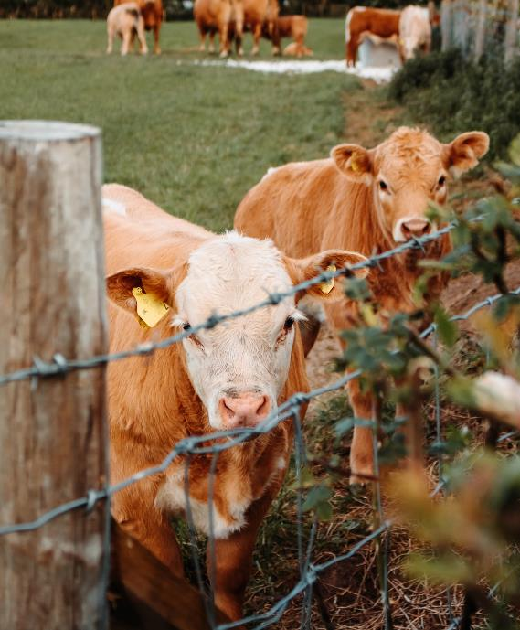
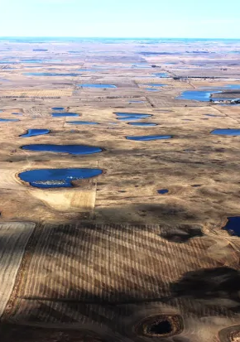
PHOSPHATE SOURCES
Soil
Rocks
Wastewater treatment plants
Fertilized lawns and croplands
Failing septic systems
Animal waste
Disturbed land areas
Drained wetlands
Commercial cleaning preparations
Notes:
Go over the sources of phosphates, reading the information on the slide

Slide 30
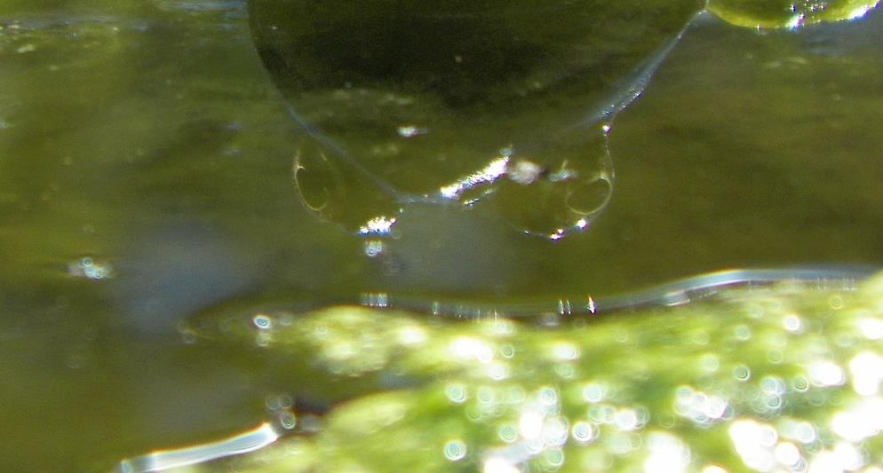
IMPACTS OF EXCESS PHOSPHATE
Stimulates plants and algae growth
Lowers dissolved oxygen
Harm fish and aquatic invertebrates
Eutrophication
Notes:
Go over the impacts of excess phosphate in waterbodies, going over the information on the slide.
An excess of phosphate eventually can lead to Eutrophication (next slide).

Slide 31
EUTROPHICATION
When a body of water becomes overly enriched with minerals and nutrients that induce excessive growth of plants and algae
Excess amounts of nutrients can lead to Eutrophication
→ blocks sunlight
→ less photosynthesis
→ less oxygen
→ Subsurface vegetation dies
→ Decomposition consumes oxygen
→ Fish kills
Notes:
Explain eutrophication, going over the information provided in the slide

Slide 32
STREAMFLOW
TURBIDITY
NITRATE-NITROGEN
ORTHOPHOSPHATE

Slide 33
STREAMFLOW

Slide 34
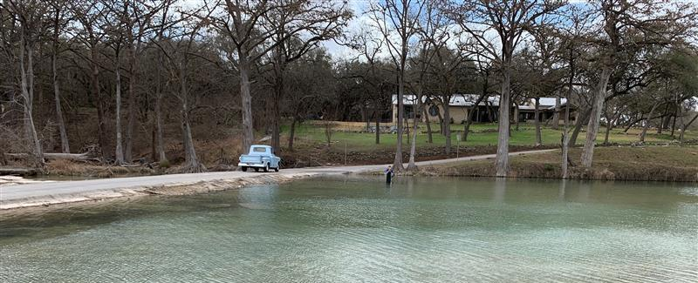
STREAMFLOW METHODS
Flow Gauge Station - instrument that measures and records the amount of water flowing in a river or stream in intervals
Streamflow Estimate – a velocity measurement at one point along the stream width that is extrapolated to represent the flow of the entire stream width and depth.
Notes:
Explain the two methods for collecting streamflow measurement

Slide 35
FLOW GAUGE STATION METHOD

Slide 36
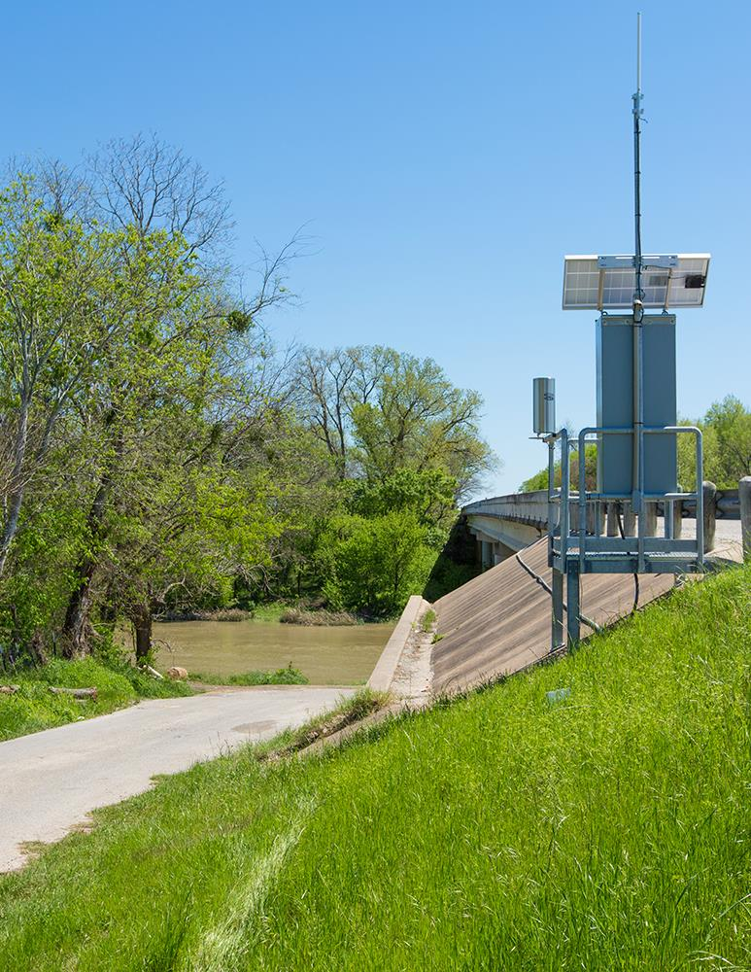
FLOW GAUGE STATION METHOD
Verify your site is within 0.25 mile of a gauge
Monitoring Form:
Mark “1-Flow Gauge Station” as the method used
Record “Discharge (cfs)” from the gauge that coincides with the date and time of the monitoring event
Notes:
Explain the flow gauge station method. Some talking points:
What entities operate and maintain gauges
How often they record measurements
Be sure to mention that the site is 0.25 RIVER miles, explained in further slide

Slide 37
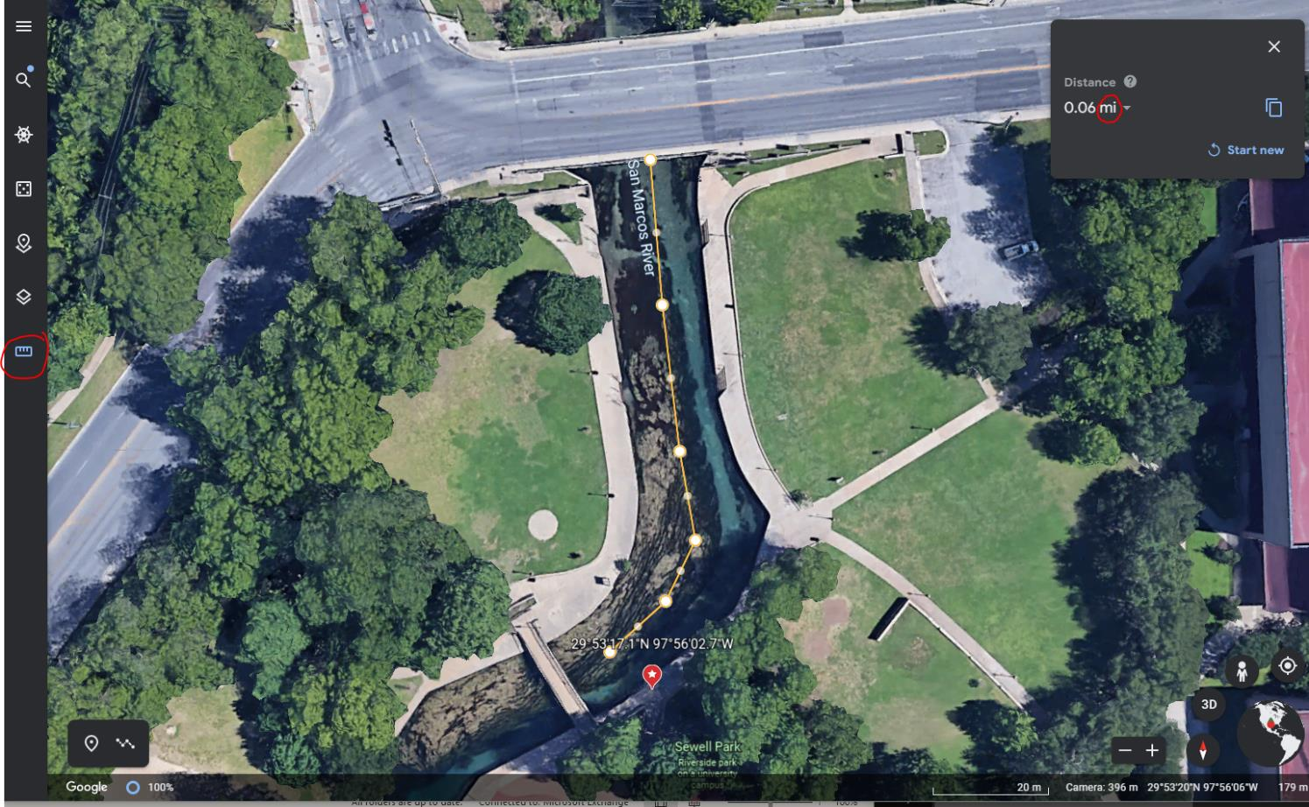
WWW.GOOGLE.COM/EARTH/
Notes:
Go through a demonstration to show trainees how to measure river miles using google earth

Slide 38
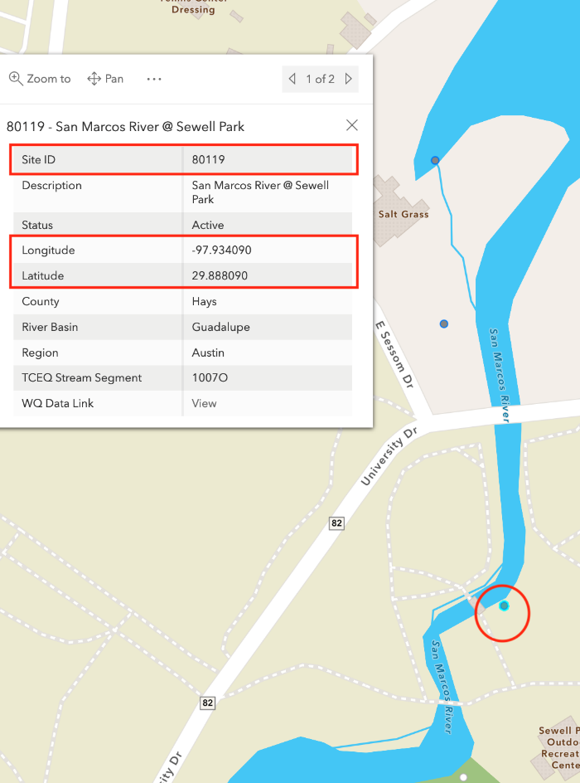
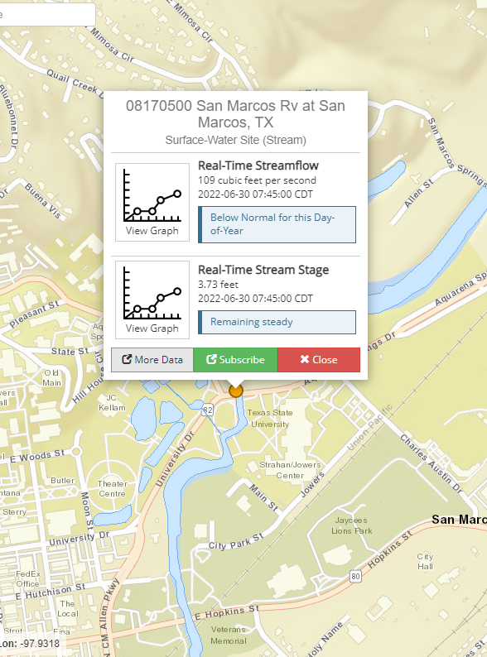
DATAMAP
USGS Flow Data
Notes:
Remind trainees that they can find the site ID and Lat/Long on the Datamap.

Slide 39
STREAMFLOW ESTIMATE METHOD

Slide 40
Notes:
Go over the second method: the stream flow estimate
Talking points:
Go over the discharge equation and how it is derived
Depth measurement is taken at equal intervals to determine the average depth of the stream

Slide 41
STREAMFLOW ESTIMATE METHOD
Notes:
If the location of the training isn’t adequate for going out in the water and conducting streamflow in the field slides 41-44 can be used to go over the method during the presentation portion. If the in the field method will be used, you can remove slides 42-44.

Slide 42
PHASE I – STREAMFLOW ESTIMATE EXAMPLE
Width = 15
Depth measurements
Depth 1 = 2 in = 0.17 ft
Depth 2 = 2 in = 0.17 ft
Depth 3 = 2 in = 0.17 ft
Depth 4 = 4 in = 0.33 ft
Depth 5 = 3 in = 0.25 ft
Depth 6 = 2 in = 0.17 ft
Depth 7 = 1 in = 0.08 ft
Time measurements
Time 1 = 27.55
Time 2 = 17.29
Time 3 = 19.23
Flow Measurement Method =
Depth Average =
Time Average =
Avg Velocity (10ft/AVG TIME ) =
Discharge (WIDTH X AVG DEPTH X AVG VELOCITY) =
2-streamflow estimate
0.19 ft
21.36 sec
0.47 ft/s
1.34 cfs
Notes:
If the in the field method will be used, you can remove slides 42-44.

Slide 43
PHASE II – STREAMFLOW ESTIMATE EXAMPLE
Width = 18
Depth measurements
Depth 1 = 2 ft
Depth 2 = 3 ft
Depth 3 = 4 ft
Depth 4 = 4 ft
Depth 5 = 4.5 ft
Depth 6 = 4.5 ft
Depth 7 = 3 ft
Depth 8 = 2 ft
Depth 9 = 2 ft
Time measurements
Time 1 = 27.51
Time 2 = 25.25
Time 3 = 26.94
Flow Measurement Method =
Depth Average =
Time Average =
Avg Velocity (10ft/AVG TIME ) =
Discharge (WIDTH X AVG DEPTH X AVG VELOCITY) =
2-streamflow estimate
3.22 ft
26.57 sec
0.38 ft/s
22.02 cfs
Notes:
If the in the field method will be used, you can remove slides 42-44.

Slide 44
PHASE III – STREAMFLOW ESTIMATE
Width = 10
Depth measurements
Depth 1 = 1 in
Depth 2 = 1.5 in
Depth 3 = 1.5 in
Depth 4 = 1 in
Depth 5 = 0.5 in
Time measurements
Time 1 = 15.80
Time 2 = 13.65
Time 3 = 14.27
Flow Measurement Method =
Depth Average =
Time Average =
Avg Velocity (10ft/AVG TIME ) =
Discharge (WIDTH X AVG DEPTH X AVG VELOCITY) =
2-streamflow estimate
= 0.08 ft
= 0.13 ft
0.09 ft
= 0.13 ft
14.57 sec
= 0.08 ft
0.69 ft/s
= 0.04 ft
0.62 cfs
Notes:
If the in the field method will be used, you can remove slides 42-44.

Slide 45
ADVANCED MONITORING PREPARATION
Monitoring frequency
Dress for the outdoors
Try to invite a buddy
Bring the following:
Advanced Environmental monitoring form
Advanced Field Guide
Monitoring kit/supplies
Notes:
Go over the steps needed to prepare for a monitoring event:
We ask community scientist to go out and monitor once a month at the same time each month. Monitoring should take place before 12 or after 4.
Not required, but it is best to suit up in outdoor clothing that is protective of the elements
A buddy is not required, but it is suggested for safety purposes
A monitoring form, field guide and monitoring supplies are always required

Slide 46
STREAMFLOW
TURBIDITY
NITRATE-NITROGEN
ORTHOPHOSPHATE
Notes:
Move on to the remaining parameters out in the field

Slide 47
PHASE I-III
Notes:
Have trainees conduct phase I-III

Slide 48
WRAP UP & NEXT STEPS

Slide 49
AFTER SAMPLING
Clean and store equipment
Submit monitoring form
Notes:
Discuss what to do after a sampling event by reading the slide. Talking points:
After a monitoring event is complete, properly cleaning and storing of equipment is important. These practices will not only prolong the condition of the equipment, but they will also ensure accurate monitoring results.
Monitoring forms are accessible directly on the Texas Stream Team website (www.TexasStreamTeam.org). After a monitoring event, submit the monitoring form to your Group Data Coordinator, if available. If your group has no Data Coordinator, submit a photo or scanned copy of your monitoring form to Texas Stream Team at TxStreamTeam@txstate.edu and Texas Stream Team will enter your data for you.

Slide 50
NEXT STEPS
Adopt or create a monitoring site! View the Datamap
Submit data at least once a month to TxStreamTeam@txstate.edu
Visit the Texas Stream Team calendar of events for future trainings.
www.TexasStreamTeam.org | TxStreamTeam@txstate.edu | 512-245-1346
Notes:
Website review: share the monitoring form location, the calendar, trainer page, and equipment form.

Slide 51
PHOTO ARTIST CREDITS
Jennifer Idol
Jenya Mendelenko
Flow photo
https://www.usgs.gov/special-topic/water-science-school/science/how-streamflow-measured?qt-science_center_objects=0#qt-science_center_objects

