Slide 1


Your International Student Health Plan
Brought to you by Academic HealthPlans
Texas State University

Slide 2



Your insurance team
Academic HealthPlans (AHP) is your plan administrator.
  AHP provides the following services:
  Website
  Plan Materials
  Enrollment
  Billing
  Customer Care for Enrollment
  On-campus Support
UnitedHealthcare StudentResources (UHC) is your insurance carrier.
  UHC provides the following services:
  Claims Administration
  Claims Customer Service
  Distribution of ID Cards
  Access to a Large Network of Providers

Slide 3
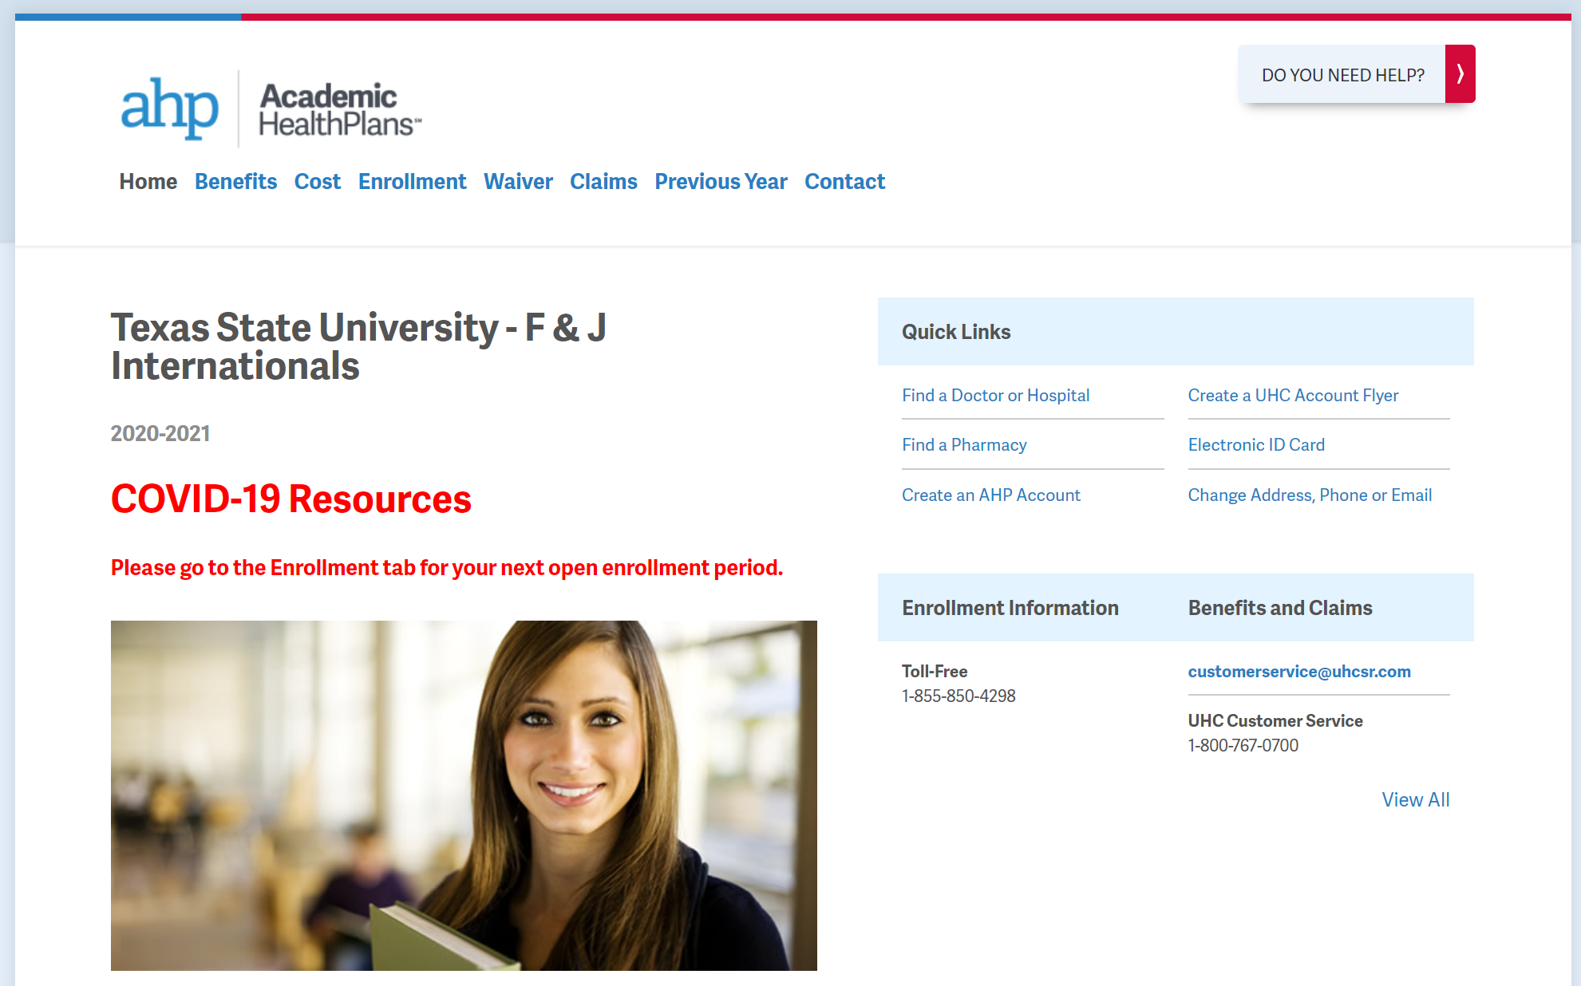
txstateintl.myahpcare.com
Benefits
Plan details
How your plan works
Value-added benefits
Academic Emergency Services
Enrollment
Dependent enrollment deadlines
Qualifying events

Slide 4
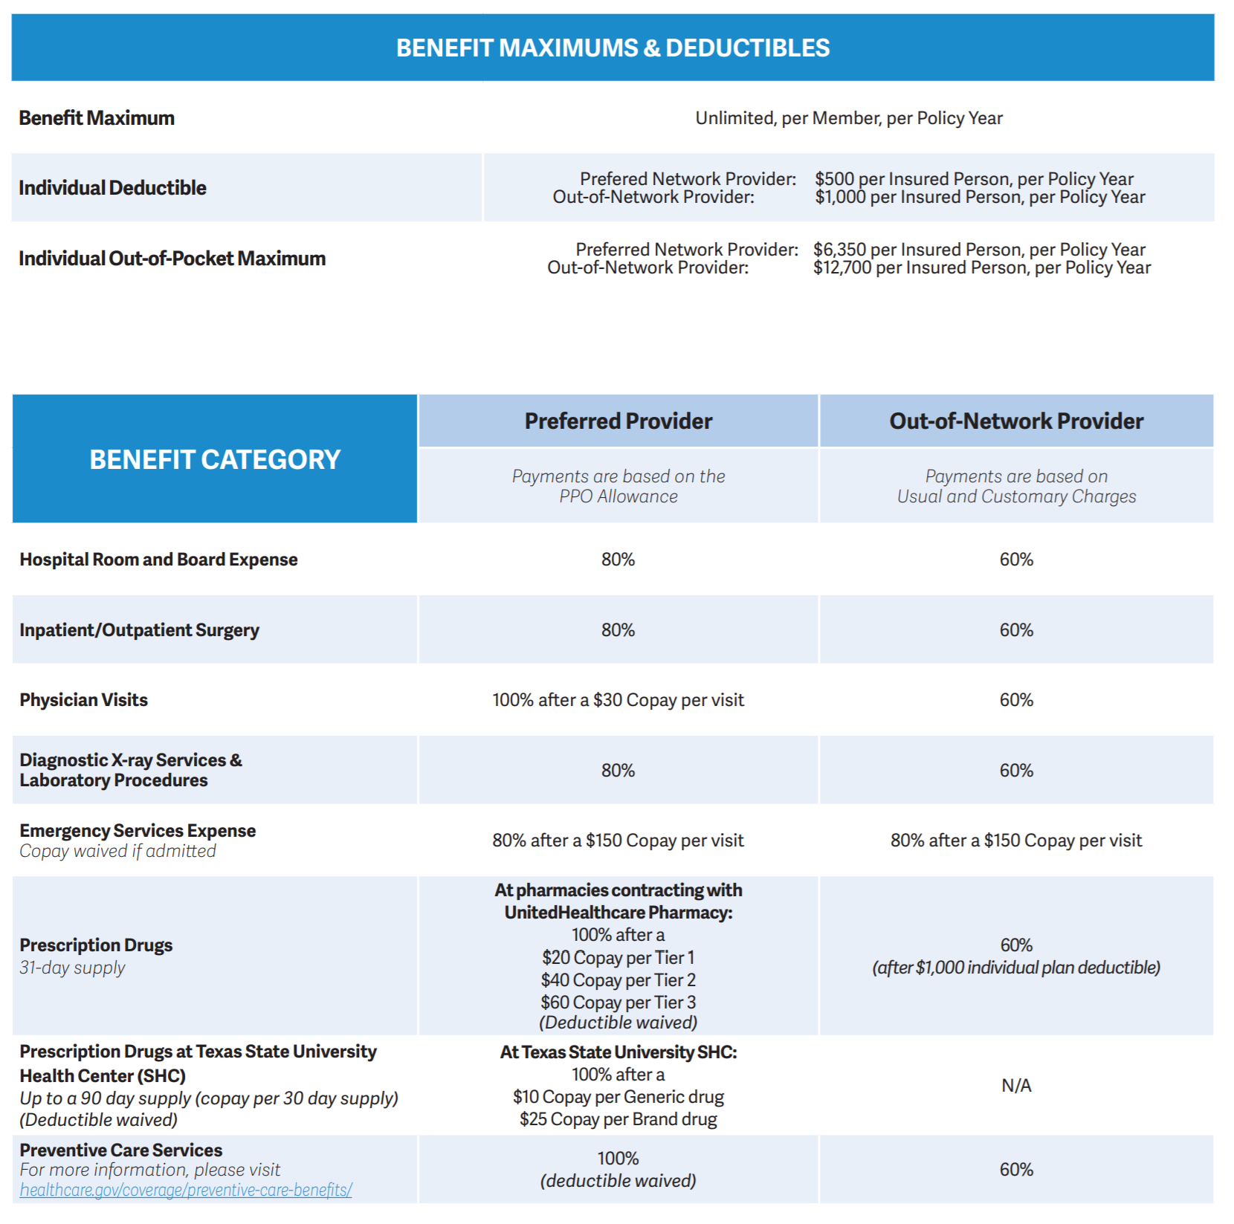
Understanding your benefits
Individual Out-of-Pocket Maximum:
The amount you will be responsible for before the insurance company begins to pay claims at 100%.
Deductible:
The amount you will pay out-of-pocket before the insurance company begins to pay. (Typically, this does not apply to doctor’s visits and prescription drugs.)
Co-insurance:
The percentage that the insurance company will pay for the listed services, after you meet your deductible and before your out-of-pocket max. is met. (In-network saves you money!)
Copayment:
The amount you will have to pay when services are received.

Slide 5
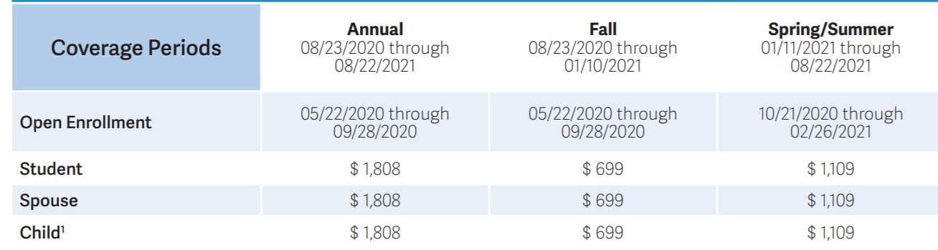
Understanding your enrollment
Open Enrollment:
Dates during which you can enroll dependents in the plan.
Coverage Period:
The dates that your health insurance will pay your claims for the current plan year.
Premium:
The amount that you will pay per semester for your coverage. (If an annual coverage period is offered, you may purchase insurance for the entire year.)

Slide 6

Academic Emergency Services
Academic Emergency Services (AES) provides immediate access to assistance if you experience a travel related crisis.
Services include:
Emergency medical evacuation
If you are overseas and an emergency occurs, we will get you out of there ASAP.
Medically advisable repatriation
If you are studying in the U.S., we will make sure you get back home if your health depends on it.
Visit by family or friends
If there is a medical emergency and you are hospitalized, we will make sure the ones that care about you most are there to support you.
  And…
  Pre-travel information
  Lost luggage assistance
  Prescription assistance
  Translation assistance
  Emergency message transmittal
For more details, visit txwes.myahpcare.com.

Slide 7

COVID-19 Resources
Testing and Treatment
Testing: No copays, deductibles or coinsurance for medically necessary lab tests to diagnose COVID-19.
Treatment: Treatment for COVID-19 is covered by UHC. Please see UHC COVID-19 Information at txstateintl.myahpcare.com/covid19resources for details.
24/7 Student Assistance Program
Access to counseling, mediation, legal and financial support.

Slide 8

HealthiestYou Telemedicine
Key Benefits
Physical health & behavioral health providers and counseling services
Talk to a Board-Certified Physician 24/7/365
No appointment necessary
No consultation fee for UHCSR members
$40 consultation fee for non UHCSR members
Avoid trips to the doctor’s office, urgent care or emergency room
Use whatever device is convenient - smart phone, tablet, computer, etc.

Slide 9

Optional Supplemental Coverage
VSP Vision Plan
Vision coverage is an add-on service. Medical insurance plans (i.e. the Student Health Insurance Plan or the SmartCare plan) cover illnesses or diseases of the eye, but not routine examinations, glasses nor contacts.
Vision for insureds under the age of 19 is often covered in medical plans.
Cigna Dental Plan
Dental coverage is also an add-on service. Most medical plans will cover accidental injuries to natural teeth, but not routine examinations, fillings or braces.
Dental for insureds under the age of 19 is covered in medical plans.
Enroll in vision and/or dental online at txstateintl.myahpcare.com/enrollment.

Slide 10
Top Health Plan Tips
Texas State Student Health should be your first stop for non-emergency care.
Keep us and your school informed of any address changes.
Use the Emergency Room for emergency situations only.
Use the free Nurseline to find the best plan of action for medical treatment.
Keep receipts of all payments made for medical services and prescriptions.
Always choose an in-network physician.
Use web tools located at txstateintl.myahpcare.com to find a provider.
Check online reviews before choosing a physician.
Request provider to prescribe a generic drug to save money.
If you need more information on your plan, txstateintl.myahpcare.com should be your first stop.
Create an account by going txstateintl.myahpcare.com and click on the “Create a UHC Account Flyer” for instructions on how to access important healthcare information such as your insurance card and available discount programs.
Always carry your ID card with you.

Slide 11

Questions?
Contact Us
Enrollment Information:
Academic HealthPlans
txstateintl.myahpcare.com
help.ahpcare.com
Claims & Benefit Information:
UnitedHealthcare StudentResources
1-800-767-0700

