Slide 1
Understanding F-1 International
Student
Needs
What in the world does this acronym mean?
(RCL, CPT, OPT, etc.)
Notes:
JT

Slide 2
Presentation Overview
Graduate College
Credential Evaluation
International Student and Scholar Services (ISSS)
Definitions
Who is an international student?
International Student Numbers at Texas State
International Documents
International Student Forms and Regulations
Work Authorization
Cultural Adjustment
Student Challenges
Annual Events
Student Panel
Notes:
JT

Slide 3
Mark Moore Graduate College
Notes:
MM

Slide 4
Credential Evaluation
What is it?
What is the process?
What resources do we use?
What do you, as advisors, need to know?

Slide 5
Credential Evaluation
Credential Evaluation is the evaluation of international degrees and the conversion to the U.S. education system
Two main parts: 1. Degree equivalency 2. GPA calculation
Credential Evaluation is an art not a science
No two evaluations are the same
Notes:
Scales change and students as well as institutions provide varying levels of information.
There are five primary education models worldwide: U.S., British and variations, French and variations, Russian, Bologna and ECTS (Europe)

Slide 6
Degree Equivalency
What is the process?
Receive complete transcripts
If school is unknown, look for accreditation/recognition.
Compare education history, degree type, duration.
Utilizes Primary, Secondary, and Tertiary sources to determine degree equivalence.
Notes:
Accreditation: Use Primary resources to determine accreditation. In most cases this is the Ministry website for the country where the degree was earned.
Degree Equvalence: Bachelor’s and Master’s degrees are not created equal. In many cases a 3 year Bachelor’s degree can be combined with a 2 year Master’s degree to be the equivalent of a U.S. Bachelor’s
We use internal policies and the AACRAO Edge resource to determine degree equivalence

Slide 7
GPA Conversions
What is the process?
Receive complete transcripts
Use native transcript key whenever possible. Evaluations are done based on Program -> University -> Country in that order.
Use secondary resources to determine equivalencies. For example: First class from all Indian institutions is considered an “A”
Calculate a GPA from the last 20 courses excluding Projects/Mini Projects, Viva Voce, and Thesis
Evaluation Sheet
Every International GPA will include an Evaluation sheet. This explains GPA conversions and Degree equivalency for each school/degree.
These evaluation sheets are maintained for future use to maintain consistency. We currently have a library of over 800 evaluations for different schools and programs across the globe.

Slide 8
Credential Evaluation Resources
Primary Resource: University websites, PDFs, Ministries of Education, Transcripts
The most important resources we use come from the University or the accrediting/recognizing bodies associated with it
Secondary Resource: AACRAO Edge, Classbase/Scholaro, WES, NUFFIC, NAFSA other sources
AACRAO Edge is our primary secondary resource but we do use other secondary resources to confirm AACRO findings.

Slide 9
What Do You Need to Know?
The name of a degree is often not what we consider it equivalent to. It’s important not to take things at face-value with International Credentials.
Grading systems are very different across the world despite sometimes overlapping in Alpha grades or percentages.
We don’t always get it right. There are many variables at play with each evaluation. There may be pieces of information that are missing that would help determine the grade scale. Remember, it is an art, not a science!
If you, or your applicant ever have a question about an evaluation please reach out to mm1854@txstate.edu

Slide 10
Questions?

Slide 11
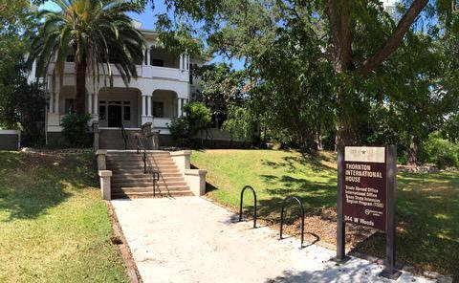
International Student and Scholar Services (ISSS)
ISSS is here to assist students, scholars, faculty and staff to navigate federal immigration regulations.
Dr. Jonathan Tyner – Interim Associate Director, PDSO Vacant – Coordinator, DSO Victoria Gonzales – Engagement Specialist, DSO Vacant – Administrative Assistant II, DSO Contact information: Office: Thornton International House Phone: 512.245.7966 Email: international@txstate.edu
Notes:
JT

Slide 12
Definitions
DHS: Department of Homeland Security – oversees federal agencies responsible for international students and scholars:
U.S. Citizenship and Immigration Services (USCIS)
U.S. Customs and Border Protection (CBP)
U.S. Immigration and Customs Enforcement (ICE)
Student and Exchange Visitor Program (SEVP)
SEVIS: Student and Exchange Visitor Information System – Federal system, used by a DSO, to monitor and maintain all F-1 immigration records.
DSO: Designated School Official – Trained and authorized by DHS to manage SEVIS records. Texas State has four DSOs, all ISSS staff.
Form I-20: Certificate of Eligibility for Nonimmigrant Student Status. Used only by F-1 students.
Notes:
JT

Slide 13
Who is an international student?
An international student is on a specific visa while pursuing an academic program of study at a SEVIS-approved US institution.
Common visa statuses are A1/A2, B1/B2, E1/E2, F1/F2, H1/H4, J1/J2, K1/K2, L1/L2, M-1, R-1, TN/TD.
See visa classifications and definitions here: www.international.txstate.edu/help/visa_classification.html
F-1 Student – the most common visa status at Texas State. 87% of international students are on F-1 visas.
Students who are undocumented, permanent residents, refugee, or asylum status in the US are not considered international students.
Notes:
JT

Slide 14
Who do we advise?
ISSS only monitors F-1 and J-1 students.
F-1 Student: An F1 visa is issued by DHS to international students who are attending an academic program or English Language Program at a US college or university.
J-1 Student: A J1 visa is issued by the US Department of State to research scholars, professors, and exchange visitors participating in programs that promote cultural exchange, especially to obtain medical or business training within the US.
Notes:
JT

Slide 15
Texas State International Students
Fall 2020
Total Student: 492
F Visa - 430, Other Visas - 62
Notes:
JT

Slide 16
International Student Enrollment Trends
Notes:
JT

Slide 17
Enrollment by Region

Slide 18
Enrollment by Country (Top 10)
492 students from 72 countries
2020 | Top 10 Countries of Origin | # of Students (% total population)
1 | India | 147 (30%)
2 | China (Mainland) | 44(9%)
3 | Bangladesh | 35 (7%)
4 | Nigeria | 30 (6%)
5 | Mexico | 25 (5%)
6 | Nepal | 22 (4%)
7 | Vietnam | 19 (4%)
8 | South Korea | 13 (3%)
9 | Iran | 10 (2%)
10 | Japan | 9 (2%)
Total students |  | 354
% of total students |  | 72%

Slide 19
Enrollment by Major (Top 10)
492 students from 72 countries
2020 | Top 10 Majors | # of Students (% total population)
1 | Computer Science | 123 (25%)
2 | Engineering | 46 (9%)
3 | Data Analytics & Information Systems | 27 (6%)
4 | MSEC | 23 (5%)
5 | Geographic Info Science | 17 (3%)
6 | Business Administration | 16 (3%)
7 | Computer Information Systems | 9 (2%)
8 | Exercise Science | 9 (2%)
9 | Finance | 8 (1.5%)
10 | Technology Management | 8 (1.5%)
Total Students |  | 286
% of total students |  | 58%

Slide 20
Enrollment by Academic College
College | Total Students | F-1 Only | % F-1
Applied Arts | 13 | 12 | 92%
McCoy College of Business | 82 | 63 | 77%
Education | 33 | 32 | 97%
Fine Arts & Communication | 26 | 25 | 96%
Health Professions | 10 | 7 | 70%
Liberal Arts | 55 | 50 | 91%
Science & Engineering | 260 | 229 | 88%
University College | 11 | 11 | 100%
Graduate College | 2 | 1 | 50%
See numbers and trends: International Student Statistics
Notes:
JT

Slide 21
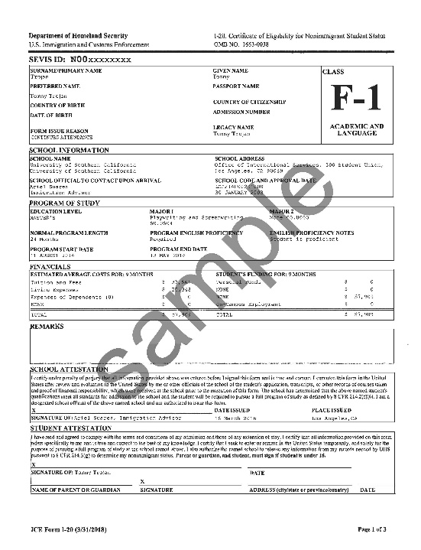
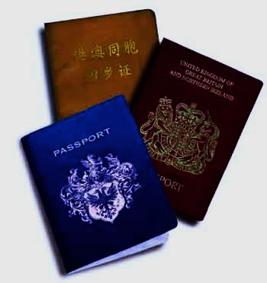
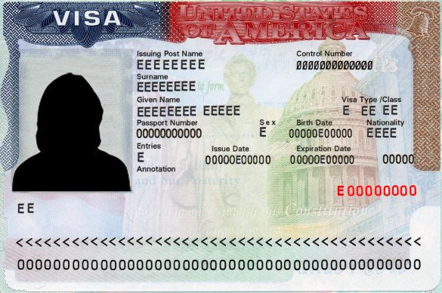
Immigration Documents
Passport
I-20
Visa
Must always be valid.
Renew passport at student’s embassy or home country abroad
Certificate of Eligibility for Nonimmigrant Student Status
I-20 and acceptance letter are needed to request an F-1 Visa at the US Consulate in the home country.
An expired visa does not affect the student’s immigration status.
Does not need to be valid to remain in US.
Notes:
VG

Slide 22
Form I-20: Certificate of Eligibility Most important legal document for F-1 students.
Academically admission to a SEVP-certified school.
Accepted for a full course of study.
Has enough funding to meet the cost of attendance (tuition and living expenses).
Start Date – first day of classes. Student may enter and begin work as early as 30 days before the Start Date.
End Date – date of program completion. Program extensions can be granted in limited situations.
Change of Major – a new I-20 will be made for students who change majors.
Travel Signature – DSO endorsement for international travel. Required every semester.
Notes:
VG

Slide 23
F-1 International Student Regulations
Notes:
Vg

Slide 24
Program Extension Certification Form
An F-1 Student who will not complete their academic program by the I-20 program end date must apply for a program extension before the I-20 program end date.
Advisors certify that the delay in completion is caused by compelling academic reasons, such as changes of major, research topics, or unexpected research problems.
ISSS has the discretion to interpret the term "compelling academic or medical reasons”.
Delays caused by academic probation or suspension are not acceptable reasons for a program extension.
Notes:
VG

Slide 25
Full-Time Enrollment Requirement
F-1 students must maintain full-time enrollment every fall and spring.
Summer full-time enrollment is required only for new F-1 students beginning in summer.
9 hours for Graduate students
12 hours for Undergraduate students
Notes:
VG

Slide 26
Concurrent Enrollment Certification Form
An F-1 student may be enrolled in two different SEVIS-approved schools at one time as long as the combined enrollment amounts to a full-time course load﻿.
Advisor certifies that the requested courses are transferable credits that will contribute to the student’s program of study
Notes:
VG

Slide 27
Distance Learning Courses
Only one truly distance learning class per semester may be counted toward the full-time enrollment requirement.
Class considered “Distance Learning” is taken online or through correspondence and does not require the student's physical attendance for classes, examination, or other purposes integral to completion of the class.
If a class has any required face-to-face components the class is not considered a distance learning course.
Hybrid courses are considered as face-to-face
Online Class | Face-to-Face Class
1 | 3 – UG, 2 – GR
2 | 3 – UG, 2 – GR
Notes:
VG

Slide 28
Reduced Course Load (RCL)
Full-time Enrollment Exception: Students must receive International Student and Scholar Services (ISSS) authorization before 1) dropping a class or 2) enrolling less than full-time.
Not enrolling full-time is a violation of status that results in the immediate termination of the student’s immigration status.
Approved Conditions:
Academic Difficulty
Illness or Medical Condition
To Complete Course of Study in Current Term (Student’s final semester)
Notes:
JT

Slide 29
Academic Difficulty RCL
Academic difficulties include:
Initial difficulties with the English language
Initial difficulties with reading requirements
Unfamiliarity with American teaching methods
Improper course level placement
Notice: Only once per program level and enroll in at least 6 hours.
Reasons not allowed:
"imminent danger of failing a class" is not a permissible reason unless sufficient facts prove the student is on the verge of failure because of an improper course level placement.
Financial difficulty

Slide 30
Medical RCL
F-1 students with documented medical condition(s) can be eligible for a medical reduced course load.
Medical RCL form must be signed by a medical professional
May drop down to zero credit hours
Cannot exceed 12 months
Notice: Remind students of Texas State’s continuous enrollment policy if seeking a medical RCL with no enrollment.

Slide 31
Final Semester RCL
F-1 students in their final term can just take the courses needed to complete their program.
Must enroll in at least one credit hour
May not use more than once unless:
Student fails a course
Graduate students in thesis/dissertation only are permitted multiple final semester RCLs

Slide 32
Employment
F-1 students are permitted to work on-campus without ISSS approval.
F-1 students must have a valid I-20.
20 hours a week while school is in session.
40 hours a week during university breaks and summer.
ALL off-campus work requires authorization from ISSS.
Internships, student teaching, and other work-related opportunities off-campus (even unpaid) are considered employment when there is exchange of work for course credit.
Curricular Practical Training (CPT)
Optional Practical Training (OPT)
Severe Economic Hardship Work Authorization
Notes:
JT

Slide 33
Curricular Practical Training (CPT)
Key word is CURRICULAR and CPT must be an integral part of an established curriculum.
CPT is alternative work/study, internship, cooperative education, student teaching, directed project, or any other type of practicum course that is required for the student’s degree.
Student must complete one full academic year before being eligible for CPT, unless a graduate program required immediate participation in CPT.
Part-time (less than 20 hours) or full-time (more than 20 hours per week).
CPT should be approached primarily from the curricular perspective, and only secondarily from the employment perspective. The school's curriculum, not the student's desire for employment or income, should drive CPT authorization﻿.

Slide 34
CPT Application Process
Student meets with Academic or Faculty Advisor to discuss planned internship.
Student registers for internship class.
Student submits the following to ISSS:
Curricular Practical Training Certification Form signed by Advisor
Class schedule showing enrollment in internship course
Hiring or job offer letter from company
Final semester RCL, if it is the student’s final semester and will not be enrolled full-time
Student receives authorization and new I-20 from ISSS before starting employment
Notes:
jt

Slide 35
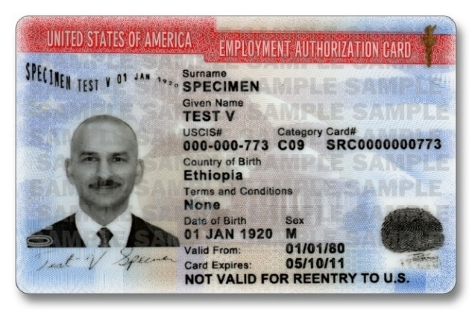
Optional Practical Training (OPT)
USCIS grants F-1 students 12 months of temporary employment authorization. Students in designated STEM majors are eligible for a 24-month extension known as STEM OPT.
Advisors certify the student will complete their program of study in a given semester Completion of Degree Certification Form.
Students on thesis/dissertation only are eligible to apply for OPT before officially graduating.
Students are encouraged to apply for OPT once applications are accepted (90 days before graduation).
Students will apply for OPT with ISSS
Notes:
jt

Slide 36
International Student Forms
Certification Forms Needing Advisor Approval:
Reduced Course Load Form
Academic, Medical, and Final Semester
Concurrent Enrollment Form
Program Extension Form
Curricular Practical Training Form
Completion of Degree Form (for Optional Practical Training)
Notes:
VG talk about quick guide

Slide 37
F-1 Student Regulations Reminders
F-1 students are required by DHS to maintain lawful F-1 status by:
Enrolling full-time (9 hours – GR, 12 hours – UG) every Fall and Spring semesters, and summer if it is the student’s first semester.
Not working off-campus without proper authorization from ISSS via CPT or OPT.
Enrolling in enough face-to-face courses when taking a distance learning course.
Notes:
VG

Slide 38
How TXST Advisors CAN Help
In compliance with DHS regulations ISSS must maintain:
Documentation that supports the granting of reduced course load authorizations (Academic Difficulty RCL Form)
Documentation that a student is in the final semester and does not need to be full-time to graduate (Final Semester RCL Form)
Documentation supporting an I-20 extension (Program Extension)
Verification that courses taken at another school will count towards the student’s degree at Texas State (Concurrent Enrollment Form)
Documentation supporting the granting, recommendation, and reporting of off-campus practical training (CPT and OPT Forms)
Notes:
VG

Slide 39
Cultural Adjustment
Notes:
VG—What is culture?

Slide 40
Notes:
VG

Slide 41
Cultural Adjustment
International students bring their values, religious beliefs, customs, and assumptions, to Texas State. Social norms, academic practices, and communication styles are a few differences they encounter.
Students often experience culture shock upon arriving in the US; some students experience the phases of Culture Shock more intensely and longer than others.
Learning how to navigate Texas State’s academic and community culture can be challenging. For example: social roles, academic expectations, class attendance, campus policies and procedures, and overcoming any language barriers.
Every language barrier or cultural difference is an opportunity to learn and look at the world from a different perspective.
Students may need assistance with adjusting to the USA work culture as an office, research, or teaching assistant.
Notes:
VG

Slide 42
Student Challenges
International students come from many different cultures and have diverse experiences with higher education.
Some have never exercised much academic choice and are expecting to be told what to do and what to take.
Some email you constantly about many non-academic issues.
Some constantly challenge you because ‘No’ doesn’t mean no in their culture where they push to get anything.

Slide 43
ISSS Annual Events
Event funding opportunities available!
@txst_isss
@txst_isss
/txstISSS
www.international.txstate.edu/events.html
Notes:
VG

Slide 44
Presentation is available on International Student and Scholar Services (ISSS) website – Department Resources: http://www.international.txstate.edu/departments.html
Thornton International House
Phone: 512-245-7966
international@txstate.edu

Slide 45
Questions?

Slide 46
Student Panel

