Slide 1
Understanding Infotypes in PA20 in SAP

Slide 2
Display HR Master Data (PA20)
Infotype 0000 Actions
Infotype 0001 Organizational Assignment
Infotype 0006 Address
Infotype 0007 Planned Working Time
Infotype 0008 Basic Pay
Infotype 0014 Recurring Payments
Infotype 0015 Additional Payments
Infotype 0027 Cost Distribution
Infotype 9001 Staff ULP
Infotype 9003 Rank and Tenure
Infotype 9004 Education
Notes:
These are some of the most common infotypes that a manager would check on an employee.
These infotypes are best viewed using SAP GUI.

Slide 3
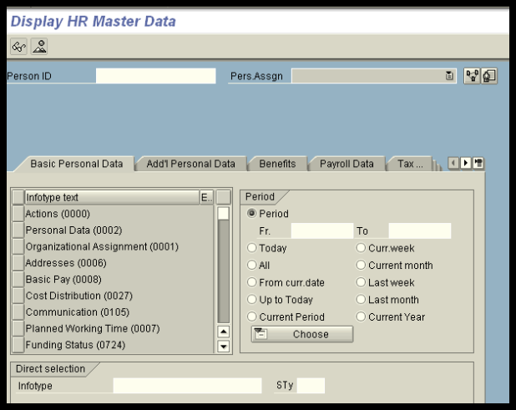
Input Person ID and Select Pers. Assgn if concurrent employee
Notes:
If an employee is concurrently employed in the same department, you can select the assignment to view by using the drop-down on the “Pers Assign” selection.

Slide 4
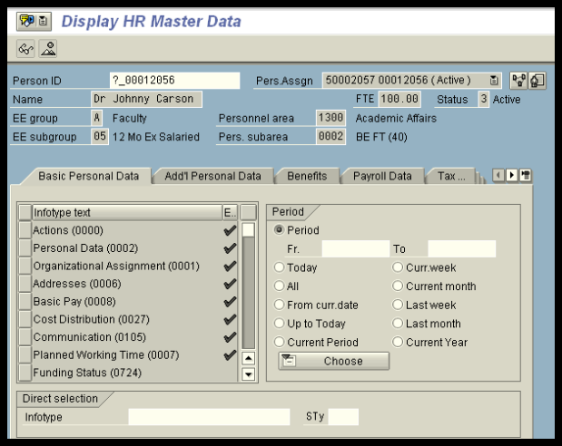
Review Employee Information
Notes:
All information is viewed with the “eyeglass or mountain” view.

Slide 5
Select Infotype or Enter Infotype number
Notes:
The infotype is selected by clicking on the box to the right of the information or can be entered by number in the field at the bottom of the screen.

Slide 6
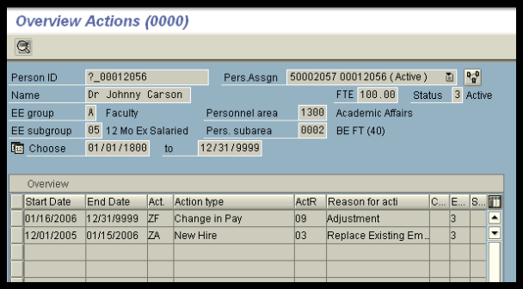
Actions (IT0000)
Notes:
The overview allows you to see all actions that have taken place on an employee. Use the mountain to view a list of all actions. The eyeglasses only allow you to see one action at a time.

Slide 7
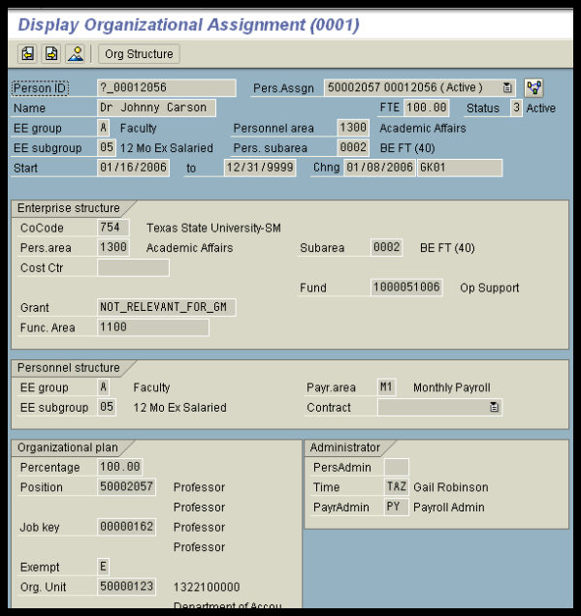
Organizational Assignment (IT0001)
Notes:
This is the one infotype where you will see the employee’s position title.

Slide 8
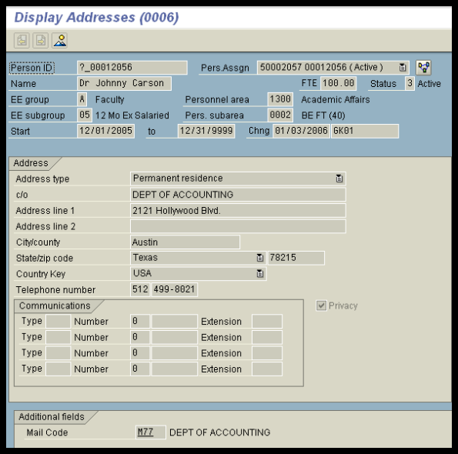
Address (IT0006)
Notes:
A permanent and temporary address can be stored on an employee and the employee can update in ESS. The employee’s personal cell or pager number can be stored in the communications section. The employee will also provide this information through ESS.
The privacy indicator is stored on this infotype which means you cannot release the employee’s address or phone number to anyone if the privacy indicator is selected.
The employee’s university mail code is also stored on this infotype. If a change needs to be made, contact HR or Faculty Records.

Slide 9
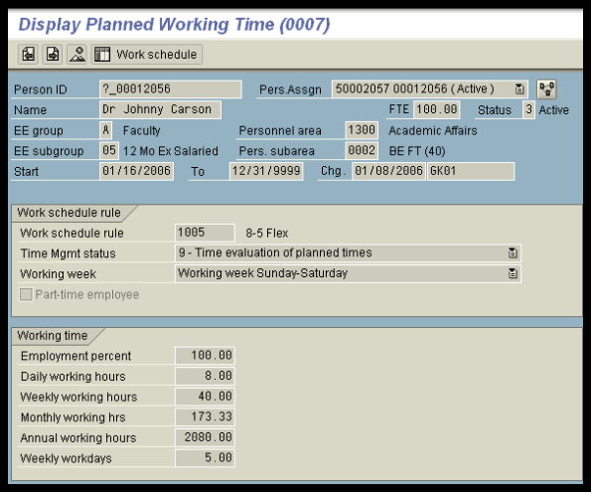
Planned Working Time (IT0007)
Notes:
This is the only infotype where the employee’s employment percent or FTE is stored. Every hourly student and task employee will have an FTE of 100% on each appointment. This is the system default and we will not change it because we do not use FTE for this group of employees.
This infotype allows you to view the work schedule for an employee. This is useful for those departments who have employees who work different work schedules such as the police department and the physical plant.

Slide 10
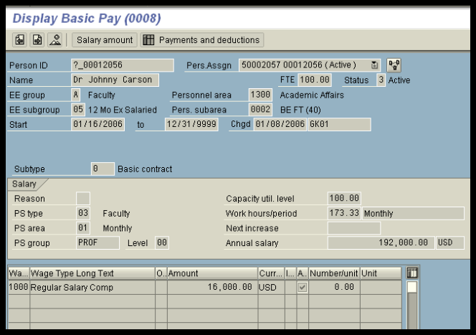
Basic Pay (IT0008)
Notes:
Note: Per course faculty will have a blank on this info type. All salary payments for per course faculty are stored in info type 14, Recurring Payments.

Slide 11
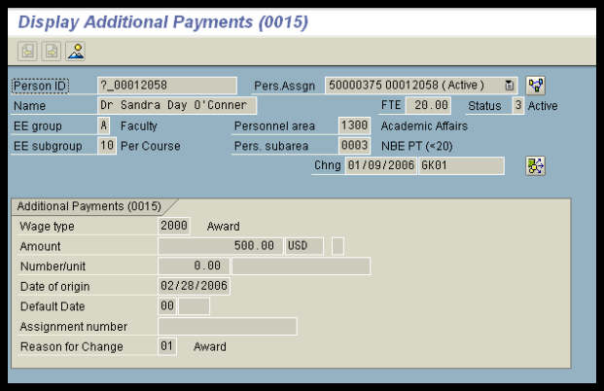
Additional Payments (IT0015)
Notes:
Additional payments are one-time payments such as awards and stipends.
A payment can to be made from an account other than the employee’s regular cost distribution account. The symbol that is circled indicates that another account has been entered for this payment. This can be done for recurring payments, such a teaching overloads as well.

Slide 12
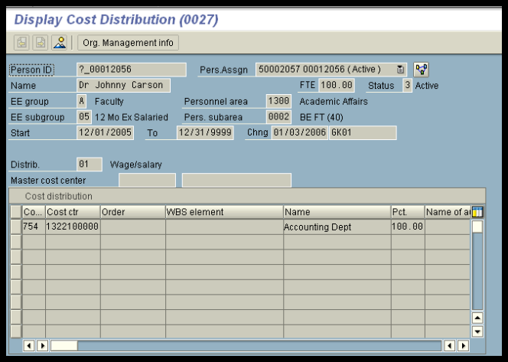
Cost Distribution (IT0027)
Notes:
An employee’s cost distribution must always equal 100%, no matter their employment FTE.

Slide 13
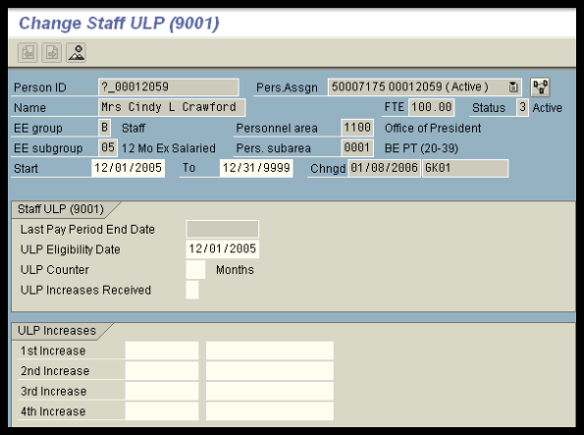
Staff ULP (IT9001)
Notes:
The infotype will show you have many ULP increases an employee has earned on an assignment.
Once payroll is run, the Last Pay Period End Date will be updated.

Slide 14
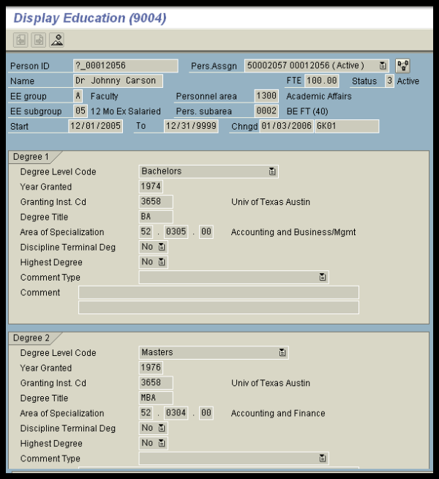
Education (IT9004)
Notes:
The Education infotype was designed to capture up to 7 degrees on an employee.
Degree 1 is always the first or lowest degree held by the employee.

Slide 15
Questions
Katie Bonner | for salaried staff and non-academic graduate students | kb1367@txstate.edu
Teresa Duggins | for NSNR staff hourly and hourly employees | td01@txstate.edu
Lisa Gonzalez | for hourly students | lisag@txstate.edu
Elizabeth Mello | Faculty Records, for faculty and academic graduate students | es15@txstate.edu

