Slide 1
Orientation for CDIS Majors
Round Rock

Slide 2
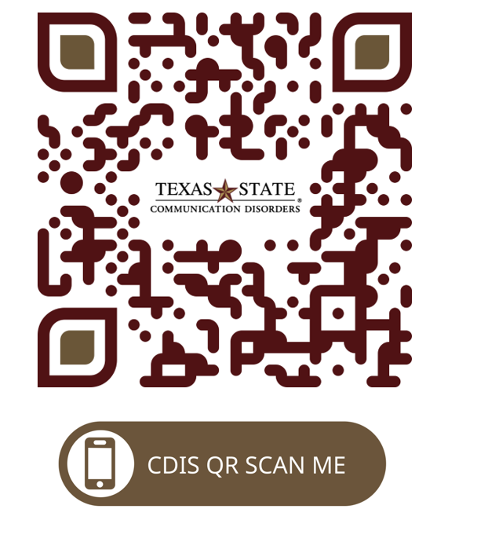
CDIS website https://www.health.txstate.edu/cdis/

Slide 3
Application Process
Number admitted
Notification of acceptance
June/July
Registration for the fall
DAR
Assigned a permanent advisor in the fall

Slide 4
Undergraduate Course Sequence and Degree Requirements
Support Courses
Specific required courses
Support electives
Equivalency guide
CHP Advising Center: Encino Hall 302
512-245-3506; hpadvising@txstate.edu

Slide 6
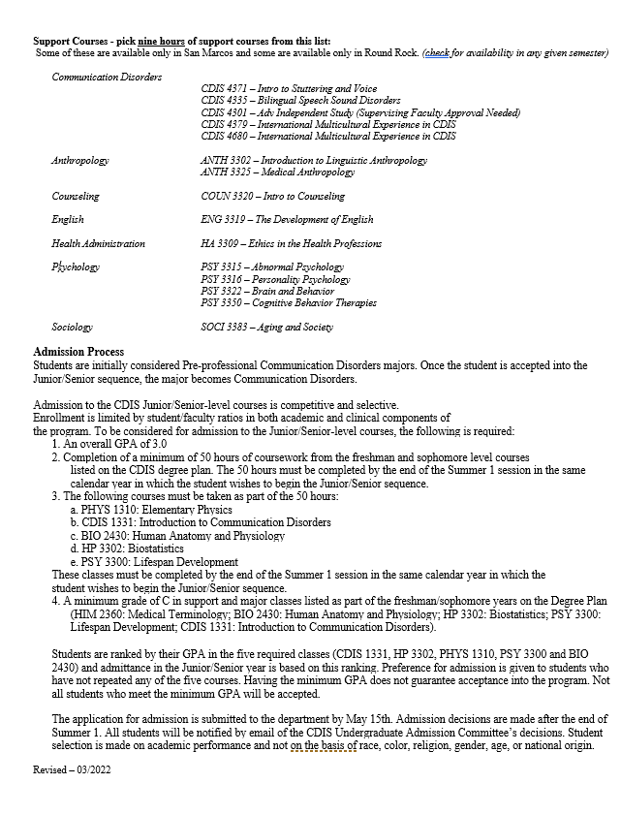

Slide 7
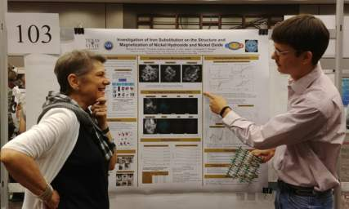
Misc Academics
Honors’ College
Minors

Slide 8
Other Departmental Opportunities
Student Service Organizations
NSSLHA
Sertoma
BIG
Student Affairs:
LaTonya Y. Henry
LH17@txstate.edu

Slide 9
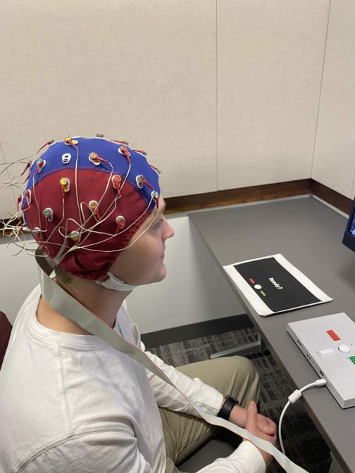
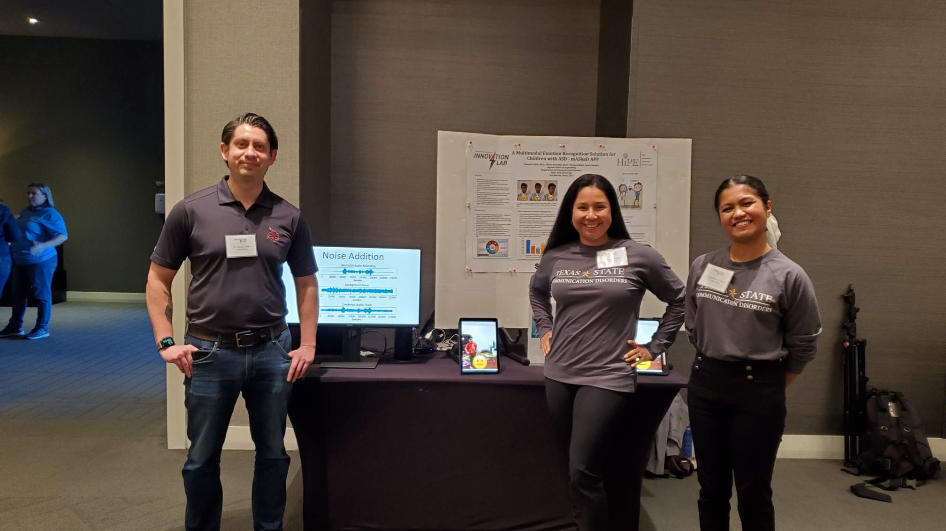
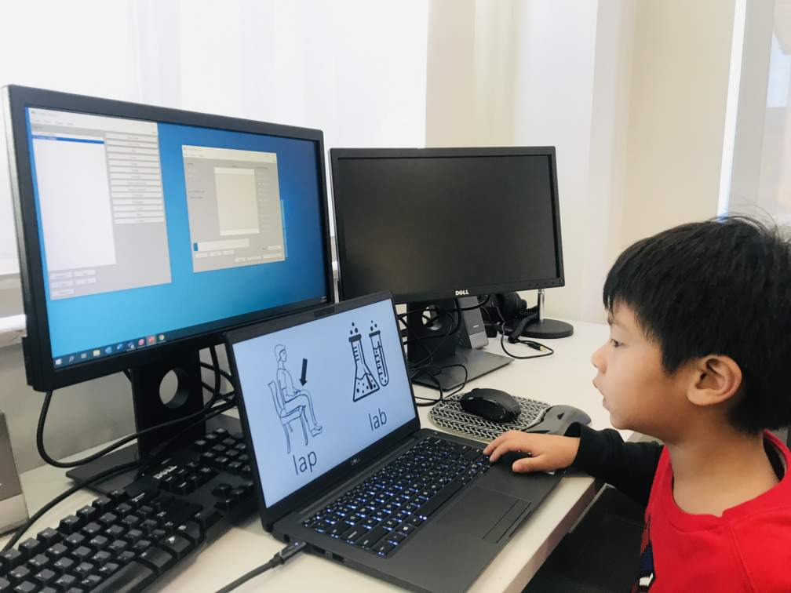
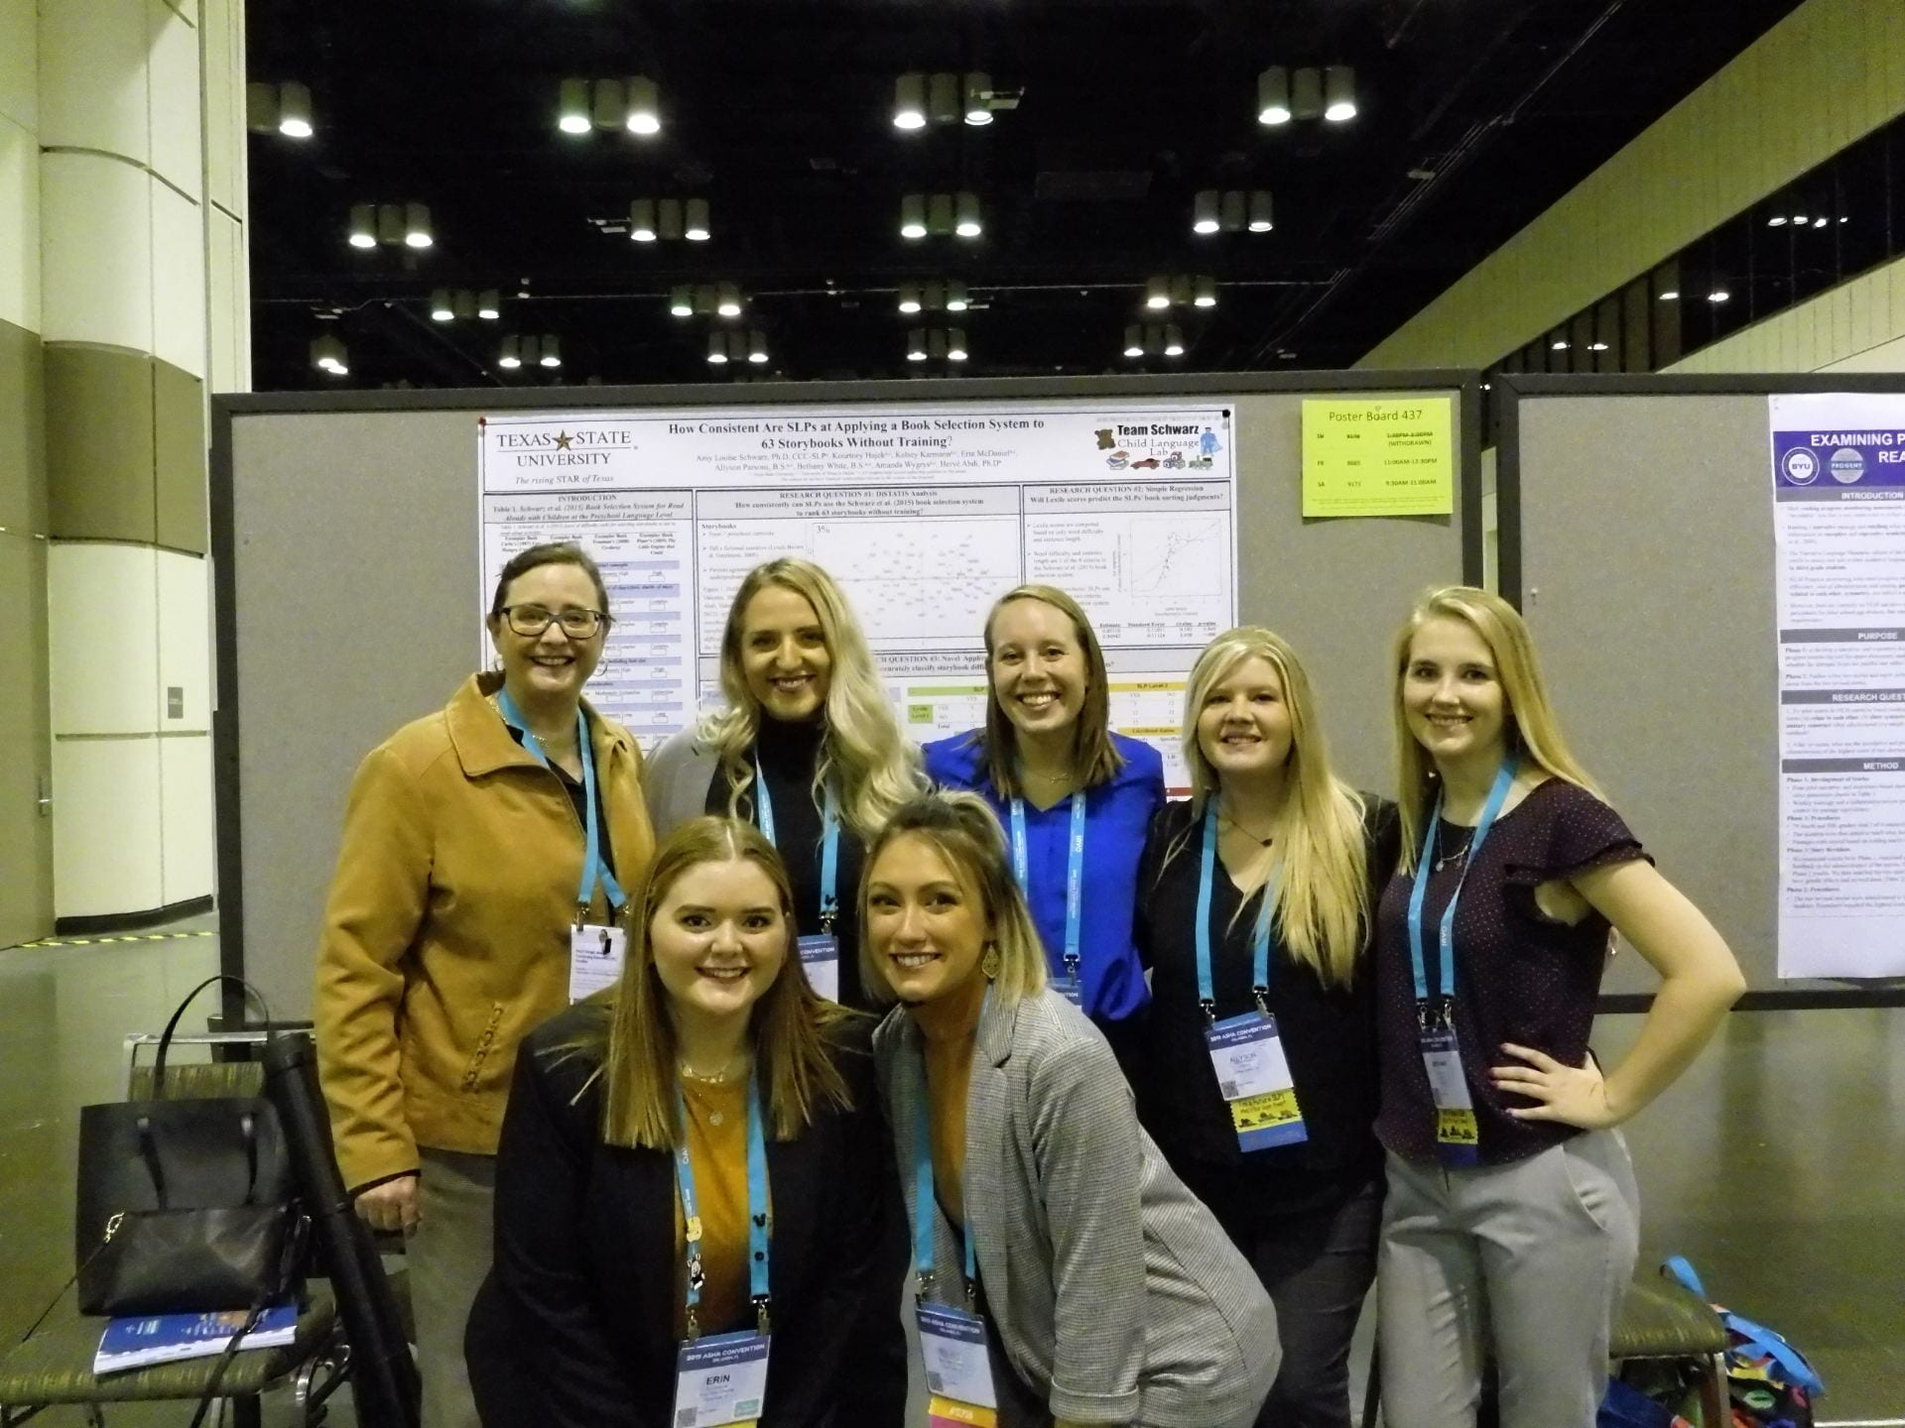
Research Labs
Faculty research labs and projects
Bilingual Language Acquisition Brains (BLAB) Lab
Child Language Lab
Child Speech Lab
NEUral Systems Research in Aging Lab (NEURAL)
Stuttering Research Lab
Team Schwarz Child Language Lab

Slide 10
Living and Studying in Round Rock
Moving/Housing
Create a group (ls12@txstate.edu)
Round Rock Off-Campus Housing Guide
Contact: 512-245-4663; reslife@txstate.edu
FAQ Willow Hall in Round Rock

Slide 11
Academic Assistance
ODS
Student Learning Assistance Center
Writing Center
VASC-RR

Slide 12
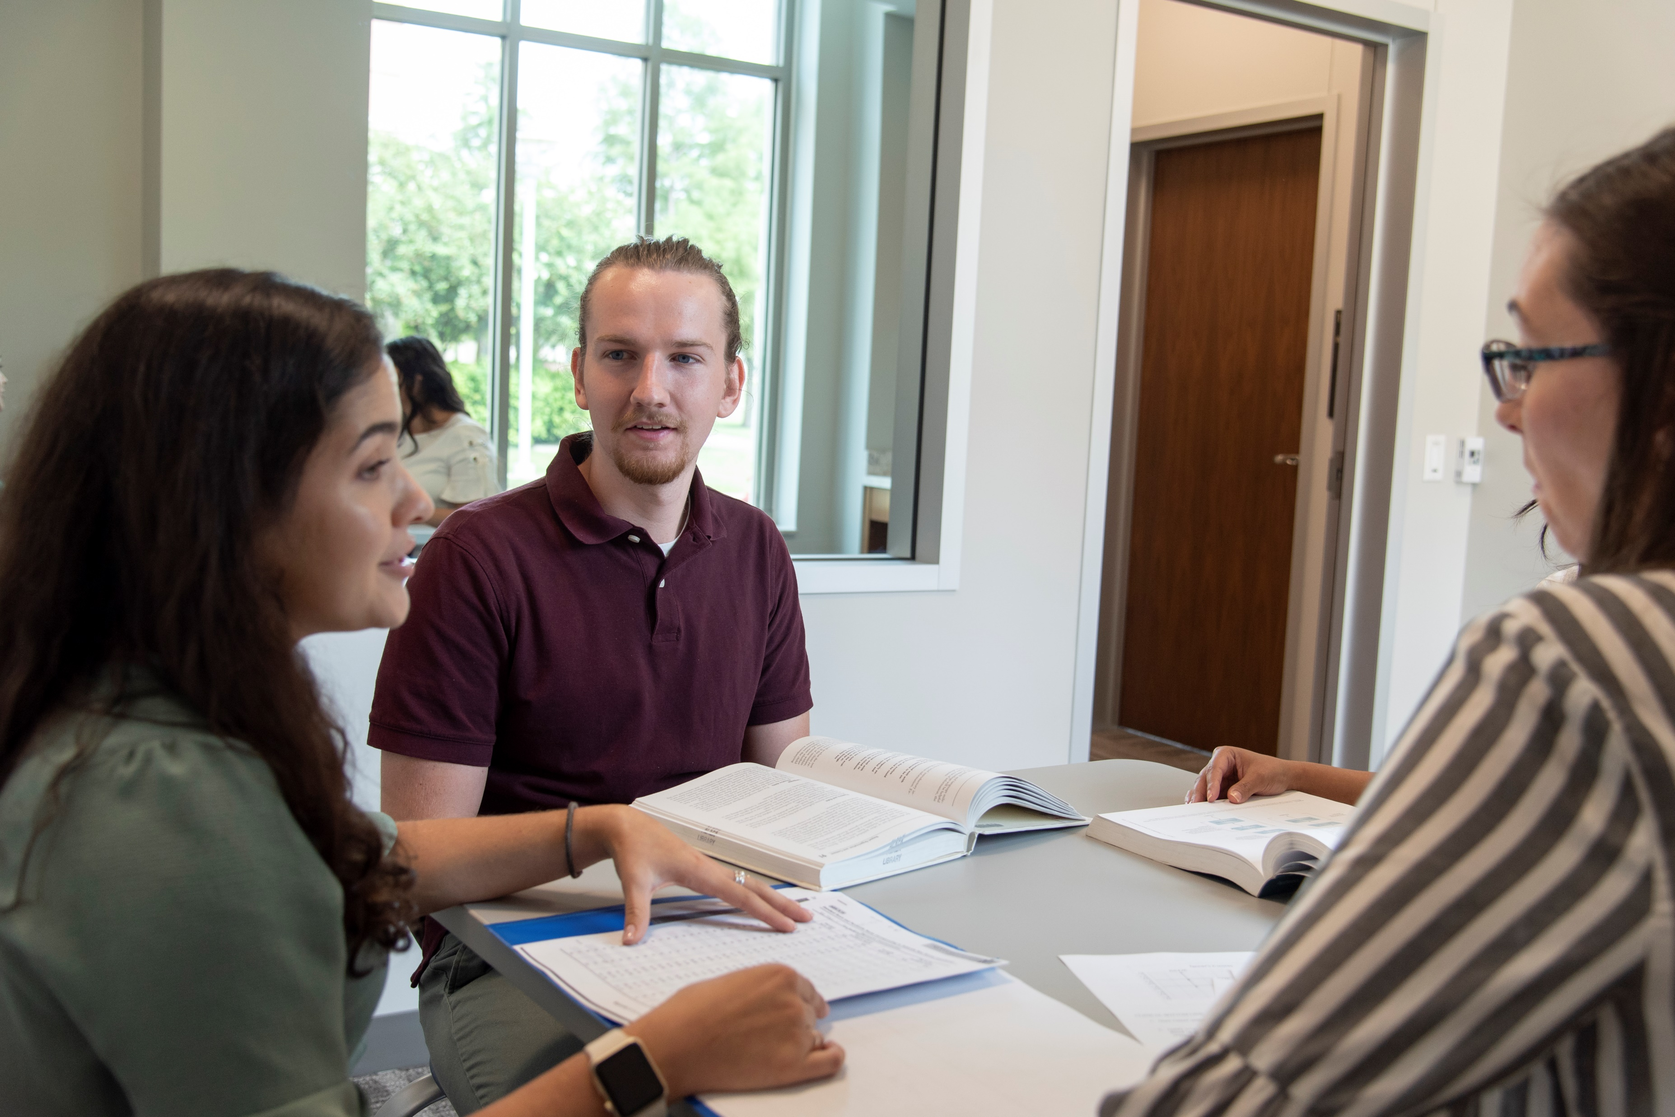
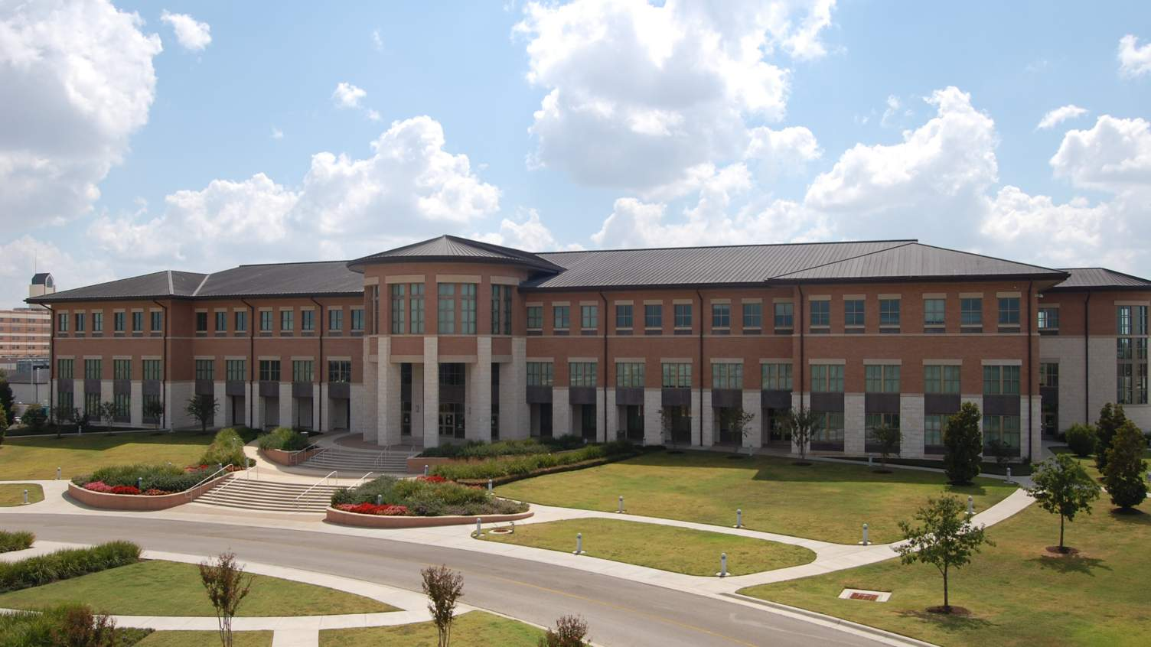
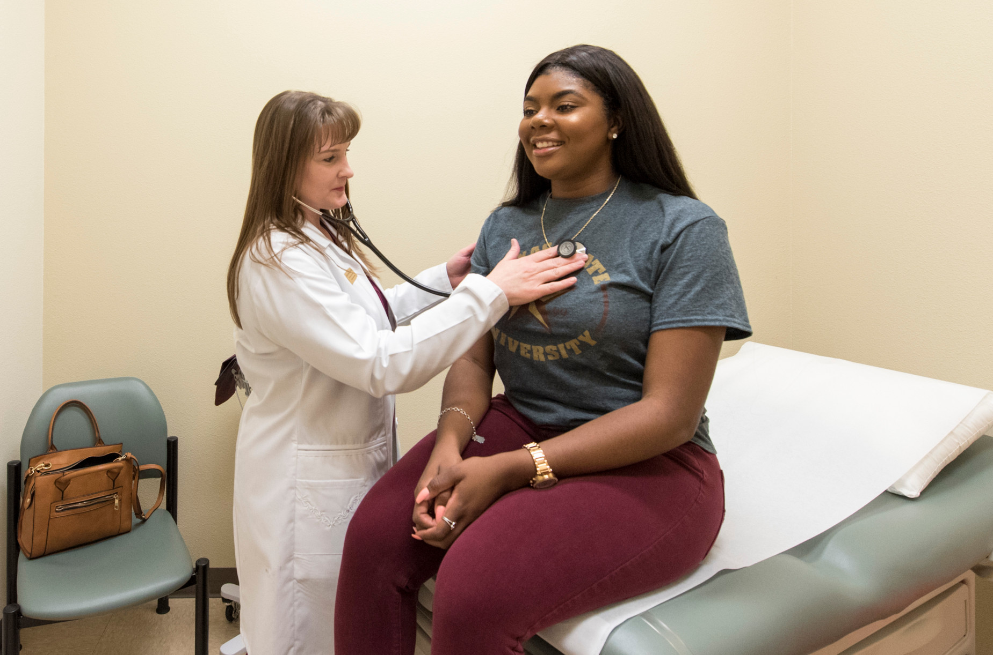
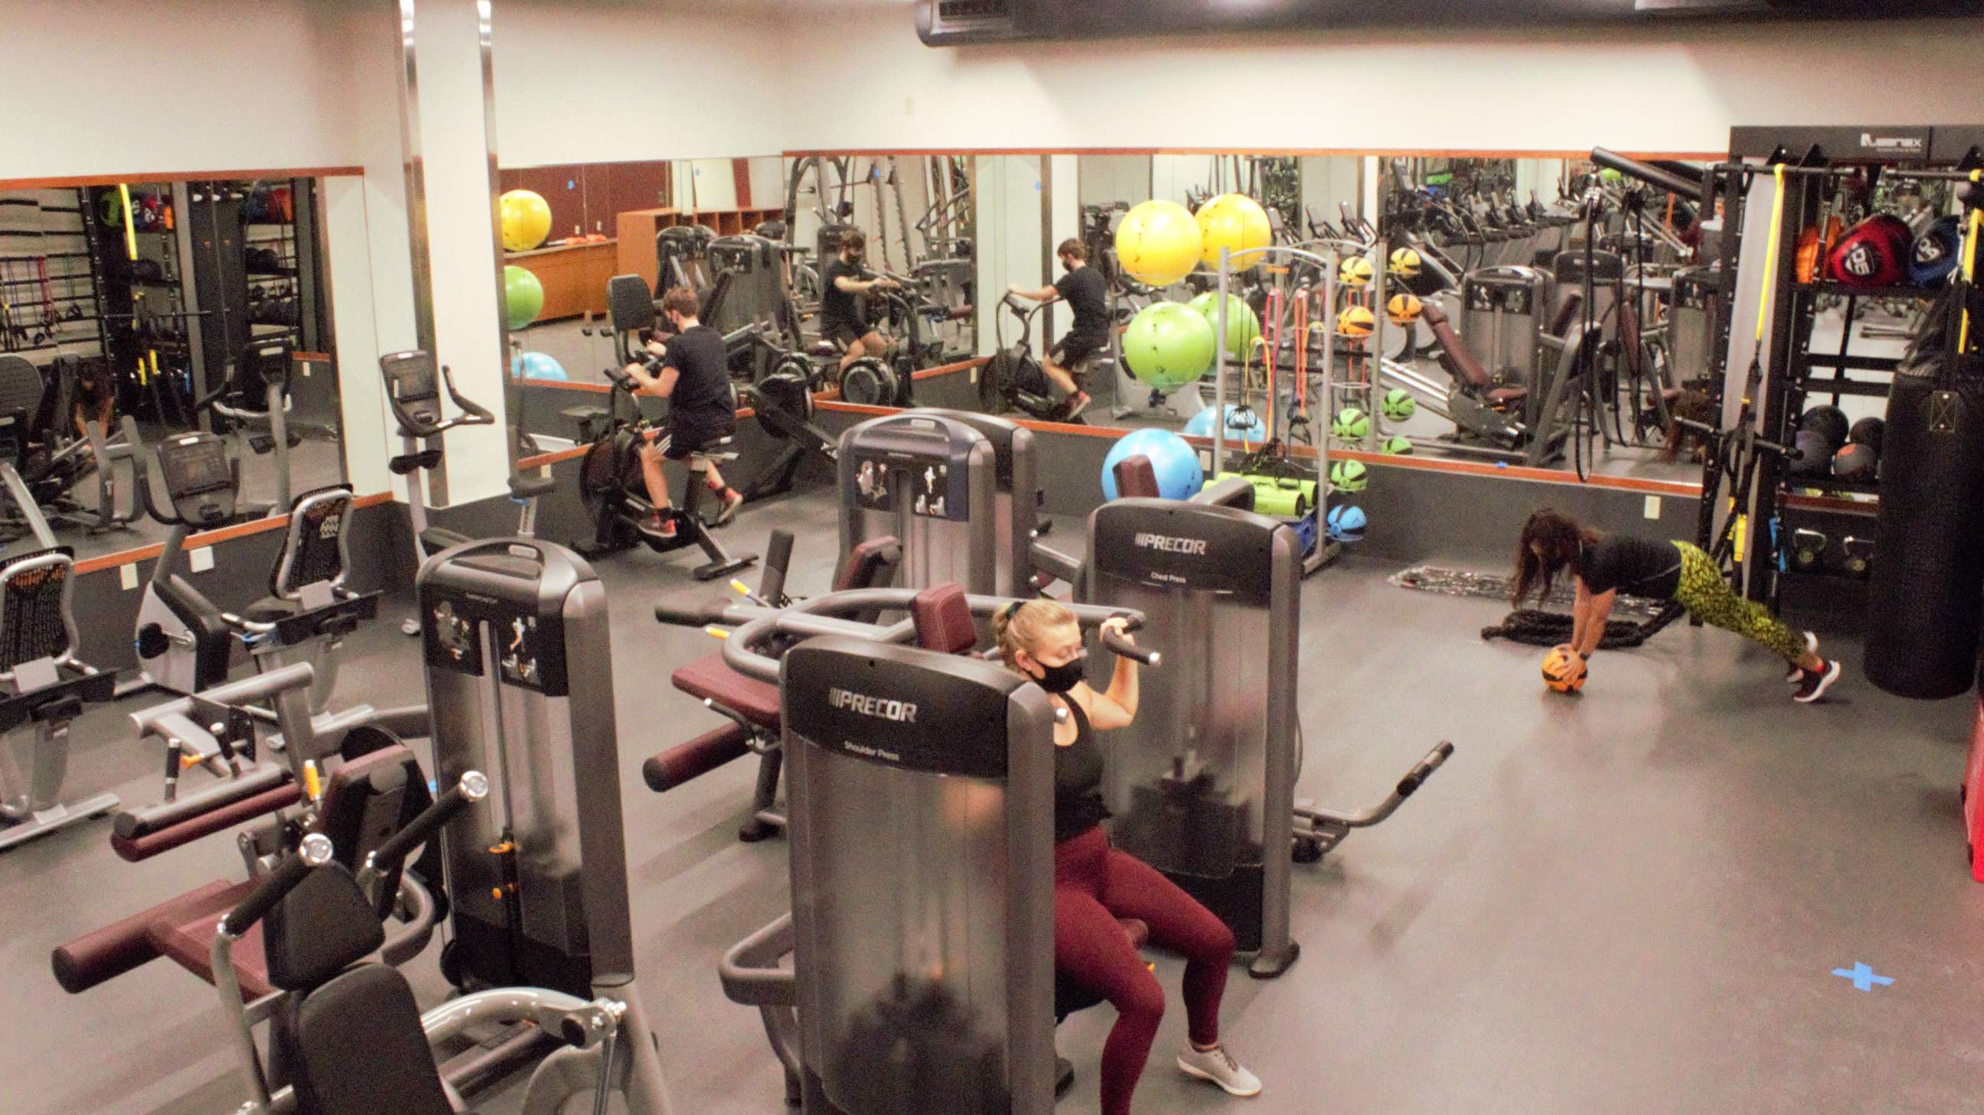
Round Rock Campus
4 buildings: Avery, Nursing, Willow, Campus service building
Academic Student services
Health Center, counseling center, library, ODS, ITAC
Workout facilities
Study areas
PARKING!

