Slide 1
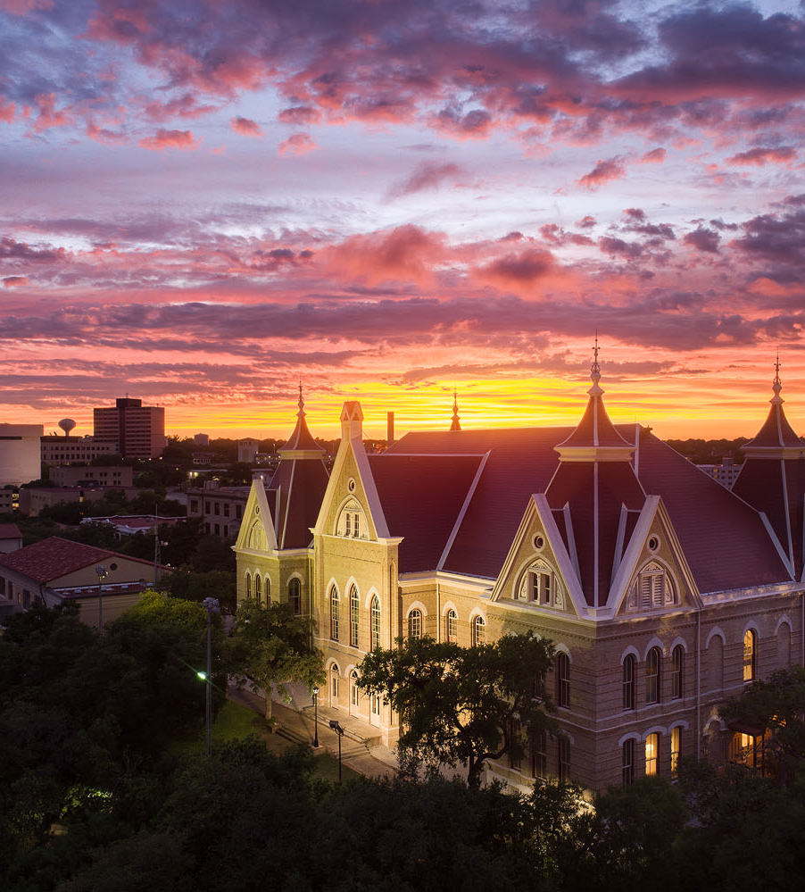
State Foundation: Research Grant Experiences with the Greater Texas Foundation
Taylor W. Acee, Ph.D.

Slide 2
Grant Processes
Formulate Proposal
Engage Funder
Implement Project
Produce Deliverables
Generate ideas
Search funders
Draft proposal
Build team
Request meeting
Submit proposal
Revise submission and negotiate with funder
Reports to funder
Presentations
Publications
Participants served
Quantitative metrics
Other deliverables
Follow budget and timeline
Keep funder apprised
Request modifications, as needed

Slide 3
Formulate Proposal
Generate ideas – e.g., developed from a line of research and novel methodological opportunities;
Search funders – e.g., word of mouth, review of funders’ goals, and previously funded work.
Refine ideas – e.g., used similar language and target populations as funder, reduced jargon, and flaunted methods.

Slide 4
Formulate Proposal
Draft generic proposal
  Concept paper
  Project goals, objectives, and timeline
  Budget
Engage funder
  Pitch idea and get feedback
  Clarify application process
Draft proposal according to funders’ guidelines
  Concept paper
  Full proposal

Slide 5
Formulate Proposal
Proposal examples
  Generic
    Letter of Interest
    Work plan
    Budget
  Full proposal
    Proposal
    Project timeline
    Budget
    Budget narrative
    Quantitative metrics

Slide 6
Formulate Proposal
Build team
    CO-Pis with content and methodological expertise and experience.
    Professional, post-doctoral, and student support.
    Partnerships

Slide 7
Engage Potential Funder
Request meeting
Submit proposal
Revise proposal and negotiate
  E.g., added deliverables and requested $45,000 more.

Slide 8
Implement Project
Follow timeline and budget
  e.g., internal reports, flexibility with annual budget
Keep funder apprised
  e.g., publication, twitter, updates
Request modifications, as needed
  e.g., student stipend, 10% of budget
Track metrics

Slide 9
Produce Deliverables
Reports to funder
Presentations
Publications
Participants served
Quantitative metrics
Other deliverables

Slide 10
Strategies
Align argument with funder’s goals
  Clear and simple message with strong needs statement.
  Scholarly and practical significance.
  Clean study with detailed procedures and measurable outcomes.
Engage funder
Flaunt credibility of team and ideas in grant narrative

Slide 11
Tips and Lessons Learned
Keep IDC for project
Incentive funding during long semesters
  Instructional modification (Y/N)
Summer funding
  25% in summer is cheaper than 25% in fall or spring.
Include meaningful deliverables during grant period

Slide 12
Grant Processes
Formulate Proposal
Engage Funder
Implement Project
Produce Deliverables
Generate ideas
Search funders
Draft proposal
Build team
Request meeting
Submit proposal
Revise submission and negotiate with funder
Reports to funder
Presentations
Publications
Participants served
Quantitative metrics
Other deliverables
Follow budget and timeline
Keep funder apprised
Request modifications, as needed

Slide 13
Thank you!

