Slide 1

Spring 2024
Registration Reflection +
Planning Activity
First Year
Advising + Seminar

Slide 2

Overview
Key Takeaways from the Presentation
Academic Planning Resources
Ensuring a Best-Fit Major
Preparing for Spring 2024 Registration

Slide 3

Think-Pair-Share
Instructions:
Jot down initial thoughts or concerns regarding spring registration and your current academic plan.
Note down any questions you may have.
Which advising option would work best for you? Why?

Slide 4

Think-Pair-Share
Instructions:
Discuss your thoughts with a neighbor.
Compare concerns and questions.

Slide 5

Think-Pair-Share
Instructions:
Share any insights or common questions with the class.
Questions to Address:
  What questions do you want to ask an advisor?
  What steps will you take to prepare for registration?

Slide 6

Registration Action Plan
Reflect on the key actions necessary for a successful registration.
Create a personalized action plan based on the given checklist and your own needs.
Review your plan and note any questions or concerns for further clarification.

Slide 7
Checklist of Actions
Ensure no holds on your account.
Look up class times and prerequisites.
Reflect on your major choice.
Review your Fall 2023 courses.
Get academic planning assistance.
Set a reminder for registration day.

Slide 8
Create Your Registration Action Plan

Slide 9
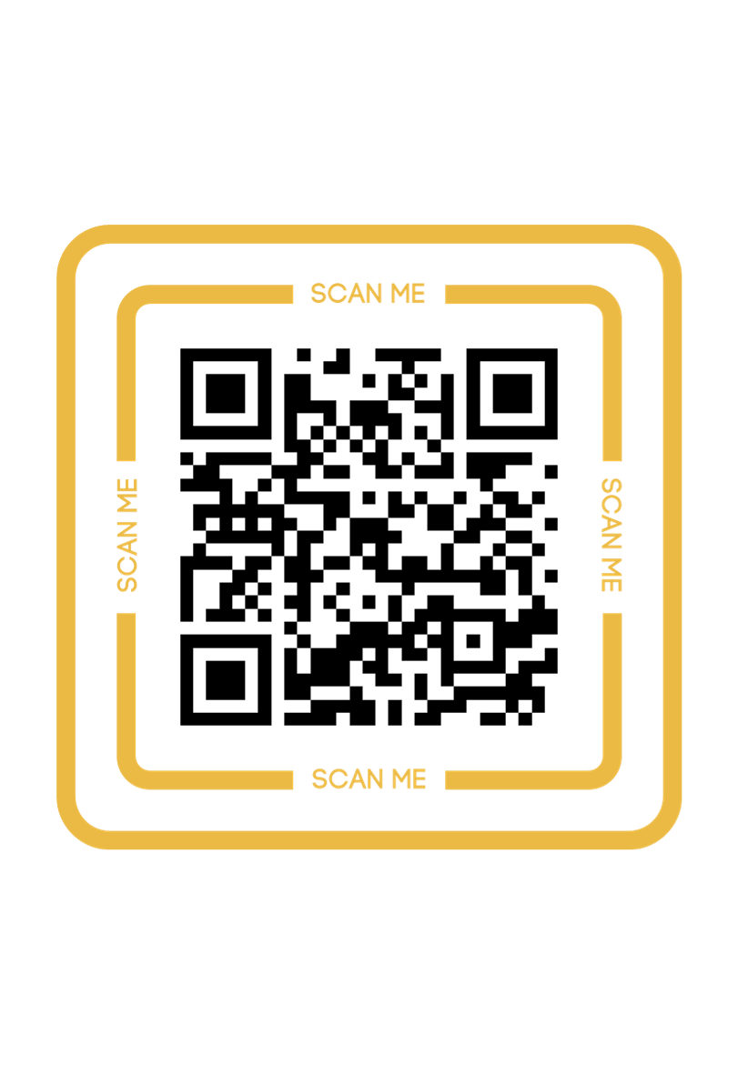
Contact First-Year Advising for all academic planning and registration questions
Connect:
Location: Trauth-Huffman Hall – First Floor
Phone: 512.245.7223
Email: firstyear@txstate.edu

