Slide 1
Texas State Title IV-E Child Welfare Partnership (CWP) program
Information Meeting
Pre-Service Students

Slide 2
Introductions
Please share the following information with the group:
What is your name?
Are you a BSW or MSW student?
What is one thing you are hoping to learn today?
_________________________________
In the chat, please add the following information so that we can follow up with you after the meeting:
Name
Email Address
Anticipated Graduation Date
Preferred location for internship (Austin, San Antonio, San Marcos, etc)
This Photo by Unknown Author is licensed under CC BY-SA-NC

Slide 3
The Title IV-E ChilD WeLfare Partnership PRogram
The Title IV-E Child Welfare Partnership (CWP) program is a collaboration between the School of Social Work at Texas State University and the Texas Department of Family and Protective Services (DFPS). This partnership started over 25 years ago, and funding for the program is provided through Title IV-E of the Social Security Act.
The CWP program aims to increase the qualifications and numbers of BSW/MSW graduates who enter the field of child welfare, and to enhance the knowledge and skills of selected DFPS employees through graduate social work education. Students in the program receive financial assistance and ongoing training while completing their social work degree, in exchange for working for DFPS for a period of time after graduation.

Slide 4
Our Mission
The mission of the Title IV-E Child Welfare Partnership is to enhance the values, knowledge, and skills of the child welfare workforce in Texas through social work education, financial assistance, ongoing training, and career support.

Slide 5
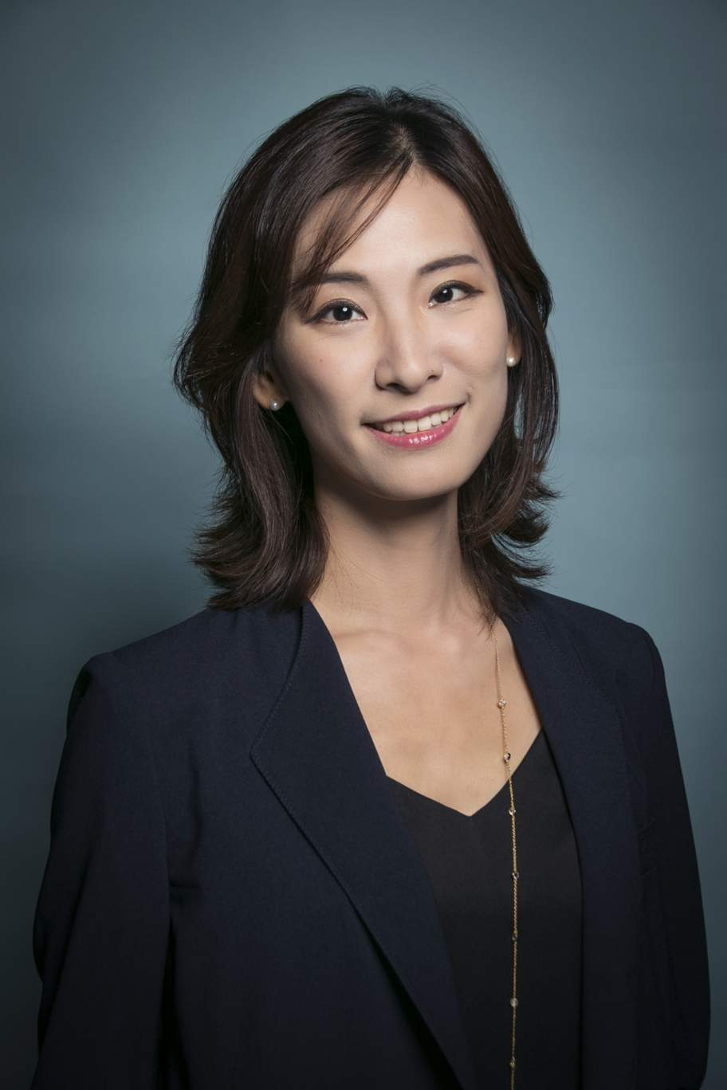
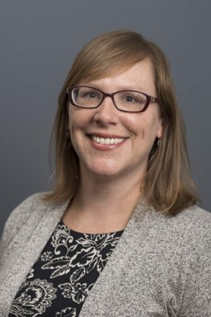
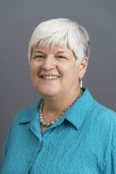
Texas State University Title IV-E Child Welfare Partnership Program Team
Principal Investigator: Dr. Mi Jin Choi is responsible for the oversight of the program, curriculum development, and program evaluation. She also serves as an informal academic mentor to students in the Title IV-E CWP program.
Grant Director: Ms. Martha Wildberger is responsible for oversight of the program, the day-to-day operations of the Title IV-E CWP program, and supervision of students in their field placement.
Grant Coordinator: Ms. Michele Bauman is responsible for budgeting, accounting, and providing general administrative assistance on the grant.
Dr. Mi Jin Choi
Principal Investigator
M_c951@txstate.edu
Martha Wildberger
Grant Director
mw38@txstate.edu
Michele Bauman
Grant Coordinator
Michele.bauman@txstate.edu

Slide 6
the Program in a nutshell
If you are accepted into the program, you will complete your final field placement at CPS. During your internship, you will participate in the same training program as new CPS employees.
In exchange for receiving a $5500 stipend during your internship, you will be under contract to work at CPS in a Title IV-E eligible position for eight months after graduation.
Thus, the two main benefits of the program are: 1) you will receive a monetary stipend while you complete your internship, and 2) upon successful completion of your internship, you will have a job in the field of social work after you graduate!

Slide 7
The stipend
The $5500 stipend is disbursed through the Financial Aid office before the start of the semester that you start your final field placement.
The stipend is counted in the total resources for the purposes of calculating any other financial aid or loans. It is the student’s responsibility to contact Financial Aid to determine whether or not the stipend will have any impact on the student’s financial aid package for the semester the student receives the stipend.
If the student does not complete the 8-month commitment, they may have to pay back a pro-rated amount of the stipend monetarily. This will be arranged with DFPS.

Slide 8
What to expect during the internship
“I'm not telling you it's going to be easy - I'm telling you it's going to be worth it.” - Art Williams
As a Title IV-E CWP student intern, you will be treated much like a new employee at CPS during your field placement. You must successfully complete all components of the CPS training program during your internship to be eligible to be hired at CPS after graduation.
The CPS training program is a mix of classroom training, online training, and on-the-job training.
During on-the-job training at CPS, students in the CWP program are paired with a mentor worker, and the student is expected to shadow the mentor worker on any job-related tasks. This could include visits in the evenings, on the weekends, or visits outside of the central Texas area.
Students are provided with hands-on experience working with children and families during the internship, so they are prepared to be case assignable after graduation.

Slide 9
Working at CPS after graduation
Students in the CWP program generally get hired as Conservatorship Specialists. Conservatorship caseworkers work with children and families after children are removed from the home due to abuse or neglect. They work with children, birth parents, caregivers, and a variety of other professionals to ensure the child’s safety and establish a permanency plan for the child.
Visit the DFPS website to learn more about the Conservatorship caseworker position: http://www.dfps.state.tx.us/Jobs/CPS/cvs.asp

Slide 10
Eligibility requirements
BSW or MSW students in good academic standing are eligible to apply to the program the semester before they start their final field placement.
Students must demonstrate a passion for working with children and families from diverse backgrounds.
Students must be willing to complete a full-time internship at Child Protective Services (CPS) and commit to working at CPS in the Austin or San Antonio area after graduation.
Students must have taken a child welfare-related elective, or demonstrate a passion for child welfare through personal or professional experiences.

Slide 11
The Application Process
The application process starts the semester before you start your final field placement. For example, if you are scheduled to complete your final field placement in the Spring of 2024, the application process would start in the Fall of 2023.
As a part of the application process, you will be required to complete a packet of paperwork and participate in the formal interview process at CPS. There may be limited funding slots, and CPS makes the final decision about who is accepted into the CWP program.
If you meet the eligibility requirements, the first step is to contact Ms. Martha Wildberger, and she will walk you through the application process.

Slide 12
QUESTIONS?
If you have any questions or concerns, please don’t hesitate to reach out to the Title IV-E Child Welfare Partnership team. We are here to help you be successful!
General email contact: CWPartnership@txstate.edu
Dr. Mi Jin Choi: M_c@txstate.edu
Ms. Martha Wildberger: mw38@txstate.edu
Ms. Michele Bauman: michele.bauman@txstate.edu
CWP Office Location: Encino Hall, Room123B Texas State University, San Marcos, Texas
This Photo by Unknown Author is licensed under CC BY-NC

Slide 13
Thank you!
“Education is the most powerful weapon which you can use to change the world.”
-Nelson Mandela
Texas State Title IV-E Child Welfare
Partnership (CWP) Program

