Slide 1


Slide 2

Prescription Drug Misuse (PDM) Across the Lifespan
Ty Schepis, Ph.D.
Professor, Department of Psychology

Slide 3
U.S. Prescription Drug Misuse (PDM)
One of the highest rates worldwide, if not highest
Adolescent PDM is a focus because of fears about early initiation and altered development
Within the U.S., young adults (18-25 years) have the highest rates of PDM, so key group for research
While adults 50 and older have much lower rates, they may be at higher risk for consequences

Slide 4
Opioid PDM Trends
Schepis et al., 2022, American Journal on Addictions.

Slide 5
14-day Opioid PDM and Sexual Identity

Slide 6
14-day Opioid PDM and Gender Identity

Slide 7
14-day Opioid PDM, Sexual and Gender Identity

Slide 8
State LGBT Policies and Gender Minority PDM

Slide 9
Quality-of-Life and Opioid PDM in Adults 50+
Schepis et al., 2021, Aging and Mental Health.

Slide 10
Opioid PDM History and Health in Adults 50+
Schepis et al., 2021, Aging and Mental Health.

Slide 11
Dissemination
Most through publications and conference presentations
Clinical Impact:
NIDA Notes Article
NIDA Drug Facts on Older Adult Substance Use
FDA Prescribing Guidance for Stimulant Medication
UK Home Office Report on Benzodiazepines

Slide 12
Dissemination
Most through publications and conference presentations
Clinical Impact:
NIDA Notes Article
NIDA Drug Facts on Older Adult Substance Use
FDA Prescribing Guidance for Stimulant Medication
UK Home Office Report on Benzodiazepines

Slide 13
Special thanks to:
Sean Esteban
McCabe, Ph.D.
H. Scott Swartzwelder, Ph.D.
Laura J. Holt, Ph.D.
NIDA and FDA
funding
University of Michigan Center for the Study of Drugs, Alcohol, Smoking and Health
Duke University School of Medicine
Trinity College (Hartford, CT), Department of Psychology
1R01DA043691
2R01DA043691
1R01DA042146
1R03DA041584
FDA Award 75F40121C00148

Slide 14

Texas Community Health News
Daniel Carter and Kym Fox

Slide 15
Health News Landscape
Newsroom staffs decimated
Reduced skills and capacities, especially at local and regional outlets
Data training primarily available at elite masters programs
… few stories showing how policy decisions and trends affect local communities
… little opportunity for public data to generate new stories

Slide 16
Telling stories with public health data
Contextualize local stories to show how they relate to policy decisions and structural patterns
Discover patterns found through exploratory data analysis with local consequences

Slide 17
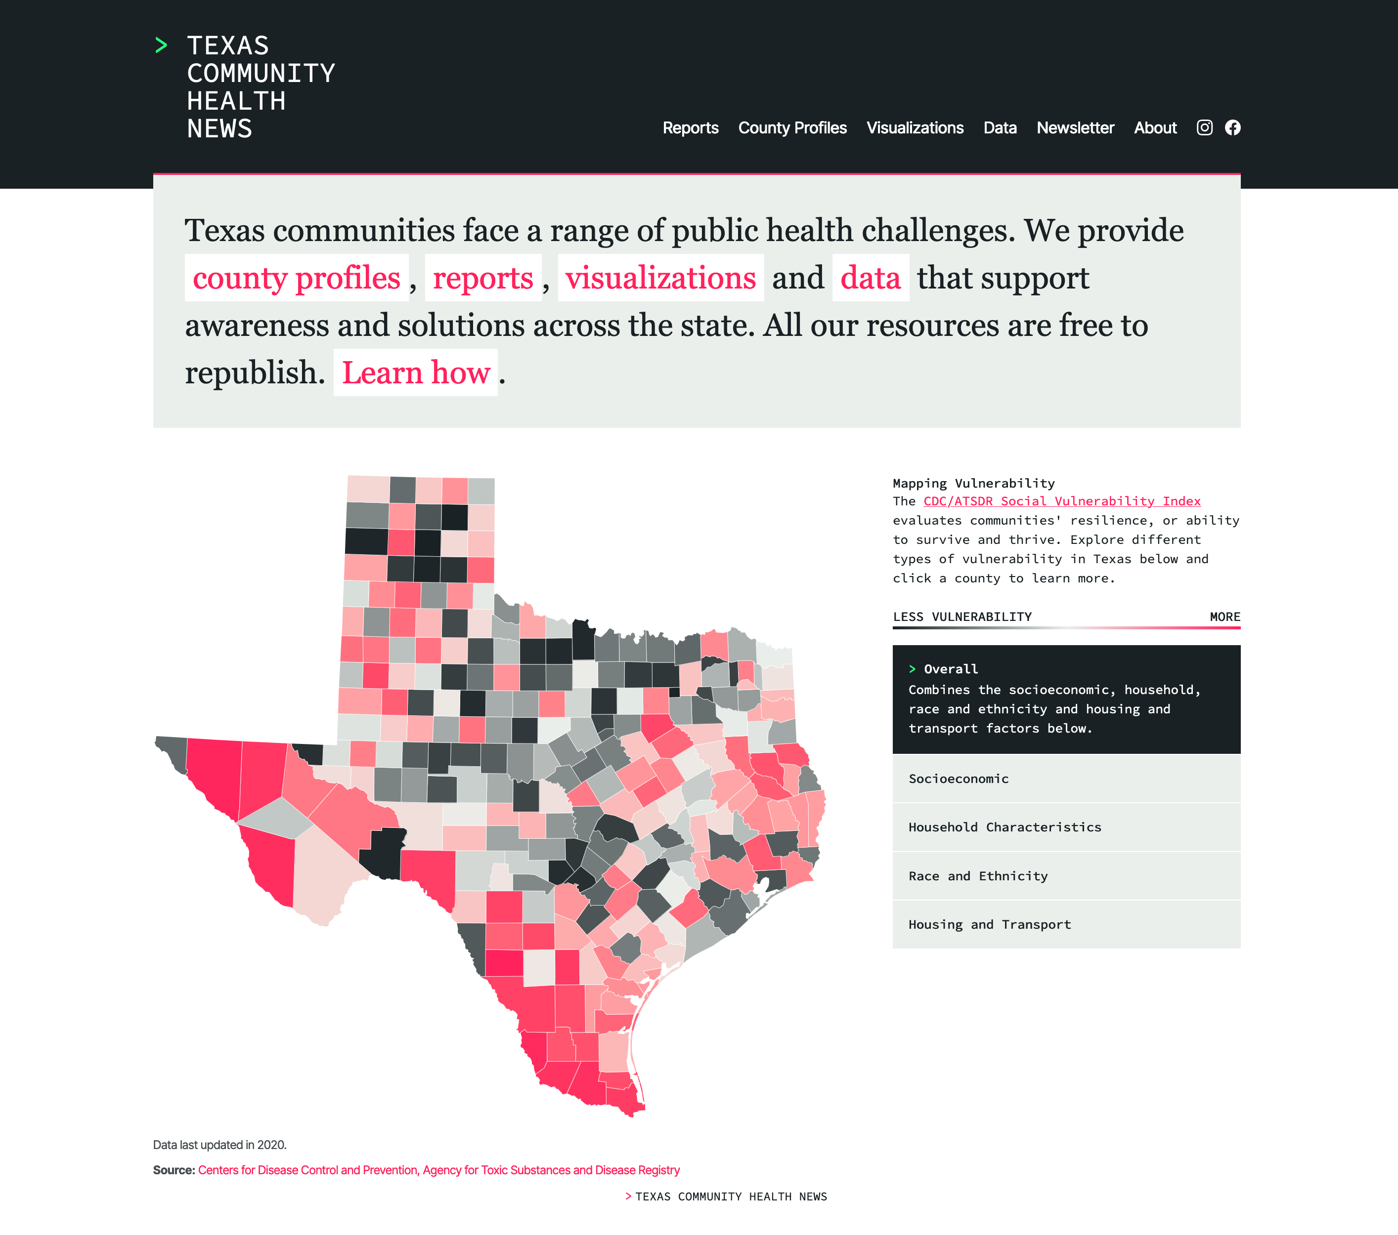
Design challenges
Insufficient staff time
Insufficient expertise
Insufficient data and technical skills

Slide 18
Solutions
Free-to-republish articles
Simple localization
Visualization library
Statewide health dataset
Partnerships

Slide 19
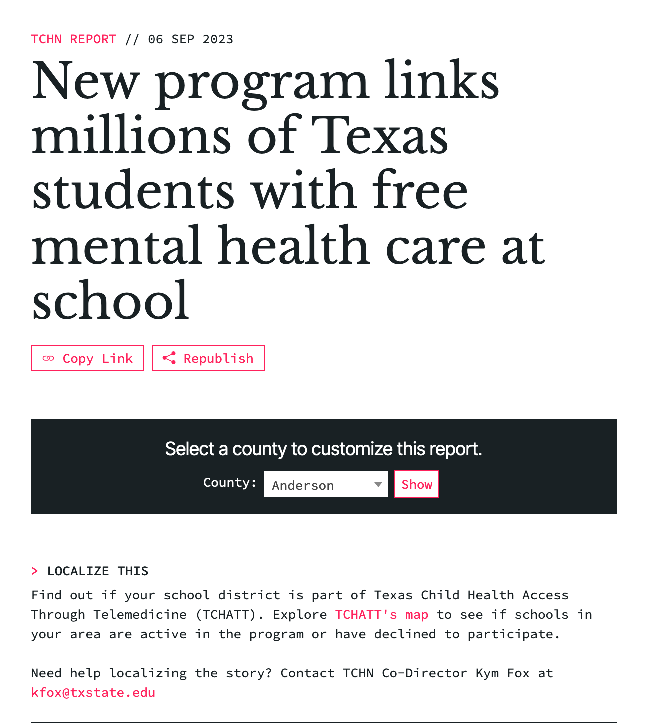
Making context easy

Slide 20
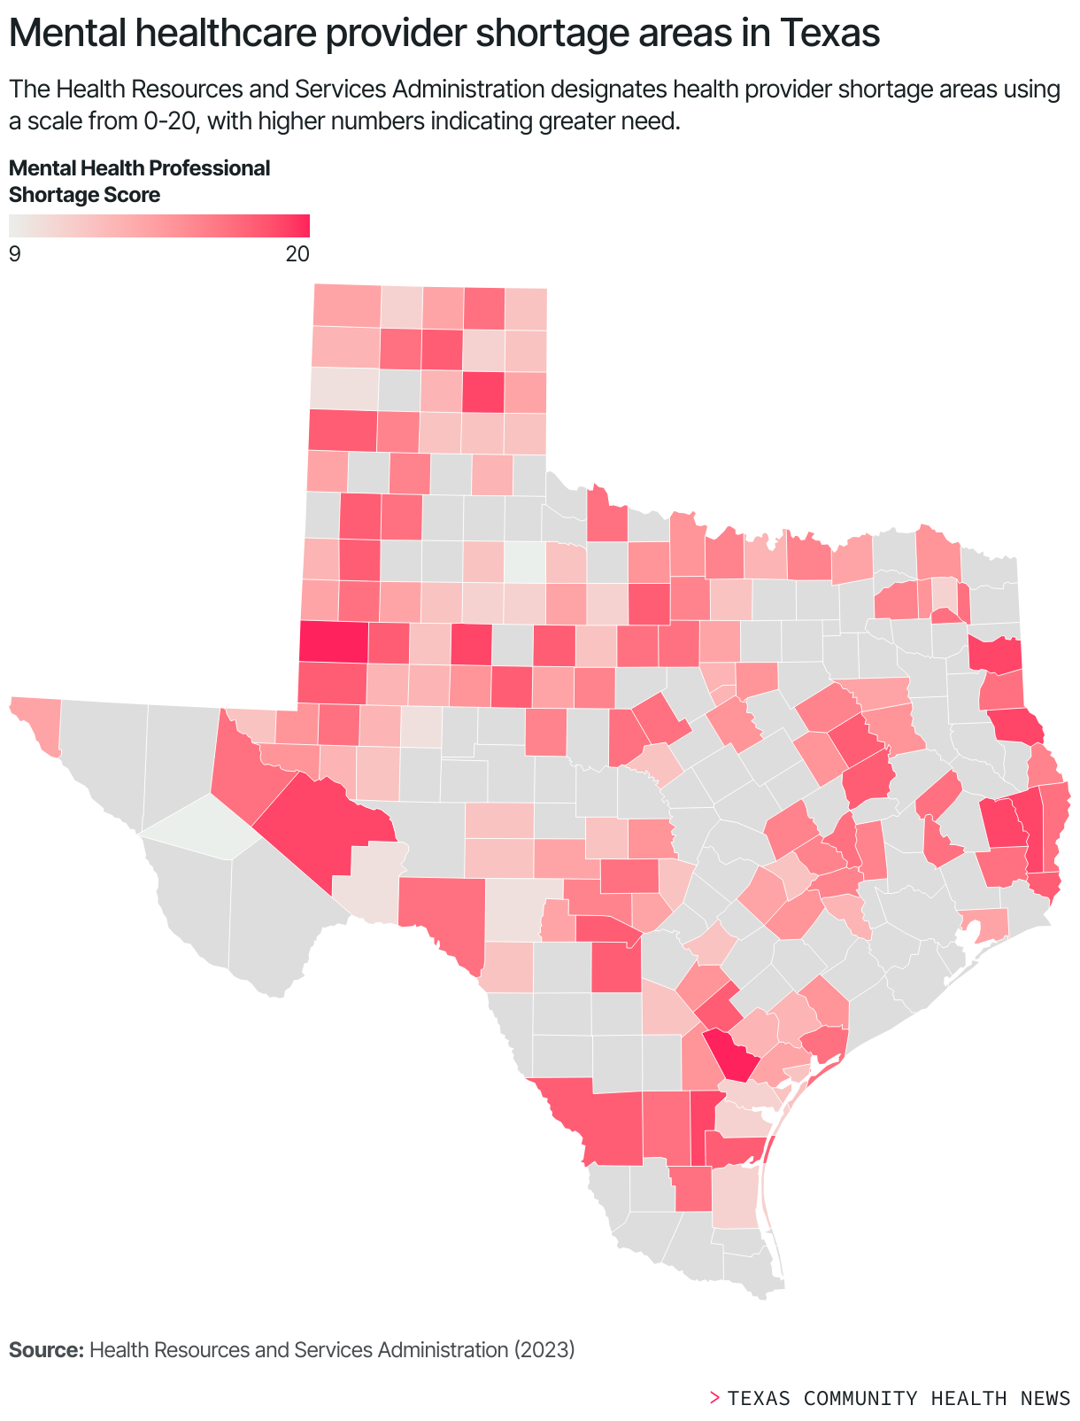
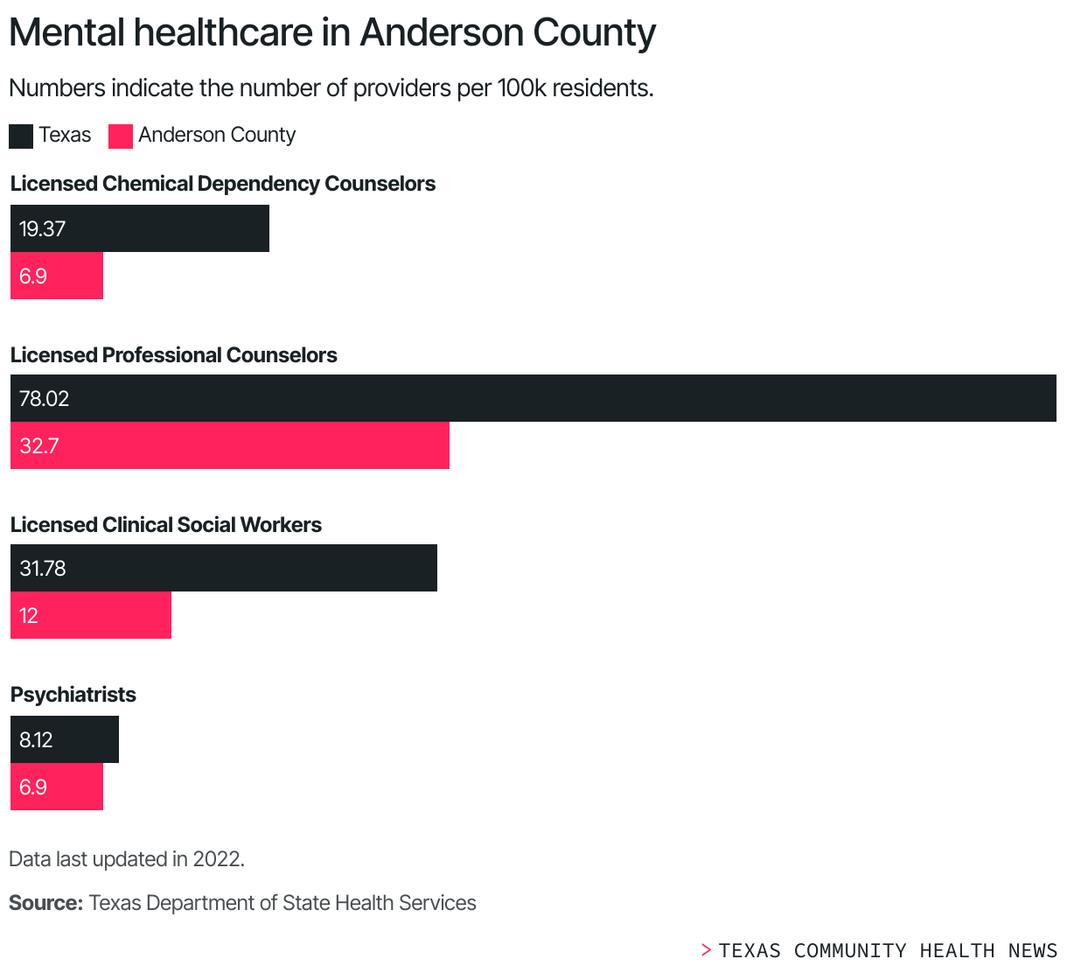

Slide 21
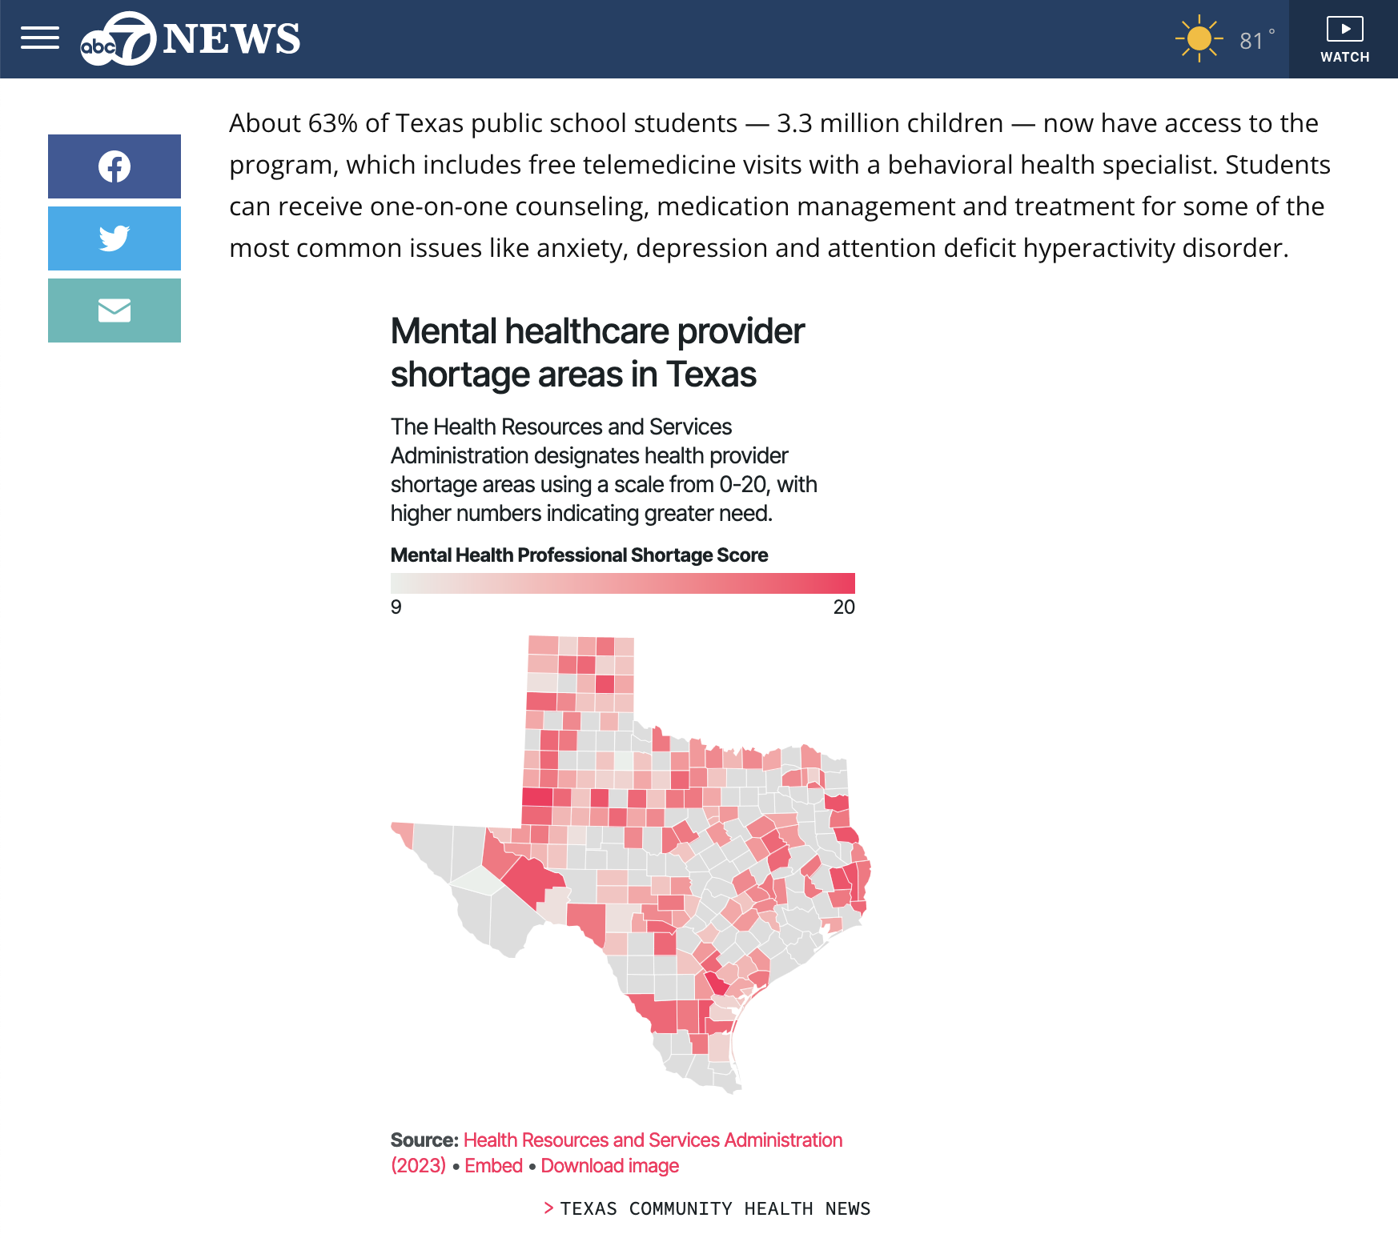
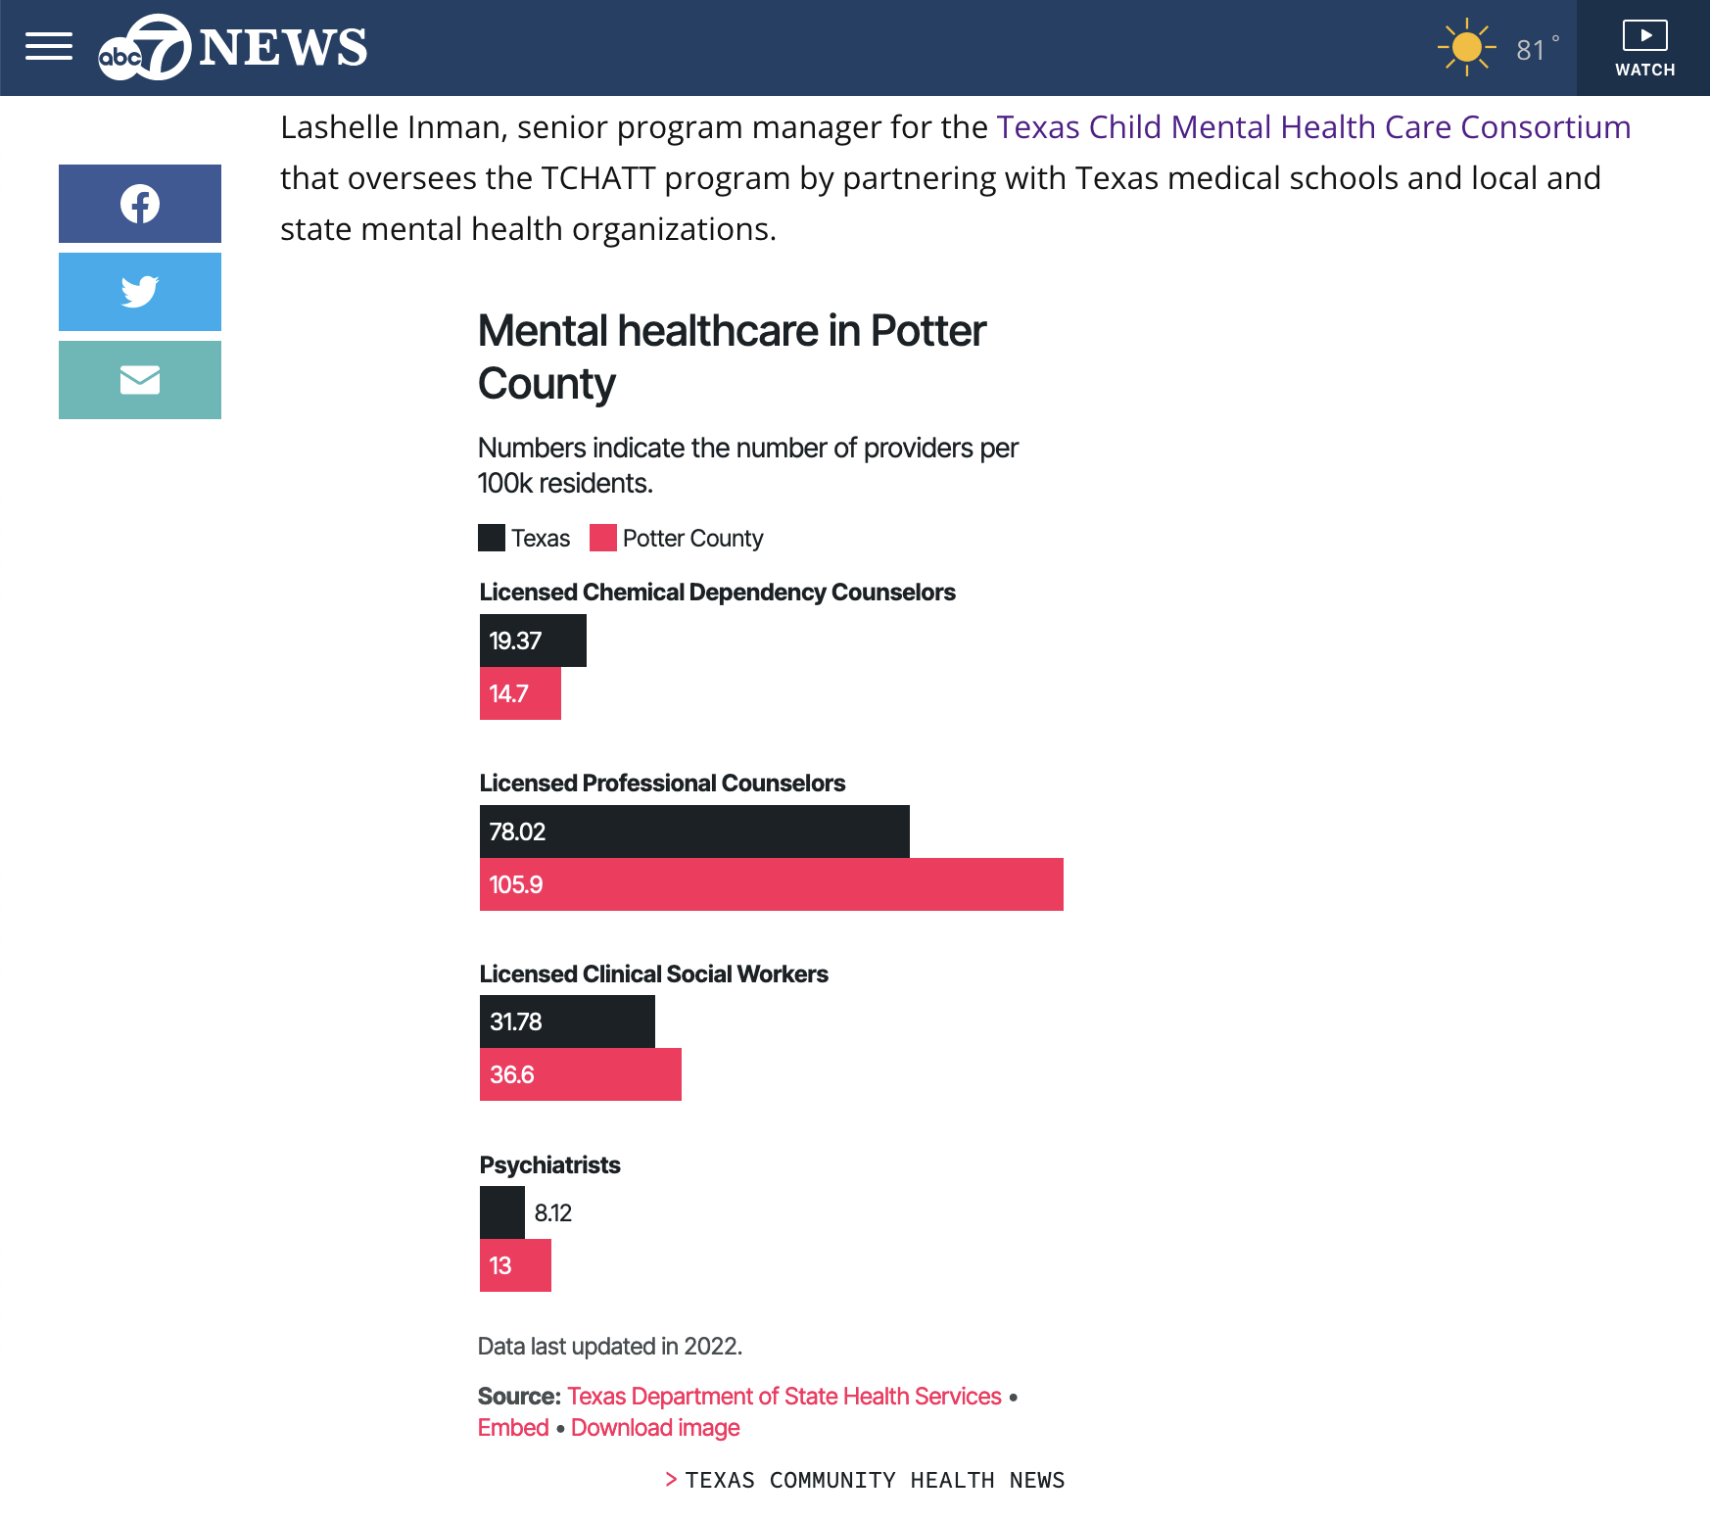

Slide 22
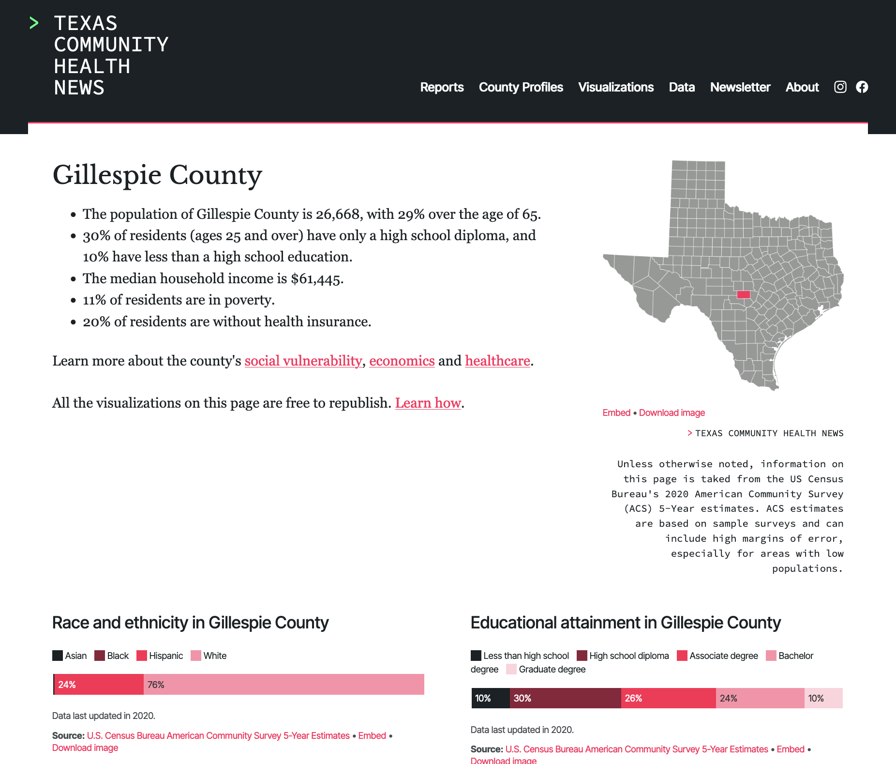
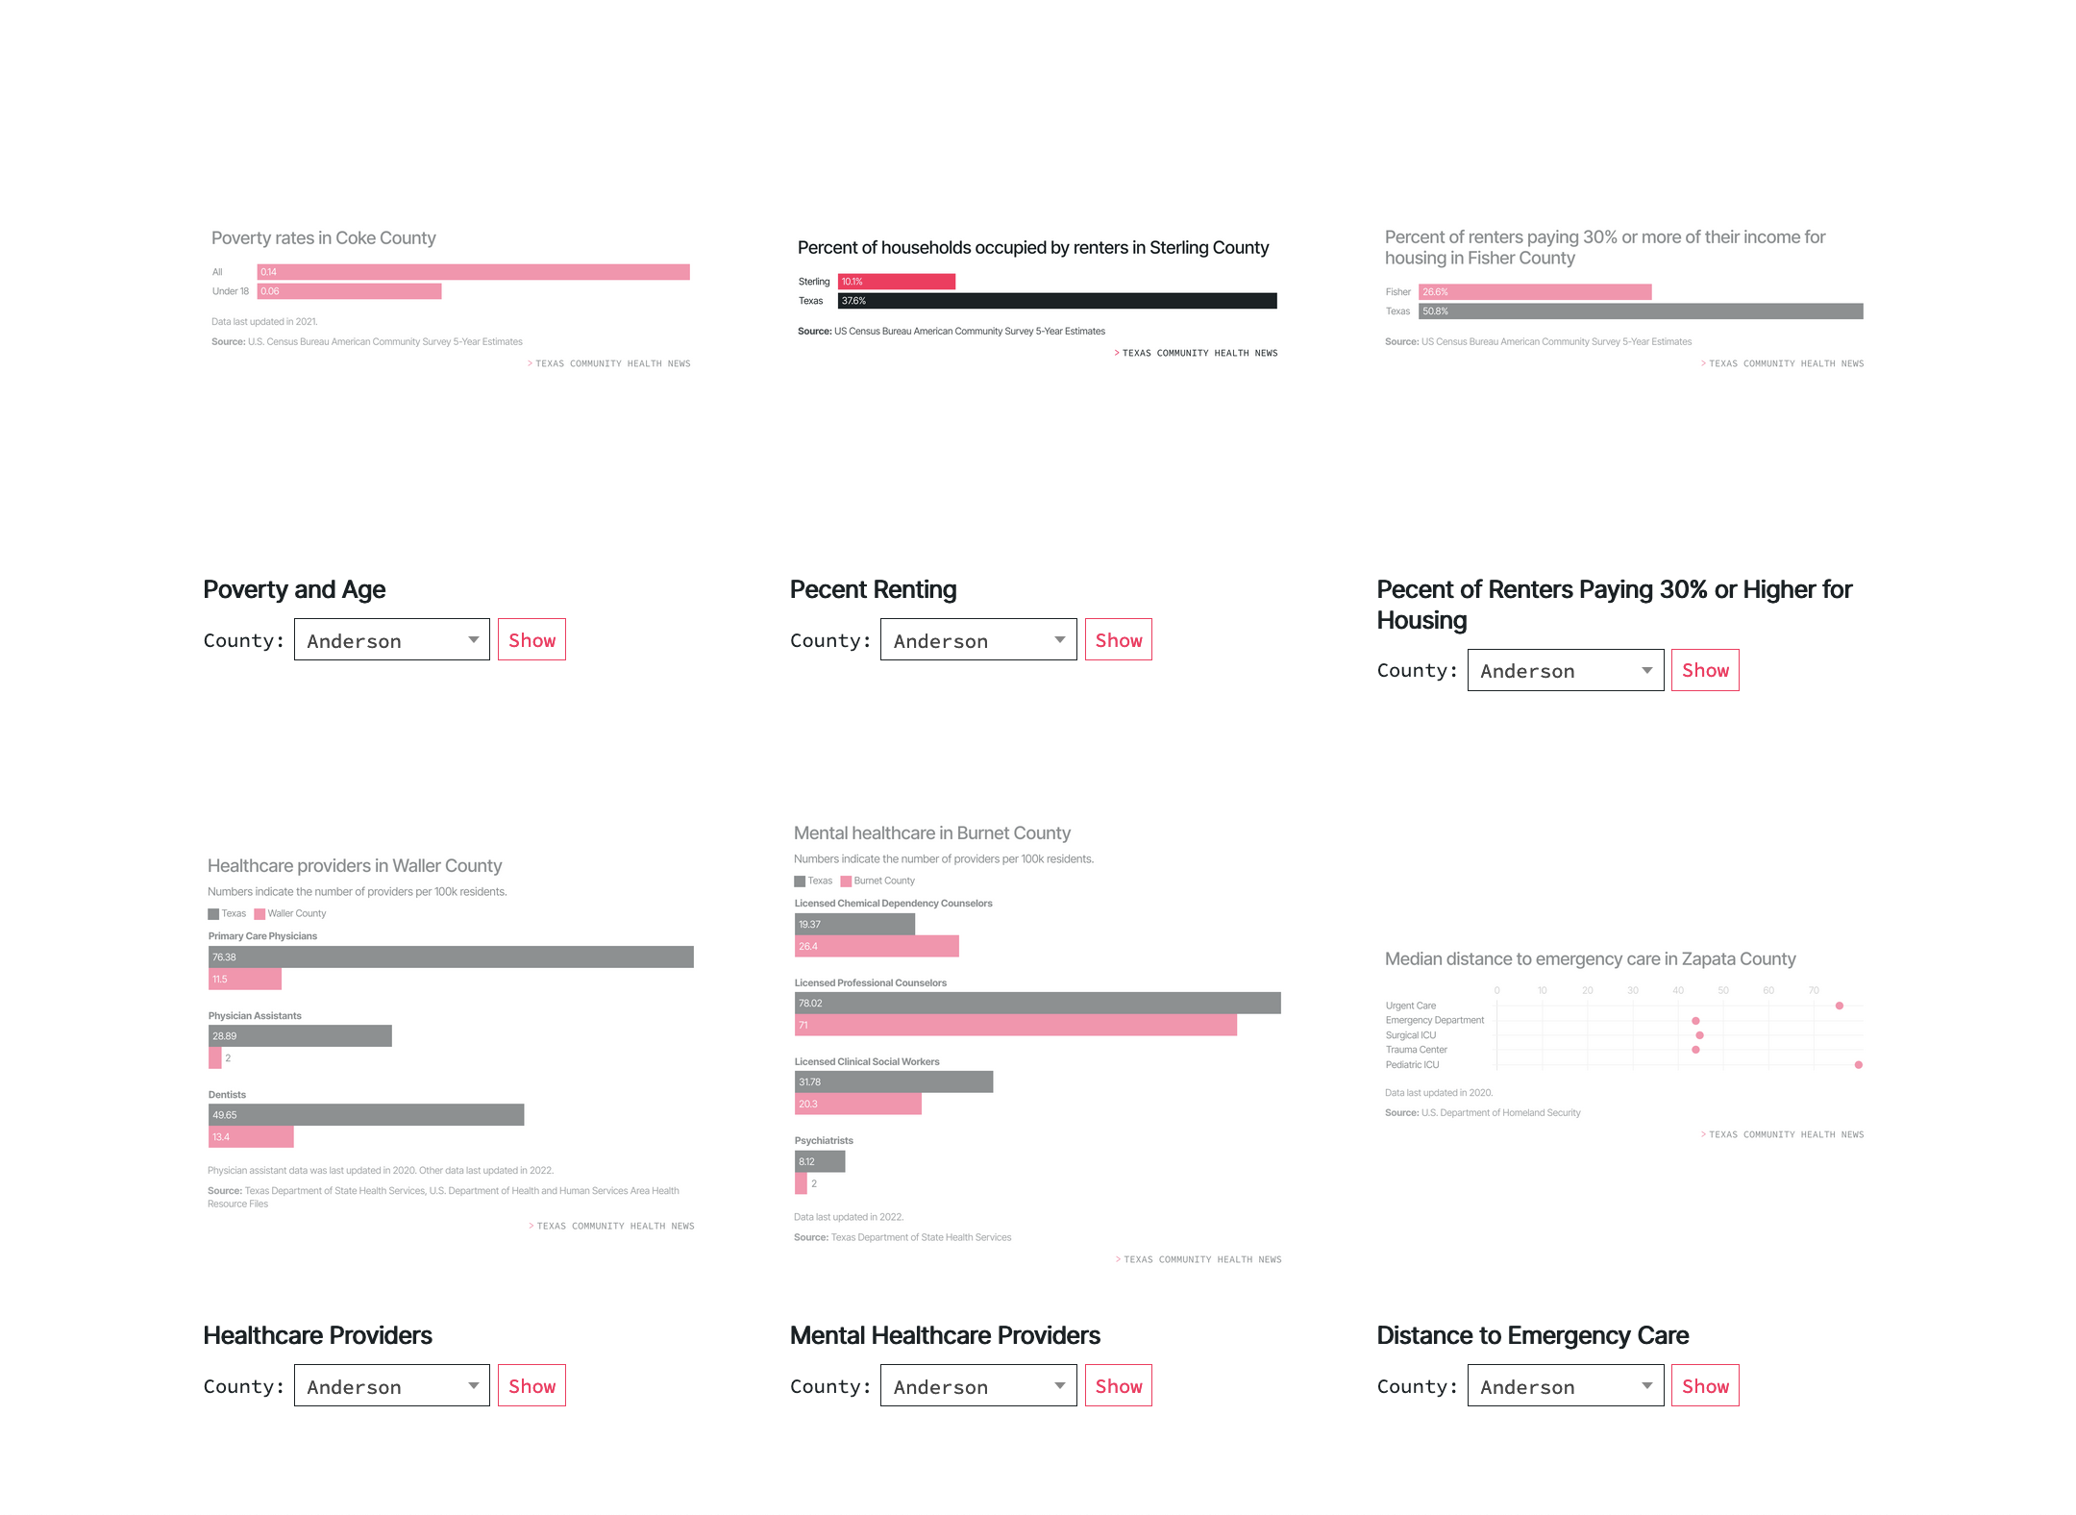

Slide 23

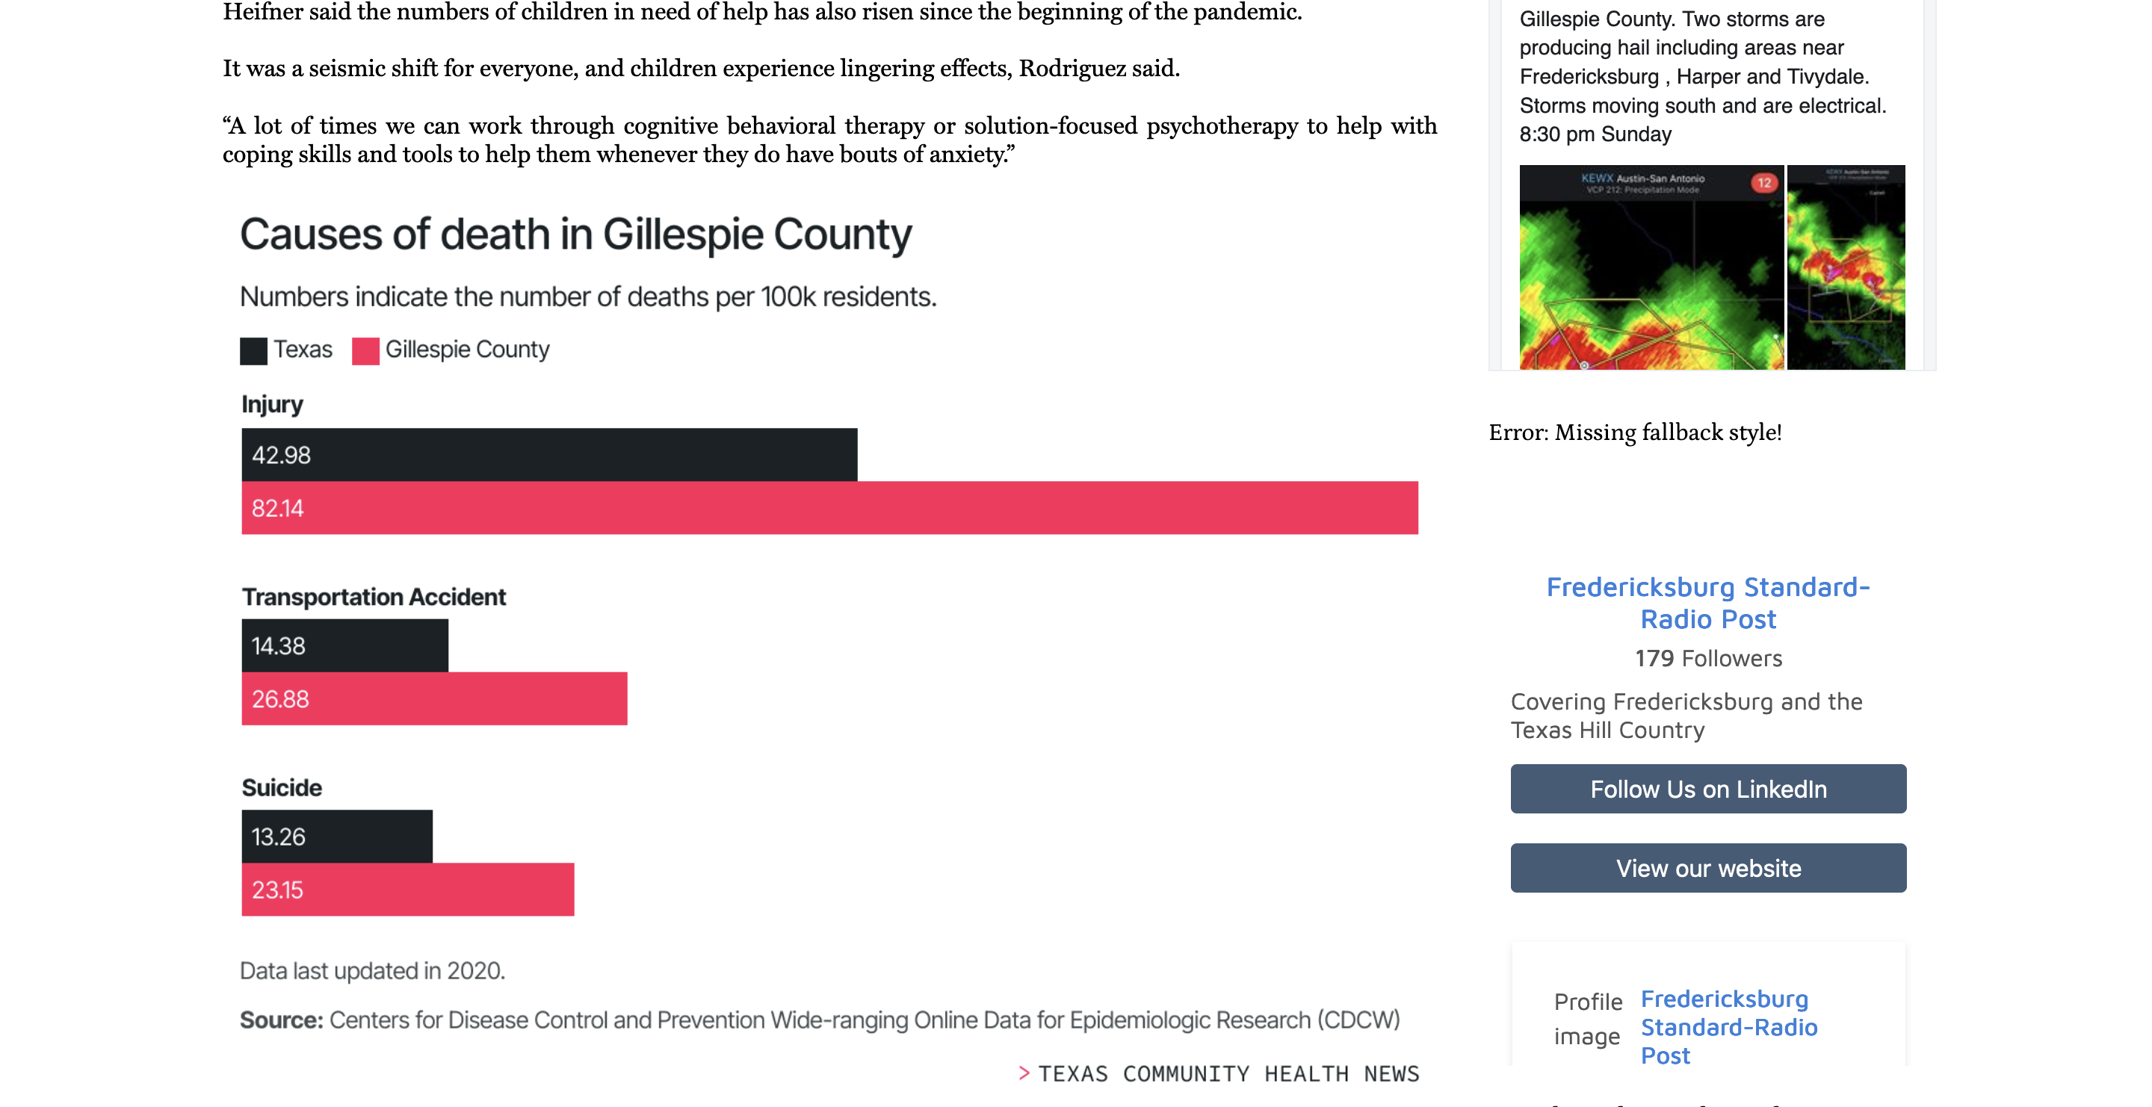

Slide 24
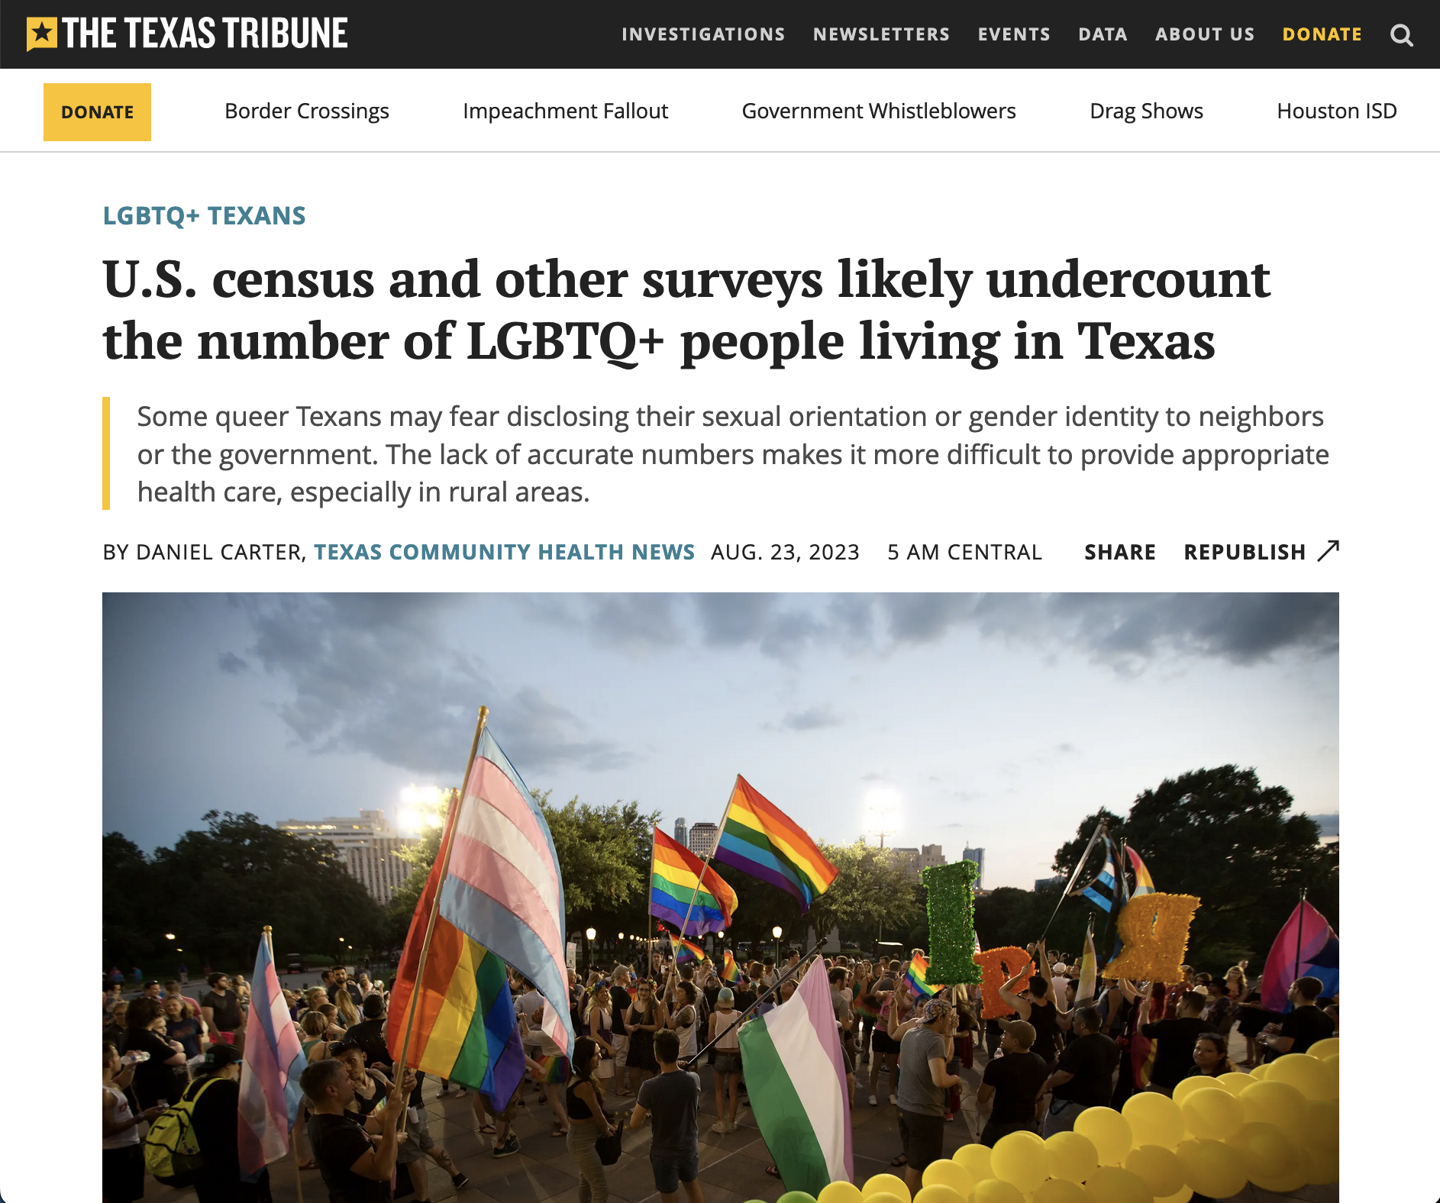


Increasing discovery

Slide 25

Working with researchers
Theoretical claims are often not seen as newsworthy.
Metrics / indexes / scales can be opaque to journalists.
Empirical claims are rarely tied to local contexts — generalizability fights specificity.
Journalists don’t have time to fill in the story that research could tell — they’re much more likely to look for your research to contextualize their story.
“The theory of everything?”
“I want you to lead with this.”
“I’m not gonna lead with it.”

Slide 26


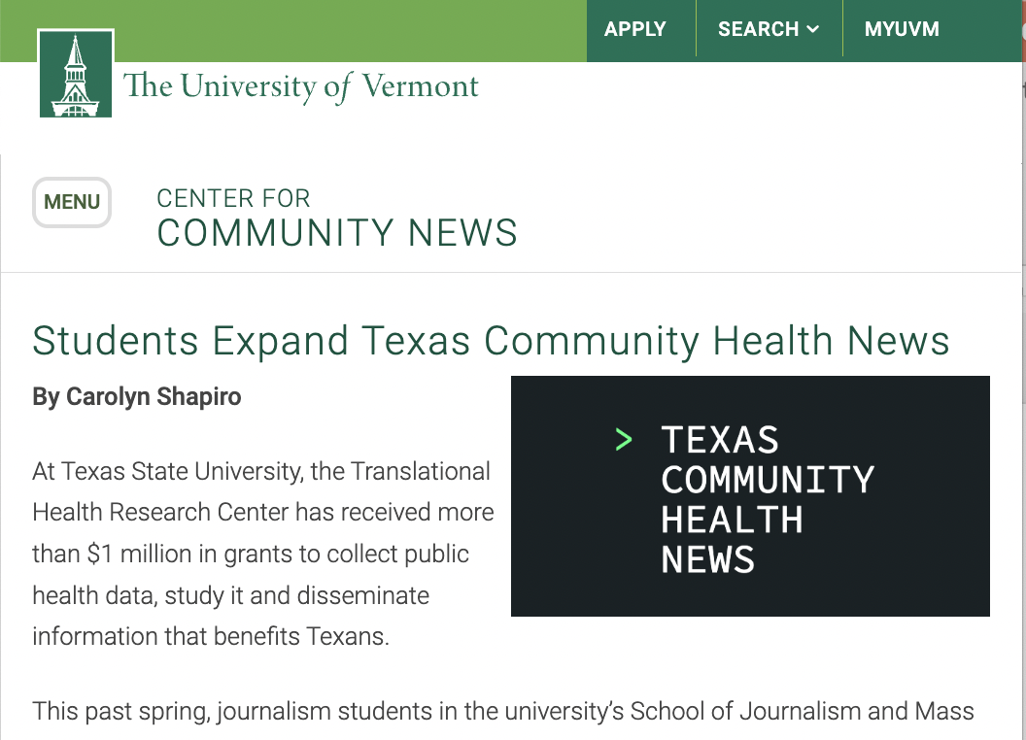
Texas Community Health News

Slide 27
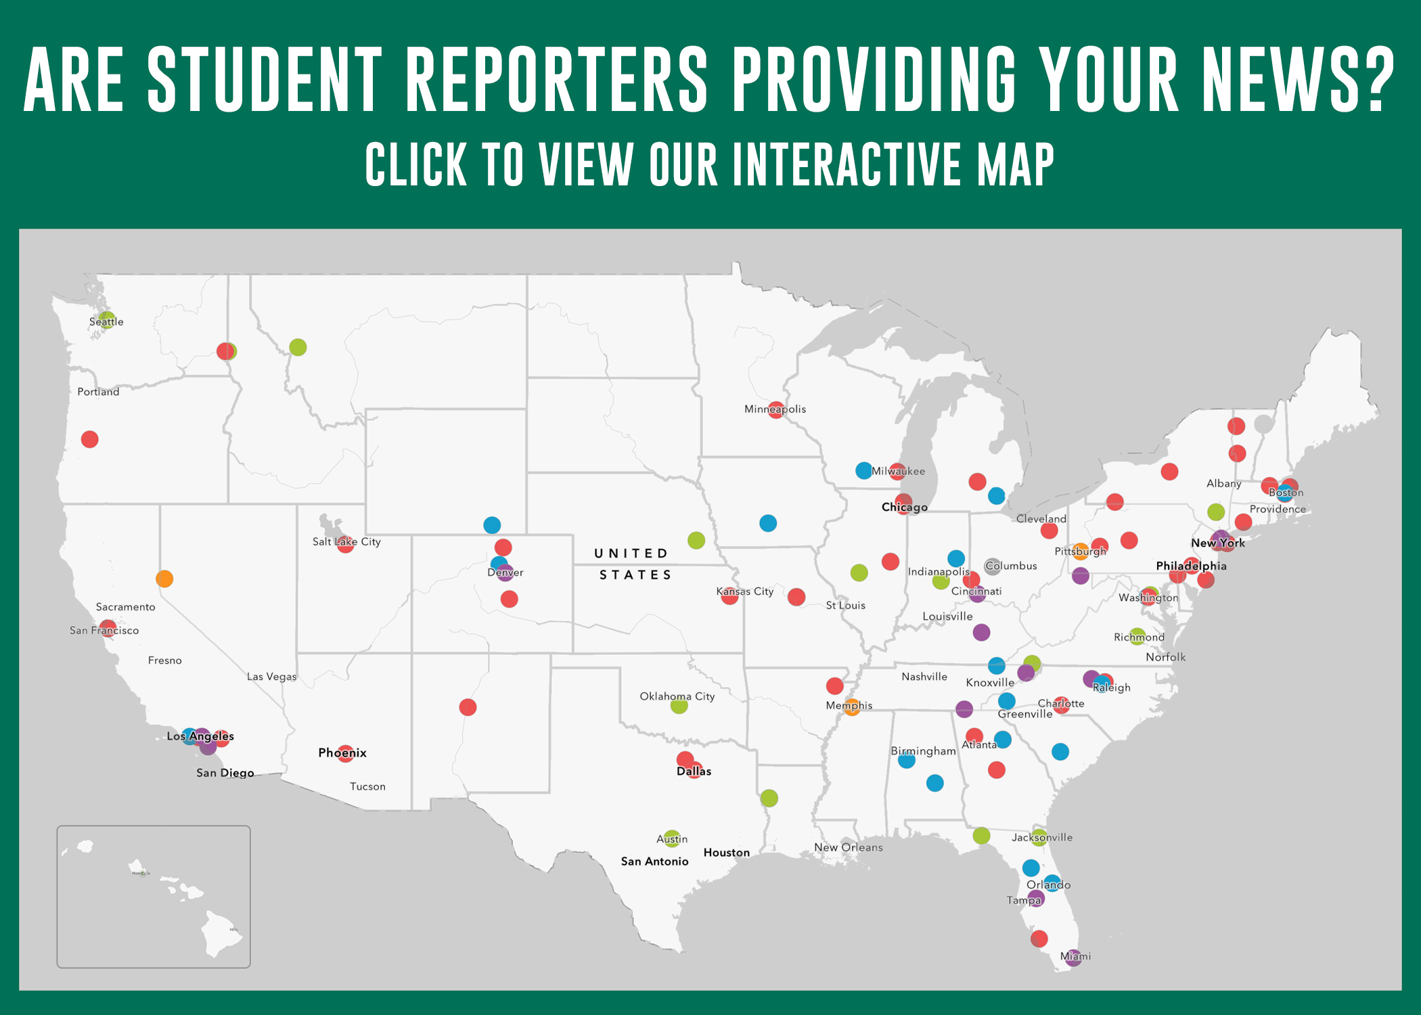
National Community Journalism Initiatives
120
University led student reporting programs that provide local news
15 million
Americans received their news from students
20+
Media outlets published TCHN content in our first 3 months
1,500+
Media outlet partners
UVM Center for Community News August 2023 survey

Slide 28
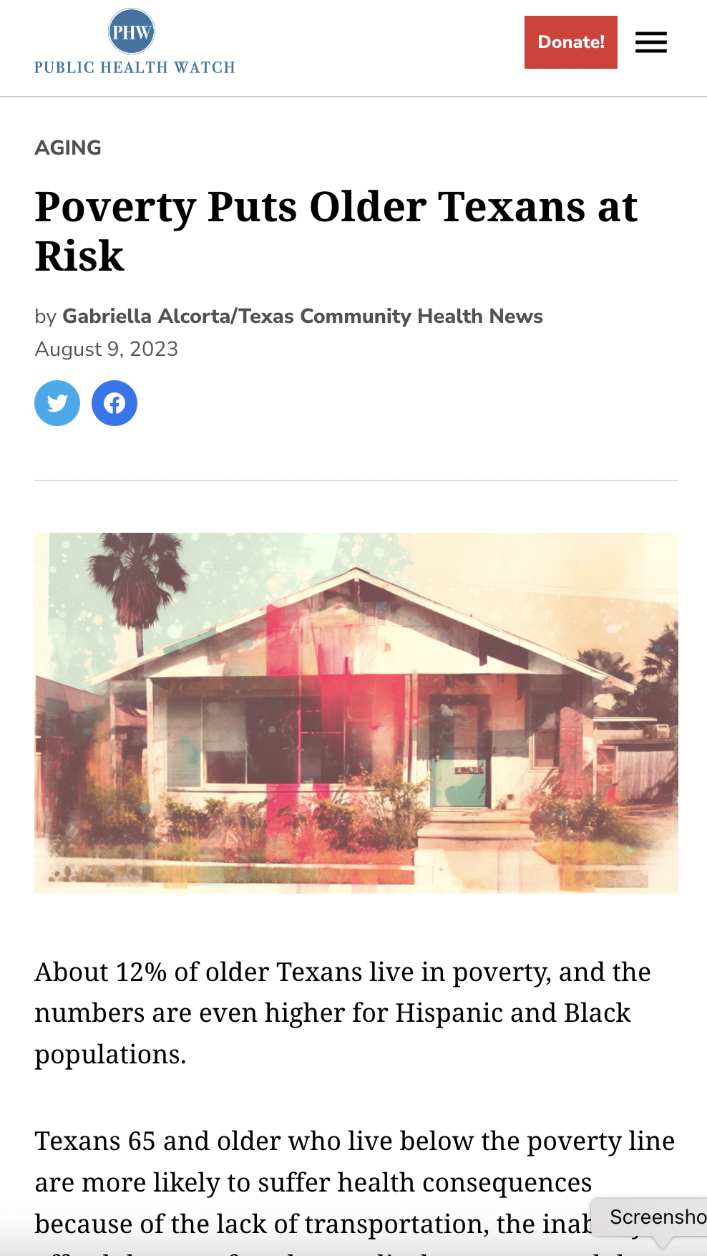
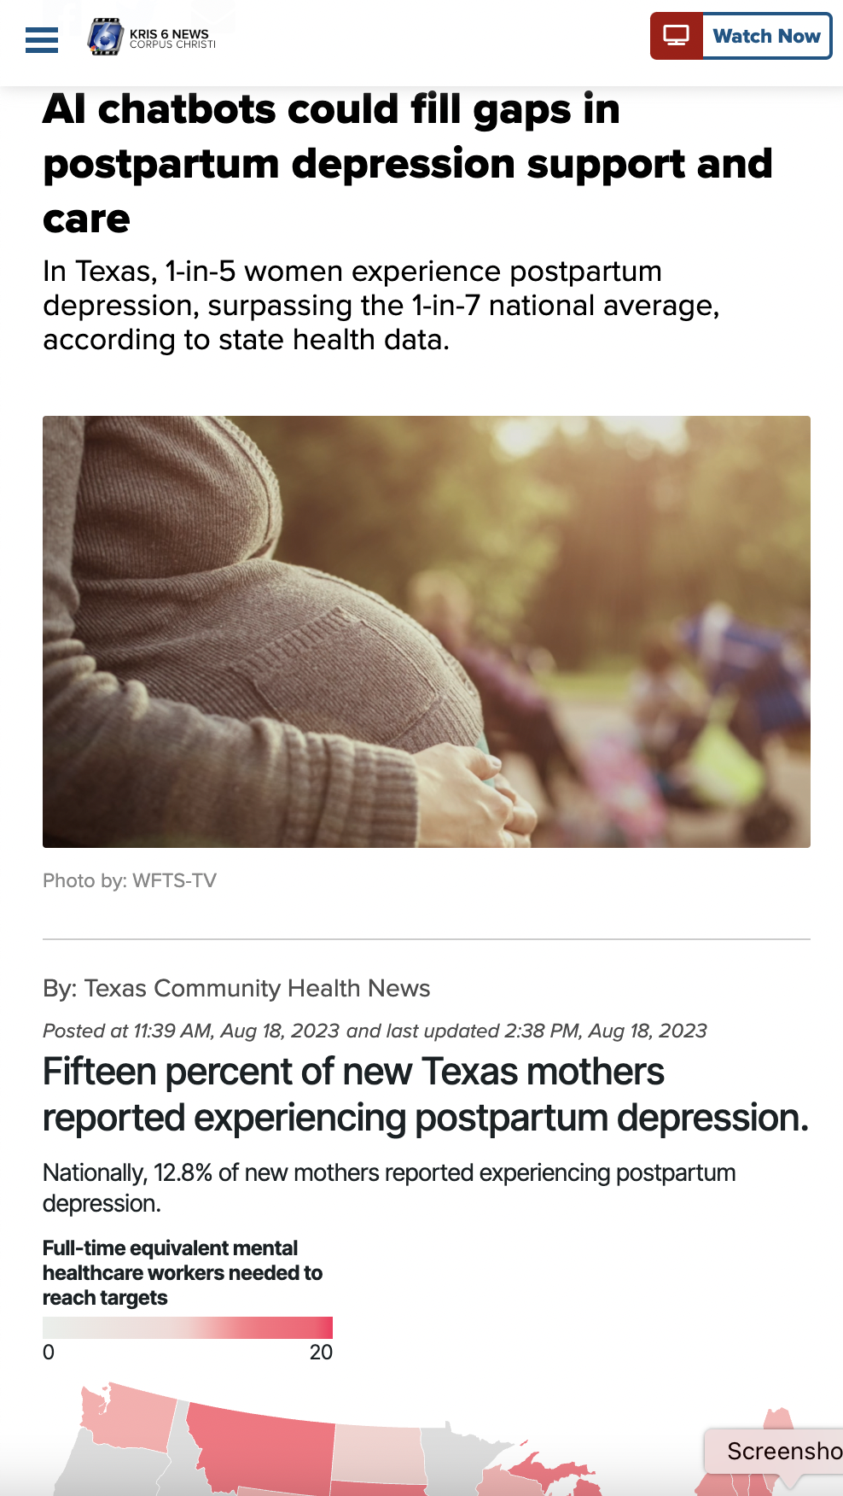
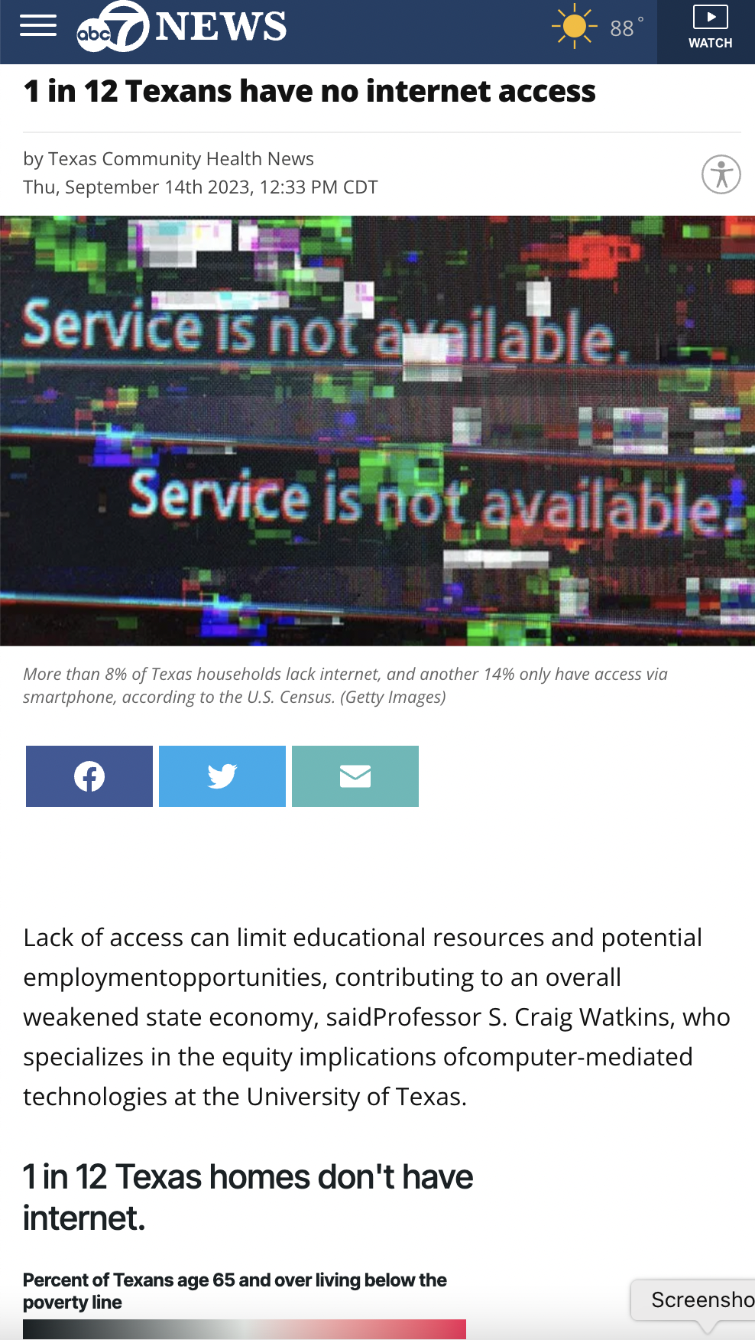
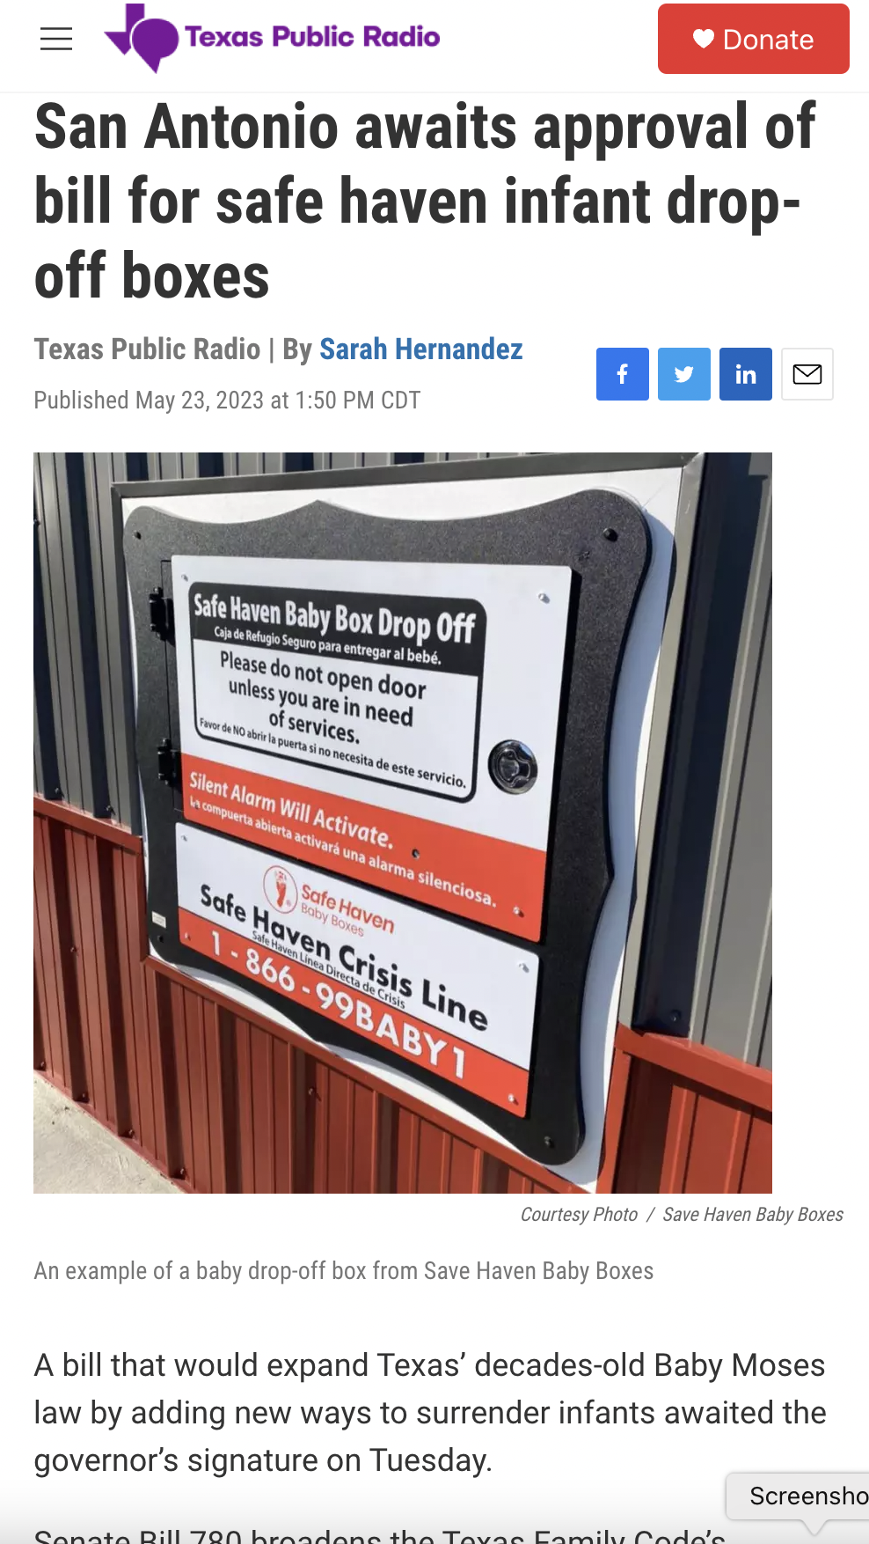
Produce health-related journalism

Slide 29
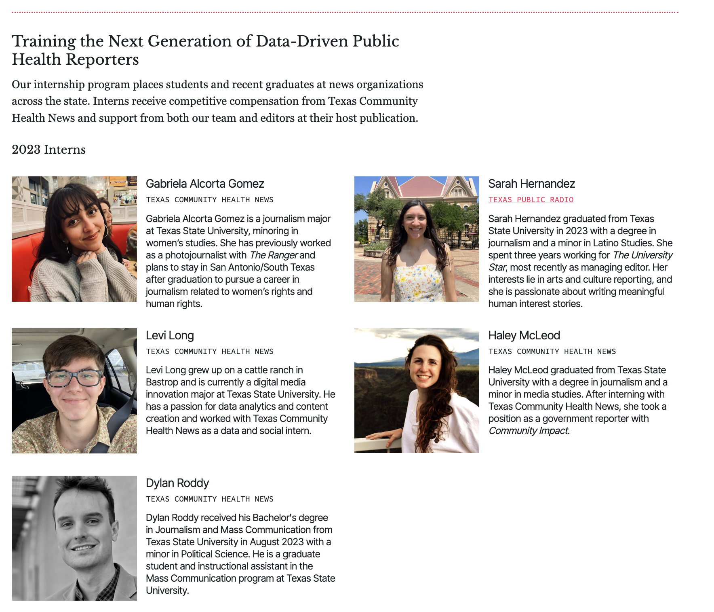
Interns

Slide 30


Media partners
Non-profit radio
Non-profit digital
Daily newspaper
Non-profit digital
San Antonio
National
Victoria
Austin
Public radio outlet
Serves South Texas
Bureau in the Valley
Based in Austin
Project & investigative journalism
Regional daily newspaper
2nd oldest paper in Texas
Statewide digital news outlet
Focus on issues & policy

Slide 31



Journalism Organization Partnerships
50
Community journalists trained TCCJ workshops across the state
150
Visits to TCHN booth at TPA
75
Media outlets – companies own multiple outlets
40+
College Media outlet
Training sessions at TIPA state conference – San Marcos
Coming spring 2024

Slide 32
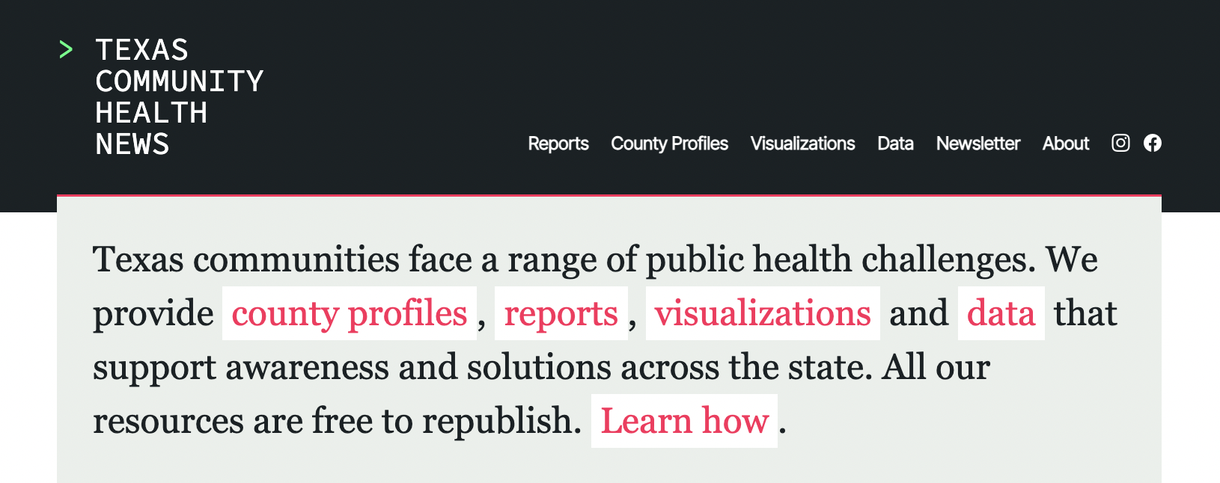

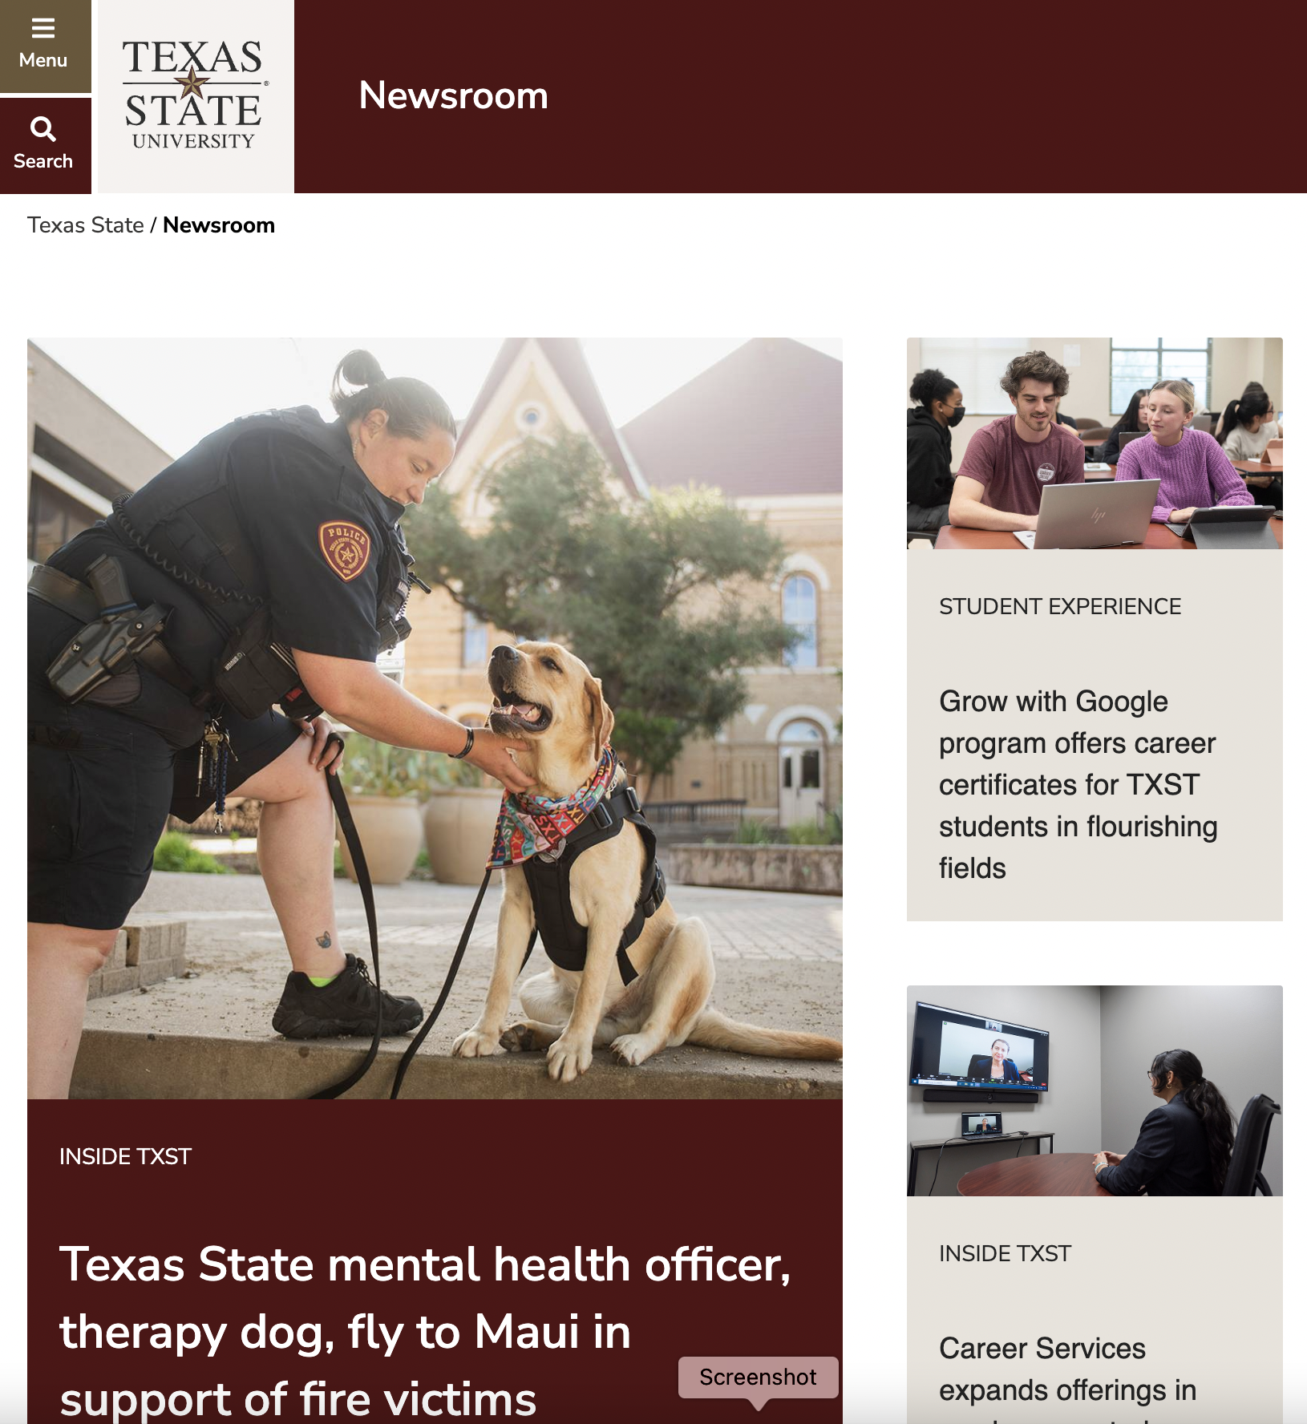

What we are and what we are not

Slide 33
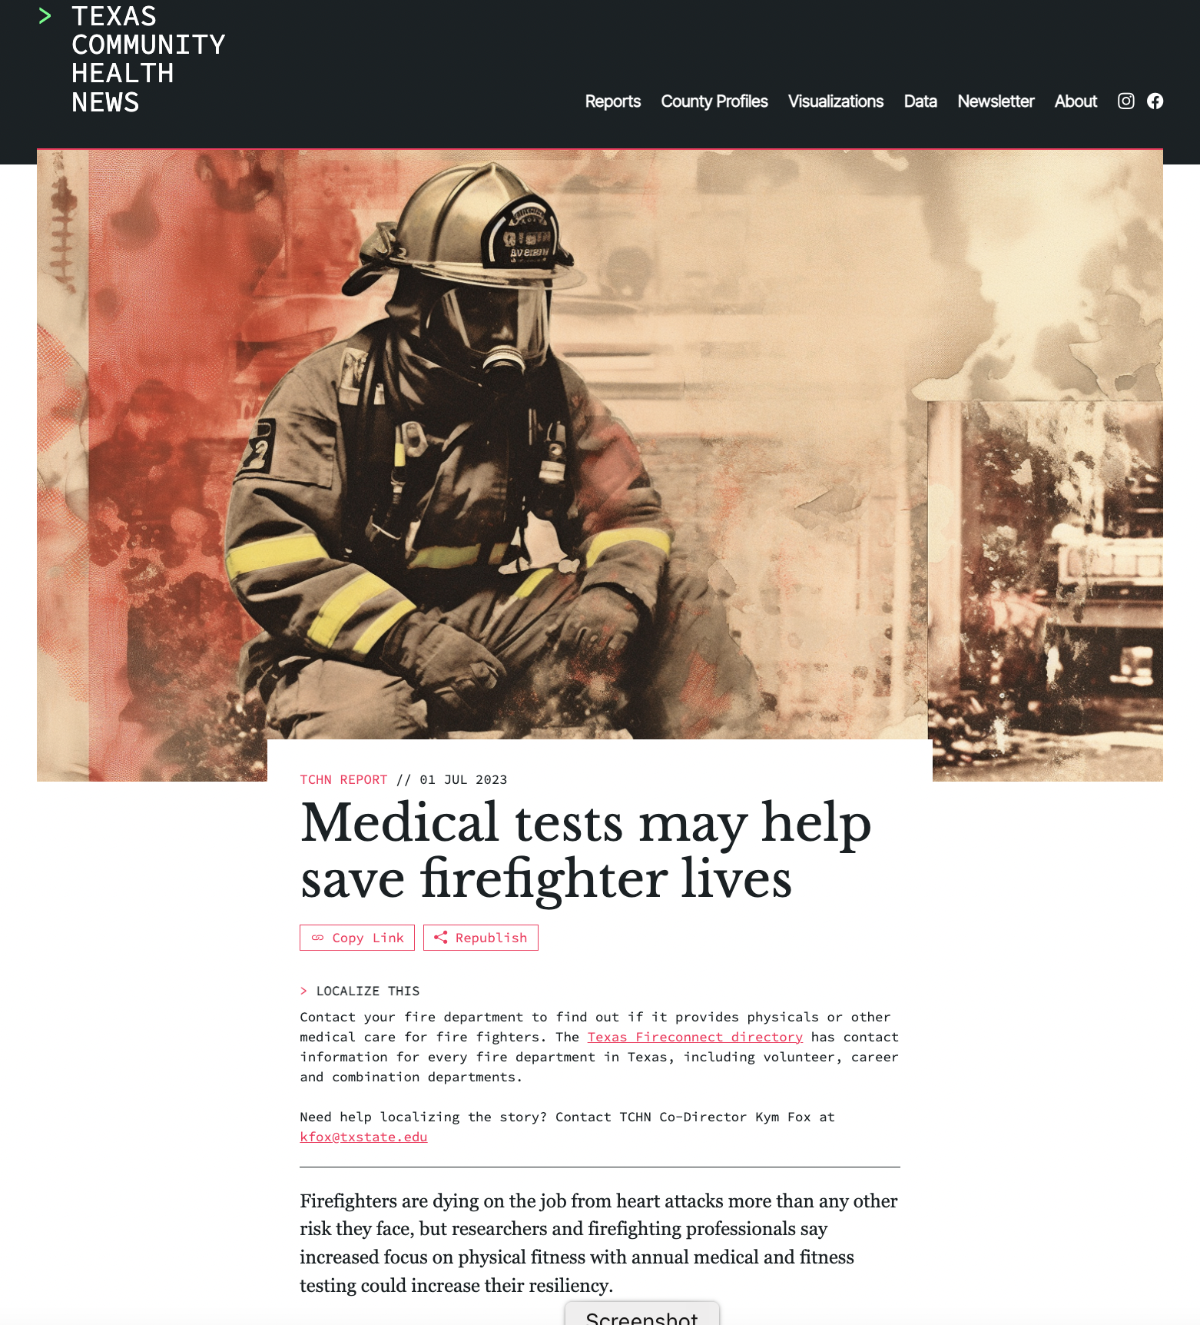
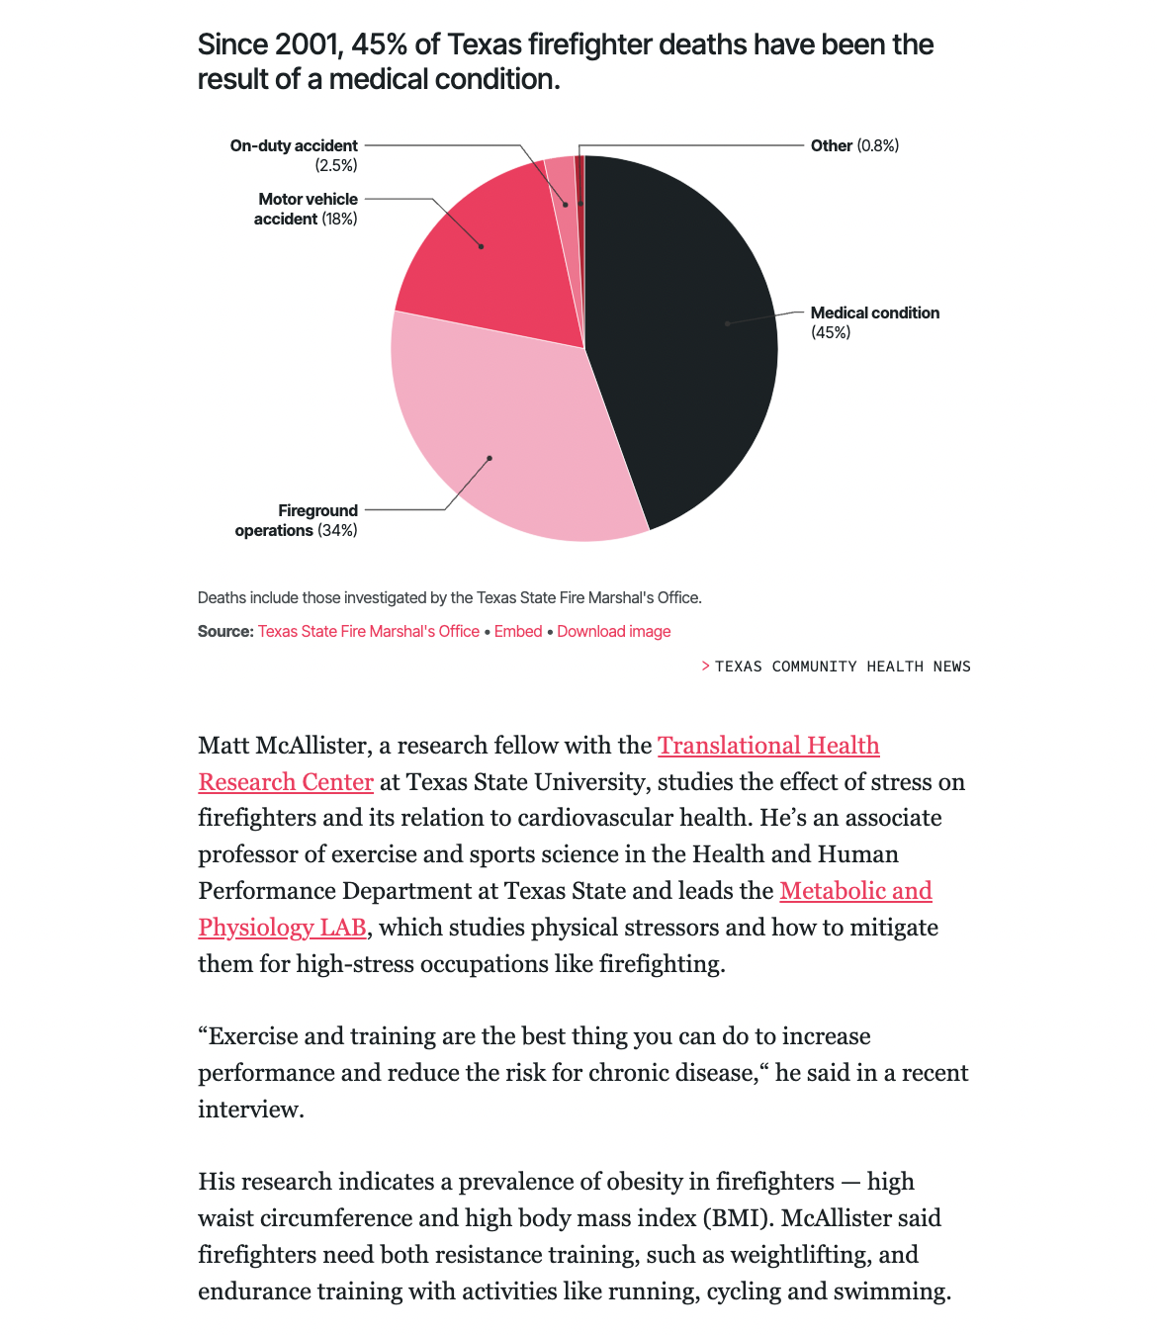
Journalists need expert sources
Contact us
Let us know what you’re doing
Reply
To TCHN emails & calls
Students
Are tomorrow’s journalists

Slide 34
CONTACT US

210-508-9364
Kym Fox (m)

kfox@txstate.edu
dcarter@txstate.edu
Texas Community Health News
School of Journalism & Mass Communication
Old Main


