Slide 1
Texas State University Procurement & Strategic Sourcing
Procurement 101 Training
Notes:
Overview

Slide 2
TABLE OF CONTENTS
INTRODUCTION
P&SS PILLARS
REVIEW
CONTACT
Our Team
Training Objective
HUB Program
PCard
Vendor Management
Purchasing
Contracts
Financial Responsibility
Compliance
Training
Financial Support Services
Financial Services
Procurement
Account Payables
Material Management
Payroll & Tax Compliance
Notes:
Overview

Slide 3
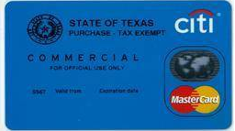
5 Pillars of Procurement & Strategic Sourcing
.
HUB
P-Cards
Vendor Management
Purchasing
Contracts
A mandated program that was created to promote equal procurement opportunities for small, minority, service - disabled veteran, and woman owned businesses throughout the state of Texas.
The Procurement Card is a fast, flexible alternative for processing low dollar purchases from vendors that accept procurement cards.
The process of overseeing and managing relationships with external vendors who provide goods or services to TXST.
A contract is an agreement between parties, creating mutual obligations that are enforceable by law.
The process of acquiring goods or services from a vendor, in exchange for money.
Notes:
Overview

Slide 4
Procurement & Strategic Sourcing Leadership
Dan Alden
Billy Becker
Brenna Russell
Director
Associate Director
Assistant Director
and HUB Coordinator
Purchasing, eProcurement, and Reporting.
Contracts and Sourcing
Notes:
Overview

Slide 5
OUR TEAM
CYNTHIA BALBOA
CHRISTINE BONNER
LIN GACAYAN
LISA LEOPOLD
EMILY McKENZIE
PCARD
CONTRACT SPECIALIST - ACADEMIC
ADMIN I
BUYER III
BUYER II - ACADEMIC
MARY MORRISON
NICOLE MOSES
ILONA RHYMER
SLOANE THOMPSON
SOFIA HERNANDEZ
HUB SPECIALIST
BUYER II - ADMIN
CONTRACT SPECIALIST - ADMIN
VENDOR MANAGEMENT
ADMIN II
Notes:
Overview

Slide 6
Training Objective – Financial Responsibility
The fundamentals of financial responsibility call for each employee to make a personal commitment.
To “do the right thing”
Make decisions that are just and right for the common good.
Notes:
Overview

Slide 7
Purchasing and Contracts Overview
Financial management - Involves every employee because we are all responsible for:
protecting and conserving TXST resources
using these resources in a prudent manner for their designated purposes
By practicing good financial management - TXST and its employees become accountable to:
each other
our constituents
our regulatory bodies
Notes:
Overview

Slide 8
Purchasing and Contracts Overview
We are governed by many Texas laws with respect to procurement including Government & Education Codes, Administrative Code and the General Appropriations Act.
TEC§51.9335(a): An institution of higher education may acquire goods or services by the method that provides the best value to the institution, including:
Competitive bids;
Competitive sealed proposals;
Catalog purchase (State of Texas contracts);
A group purchasing program (cooperative); or
An open market contract (<$15k)
TAC§20.133: Only certified individuals may perform contract development activities or issue solicitations on the ESBD.
UPDATED: Statewide Procurement Manual and Contract Management Guide - https://comptroller.texas.gov/purchasing/publications/procurement-contract.php
Texas State University System (TSUS) Policies - http://www.tsus.edu/about-tsus/policies.html
Texas State University Contract Management Handbook - http://www.tsus.edu/offices/finance/procurement.html
Notes:
Overview

Slide 9
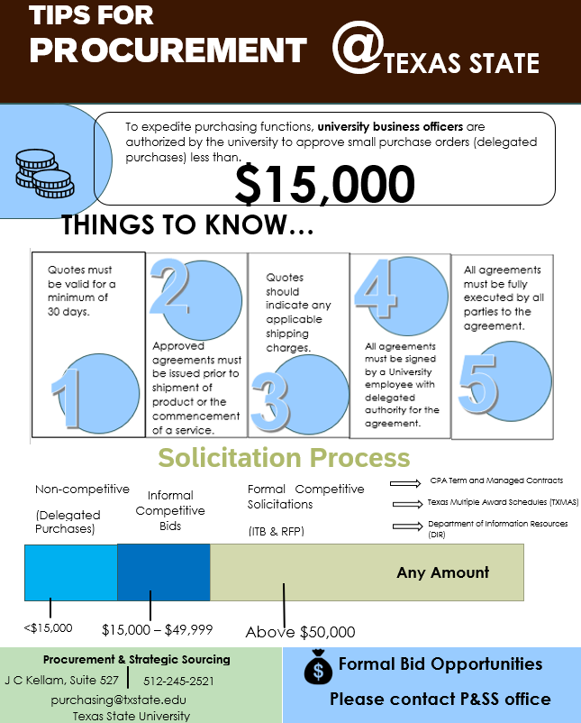
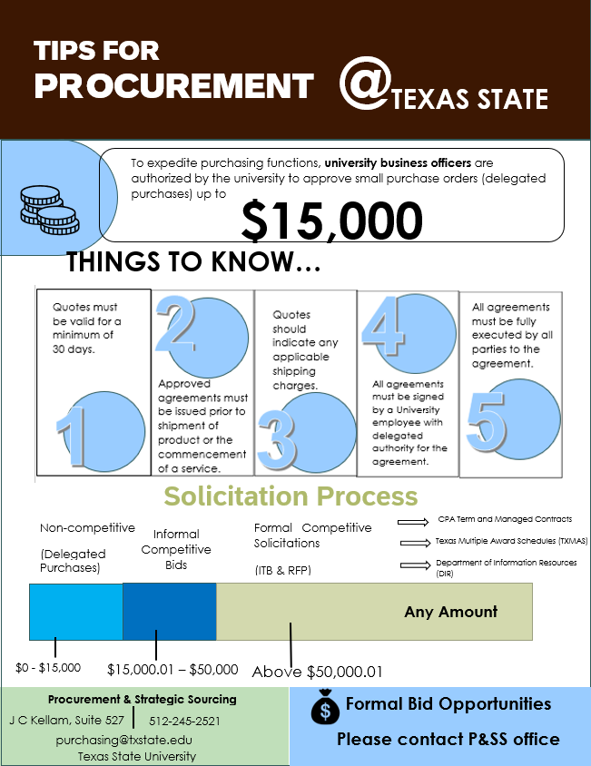
For helpful resource documents visit the P&SS website “Forms” to view.
Notes:
Overview

Slide 10
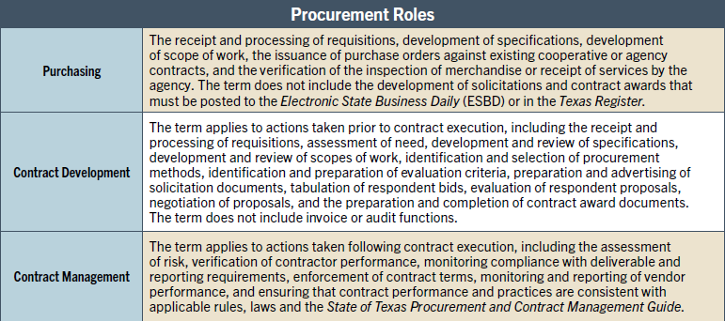
SPD Professional Certification and Training Program
The term “public procurement professional” refers to any agency employee that conducts Purchasing, Contract Development, or Contract Management activities. A description of the three procurement roles is summarized in the table below.
All public procurement professionals, including those from agencies exempt from the purchasing authority of the Statewide Procurement Division (SPD), must receive training and continuing education to the extent required by SPD. An agency employee who is required to receive the training may not participate in purchases by the employing agency unless the employee has received the required training.
Notes:
Overview

Slide 11
Purchasing and Contracts Overview - Ethics
Maintain high ethical standards as stewards of public monies. Conduct must not create a conflict of interest.
Equal opportunity to all qualified and reputable vendors
No benefits / gifts for performing official duties or that may result in an obligation
No misuse of information
No self-dealing
No workarounds for policy (e.g., splitting orders to get under thresholds)
Vendor ethics - pressure or bullying tactics to fulfill sales quotas
Actions and communications must be free from perception of impropriety.
The Texas State University System Conflict of Interest Policy and Code of Ethics are established within TSUS Rules and Regulations located at https://www.tsus.edu/about-tsus/policies.html
Texas State University Ethics for Faculty and Staff are established with TXST UPPS https://policies.txst.edu/university-policies/01-04-02.html
Notes:
Overview

Slide 12
CONTRACT MANGAGEMENT–CONTRACT AUTHORITY
Texas State is not bound by a contract, purchase, or agreement signed by an unauthorized person on behalf of the university. TXST may hold the person who signed without proper authorization personally liable for any damages resulting from its repudiation. UPPS 03.04.04
Only authorized TXST representative may enter into certain contracts, purchases, or agreements on behalf of Texas State (see UPPS No. 03.04.02, Contracting Authority). “The president has authority to enter into contracts on behalf of the university provided that the contract does not require approval from the Chancellor or The Texas State University System (TSUS) Board of Regents”.
Notes:
Contracts

Slide 13
Contract and Purchasing Authority
The authority to obligate the institution (“signature authority”) is passed down from the legislature:
Notes:
Contracts

Slide 14
CONTRACT MANAGEMENT
TXST is committed to executing contracts in compliance with applicable law and TSUS Rules and Regulations
The TSUS Marketplace Contracts+ (TCM) serves as the central contract repository and system of record for all TXST contracts.
Contract Request – Submit via TSUS Marketplace Contacts Request.
How to Create and Submit a Contract Request
All contracts require review prior to approval. Contract review may include Information Technology and OGC review.
Contract Manager (Department Stakeholder) performs contract monitoring per TXST Contract Management Procedure located at https://www.txst.edu/procurement/contracts/routine_contract_monitoring.html.
Contract Term and Renewals – Notify Contract office a minimum of 60 days prior to renewal
Maximum Contract Amount – Do not exceed contract value, increases may require additional approval.
Notes:
Contracts

Slide 15
Contracts Updates & Reminders
Contract Monitoring & Responsibilities
Risk Assessment – Required at $500k
Enhanced Contract Monitoring – with a risk score of 26 and higher or at >$1M
FS-07 Contract Close-out – Required on all contracts $250k and greater
Resources
TXST Guidelines Summary
TXST Required Forms Per Procurement
Contract Flow Charts - <100k (1-2 weeks); $100k - $499k (min 4 weeks); >$500k (min 11 weeks)
Notes:
Contracts

Slide 16
Purchasing and Contracts Overview – GPO Contracts
Texas Institutions of Higher Education Commonly Use Existing Contracts From the following Group Purchase Organizations (GPO)
BuyBoard/Texas Association of School Boards (TASB) Choice Partners
Educational & Institutional Cooperative Purchasing (E&I) Education Service Centers – Various Regions
National Cooperative Purchasing Alliance (NCPA) Houston – Galveston Area Council (HGACBuy)
OMNIA Partners (formerly National IPA/USA Communities) Provista
The Interlocal Purchasing System (TIPS) Sourcewell
The Purchasing Association of Cooperative Entities (PACE) UT System Supply Chain Alliance (Alliance)
* To search vendor cooperative agreements, sign up for free access to Pavillion at Website: www.withpavilion.com Email: hello@withpavilion.com
Notes:
Contracts

Slide 17
Purchasing and Contracts - State Contracts
State of Texas Contracts
Department of Information Resources (DIR) http://dir.texas.gov/ software, hardware, and telecommunications
TXSmartBuy http://www.txsmartbuy.com/ various goods and services including “green items” – recycled, remanufactured or environmentally sensitive items available for purchase
Texas Multiple Award Schedule (TXMAS) http://comptroller.texas.gov/procurement/prog/txmas/ various goods and services
Notes:
Contracts

Slide 18
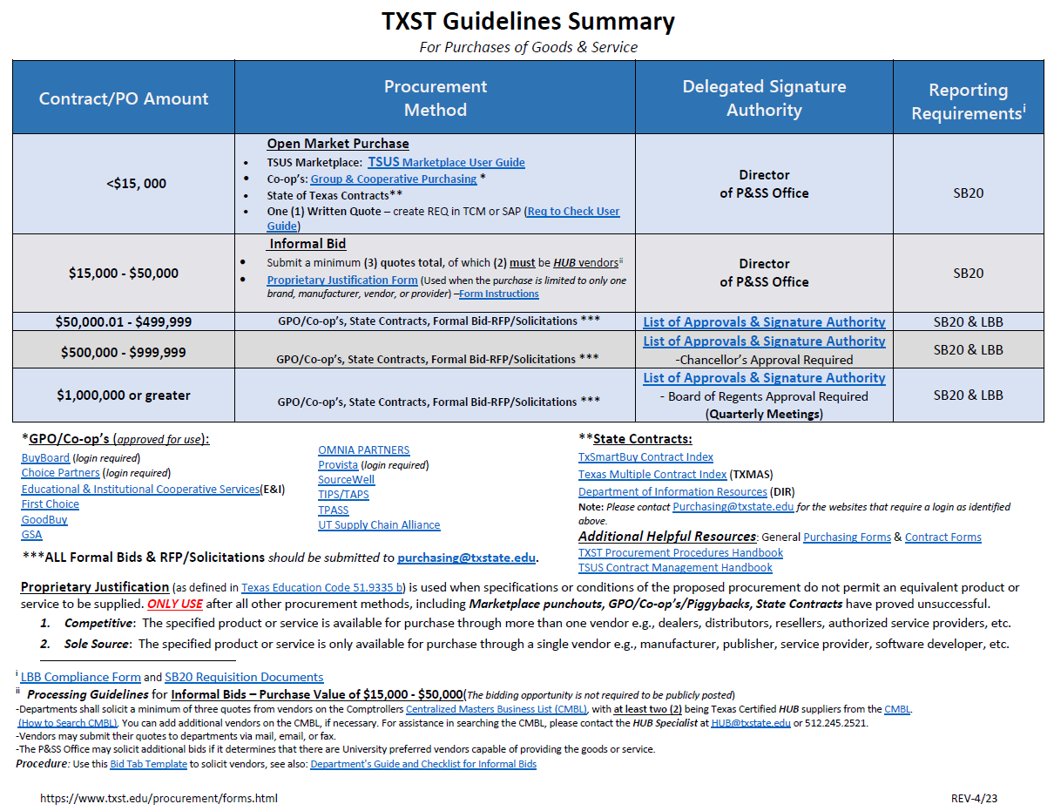
Purchasing Overview- Guidelines Summary
Dollar Range |  | Solicitation Method
$0 | <$15,000 | Open Market: Competitive quotes are encouraged, but not required. A purchase order can be issued after a written quote is solicited from a single source. A good faith effort should be made to include quotes from a certified Texas HUB vendor.
>$15,000 | <$50,000 | Informal Bid: A minimum of three written quotes are required. A good faith effort must be made to include quotes from certified Texas HUB vendor. Award is generally based on cost & delivery. Non-competitive methods may also be used, if appropriate.
>$50,000 | + | Formal Bid: A competitive solicitation may be required. A good faith effort must be made to include quotes from certified Texas HUB vendor. Non-competitive methods may also be used, if appropriate.
The solicitation method is generally determined by the estimated TOTAL dollar value of the product or services being purchased for the life of the contract.
Note: The utilization of existing contracts that have been competitively awarded eliminates the need for bidding at the institution level.
Notes:
Contracts

Slide 19
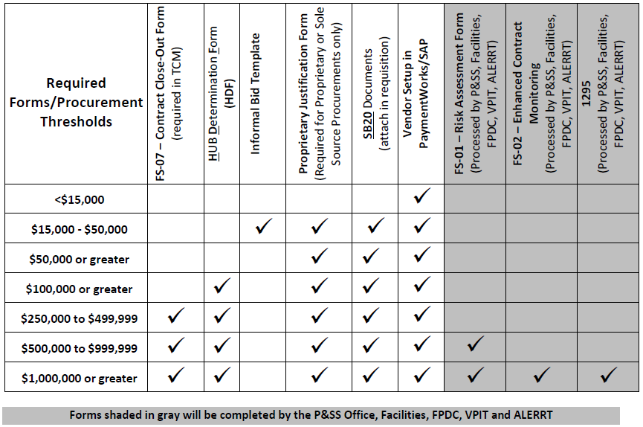
TXST Required Forms per Procurement
Notes:
Contracts

Slide 20
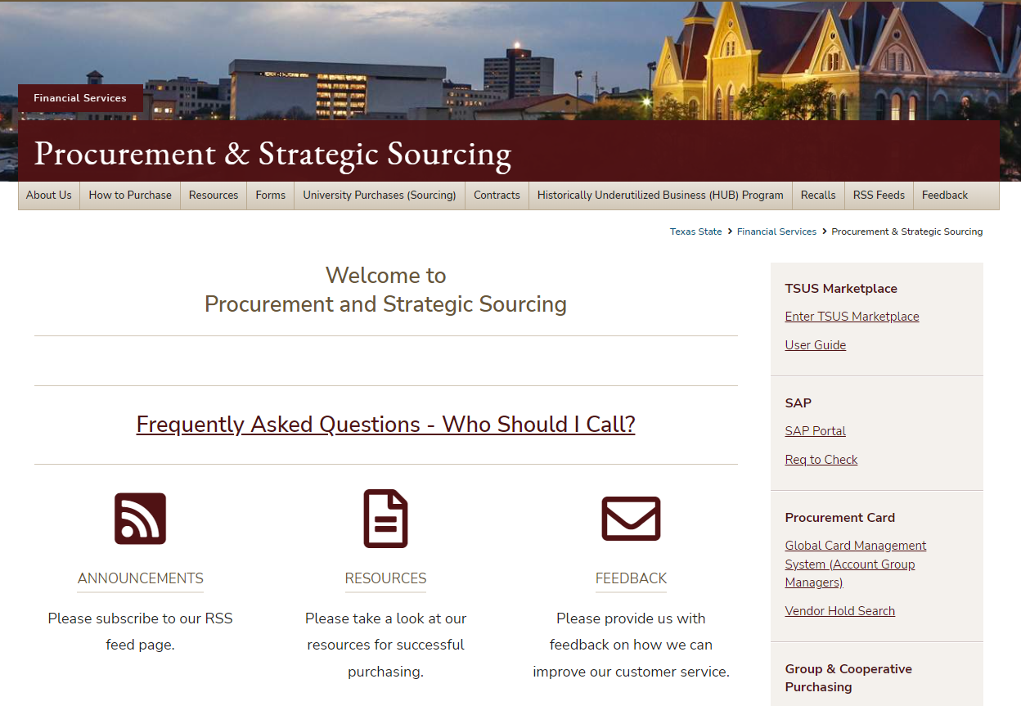
Purchasing and Contracts Overview
TXST Procurement & Strategic Sourcing Web Page - https://www.txst.edu/procurement/
Notes:
Contracts

Slide 21
Purchasing Overview
For each purchase you initiate, authorize, or process ask yourself the following questions:
Does the purchase comply with all applicable TXST policies?
Does this purchase violate any applicable Conflict of Interest policy or law?
Could this purchase negatively impact the financial health or reputation of TXST?
Does this purchase have proper authorization?
Is there source documentation (e.g., quote, contract, etc.) to support this purchase?
Are adequate funds available to support this transaction?
Notes:
Procurement

Slide 22
Purchasing Overview
Employees are not authorized to make purchases which obligate Texas State University without first obtaining a purchase order.
Purchase orders are not intended to be used strictly as a payment tool; it also includes TXST T&C’s.
The purchase order should be created prior to the commitment or obligation.
Purchase orders submitted after the commitment has been made or after the goods and services are received are considered “after the fact” and require proper justification for the eNPO.
If there is a contract in place for the goods or services an eNPO will not be accepted and a PO should be submitted.
Notes:
Procurement

Slide 23
Purchasing Overview – Proprietary Justification
Defined in SPD rules (34 TAC §20.25(b)(44)):
Products or services manufactured or offered under exclusive rights of ownership, including rights under patent, copyright, or trade secret law.
A product or service is proprietary if it has a distinctive feature or characteristic which is not shared or provided by competing or similar products or services.
Submit Proprietary Justification Form to Procurement Office for review and approval for purchases >$15,000 of goods or services.
Notes:
Procurement

Slide 24
Purchasing Overview – Emergency Justification
Defined in Texas Administrative Code Title 34, Part 1, Chapter 20.
Requires a written justification submitted to P&SS.
Submit a TXST Emergency Purchase Justification Form for purchases >$15,000.
Emergency purchases should be made as competitively as possible.
The emergency purchase of goods or services should not exceed the scope or duration of the emergency.
Notes:
Procurement

Slide 25
Purchasing Updates & Reminders
SB20 docs
LBB form
HUB Determination Form (HDF) and HUB Subcontracting Plan (HSP)
EHSREM new material group and workflow approval
TXST Required Forms per Procurement - https://www.txst.edu/procurement/contracts/contract_forms.html
Amazon – Use Firefox
Always use TSUS Marketplace for purchases using an existing contract. TSUS Marketplace purchasing is preferred over SAP
Workflow status is available to track in both TSUS Marketplace and SAP.
State Use Program workflow
Notes:
Procurement

Slide 26
State Use Program
State Use Program (SAO Audit finding) – “The University Should Strengthen Its Purchasing Processes to Ensure That It Complies with State Use Program Requirements”.
State Use Program Requirements - Texas Human Resources Code, Section 122.0095, requires each state entity that purchases products or services to
designate an employee to ensure that it complies with all requirements and
report to the Comptroller’s Office and the Texas Workforce Commission when products or services are available through TIBH Industries but are purchased from a different vendor.
State statute requires state agencies and institutions to purchase from the State Use Program unless the needed product or service meet certain exceptions. Agencies and higher education institutions are also required to report the purchase of products or services available from an organization eligible under the State Use Program but purchased from a business outside the State Use Program, including the cost paid and reasons for not purchasing from the State Use Program.
Classifications of acceptable exceptions include:
The product or service available does not meet the reasonable requirements of the agency or institution. This may include an inability to meet product specifications or to deliver the needed product within a certain period of time.
The inability to provide temporary services within certain regions of the state.
WorkQuest Punchout
Notes:
Procurement

Slide 27
PCard Program
Limits - $2000 single transaction; $10,000 per month
PCard log updated monthly log procedure and instructions: Video, PDF instructions
Reminder to check your budget as it relates to using your PCard make sure transfers are completed prior to posting dates.
Prohibited items – Alcohol, Gift Cards, Animals, Fuel, Phone Services, Travel, Weapons, and other
Waiver – Card increases, restricted items. Awards, Flowers, Catering, Meal, and Food Services (not food for resale) do not require a PCard waiver.
Vendor Holds – verify that the vendor is not on hold for purchases over $500. Link here
Questions? Please contact p_card@txstate.edu See resources available at: https://www.txstate.edu/procurement/howtopurchase/procurementcard.html
Notes:
PCard

Slide 28
PCard Growth
Notes:
Dan

Slide 29
Vendor Management
Vendor Management policy requirements can be located at FSS/PPS No. 03.13
New Vendor Registration via PaymentWorks
Send vendor registration invite via PaymentWorks to the vendor. Instruction here.
New vendor registration and changes to vendor records in TXST SAP system (system of record) are required to be setup via PaymentWorks.
Vendor Management will approve vendor registration. Contact vendorrequests@txstate.edu for any questions or support. Note: foreign vendor registrations have multiple approvers before vendor management.
Department can search and track vendor registration via PaymentWorks. Go here for instructions.
Notes:
Vendor Management

Slide 30
Vendor Management
FS-06 – For Individuals only
The FS-06 form is used to determine if the contractor is currently or has been employed at TXST within the past 12 months
Employees cannot be set up as vendors, they must be paid by PCR or stipend.
Exceptions for this include: eNPO reimbursement for employees for certain items (registrations, seminars, work boots, etc.) paid on their employee number, not a vendor number.
All sections need to be completed, including Account Manager and Contractor signatures before submitting.
FS-06 needs to be sent to purchasing@txstate.edu
FS-06 should be fully approved by Vendor Requests before creating a Requisition/eNPO or TCM Form Request.
Approved forms will be returned to department contact listed on Section I. Be sure to include your name and net id.
If setting up new vendor, send FS-06 in once their registration is completed through PaymentWorks and/or in SAP.
Notes:
Vendor Management

Slide 31
Vendor Management
Email vendorrequests@txstate.edu with PATS as the subject line with the vendor number to add vendors to TCM.
If a vendor is blocked in SAP, reach out to me so I can unblock them or let you know why they are blocked. (Depending on the vendor)
I can correct 0TINS for reports or other needs.
If a vendor is requesting TXST complete a vendor profile, direct them to me.
Notes:
Vendor Management

Slide 32
HUB Program Review
Historically Underutilized Businesses (HUBs):
Small business (per TAC) with principal place of business in Texas
51% or more owned by:
Ethnic minority
American Woman
Service-disabled Veteran
Owner must reside in Texas and actively participate in daily operations
Must be certified by the state
The Statewide Procurement Division, Historically Underutilized Business (HUB) Program administers the HUB program in accordance with:
Texas Government Code Title 10, Subtitle D, Chapter 2161 & Texas Administrative Code, Title 34, Part 1, Chapter 20, Subchapter D, Division 1, Rule §20.281 – 20.298
Notes:
HUB

Slide 33
State of Texas HUB goals
State agencies shall make a good faith effort to assist HUBs in receiving a portion of contracts.
Texas State University has adopted the State of Texas HUB goals as follows:
21.1% Building Construction
32.9% Special Trade
23.7% Professional Services (engineering, architecture, etc.)
26.0% Other Services
21.1% Commodities
Notes:
HUB

Slide 34
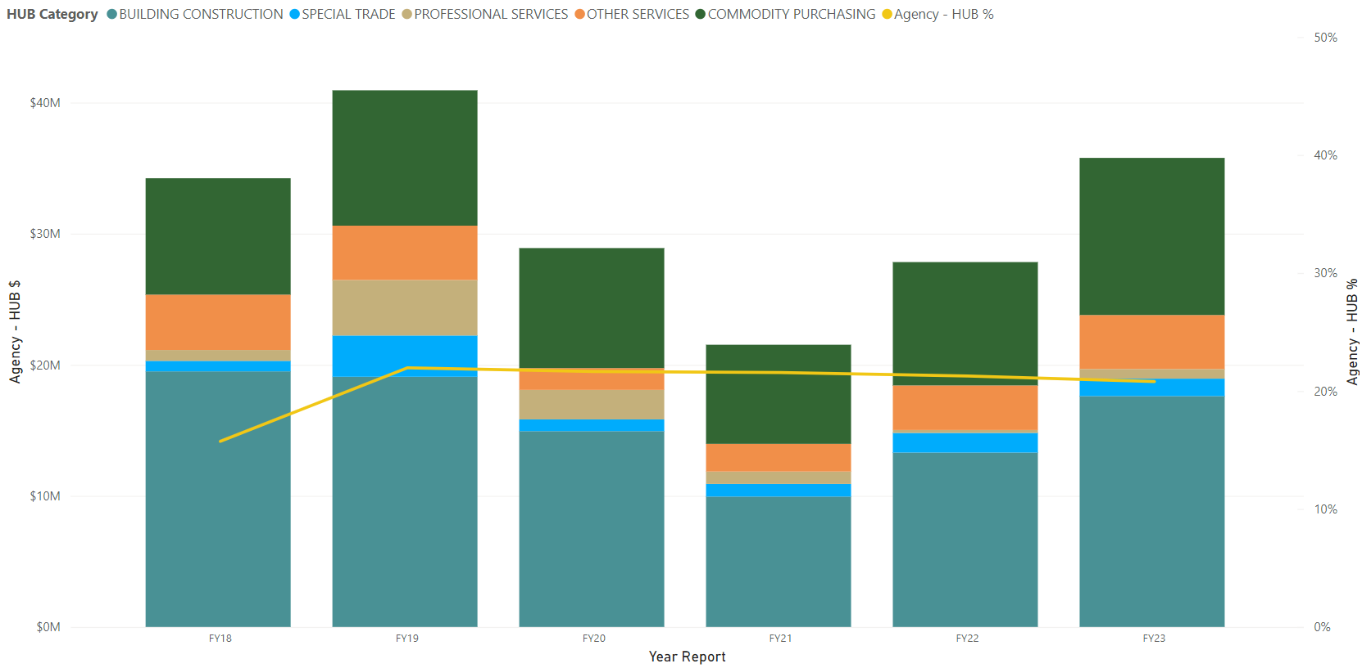
Total Annual HUB Spend and HUB%
Notes:
Mary

Slide 35
HUB Program Reminders
Informal Bids (15k-50k)
Require 3 bids from CMBL vendors, 2 need to be HUBs
If you need help finding HUB vendors, I can help and provide training on using the state’s commodity codes and CMBL list.
Notes:
HUB

Slide 36
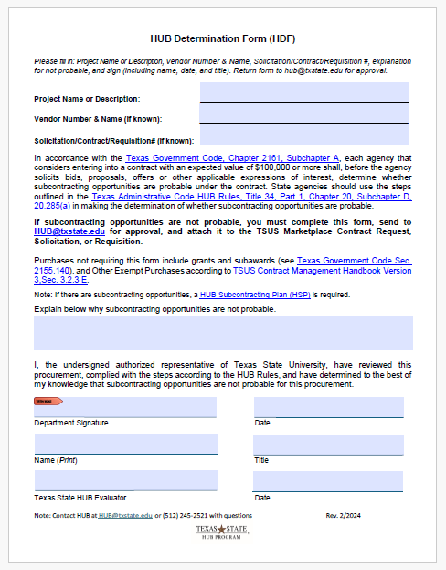
New HUB Determination Form(HDF)
Non-exempt (per TSUS CHMB Sec 3.2.3E) and non-grant procurements >= $100,000 will require either:
a HUB Subcontracting Plan (HSP), filled out by vendor
Or a HUB Determination Form (HDF) filled out by TXST department
The HDF states that the department has reviewed the purchase and has determined that subcontracting opportunities are not probable
Other Exempt purchases (per TSUS CMHB Sec 3.2.3 E) and grants and subawards (per Texas Government Code Sec. 2155.140) do not require either HUB form
For example: utilities, hotel rooms, library books, subscriptions, etc.
Notes:
Mary

Slide 37
Spot Bid Fair, May 14-15, 2024 in Irving, TX
Bypass the solicitation process and streamline purchasing
Engage new HUB vendors with TXST and get competitive pricing
<$50,000 for Commodities and < $100,000 for Services
Purchases can range from services to supplies, e.g., golf carts, storage sheds, printers, paper, office furniture, cars, etc.
Portal opens on March 1, 2024, please provide bids by end of April
What are you purchasing that we could put in the Spot Bid Fair?
Please e-mail hub@txstate.edu with bid opportunities
Notes:
Mary

Slide 38
Save the Date!!!
Notes:
Mary

Slide 39
RSS Feeds & Contacts
Stay informed on process and form changes.
Please see below for RSS Feed setup instructions:
How to Add RSS Feed for Purchasing
Procurement & Strategic Sourcing
512-245-2521
purchasing@txstate.edu
contracts@txstate.edu
p_card@txstate.edu
vendorrequests@txstate.edu
HUB@txstate.edu
Notes:
Close

Slide 40
Thank you for coming!

