Slide 1

Current State of Academic Budgeting
October 24, 2023

Slide 2
AGENDA
INTRODUCTION
AVAILABLE RESOURCES
FUTURE MODEL
Basic Principles
Formula Funding
Position Management
Permanent Funding
New Academic Programs
Faculty Resources
Responsibility Center Management (RCM)
Online Program Management

Slide 3

BASIC PRINCIPLES
Incremental Budget Model
Heavily Centralized
Data Informed Decision Making
Sources of Funding:
Auxiliary Funds – Housing, Dining, Bookstore, Athletics
Designated Funds – Tuition, Electronic Course Fee, Institutional Services Fee
E&G Funds – Higher Education Fund (HEF), Operations Support, Capital Construction Assistance Program (CCAP), Space Support
Gift/Grant Funds

Slide 4
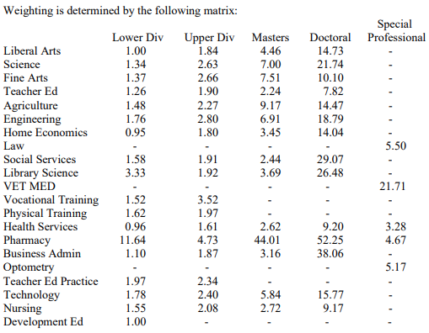
FORMULA FUNDING
Instruction and Operations Formula
Teaching Experience Supplement
Infrastructure Support
CORE/Potential Texas University Fund
Higher Education Fund
As approved in the 88th Regular Legislative Session by the General Appropriations Act HB1.
Notes:
General Academic Funding; Matrix impacts instruction and operation formula - rate is $56.27/SCH; teaching experience 10% added to lower and upper division SCH taught by tenured/tenure-tract faculty; space support avg $5.45/sqft; endorsement equals approval to prioritize for funding

Slide 5
POSITION MANAGEMENT
New Positions
Reauthorizations
Faculty Positions
Staff Positions
Primarily New Academic Programs, additional allocated via EVPAA Salary Reserve
Based on metrics including student enrollments and SCH trends
Review of rank, title, area of expertise; salary currently based on CUPA-HR salary data
Includes review of reclassifications and internal promotions; salary based on university pay plan, market analysis

Slide 6
AVAILABLE RESOURCES
Breakdown of Permanent Funding – Academic Affairs
Does not include cost centers in the Institutional Division (primarily financial aid).
Notes:
Enrollment Management taken out of FY24

Slide 7
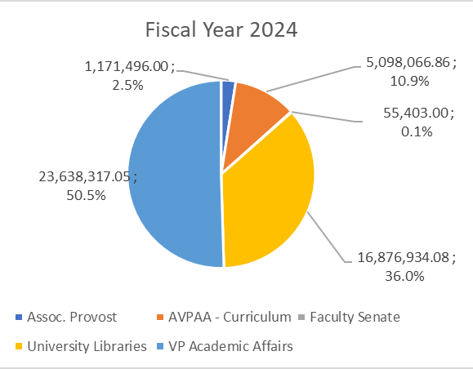
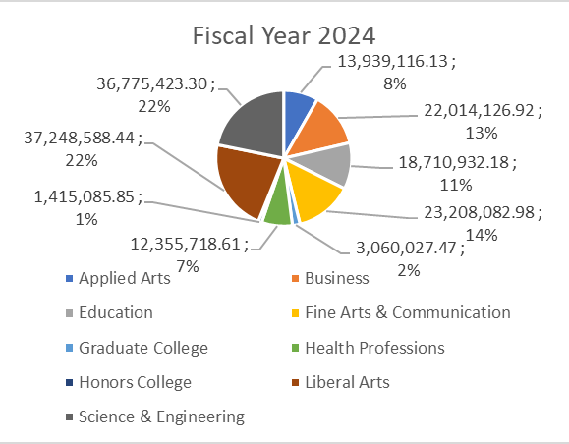
FUNDING BY UNIT
Administrative
Colleges

Slide 8
BREAKDOWN OF COLLEGE FUNDING

Slide 9
BREAKDOWN OF COLLEGE FUNDING, CONT.

Slide 10

NEW ACADEMIC PROGRAMS
11
NUMBER OF NEW DOCTORAL PROGRAMS SUBMITTED TO THE COORDINATING BOARD
9
ADDITIONAL PROGRAMS PRELIMINARILY APPROVED FOR IMPLEMENTATION IN THE NEXT STRATEGIC PLAN
$16M +
SPENT ON NEW PROGRAMS FY17 – FY23
11
GRADUATE PROGRAMS AMONG BEST IN THE NATION FOR 2022, US NEWS & WORLD REPORT

Slide 11
NEW ACADEMIC PROGRAMS: KEY FACTORS
Guided by a variety of factors such as workforce analysis, industry needs, department capacity and trends in existing programs, surveys of potential students, programs at other universities.
Curriculum design, learning outcomes, and number of majors largely determine estimated revenue (number of majors, SCH, course, and degree timeline) and estimated expenses (additional instructional needs, additional support and service needs, assistantships, renovations/space, faculty research start-up, operational funds).
Program enrollments are monitored for alignment with new budget needs; new positions or other funding approved in the program proposal may not be authorized if enrollments are below target.
New program proposals prioritized by a more robust and inclusive university strategic planning process that is revisited on a bi-annual basis.

Slide 12
FACULTY RESOURCES
Notes:
Shows more students are exposed to our faculty than our peers.

Slide 13






RESPONSIBILITY CENTERED MANAGEMENT (RCM)
Increases Unit Decision Making Opportunities
Incentivizes Revenue Growth and Cost Control
Increases Transparency and Data Informed Decision Making
Increases Accountability for Outcomes
Provides Central Funding for Strategic Initiatives
Notes:
Increased Responsibility and Opportunity

Slide 14
ONLINE PROGRAM MANAGEMENT
TXST Online
Department
Academic Partnerships
Instructional Connections
TXST Online Operations
Chair: Course Schedule, Faculty Assignments, Faculty Credentialing, Course Cap, & Approval of Marketing Material
Faculty: Course Content, Course Development, Course Instruction, Assessment
Services: Admissions, Registration, Financial Aid, Student Accounts, Advising, Faculty and Student Support
Support: Instructional Design, Video, and Technology
Marketing, Recruiting, Marketing Research
Recruit Academic Assistants (AA), and Adjuncts (AA and Adjuncts Approved by Chair)

Slide 15


THANK YOU
QUESTIONS?

