Slide 1
E-PCR Initiator Monitor
Benefits of E-PCR Initiator Monitor (ZWFHCM6):
Track workflow of your PCRs
Print FPM PCR Forms
See comments on PCRs

Slide 2
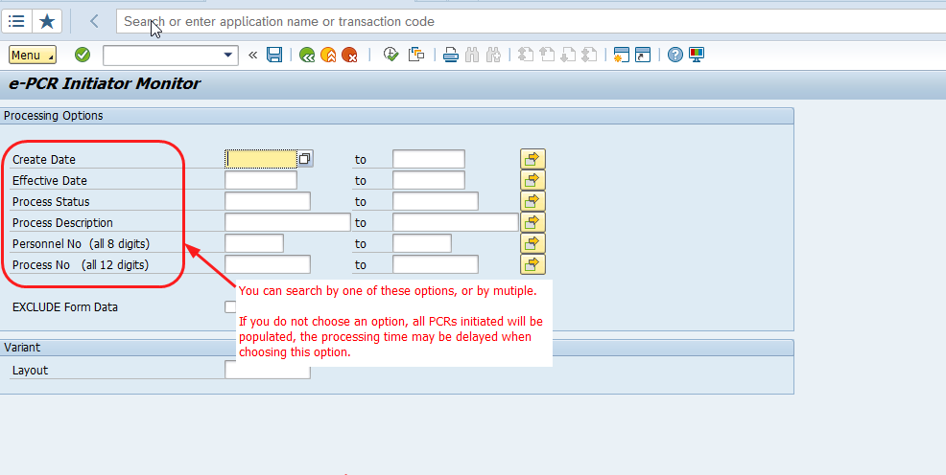
E-PCR Initiator Monitor Instructions
E-PCR Initiator Monitor transaction code is (ZWFHCM6):

Slide 3
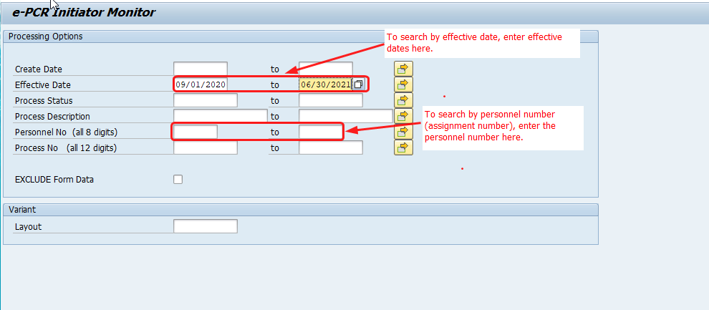
E-PCR Initiator Monitor Instructions
Searching by effective dates and personnel number:

Slide 4
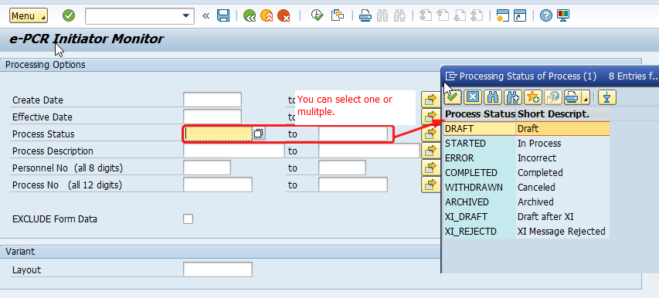
E-PCR Initiator Monitor Instructions
Searching by Process Status:

Slide 5
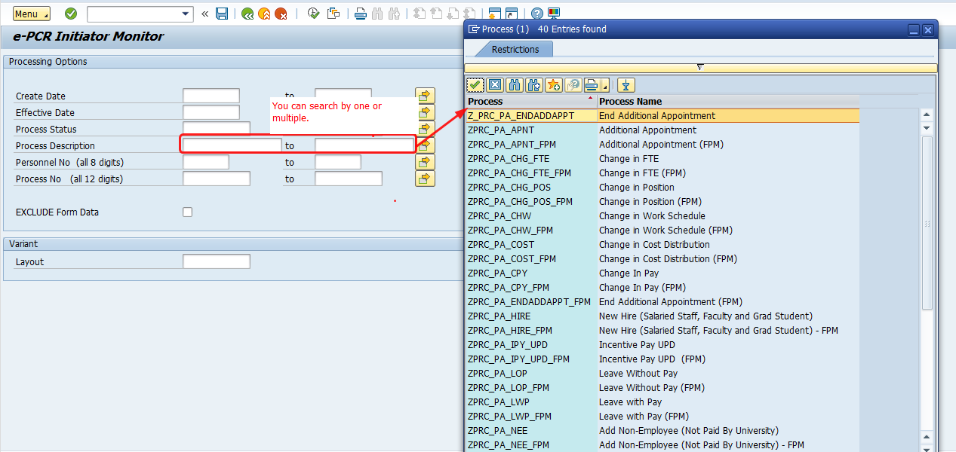
E-PCR Initiator Monitor Instructions
Searching by Process Description:

Slide 6
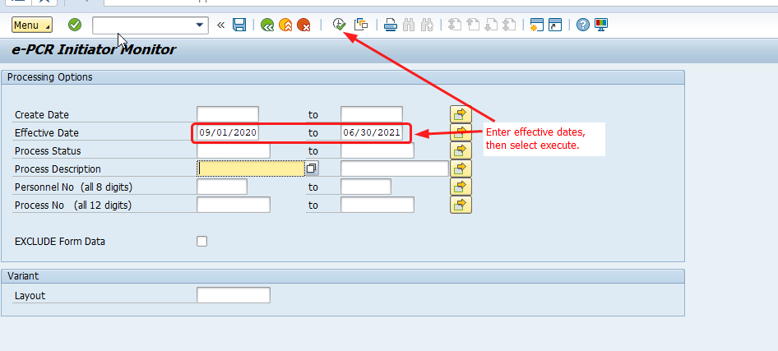
E-PCR Initiator Monitor Instructions
Example of searching by effective dates only:

Slide 7
E-PCR Initiator Monitor Instructions
E-PCR Monitor Report:

Slide 8
E-PCR Initiator Monitor Instructions
Viewing Workflow Level:

Slide 9
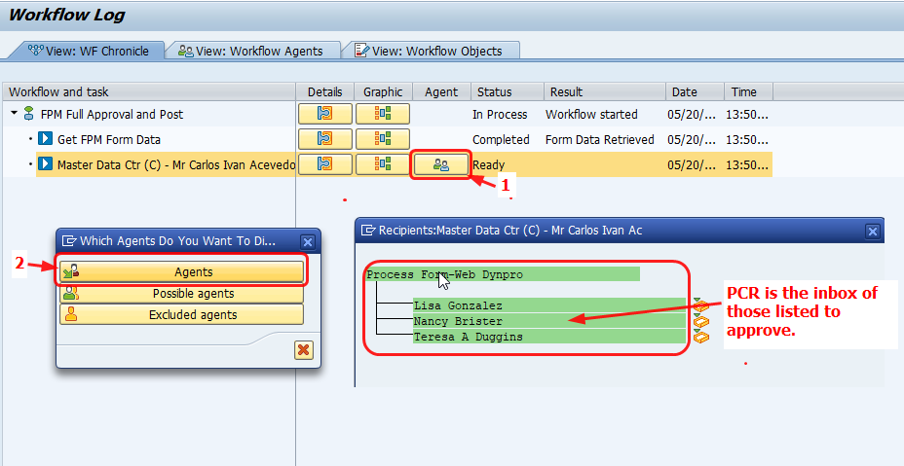
E-PCR Initiator Monitor Instructions
Next click on “Ready”, then “Agents”:

Slide 10
E-PCR Initiator Monitor Instructions
Viewing PCR Overview and PCR Approvers:

Slide 11
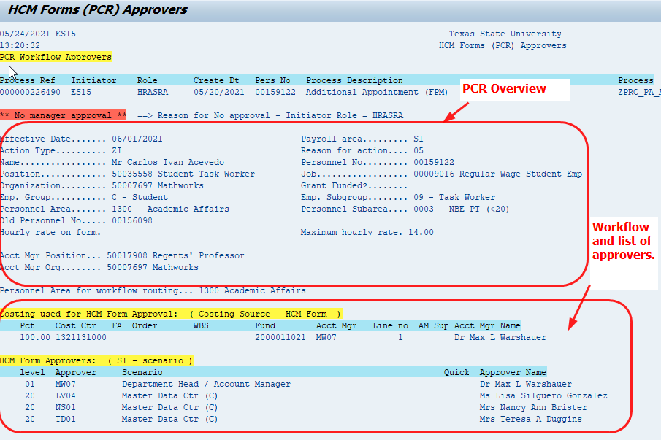
E-PCR Initiator Monitor Instructions
Viewing PCR Overview and PCR Approvers:

