Slide 1
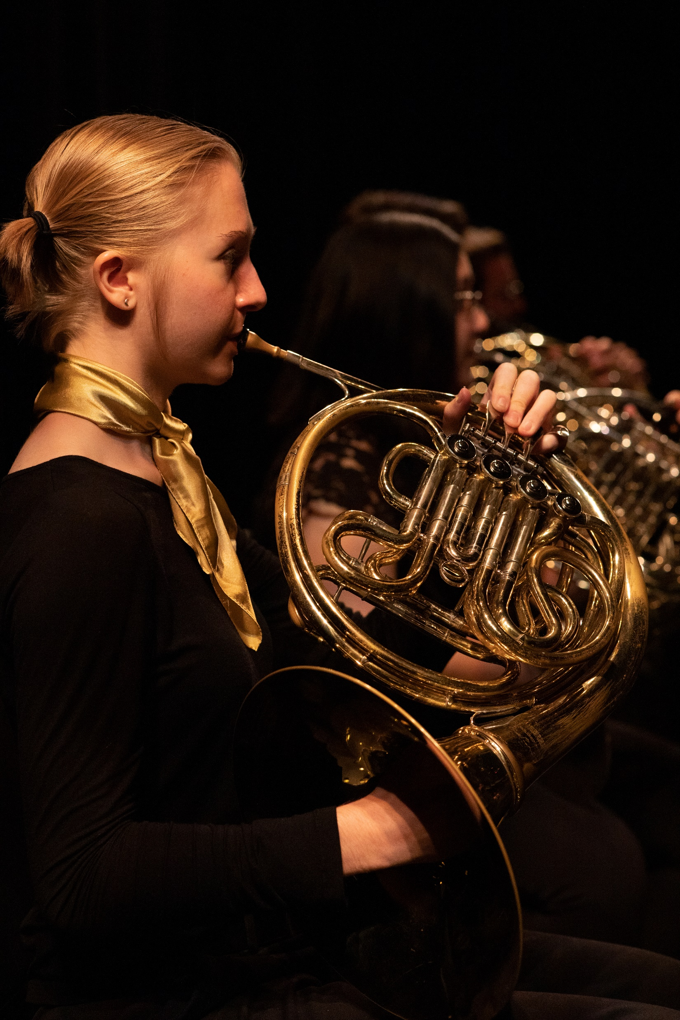
“All That Brass”
Senior Recital
Jane Doe, horn
John Doe, piano
Day, Month Date, Year
Time
Venue
2024-2025
Student Artist Series

