Slide 2
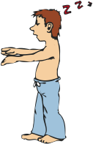
Sleepless in San Marcos: How to get your Zzzzz’s “To sleep, perchance to dream—ay, there’s the rub.” Hamlet (III, I, 65-68)
Gregg Marshall, PhD, RRT, RPSGT, RST
Chair/Associate Professor
Department of Respiratory Care and Texas State Sleep Center

Slide 3
What I hope you learn….
1) The incidence of sleep disorders in the US
2) The normal NREM/REM sleep cycle we SHOULD be experiencing every night
3) The “enemies” of Slow-Wave Sleep that rob us restorative sleep during the night
4) Five lifestyle changes that can drastically improve sleep

Slide 4
Do you find yourself….
Having trouble sleeping at night?
Tired and dozing during the day?
Having difficulty staying focused and concentrating?
Waking up to with headaches?
Hearing complaints about your snoring?
“Never getting a good night’s sleep?”

Slide 5
What is a GOOD night’s sleep?
6-8 hours of uninterrupted sleep
Awakening refreshed, rested, clear-headed
No daytime sleepiness issues or slowdowns in the afternoon

Slide 6
Q: How are we sleeping?
The majority of Americans are notoriously sleep deprived with chronic sleep problems affecting over 40 million adults in the US (1 in 6)
Insomnia (1 in 8)
Sleep apnea (1 in 15)
Obstructive sleep apnea (1 in 22)

Slide 7
Q: Does the lack of sleep affect the aging process?
A: You may not like this answer…
http://www.sleepreviewmag.com/2014/08/sleep-affect-face-premature-aging/

Slide 8
The BIG missing question…
Q: “How are you sleeping?”
By far, one of the most neglected assessment question relates to the quality and quantity of sleep

Slide 9
Stages of Sleep
Sleep is an ACTIVE process
Two primary stages of sleep
Non-Rapid Eye Movement (NREM) Sleep
Brain resting/Body active
Rapid Eye Movement (REM) Sleep
Body resting/Brain active

Slide 10
Stages of Sleep
NREM Sleep
Nonrapid Eye Movement – initiate stages of sleep
Stage 1 & 2 – respiratory rate and depth of breath variable, may have periods of apnea (absence of breathing)
Stage 3 (Delta Sleep) – “Restorative Sleep” with respiratory rate slowing significantly, deep sleep -- aka Slow Wave Sleep (SWS)

Slide 11
Stages of Sleep
REM Sleep
Rapid Eye Movement apparent, respiratory rate and depth variable, some periods of apnea, heart rate irregular, “Dream State”
Profound sense of paralysis with all skeletal muscles losing tone, loss of respiratory muscle tone will decrease respiratory rate more

Slide 12
REM cont….
Loss of pharyngeal tone in the throat CAN cause tongue to relax into the back of the oral cavity and if obstructs the oral airway → results in snoring, apnea, gasping, disrupted sleep
Time spent in REM lengthens during the night and very difficult to awaken someone in REM stage
Enhances learning and memory – contributes to emotional health

Slide 13
NREM vs REM Sleep
Beginning with NREM Stage 1, sleep onset and movement into and out of Stages 1, 2, & 3 for 30 to 60 minutes
Transition to REM lasting 5 – 40 minutes
Cycling between NREM and REM in 60 – 90 minute cycles
Normally, three to four REM episodes per night

Slide 14
Sleep Architecture
8 Hour Night

Slide 15
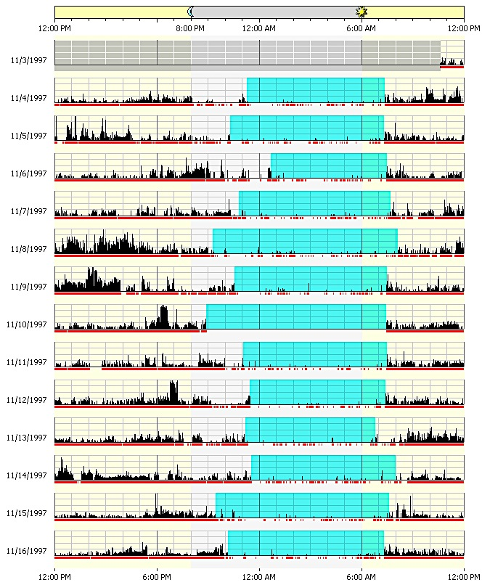
Normal Sleep Cycle
13 days
Tracking 24 hours

Slide 16
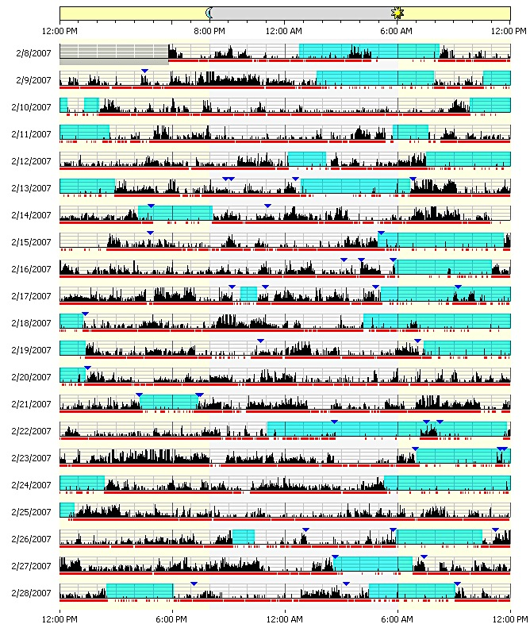
Insomnia
21 days

Slide 17
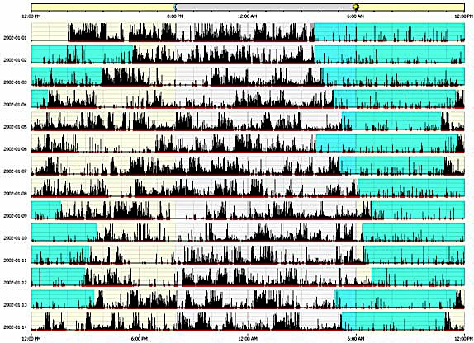
Delayed Sleep Phase (DSP)
14 days

Slide 18
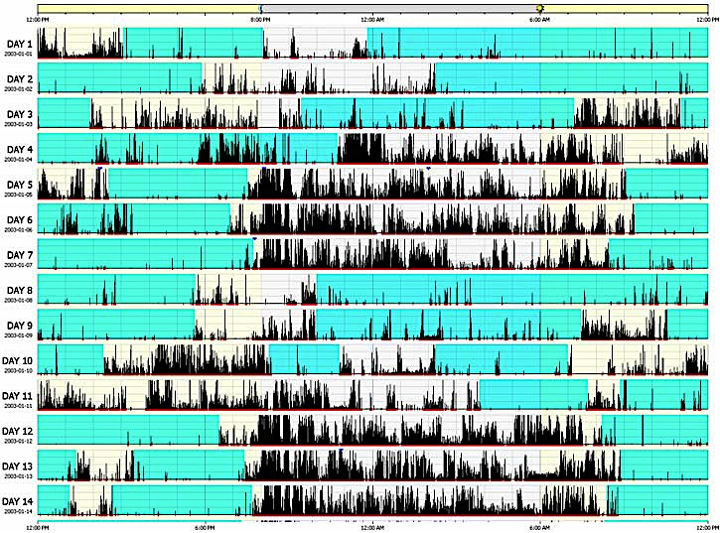
Shift-workers Syndrome
14 days

Slide 19
“Enemies” of SWS or Delta Sleep
Stage 3 “Restorative Sleep” limited/prevented by
OTC sleep aids such as
Diphenhydramine
Sominex, Benadryl, Tylenol PM, any “PM”
Doxylamine (Unisom)
Cold/allergy medication
Alcohol before bedtime – “nightcap”
Smoking (increases sleep onset time)

Slide 20
Long-term effects of reduced SWS
One study found that after only three nights of selective slow-wave sleep suppression, young healthy subjects became less sensitive to insulin. Although they needed more insulin to dispose of the same amount of glucose, their insulin secretion did not increase to compensate for the reduced sensitivity, resulting in reduced tolerance to glucose and increased risk for type 2 diabetes. The decrease in insulin sensitivity was comparable to that caused by gaining 20 to 30 pounds.
Decreased mental acuity, concentration, memory

Slide 21
Sleep disruption
Disruption affects levels of neurotransmitters and stress hormones
Impairs thinking and emotional regulation
Insomnia may amplify the effects of psychiatric disorders, and vice versa
More than 84 sleep identified sleep disorders, but most common are insomnia, obstructive sleep apnea, various movement syndromes, and narcolepsy

Slide 22
FDA approved Rx for sleep
Benzodiazepine (immediate release)
ProSom, Dalmane, Doral, Restoril, Halcion
Non-BZDs (immediate release)
Lunesta, Sonata, Ambien
Modified Non-BZDs (continual release)
Ambien
Melatonin Receptor Agonist
Rozerem
SHORT TERM TREATMENT OF INSOMNIA use only 2-4 weeks to “break” poor sleep cycle

Slide 23
5 Lifestyle Interventions
1) Lifestyle changes: decrease caffeine, alcohol, nicotine
2) Physical activity: regular aerobic activity helps people fall asleep faster, spend more time in deep sleep, and awaken less often in the night
3) Sleep hygiene: regular sleep/wake schedule, using the bedroom only for sleeping or sex, keeping bedroom dark and free from TV or computer light, retain bedtime by staying awake longer before bed, no naps during the day, taking HOT shower before going to bed

Slide 24
5 Lifestyle Interventions
4) Relaxation techniques: meditation, guided imagery, deep breathing exercises, progressive muscle relaxation
5) Cognitive behavior therapy: CBT techniques help change negative expectations and build confidence the patient can have a good night’s sleep (change the “blame game” of blaming all problems during the day on the lack of sleep)

Slide 25
Texas State Sleep Center
2-bedroom, 2 bathroom sleep center
Accredited by American Academy for Sleep Medicine (AASM) and Medicare/Medicaid
Operational 7 nights a week and Saturday mornings for narcolepsy testing
Medical Director: Dr. Joseph Hong, MD, Board Certified in Internal, Pulmonary & Critical Care, and Sleep Medicine
Most insurances accepted (certainly ours!)
Referral required from PCP

Slide 26
Texas State Sleep Center

Slide 27
Thank you!
Please feel free to contact me with questions or comments.
sm10@txstate.edu

