Slide 1
HeartWise: Be Sweet to your
February 12, 2015
12:15-12:45

Slide 2
From St. David’s School of Nursing…
Dinorah Martinez-Anderson, MSN,APRN,FNP-C
Marylyn Kajs-Wyllie MSN,APRN, CNS, CNRN
Pamela Willson, PhD,APRN, FNP-C,FAANP

Slide 3
Objectives
Identify personal cardiovascular risk factors.
Identify your readiness to take actions to reduce cardiovascular risks.
Make a personal action plan to manage a risk factor(s).

Slide 4
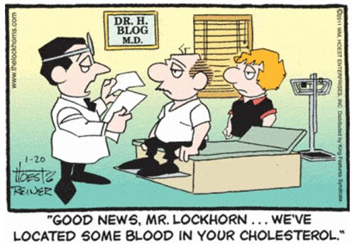
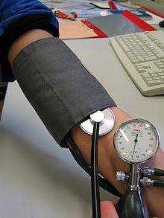
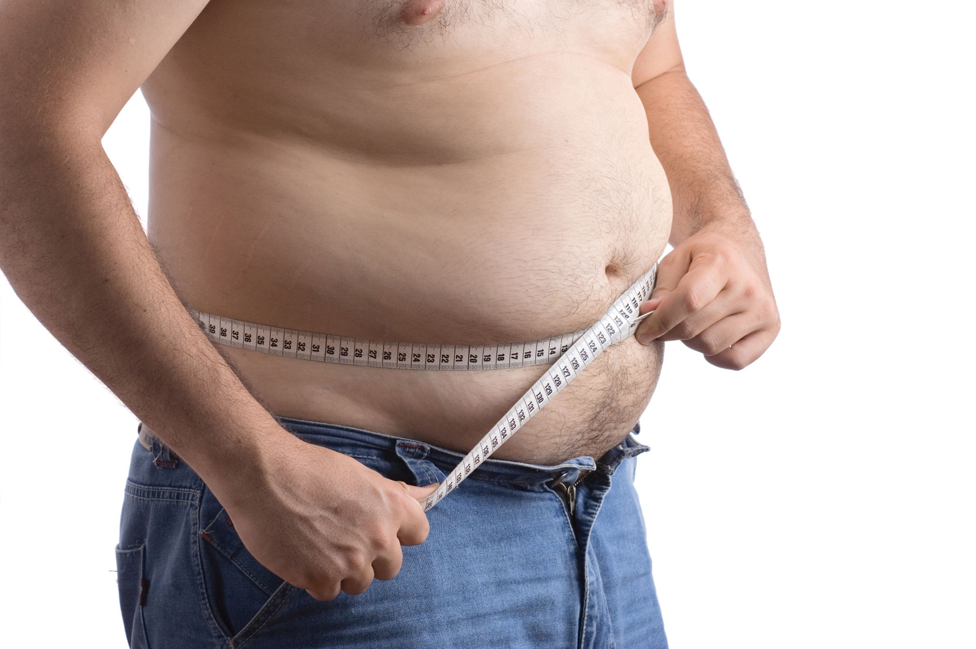
KNOW YOU NUMBERS
There are 3 important numbers that can save your life.
Key to Heart Health- Blood Pressure
Predictor of Heart Attack- Cholesterol
Connection to Heart Disease- Waist Size
http://www.webmd.com/heart/features/do-you-know-your-heart-numbers?page=2

Slide 5
Check your Knowledge
What is an ideal Blood Pressure?

Slide 8
Check your Knowledge
What is an ideal
Cholesterol level?

Slide 9
Heart Healthy Quiz
https://media.heart.org/fc/patient_ed/Healthy_Heart_Quizzes_Reskin_v0.6/index-3.html?xmlHash=ffc126cf47c3b1b5553594ae68110ad2

Slide 15
Concerns Problems
Risk Factor | Problem with self-management
Inactivity | Can’t find time to exercise
Eating too much salt | Don’t know how much salt is in my food

Slide 16
Readiness Statement | Strongly Disagree | Disagree | Unsure | Agree | Strongly Agree
I really want to take action to manage my risk factors. | 0 | 1 | 2 | 3 | 4
At times, I feel overwhelmed about the actions I need to take to manage my risk factors. | 4 | 3 | 2 | 1 | 0
At times, I wonder if my actions will really improve my health. | 4 | 3 | 2 | 1 | 0
I know my risk of for cardiovascular disease will increase if I don’t take action to manage my risk factors. | 0 | 1 | 2 | 3 | 4
I often think about actions I can take to manage my risk factors. | 0 | 1 | 2 | 3 | 4
I’m not just thinking about taking action to manage my risk factors, but I’m already doing something about it. | 0 | 1 | 2 | 3 | 4
It is important that I communicate what I want to do to manage my stroke risk factors with my health care team and care givers. | 0 | 1 | 2 | 3 | 4
Modified from: Prochaska, DiClemente & Norcross. (1992). In search of how people change. Am Psychol, 47(9),1102-4.
Notes:
So let’s see how ready you are to take actions to reduce your risk for cardiovascular disease. Here is a list of readiness statements. I am going to read each readiness statement out loud and I want you to put a check in the box that best describes how much you agree or disagree with each statement. After I have read all the statements and you have marked each box we will determine how ready you are to take action by filling in the numbers you see displayed on the screen.
If you scored 21 or higher, this means you are ready to take action to reduce your CV risk. If you scored lower than 21, then you are just not sure you are ready yet– but it does not mean you should not try. Remember, this exercise gives you a chance to get started on reducing your risk of stroke with support from us and members of this group.

Slide 17
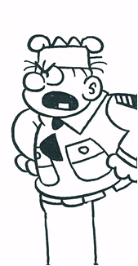
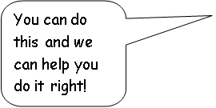
Action Planning
Funding: Co-Investigator. Willson, P. PI: Anderson, J., Kent, T. Feasibility of implementing VTEL self-management to prevent stroke (VSTOP) (H-27145). NINR $100,000. [Baylor &VHA IRB] 2010-2013.
Notes:
The handouts were adapted from the materials we developed in our program of research looking at the feasibility of Advanced Practice Nurses conducting self-management group sessions to Veteran’s via video conferencing. The funding was from the National Institutes for Nursing Research. Mort Walker, a Veteran graciously drew the “Beetle Bailey” art work for the Veteran Patient Educational Materials. We publicly thank him again for his gift.

Slide 18
What is a Action Plan?
Something YOU want to do for yourself
Something you can ACHIEVE
Something VERY SPECIFIC
Something that ANSWERS THESE QUESTIONS:
What?
How Much?
When?
How Often?
Something you have a CONFIDENCE LEVEL of 7 or more on a 1 – 10 scale of accomplishing
Notes:
A step that will help you be successful with self-management planning is a skill is called “Action Planning” and it is very similar to goal setting.
The difference is that when you make an Action Plan you learn to break down big goals into a smaller goal that is specific and achievable.
When making an Action Plan you break down your big goal into the actions you need to take to get there. The best way to do this is to answer these four very specific questions:
WHAT do I want to do? HOW MUCH will I do? WHEN will I do it? HOW OFTEN will I do it?
Paraphrase: There is one final step to making an Action Plan. That is determining your LEVEL OF CONFIDENCE for completing your Action Plan. It is important that you believe in your ability to do what you plan to do. In other words, your Action Plan needs to be realistic for you to achieve. You may want to walk a mile, but in reality you believe you can only walk a half a mile. So after you answer the four questions of -What, How Much, When, and How Often - set your confidence level using a scale of 0 to-10. Here’s how it works, if you are not confident at all and you have 0 percent confidence, your confidence level is “0”. On the other hand, if you are 100 percent sure you can do it, then your confidence level is “10”. Make sure you have a confidence level of at least “7” or more to be successful with your Action Plan.
Facilitator # 1 - So, turn to page 14 and follow along as we all make and an Action Plan for this week. Also, you should have a blank Action Plan Form to write on as we do this together. [Insert Name of Facilitator #2] and I will go first to get us started.
What I want to do is – Swim
How much will I do is – 30 minutes
When I will do it is – 6:30 pm
How often I will do it is - 3 day a week –
I am confident at a level of 7 that I can do this for one week.

Slide 19
Risk Factor Self-Assessment Tools
Heart Attack: know your numbers
http://www.heart.org/HEARTORG/Conditions/HeartAttack/HeartAttackToolsResources/Heart-Attack-RiskAssessment_UCM_303944_Article.jsp
Blood Pressure- know your numbers
http://www.heart.org/HEARTORG/Conditions/HighBloodPressure/WhyBloodPressureMatters/Assess-Your-High-Blood-Pressure-Related-Risks_UCM_301829_Article.jsp
Diabetes- know your numbers
http://www.heart.org/HEARTORG/Conditions/Diabetes/DiabetesToolsResources/My-Diabetes-Health Assessment_UCM_313901_Article.jsp

Slide 20
References
Anderson, J.A., Godwin, K.M., Petersen, N.J., Willson, P.C. (2013). A pilot test of videoconferencing to improve access to a stroke risk-reduction programme for Veterans. Journal of Telemedicine and Telecare, 19(3), 135 – 141.
Anderson, J. A., Willson, P., Godwin, K. M., Petersen, N. J., & Kent, T. (2014). Use of a Clinical Video Teleconference (CVT) Technology Model to Implement Patient Self-Management to Prevent Stroke. The Internet Journal of Advanced Nursing Practice. 13(1).

Slide 21
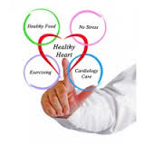
Thank You & Your Thanks You!
Contact Us at:
Dinorah d_m282@txstate.edu
Marylyn mk35@txstate.edu
Pamela Willson, PhD, APRN, FNP-BC, CNE, FAANP
paw66@txstate.edu

