Slide 1
Developing Skills for Stress Management: How to Chill Out!
By
Clare Duffy, Ph.D.
Licensed Psychologist
Texas State Counseling Center
www.counseling.txstate.edu

Slide 2
Overview
Recognizing and Acknowledging Your Stress
Sabotaging Yourself
Taking a “Time Out”
Attaining Coherence
Re-engaging with Coherence
Making a Plan for Stress Reduced Living
Notes:
Only so much time, high points & reminders

Slide 3
Signs of Stress
Physical
Behavioral
Emotional
Cognitive
Spiritual
Relational
Notes:
Different for everyone!
Examples
The point is to know your signs and address them as soon as possible. Ignoring them only worsens them, doesn’t make them go away

Slide 4
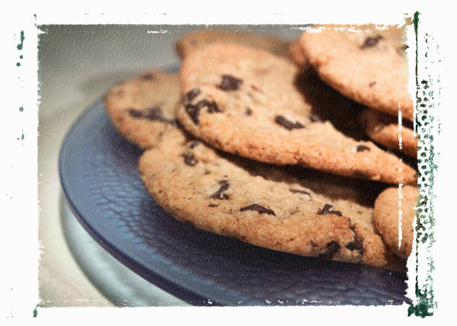
Sabotaging Yourself
Caffeine
Nicotine
Sugar
Under & Over Eating
Alcohol & Other Drugs
Notes:
Turn to these as main resource, but sabotages us

Slide 5
Taking a “Time Out”
This is common sense that we ignore
We say things like,
“Let me have some time to think.”
“I need to calm down”
Notes:
“One of the first things most of us do when children (or adults) are overwhelmed with inner turbulence is: we instinctively try to calm them down into a state of ease before starting to sort out solutions. Why do we do this? Because we intuitively sense that the state of ease helps us to get back in our heart which helps to re-stabilize the mind and emotions—this re-connects us with our reasoning capacity and clear view.” Doc Childre, “The State of Ease” 2010. Institute of Heart Math

Slide 6
Find Your Sweet Spot!

Slide 7
Understanding Emotional Regulation
The Heart-Brain Connection
Operates independently from the brain
Communicates with the brain
Primary regulator of the respiratory system
The Power of Positive Emotion
It’s scientifically proven that radiating love and self-care through your system activates beneficial hormones and boosts your immunity.
Notes:
EmergenC

Slide 8
What Is Heart Rate Variability?
Our hearts do not beat at a steady rate. The heartbeat rate is constantly increasing and slowing down as we deal with daily tasks, events, thoughts, emotions, etc.
HRV is the pattern with which the heartbeat changes. The pattern can be very smooth or very erratic.

Slide 10
What is Coherence?
Coherence is a state of peak physiological functioning. The heart and brain are working in sync with each other and working in concert with the respiratory system to achieve peak performance. In a state of coherence, emotions are calm and controlled, thinking is more clear, and the branches of the autonomic nervous system are working smoothly and in sync.
Notes:
Practicing inner-ease creates “flow” by helping to regulate the balance and cooperation between our heart, mind and emotions—coherence.” Doc Childre, “The State of Ease” 2010. Institute of Heart Math

Slide 11
Why Is Coherence Desirable?
In a state of Coherence a person can overcome emotional hijacking and access heart intelligence. It allows you to “listen to your heart” in times of stress and maintain more effective control over your stress reactions. It helps you to cope and problem-solve.

Slide 12
How Does One Gain Coherence?
Coherence can be attained by bringing the heart, brain, and breathing in sync with each other through heart focus & breathing and by generating positive emotion.

Slide 13
Let’s Practice
Notes:
Anyone have their performance appraisals pretty soon?
Tax Time!
Who’s paid all of their bills this month!
Anyone worry about their kids? What about when they become teenagers?!
Take your pulse rate when I tell you to start…then stop when I say so. Count the number of beats. (15 seconds). Multiply by 4…write down your number.

Slide 14
Maintaining Coherence to Re-engage
Clarifying priorities
Identifying and using support system
Assertiveness
Communication
Responsibility & Control
Notes:
Priorities are crucial while trying to do both school & family.
Allowing others to help is good time management
Saying no to what is not reasonable right now is not incompetence, but confidence in knowing yourself and what your limitations are. Compromising w/ family, schoolmates, employer
Communication saves time and frustration
Letting go of what is not yours frees up huge amounts of physical & emotional energy

Slide 15
Making a Plan for Stress Reduced Living
Remember to breathe.
Choose one sabotaging behavior on which to focus for change.
Identify healthy ways for you to relax & take a break.
Notes:
Breathing is #1
What is one small thing you can change (refer to self sabotaging list, shifting bedtime, etc.)
Must have at least some amount of time per day & per week to refocus, relax. Incorporate it into your schedule.

Slide 16
Remember…
Notes:
You are human which means that you have emotions and life has stressors…being able to manage both productively is your goal…not to pretend that you don’t have these stressors and emotions.

