Slide 1
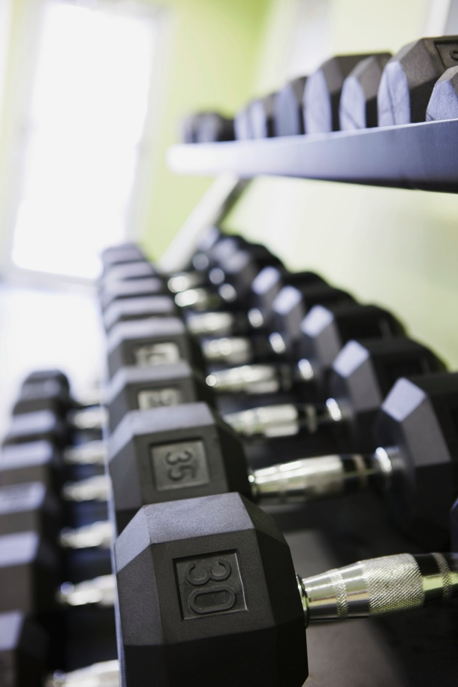
Chapter ??
Resistance Training

Slide 2
In a typical week, how many times do you engage in MUSCLE-STRENGTHENING physical activity…?
Times | Count | Percent
0 | 432 | 56.5%
1 | 78 | 10.2%
2 | 104 | 13.6%
3 | 78 | 10.2%
4 | 27 | 3.5%
5 | 30 | 3.9%
66%

Slide 3
Recommendations
General Guidelines:
30 min of moderate PA on at least 5 days per week, AND
2 days per week of activities that target muscular strength and endurance.
Work each muscle group
3 sets of 8 to 12 repetitions
Alternate pushing and pulling motions
No rest necessary
Less than an hour!

Slide 4
Chronic Adaptations: Skeletal Adaptations
RT is very likely to have a positive effect on bone tissue
Stronger women tend to have stronger bones
Tendon/ligament strength increases
Notes:
Decreased osteoporosis.

Slide 5
Chronic Adaptations: Cardiovascular Changes
No change in maximal aerobic fitness
Can NOT use target heart rate zones during RT
Improved running efficiency
Increased capillarization
Can lead to decreased recovery times from injury
Notes:
It won’t decrease VO2; can help improve movement efficiency/economy
aka: decrease running time
Basically, need to perform RT AND cardio act.

Slide 6
Chronic Adaptations: Body Composition Changes
Increase in fat-free mass (e.g., muscle) will lead to deceased body fat %
Increased caloric expenditure at rest!

Slide 7
Factors that Influence Adaptations to RT
Age
Sarcopenia: loss of muscle mass with age
Fast twitch fibers especially!!!
Genetics
Gender
Females have lower output of testosterone and growth hormone than males.
This means that it is much more difficult for females to build muscle mass.
Notes:
Isometric ex have no effect on performance with free weights
Training sprint athlete: have perform fast contraction ex rather than slower speed
Starts around 30
% of fast twitch to slow twitch fibers

Slide 8
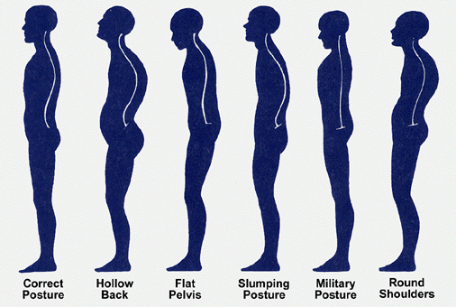
Posture and Pain

Slide 9
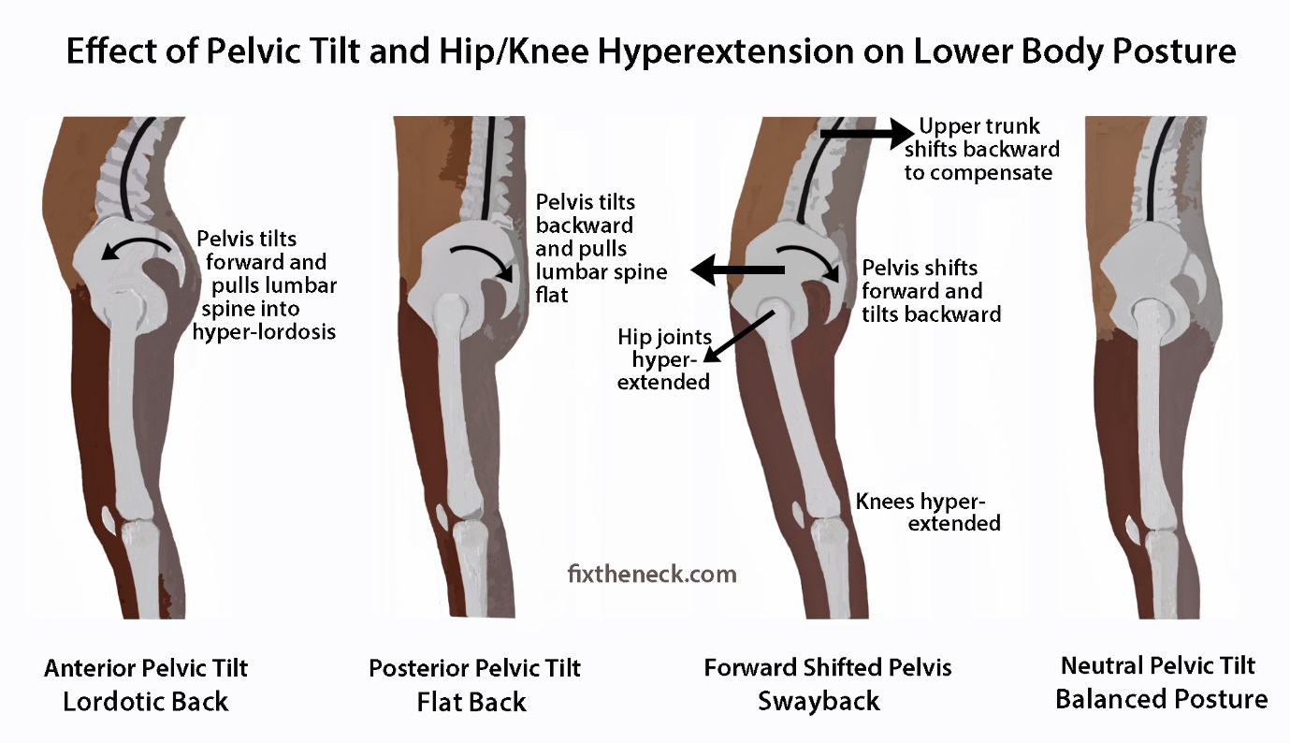
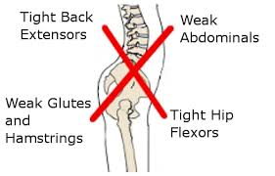
Proper resistance training can help improve common postural problems Abdominal strength lower back strength Upper back strength rotator cuff strength

Slide 10
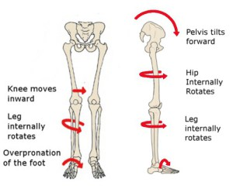
Avoid physical therapy…

Slide 11
Question time
It has been a pleasure to speak today
Let’s discuss your questions.

