Slide 1
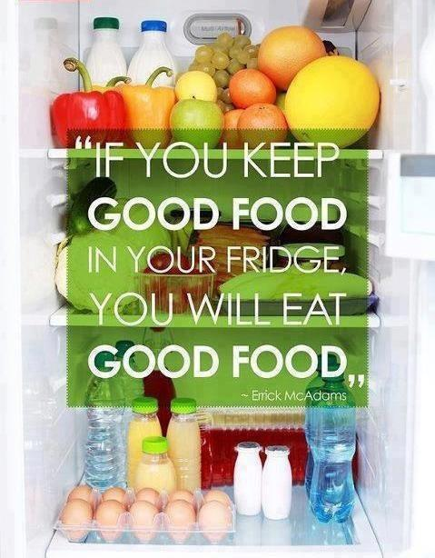
Keeping a Healthy Pantry during the Holiday Season
Lesli Biediger-Friedman, PhD, MPH, RD, LD
Assistant Professor
Nutrition and Foods

Slide 2
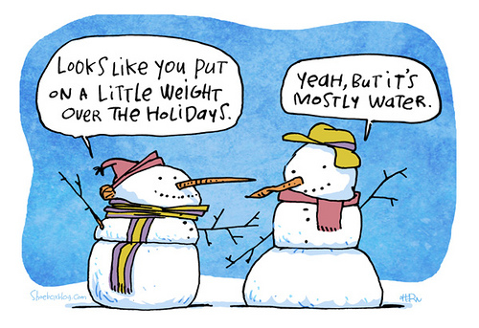
Weight Gain during the Holidays
Statistics show that Americans gain between 1 and 10 pounds between Thanksgiving and the New Year.
According to researchers at the National Institutes of Health, most Americans never lose the weight they gain during the winter holidays.
The pounds add up year after year, making holiday weight gain an important factor in adult obesity.

Slide 3
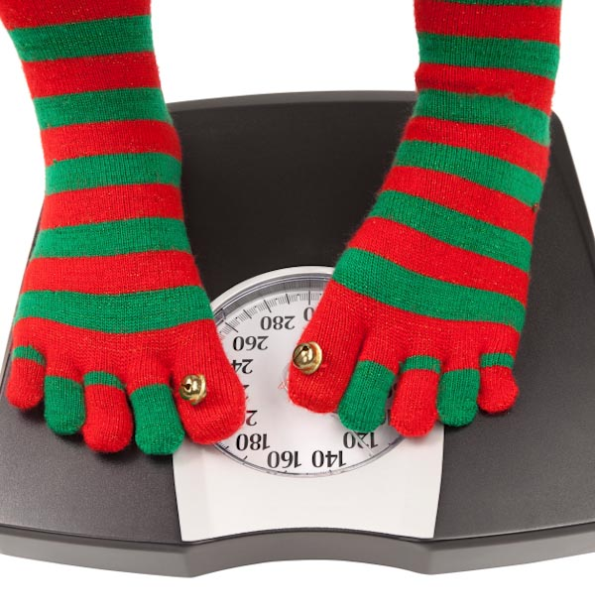
Enjoy the Holidays without the Weight Gain
There are many strategies to help you avoid overeating.
Using a smaller plate, for instance, allows you to put less food on your plate and encourages proper portion sizes.
Start by filling your plate with vegetables and salad before going to the entrees and desserts.
Research shows eating a salad before your meal can help you eat fewer calories overall.
Eat slowly and savor every bite, and before you go back for seconds wait 10 minutes to see if you really are still hungry.

Slide 4
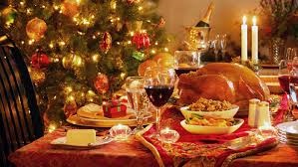
Enjoy the Holidays without the Weight gain
In preparation for a big holiday party or feast, do not skip meals throughout the day. This can result in overeating later.
It is especially important to eat breakfast, as research shows that those who eat this morning meal tend to consume fewer calories throughout the day.
High-fiber foods will satisfy hunger but are lower in calories, so include fruits, vegetables and whole grains in your meals.

Slide 6
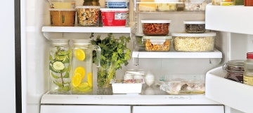
Tips to transform a refrigerator for healthy eating

Slide 7
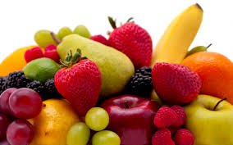
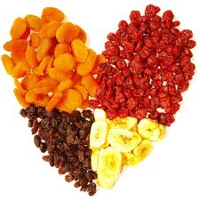
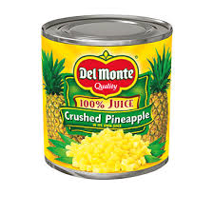
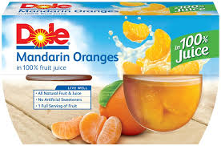
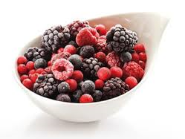
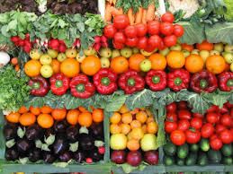
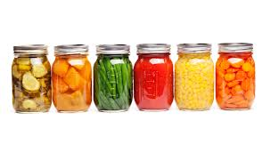
Fruit & Vegetables
Fresh
Canned or packed
Frozen
Dried

Slide 8
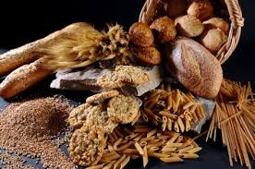

Bread, Cereals And Other Grain Products
Bread, whole wheat
Cereal (whole grain)
Crackers (look for varieties that are whole grain and lower in salt)
Oatmeal
Pasta (consider whole grain varieties)
Rice (include some whole grain rice, such as brown rice)
READ THE LABEL:
Look for products that have 3 grams of fiber or more
6 grams of sugar or less

Slide 9
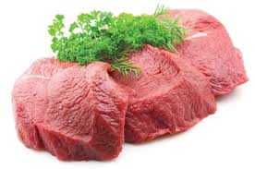
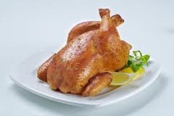
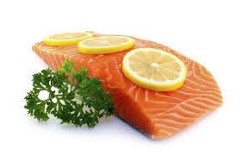
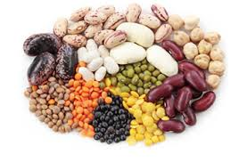
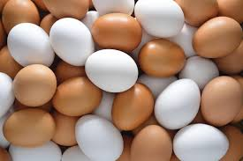
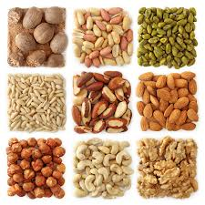
Proteins
Nuts
Poultry
Fish
Dry Beans
Eggs
Meat

Slide 10
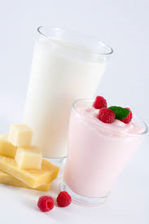
Milk and Milk Products
Cheese, cheddar and/or other favorite varieties
Ice cream or frozen yogurt, low fat or fat-free
Milk, low fat or fat-free
Yogurt, low fat or fat-free

Slide 11
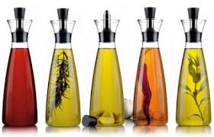
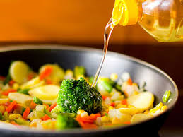
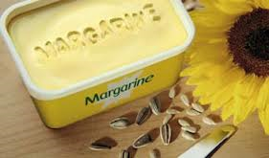
Oils And Foods That Are Mainly Oil
Extra virgin olive oil for dressings, dipping and drizzling
Mayonnaise-type salad dressing (light and low fat forms available)
Other oil for cooking: canola, corn, cottonseed, safflower, soybean, sunflower
Soft (tub or squeeze) margarine with no trans fats

Slide 12
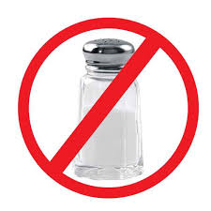

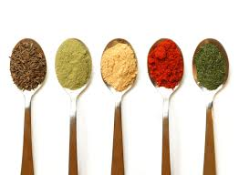
Seasonings
Black pepper (consider freshly ground black pepper)
Chicken broth, low sodium
Chili powder
Cinnamon
Garlic, fresh or dry (minced or powdered)
Italian seasoning
Mustard, Dijon-type
Rosemary, dried leafy
Thyme, dried leafy
Vanilla
Vinegar (consider vinegars such as balsamic, red wine, cider, and white wine or rice vinegar)

Slide 13
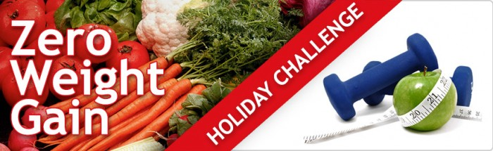
Get Active, Healthy, and Happy
Regular physical activity helps with weight control, reduces the risk for many diseases, and strengthens muscles, bones and joints.
Maintain your physical activity during the holidays — better yet, try to get more active!
Find fun, creative ways your friends and family can spend time being active instead of eating.

Slide 14
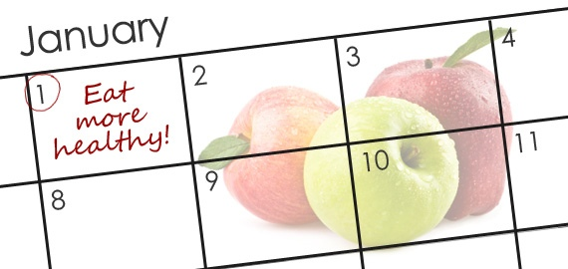
Small Changes Make a Big Difference
Resolutions for the new year:
I will drink water instead of soft drinks
I will limit servings of juice and consume fresh fruit instead
I will eat cereal with fruit for breakfast
I will be physically active for at least 1 hour each day
I will eat at the table, not in front of the TV
I will eat healthy snacks
I will become more nutrition wise and choose healthy foods for my family
I will cook more meals at home instead of buying fast and highly processed food

Slide 15
References:
Henneman, A. Basic Foods for Cupboard, Fridge and Freezer: Create Your Own List! University of Nebraska website. Available at http://food.unl.edu/fnh/basic-listn Accessed on December 10, 2014
Academy of Nutrition and Dietetics. Enjoy the Holidays without the weigh gain. Eatright.org website. Available at http://www.eatright.org/Public/content.aspx?id=6442479249&terms=weight%20gain Accessed on December 10, 2014.
United States Department of Agriculture. My Plate Holiday Makeover. Available at: http://blogs.usda.gov/tag/myplateholidaymakeover/ Accessed on December 10, 2014.
Neighborhood Health Plan. Thumbs up for healthy food choices.
Centers for Disease Control and Prevention. Resolve to Undo Holiday Overindulgences. Available at http://www.cdc.gov/features/HealthyResolutions/index.html Accessed on December 10, 2014.

Slide 16
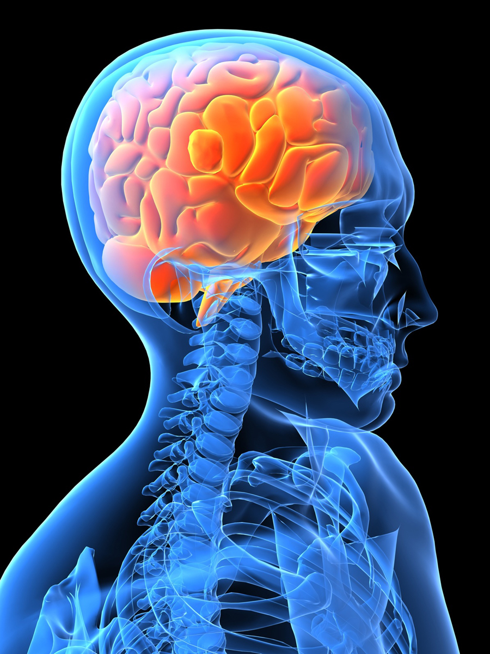
Healthy Brains
Krystle Zuniga PhD, RD
Assistant Professor
Nutrition and Foods

Slide 17
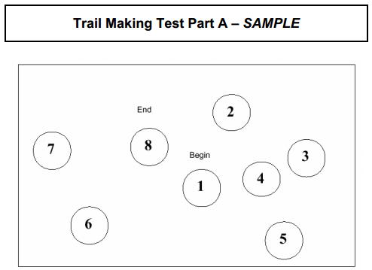

TRAIL MAKING TEST

Slide 18
TRAIL Making Test
Percentile
 | 25-34 | 30-44 | 45-54 | 55-59 | 60-64 | 65-69 | 70-75 | 80-84
90 | 14 | 16 | 19 | 23 | 22 | 25 | 26 | 31
80 | 17 | 20 | 23 | 25 | 24 | 29 | 30 | 39
70 | 19 | 23 | 27 | 27 | 26 | 31 | 34 | 42
60 | 21 | 24 | 29 | 30 | 29 | 32 | 36 | 47
50 | 23 | 26 | 31 | 32 | 32 | 37 | 38 | 52
40 | 25 | 28 | 33 | 33 | 34 | 39 | 41 | 58
30 | 27 | 32 | 34 | 35 | 37 | 42 | 45 | 63
20 | 33 | 36 | 38 | 40 | 42 | 45 | 49 | 75
10 | 40 | 46 | 50 | 53 | 45 | 53 | 61 | 93
Tombaugh T. Archives of Clinical Neuropsychology 2004

Slide 19
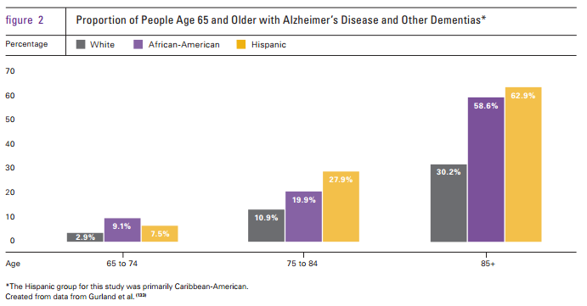
Incidence of Cognitive Impairment and Dementia
1 in 7 older adults have dementia
1 in 5 older adults with cognitive impairments
Alzheimer’s Disease is 6th leading cause of death in U.S.

Slide 20


Slide 21
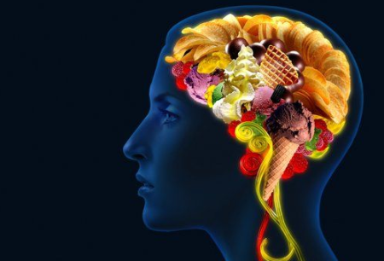

Slide 22
Nutrition Impacts on the Brain
Mediterranean Diet
(Nuts, fish, oils)
Fruit and Vegetables
Flavonoids (chocolate, wine, tea)

Slide 23
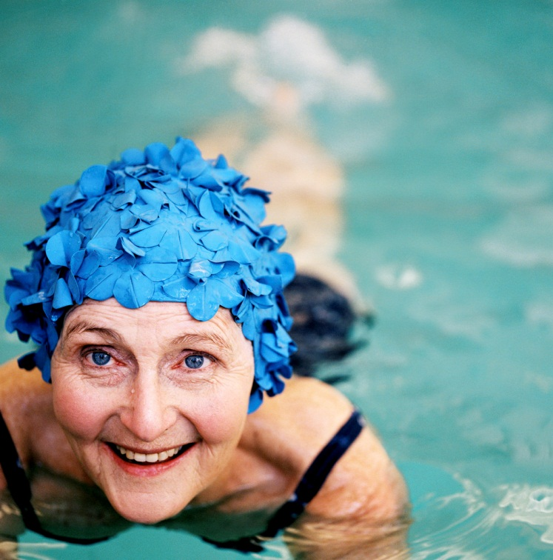
Physical Activity
Reverse Brain Volume Loss
Increase Blood Flow to Brain
Improve Memory, Attention, Processing Speed
NEVER TOO LATE!

Slide 24
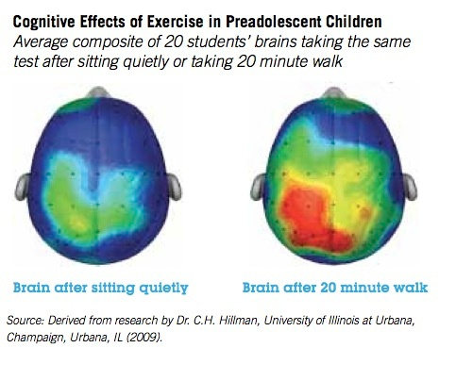
Benefits in Children
Scholastic Achievement
Cognitive Function
Brain Development
Brain Activity
Behavior

Slide 25

Cancer-Related Cognitive Impairment in Breast Cancer Survivors “Chemobrain”
Changes in attention, concentration, and memory
Hyperactivation and reduced brain volume
15-25% incidence
  Up to 20 years post-treatment
Multifactorial etiology
  Treatment (neurotoxic, DNA damage)
  Hormone changes
  Inflammation
  Fatigue & Distress

Slide 26
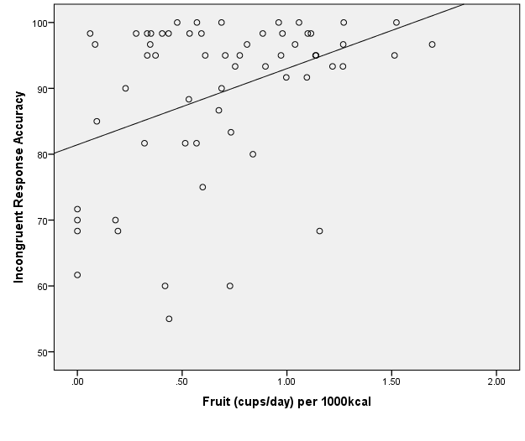
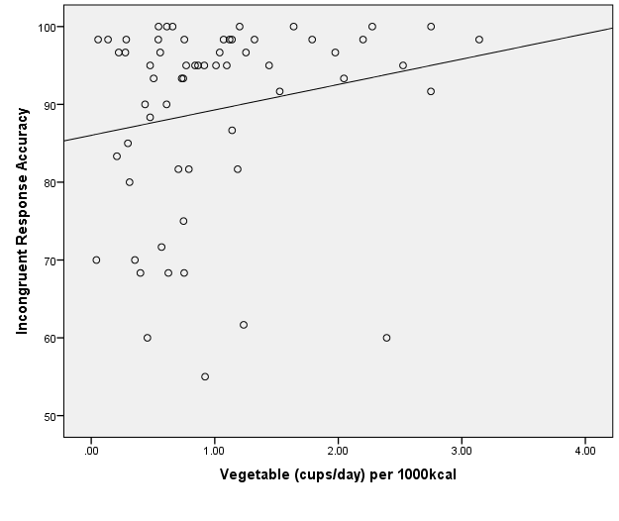
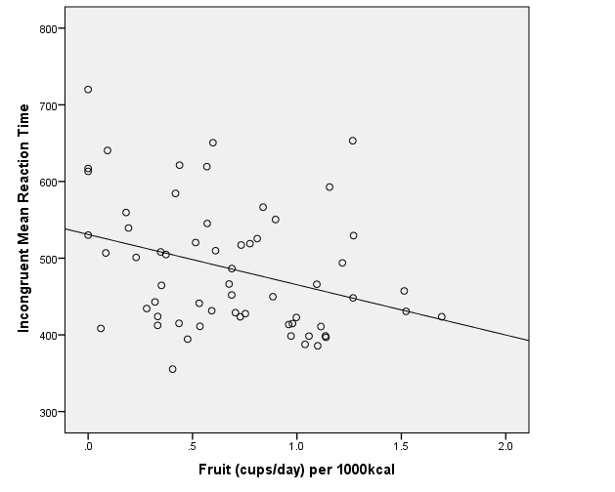
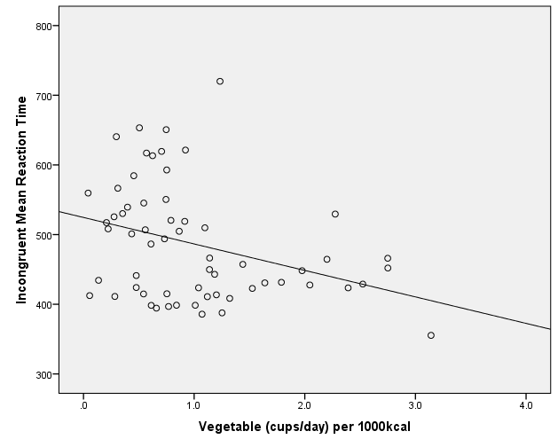
Fruit and Vegetable Consumption and Cognitive Function
Better Accuracy
Shorter Reaction Times
Zuniga et. al. In review

Slide 27
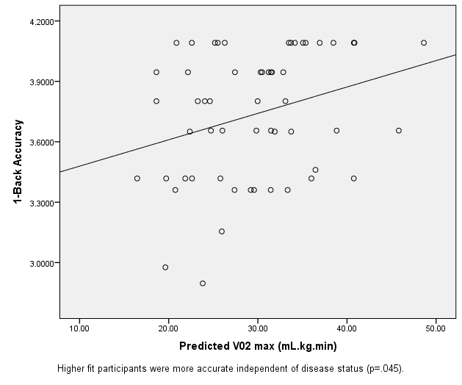
Fitness and Memory
Mackenzie M et. al. In review

Slide 28
Take Home Points
Physical activity and nutrition impacts brain structure and function at all ages
Aerobic > Nonaerobic
  Every bit of exercise helps!
Maintain a healthy body weight
Healthy foods > dietary supplements

Slide 29
Thank You!

