Slide 1
What is a Justice of the Peace?
Hon. YOUR NAME, YOUR COUNTY PRECINCT X
Contact Information if Preferred

Slide 2
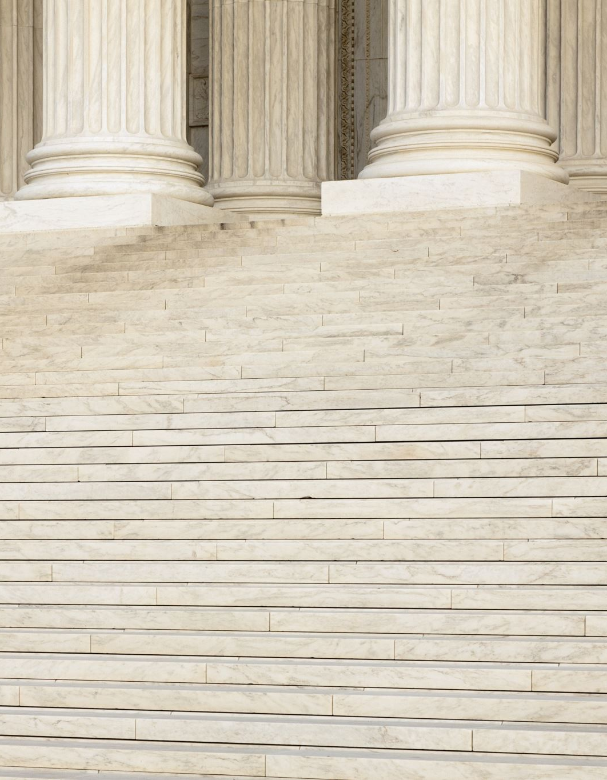
History of Justices of the Peace
Over 800 years of history!
King Richard I (“The Lionheart”) commissioned knights to preserve the peace in unruly areas beginning in 1195.
Act of 1327 appointed “good and lawful men” to “guard the peace” in every county.
In the colonies, volunteer justices resolved local conflicts and kept the peace.

Slide 3
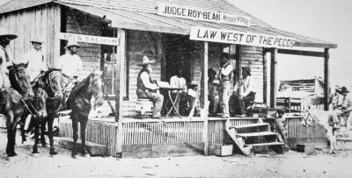
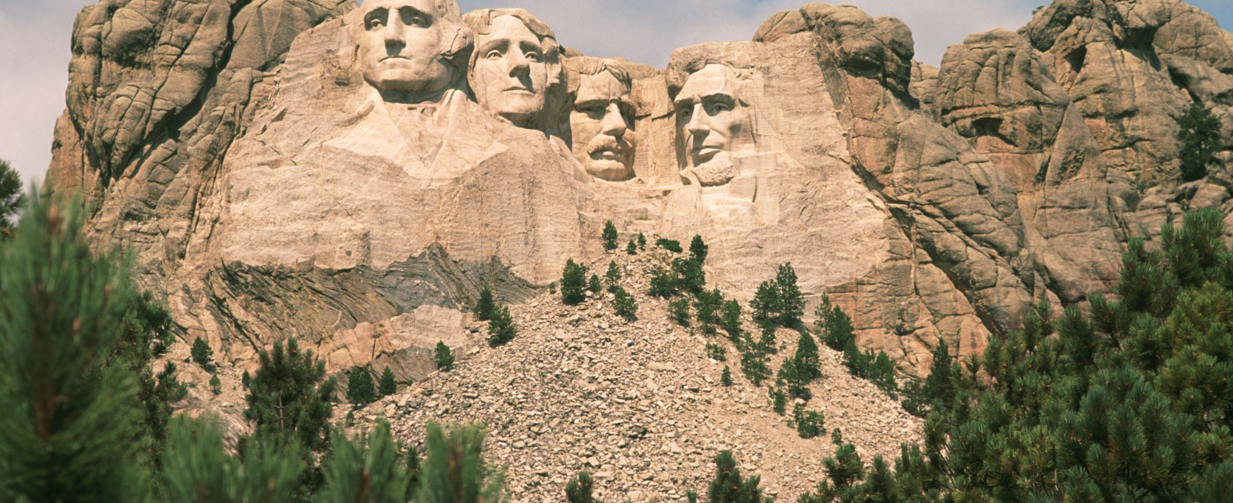
Famous Justices of the Peace
George Washington served as a justice of the peace early on in his career.
Many have heard of Judge Roy Bean, the “Law West of the Pecos.” Bean was a saloon-keeper and justice of the peace in Val Verde County.
This Photo by Unknown Author is licensed under CC BY-NC-ND

Slide 4
What Does It Take to Be a Justice of the Peace?

Slide 5
Requirements
Live in Texas for at least 12 months and your precinct for at least 6 months
Be a United States citizen
Be at least 18 years old on the first day of the term
Be mentally competent
Cannot be a convicted felon

Slide 6
Training Requirements
80 hours of training your first year
20 hours each additional year
Specific requirements
Juvenile diversion issues
Civil law
Setting bail

Slide 7
Texas Justice Court Training Center
Funded by grant from the Texas Court of Criminal Appeals under the supervision of the Justices of the Peace and Constables Association of Texas (JPCA)
Provides training and other educational materials.

Slide 8
Don’t Y’all Just Do Weddings?

Slide 9
No! So What Do We Do?

Slide 10
Small Claims Cases
If someone is suing for up to $20,000, they can do it in justice court
What types of cases can that be?
Car accidents
Debt claim cases (like credit cards)
Damage to property

Slide 11
Evictions
Cases where a person is trying to get back possession of a residence or business
Often because rent hasn’t been paid
Other lease violations like criminal activity or disallowed pets
Squatters

Slide 12
Criminal Cases
Justices of the Peace hear criminal cases where the person can’t go to jail as punishment for the crime
Examples
Traffic violations
Public intoxication
Minor alcohol offenses
Disorderly conduct

Slide 13
Truancy Hearings
Discover why a child is not attending school
Resolve the issue in a non-adversarial, non-criminal process
Nothing more relevant to quality of life measures down the line than getting a diploma or GED

Slide 14
Administrative Hearings
Cruelly-Treated Animals
Tow Hearings
Occupational Driver’s Licenses
Dangerous Dogs
Public Nuisance
Handgun License
Driver License Suspension
And more!!

Slide 15
Magistrate Duties
When someone is arrested…
Provide them their rights under state law and the U.S. Constitution
Appoint an attorney if necessary
Set bail in order to secure the release of the accused while ensure their appearance and the safety of the community and any victim

Slide 16
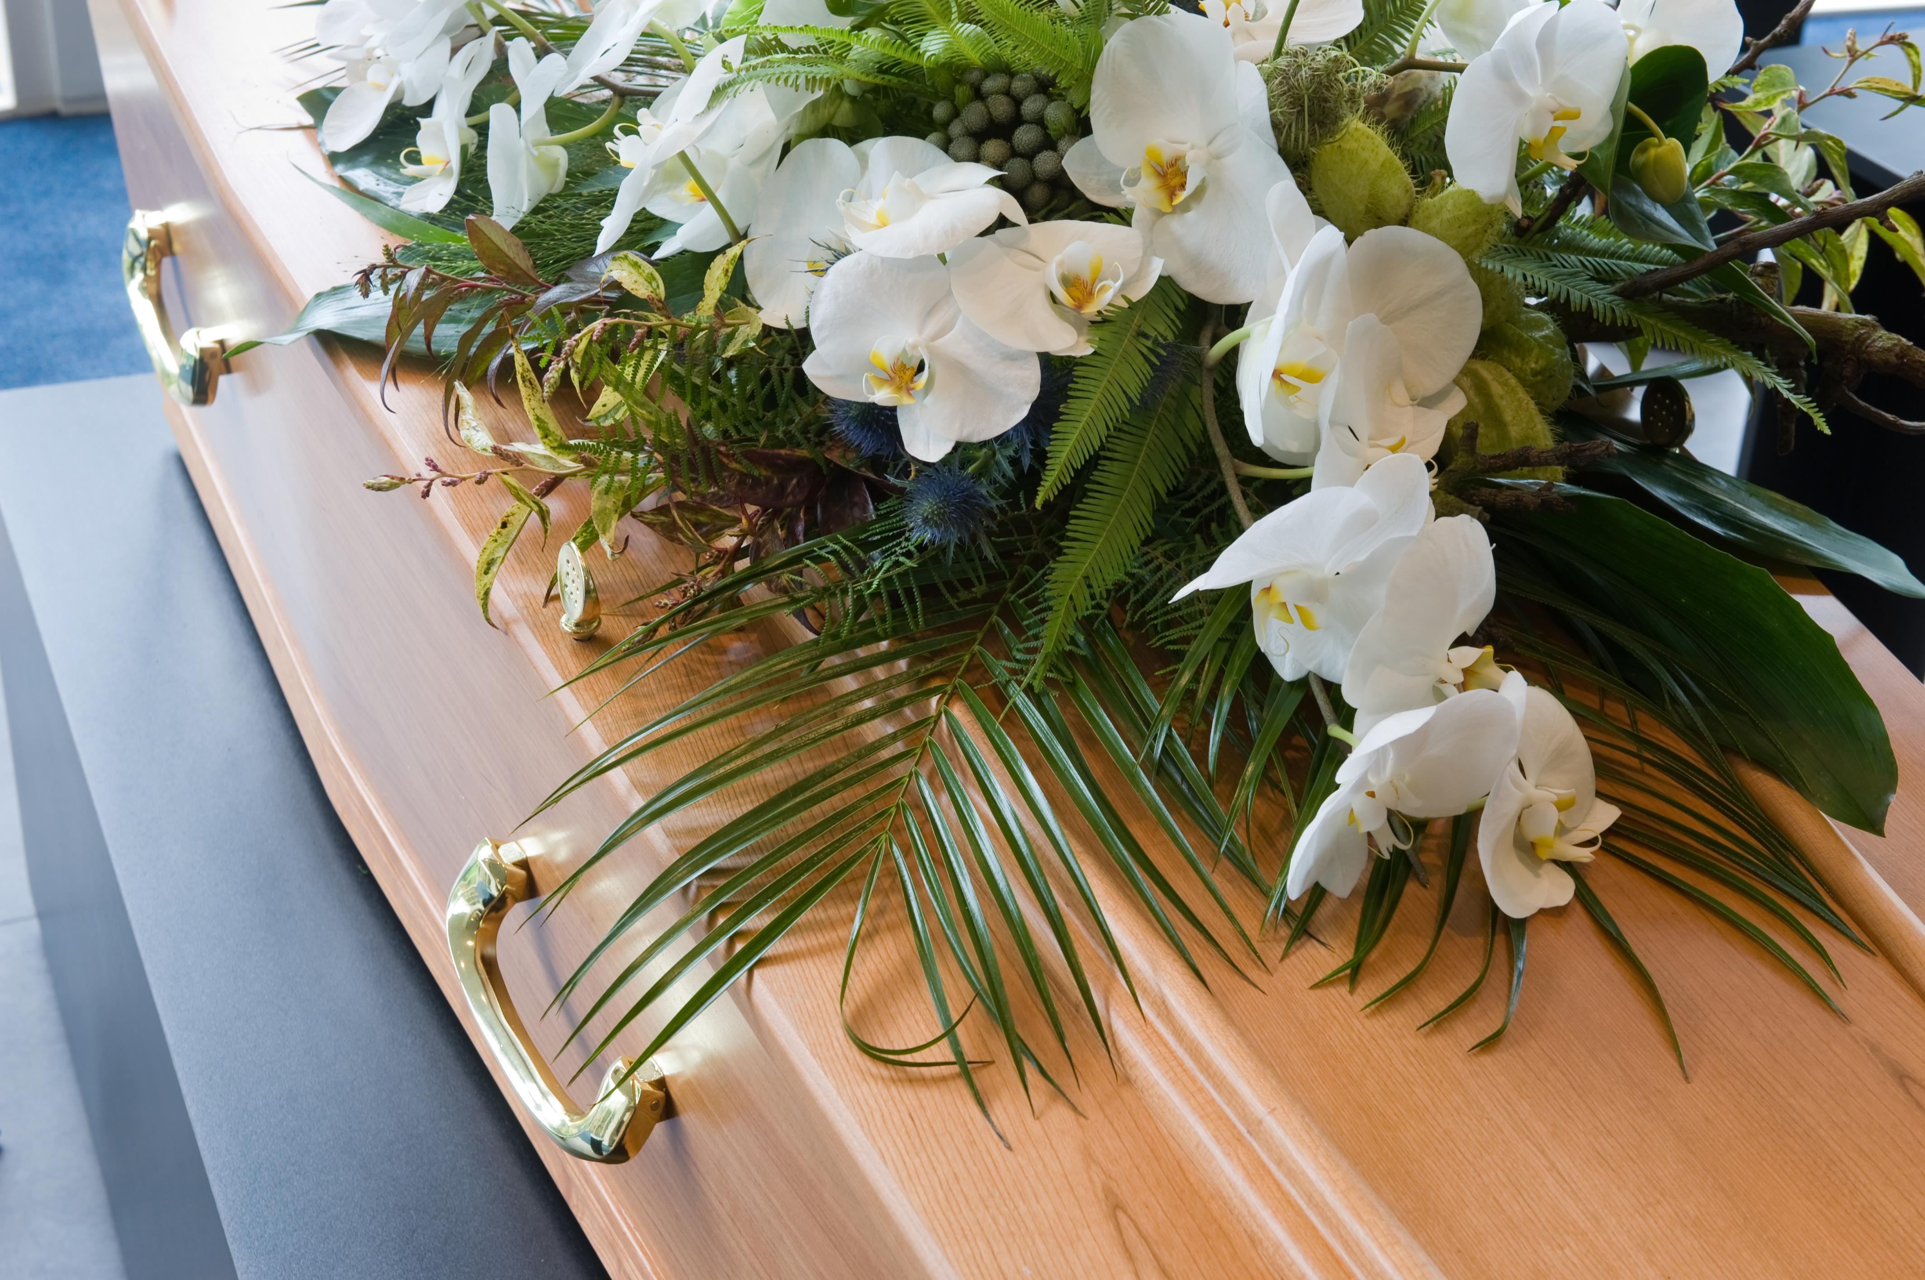
Inquests
In most counties, a Justice of the Peace must determine the cause and manner of death and fill out the death certificate for any death where there is not an attending physician

Slide 17
How To Be a Good Judge
4 Guiding Principles
Know Your Job
Do Your Job
Do Only Your Job
The Golden Rule

Slide 18
Thank you!
Questions?

