Slide 1
How to Set Up a Vendor in PW
For Texas State Employee Use
Email VendorRequests@txstate.edu for additional help!

Slide 2
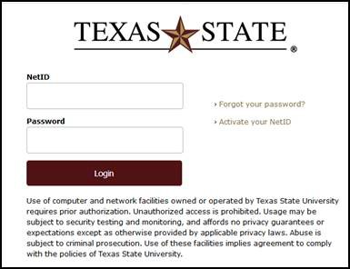
How to Set Up a Vendor in PaymentWorks
Go to Vendor Self-Service Website https://www.txstate.edu/procurement/resources/VENDOR-Self-Service.html
Click employee PW link
Log in
Click Vendor Master Update

Slide 3
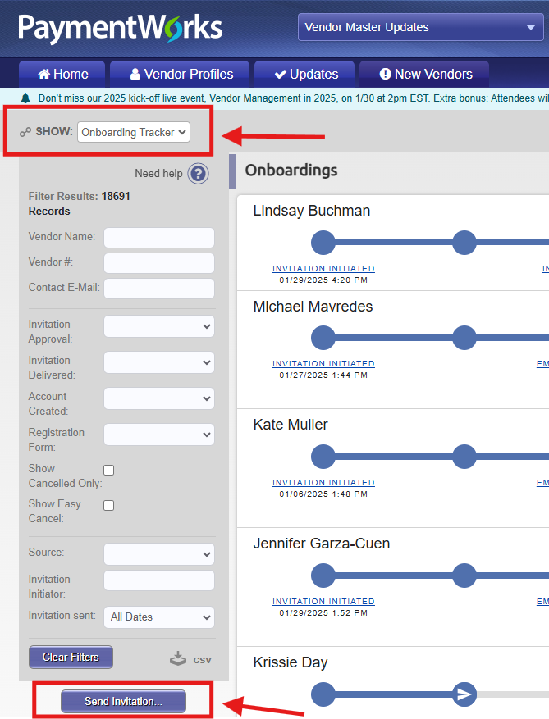
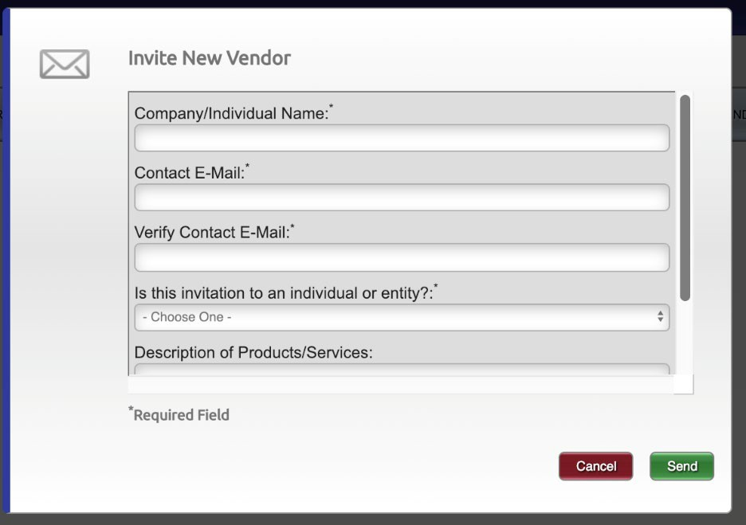
Make sure SHOW is on Onboardings
SHOW: Onboardings
Click Send Invitation
Complete Invite information & click SEND

Slide 4
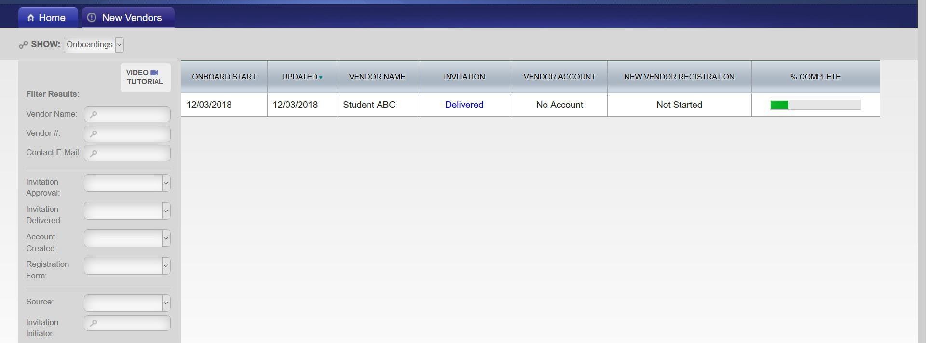
Vendor Invite Status
SHOW: Onboardings shows invite status
You can search for only your invites, by adding your Net ID in Invitation Initiator box at the bottom of the Filter Results:

Slide 5
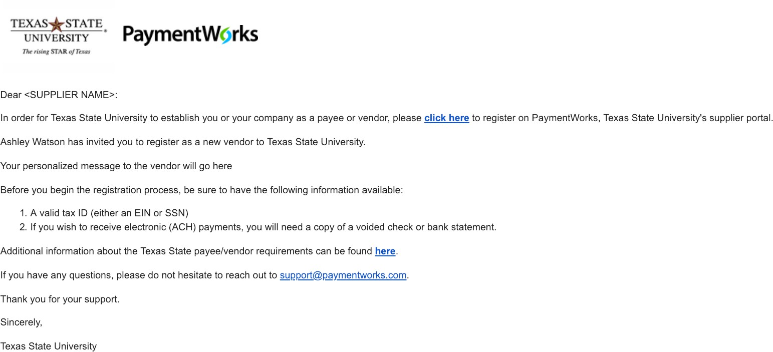
Vendor receives email

Slide 6
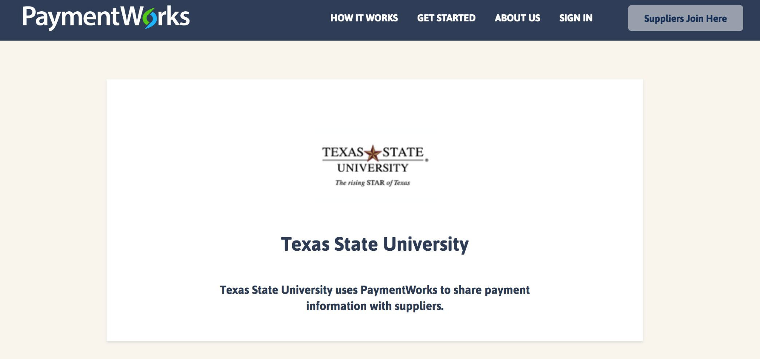
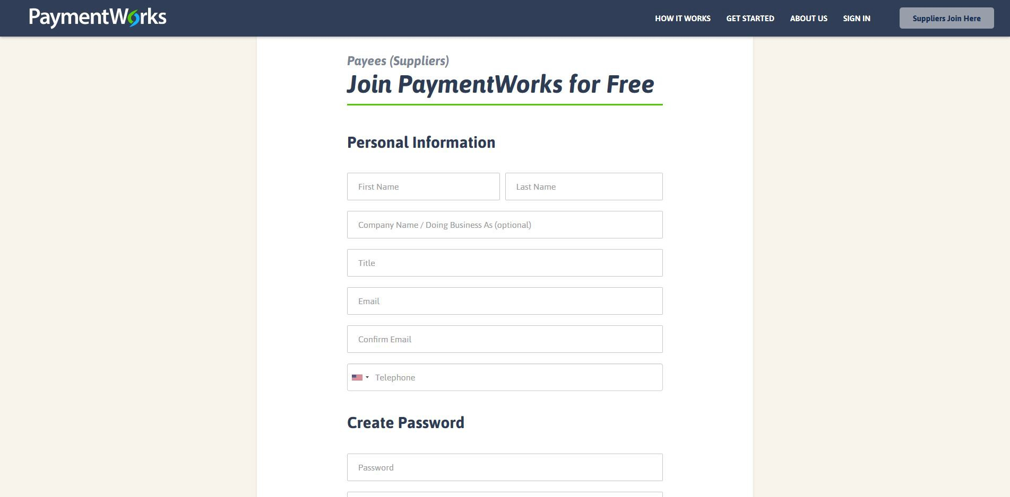
When Vendor clicks link in invitation email,
it takes them to PW log in page where they click Suppliers Join Here
It takes them to Join PW to create account

Slide 7
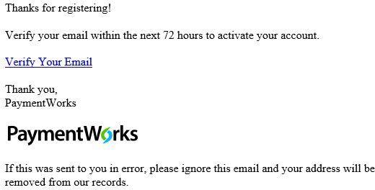
Vendor will receive an email to validate their email.
Once validated, they will log into www.paymentworks.com, complete online registration form and SUBMIT.
Let vendor know someone from PW may call to validate the LAST FOUR of their bank account number. If left a message, they need to return the call as this is the last step in the process.

Slide 8
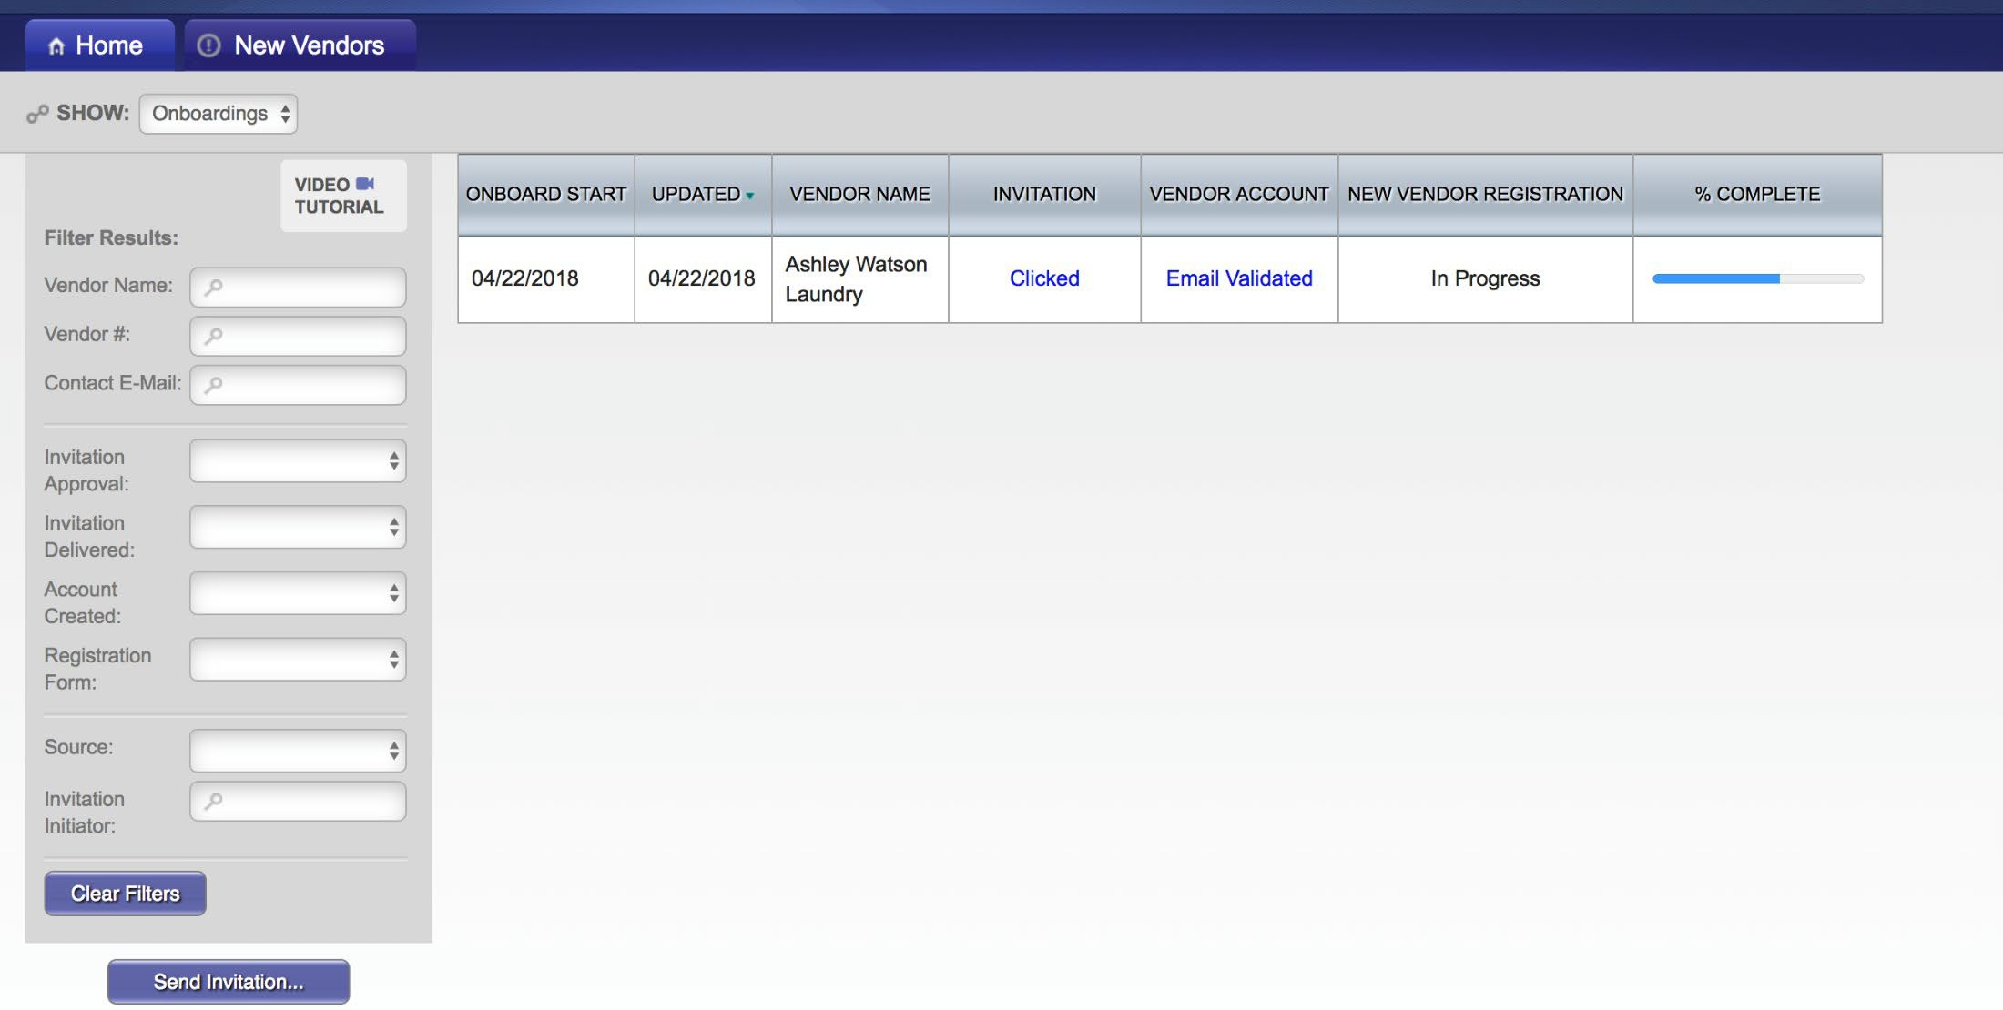
Tracking Onboardings
Invitation column:
Account Column:
New Vendor Registration column:
Sent
Delivered
Not Deliverable
Opened
Clicked
Self Registered
Email Validated
Created
Confirmed
No Account
Submitted
Approved
Processed
Complete
Rejected
Invitation/Reminders Cancelled

Slide 9
Important Notes for Foreign Vendors
Foreign vendors can’t receive ACH payments, if vendor selects Direct Deposit in error, they are unable to add wire information that is needed. Just an FYI so you know it will delay the registration process.
If Foreign vendors answer NO to the question Does your bank accept US checks, it will prompt them to add wire transfer information.
AND select US Dollar as wire currency.
If Foreign vendors answer Yes to the question Does your bank accept US checks, they will be set up with Check as their payment method.
The approval process takes longer for Foreign Vendors so plan accordingly.

Slide 10
Additional Comments
Please email VendorRequests@txstate.edu with ANY questions you have. Easier to answer lots of emails then fix problems later. ☺
If a vendor sits in APPROVED status for over 24 hours, PW & SAP may not have ‘connected’ correctly. Vendor should be in SAP.
With other Universities using PW now, it’s important to send email invite to the correct person so they can have one account with everyone. Also, it is best if a generic email is used.
Bank validation is a critical part of the PW process. Registrations will be kicked back if PW is not able to reach them to validate the LAST FOUR of their bank account number. This is to protect both us and the vendor.

