Slide 1
TEXAS STREAM TEAM OPTICAL BRIGHTENER COMMUNITY SCIENTIST TRAINING
Date – Location
Texas Stream Team is funded in part through a grant from the U.S. Environmental Protection Agency through the Texas Commission on Environmental Quality
Notes:
Use this time to welcome participants to the training!

Slide 2
NAME,
TITLE ORGANIZATION
Notes:
Add some information about yourself/your group here
Your name and title
Your organization and their logo

Slide 3
AGENDA
1
Introduction to Texas Stream Team and optical brighteners
2
Phase I – Recap and continuation
3
Phase II – Conduct protocols with trainer assistance
Phase III – Conduct protocols without trainer assistance
4
5
Wrap Up and Next Steps
Notes:
Talk about how there are three phases total that must be completed to receive a Texas Stream Team Optical Brightener certificate. Describe what each of the phases look like.

Slide 4
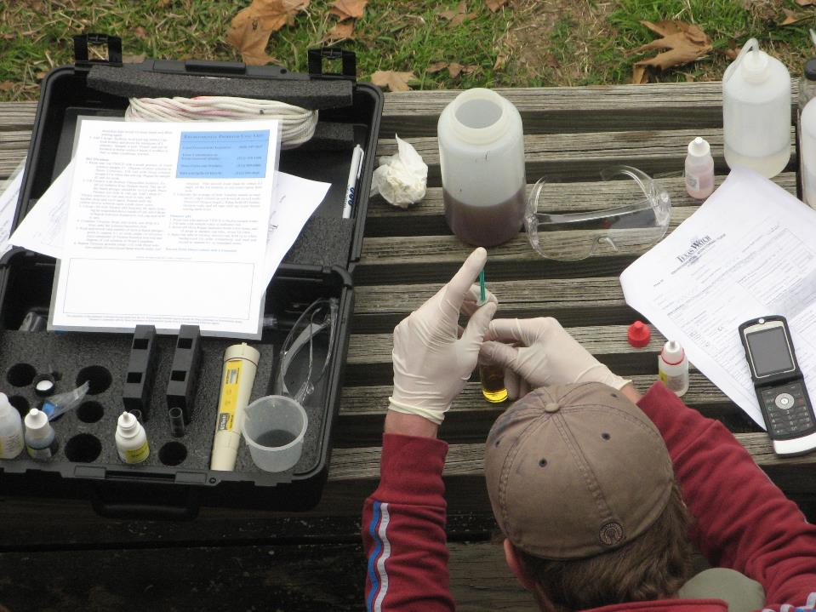
STATEWIDE COMMUNITY SCIENCE WATER QUALITY MONITORING SINCE 1991
A network of trained community scientists and supportive partners administered through a cooperative partnership between:
Notes:
Mention here that Texas Stream Team is a statewide community science water quality monitoring program that has been operating since 1991 and is a network of trained community scientists and supportive partners administered through a cooperative partnership between the United States Environmental Protection Agency, the Texas Commission on Environmental Quality, and the Meadows Center for Water and the Environment.
Mention that the Meadows Center is a research institute affiliated with Texas State University and is home to the Texas Stream Team program which is one of the largest, longest-running statewide water quality community science programs in the country.
Also mention that Texas Stream Team receives partial funding from the EPA, through a clean water act section 319 grant administered by the TCEQ.

Slide 5
MISSION:
To facilitate environmental stewardship by empowering a statewide network of concerned community scientists, partners, and institutions in a collaborative effort to promote a healthy and safe environment through environmental education, data collection, and community action.
12,400+
Community Scientists
1,600+
Monitoring Sites
150+
Partners
Notes:
Read the mission statement and mention the program metrics to give trainees an understanding of our programs reach.

Slide 6
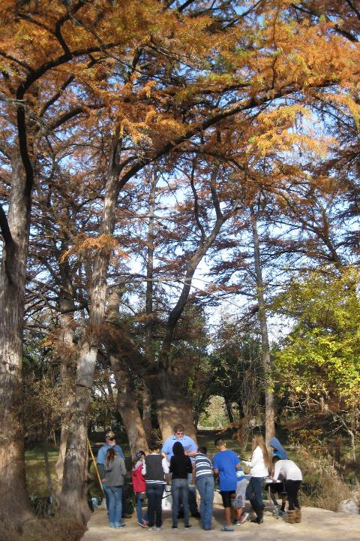
WHAT WE DO
Environmental Education
Data Collection & Analysis
Community Action/Engagement
Watershed Services
6
Notes:
Talk about all the different services that Texas Stream Team offers other than water quality monitoring and data collection. Talking points:
A robust environmental education program
Data collection through our statewide community scientists and they perform different analysis to highlight, review, and showcase data
Community action and engagement by providing educational workshops for schools and youth programs. They also provide community assistance for education and outreach strategies, grants, and loan applications. And they help with informing the public about environmental management decisions.
Watershed services by connecting homeowners to watersheds to promote nonpoint source pollution reduction. They help gather information and grow monitoring efforts to address data gaps. And lastly, we help with local planning, protection, restoration clean-ups, and habitat monitoring.

Slide 7
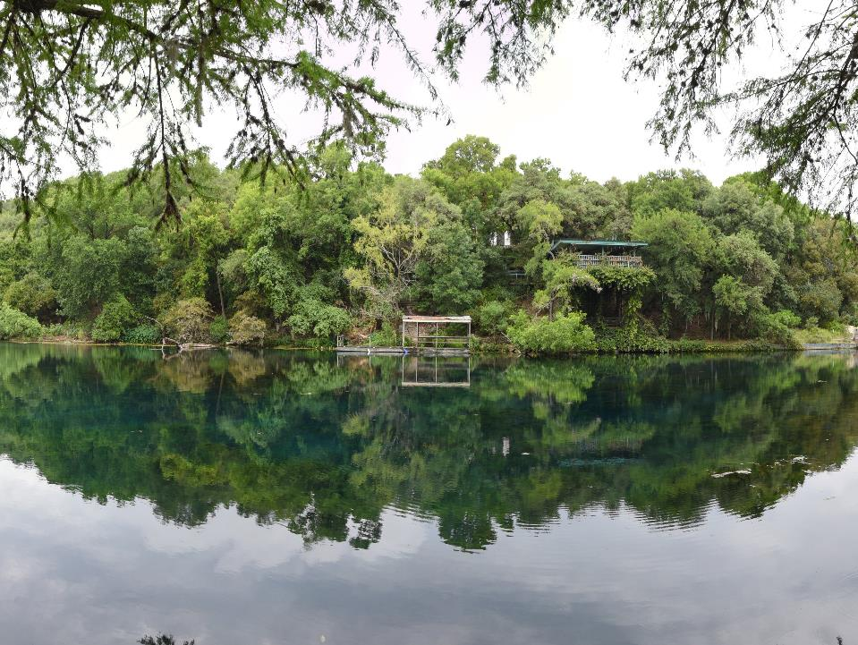
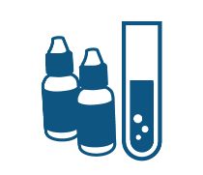
COMMUNITY SCIENTIST TRAININGS
Standard Core
Probe Core
E. coli Bacteria
Optical Brightener
Advanced
Riparian Evaluation
Notes:
Briefly review all the trainings Texas Stream Team offers. Talking points:
Standard Core – parameters include conductivity or salinity, dissolved oxygen, pH, temperature and various field observations using a chemical standard core kit.
Probe Core - includes the same parameters as the Standard Core training, however parameters are collected using meters or probes as opposed to the chemical tests.
E. coli Bacteria - involves measuring E. coli bacteria to determine the relative risk of swimming or contact recreation in a water body. E. coli is a bacteria that originates from the waste of warm-blooded animals and the presence of this bacteria indicates that associated pathogens from waste may be reaching a body of water.
Optical brightener - involves testing for synthetic compounds commonly used in laundry detergents and other cleaning products, called optical brighteners. This trainings is designed for Bacteria Community Scientists to aid in tracking bacteriological sources
Advanced training – parameters include nitrate-nitrogen, phosphate, turbidity, and streamflow using the advanced chemical kit.
Macroinvertebrate bioassessment - uses freshwater macroinvertebrates, fish, and habitat to determine the health of a lake, river, or stream.
Riparian evaluation - used to evaluate the health of a lake, river, stream, or estuary based on the riparian habitat.
It is also worthwhile to mention both the E. coli Bacteria and Advanced Training have prerequisites - must have Core certification plus six months of core monitoring.

Slide 8
PROGRAMS
WPP/TMDLs
Student Organizations
Junior Monitor Ambassador Program
Notes:
Briefly review the different outreach programs Texas Stream Team also leads. Talking points:
Watershed Protection Plan and Total Maximum Daily Loads – Texas Stream Team provides assistance on analyzing WQ data, informing SH’s, initiating outreach and more.
Student organizations - Texas Stream Team offers institutions guidance for creating a Texas Stream Team student chapter.
Junior Monitor Ambassador Program – this is a program designed to engage 8–13-year-olds in the Texas Stream Team by partnering them with certified community scientists to assist with monitoring events.

Slide 9
DATA USES
Offers a look at the overall quality of watersheds and local water quality
Assist TCEQ and TPWD in determining causes of NPS pollution
Data trends can have real world effects
Education and outreach
Data Summary Reports
Supports WPP and TMDLs
Research projects
Submitted to EPA’s Water Quality Exchange database
Submitted to the Waterways Dataviewer database
Publicly accessible on our interactive Datamap
Notes:
Talk about the different ways Texas Stream Team data is used.

Slide 10
QUALITY ASSURANCE
TCEQ-approved Quality Assurance Project Plan (QAPP)
Monitoring techniques are standardized statewide to ensure consistent data quality
Data are reviewed to ensure they are representative of the samples analyzed and locations monitored
Notes:
Here, talk about how all monitoring done by Texas Stream Team falls under a Quality Assurance Project Plan (can be pronounced as KWAP or spoken out as Q-A-P-P). Talking points:
Standardizations are included in the QAPP. Given the regulatory implications associated with the use of water quality data, the TCEQ uses scientifically rigorous and consistent water quality sampling methods to help​ ensure valid data outcomes.
Data is reviewed by the group Data Coordinators and our Texas Stream Team staff.

Slide 11
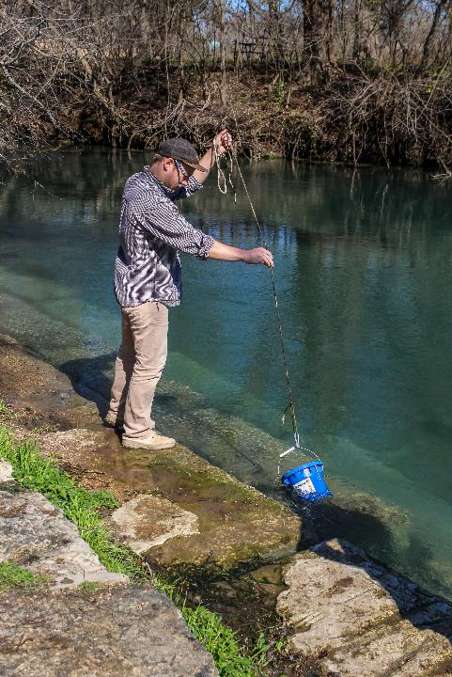
WHY COMMUNITY SCIENCE MONITORING?
More cost effective than professional monitoring
More frequent than professional monitoring
Can trigger alarm bells to alert state officials
Notes:
Explain the importance of community scientist monitoring here. Talking points:
The cost of community science monitoring is very affordable compared to professional monitoring costs. State water quality monitoring equipment can cost well over $10,000. Texas Stream Team offers a way for Texans to get involved using customized kits to collect data, similar to those collected by professionals, at a much lower cost.
Professional monitoring by the state is conducted on a quarterly basis. Whereas Texas Stream Team community scientists are trained to monitor water quality parameters monthly.
Because community scientists monitor more frequently, they might detect measurements that fall outside of the normal range of values before state officials can. Community scientists have alerted state officials of incidents that may have otherwise gone unnoticed, such as fish kills, illegal dumping, and more.
Optical brighteners were introduced to community science monitoring due to their simplicity, efficiency, and effectiveness, first using tampons as absorbent material.

Slide 12
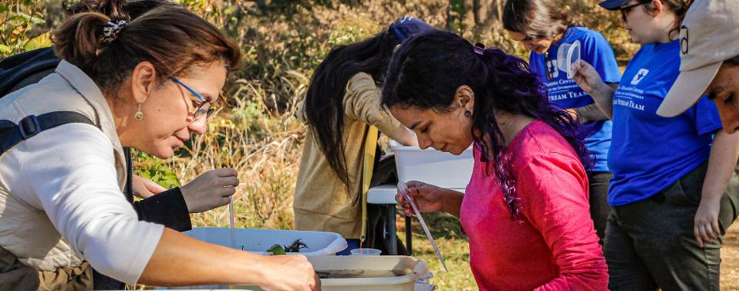
PROGRAM STRUCTURE
TEXAS
STREAM
TEAM
PARTNER ORGANIZATIONS
COMMUNITY
SCIENTIST
Notes:
All partner organizations that lead trainings follow the monitoring methods procedures established by Texas Stream Team. Texas Stream Team is considered the parent organization of all partner monitoring groups, and they are located at The Meadows Center for Water & the Environment, a research institute affiliated with Texas State University in San Marcos, TX.
Texas Stream Team can provide monitoring to partner organizations and their monitoring efforts.

Slide 13
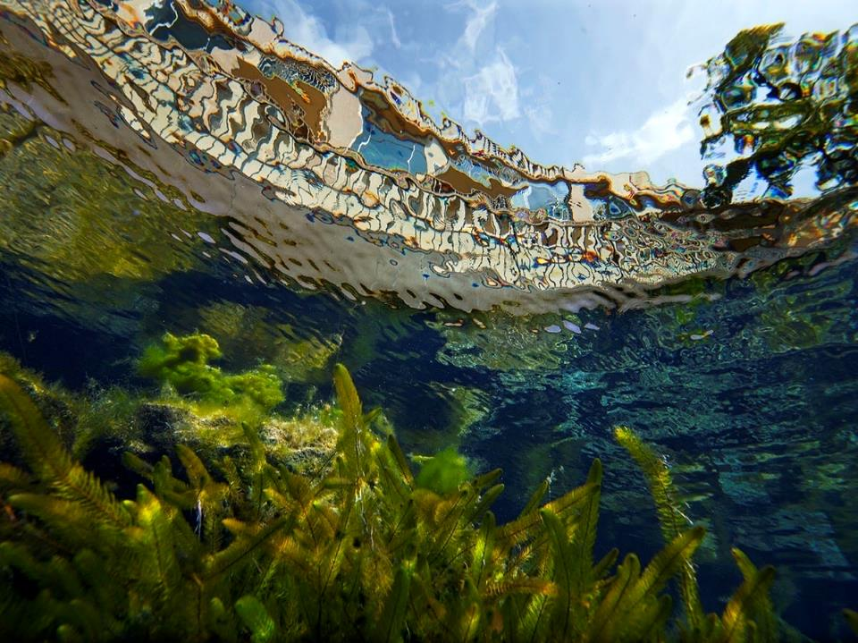
OPTICAL BRIGHTENER INTRODUCTION

Slide 14
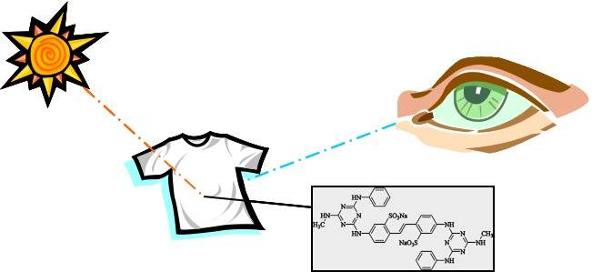
WHAT ARE OPTICAL BRIGHTENERS?
Synthetic Chemicals/dyes in everyday products
Enhance the appearance of materials by making them look whiter and brighter (fluoresce)
Widely used in commercial and household products since the 1940s
Readily absorb to cotton
Photo decay when exposed to UV light
Notes:
Explain what optical brighteners are and what function they serve:
At the base, they are synthetic chemicals
OBs absorb light from the invisible ultraviolet region of the electromagnetic spectrum that we can’t see, and re-emit that light in the visible blue region where we can see it. Our eyes will perceive this white to be brighter/whiter than the white that doesn’t contain optical brighteners.
Around the 1940s manufacturers would add OBs to their products to help mitigate the natural yellowing and dulling of clothing.
Readily absorb to cotton fibers
When exposed to prolonged UV radiation, the molecules undergo a chemical change that breaks down their ability to fluoresce, essentially "wearing out" their brightening effect over time;

Slide 15
OPTICAL BRIGHTENER SOURCES
Detergents
Fabric Softeners
Stain Removers
Multi-purpose Cleaners
Toilet Cleaners
Shampoo and Conditioners
Toothpaste
Fabric Refresher
Toilet Paper
Notes:
Share the different sources of OBs

Slide 16
ENVIRONMENTAL CONCERNS
Not biodegradable; accumulate in water bodies and sediment.
Potential Indicators of Wastewater Contamination
Limited understanding of their impact on aquatic life and ecosystems.
Notes:
Emphasize that optical brighteners are not biodegradable and can persist in the environment – and they are only introduced anthropogenically.
Presence often correlates with human fecal contamination. May highlight sources like failing septic systems, illicit discharges, or industrial effluents.
Limited understanding:
Our understanding of how OBs behave in surface water—and the extent of their potential harm to aquatic organisms and habitats—is still limited.
Emerging research is revealing ways in which OBs negatively impact water bodies.
Since their discovery, hundreds of OBs have been created, many of which have been removed from the market due to safety or toxicity issues.
Remaining OBs are considered safer and less eco-toxic, but concerns remain about their short-term, long-term, and cumulative effects.
Fun fact: Laundry detergent companies are not required to list all the ingredients in their products. However, now most brands allow you to view their complete ingredient lists online.

Slide 17
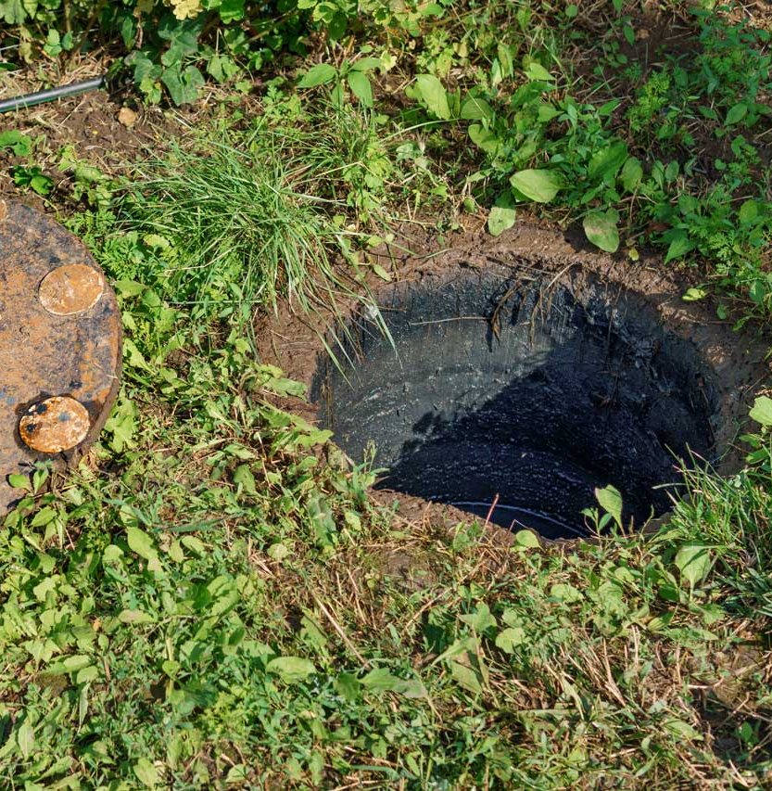
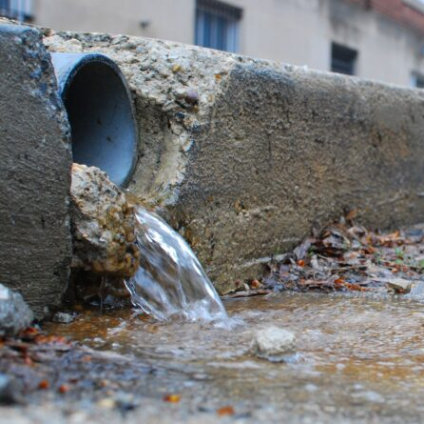
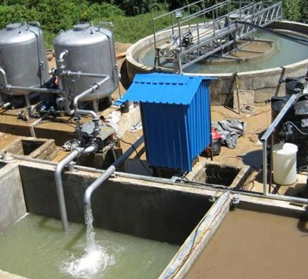
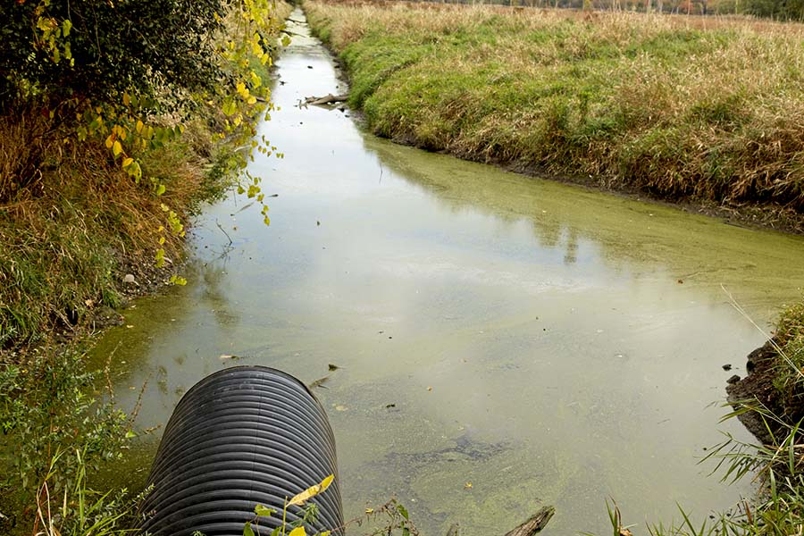
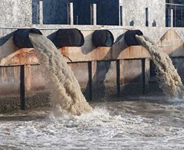
SOURCE TRACKING
Effluent from wastewater treatment plants
Illicit discharges (failing or malfunctioning septic systems)
Industrial effluents (laundries, textile manufacturing, carpet cleaners, and paper mills)
Stormwater runoff (urban areas)
Agricultural runoff (rural areas with septic systems)
Notes:
Explain how optical brighteners can end up in water bodies. Review the list on the slide to highlight the various ways OBs can wash into surface waters, indicating pollution from these sources:
Key Sources of Optical Brighteners in Water:
Effluent from Wastewater Treatment Plants - partial treatment leaves residues in waterways.
Failing Septic Systems - direct seepage into nearby streams or groundwater.
Urban Stormwater Runoff - detergent residues from laundry and car washes.
Industrial Effluents - textile and carpet manufacturing, paper mills.
Agricultural Runoff - Septic leaks in rural areas.
Swimming Pools – Drainage or overflow.

Slide 18
OPTICAL BRIGHTENER MONITORING
Detectable using 365 nm UV LED black lights.
Complements bacterial data for more accurate pollution source tracking.
Routine data collection for trend analysis.
Serve as a low-cost preliminary screening tool.
No screening criteria set by the TCEQ for optical brighteners
Notes:
Detectable due to the blue re-emitted blue fluorescence.
The goal is to see if Obs are present in a waterbody to track potential wastewater contamination issues.
Gathering data consistently and regularly over time to identify patterns, trends, or changes in the data.
Explain that optical brightener monitoring is a relatively new approach, gaining traction in community science programs around 2010. Describe how this method involves suspending a cotton material—here, organic tampons—to absorb a water sample and detect the possible presence of optical brighteners.
Currently, there is no state professional monitoring for OBs. Making this training the first proactive monitoring for water quality community science in the state.

Slide 19
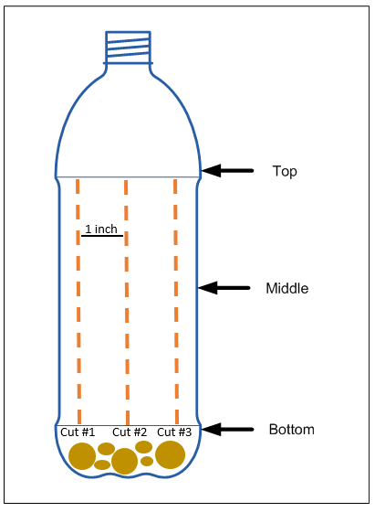
COLLECTION METHODS
Whirl-Pak® Bag Method - A water sample is collected in a black photo-sensitive Whirl-Pak® bag.
Suitable for tidally influenced streams.
Useful when accessing the centroid of flow is challenging.
Ideal for shorter deployment times (24 hours).
Modified Bottle Method - A slitted plastic bottle is used to house a tampon, allowing water to flow through.
Ideal for streams with consistent flow.
Ideal when the centroid of flow is accessible.
Notes:
Go over the two different collection methods and the appropriate time to use them.
It is important to note here that this method is not applicable for coastal environments, as it degrades the tampon.

Slide 20
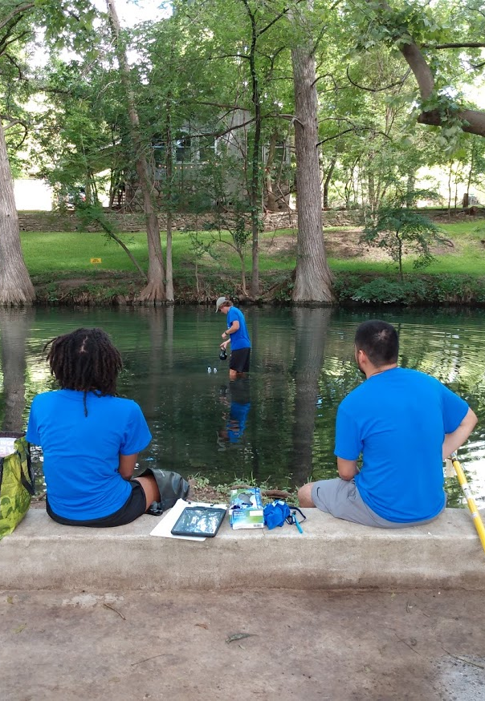
MONITORING PREPARATION
Monitoring frequency
Dress for the outdoors
Try to bring a buddy
Bring the following:
Optical Brightener monitoring form
Optical Brightener Field Guide
Monitoring supplies
Notes:
Go over some steps to prepare for a monitoring event. Talking points:
We ask community scientists to monitor optical brighteners either alongside their regular bacteria monitoring or following a positive bacteria result. While long-term, consistent data is valuable, community scientists may opt to conduct optical brightener monitoring only in response to positive bacteria findings, as this training primarily supports identifying and tracking bacteriological sources. Alternatively, community scientists may collect semi-regular optical brightener data at their bacteria site to enable a more comprehensive and informed analysis of site conditions. Conduct before bacteria monitoring.
Not required, but it is best to suit up in outdoor clothing that is protective of the elements – like you do for your Core and Bacteria monitoring events
A buddy is not required, but it is suggested for safety purposes
The monitoring form, field guide, and monitoring supplies are always required

Slide 21
ENSURING QUALITY CONTROL AND PREVENTING CONTAMINATION
Key Quality Control Measures
Buddy System
Field Audit Sessions
Data management
Standardized submersion time
Sample location
Contamination Prevention Tips
Avoid cross-contamination
UV light protection
Equipment hygiene and consistency
Notes:
Buddy System: monitor with another person to ensure safety and verify observations.
Field Audit Sessions: Attend bi-annual audits to review and maintain proper monitoring techniques.
Data Management: Use standardized forms and follow checklists to ensure accuracy before data submission.
Standardized Submersion Time: Ensure consistent exposure times for tampons (24–72 hours).
Sample Location: Deploy samples in the centroid of flow and shaded areas to maximize accuracy.
Avoid Cross-Contamination: Always wear clean, sterile gloves. Handle tampons by the string only to avoid contact with absorbent material.
UV Light Protection: Store samples in shaded areas to prevent optical brighteners from degrading due to UV exposure.
Equipment Hygiene: Inspect and rinse all equipment with deionized water before and after sampling. Use sterile, untreated tampons for accurate results.
Equipment Consistency: Use the same (365 nm) UV LED black light flashlight for each monitoring event and shine the light at the same distance to ensure accurate optical brightener detection.
IF YOU ARE USING THE PREREQUISITE MODULE FOR YOUR TRAINING, YOU CAN REMOVE SLIDES 3-21 FROM THIS PPT SO YOU CAN JUMP RIGHT INTO PHASE I

Slide 22
PHASE I
Notes:
In Phase I, give trainees the opportunity to practice setting up and deploying a modified water bottle and to practice sample collection (both methods). Then, guide them in observing samples and detecting blue fluorescence using real-life examples.

Slide 23
BOTTLE METHOD SUPPLIES
Recycled and Rinsed (Clear) Plastic Bottle with slits
DI Water
Monofilament Line or Rope
Weighted Kettlebell or Similar Object
Organic Cotton Tampons (e.g., Natracare)
Gloves
Fine Tip Sharpie
365 nm UV LED Black Light Flashlight
Tweezers
Waste Bottle
Black Photosensitive Whirl-Pak® Bags – make sure seal is not broken
Scissors or Scalpel
Notes:
Go over each training supply item and important things to note about each for the bottle method specifically.
Explain here that we use organic tampons because they are less likely to be pre-contaminated with optical brighteners, ensuring more accurate results. Additionally, a 365 nm flashlight is used because this wavelength is optimal for causing most optical brighteners to fluoresce. (Note: Flashlights can vary in their nanometer wavelength range.)

Slide 24
BOTTLE METHOD - SAMPLE DEPLOYMENT
(STEPS 1-2 ON FG)
Label Whirl-Pak bag with site ID, date, and deployment time
Rinse the bottle 2X with DI water and check for OB contamination
Tie monofilament line or rope around bottle neck
Rinse scalpel with DI water and cut 4-6 inch equally spaced slits along the bottle’s length
Notes:
FOR IN-PERSON TRAININGS, IT IS BEST TO PREPARE THE BOTTLE AND WHIRL-PAK BAG AT ONCE SO YOU ONLY HAVE TO GO OUT IN THE FIELD ONCE.
Explain prepping a whirl-pak bag for sample transportation and deployment tracking (can also use the MF). As long as the tample is covered while transported.

Slide 25
Notes:
Go over the different examples of what may be seen on the tampon. Highlighting what counts as a hit and what doesn’t.

Slide 26
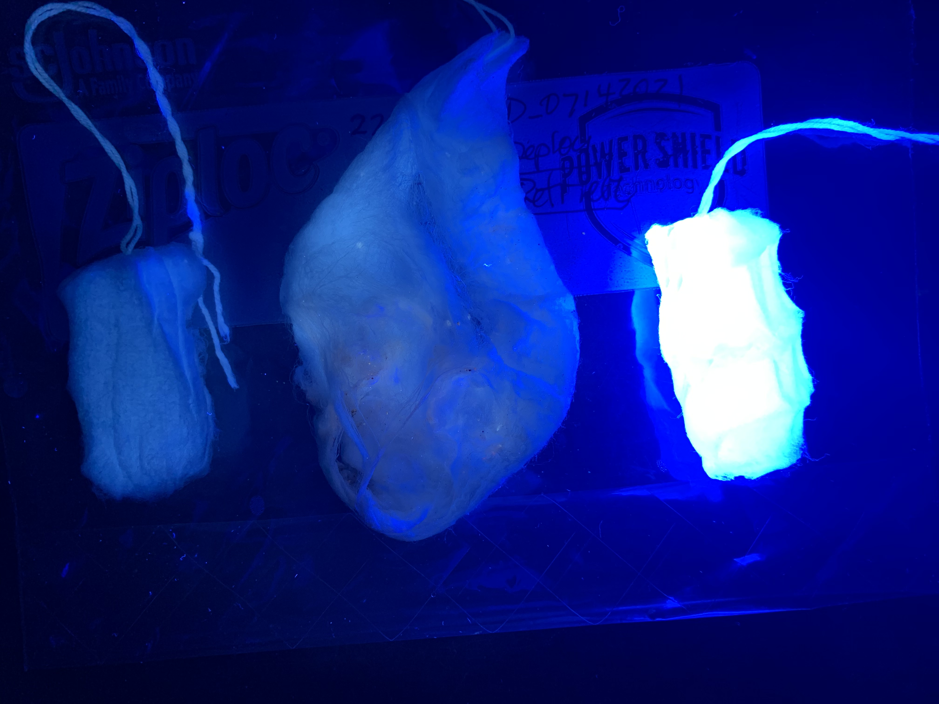
SAMPLE ANALYSIS
After 24-72 hours, place tampon on a clean surface in a dark setting
Gently unravel tampon and expose as much surface area as possible
Expose the tampon with a black light flashlight, looking for distinctive blue fluorescence
Document the presence or absence of fluorescence on the Monitoring Form
Notes:
Explain how to analyze optical brightener sample results. Emphasize cross-contamination & UV contamination here. After going over this slide, go through real examples.
Discuss the potential for false positives and false negatives here (which can be documented on the Monitoring Form). Optical brighteners may be detected from sources such as car washes or golf courses, which are unrelated to sewage. Conversely, they may not be detected in stagnant waters, where optical brighteners are not effectively distributed.

Slide 27
PHASE II
Notes:
In Phase II, trainees will continue with the whirl-pak method they grabbed in their phase I while out in the field. Here trainees will practice submerging the tampon and being mindful of cross contamination & UV light exposure.

Slide 28
WHIRL-PAK METHOD SUPPLIES
Black Photosensitive Whirl-Pak® Bags – make sure seal is not broken
DI water
Organic Cotton Tampons (e.g., Natracare)
Gloves
Fine Tip Sharpie
365 nm UV LED Black Light Flashlight
Tweezers
Waste Bottle
Sample Bucket or Extension Pole (optional)
Notes:
Go over each training supply item for the whirl-pak method and important things to note about each.

Slide 29
WHIRL-PAK METHOD - SAMPLE COLLECTION
(STEPS 3-4 ON FG)
After collecting the water sample, remove the tampon from its packaging and place in Whirl-Pak bag
Allow tampon to soak in the Whirl-Pak bag (positioned upright)
Notes:
Explain how to prepare the tampon for submersion before having the trainees do it. Emphasize cross-contamination here.

Slide 30
Notes:
Reminder on what may be seen on the tampon. Highlight what counts as a hit and what doesn’t.

Slide 31
SAMPLE ANALYSIS
After 24-72 hours, place tampon on a clean surface in a dark setting
Gently unravel tampon and expose as much surface area as possible
Expose the tampon with a black light flashlight, looking for distinctive blue fluorescence
Document the presence or absence of fluorescence on the Monitoring Form
Notes:
Reminder on how to analyze optical brightener sample results. Emphasize cross-contamination & UV contamination here. After going over this slide, go through real examples. Ensuring trainees are analyzing different examples from phase I (rotating examples work best).

Slide 32
PHASE III
Notes:
In Phase III, trainees will repeat this procedure independently, without assistance from the trainer. The trainee will have the option to choose their method of choice (if you have the supplies for them to choose, if not you make ask them to pick a specific method).

Slide 33
METHOD OF CHOICE
Notes:
Have trainees practice checking for contamination and setting up the deployment method of their choice – encouraging them to use the method they will use after trained.

Slide 34
Notes:
Reminder on what may be seen on the tampon. Highlight what counts as a hit and what doesn’t.

Slide 35
SAMPLE ANALYSIS
After 24-72 hours, place tampon on a clean surface in a dark setting
Gently unravel tampon and expose as much surface area as possible
Expose the tampon with a black light flashlight, looking for distinctive blue fluorescence
Document the presence or absence of fluorescence on the Monitoring Form
Notes:
Reminder on how to analyze optical brightener sample results. Emphasize cross-contamination & UV contamination here. After going over this slide, go through real examples. Ensuring trainees are analyzing different examples from phase I and II (rotating examples work best).

Slide 36
WRAP UP & NEXT STEPS

Slide 37
OPTICAL BRIGHTENER DETECTION
Document all observations, including photographs of site and nearby environmental factors
Conduct upstream monitoring
Notify county authorities about potential septic tank inspections
Conduct monitoring throughout various seasons and conditions
Notes:
Discuss what to do if a community scientist detects optical brighteners at their monitoring site.
Mention the following:
Accurately document all observations, including photographs of the monitoring site and any relevant nearby environmental factors such as residential properties, commercial establishments, and agricultural activities. Additionally, it is crucial to record the presence of any nearby septic tank systems, stormwater drains, sewer pipelines, or industrial discharge points.
Conduct upstream and downstream monitoring from the site where optical brighteners were detected. This approach aids in bacterial source tracking. Furthermore, if the waterway traverses’ multiple areas, sampling at various points will help identify the specific locations of optical brightener sources.
If the monitoring site is situated in proximity to a septic tank system, community scientists are encouraged to notify their county authorities and engage local initiatives to facilitate a septic tank inspection.
It may be advantageous to conduct monitoring during dry conditions to eliminate the potential influence of stormwater runoff, which can dilute bacterial concentrations.
You may also mention resources, such as the Wastewater Outfalls Viewer that community scientists may use to help locate wastewater treatment plants near their monitoring sites.

Slide 38
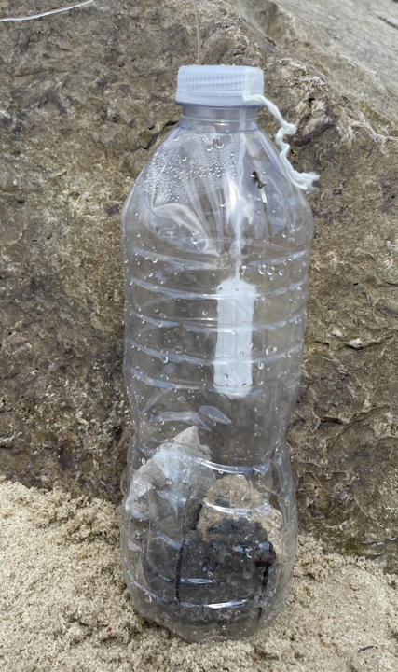
AFTER MONITORING
Clean and store equipment
Submit Optical Brightener Monitoring Form
Notes:
Discuss what to do after a sampling event by reading the slide. Talking points:
Cotton tampons can be disposed of in a household compost (if available) or in the trash after sample analysis
Recycle monofilament line (if used). We strongly encouraging keeping the line and reusing, if possible.
Dispose of used Whirl-Pak bags and used gloves in normal household trash.
Satanize workspace and any other reusable tools, if needed (tweezers, bottle, scalpel, etc.)
Monitoring forms are accessible directly on the Texas Stream Team website (www.TexasStreamTeam.org). After a monitoring event, submit your electronically (preferred method) or a hard copy can be submitted to your Group Data Coordinator, if available. If your group has no Data Coordinator, submit a photo or scanned copy of your monitoring form to Texas Stream Team at TxStreamTeam@txstate.edu and Texas Stream Team will enter your data for you.

Slide 39
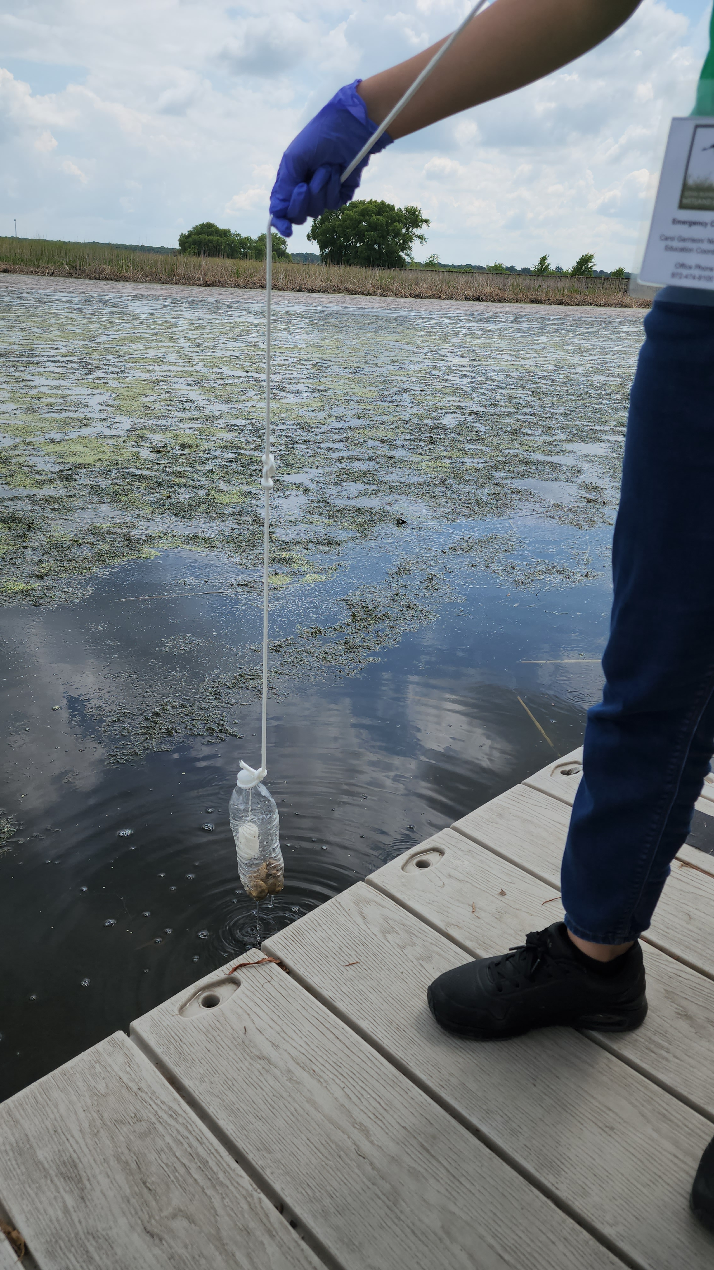
NEXT STEPS
Submit data at least once a month to TxStreamTeam@txstate.edu
Follow the detection steps if you get a hit
Visit the Texas Stream Team calendar of events for future trainings
www.TexasStreamTeam.org | TxStreamTeam@txstate.edu | 512-245-1346
Notes:
Website review: share the monitoring form location, Datamap, calendar, resource page, etc.
*Be sure to encourage trainees to utilize their Bacteria monitoring sites for Optical Brightener Monitoring*

Slide 40
PHOTO ARTIST CREDITS
Jason Allen
Anna Huff
Jennifer Idol
Jenya Mendelenko
Matthew Mohondro
Andrew Shirey
Erich Shlegel
Pat Stroka
Notes:
If you use this presentation, please always include this page to give credit to our artists.

