Slide 1








Envisioning the Future of IPE:
INSIGHTS AND INNOVATIONS
Presenters:
Takiyah Mitchell
Dr. Rebecca Reynolds
Dr. Lan’tejuana Cooper

Slide 2




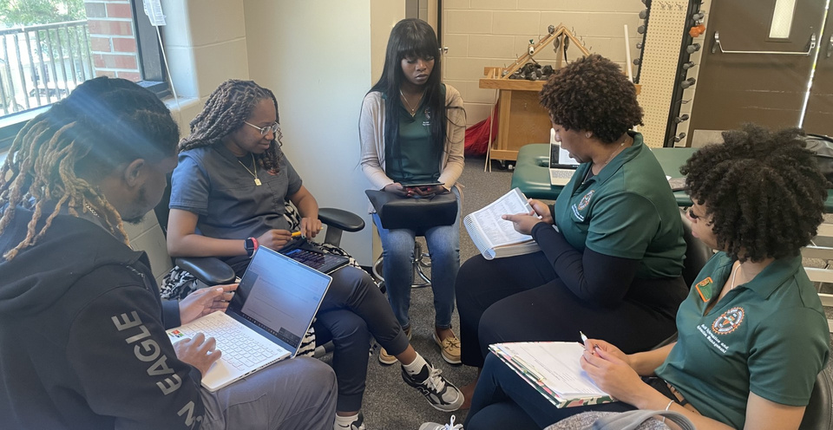

Audience Engagement
What is IPE?
"What comes to mind when you think of IPE... Who are the players, etc.." "Briefly, what are some examples of IPE your programs have utilized?

Slide 3





IPE Definition
  According to the World Health Organization (WHO), interprofessional education (IPE) is an experience that “occurs when students from two or more professions learn about, from, and with each other” (WHO, 2010).
  Interprofessional education (IPE) is an important step in advancing health professional education for many years and has been endorsed by the Institute of Medicine as a mechanism to improve the overall quality of health care (Buring et al., 2009)

Slide 4


IPE Implementation
Advantages
Challenges
  Improved communication
  Impact of IPE on patient care
  The culture of collaboration
  Time
  Faculty and staff workload
  Institutional support

Slide 5



Current Practices
Future Vision
  IPE Projects with other disciplines
  EHR platforms integration with simulation labs.
  IPE with AI Interaction
such as virtual patients
to enhance peer and
personalized learning
and collaboration

Slide 6


Conclusion
  How can we as educators fill the gap of the lack of student preparedness for healthcare workforce interaction and collaboration

Slide 7


Q & A!

Slide 8
References
WHO (World Health Organization). Framework for action on interprofessional education and collaborative practice. 2010. [March 4, 2013]. http://www​.who.int/hrh​/resources/framework_action/en/index​.html.
Buring, S. M., Bhushan, A., Broeseker, A., Conway, S., Duncan-Hewitt, W., Hansen, L., & Westberg, S. (2009). Interprofessional education: Definitions, student competencies, and guidelines for implementation. American Journal of Pharmaceutical Education, 73(4), 1-59.

