Slide 1
Four Big Questions to Ask Before Using AI
March 27, 2025
TXST AI in Teaching & Learning Symposium
Ben Mitchell-Yellin
bmy@shsu.edu
Notes:
Introduction:
Thank you for your interest in sharpening your skills in revenue cycle project implementation. This series of presentations will engage a number of operational leaders who are experts in their areas of expertise, and can provide insight into the specific challenges, potential gaps, and critical areas of focus necessary to make an implementation successful. The order of presentations, for the most part, will follow the same journey as an account through the revenue cycle with few exceptions.
Each section is marked so you can go right to the section you need if you just need a reference, or take the entire course to perfect your operational knowledge. It is intended to help with onboarding, as well as to refresh anyone in need who maybe hasn’t worked specifically with another team in Conifer.

Slide 2
The Plan
Getting our heads in the game
Making things explicit
Four questions
Case studies
Share out
Wrap-up
Reasons for and against

Slide 3
Getting our heads in the game
What are some contexts in which someone may want to use an AI tool to complete an everyday task?
What are some tools they may wish to use?

Slide 4
Making things explicit
Can you think of some names of generative AI tools?
What other types of AI are there, and how are they different?
We’re going to narrow our focus just to generative AI tools.

Slide 5
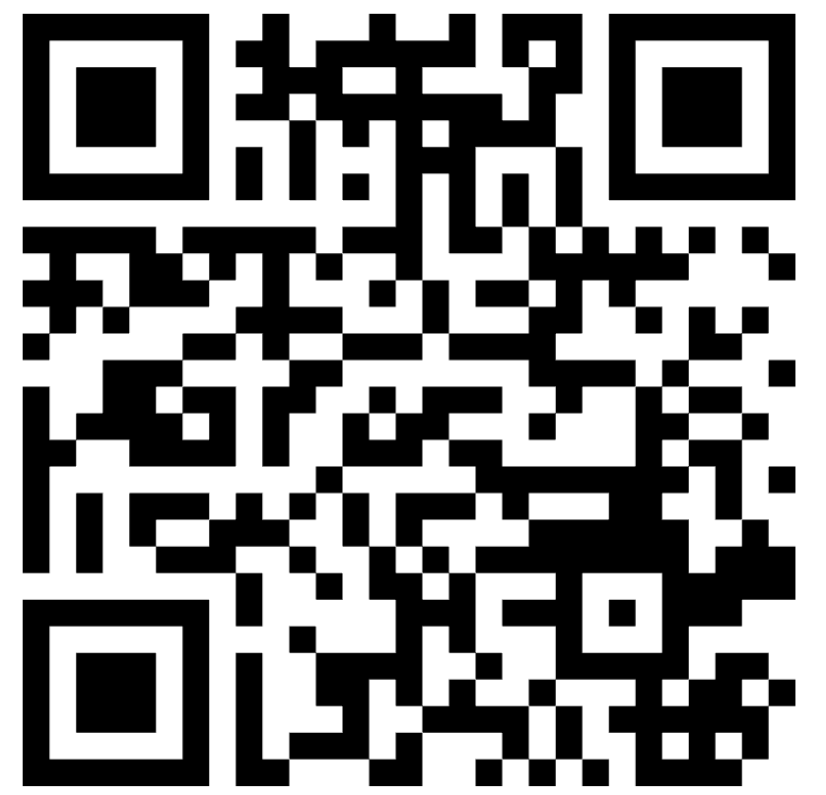
Reasons for and against
When or why should/shouldn’t you use AI?
https://www.menti.com/als7i1rkoc98
Let’s think about some reasons one should use an AI tool, as well as some reasons one should not do so.
We can also think about some contexts where one should or should not use AI.

Slide 6
Four questions
Am I using this AI tool for a good purpose?
2. Would I be missing out on something worthwhile by replacing my usual way of achieving this goal with a process that uses AI?
3. Is the time or money I would be saving by using this AI tool being put to good use?
4. How does using this AI tool interact with the systems and structures that shape our lives?
I want to introduce a framework for thinking about when we should use AI tools to complete everyday tasks.

Slide 7
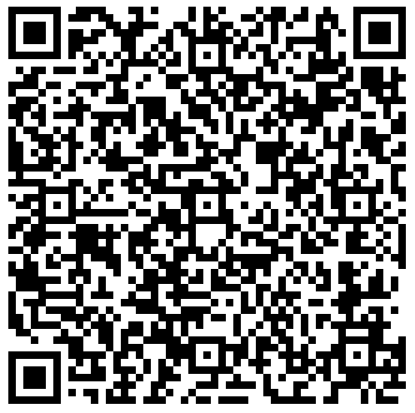
Case studies
Let’s think through these questions in relation to some cases.
Step 1: Split into groups
Step 2: Assign a case to each group
Step 3: Complete the worksheet

Slide 8
Share out
Now let’s hear from each of the groups.
In 5 minutes or less, please walk us through your discussion.

Slide 9
Wrap-up
Thank you!
Questions?
Concerns?
Something to add?

