Slide 1
The Grain of the Voice: Building Students’ Conviction in Writing
Dr. Jennifer Stob, School of Art and Design
jstob@txstate.edu

Slide 2
Benjamin Bratton, “The Five Stages of AI Grief,” Noema, June 20, 2024, https://www.noemamag.com/the-five-stages-of-ai-grief/
Kübler-Ross’s stages of grief provide a useful typology of the Western theory of AI: AI Denial, AI Anger, AI Bargaining, AI Depression and AI Acceptance. These genres of “grief” derive from the real and imagined implications of AI for institutional politics, the division of economic labor and many philosophical and religious traditions. They are variously profound, pathetic and predictable.
…
The stages of AI grief do not go in any order. This is not a psychological diagnosis; it is mere typology. The positions of real people in the real world don’t stay put inside simple categories. For example, AI Denial and AI Anger can overlap, as they often do for critics who claim in the same sentence that AI is not real and yet must be stopped at all costs.

Slide 3
Elisabeth Kübler-Ross, On Death and Dying. New York: Macmillan, 1969
Denial
refusing to accept or acknowledge the death
Anger
blaming a medical doctor for not preventing an illness
Bargaining
"If only I had brought her to the doctor sooner, this would have been cured."
Depression
loss of interest in activities you normally enjoy
Acceptance
cherish the memories that were shared, and make plans for moving forward
Examples from Jennifer Fisher, “5 stages of grief: Coping with the loss of a loved one,” Harvard Health Publishing, December 12, 2023, https://www.health.harvard.edu/mind-and-mood/5-stages-of-grief-coping-with-the-loss-of-a-loved-one

Slide 4
Machiavellianism and anti-intellectualism in our contemporary public discourse (selected bibliography)
Guy J. Curtis, Helen M. Correia, Melissa C. Davis, “Entitlement mediates the relationship between dark triad traits and academic misconduct,” Personality and Individual Differences, Volume 191, 2022. https://doi.org/10.1016/j.paid.2022.111563.
Laura Lacy Graham, “Public Attitudes toward Higher Education and its Value,” State Science and Technology Institute, September 5, 2024. https://ssti.org/blog/public-attitudes-toward-higher-education-and-its-value
Brian Kennedy and Alec Tyson, “Americans’ Trust in Scientists, Positive Views of Science Continue to Decline,” Pew Research Center, November 14, 2023. https://www.pewresearch.org/science/2023/11/14/americans-trust-in-scientists-positive-views-of-science-continue-to-decline/
Matt Motta, Anti-scientific Americans : the prevalence, origins, and political consequences of anti-intellectualism in the US. New York: Oxford University Press, 2024

Slide 5
Societal deficit of trust and societal erosion of attention (selected bibliography)
James Crawford, Stand Out of Our Light: Freedom and Resistance in the Attention Economy. Cambridge: Cambridge University Press, 2018.
Ezra Klein, Why We're Polarized. New York: Simon & Schuster, 2020.
Vivek Murthy, Together: The Healing Power of Human Connection in a Sometimes Lonely World. New York: Harper Wave, 2020.
Lee Rainie, Scott Keeter, and Andrew Perrin. "Trust and Distrust in America." Pew Research Center, July 22, 2019. https://www.pewresearch.org/politics/2019/07/22/trust-and-distrust-in-america/.
Sherry Turkle, Reclaiming Conversation: The Power of Talk in a Digital Age. New York: Penguin Press, 2015.
Twenge, Jean M. iGen: Why Today's Super-Connected Kids Are Growing Up Less Rebellious, More Tolerant, Less Happy--and Completely Unprepared for Adulthood. New York: Atria Books, 2017.

Slide 6
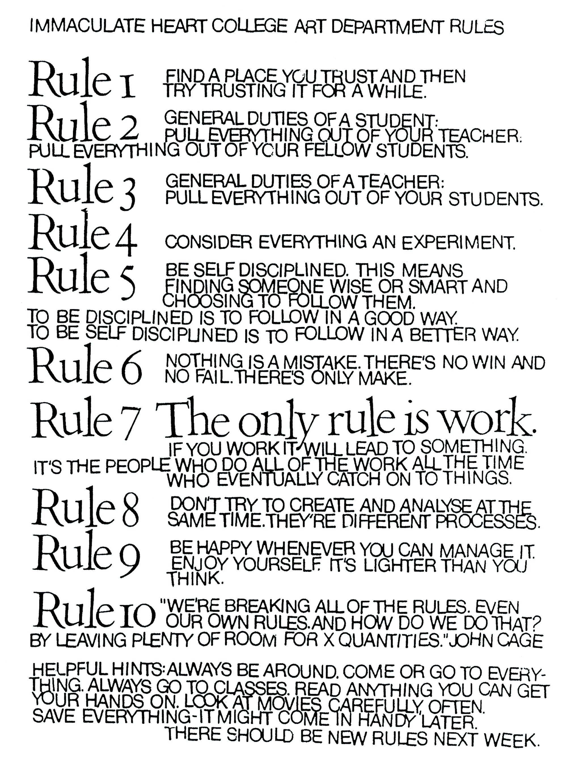
Corita Kent, Ten Rules for Students and Teachers, 1967-1968. Poster.

Slide 7
Roland Barthes, "The Grain of the Voice." Image Music Text, translated by Stephen Heath. New York: Hill and Wang, 1977.
Something is there, manifest and stubborn…something which is directly the cantor’s body, brought to your ears in one and the same movement from deep down in the cavities, the muscles, the membranes, the cartilages, and from deep down in the Slavonic language, as though a single skin lined the inner flesh of the performer and the music he sings.
The “grain” is the body in the voice as it sings, the hand as it writes, the limb as it performs.

Slide 8
Donna Haraway, "Situated Knowledges: The Science Question in Feminism and the Privilege of Partial Perspective." Feminist Studies 14, no. 3 (1988): 575-99.
I am arguing for politics and epistemologies of location, positioning, and situating, where partiality and not universality is the condition of being heard to make rational knowledge claims. […] I am arguing for the view from a body, always a complex, contradictory, structuring, and structured body, versus the view from above, from nowhere, from simplicity.

Slide 9
High literacy level and economic/ personal well-being (selected bibliography)
David Autor, Work of the Future: Building Better Jobs in an Age of Intelligent Machines. Cambridge: MIT Press, 2022.
Kai Shulman and Sarah Trabucchi, Reading for Life: The Impact of Youth Literacy on Health Outcomes. New York: Scholastic, 2023.
Sidney Verba, Kay Lehman Schlozman, and Henry E. Brady. Voice and Equality: Civic Voluntarism in American Politics. Harvard University Press, 2017.
Fareed Zakaria, In Defense of a Liberal Education. New York: W. W. Norton & Company, 2016.

Slide 10
Classroom AI Policies for Undergraduate Writing (>3 pages): What I have tried and recommend
Professorial AI Praxis
Use AI yourself, as a scholar and professor. Keep notes on what it does well and what it doesn’t. Share with students.
A good place to start: Ethan Mollick, “15 Times to use AI, and 5 Not to: Notes on the Practical Wisdom of AI Use,” One Useful Thing, December 9, 2024. https://www.oneusefulthing.org/p/15-times-to-use-ai-and-5-not-to
Keep abreast of developments in AI. Find a series of experts you trust and can consistently follow.

Slide 11
Classroom AI Policies for Undergraduate Writing (>3 pages): What I have tried and recommend
Writing as Cornerstone
Permit AI use and…
Talk to students about the grain of the voice (or however you want to explain it)
Grade accordingly
Adjusted rubric, rigorous standards
Criteria that rewards originality
Penalties for conceptually empty work
Office hours meeting to discuss any discrepancies

Slide 12
Classroom AI Policies for Undergraduate Writing (>3 pages): What I have tried and recommend
Writing as Cornerstone
Incorporate writing into every single undergraduate humanities seminar session (in class or prior to class, on Canvas)
Viewing journals
Discussion questions
Whiteboard brainstorming
Reading responses
Opening reflections in the first five minutes of class
Prohibit AI for this kind of writing, and explain why

Slide 13
Classroom AI Policies for Undergraduate Writing (>3 pages): What I have tried and recommend
Failing at writing is winning at thinking better later:
Implement multi-draft assignment structures into longer undergraduate humanities seminar writing assignments.
Celebrate editing and revision (tongue-in-cheek)
Assignments that don’t have multiple drafts: allow resubmission and regrading for improved grade (within a reasonable time frame)

Slide 14
Classroom AI Policies for Undergraduate Writing (>3 pages): What I have tried and recommend
Flexible Assignment Formats:
Three 4-page papers (2 citations each) or…
One 12-page comprehensive paper (6 citations)
Structural expectations stay the same:
Clear introduction
Defined thesis
Coherent argumentation
Substantive conclusion

Slide 15
Classroom AI Policies for Undergraduate Writing (>3 pages): What I have tried and recommend
Always include an element of peer review in essay writing:
Collective topic brainstorming
Work-in-progress in-class presentation
Troubleshooting in-class presentation
Final paper presentation
Department or school-wide symposium
Encourage students to target potential scholarly publications

Slide 16
What I plan to try
Permit AI use and…
Require submission of AI prompts used in essay research development and writing
Discuss in peer workshopping what worked best and why
Require submission of X number of questions posed to AI while reading/viewing assigned material (encourage fact-checking)
Discuss what was helpful and why

Slide 17
What I plan to try
AI-generated feedback for student writing assignments
Generated by the students’ own prompts?
Add professor commentary
Ensure feedback reflects individual student's learning journey

Slide 18
jstob@txstate.edu
If you adopt any of these strategies, I would love to hear about your experiences. Thanks!

